Slide 1
Spelling – Revision of the zh sound spelt ‘s’

Slide 2
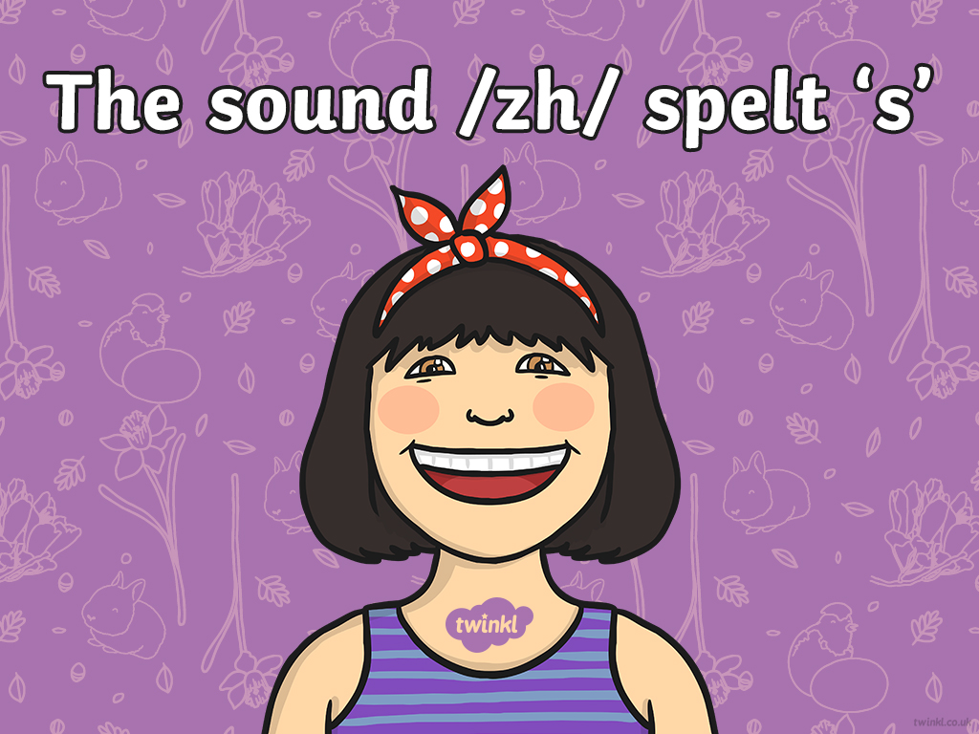

Slide 3
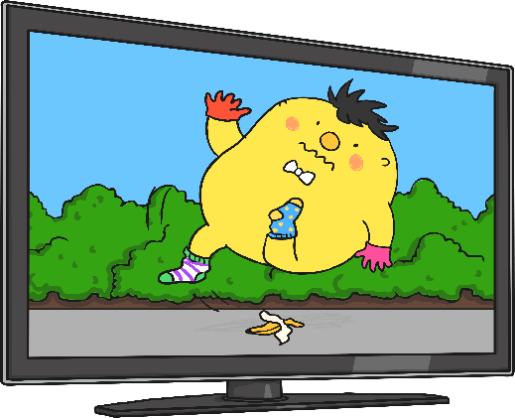



Say each word. Think about the sound the ‘s’ is making in each one.
television
treasure
division
The letter ‘s’ is making the sound /zh/.

Slide 4

Look at your partner as they say the sound /zh/ that the ‘s’ makes. Look at the shape of their mouth and what their teeth are doing. Swap over.

Slide 5
Split into two teams. Take it in turns to click on two cards. If you find a /zh/ word and its matching explanation, score a point for your team. Whichever team has found the most pairs at the end of the game wins.
usual
?
being able to see
?
pleasure
?
measure
?
your free time when you are not at work or school
?
something that often happens, normal
?
to find out how long, heavy, full something is
?
leisure
?
a particular event
?
occasion
?
vision
?
a feeling of happiness or enjoyment
?
(Click the cards again to turn them back over if the words are not all found in that turn.)

Slide 6
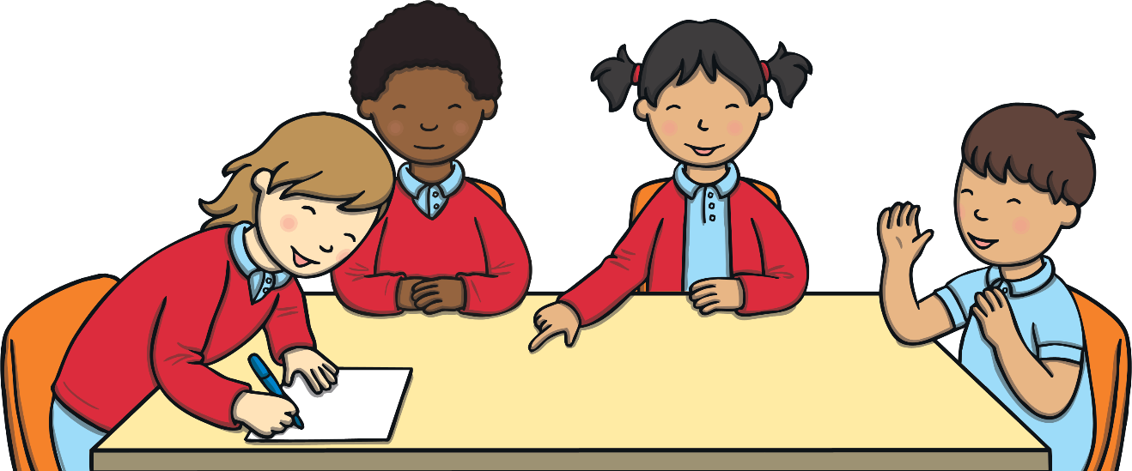
Here are this week’s spellings to practise.
television
treasure
usual
division
vision
pleasure
measure
occasion
usually
leisure
Work hard to learn them and the rule we have looked at today.

Slide 7
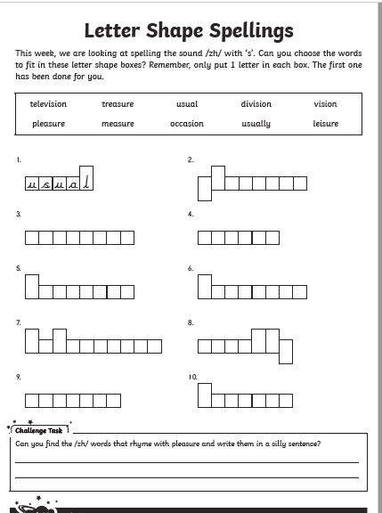

Slide 8
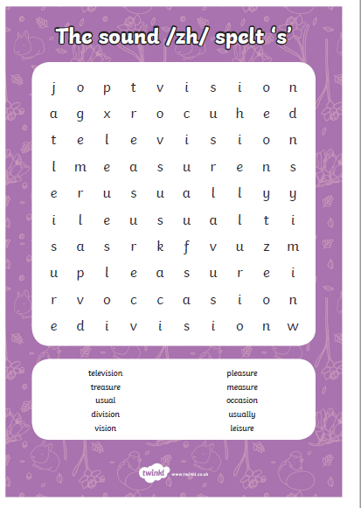

Slide 9
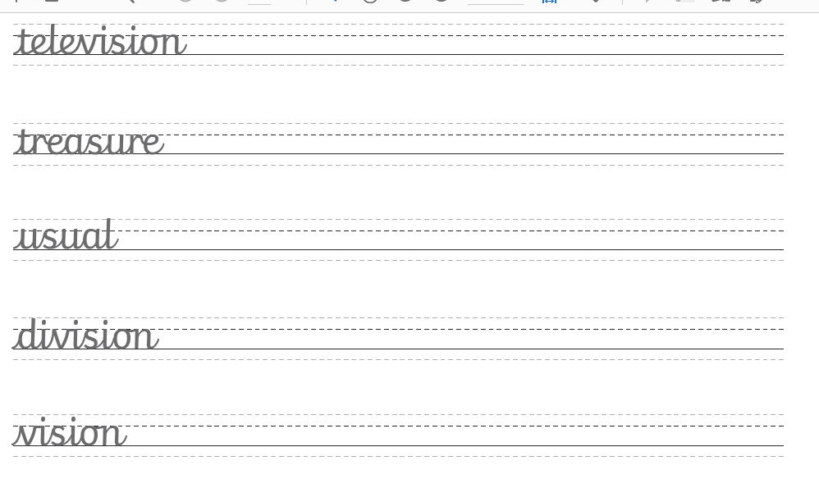

Slide 10
