Slide 1
Spelling – Revision of adding suffixes ment, ness and ful

Slide 2
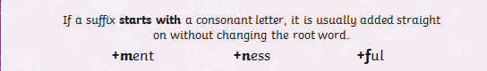
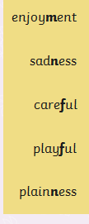
Do these words follow his rule?

Slide 3

There is an exception to this rule.
To add -ment to the word ‘argue’, you must remove the ‘e’ before adding the suffix.
argue + ment
arguement
argument

Slide 4
Look carefully at these spellings. The root words all have more than one syllable and end in a –y with a consonant before it.
Root word
Suffix
merry
+
ment
=
merriment
happy
+
ness
=
happiness
plenty
+
ful
=
plentiful

Slide 5
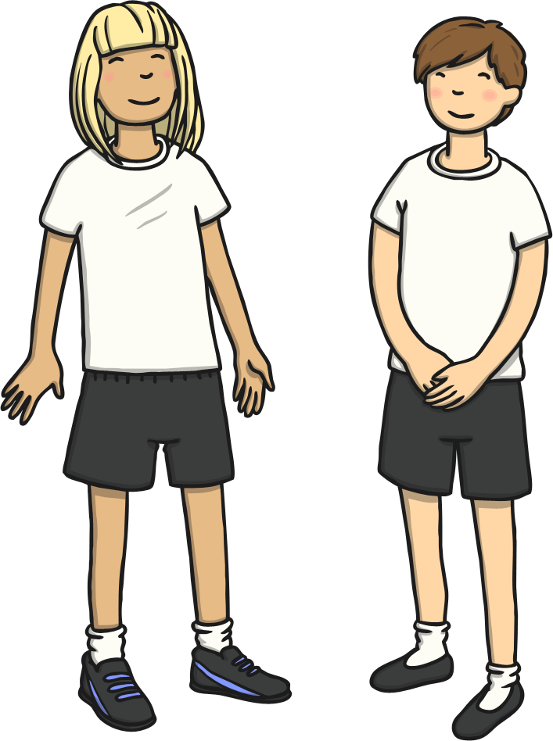
Can you think of a rule for adding a suffix to a word that has more than 2 syllables and ends in –y with a consonant before it?
If a word has more than 2 syllables and ends in –y . . .
. . . change the –y to ‘i’ and add the suffix.

Slide 6


Here are this week’s spellings to practise.
enjoyment
sadness
careful
playful
plainness
argument
merriment
happiness
plentiful
cheerful
Work hard to
learn them!

Slide 7
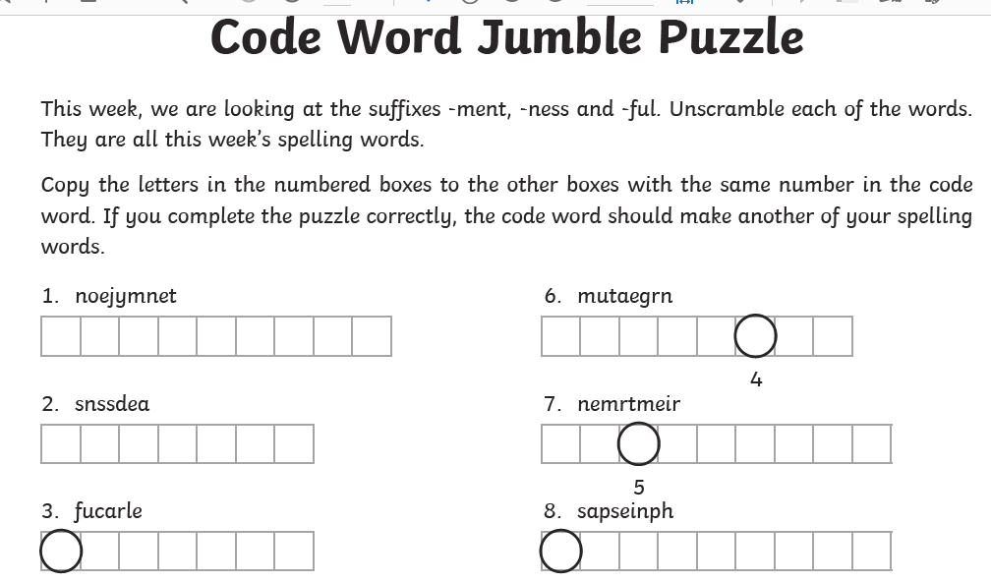

Slide 8
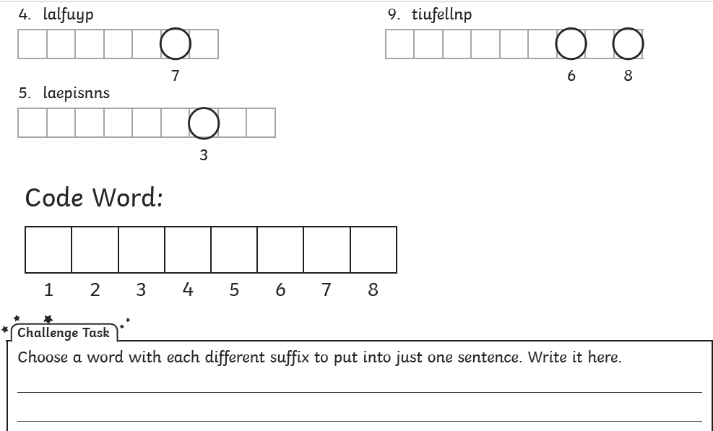

Slide 9
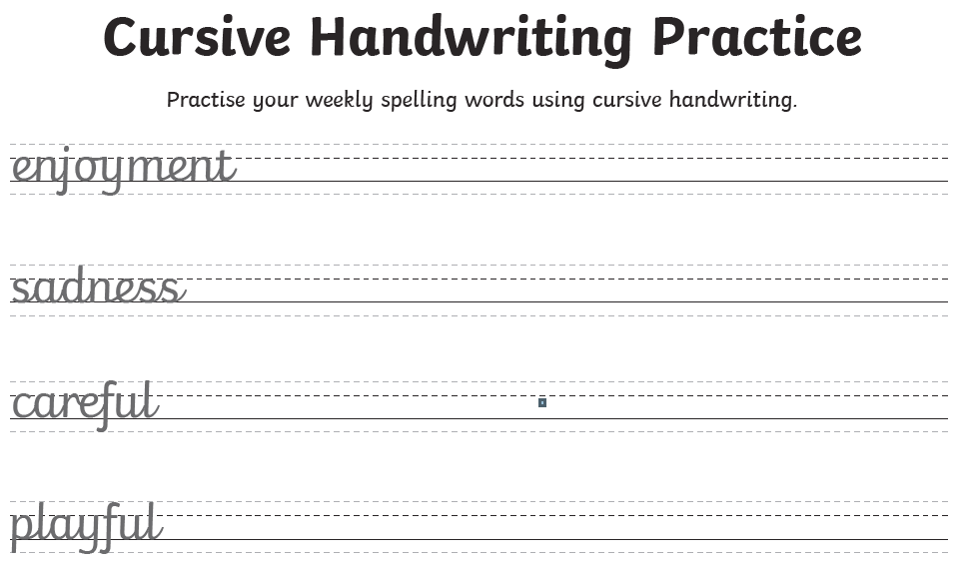

Slide 10
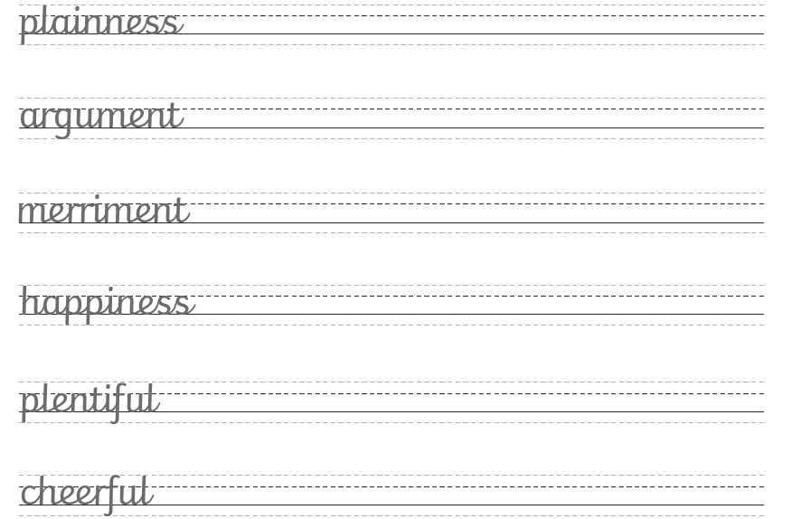

Slide 11
