Slide 1
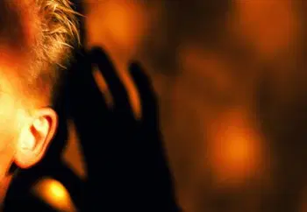
SPIRITUALITY
FOCUS:
How does God talk to us?
We can learn about this through the stories we read in the Bible.

Slide 2

In the name of the Father
and of the Son
and of the Holy Spirit. Amen
OPENING PRAYER:
O Lord, bless our home so that,
in working together
and playing together,
we may learn to serve you
and to serve one another.
Keep us safe and happy.
Amen

Slide 3
God’s often presented, especially in Old Testament stories, as Big and Bossy and Most Definitely In Charge. (He’s the Big Guy With A Plan, and He Must Be Obeyed!)
But this isn’t always God’s way of dealing with us humans!
Like you guys, sometimes I need a bit of bossing and ordering about, especially when I’m being lazy and I can’t be bothered to do the stuff I know needs to be done.
But sometimes I need something else, especially after I have tried really hard and feel like I'm failing.
The following story tells about how God recognises what we need, and speaks to us accordingly.

Slide 4
It’s a story about the prophet Elijah, who lived way after Moses had died.
Working upon God’s instructions, Elijah had tried so hard to ‘fix’ things that were wrong and to get people, and the people’s leaders, to do God’s will and be better: ‘to do good and be fair with each other’.
To begin with, God was there, telling him what he needed to do and say, but the people and their leaders just wouldn’t listen or follow him.
Elijah became afraid of the people and their leaders, and afraid of God and what God had asked him to do. The job was just too big and scary.
So he got scared and ran.

Slide 5
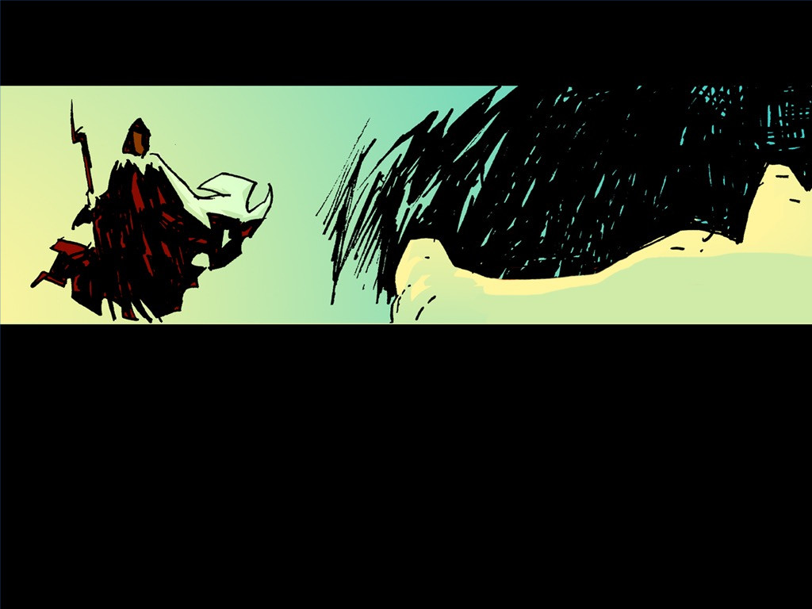
A reading from the Book of Kings:
So Elijah got up and ate and drank. The food made him strong enough to walk for 40 days and nights. He walked to Mount Sinai, the mountain of God. There Elijah went into a cave and stayed all night.
Then the Lord spoke his word to him: “Elijah! Why are you here?”
Elijah answered, “Lord, God of heaven’s armies, I have always served you the best I could. But the people of Israel have broken their agreement with you. They have destroyed your altars. They have killed your prophets with swords. I am the only prophet left. And now they are trying to kill me, too!”

Slide 6
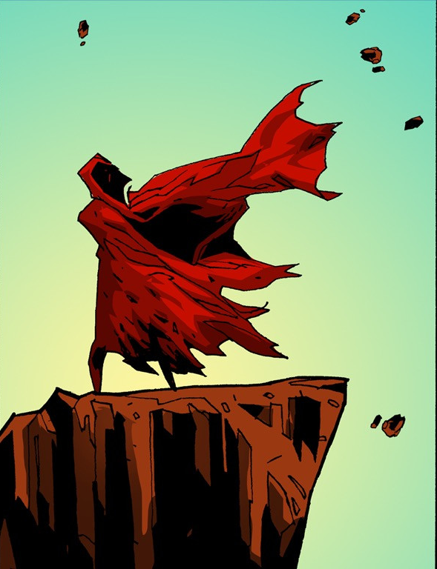
Then the Lord said to Elijah, “Go. Stand in front of me on the mountain. I will pass by you.”
Then a very strong wind blew. It caused the mountains to break apart.
It broke apart large rocks in front of the Lord.
But the Lord was not in the wind.

Slide 7
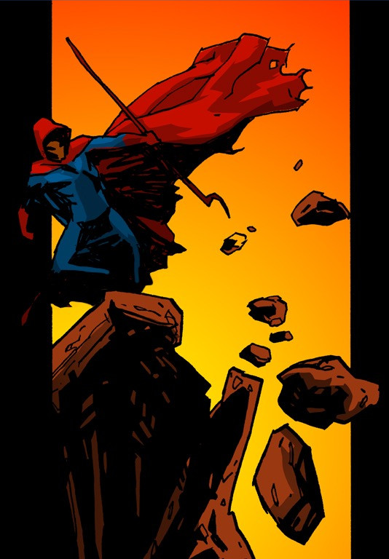
After the wind, there was an earthquake.
But the Lord was not in the earthquake.

Slide 8
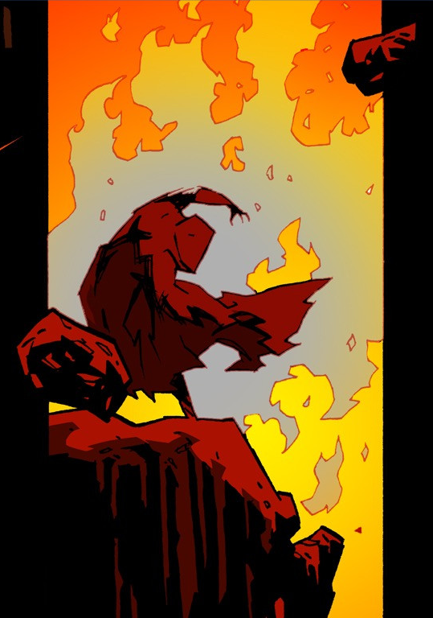
After the earthquake, there was a fire.
But the Lord was not in the fire.

Slide 9
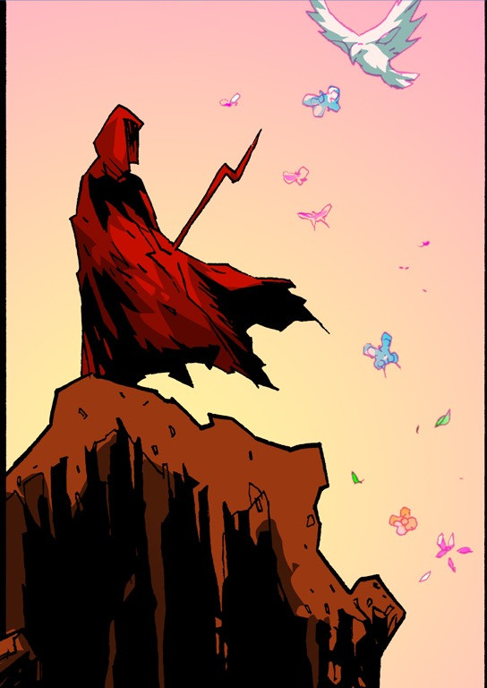
After the fire, there was a quiet, gentle voice.
When Elijah heard it, he covered his face with his coat.
He went out and stood at the entrance to the cave to listen.
The Word of the Lord

Slide 10

Elijah recognised that God’s voice can be quiet and gentle, too.
I wonder if that was because Elijah needed comfort and support at that time?
The story goes on to tell us that Elijah gained strength and went back out to continue to try to make his world a better place?
Sit quietly for a minute, and try to hear what God asks you to do in this world.
What you think God needs you for?
How will you do it?

Slide 11
CLOSING PRAYER:
Dear Lord,
Be with us when we feel tired
and fed up with how things are.
Help us to hear you,
to hear the advice
and the support you give to us
to help us keep going.
In the name of the Father
and of the Son
and of the Holy Spirit.
Amen

Slide 12
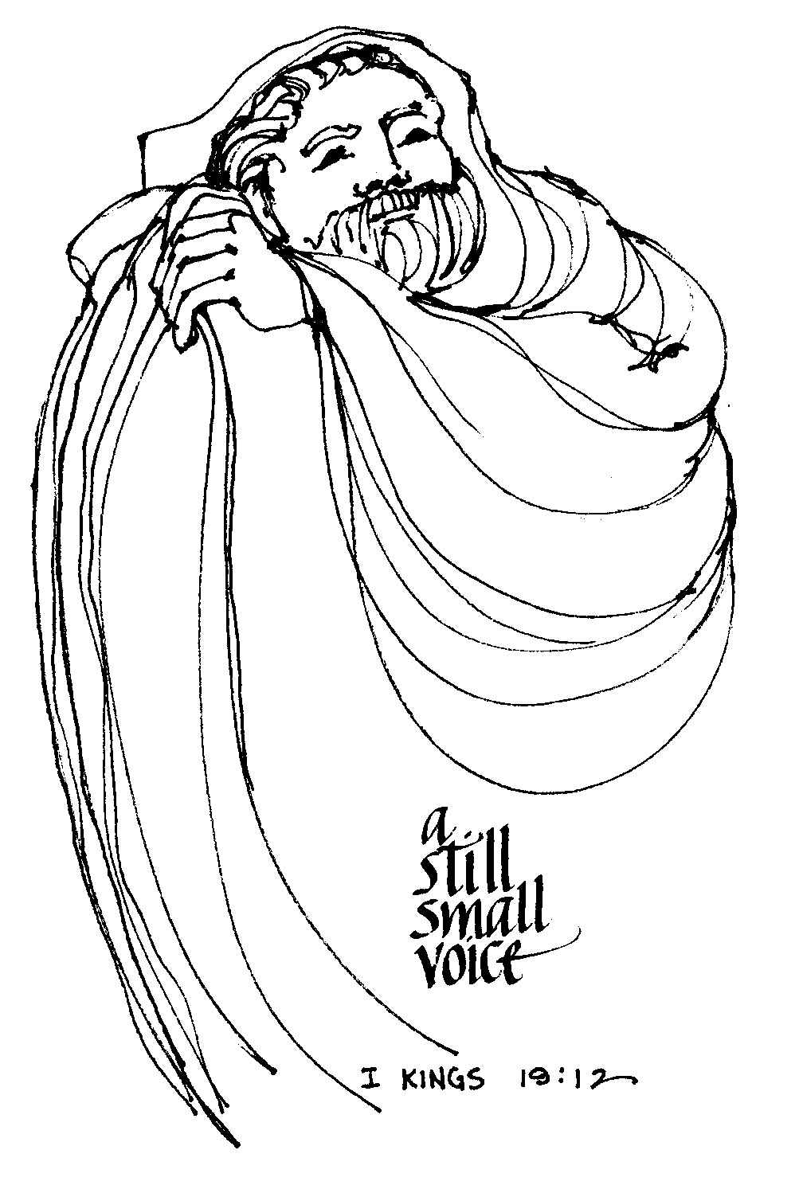
Print and stick in if you can. Otherwise, spend a few moments writing what you are thinking in your home learning books.
What do think God said to Elijah in the quietness outside the cave?
________________________________________________________________________________________________________________________________________________________________________________________________________________________________________________________
What does God say to you in the quietness?
____________________________________________________________________________________________________________________________________________________________________________________________________________________________________________________________________________________________________________________________________________________________________________________________________________________________________________________________________________________________________________________________________________________________________________________________________________________________________________

