Slide 1
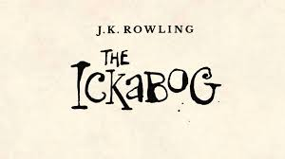
This is the new book by JK Rowling which she has published for free for children to read whilst they are at home. I have been enjoying reading it, with my son Finley, who is in Year 3.
https://www.jkrowling.com/j-k-rowling-introduces-the-ickabog/

