Slide 1
Which ture word matches the picture?

Slide 2
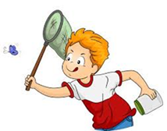
C____________

Slide 3

C______________

Slide 4

F_____________

Slide 5

L_____________

Slide 6
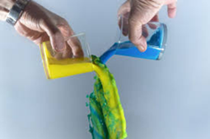
M______________

Slide 7
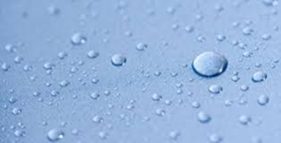
M _________________

Slide 8
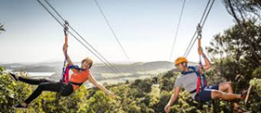
A_________________

Slide 9
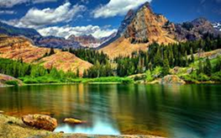
N______________

Slide 10
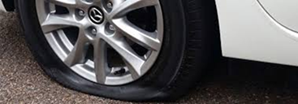
P__________________

Slide 11
