Slide 1
Wednesday 25th March
Read chapter 4 of Cliffhanger and complete the task.
Complete the Maths work on writing numbers and place value.
Carry on learning your times tables and spellings. Practise your mis words today.
If you have a magnet. Investigate materials which are magnetic. Sort them into groups.

Slide 2

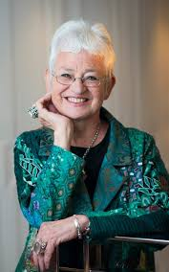
Read chapter 4 of Cliffhanger. Discuss the questions I have put on the pages.

Slide 3
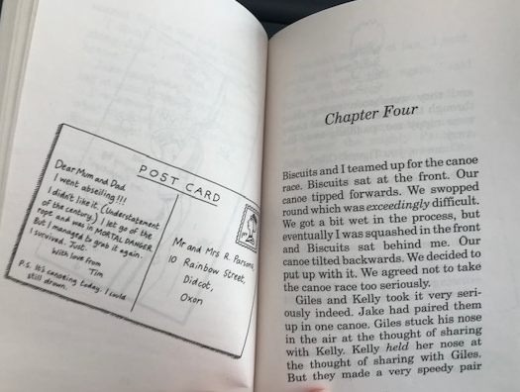
Why do you think Giles and Tim decided not to take the canoe race too seriously?
Do you think Giles and Kelly are going to be good partners together? Why? Why not?

Slide 4
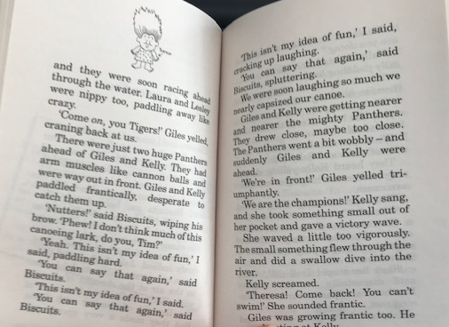
How do you know the other team were really strong?
What does the word vigorously mean?
Were Tim and Biscuits taking the race seriously?

Slide 5
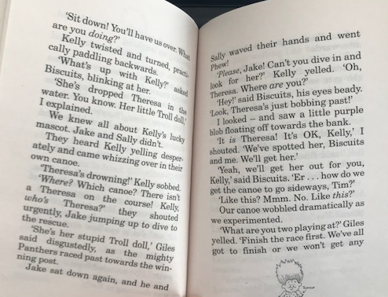
Why was Kelly so upset about Theresa?
How do you know Giles was cross with Kelly for dropping Theresa?
What does the fact that Biscuits and Tim are rescuing Theresa teach us about them?

Slide 6
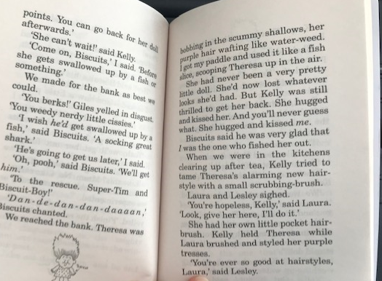
Why is Giles so annoyed with Biscuits and Tim?
How do you know Kelly was delighted to have Theresa back?
What do Biscuits and Tim pretend to be? Why?

Slide 7
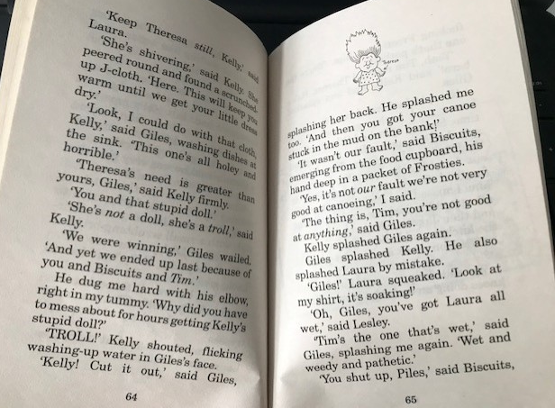
What does Giles mean when he says that Tim is the one who is wet?
How does Kelly care for Theresa?

Slide 8
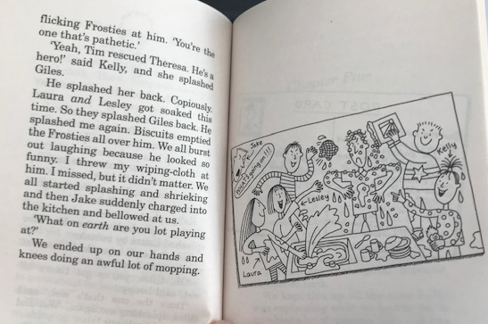
Why did Jake bellow at the children?
Do you think Jake was right to ask the children to clean up?

Slide 9
Read chapter 4 again. Decide which of the statements are true and which are false.
Correct the ones which are false.
Make up 5 of your own true and false statements for a someone in your family.

Slide 11
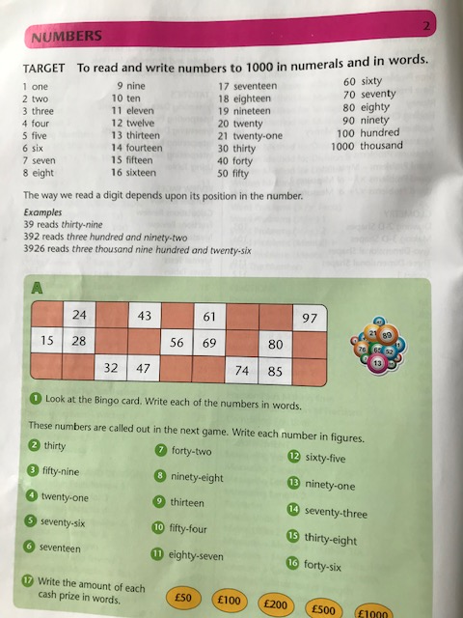

Slide 12
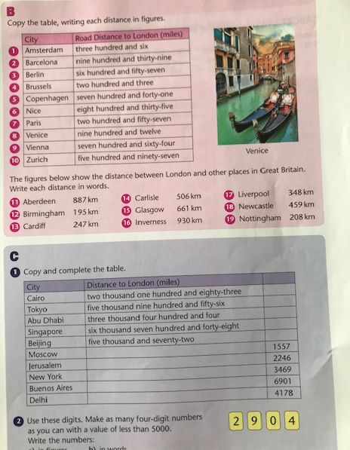

Slide 13
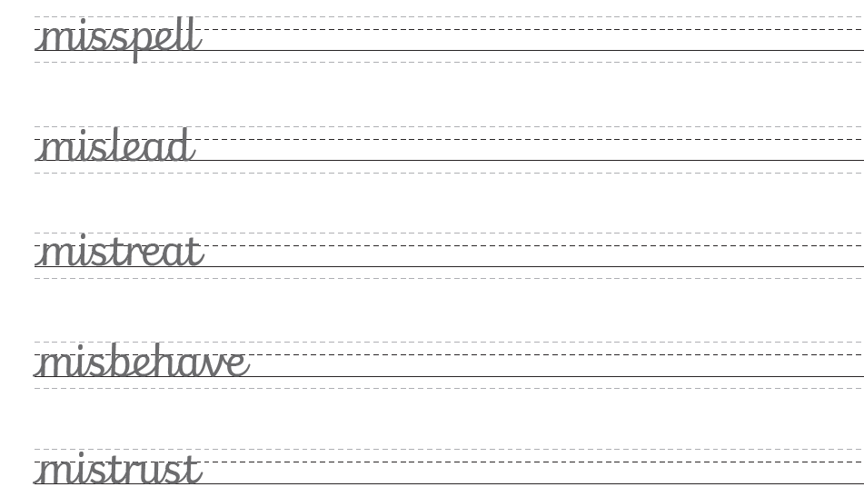

Slide 14
