Slide 1
Week beginning 6th April
Your work is on two powerpoints this week because the file was too large to up load to the website.
This is your Maths work for this week. There are:
- 3 pieces of early bird work
3 pieces of Maths work
In addition to this, keep on with your Joe Wicks PE, learning your times tables and spelling work too.

Slide 2
This week, post at least two pieces of your work onto Class Dojo
For great work posted, there will be dojos given out!

Slide 3
Morning Work
Early Bird Time!

Slide 4
Early bird work 6.4.2020 Number bonds to 100
1. 50 + = 100 | 6. + 45 = 100
2. + 40 = 100 | 7. 65 + = 100
3. 20 + = 100 | 8. + 25 = 100
4. + 90 = 100 | 9. 55 + = 100
5. 30 + = 100 | 10. + 34 = 100

Slide 5
Early bird work 7.4.2020 Adding on multiples of ten.
1. 134 + 10 = | 6. 431 + 30 =
2. 962 + 10 = | 7. 546 + 40 =
3. 188 + 10 = | 8. 674 + 50 =
4. 822 + 20 = | 9. 262 + 60 =
5. 122 + 30 = | 10. 2254 + 70 =

Slide 6
8.3.2020 - Early Bird Work What has 4 legs but can’t walk? What is the answer to this riddle?
Work out the riddle answer using this code to go with the question answers. H = 46, A = 65, I = 42, C =1000, A = 80, R = 920
1. 100 minus 35. | 5. 84 divided by 2
2. 10 multiplied by 100 | 6. What is the product of 92 and 10.
3. What is the sum of 27 and 19? | 7. Extra Challenge! 7 made 100 times bigger
4. 45 increased by 35 | 8. Now make up a word problem of your own using the words on the right to help you.

Slide 7
Maths lesson 1

Slide 8
Warm up
8 x 1 = 8 x 7 =
8 x 2 = 8 x 8 =
8 x 3 = 8 x 9 =
8 x 4 = 8 x 10 =
8 x 5 = 8 x 11 =
8 x 6 = 8 x 12 =

Slide 9
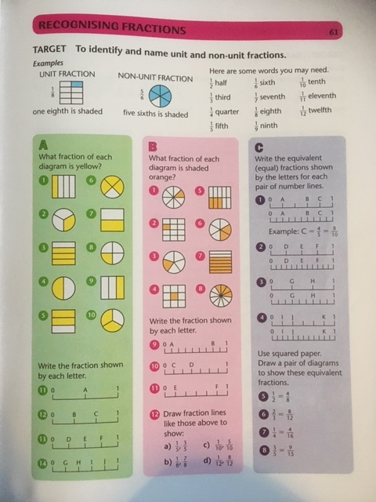
Complete section A and B.
Section C is a challenge!

Slide 10
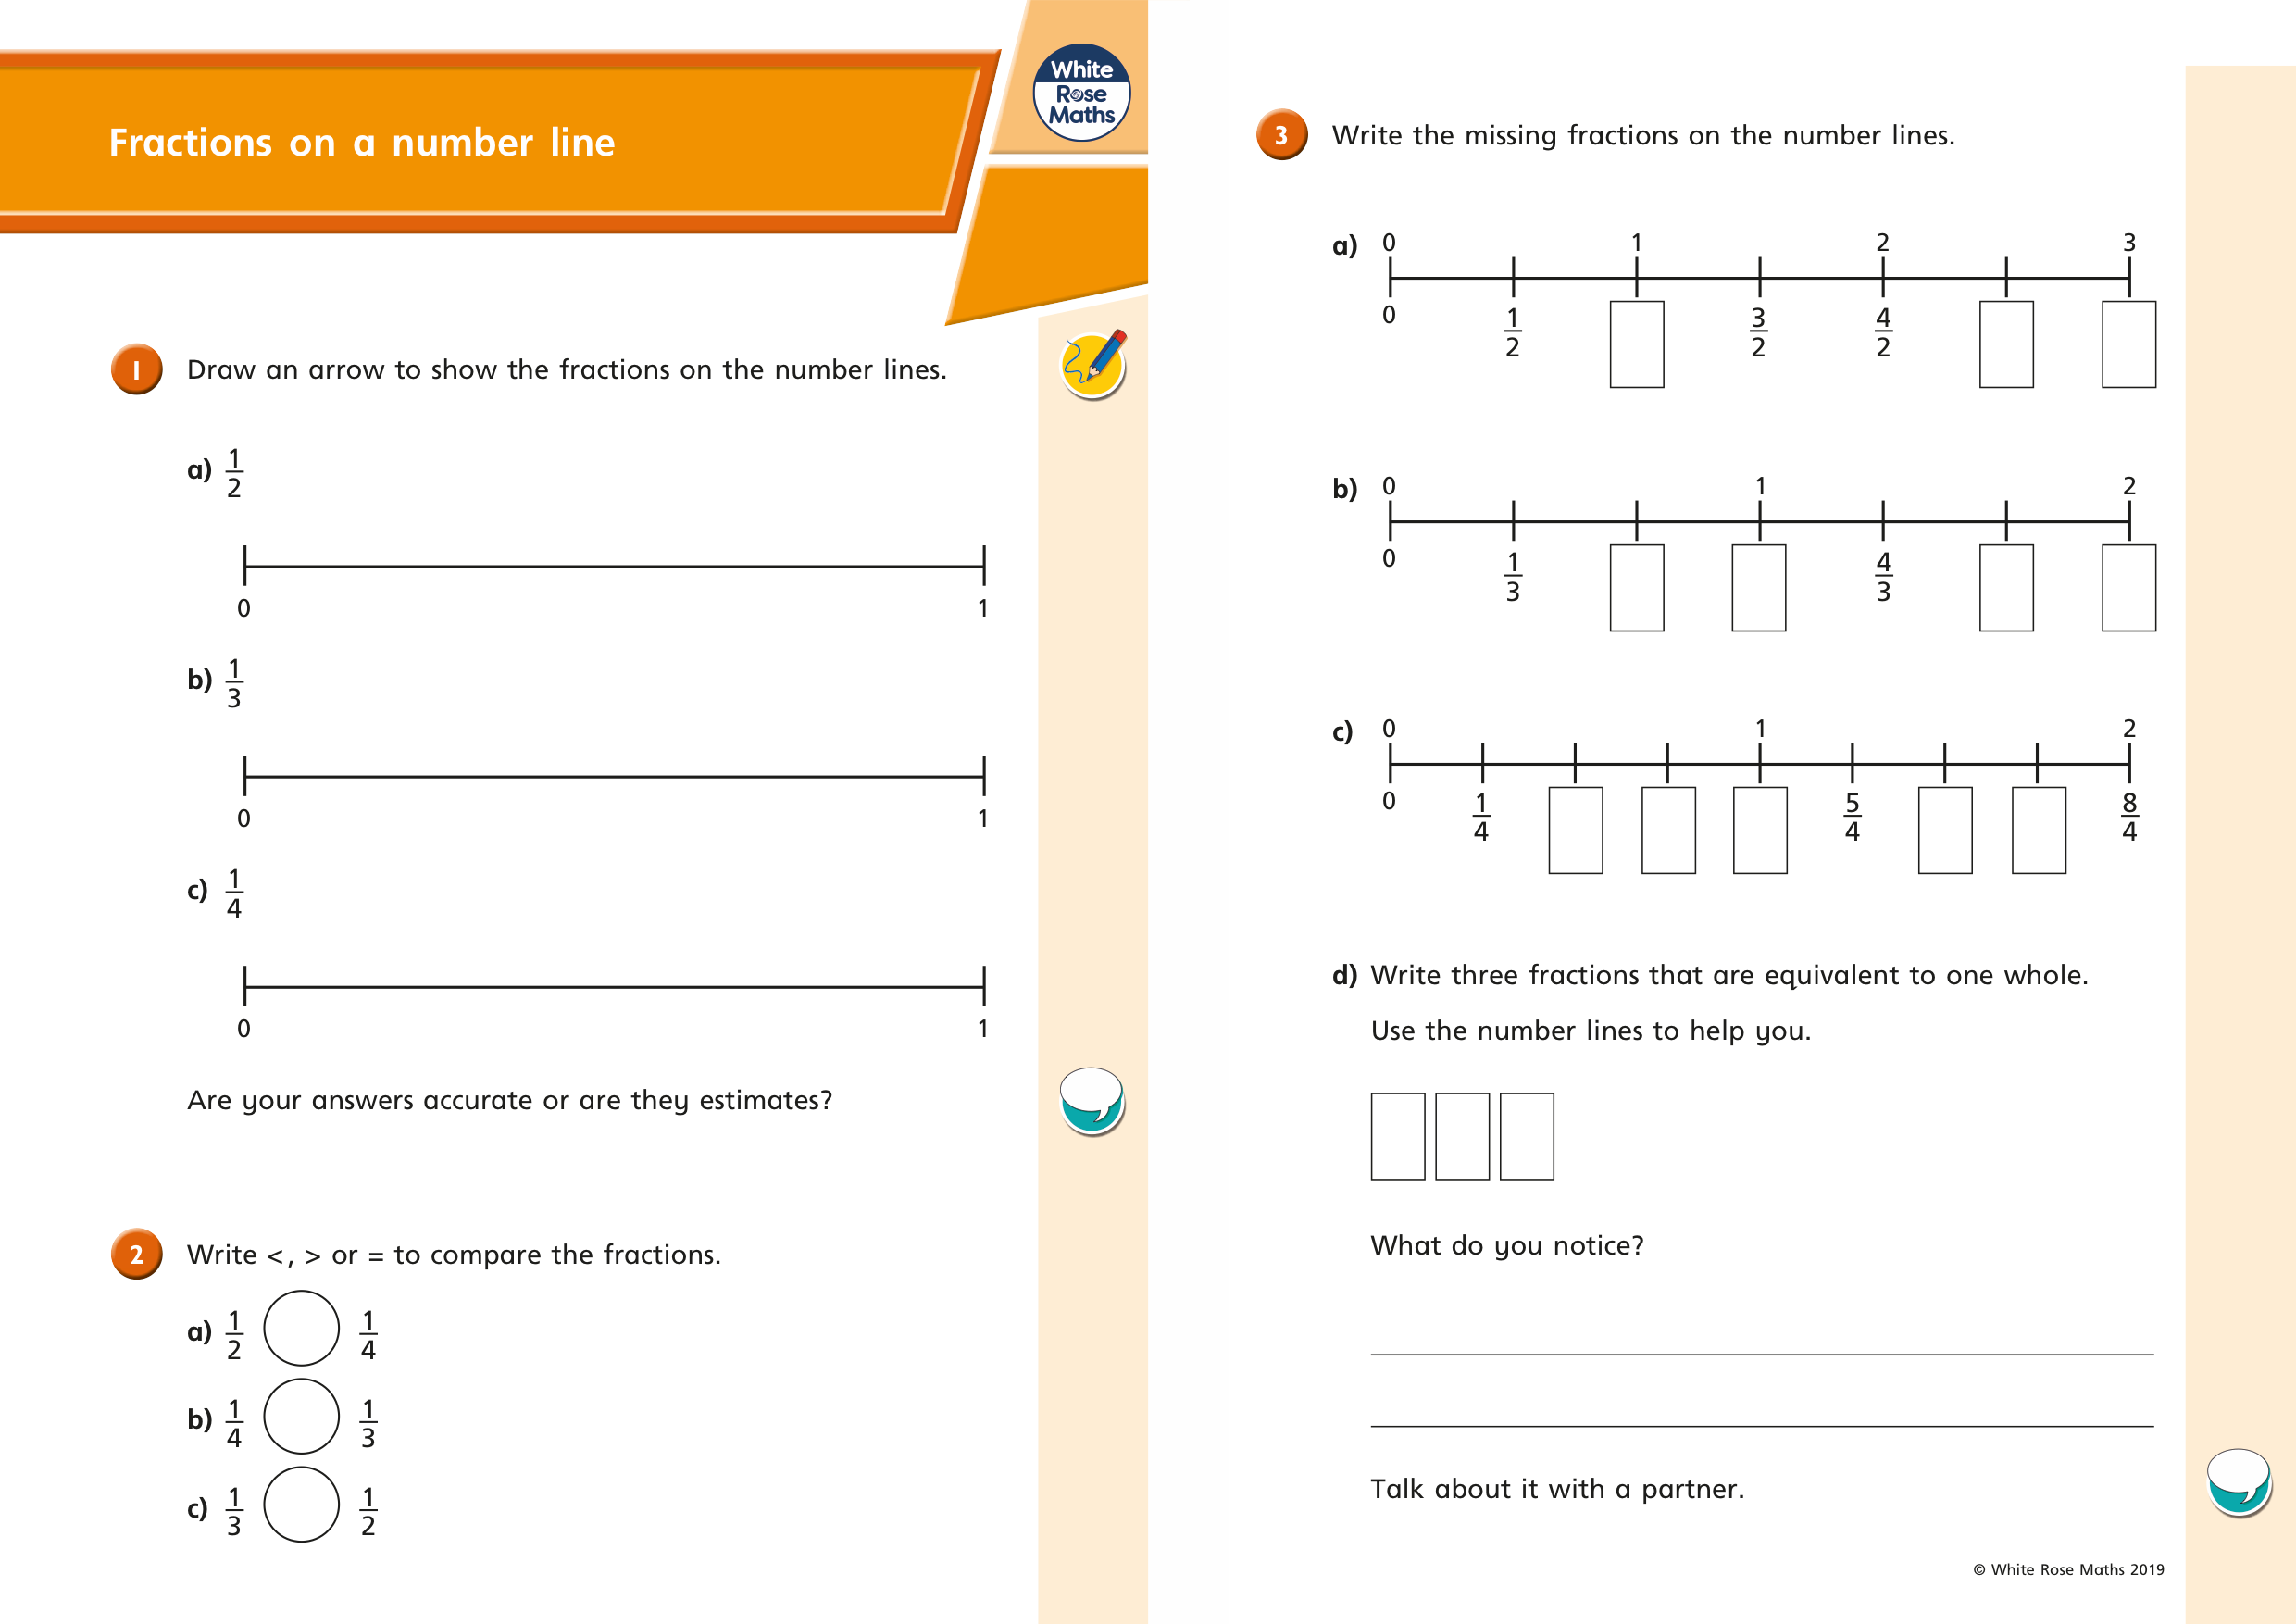
Try these to consolidate your learning!

Slide 11
If you have time...
Try a times tables game on this website.
https://www.topmarks.co.uk/maths-games/7-11-years/times-tables

Slide 12
Maths lesson 2

Slide 13
Warm up
1. 72 ÷ 8 = _____ 2. 24 ÷ 8 = _____ 3. 8 ÷ 8 = _____ 4. 48 ÷ 8 = _____ 5. 24 ÷ 8 = _____ 6. 56 ÷ 8 = _____
7. 64 ÷ 8 = _____ 8. 16 ÷ 8 = _____ 9. 40 ÷ 8 = _____ 10. 32 ÷ 8 = _____ 11. 88 ÷ 8 = _____ 12. 96 ÷ 8 = _____

Slide 14
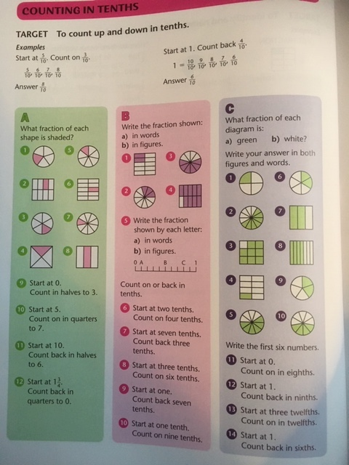
Complete section A and B.
Section C is a challenge!

Slide 16
If you have time...
Try a times tables game on this website.
https://www.topmarks.co.uk/maths-games/7-11-years/times-tables

Slide 17
Maths lesson 3

Slide 18
Warm up
1. 1 x 4 =
2. 4 x 4 =
3. 6 x 4 =
4. 5 x 4 =
5. 2 x 4 =
6. 7 x 4 =
7. 3 x 4 =
8. 0 x 4 =
9. 9 x 4 =
10. 8 x 4 =
11. 11 x 4 =
12. 12 x 4 =

Slide 19
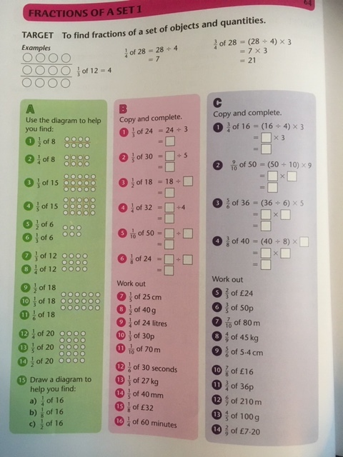
Complete section A and B.
Section C is a challenge!

Slide 20
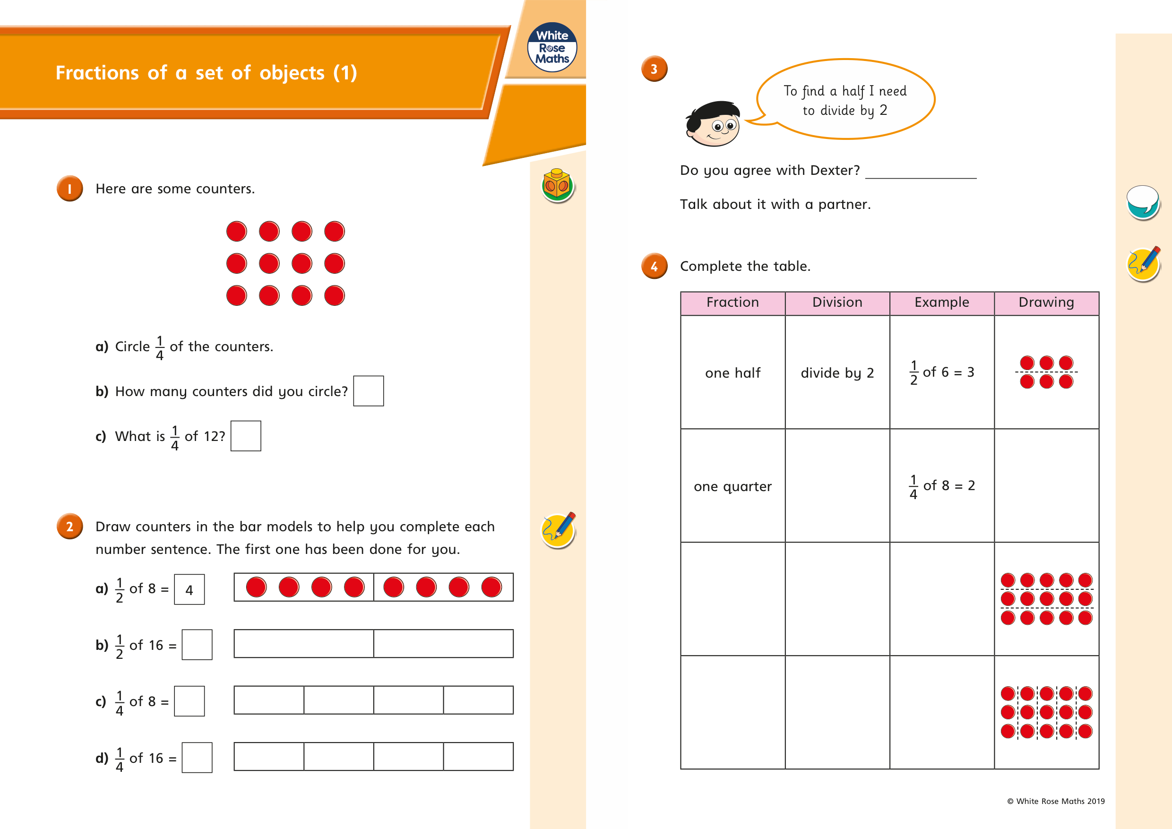

Slide 21
If you have time...
Try a times tables game on this website.
https://www.topmarks.co.uk/maths-games/7-11-years/times-tables

