Slide 1
Week beginning 6th April
Your work is on two powerpoints this week because the file was too large to up load to the website.
This is your work for this week. There are:
-1 piece of RE work
2 Science tasks
1 Design and technology task
1 Art task
In addition to this, keep on with your Joe Wicks PE, learning your times tables and spelling work too.

Slide 2
This week, post at least two pieces of your work onto Class Dojo
For great work posted, there will be dojos given out!

Slide 3
RE lesson

Slide 4

The Easter Story
What do Christians believe happened at Easter?
Read the next slides to find out.
If you have your parent’s permission, click on the internet links to watch short videos of parts of the story.

Slide 5
The Teacher
Jesus travelled around Israel and taught people about God for around three years.
When Jesus came into a town, hundreds or even thousands of people would come to listen to what he had to say.
However, there were some people, including a group of Jewish teachers known as the Pharisees, who hated Jesus.
They hated Jesus so much, they plotted to kill him!

Slide 6
Palm Sunday
Jesus went with his disciples to Jerusalem to celebrate the Passover.
As Jesus entered Jerusalem, he rode on a donkey. People took off their coats and put them on the ground.
They also broke palm branches off the trees and began to wave them.
https://www.youtube.com/watch?v=F7r2jaciG0g

Slide 7
The Last Supper
Jesus sent some of his disciples to get a room ready for the Passover meal.
When they arrived, Jesus took a bowl of water and washed their feet.
They shared bread and wine at the meal.
Jesus tried to explain to his friends what was going to happen to him, but they did not really understand.
https://www.youtube.com/watch?v=vScHI_fxJGM

Slide 8
The Garden of Gethsemane
Jesus and his followers left the meal and went to a garden to pray.
However, the disciples fell asleep and Jesus was left to pray alone.
Suddenly, Judas, one of Jesus’ followers, and arrived with some soldiers.
Judas gave Jesus a kiss on the cheek so the soldiers would know who Jesus was.
All Jesus’ friends ran away and left him alone.

Slide 9
The Trial of Jesus
After he was captured, Jesus was taken to see the Roman leader, Pontius Pilate.
Pontius Pilate didn’t think Jesus had done anything wrong and wanted to release him.
He asked a crowd outside if he should release Jesus, or a criminal called Barabbas. The crowd chose Barabbas!
Pontius Pilate asked what he should do with Jesus.
“Crucify him!” they shouted.
“But why? He is innocent,” replied Pilate.
However, the crowd would not listen.

Slide 10
The Crucifixion
The Romans began to mock Jesus.
They put a purple cloak on him and made a crown of thorns and put it on his head.
They whipped Jesus and made him carry a wooden cross on his back.
Then they put him on the cross, with two robbers either side of him. Jesus died and the sky went dark.
https://www.youtube.com/watch?v=S25U1tvuYqI

Slide 11
Jesus is buried
Jesus’ followers took his body and put it in a cave, called a tomb. They sealed the tomb with a giant, heavy stone.
Then they went away and hid, because they were very afraid that they might also be killed.

Slide 12
Easter Sunday
After three days, a group of women went to visit the tomb.
When they arrived, they saw that the stone had been rolled away from the entrance to the cave and Jesus’ body was not there.
One woman, Mary Magdalene began to cry.
Behind her, a man’s voice asked, “Why are you crying?”
“They’ve taken Jesus away and I don’t know where to find him,” sobbed Mary. (She thought the man was the gardener.)
“Mary,” said the man. When he said her name, Mary realised that the man was Jesus. He was alive!
https://www.youtube.com/watch?v=Nfnhv5h0k4M

Slide 13
Take a photo of your comic and post it on Class Dojo for Dojo points!

Slide 14
Topic Work
Design and Technology

Slide 15
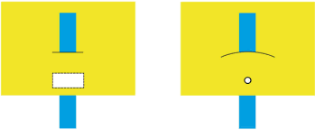

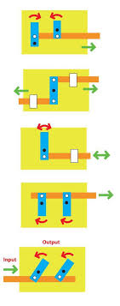
Task: Make an Easter card with moving parts!
Materials
needed:
Card
scissors
split pins
ruler
This one doesn’t need a split pin.
Easiest
Medium
First step – Make the moving mechanism.
Hardest
Look at the pictures to the right.
Choose one lever to try out.

Slide 16
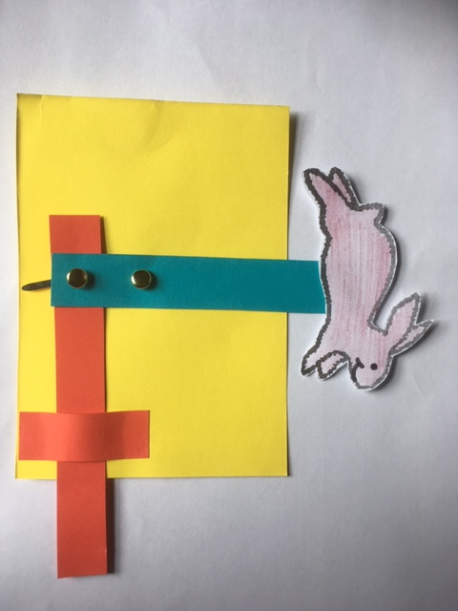
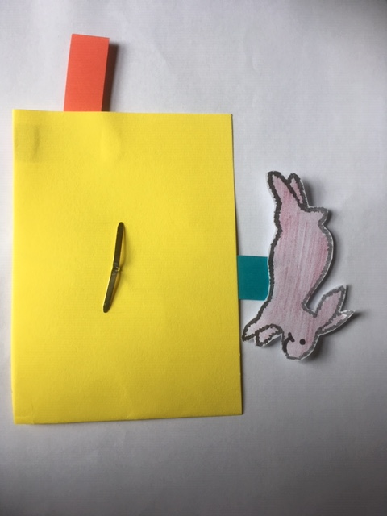
Second Step
Add something ‘Eastery’ to the end of the lever. E.g. A bunny or a chick.
Push/Pull
Turn it over to hide the mechanism.

Slide 17
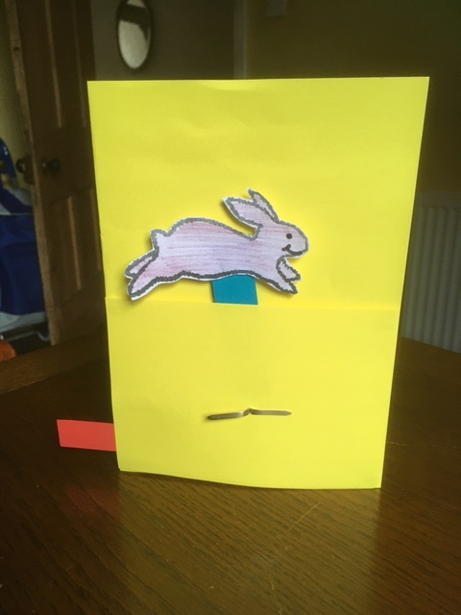
Third Step
Stick it onto a card.

Slide 18
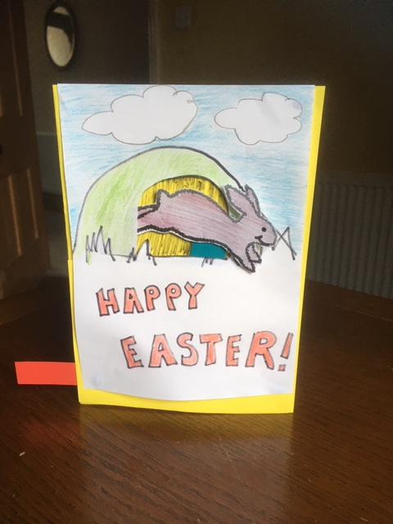
Fourth Step
Decorate the card. You could make your bunny/chick pop out of a hole/hat/egg.
Write a message inside your card.
Give the card to someone you love this Easter.
Take a photo of your card and post it on Class Dojo for Dojo points!

Slide 19
Science work
Magnets!

Slide 20


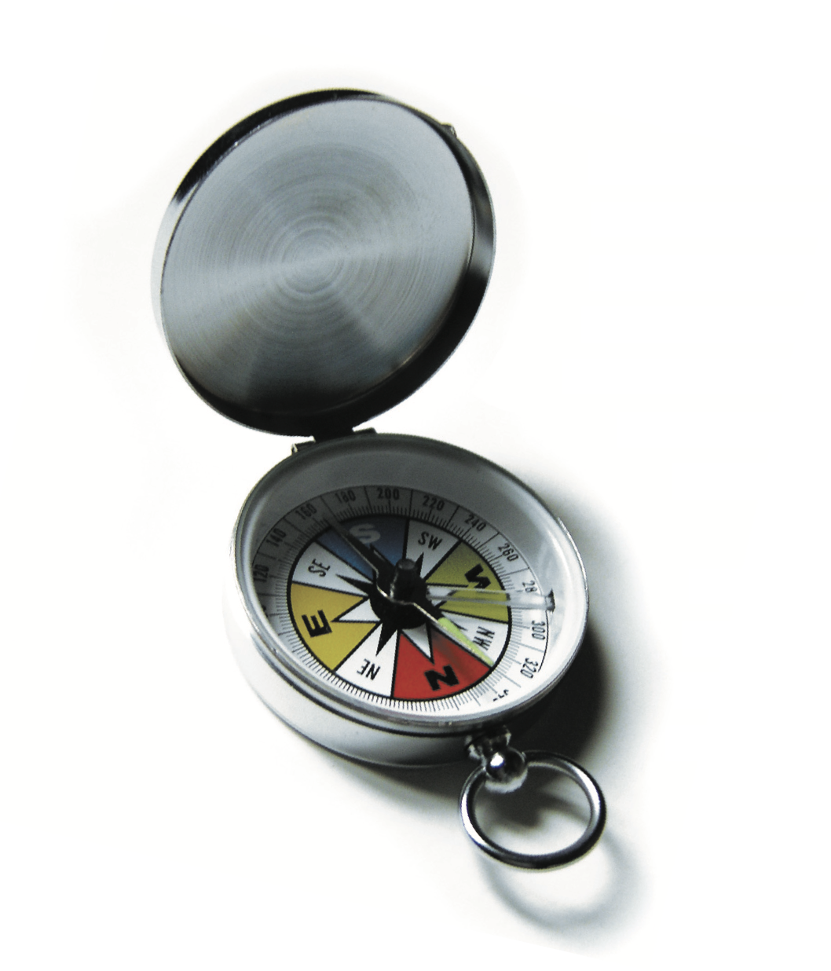
Magnets Experiment - MAKING A COMPASS
Explanation
Every magnet you’ll see has a north-seeking and south-seeking pole, just like the Earth, which is basically a giant magnet. If two magnets are brought together, the
north pole of one will attract the south pole of the other. This is why compasses work
on the Earth. The Earth’s magnetic field is strong enough to make the north pole of a very light compass needle align with the magnetic south pole of the planet. If
you’re confused (don’t compasses point north???), you may not realize that the Earth’s geographic North Pole is the opposite of its magnetic north pole! In other words, the planet’s geographic North Pole is its magnetic south pole, and vice versa.
WHAT YOU NEED:
A sewing needle
A bowl of water
A magnet

Slide 21
Make your own compass – Experiment Instructions
In this activity, you will make a magnet and see it respond to the bigger magnet that is our planet. It’s important that there is no friction on the needle, so that it can respond to the slight tug of the Earth magnet.
1. First, magnetize your sewing needle by stroking one end against the end of your magnet. Always go in the same direction. If possible always use the North Pole of your magnet.
North
2. Float the magnetized needle very carefully on the surface of the water. The end that you magnetized will point north or south, depending on how you magnetized it.
Tip - If you can’t get it to float on the water, place it onto a small piece of cork or paper.

Slide 22
Extra Magnets Experiments – try looking at this website:
https://nationalmaglab.org/education/magnet-academy/try-at-home
You could also try making a Chinese hanging compass. Look at the website for more details.
Take a photo of your compass and post it on Class Dojo for Dojo points!

Slide 23
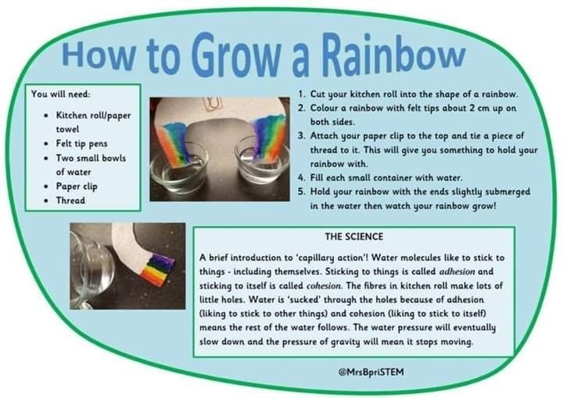
Extra Science Experiment!
Take a photo of your rainbow and post it on Class Dojo for Dojo points!

Slide 24
Art Work
Decorate a boiled egg!
Take a photo of your eggs and post it on Class Dojo for Dojo points!

Slide 25
Methods you could use:
1. Dye the egg with natural ingredients
Boil water for 30 mins with 2tbsp of vinegar and one ingredient from this list:
Bunch dandelions
Handful of onion skins
Turmeric
Paprika
Purple cabbage
Beetroot
Cool the mixture and add the boiled eggs. Leave overnight.
3. Glue tissue paper over the eggs.
2. Paint the eggs

