Slide 1

Cedar Class 2025 - 2026

Slide 2

Mission Statement

Slide 3
Welcome to your Y2 staff
Mrs Drummond teaches on a Monday, Tuesday and Wednesday afternoon.
Miss Harrison teaches on a Wednesday morning, Thursday and Friday.
Mrs Hamilton, Mrs Patel and Miss Hawkins are our teaching assistants.

Slide 4
Y2 curriculum
Our curriculum overview can be found on the Cedar Class page of the SMG website
www.smgprimary.co.uk
Our aim is to provide a fun-filled series of lessons in each subject, whether they have written or practical outcomes.

Slide 5
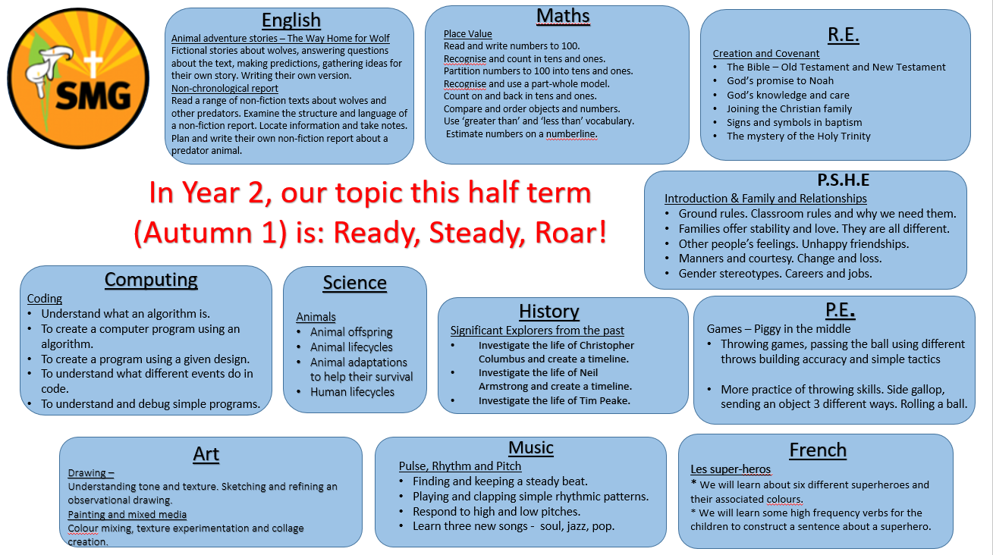
Y2 curriculum

Slide 6
Assessment
Continuous assessment in every lesson to establish which children have achieved the lesson objective and which children need extra scaffolding/support.
Termly assessments using NFER test booklets in Reading (2 papers), arithmetic and reasoning.
End of Key Stage SATs tests ended in May 2023. We take part in the optional SATs tests.

Slide 7
Religious Education
As a Catholic school, we place a great emphasis on the teaching of RE. This year our topics are –
Autumn term
Creation and Covenant
Prophecy and Promise

Slide 8
Religious Education
Spring term
Galilee to Jerusalem
Desert to Garden
Summer term
Ends of the Earth
Dialogue and Encounter

Slide 9
P.E.
PE lessons this year will be on a Monday and Wednesday afternoon.
Please ensure that PE kits are in school everyday. We will send them home for washing regularly.
Please ensure that no jewellery is worn, this includes earrings. School has a no jewellery policy everyday not just in P.E.
Please make sure long hair is tied back.

Slide 10
P.E. kits
Black shorts
School logo yellow PE t-shirt
Black pumps (trainers for outside only)
All clearly named please.

Slide 11
Special events
We will give you as much notice as possible about educational visits or any special days that we have planned.
Ribbleton library visit
An educational visit linked to our Seaside topic in the Summer term.

Slide 12
Reading books
Mrs Hamilton and Mrs Patel will hear each child read in school each week.
Teachers will provide lots of reading opportunities throughout the school day.
If your child finishes their book, they should read books from home, the library, magazines/comics/ or newspapers. Stories, poetry and non-fiction.

Slide 13
Reading books
In Year 2, once a child knows the common phonics sounds, the emphasis shifts to understanding their reading.
For a book to be changed in school, the child must be able to read it and be able to make predictions and answer questions on characters, settings and the main events of the story.

Slide 14
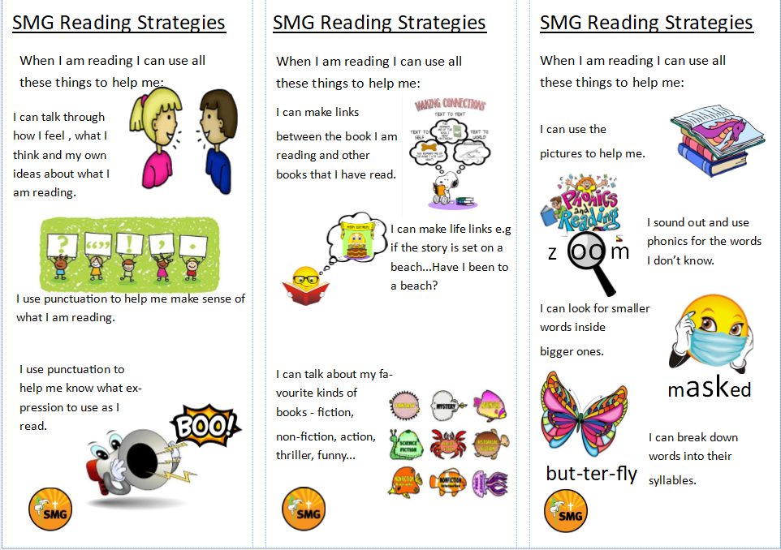
Reading

Slide 15
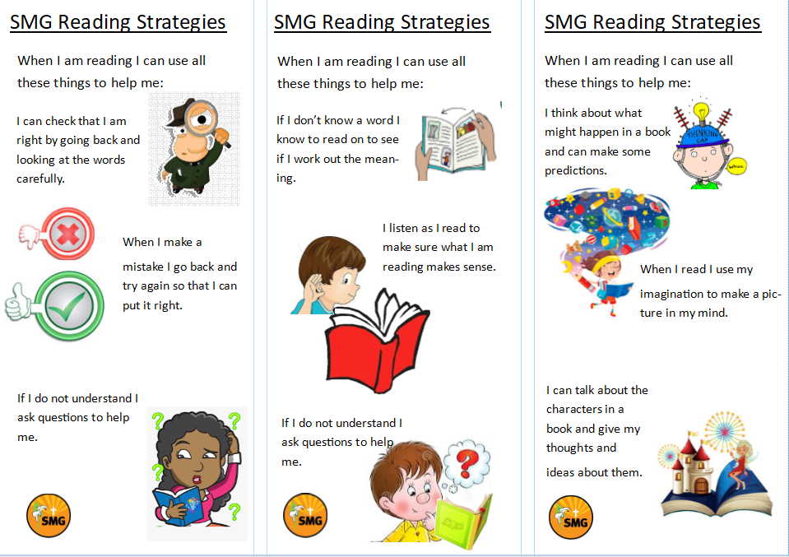
Reading

Slide 16
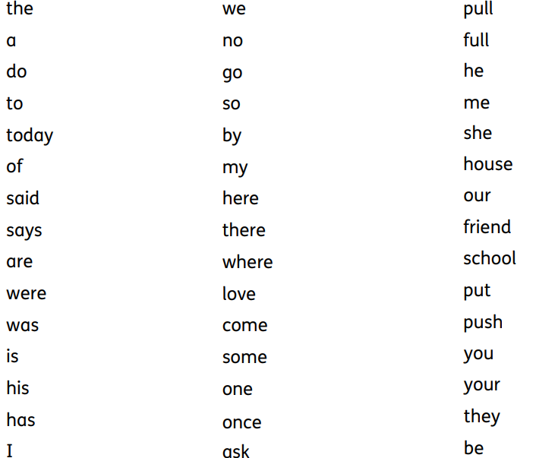
Year 1 common exception words

Slide 17
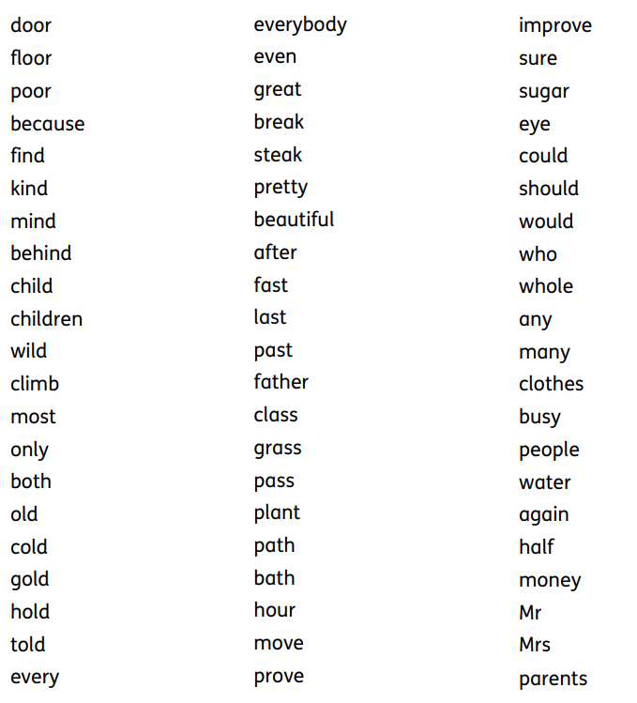
Year 2 common exception words

Slide 18
Homework
Reading – at least 4 or 5 times a week.
Times Tables – 2x, 5x and 10x
Extra homework will be posted on the Cedar page of the SMG website and will also be posted on Class Dojo.

Slide 19
Keeping in touch
Cedar Class SMG webpage
Class Dojo – please ask for a new code if you can’t access it. This is our main source of communication and information.
We are happy to speak to parents at the end of the day but ask that in the interests of health and safety, that you wait until we have dismissed all of the children.

Slide 20

Thank you for taking the time to read our class information.
Any questions? Please contact us via the ‘message’ option on Class Dojo.

