Slide 1


Slide 2
Why do we celebrate Black History Month?
Black History Month started in 1926, to promote knowledge of black history and culture
To celebrate moving away from segregation towards unity
To learn from the mistakes of the past and make sure we don’t make them again.

Slide 3
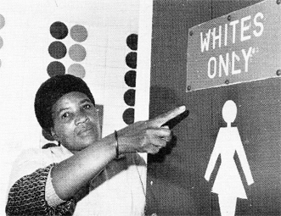
Carter G. Woodson was upset that most of the history written in America in the 1920s only talked about what white people had achieved. It looked like African Americans did not exist in history.
We know a lot more about famous black men and women today, but there are still many gaps in history to fill.

Slide 4
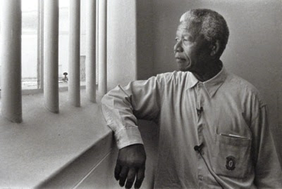
Nelson Mandela
As a young man, Nelson Mandela fought against the South African government’s racist policies. He was imprisoned from 1964 to 1990.

Slide 5
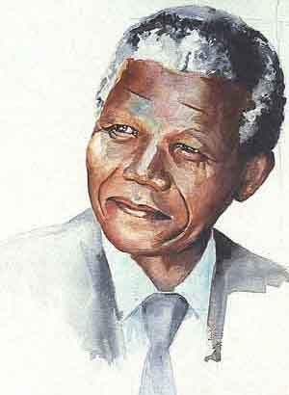
When he was freed Nelson Mandela became
President of South Africa in 1994
“Never, never again will this beautiful land experience the oppression of one by another”

Slide 6
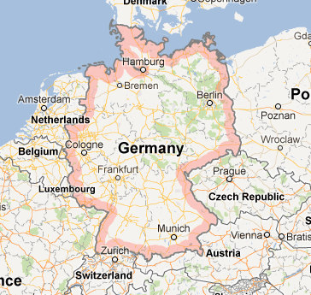
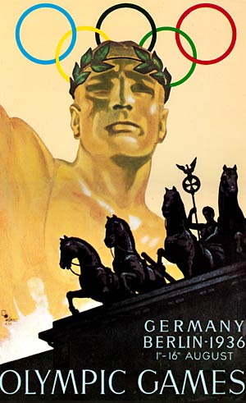
Germany
1936
Olympic
Games

Slide 7
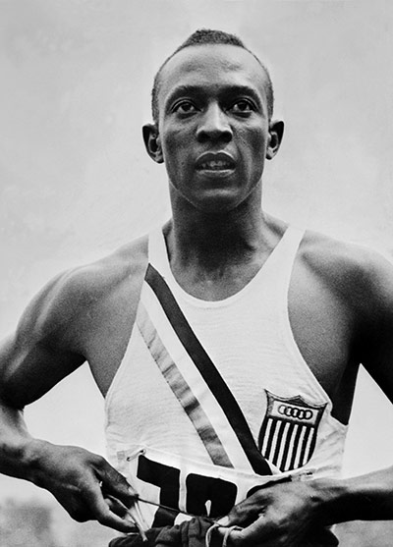
Who is Jesse Owen?
In the 1936 Olympics he won 4 gold medals in the 100m, 200m, the long jump and the relay.
Hitler refused to acknowledge him
He was not invited to the White House to shake hands with the president and when he attended an awards ceremony in a hotel he had to go up in the service elevator and was not allowed to use the front door.
He campaigned to improve the situation for black people around the world

Slide 8
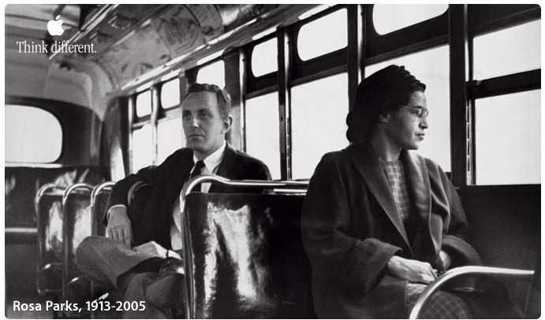
On December 1, 1955, in Montgomery, Alabama, Rosa Parks refused to obey bus driver James F. Blake's order that she give up her seat in the coloured section to a white passenger, after the white section was filled.

Slide 9
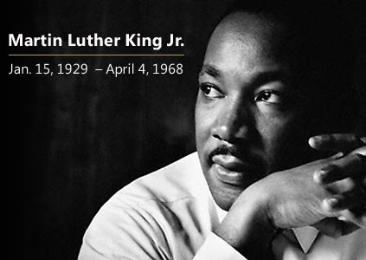
“I have a dream”

Slide 10
“I have a dream that one day my four little children will not be judged by the colour of their skin, but by the content of their character”
“

Slide 11
Imagine if…
Imagine if you couldn’t sit next to someone on the bus because they had different coloured skin to you
Imagine if you couldn’t go to the same shops as your next-door neighbour
Imagine if you couldn’t go to school with the person sat next to you because their skin was a different colour

Slide 12
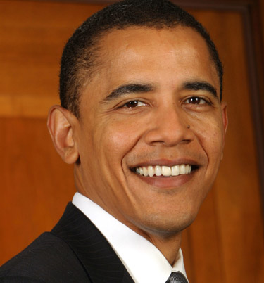
Barack Obama, the first black President
of the United States was 2 years old when
Martin Luther King delivered his speech

Slide 13
Let us pray
Lord, as we think about our brothers and sisters around the world, we ask you to help us bring down barriers and come together as one family in Your name.
Lord in your mercy, Hear our prayer
Lord, we are all your children and you love us no matter who we are, what we do and how we look. Help us to spread your love around the world so that differences do not separate us but give us something else to celebrate in Your name.
Lord in your mercy, Hear our prayer.

