Slide 1



British Values

Slide 2

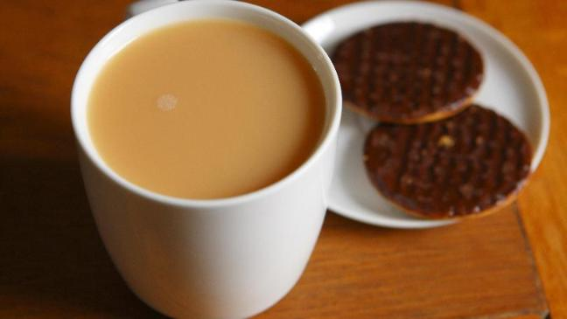

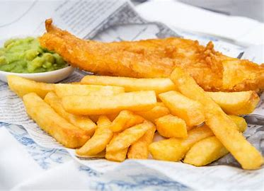
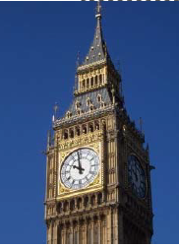
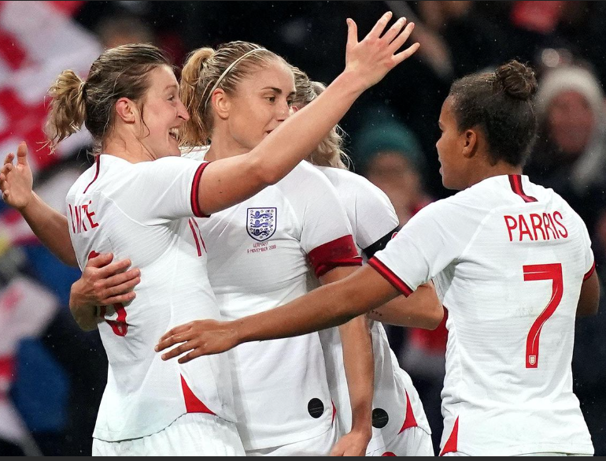
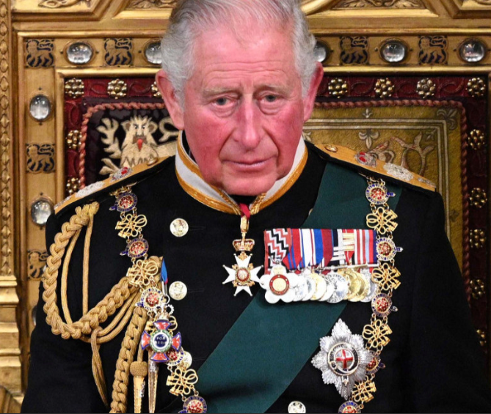


What makes us british?…
Notes:
Besides being a country that enjoys a good cup of tea our society is a fantastic place to live………
We have a say in who gets to lead our country as well as other decisions….
We have clear rules in place keeping us safe
We have freedom of speech!
We are a society which celebrates different cultures and faiths!
We come together to support our sporting heros
We have a national health service that do an amzing job of looking after us all when we need them
We have a royal family
We have some beautiful British landmarks

Slide 3
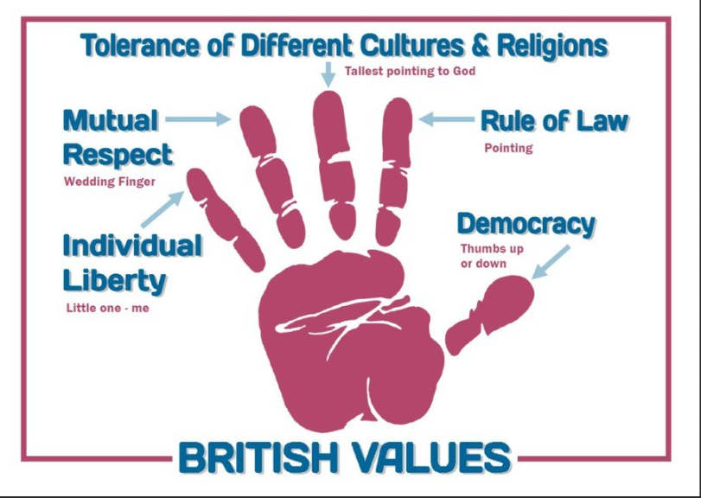
Notes:
Go through the hand diagram – explain there are mainly 4/5 british values that we should all know about/will learn about
Individual liberty
Respect and tolerance
Rule of law
Democracy

Slide 4
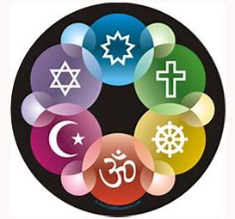
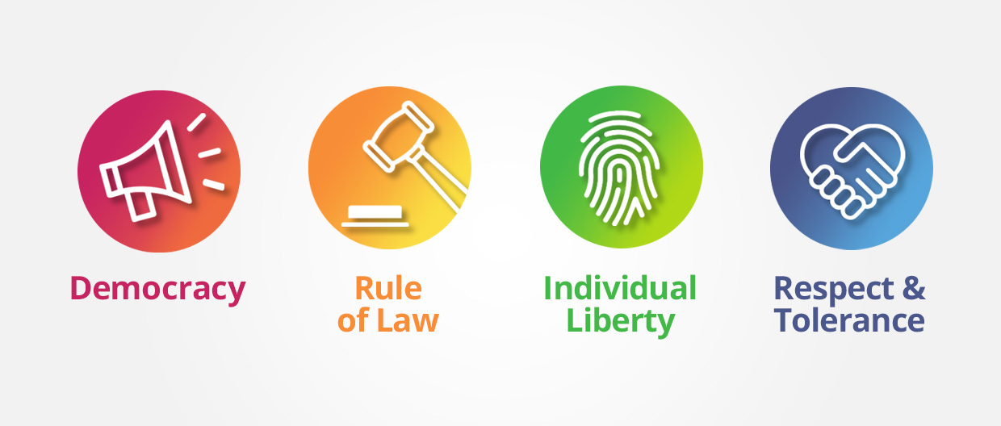
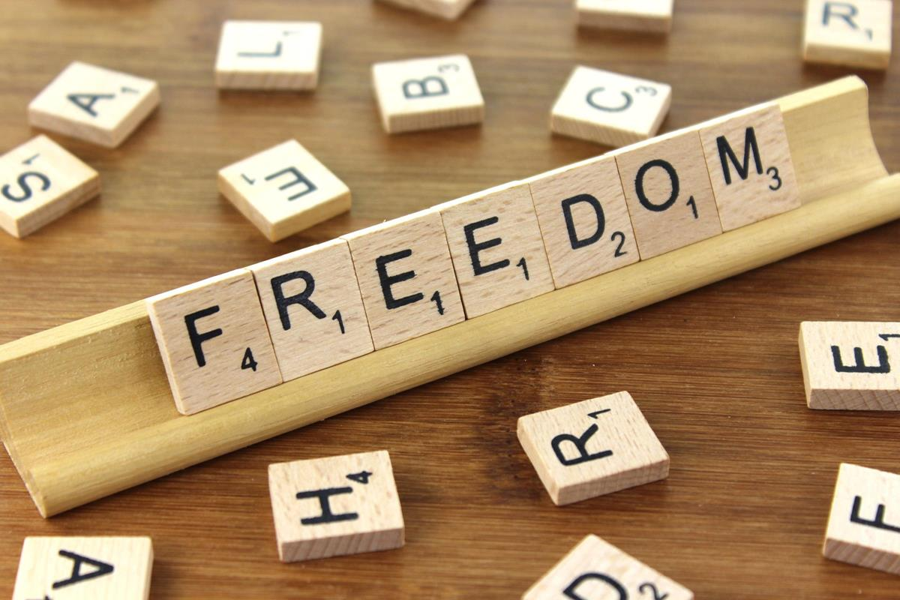
We have the freedom to express our individuality through freedom of speech, choice and presentation.
Having the freedom and protection to choose and hold the belief / faith you want
Notes:
You can be what you want to be and believe what you want to believe – and no-one has the right to tell you that you can’t.
Freedom of Speech - 'Freedom of speech is the right to seek, receive and impart information and ideas of all kinds, by any means.‘ But there maybe restrictions within the public interest and any restrictions must be proportionate.

Slide 5

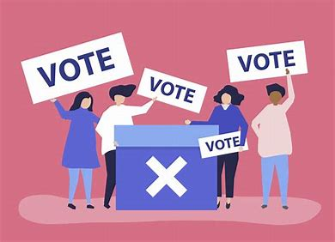
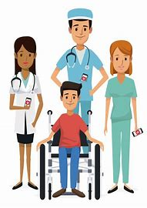

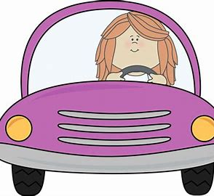
Individual Liberty
Notes:
Some countries don’t have what we have in Britain,
Some countries do not allow travel to other countries,
Some countries do no provide education for all
Some countries do not provide health care to all
Some countries people are not allowed to vote
In some countries women are not allowed to drive cars.
In Britain we have freedom and a choice.

Slide 6
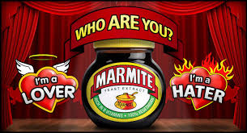
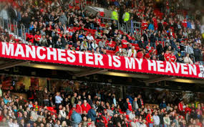
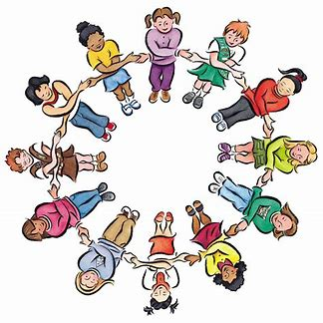
We live in a diverse multi-cultural and multi-faith society. We must not impose our beliefs on others. We should celebrate our diversity and value that people have different beliefs
We might not always agree with other people, but we try to show respect for their thoughts and feelings.
We can give respect to others and we can expect other people to show us respect.
Notes:
Everyone is treated the same regardless of sex, colour, creed or sexual orientation
Not only must your ideas be tolerated, but you have to tolerate other people’s ideas as well, as much as you might not like them

Slide 7


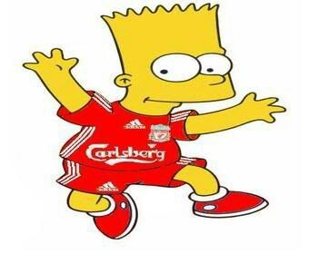
Respect and Tolerance
Notes:
Ask for someone to come to the front who supports Manchester united and someone who supports Liverpool
The two teams may not like the other team but we can be respectful, we accept that sometimes we are different and we have different interests and beliefs, treat people how you would like to be treated no matter what.

Slide 8
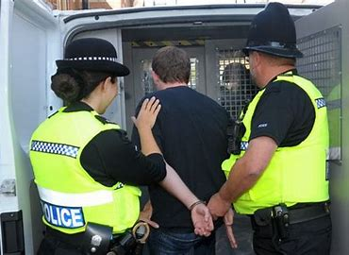
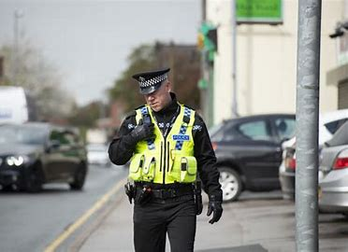
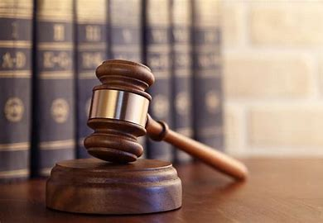
Acceptance of laws keeps our society safe and secure.
There are consequences for not following rules.
The law applies to everyone
Notes:
We have laws in place to protect the rights and freedom of all citizens
The idea being that the rule of law can not be corrupted by those in power, and no-one, despite how wealthy or powerful they are is above the law

Slide 9
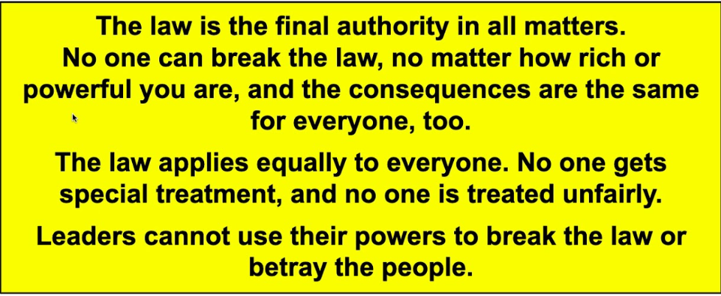
Rule of law
Notes:
No one can break the law
Applies to everyone

Slide 10
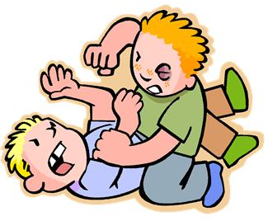
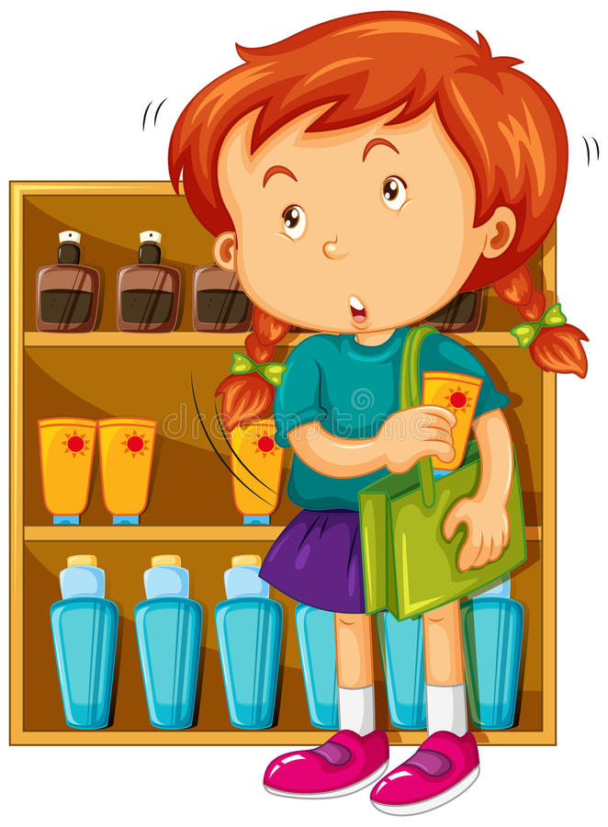
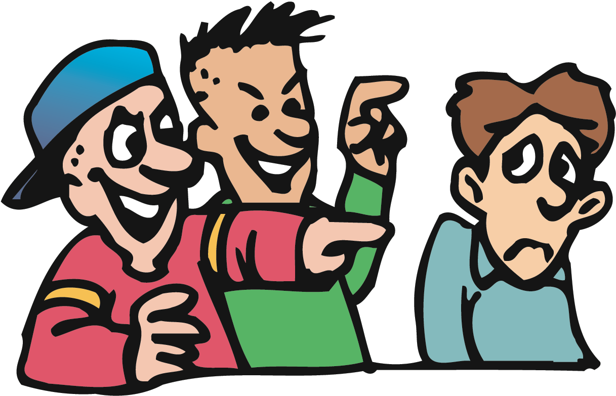
What is right and wrong?
Notes:
Name calling (hate speech, verbal abuse) WRONG
ASK - What would be the right thing to do?
Punching (assault, physical harm) WRONG
ASK - What would be the right thing to do?
Stealing WRONG
ASK - What would be the right thing to do?

Slide 11
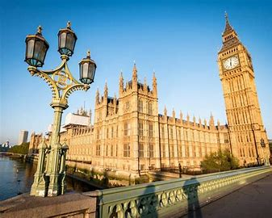
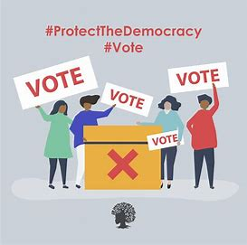
In Britain we have a choice.
Every vote counts
Being able to vote for government that is free and fair.
Do you have a school council?
Notes:
This means being able to vote for a Government in elections that are free and fair. We’re not the only country who has a democracy.
Democracy relies on listening to the needs of everyone and adapting a decision until the majority agree.
It requires thinking, understanding and patience.
Ask them if they have a school council?
This works in a similar way to British government. People are elected and have discussion regarding what they thing is good/bad right/wrong

Slide 12
What is democracy?
Pick out the words which describe democracy?
fair
unfair
war
power
vote
equal
liberty
justice
peace
control
freedom
law
fear
Notes:
Fair, vote, law, liberty, equal, freedom, justice, peace

Slide 13

British Values in School …
Having a voice – school council, talking to staff
Respecting other peoples views and opinions.
Freedom to make choices, e.g extra curricular activities
Making decisions together
Committing to school rules
RESPECT! In all forms
Being responsible for your actions
Challenging bullying, prejudice or bias.
Notes:
Examples of British values in school – what can we do?

Slide 14
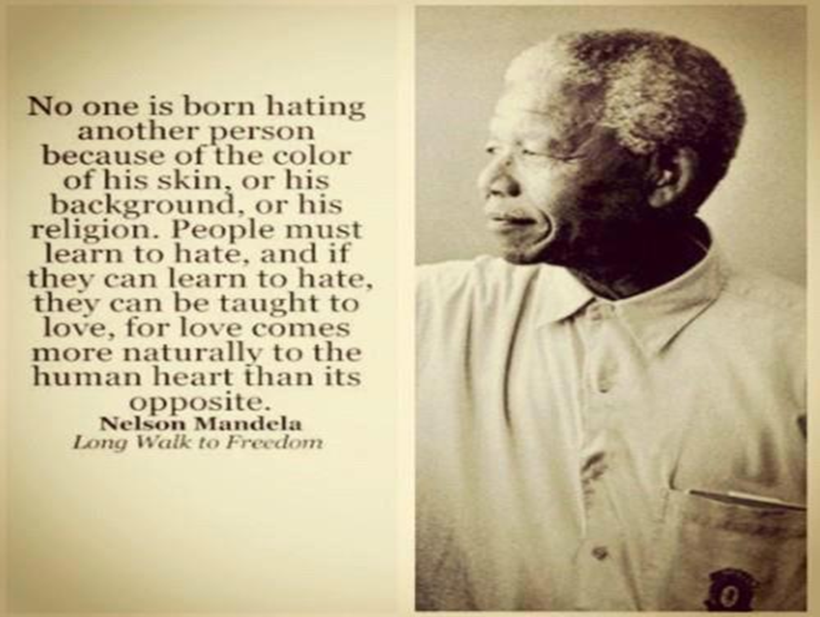
Notes:
Nelson Mandela was considered a terrorist by a lot of people and a freedom fighter by others…..

