Slide 1
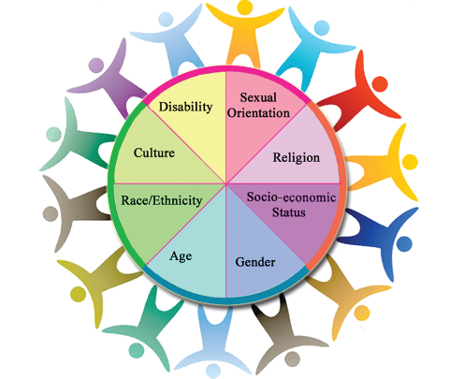
Diversity
Respecting differences and knowing
that we can't treat people
differently because of their
characteristics.

Slide 2
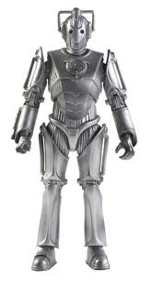
Imagine how strange it would be if you came to school one morning and everyone looked exactly the same – like robots or Cybermen from ‘Doctor Who’. You wouldn’t be able to tell who your friend was and who was your teacher.
Notes:
Read the text
Ask: what would it be like if this happened?
How would you feel?

Slide 3
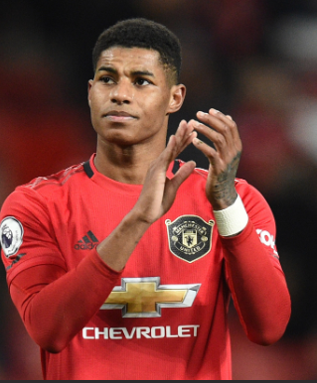
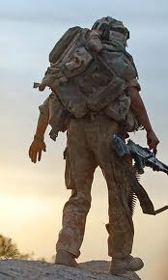
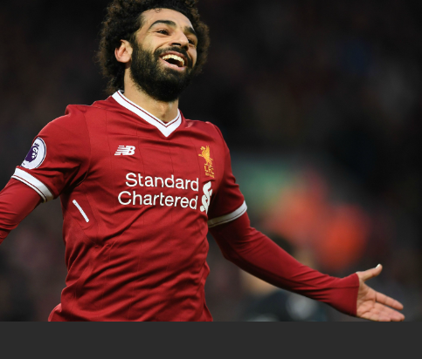
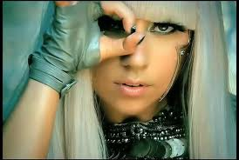
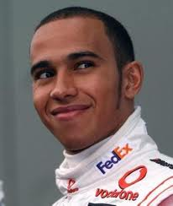
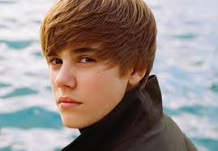
Fortunately, we’re all different. We might like to be a little more like someone else, a hero or someone we admire. But basically we are who we are and it's ok to be YOU. It's good to be different and remember that special characteristics are not to be discriminated against.
Notes:
Ask: Who would you like to be like ? Why?
What type of things would you like to change about yourself?
Say :We should all be happy with who we are because that’s what make us different.

Slide 4


Notes:
Show the video

Slide 5
Diversity...
Diversity is about the many ways in which people are different from one another.
Race
Gender
Age
When we have the freedom to live and be who we want to be, it results in an interesting mix of people.
Diversity is a mix of things...
Notes:
Ask: What is diversity?
Explain that “Diversity is about the many ways in which people are different from one another. This can include race , gender and age”
When he have the freedom to live and be who we want to be, it results in an interesting mix of people.
Ask: What other things might diversity be a mix of?

Slide 6

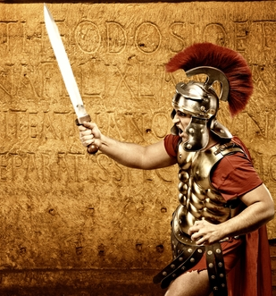
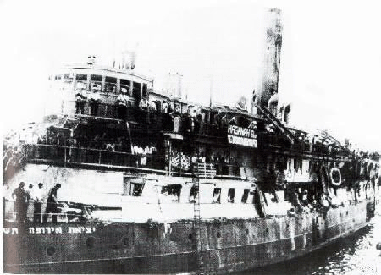
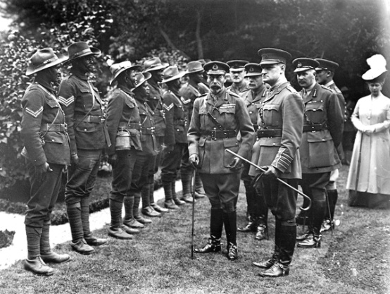
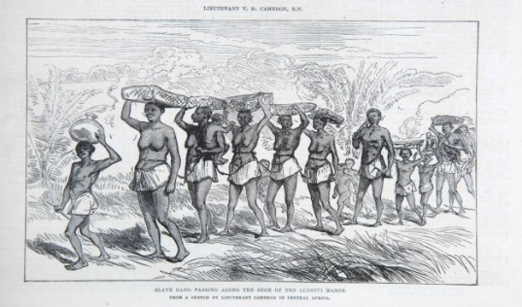
Diversity in the UK…
Down to our deepest historic roots, Britain has always been a diverse nation with people arriving here from all over the world!
As people from around the world arrive in Britain, they all contribute their own ethnic and cultural influence to our society...
Notes:
Much of our diversity comes from the British Empire, which at its height governed over one quarter of the world’s population – that’s 458 million people!
After the British Empire collapsed, people from the Commonwealth came to Britain, and countries such as the Caribbean and India were invited to help strengthen our workforce. They also bought much of their culture and traditions along with them.
The UK used to be a part of Europe (the european union) which meant that many people from European countries, like Spain, France and Italy came to the UK

Slide 7
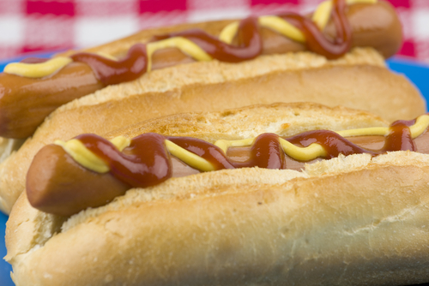
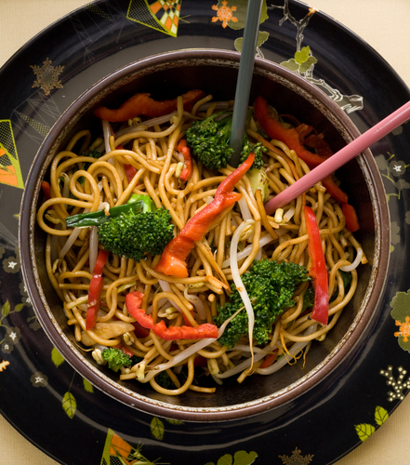
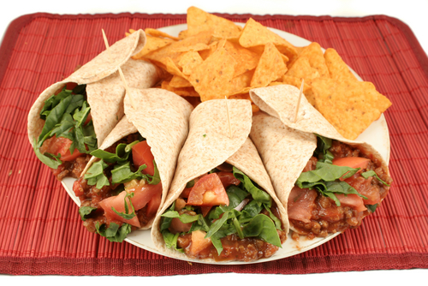
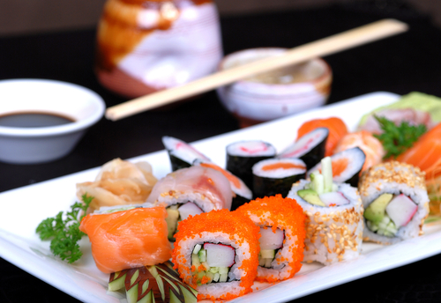
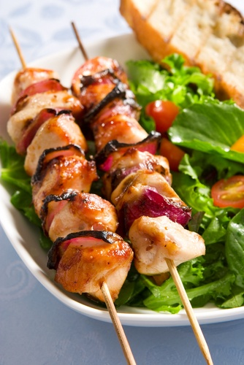
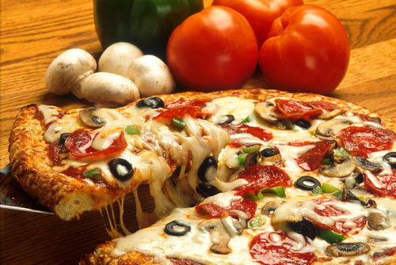
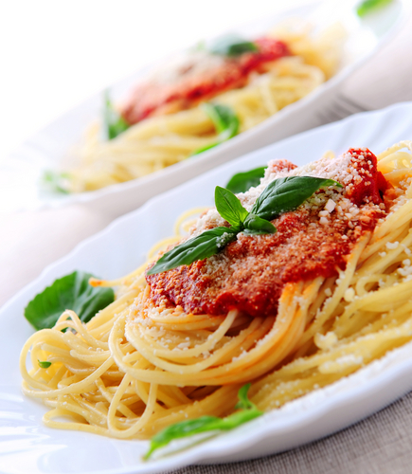
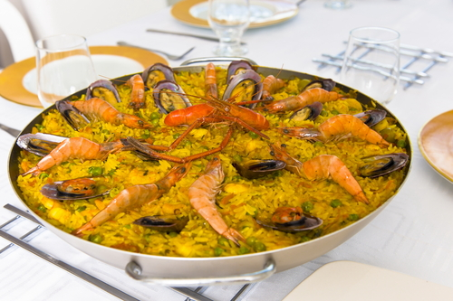
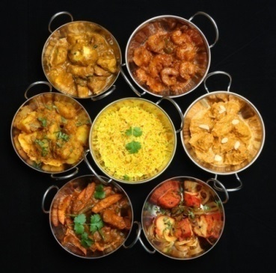
A mix of food…
Notes:
One example of diversity that came from other cultures is food.
Who has a favourite food?
Where does that food come from?
Examples:
Pizza and pasta from Italy
Hot dogs from American
Sweet and sour chicken from china

Slide 8
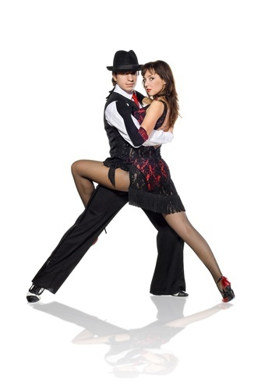

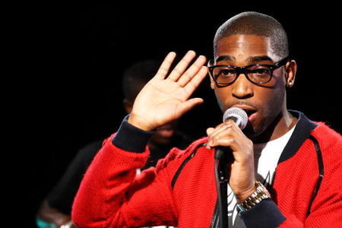
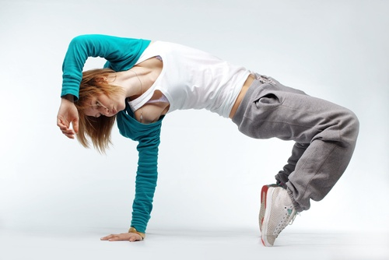
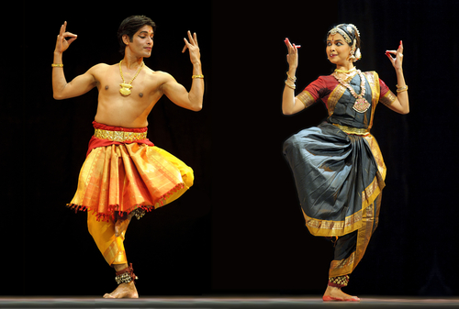
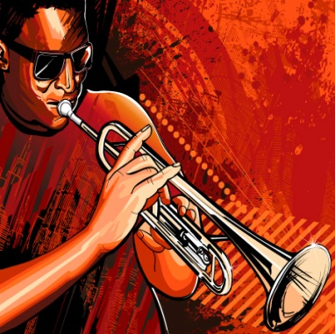
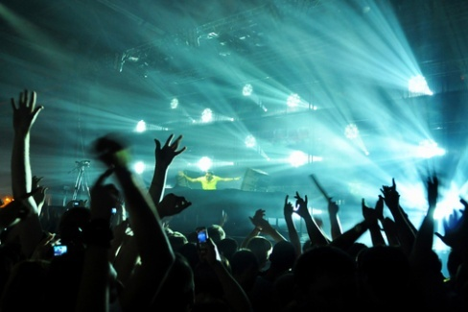
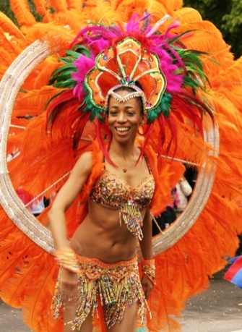
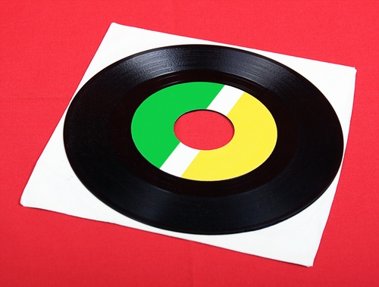
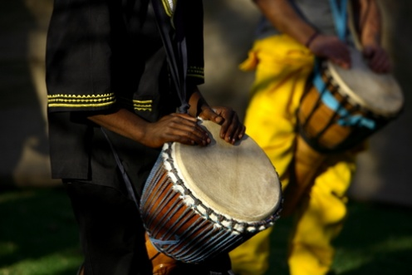
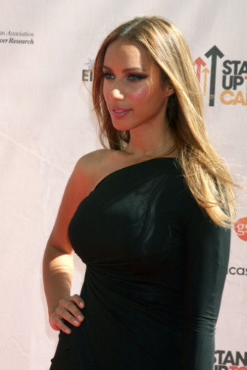
A mix of music and dance…
Notes:
Discuss the different mix of music people listen to and where they originate from.

Slide 9

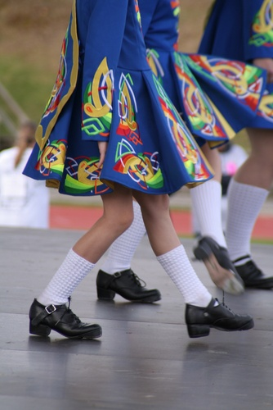
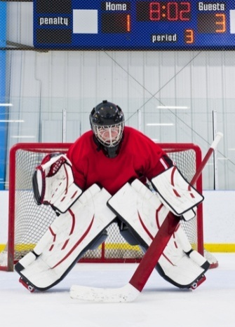
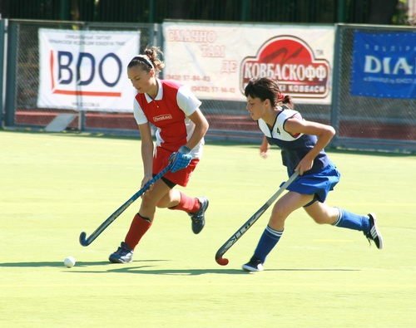
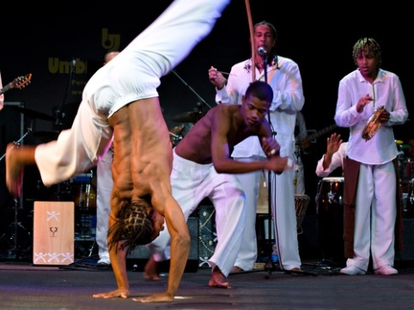
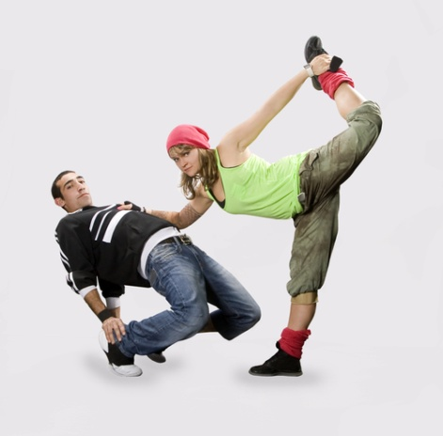
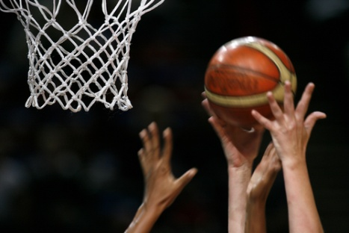
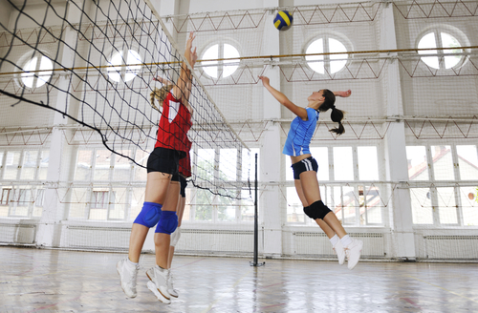
A mix of sports…
Notes:
Who has a favourite sport?
Where does that sport originate from?
Football- England
Cricket- England
Basketball – America
Golf- Scotland
Judo- Japan
Netball- USA

Slide 10

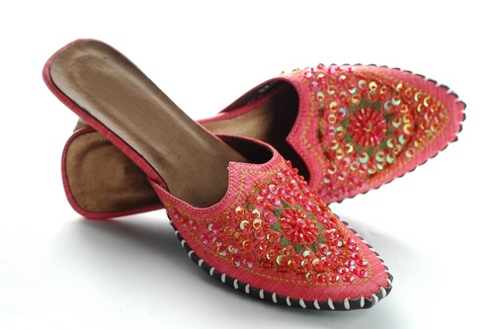
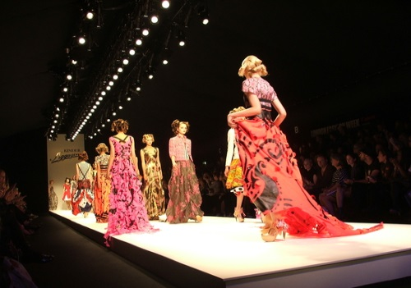
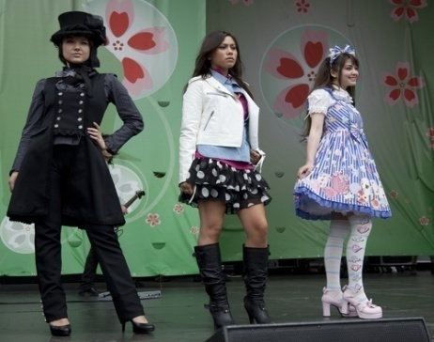
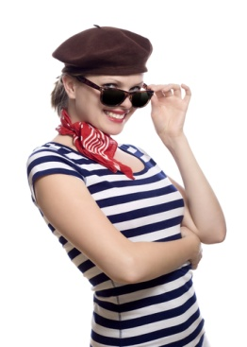
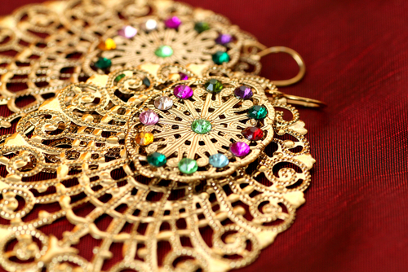
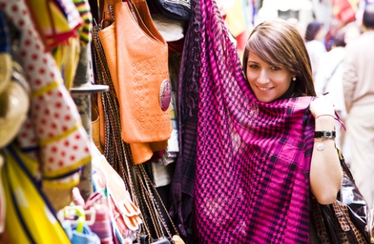
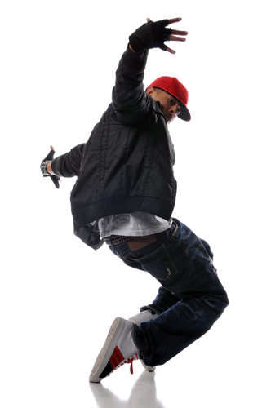
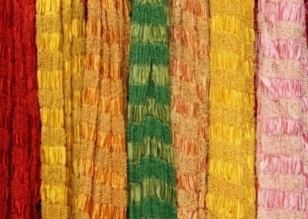
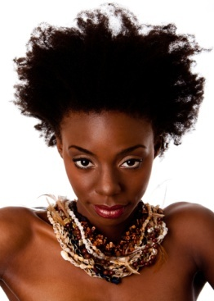

A mix of fashion…
Notes:
Fashion influences from all over the globe.
Ask what pictures./ clothing they recognise and where they think they come from?

Slide 11
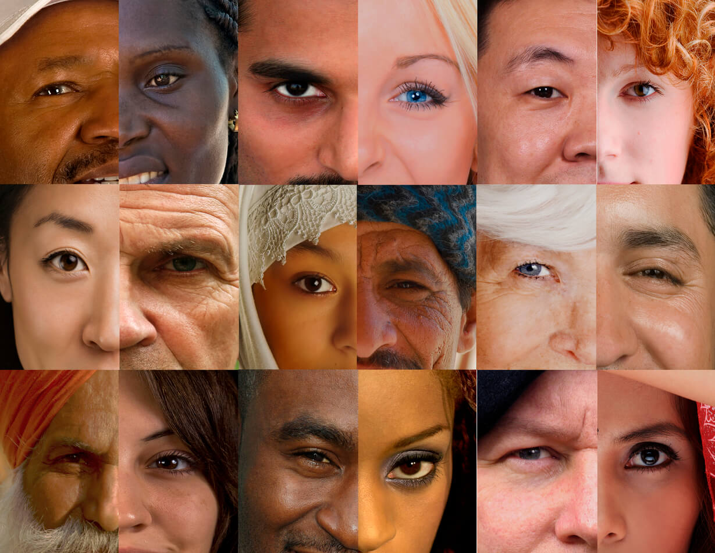
Ethnic diversity…
Diversity has made our society rich in culture; respecting and tolerating differences makes us blessed.
Can you imagine our country without all the amazing food, music, dance, sports, fashion and people that diversity brings? Do these people who bring us joy all look and speak the same? Are they all married? Are they all able to have babies? Are they all old? These characteristics are so special and need protecting – not discriminating about.
Notes:
Diversity has made our society rich in culture and contributed to our economic, social and democratic development.
Ensure audience understands what we mean by economic , social and democratic development. Illustrate with examples where possible.
What would our world be like without any diversity?

Slide 12


Respecting and tolerating differences
With freedom and diversity comes a need to respect all difference!
Do you want to live in a world where we can be who we want to be, listen to the music we like, eat the foods we enjoy, dress how we like to dress etc?
Then we must remember that the person next to us has the freedom and right to do the same.
Notes:
Read the following points
Ask: How can we ensure that we respect all differences. What can we do?

Slide 13
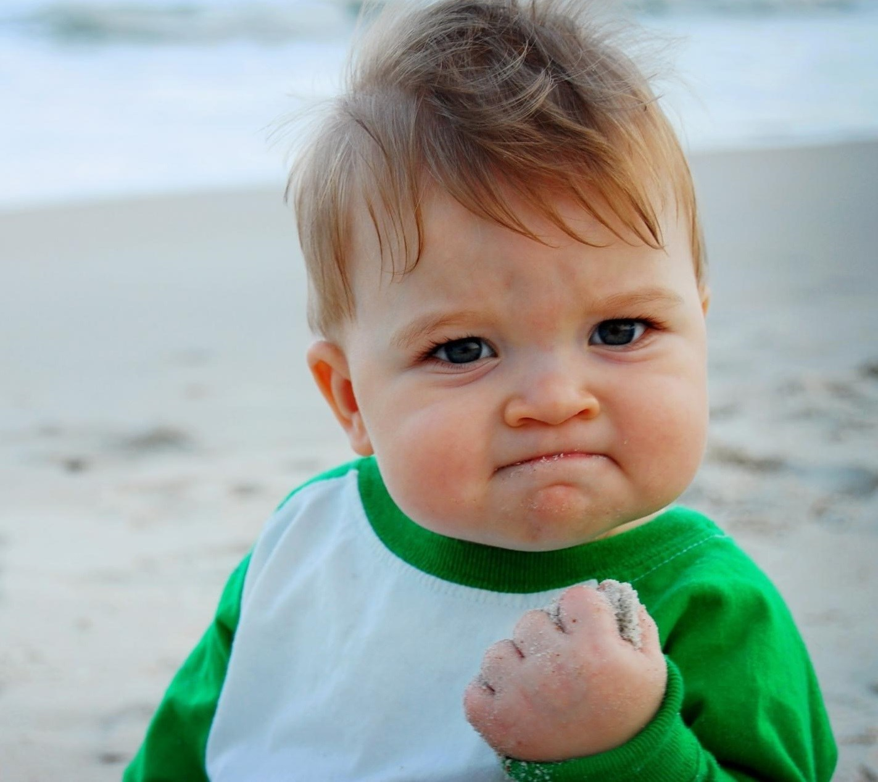
Be proud…
It is important to remember we are ALL different and it is our differences that make us unique and special, and that makes our country interesting.
Be proud and confident in your differences!
Be tolerant
Respect and celebrate difference in others!
Notes:
Read the following points.

Slide 14
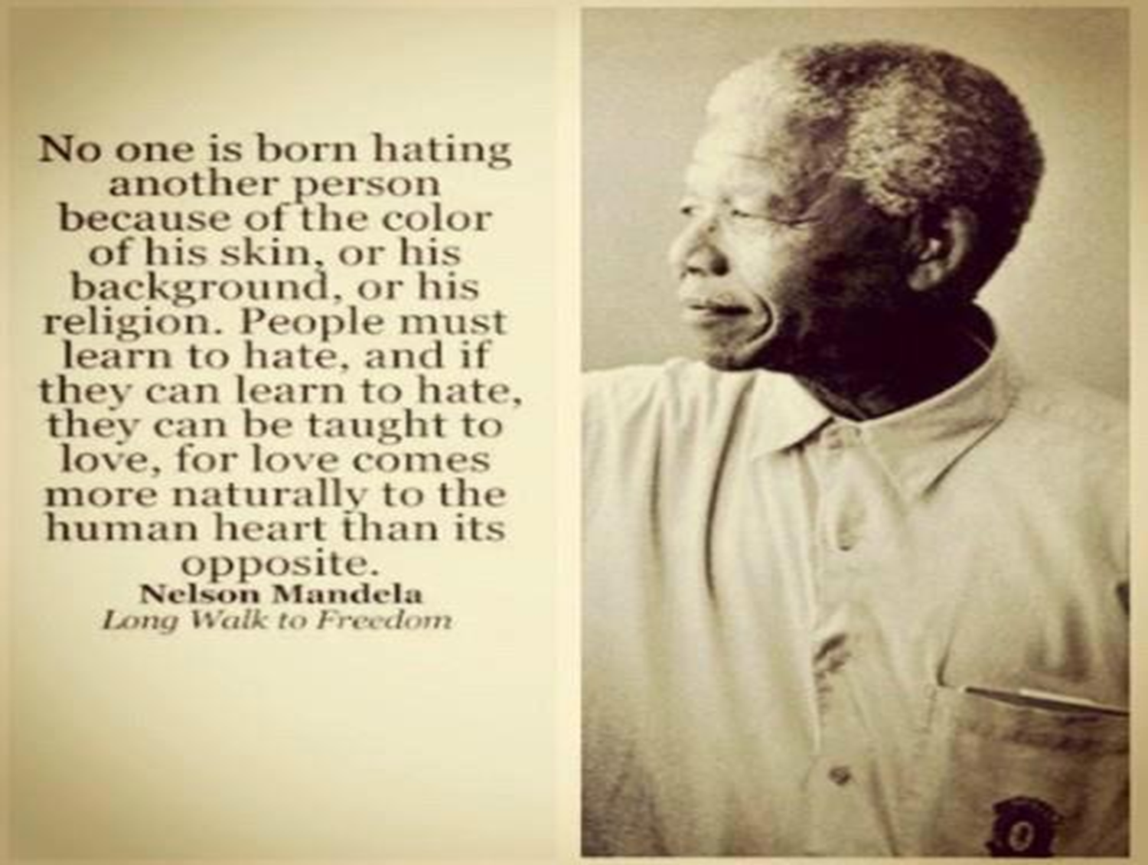
Notes:
Read out the above quote to finish off.
Reflect upon todays learning.

Slide 15
Notes:
Video may be played as students leave the assembly

