Slide 1

What does good behaviour look like at our school?
In the playground?
In the classroom?

Slide 2
Pupils’ code of conduct
Be the best that I can be at all times
Arrive at school on time and smartly dressed
Travel carefully around school, walking not running
Listen politely to all adults in school
Do what is asked of me by any grown up
Put my hand up to speak in class
Keep hands and feet to myself
Use good manners and be polite always
Be kind and gentle to others
Make each other, and guests, feel welcome in our school
Appreciate diversity, showing tolerance and respect

Slide 3
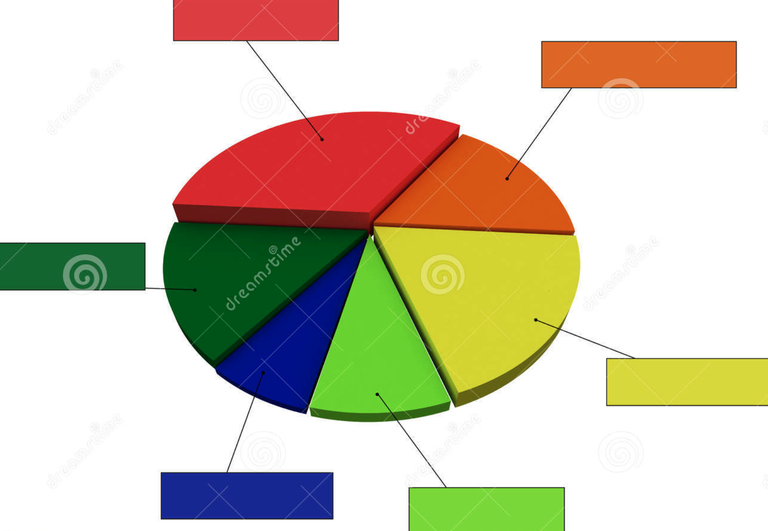

Why should I behave well?
Appreciative
Forgiving
Bold
Loving
Honest
Generous

Slide 4
If I behave well…
I can be proud of myself
My teachers, family and friends will be proud of me
I will become really clever!
I will get more dojos and be able to buy more dojo rewards
I can take part in the special rewards programme
If I get it right– a special letter will go to my family to tell them how brilliant I am!

Slide 5

What if I don’t behave well?
I get two chances to fix it!
If I can’t improve my behaviour then I will miss five minutes playtime and write in my PSHE journal about how to get things right next time
If I have to miss playtime, then I can’t join in the Easter rewards for that day.
If my behaviour does not improve, I will miss all my playtime and work in another class for a short amount of time
My family will be called and I might be put on a behaviour chart to help me
If I have to miss playtime, then I can’t join in the Easter rewards for that day.

Slide 7
What does good behaviour look like at our school?
In the playground?
In the classroom?

Slide 8
My special rules
Be the best that I can be at all times
Travel carefully around school, walking not running
Listen politely to all adults in school
Do what is asked of me by any grown up
Put my hand up to speak in class
Keep hands and feet to myself
Use good manners and be polite always
Be kind and gentle to others

Slide 9
Appreciative
Forgiving
Bold
Loving
Honest
Generous

Slide 10
If I behave well…
I can be proud of myself
My teachers, family and friends will be proud of me
I will become really clever!
I will get more dojos and be able to buy more dojo rewards
I can take part in the special Easter rewards which start today!
If I get it right every day up to Easter – a special letter will go to my family to tell them how brilliant I am!

Slide 11
What if I don’t behave well?
I get two chances to fix it!
If I can’t improve my behaviour then I will miss five minutes playtime
If I have to miss playtime, then I can’t join in the Easter rewards for that day.
If my behaviour does not improve, I will miss all my playtime and work in another classroom for a little while
My family will be called and I might be put on a behaviour chart to help me
If I have to miss playtime, then I can’t join in the Easter rewards for that day.

