Slide 1
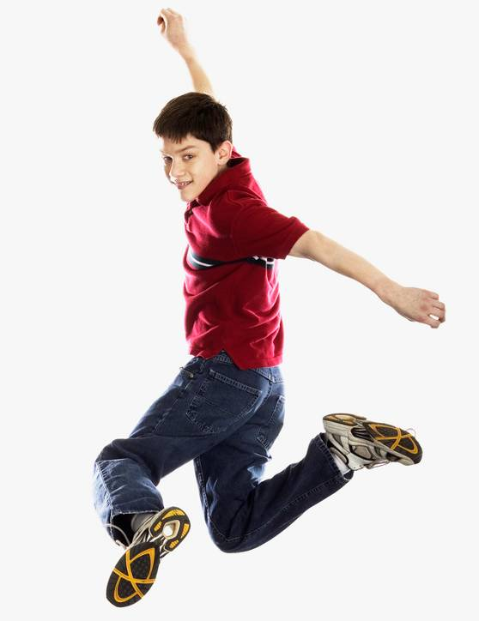
Year 4 & 5
God loves us in our differences
1 A Journey in Love - Year 4

Slide 2
Objectives
Know that God has made us
different from one another.
Know that God loves us
in our differences.
2 A Journey in Love - Year 4

Slide 3
Keywords
God,
Gifts,
Talents,
Difference,
Development,
Change,
Male and female
body parts,
Conflict,
Appreciate,
Celebrate,
Achievement,
Sensitivity,
Respect.
3 A Journey in Love - Year 4

Slide 4
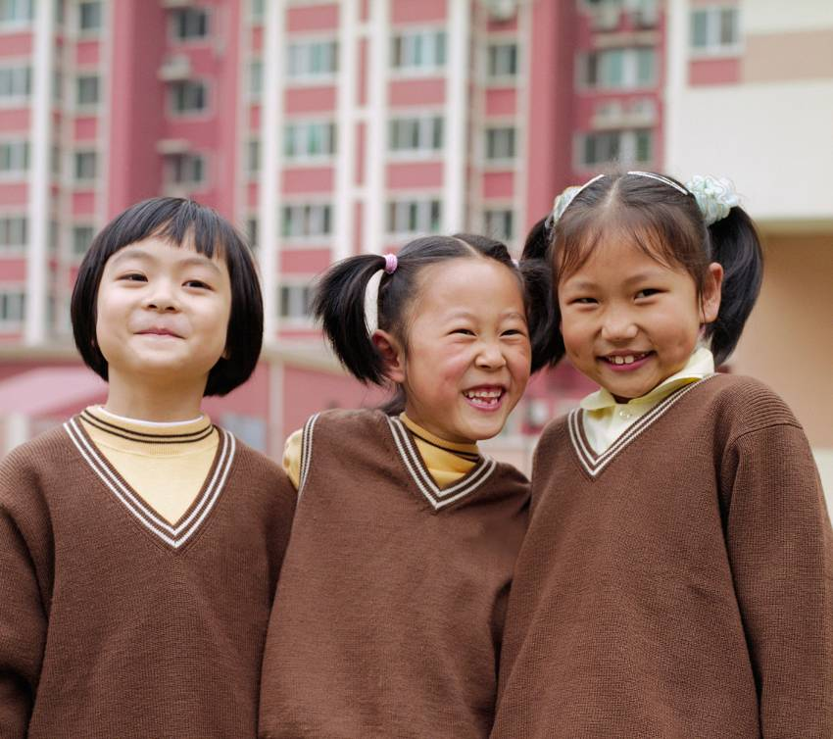
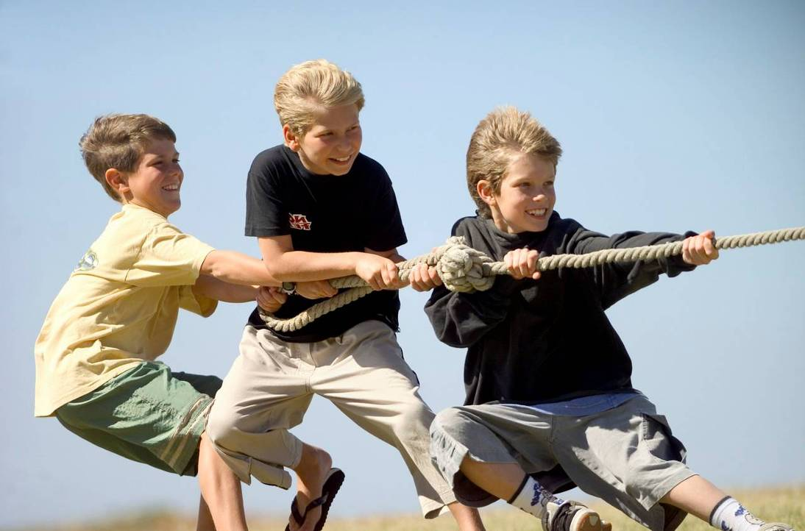
PHYSICAL
We grow and develop at different rates.
We are different shapes and sizes.
4 A Journey in Love - Year 4

Slide 5
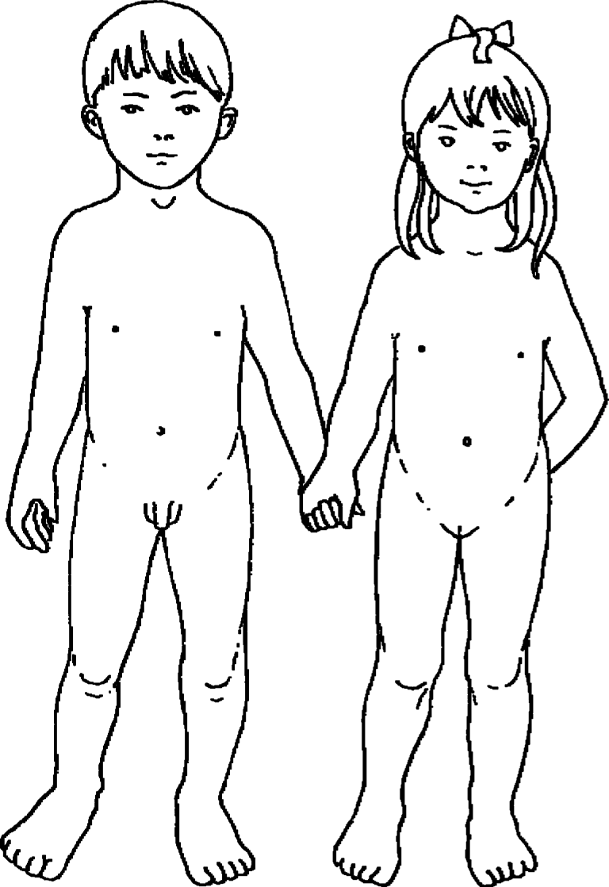
Boys and girls are different
What are the
differences?
5 A Journey in Love - Year 4

Slide 6
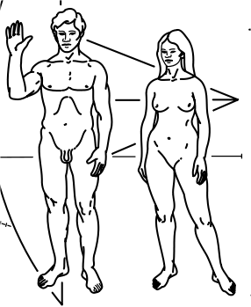
Men and women are different
What are the
differences?
6 A Journey in Love - Year 4

Slide 7
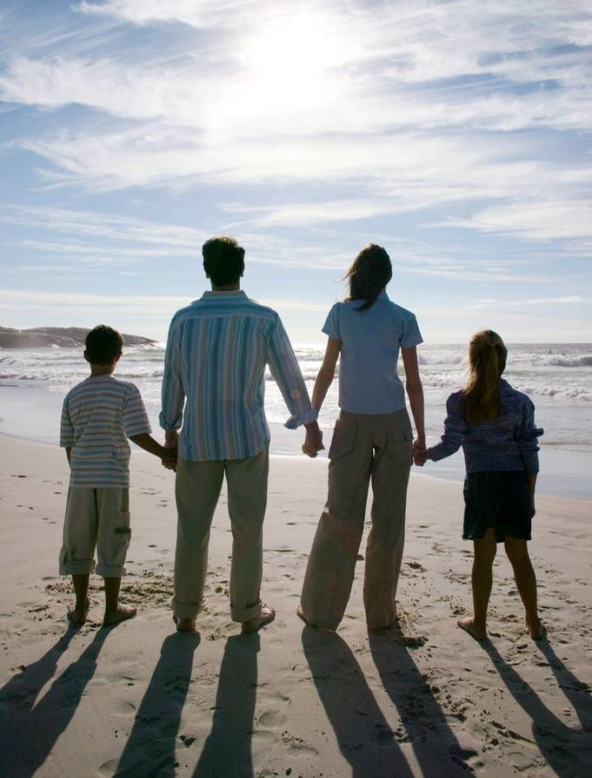
Man, woman, boy or girl...
We are each unique…
...we accept ourselves
and each other.
7 A Journey in Love - Year 4

Slide 8
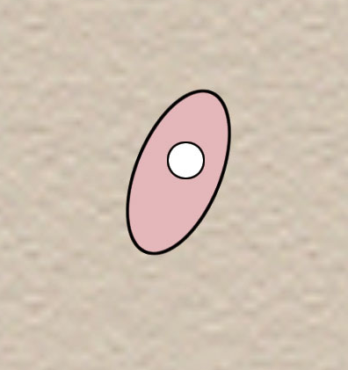
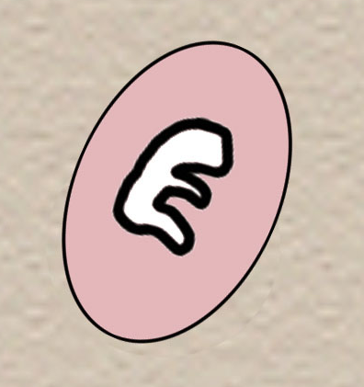
Development of a baby in the womb
Conception
4 weeks
The baby is just large enough to see.
He/she is about half the size of a full stop.
His/her heart is formed and he/she has small leg and arm buds.
8 A Journey in Love - Year 4

Slide 9
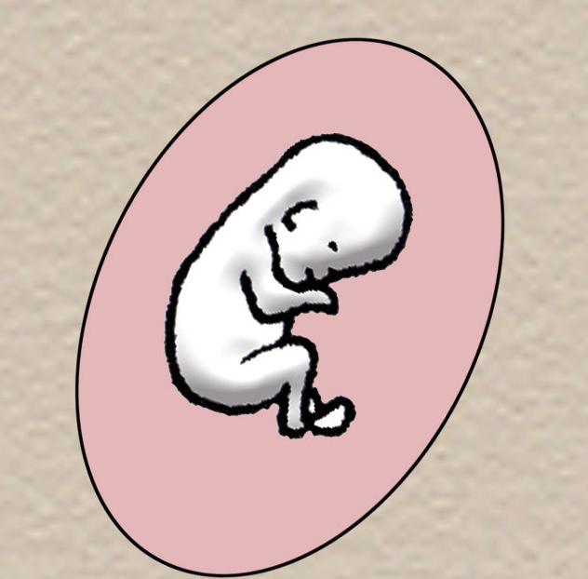
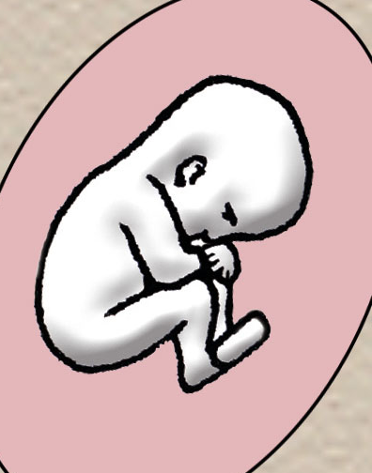
8 weeks
The baby’s eyes and ears
are developing
and legs show
knees and ankles;
toes are joined
together.
12 weeks
All the important parts
are formed
and nails
begin
to grow.
9 A Journey in Love - Year 4

Slide 10
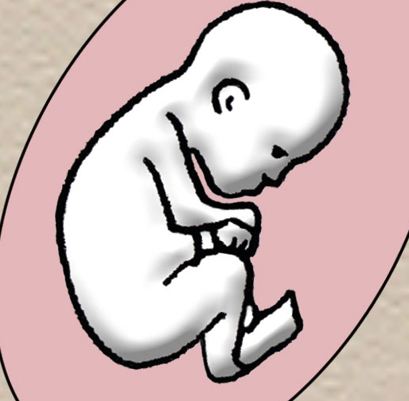
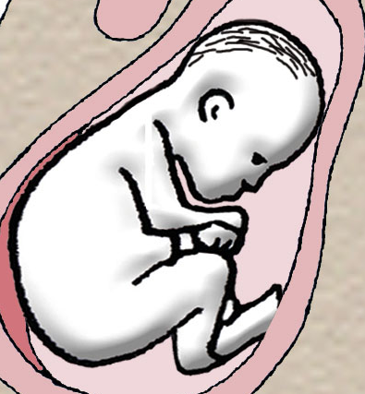
16 weeks
Some bones are hardening.
The mother can feel movements
and the baby can suck his/her
thumb.
20 weeks
The baby is now 25-27 cm long.
His/her fingernails and toenails
are fully grown.
10 A Journey in Love - Year 4

Slide 11
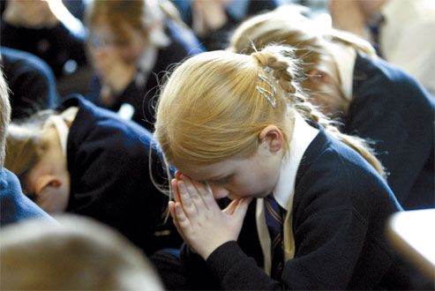
Prayer
For the wonder of me,
thank you Lord.
For the uniqueness of us all,
we thank you Lord.
For the wonder of your
love in creating us,
we thank you Lord.
Amen.
11 A Journey in Love -Year 4

Slide 12
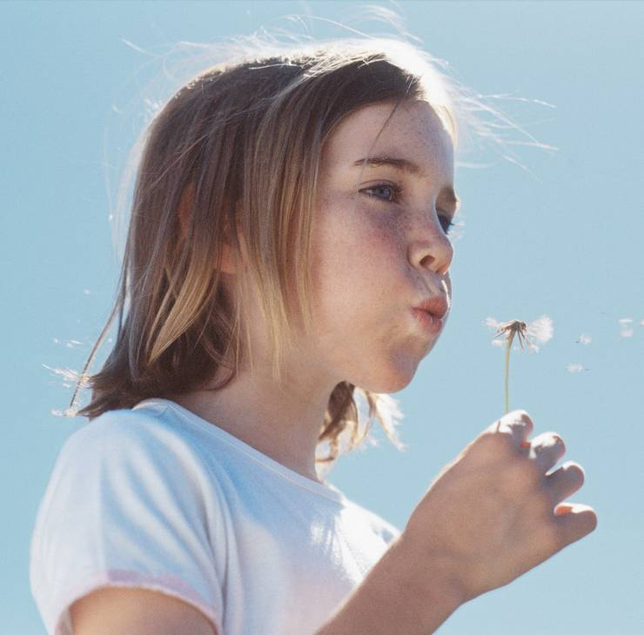
SOCIAL
How do I learn to accept and celebrate who I am?
Something
I can do?
The kind of
person I am?
What do I like about me?
The way I look?
12 A Journey in Love - Year 4

Slide 13

What do I want to improve about myself?
The way I look?
Something I can do?
The kind of person I am?
13 A Journey in Love - Year 4

Slide 14
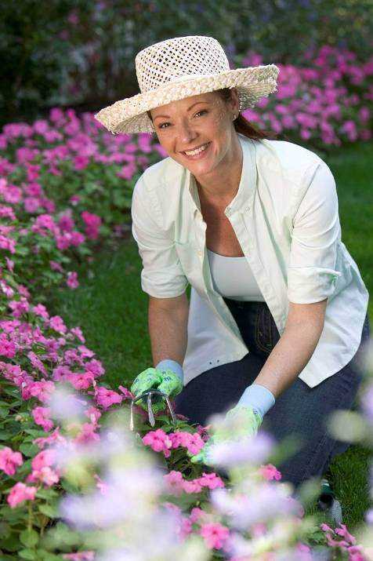
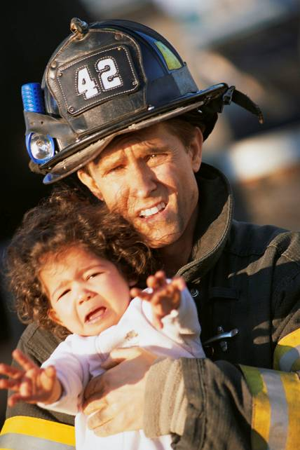
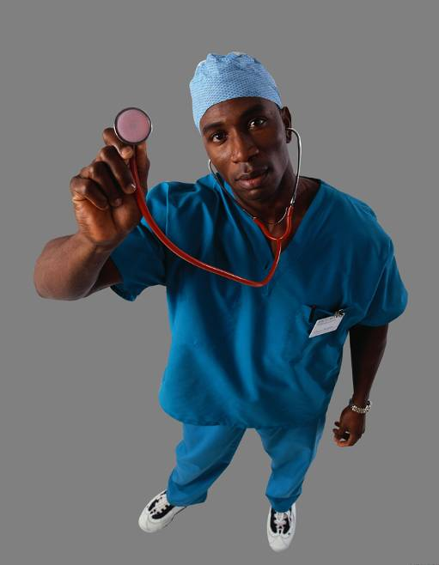
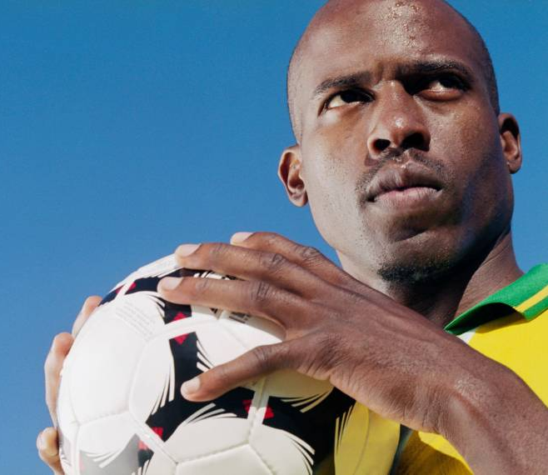
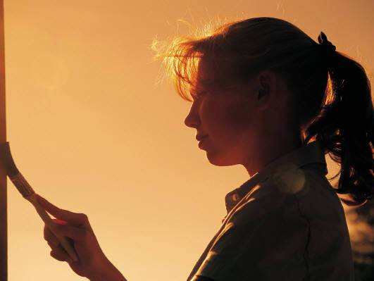
How do I accept difference in others?
We all have different gifts
and talents.
14 A Journey in Love - Year 4

Slide 15

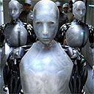
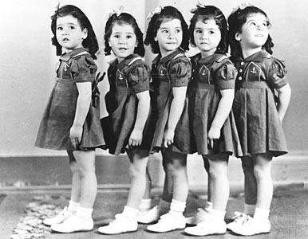
What would the world be like if we all had the same talents?
15 A Journey in Love - Year 4

Slide 16
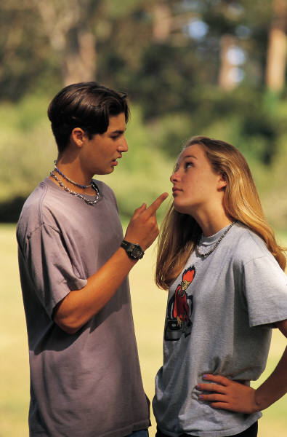
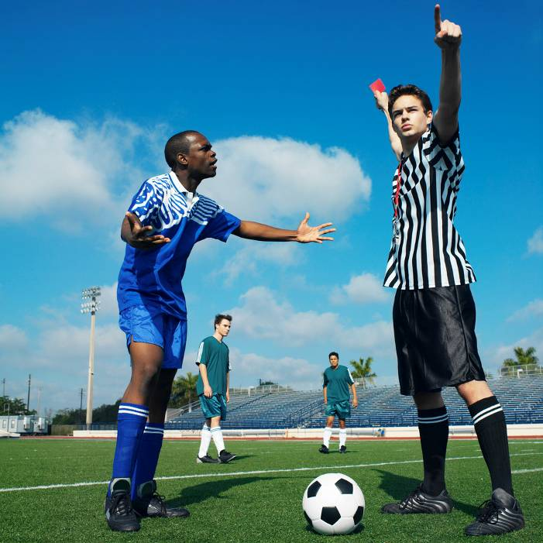
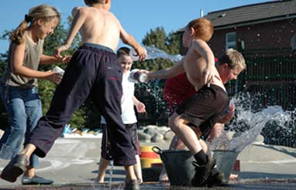
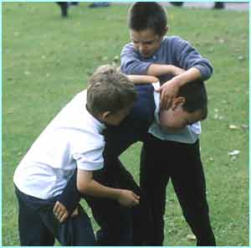
How do I deal with conflict?
16 A Journey in Love - Year 4

Slide 17
Prayer
For the times when we have been in conflict with others at home and in our community,
forgive us, Lord.
Amen.
17 A Journey in Love - Year 4

Slide 18
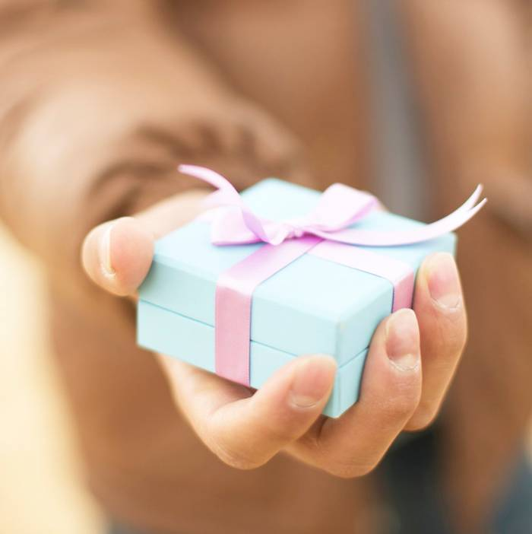
EMOTIONAL
How do I appreciate my own gifts, talents and achievements that make me unique?
Know them…
develop them…
share them…
18 A Journey in Love - Year 4

Slide 19
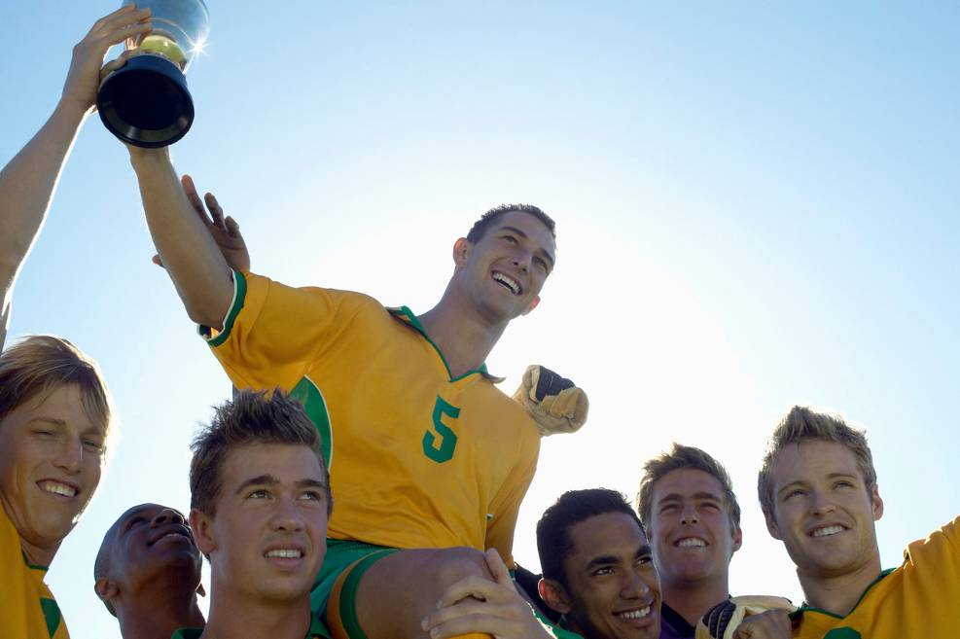
How do I appreciate others and the gifts they have been given?
Accept them…
celebrate them…
affirm them…
19 A Journey in Love - Year 4

Slide 20



How do I deal with natural, negative emotions?
Jealousy?
Anger?
Spitefulness?
Greed?
Selfishness?
20 A Journey in Love - Year 4

Slide 21
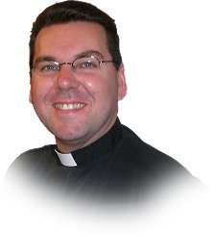

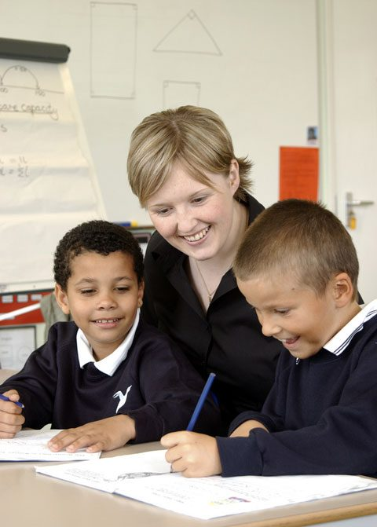
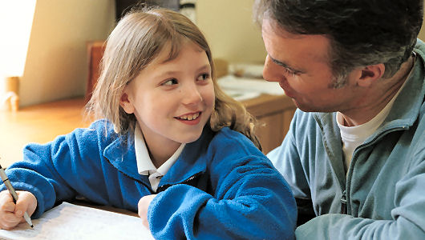
Is there anyone to talk to about these emotions?
Priest?
Doctor?
Teacher?
Who else?
Parent?
21 A Journey in Love - Year 4

Slide 22
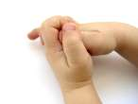
Prayer
For your gifts, talents and many blessings to us… we thank you, Lord.
Amen.
22 A Journey in Love - Year 4

Slide 23






INTELLECTUAL
I have all sorts of feelings.
Can I name them?
23 A Journey in Love - Year 4

Slide 24
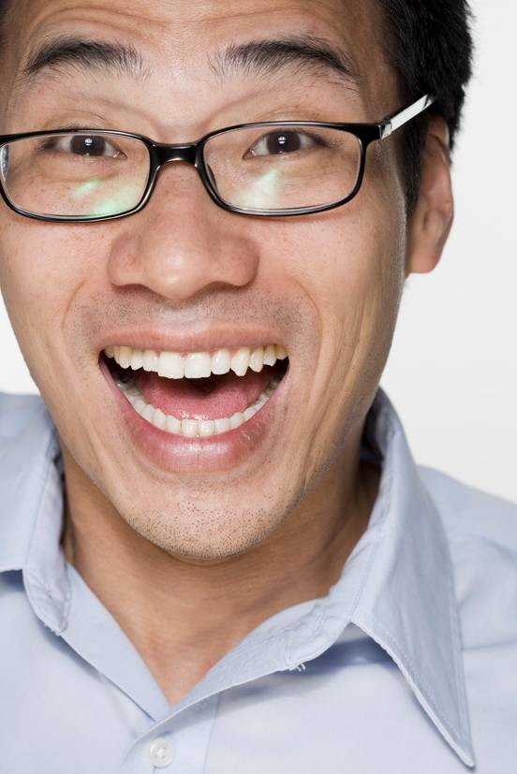
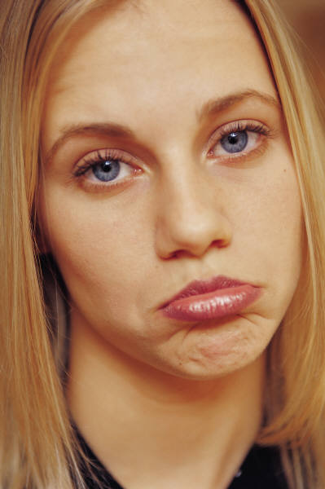
Some are
happy feelings…
some are
sad feelings…
We all feel both happy and sad feelings.
How do I deal with what I feel?
24 A Journey in Love - Year 4

Slide 25
Prayer
Lord you are always with us,
in happy and sad times.
For your constant love,
We thank you.
Amen.
25 A Journey in Love - Year 4

Slide 26
SPIRITUAL
Saint Paul’s teaching:
Love is patient and kind;
it is not jealous or conceited or proud;
Love is not ill-mannered or selfish or irritable;
Love does not keep a record of wrongs;
Love is not happy with evil, but is happy with the truth.
Love never gives up; and its faith, hope and patience never fails.
1 Corinthians 13:4-7
26 A Journey in Love - Year 4

Slide 27
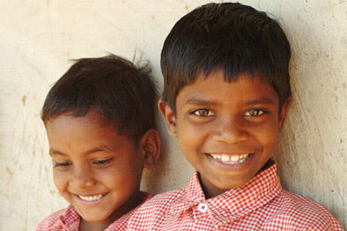
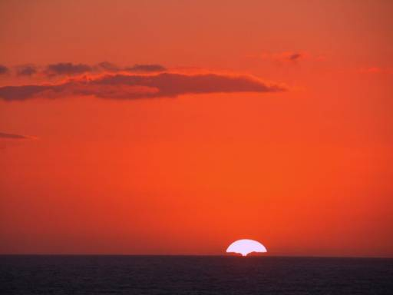
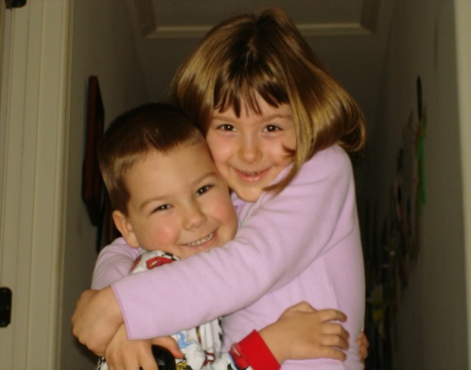
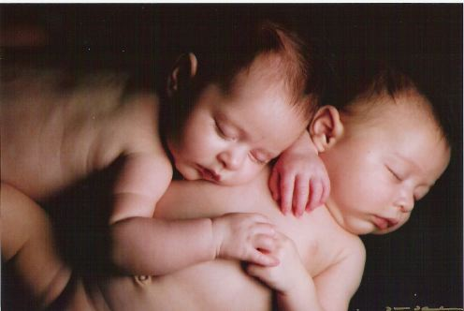
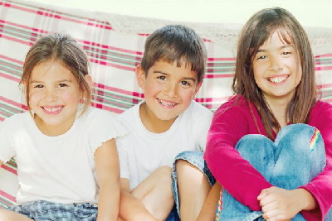
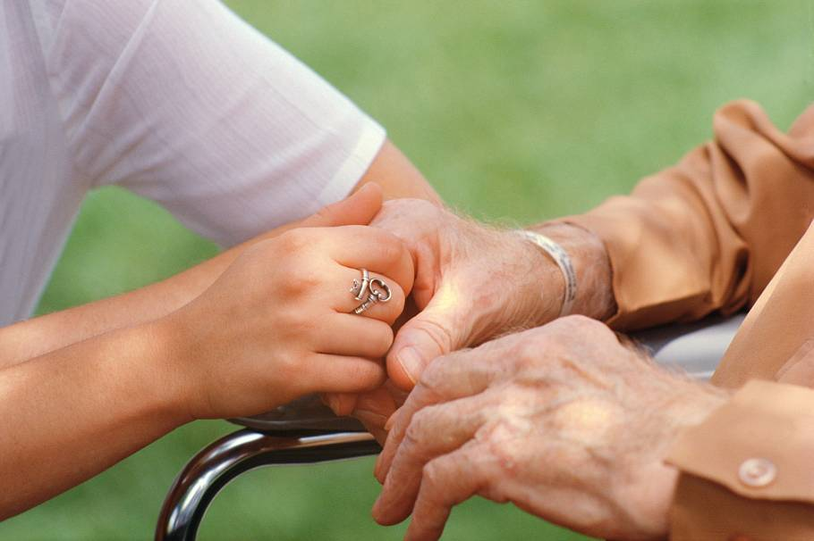

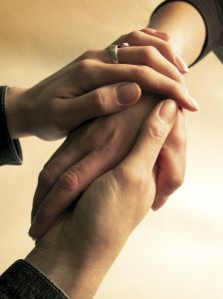
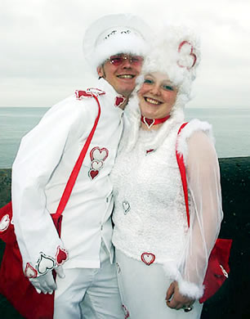
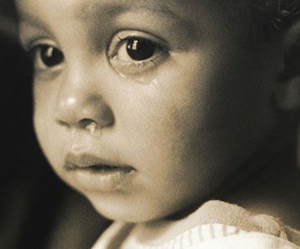
Love is…
27 A Journey in Love - Year 4

Slide 28
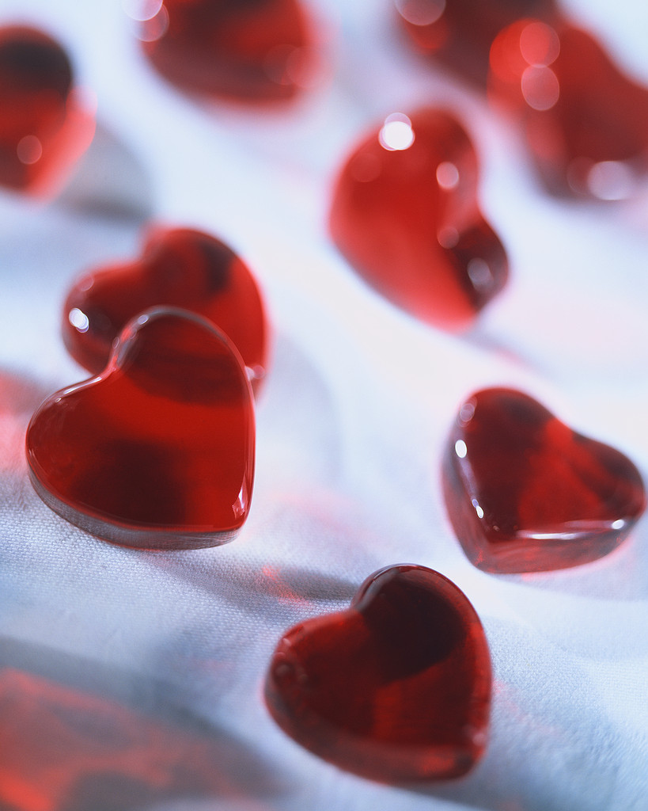
Am I always patient?
Am I always kind?
Am I always loving?
28 A Journey in Love - Year 4

Slide 29
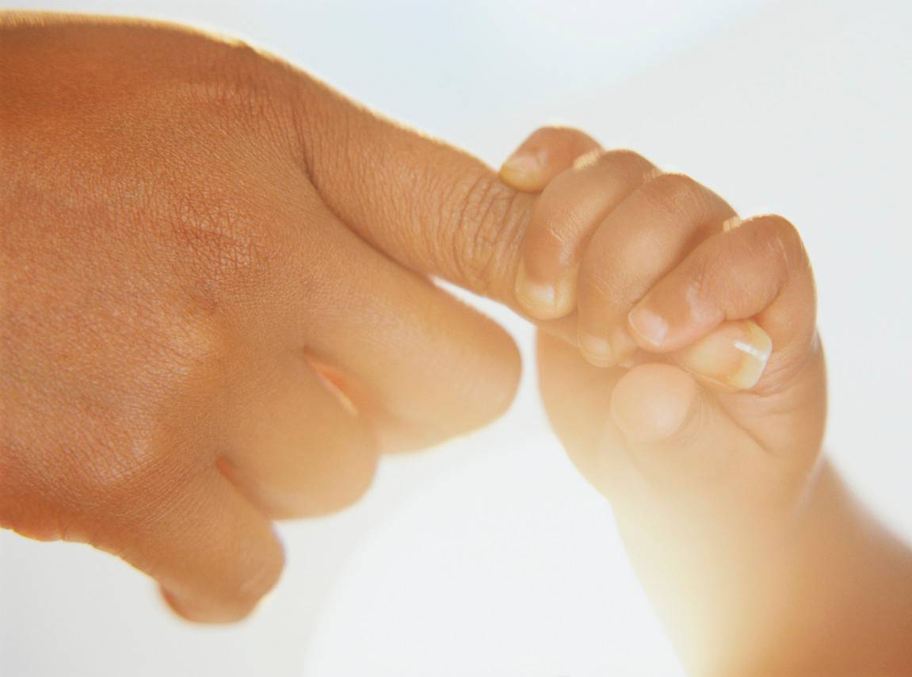
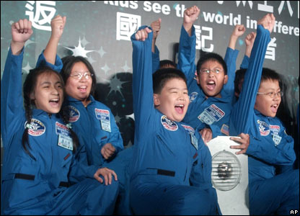
Prayer
O Lord,
It was you who created my being,
and knit me together in my
mother’s womb.
I praise and thank you for
the wonder of my being,
for all my gifts and talents.
I praise and thank you for
the gifts and talents of all
in my class and school.
Amen.
End of presentation
29 A Journey in Love - Year 4

