Slide 1
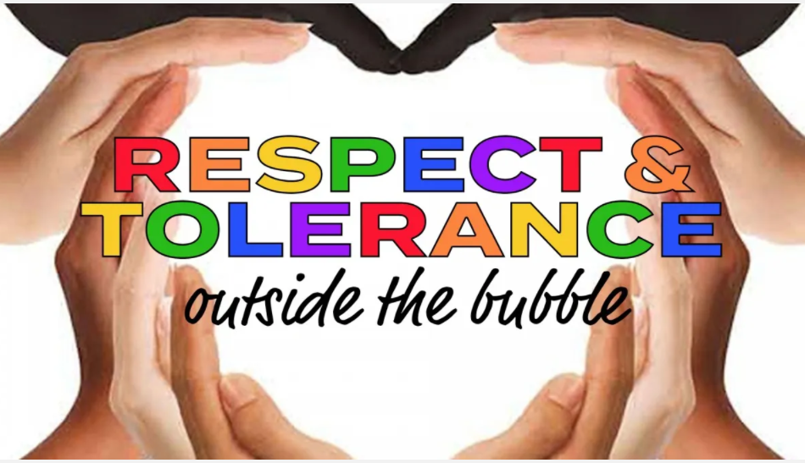


Slide 2

What is respect?
It’s how you treat others
It’s being considerate of people’s feelings
It’s recognising the value of people, property, the environment and yourself.
Knowing that it's ok to have certain characteristics
Notes:
Ask – Who do you show respect to?

Slide 3
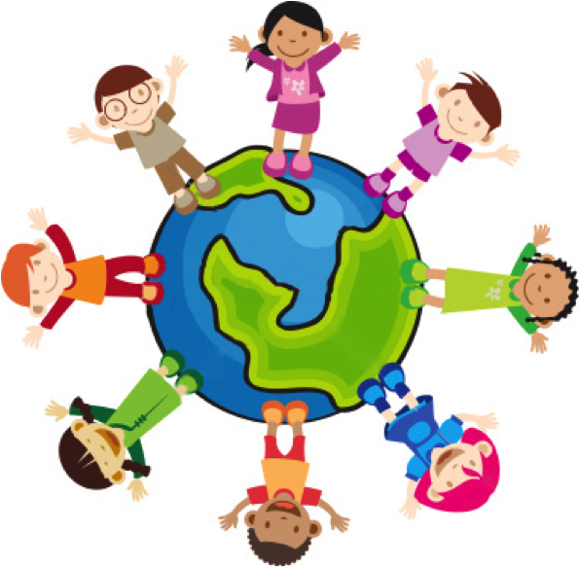
What is tolerance?
Tolerance means to accept differences – the characteristics that might make people different from one another.
Tolerance means showing respect for the
Race
Religion
Age
Gender
Opinions
of other people or groups.
Notes:
What does Tolerance mean?
Go through what tolerance means and give/ask for examples of it in action in our world.
Ask for ideas
What do you think about this?

Slide 4
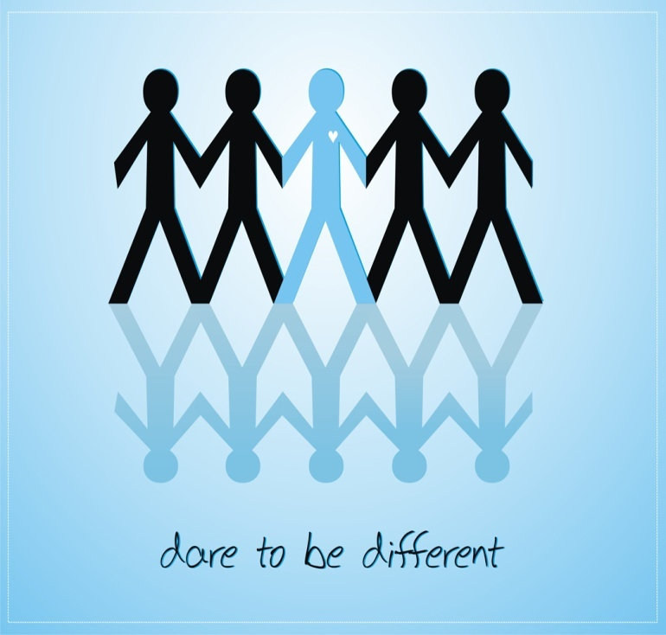
How do you treat people who are different from you?
Do you judge them by their looks?
Do you offer to be friends?
Do you get to know who a person really is?

Slide 5
Tolerance is NOT
Responding to a person in a negative way
Being mean, or unkind, or aggressive, towards people
Leaving people out of games or activities because of their personality or beliefs
Gossiping or talking about a person or group of people behind their backs
Notes:
Examples of intolerance
If someone is being intolerant, what can we do?
Act – Do something or say something if someone is being intolerant. This could be saying something to the person who is being negative or if you’re not confident to do that, then telling someone about it. Doing nothing may look like you think it is okay. And remember to remain respect in your challenge.
Support – People on the receiving end of intolerant behaviour may feel scared and alone therefore let them know you care by being respectful and showing then support.
Unite – If we come together we can stop it.

Slide 6
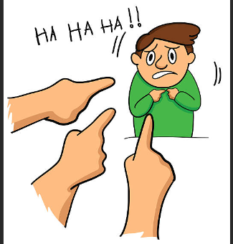

Bullying
Physical
Verbal
Emotional
Racist
Online
Notes:
Physical bullying
• being hit, pushed around by someone or more than one person
having their clothes, glasses or bag damaged
having their phone or other belongings damaged or taken from them
having money taken from them, or being forced to steal money for the bullies
Verbal bullying
being called names or having comments made about how they look
spreading nasty rumours or stories about them
threatening them
making comments about their house, belongings or
Emotional bullying
leaving them out of games or activities
making others ignore them as well
telling them they are stupid, can’t do anything right, hopeless at games etc
Racist bullying
calling them racist names
always talking to them in ridiculous accents
making fun of their country or culture or religion
Online bullying
posting offensive remarks about somebody online
encouraging a lot of people to be involved in bullying using texts or social networking sites •
sending threatening messages anonymously

Slide 7
How do we make sure bullying does not happen in our school?
How can you make sure you respect everyone?

Slide 8

We are different from each other, but we also have similarities
People come in different sizes, shapes and colours
We all have hopes and dreams
We all have feelings and emotions

Slide 9
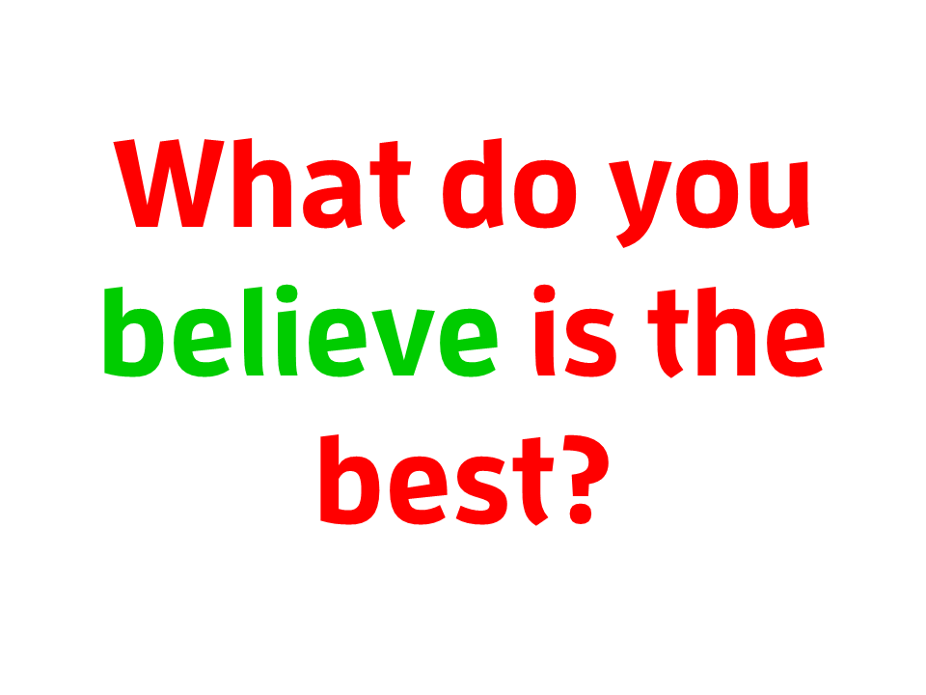
Notes:
I am going to show you 2 pictures, raise your hands to respond.

Slide 10
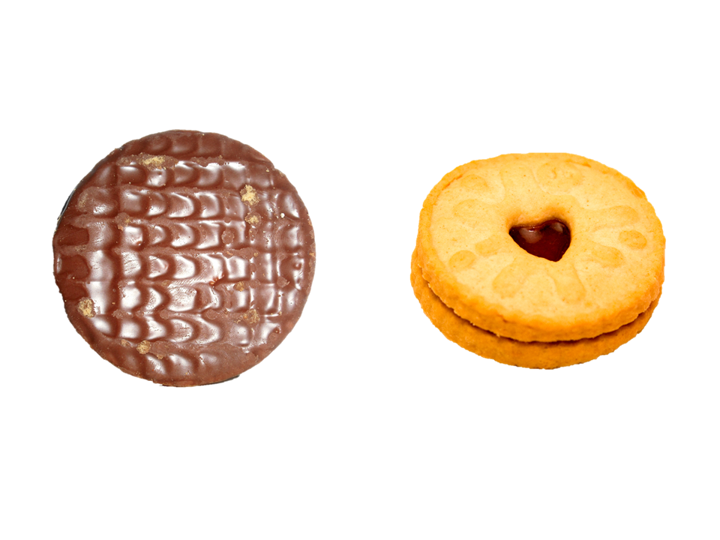
Which biscuit do you prefer?
Notes:
Do a hands up and ask why they think as they do.

Slide 11
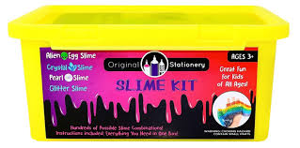

Which toy/activity do you prefer?
Notes:
Again do a hands up- pick out that some people like to play sport- may like different football teams- and some prefer to play inside and make a mess with slime.
Pick two people sat side by side
Did it matter that your friend didn’t like what you liked?
Does that mean that you are not friends? Does that mean that you wont play with your friend? NO
Would we be happy if someone was mean to us for being different to them?
It doesn’t matter if we like different things the important thing to remember is that it is ok to be different.
To show tolerance we need to work together , accept other peoples, not upset anyone because they are different.

Slide 12
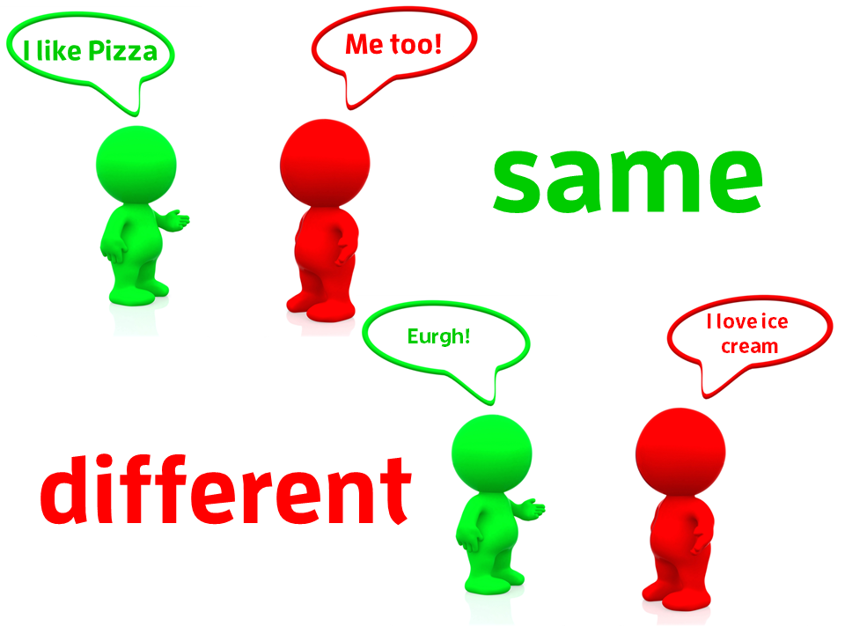
Notes:
We all have different ideas, opinions, likes and dislikes.
We are the same but different
We don’t all have to agree with one another
What is important is that we are kind, caring and helpful towards one another.
When we are have tolerance we don’t care if someone is a boy or a girl, which football team they support or if they wear glasses or not.
Because it’s the difference between us that make each one of us special.

Slide 13
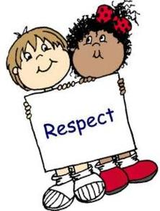
How you show respect- it’s all up to you
Respect means caring for others and treating everyone with kindness, including being tolerant of people’s different choices.
By showing respect for others, property, the environment, and yourself, you will, in turn, earn the respect that you deserve!

Slide 14
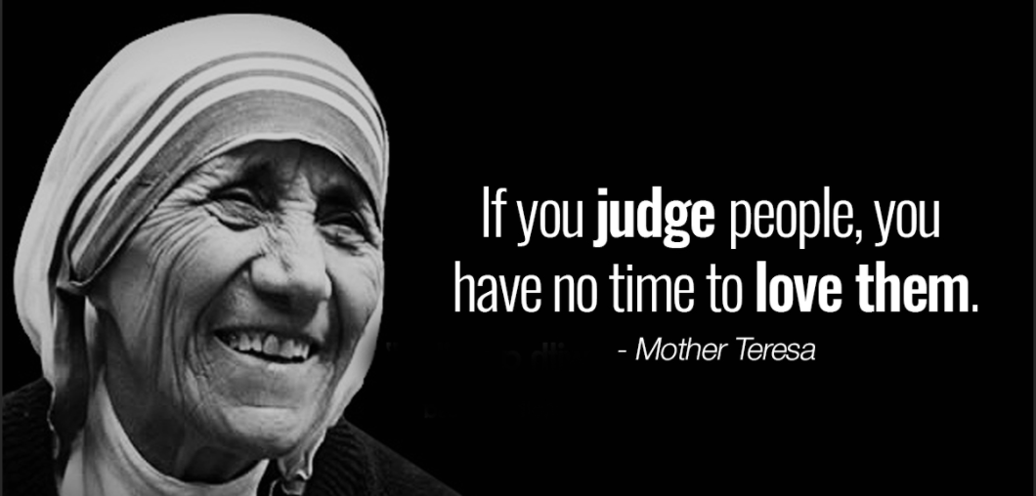

Slide 15
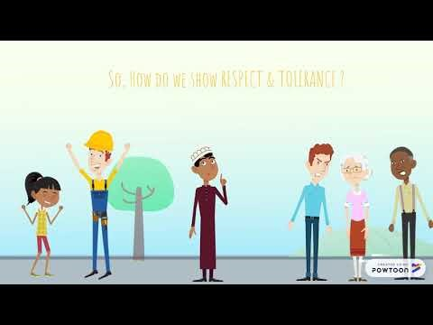

Slide 16

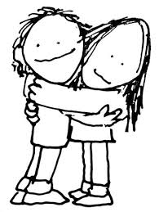



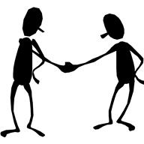


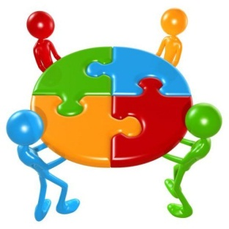


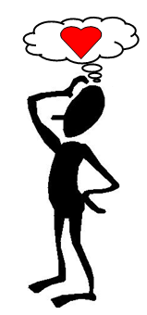
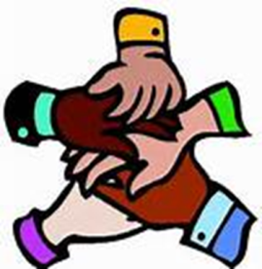

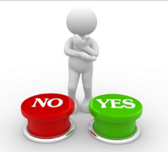
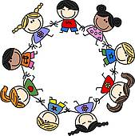

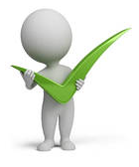
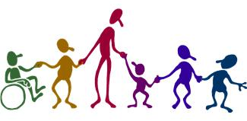
Reflect and think about how RESPECT and TOLERANCE makes the
world a better place to be.

