Slide 1
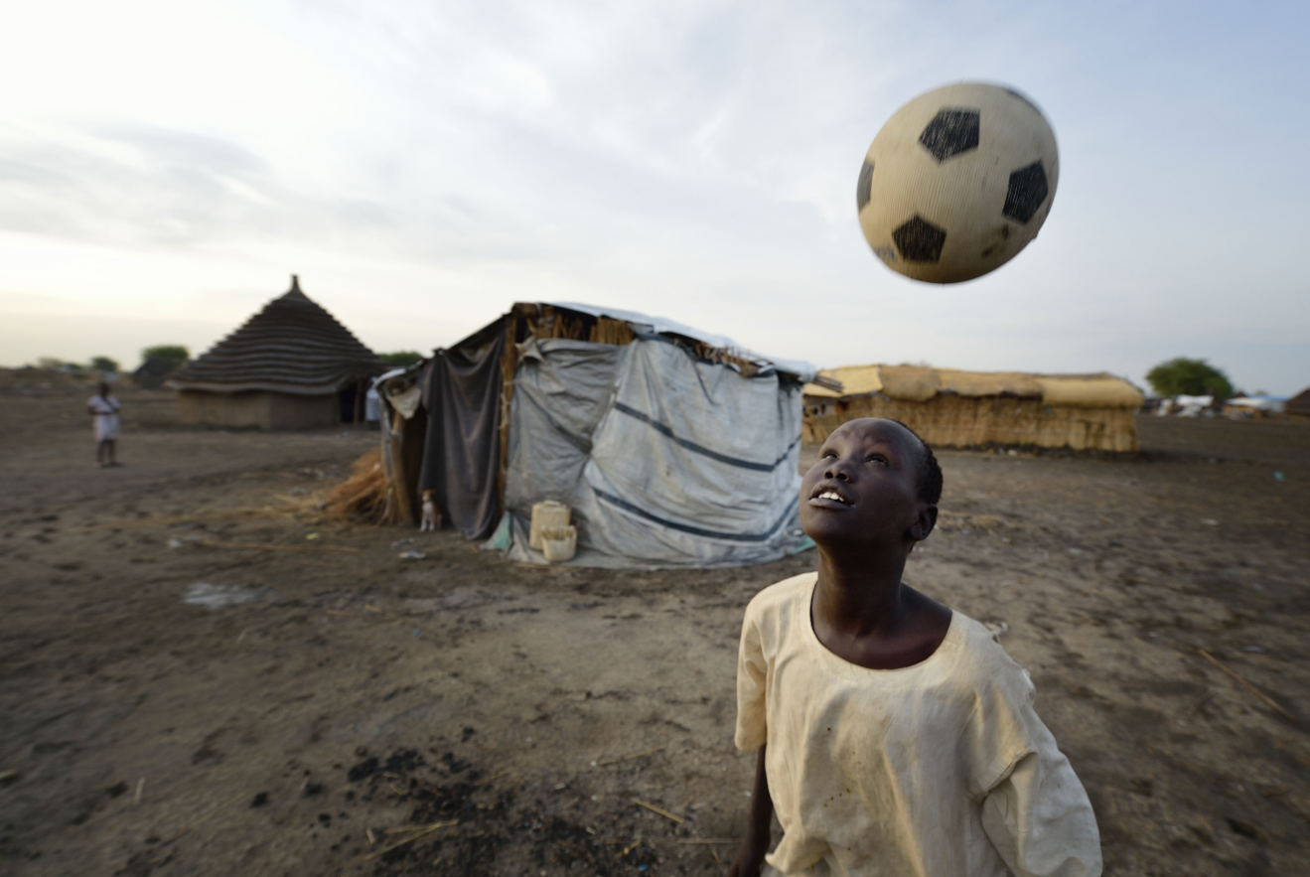

Notes:
Leader: Welcome to our assembly about sport and peace. Think about your favourite sport. Why do you enjoy it?
[Ask children to share a few examples]

Slide 2
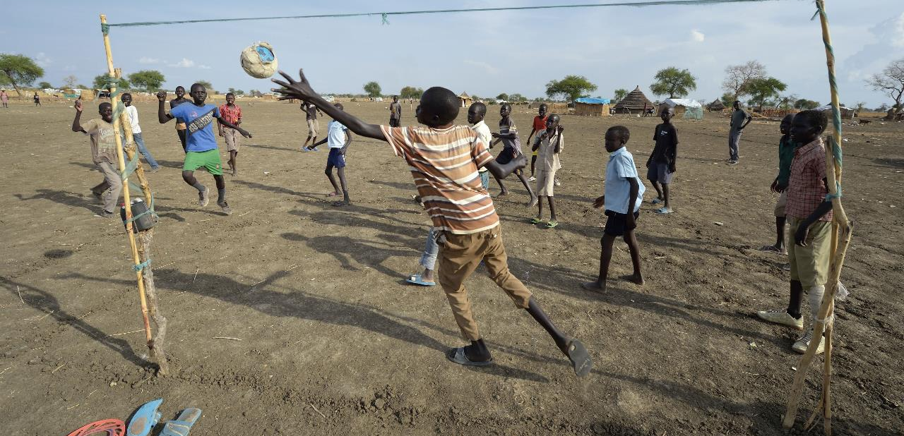

Notes:
Why is sport important?
[Discuss children’s ideas about why sport is important. Start with why sport is important in your school, followed by in your local community and in the wider world]
Sport is important for many different reasons. It brings people together to play. It teaches us lots of important things

Slide 3
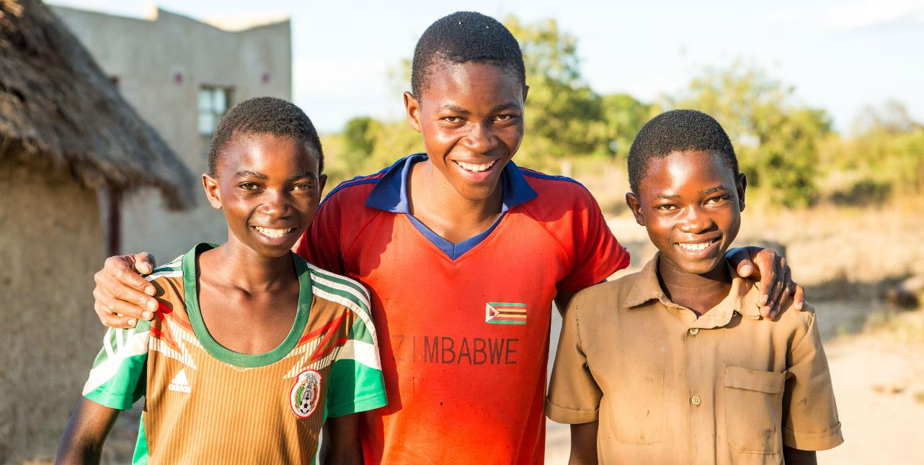


Notes:
Reader 1: We make new friends and build friendships when we play sport together. We learn to respect each other.

Slide 4
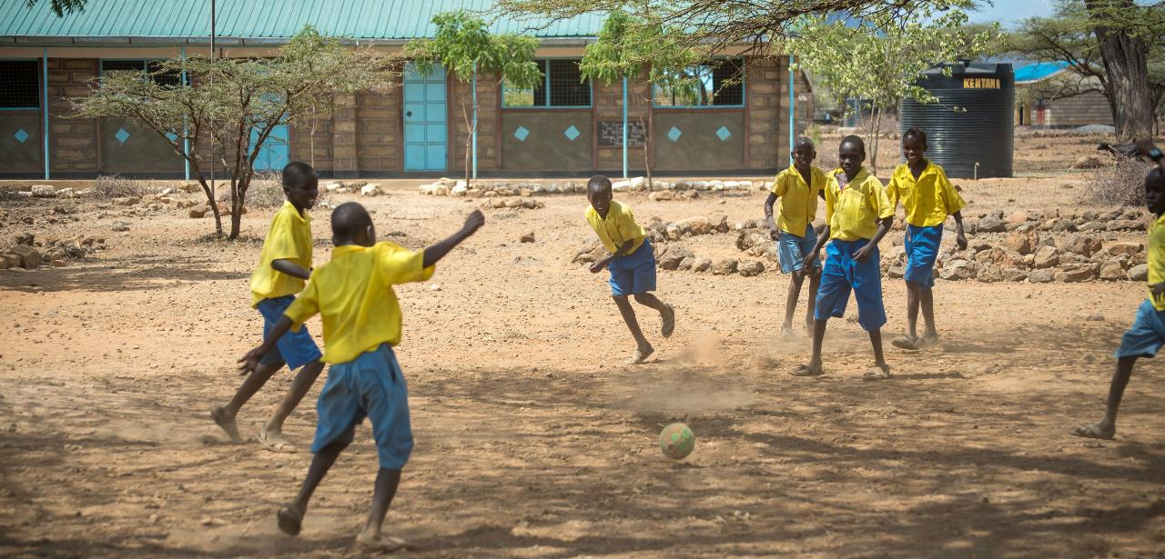


Notes:
Reader 2: Sport teaches us how to work together. We call this collaboration.

Slide 5
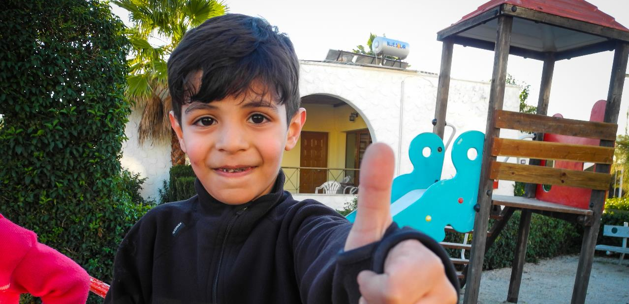


Notes:
Reader 3: We learn about the importance of honesty and how to play fairly.

Slide 6
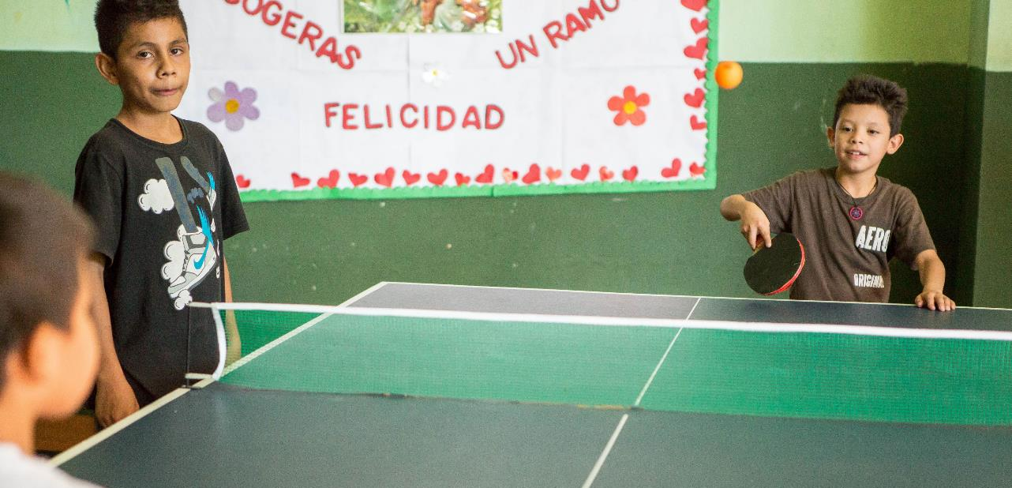

Notes:
Reader 4: Sport can help to build peace in communities where there is conflict
[If necessary, clarify what conflict means]

Slide 7
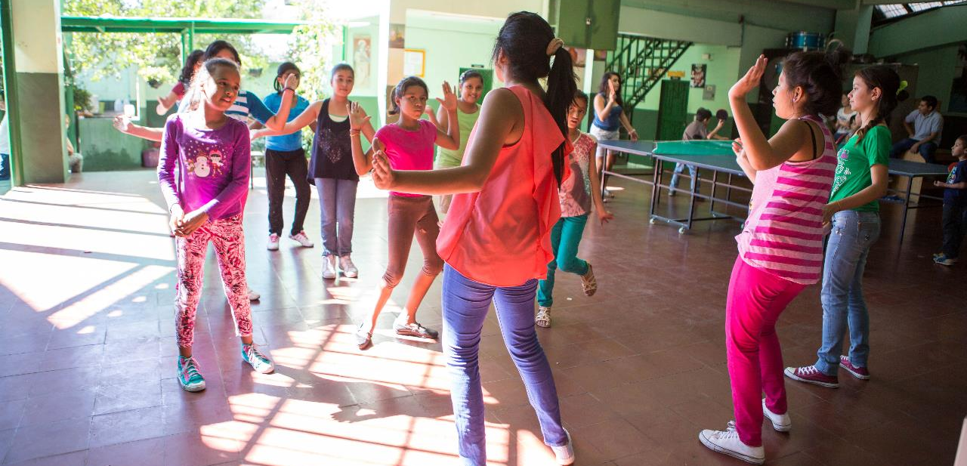
Notes:
Reader 5: Sport also helps people to have FUN!

Slide 8
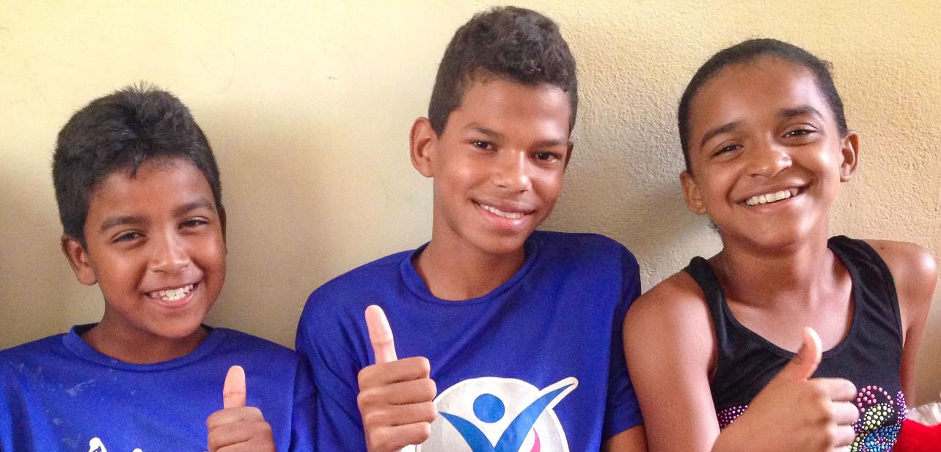
Notes:
Meet Andreia (on the right), she is 12 years old. Andreia is growing up in a shanty town in North East Brazil, where violence and gangs are an everyday problem. Andreia often used to stay at home for her own safety. But without other children to play with, she was very bored and frustrated.
Thanks to a CAFOD-funded project, she has now joined a football team and has lots of friends to play with. As well as being a lot of fun, the project also taught children about their rights and how to live in harmony in their hometown.
Since starting to play football, Andreia is a lot happier. She says: "I am not sad anymore. Now I have a lot of friends and things are better."

Slide 9
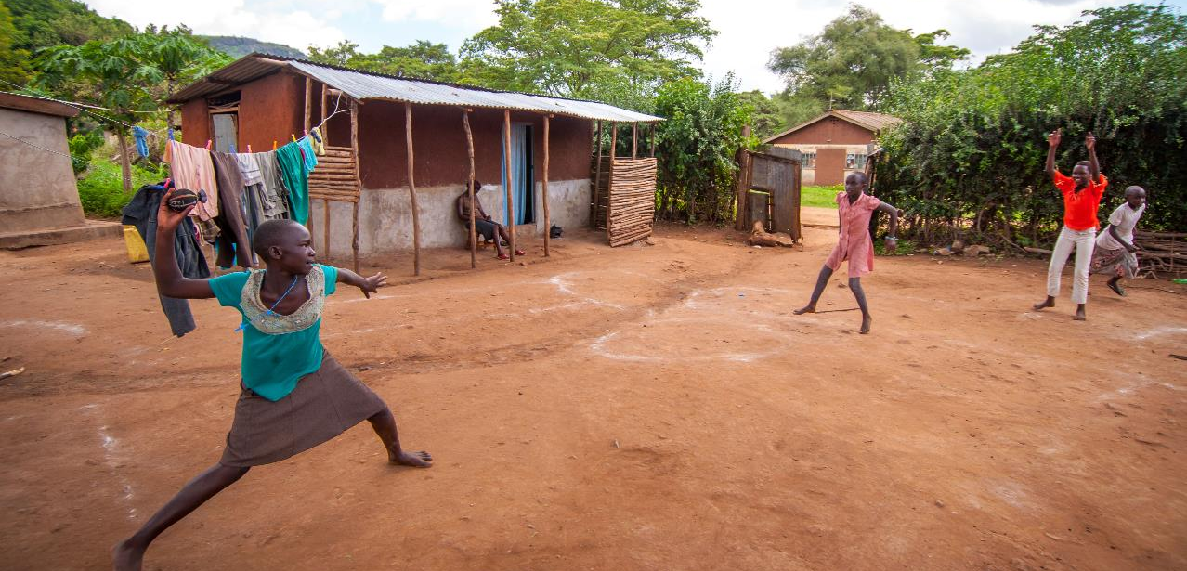
Notes:
Time to Act
Leader: Sport teaches us lots of important things. We call these important things values.
Now lets think about this important question: How can we live out these values in our own lives?
[Encourage children to come up with ways that they can put each value into action in their own lives]

Slide 10
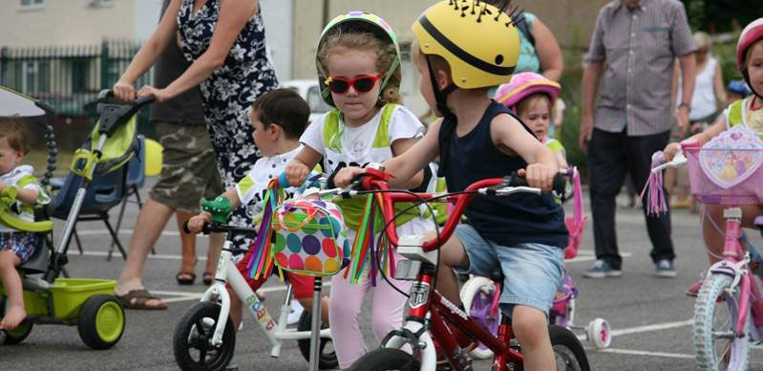
Loving God,
Give strength to people all around the world who are working hard to build peace.
Let us remember to act in friendship with others and show respect.
Help us to work together with our sisters and brothers to build a peaceful and fair world.
Amen

Slide 11
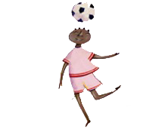
“As a real instrument of reconciliation, sport brings people together…
…the ideals of fair play, honesty, friendship, collaboration and mutual respect are the building blocks of a new civilisation of peace.”
(Pope John Paul II, 2000)
Notes:
Pope John Paul II quote (optional for Key Stage 2)
This assembly is inspired by something Pope John Paul II said:
“As a real instrument of reconciliation, sport brings people together… the ideals of fair play, honesty, friendship, collaboration and mutual respect are the building blocks of a new civilisation of peace.” (Pope John Paul II, 2000)
[Share and discuss the quote with Key Stage 2 pupils]

Slide 12
Photo credits: Caritas Internationalis, Thom Flint | CAFOD, David Mutua, Laura Ouseley | CAFOD, Ben White CAFOD, Andy McCarthy, Esther Gillingham
Notes:
Leader: Welcome to our assembly about sport and peace. Think about your favourite sport. Why do you enjoy it?
[Ask children to share a few examples]

