Slide 1
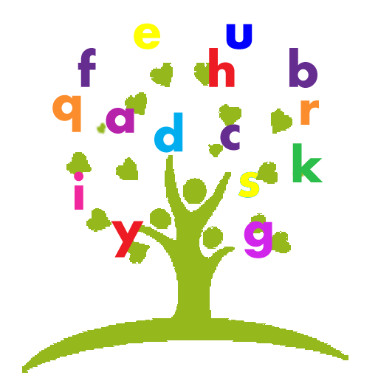

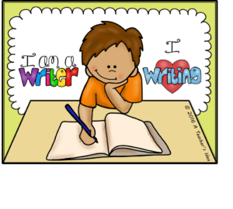
Unlocking Literacy and how you can help at home.

Slide 2

What is literacy?
‘a means of identification, understanding, interpretation, creation, and communication in an increasingly digital, text-mediated, information-rich and fast-changing world.’
UNESCO 2024
Traditionally, we think of Literacy as the ability to
Read
Write
But the spoken word underpins this, it is the foundation for effective communication and comprehension.
Oracy should never be under valued.
Keep talking!!

Slide 3
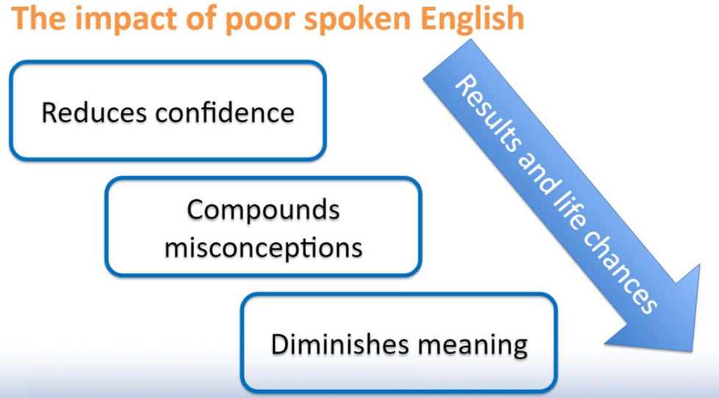

Slide 4
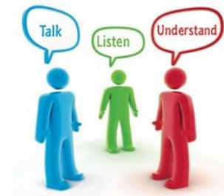
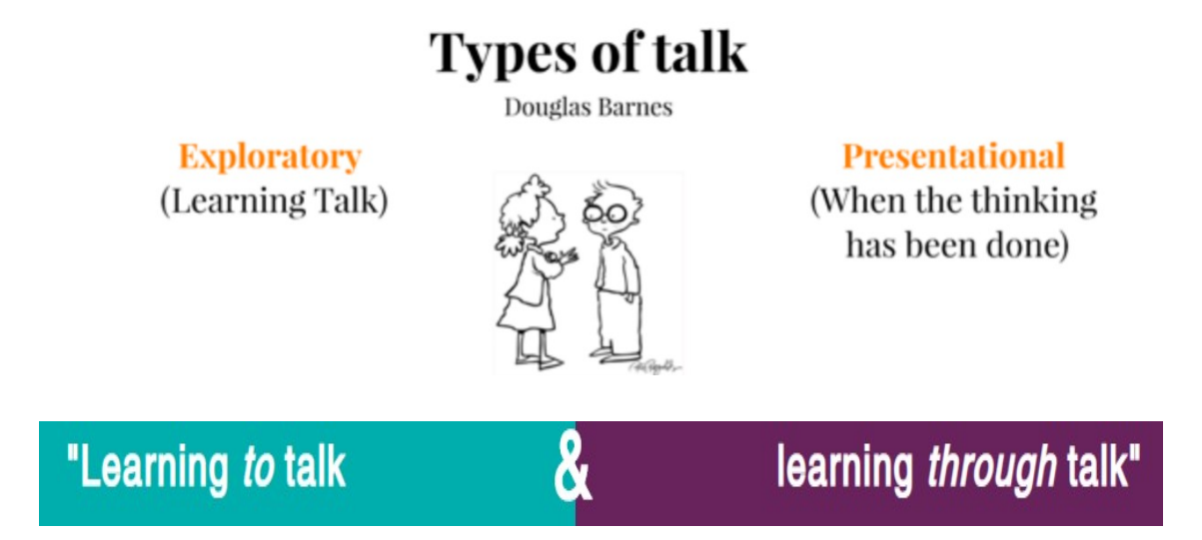
So, whenever we talk about reading, we talk about the importance of oracy.
Talk about what you’ve read, ask questions, explore word meanings, check comprehension and address any misconceptions, model new vocab from the text…keep talking!!

Slide 5
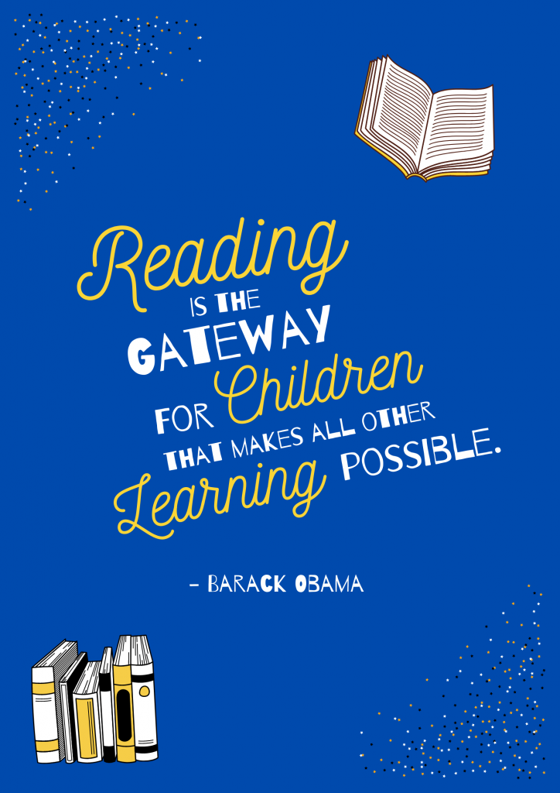
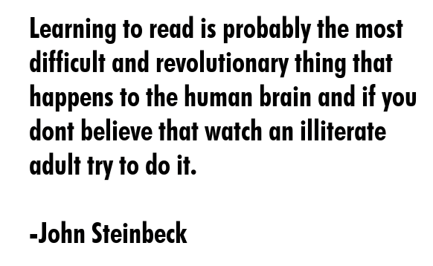
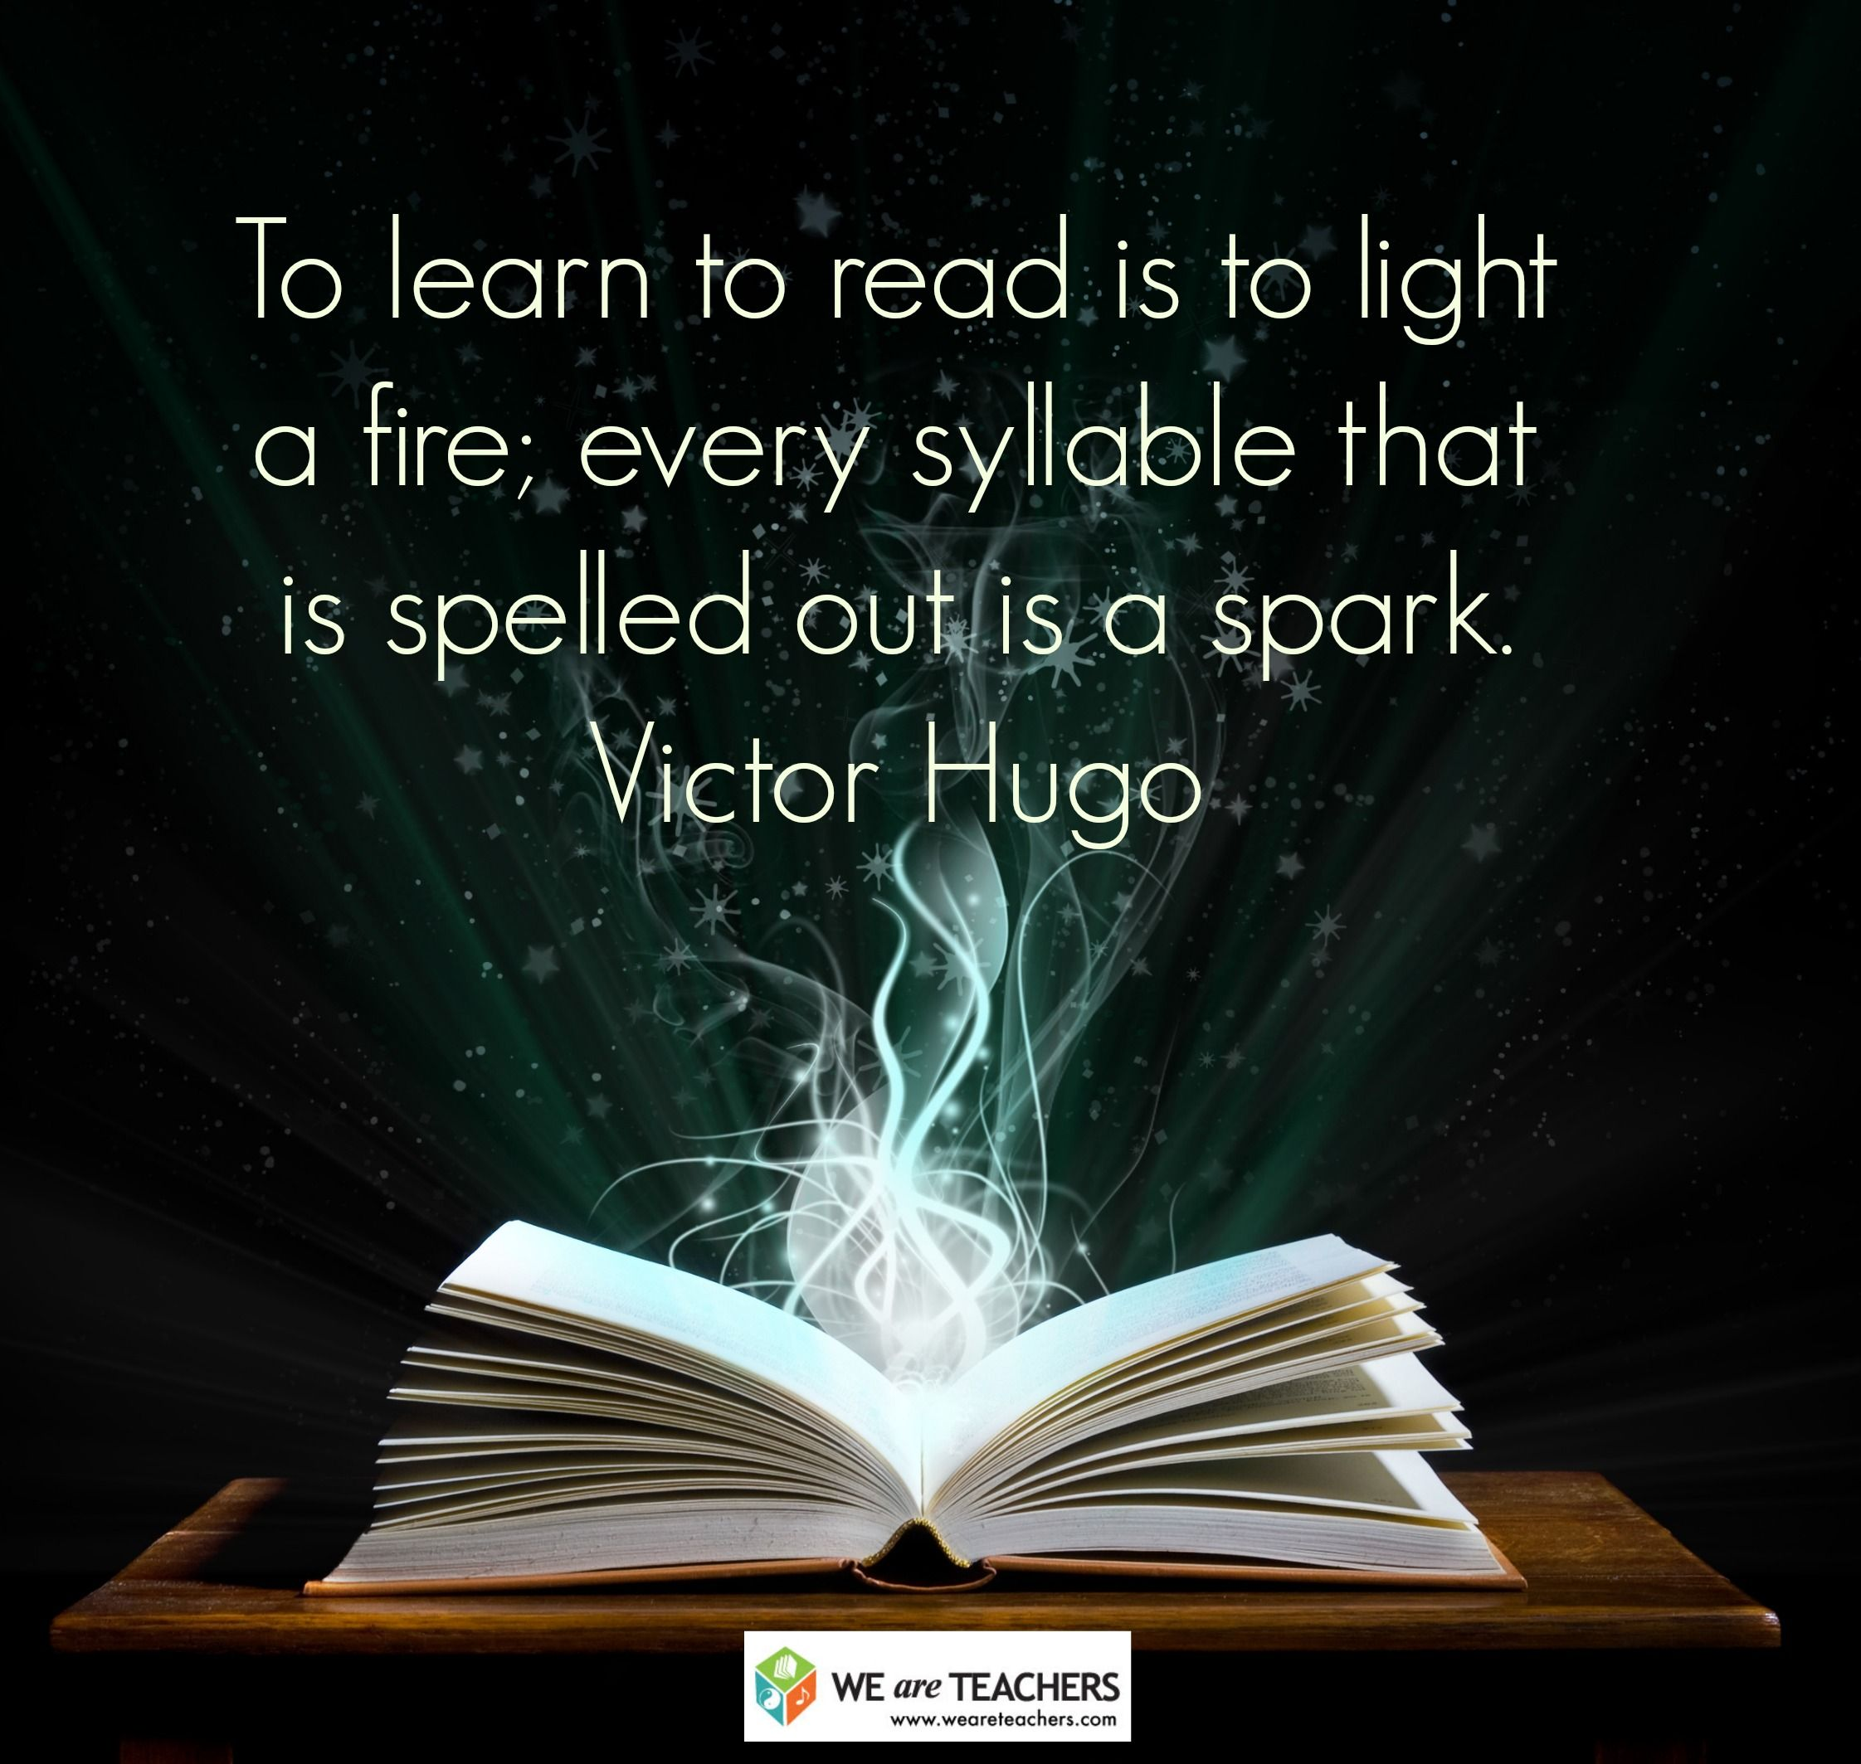

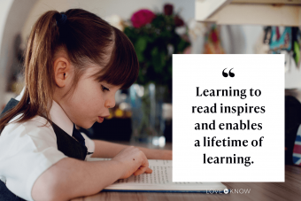
Learning to read is the key to all learning!

Slide 6
Skills and strategies used to help us when we read;
picture clues
scanning
word recognition
decoding unfamiliar words
PHONICS

Slide 7
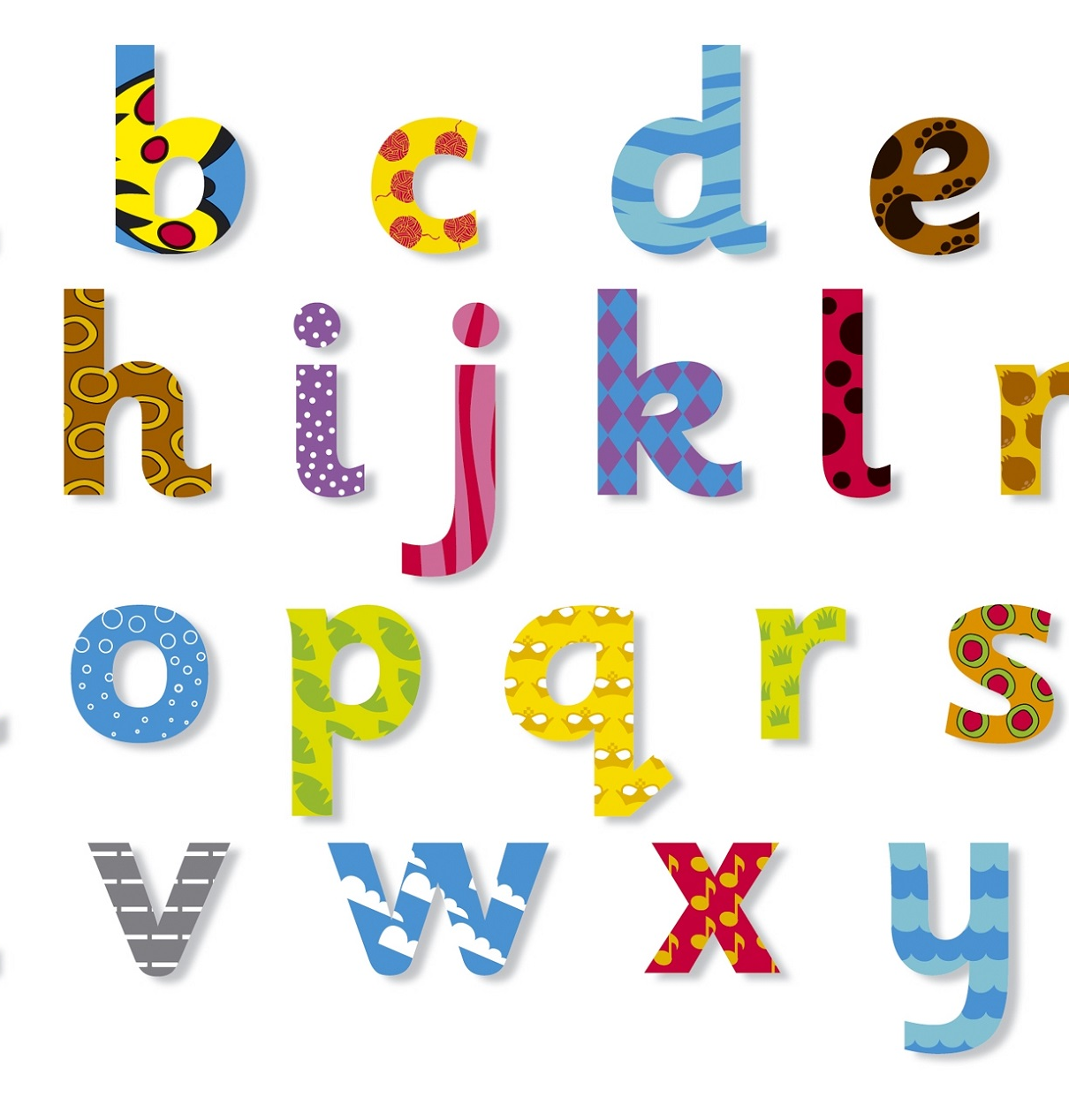
Phonics is…
Phonics is a way of teaching children how to read and write. It helps children hear, identify and use different sounds that distinguish one word from another in the English language.
Written language can be compared to a code, so knowing the sounds of individual letters and how those letters sound when they’re combined will help children decode words as they read.
Phonics is a tool to help us crack the code!

Slide 8

Phonics are taught in phases;
The Phases are the way the letters and sounds are broken down to teach sounds in a certain order. At the same time whole words that cannot be broken down easily, “tricky words” are taught to the children.
In school, we follow the
Red Rose Phonics programme
Phase 1; tuning into sounds, distinguishing sounds, environmental sounds, instrumental sounds, rhythm and rhyme, hearing sounds

Slide 9
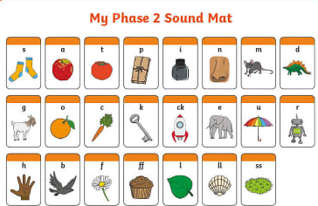
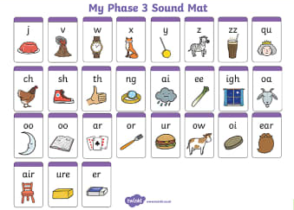
Phase 2: Phase 3:
learning the remaining individual letter sounds that weren’t covered in Phase 2 - and more complex phonemes (sounds) such as digraphs (2 letters, 1 sound) and trigraphs (3 letters, 1 sound.
Learning the most common individual letter sounds (19) and their corresponding grapheme (written letter).

Slide 10
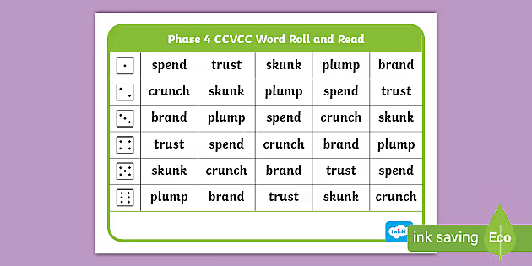
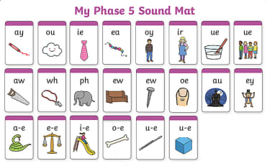
Phase 4; Phase 5;
Children become more confident at reading whole words. They will learn to recognise sets of adjacent consonants (called consonant clusters).
Alternative spellings for previously taught sounds. Children will learn that there are different ways of spelling the same sound e.g. igh, ie, i_e. They will develop an awareness of sound families.

Slide 11
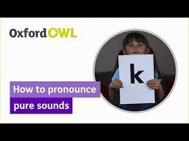
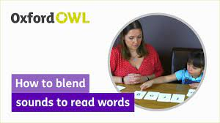
Ensure correct pronunciation of sounds
Letter sounds, not names
Different types of sound ;
soft – h
strong - ck
long – ee / oo (as in moon)
short – oo (as in book)
Beware schwaring! Sounds do not have an ‘u’ at the end!
lots of examples of correct pronunciation on the internet

Slide 12

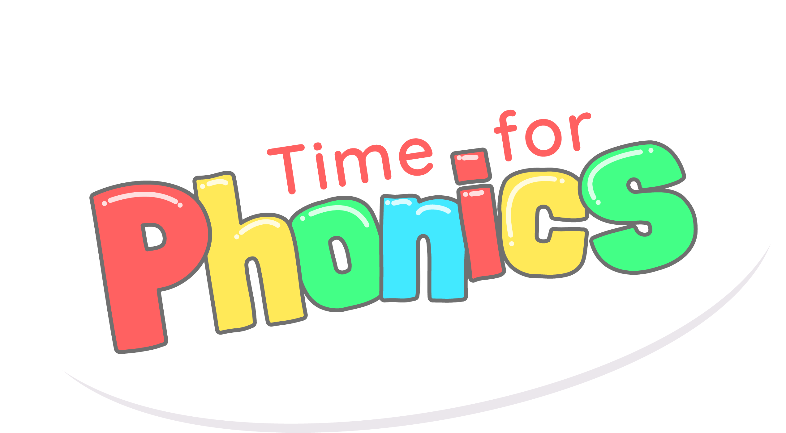
Actions and rhymes help us learn letters, sounds and the ability to blend them together to make words
Hear it, say it, see it, write it
Mnemonics; ‘down the tree and across the branches’
Phonics hands and fingers; sh-o-p = shop

Slide 13
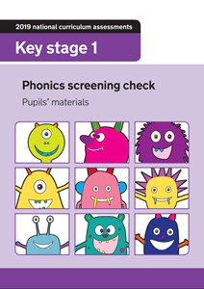
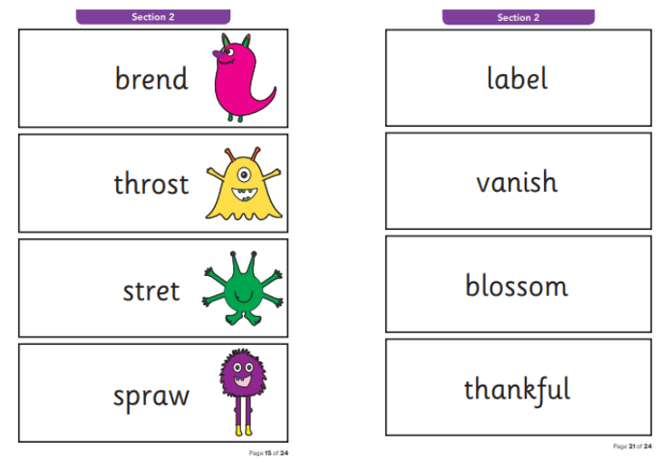
Phonics screening check
This takes place in the summer term for all Year 1 children and those Year 2 children who did not reach the expected standard in Year 1. It ‘checks’ the child’s ability to use phonics taught from phases 2-5 to read words, both real and psuedo words.

Slide 14
HFW and ‘tricky words’
Alongside the phonemes (sounds) and graphemes (way we write the sound), children will also learn to blend the sounds together at each phase to read words, including the most common words known as High Frequency Words eg can, and, them, look, when, children
They will also learn that some words cannot be decoded by segmenting and blending the sounds together; we call these ‘tricky words’. We just have to know them!
e.g. go, me, was, people

Slide 15

Home/school reading books
Children will be given 1 or 2 school reading books that correspond with the appropriate week of the phonics phase that they are currently comfortably working at, based on ongoing phonic assessments. These books are fully decodable. They also contain HFW and 'tricky words' that also correspond to the phase and week.
Although books may have previously been colour banded, this is now irrelevant for children in Year R and Year 1. It’s the week and the phonic phase that is important, not the colour.
Books are changed once a week. We expect children to re-read these decodable books throughout the week, only 10 minutes every day, to build familiarity and fluency. Please sign and date your child’s yellow reading record, every time to read with them. Send books to school EVERY DAY!
Children will also bring home a library book of their own choosing. This is for reading for pleasure and for you to read with them. We do not expect the children to decode these books.

Slide 16
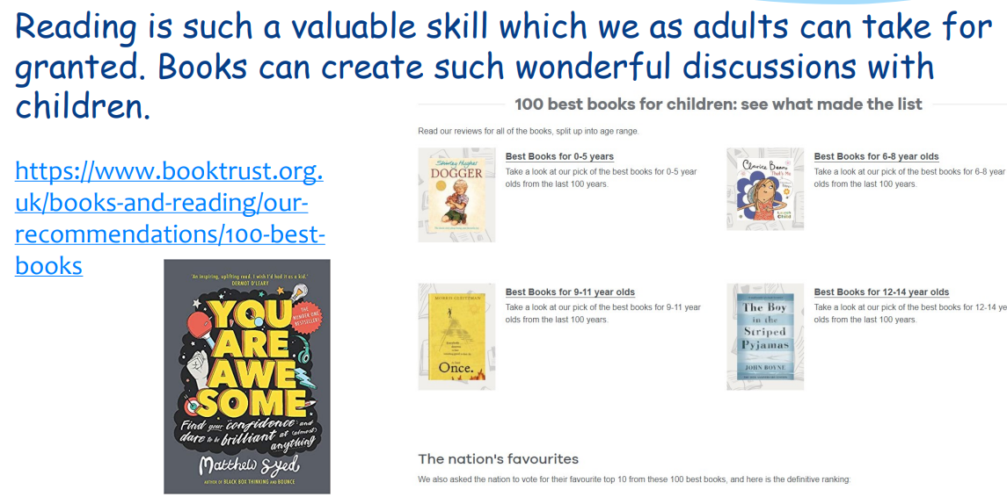
Keep talking! About books and everything else!

Slide 17
Instructions for reading at home;
PRACTICE, PRACTICE, PRACTICE!! Reading is a skill we need to practise EVERY DAY! Share books every day, even if only for ten minutes. Enjoy this special time!
Talk about the books; don’t just focus on the text. The focus is very much on strengthening comprehension, language and vocabulary
Re-read books; it helps young readers gain familiarity, confidence and fluency
Always sign, date and comment in the yellow reading record
Send book bags to school everyday

Slide 18
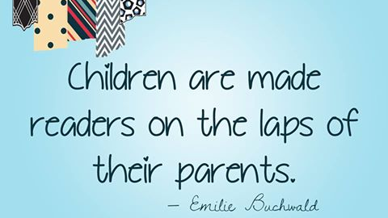

Slide 19

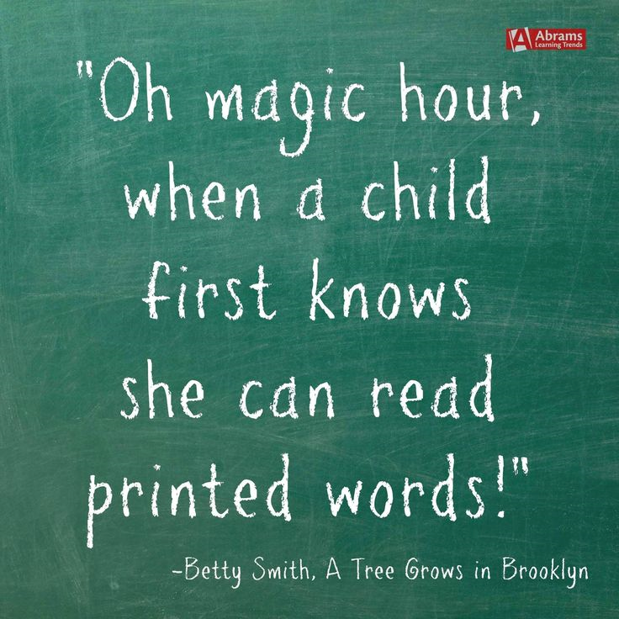

Slide 20
Glossary of terms;
Phoneme: The smallest unit of sound in a word, e.g. c/a/t, sh/o/p, t/ea/ch/er
Grapheme: A letter or group of letter representing one sound, e.g. t, h, sh, igh,
Digraph: Two letters which together make one sound, e.g. sh, ch, ee, ph, oa
Split digraph: Two letters, which work as a pair, split, to represent one sound, e.g. a-e as in cake, or i-e as in kite
Trigraph: three letters which together make one sound but cannot be separated into smaller phonemes, e.g. igh as in light, ear as in heard, tch as in watch
Segmentation: means hearing the individual phonemes within a word – for instance the word ‘crash’ consists of four phonemes: ‘c – r – a – sh’. In order to spell this word, a child must segment it into its component phonemes and choose a grapheme to represent each phoneme
Blending: means merging the individual phonemes together to pronounce a word. In order to read an unfamiliar word, a child must recognise (‘sound out’) each grapheme, not each letter (e.g. ‘th-i-n’ not ‘t-h-i-n’), and then merge the phonemes together to make the word
Mnemonics: a device for memorising and recalling something, such as a hand action of a drill to remember the phoneme /d
Adjacent consonants: two or three letters with discrete sounds, which are blended together e.g. str, cr, tr, gr
Comprehension: understanding of language whether it is spoken or written.

Slide 21
Pre-cursive style used in school; all lowercase letters start with a lead in and lead out stroke. Capitals are unaltered a b c d e f g h i k l m n o p q r s t u v w x y z

