Slide 1
Whole School
Star of the Week
Friday 11th July 2025

Slide 2
Our Father who art in Heaven
Hallowed be Thy Name
Thy Kingdom come
Thy will be done on Earth as it is in Heaven
Give us this day our daily bread
And forgive us our trespasses
As we forgive those who trespass against us
And lead us not into temptation
But deliver us from evil
Amen

Slide 3
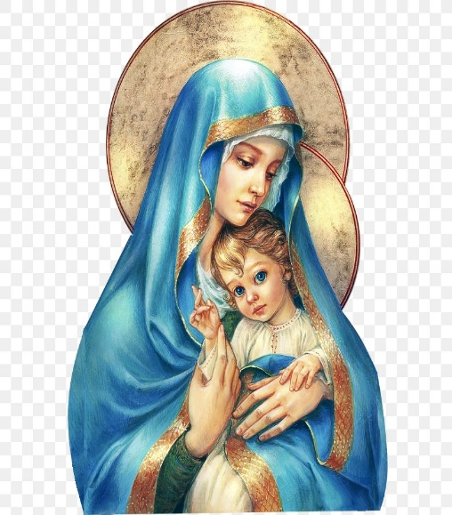
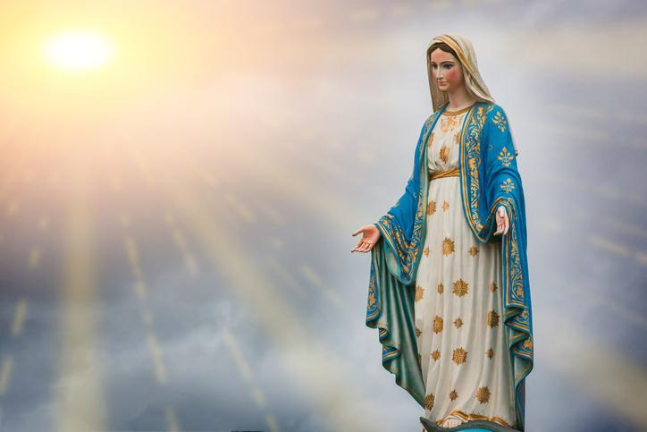
Hail Mary, Full of Grace
The Lord is with Thee
Blessed are Thou amongst women
And Blessed is the fruit of Thy womb, Jesus
Holy Mary , Mother of God
Pray for us sinners
Now and in the hour of our death
Amen

Slide 4
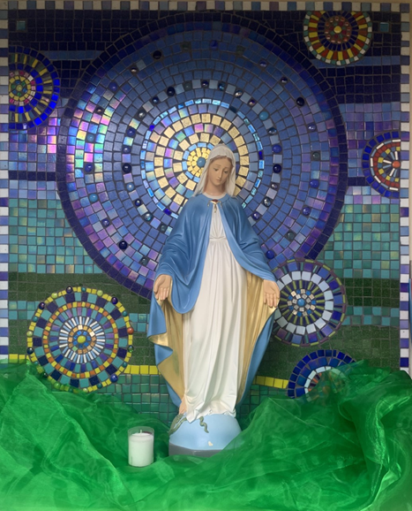
St Mary’s School Prayer
O Holy Mary,
Mother and Patron of our school,
Turn your eyes of mercy towards us,
that we may love God
With all our hearts!
May we imitate the tenderness
of your Son, Jesus,
showing love and respect
For each person
and ourselves as children of God.
Guided by the Holy Spirit,
May we create the school,
where Mercy and Compassion
Is the centre of our lives.
Amen

Slide 6
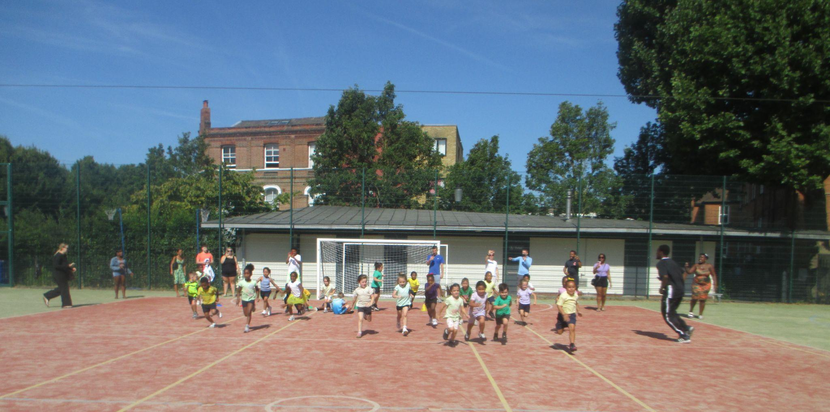
EYFS
Nursery- Whole Class
Reception- Whole class
For their amazing effort in sports day and for having the best year in EYFS. We are so proud of you all!
Miss Barker

Slide 7
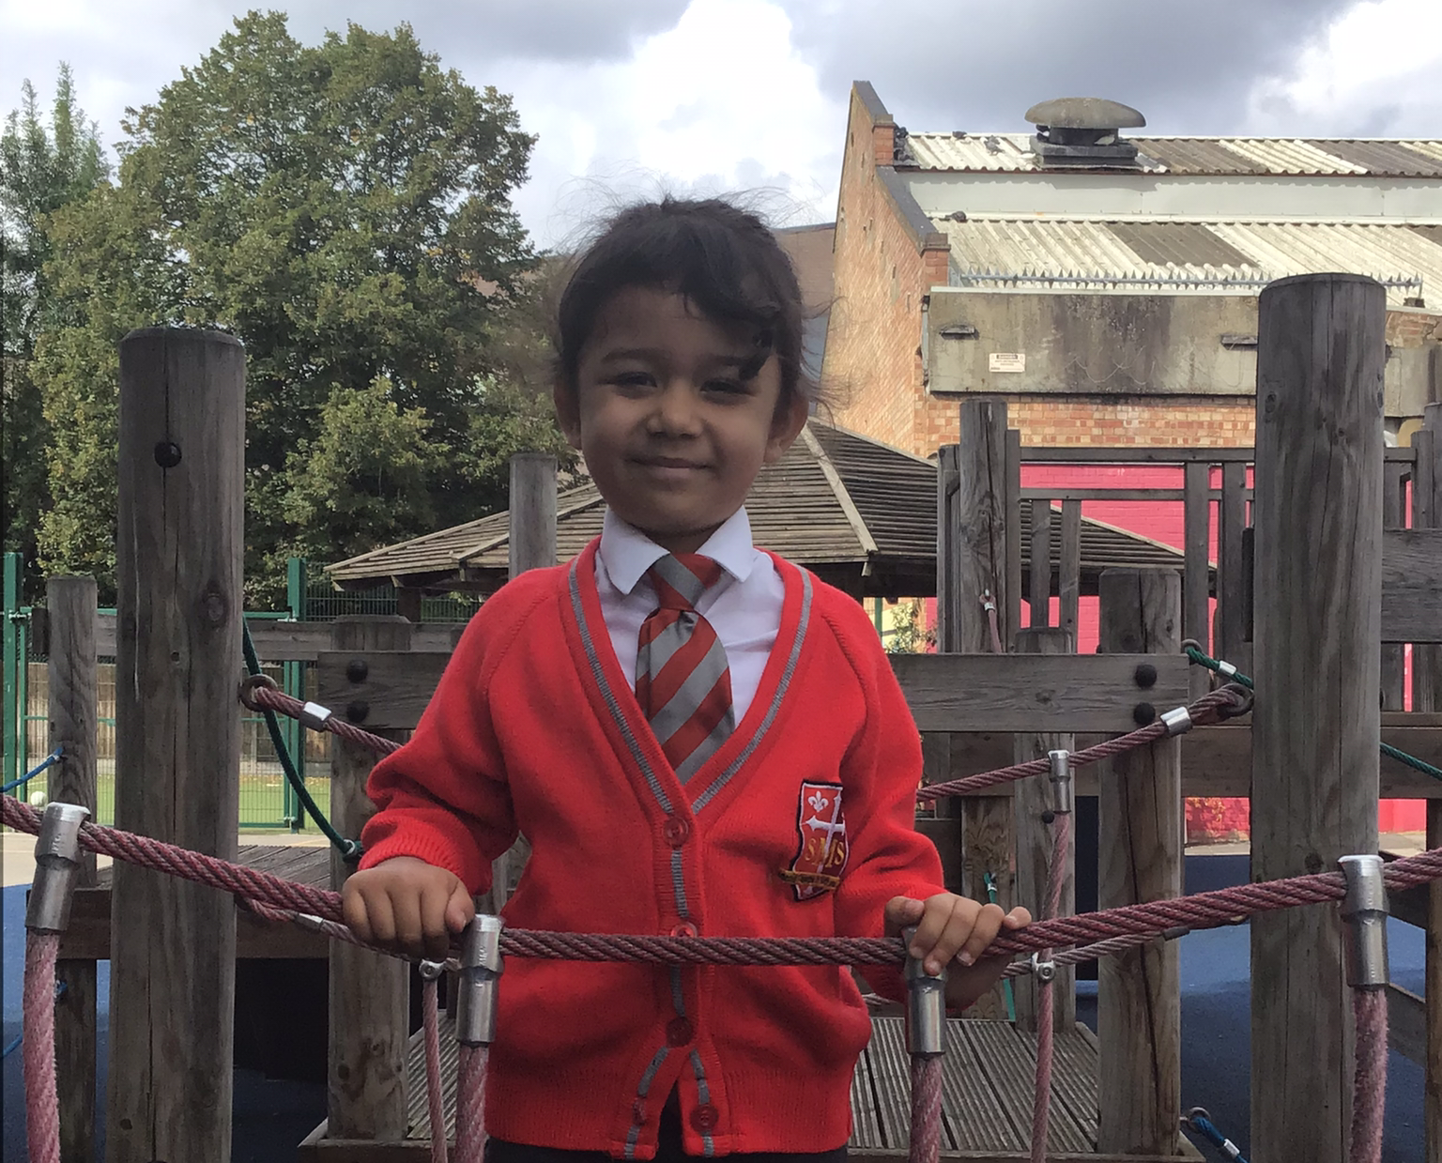
Year 1
For her fantastic sportsmanship during Sports Day!
Miss Sweet

Slide 8
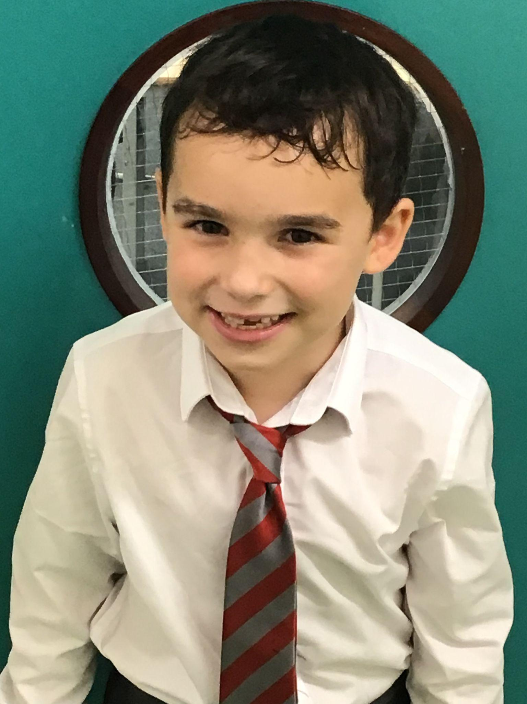
Year 2
For showing us all that, with single-minded determination, we can achieve exceptional things.
Mr Whear

Slide 9
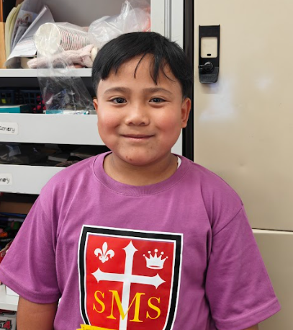
Year 3
For showing confidence and resilience in all areas.
Miss Medioli

Slide 10
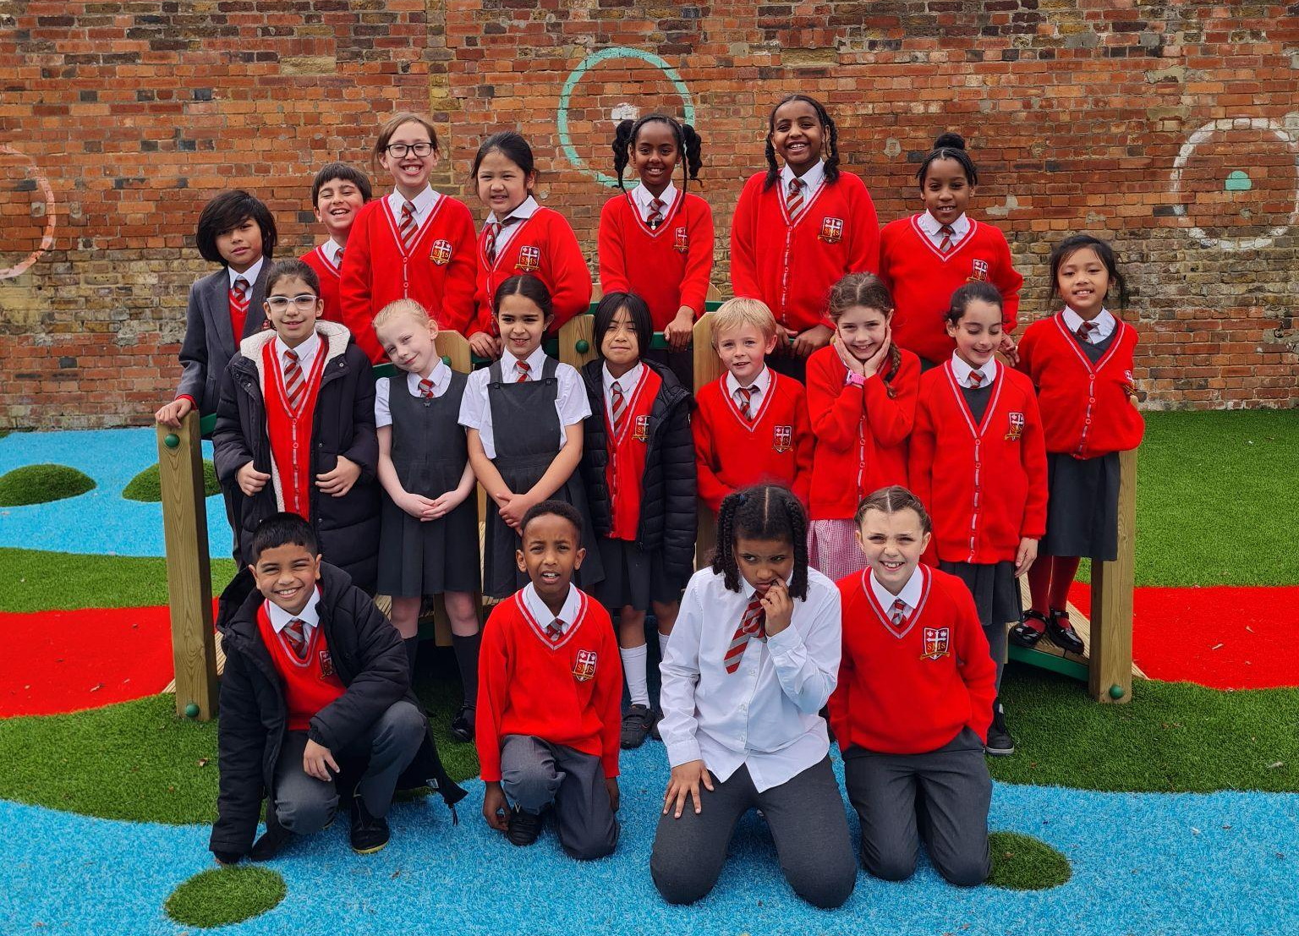
Year 4
Whole Class
For their excellent behaviour on our trip to the ballet and representing themselves and St Mary’s beautifully.
Miss Forrest

Slide 11
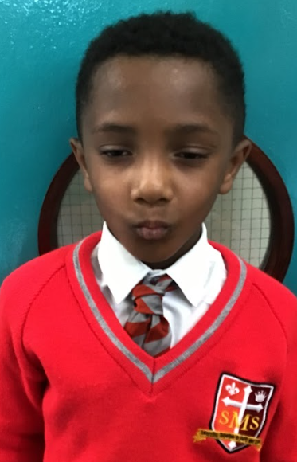
Year 5
For showing maturity and thought in his behaviour.
Mr Larke

Slide 12
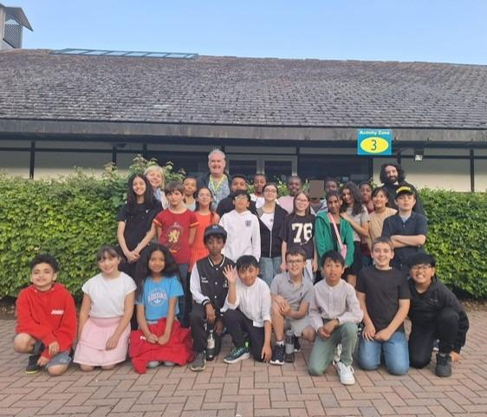
Year 6
Whole Class
For their incredible SATs results which have brought a great deal of pride to the class and school as a whole.
Mr Cherfi & Mr Fowle

Slide 13
Star Readers
Y1 - Jasmine
Y2 - Kadie
Y3 - Azrayah and Holly
Y4 - Arthur and Esey
Y5 - Carlos
Y6 - Danny

Slide 14
Y6 - Nina
Y6 - Noah
Rec - Khalil
Rec - Lillie-Mae
Rec - Jahmiel
Y4 - Franzen

Slide 15
Whole School
Star of the Week
Friday 11th July 2025

