Slide 1



Whole School
Star of the Week
Friday 11th September 2026

Slide 2

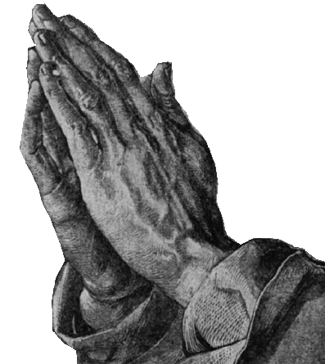
THE LORD’S PRAYER
Our Father who art in Heaven
Hallowed be Thy Name
Thy Kingdom come
Thy will be done on Earth as it is in Heaven
Give us this day our daily bread
And forgive us our trespasses
As we forgive those who trespass against us
And lead us not into temptation
But deliver us from evil
Amen

Slide 3
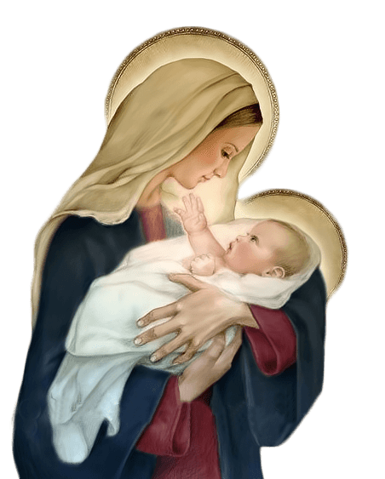
Hail Mary, Full of Grace
The Lord is with Thee
Blessed are Thou amongst women
And Blessed is the fruit of Thy womb, Jesus
Holy Mary , Mother of God
Pray for us sinners
Now and in the hour of our death
Amen

Slide 4
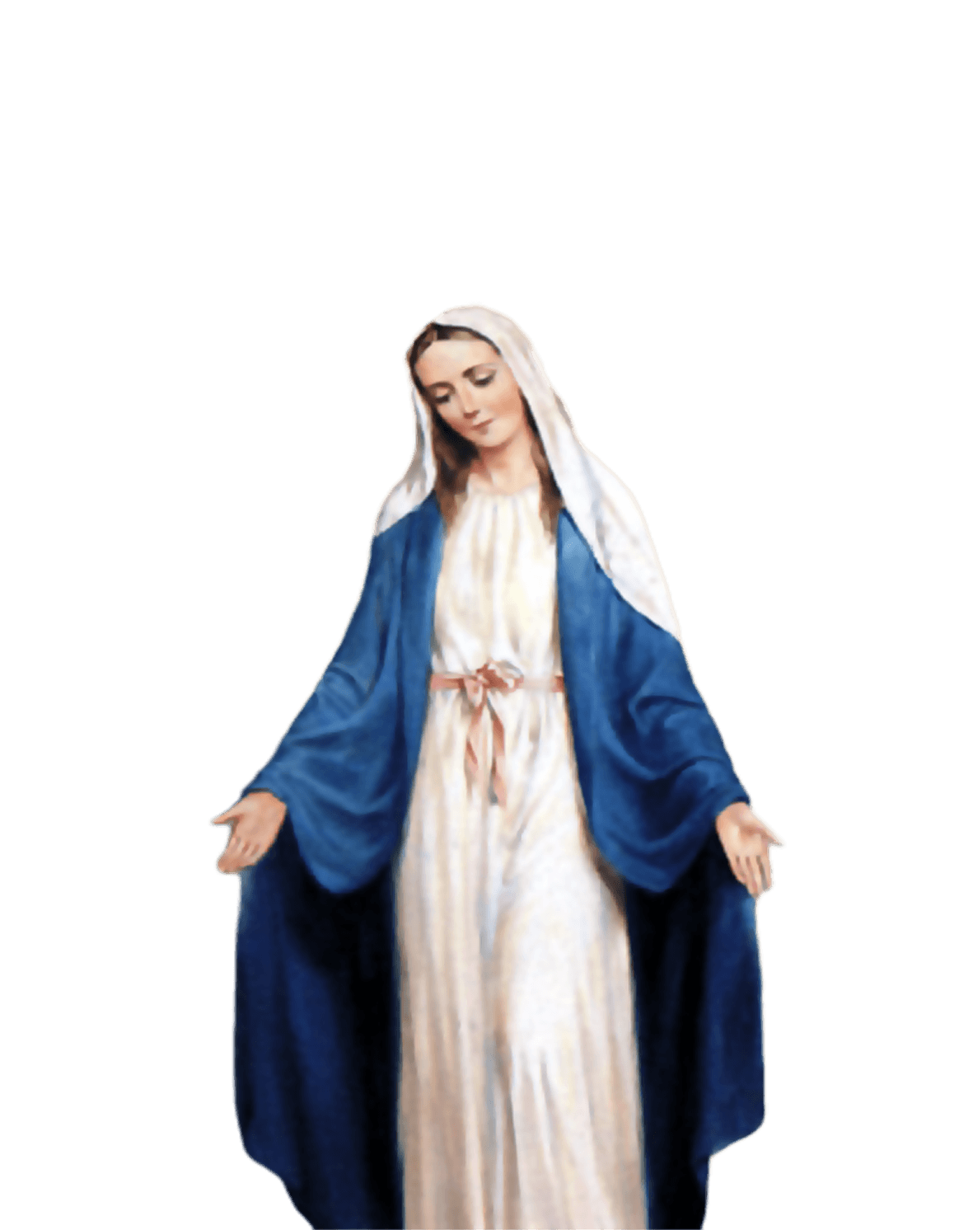
ST MARY’S SCHOOL PRAYER
O Holy Mary,
Mother and Patron of our school,
Turn your eyes of mercy towards us,
that we may love God
With all our hearts!
May we imitate the tenderness
of your Son, Jesus,
showing love and respect
For each person
and ourselves as children of God.
Guided by the Holy Spirit,
May we create the school,
where Mercy and Compassion
Is the centre of our lives.
Amen

Slide 5
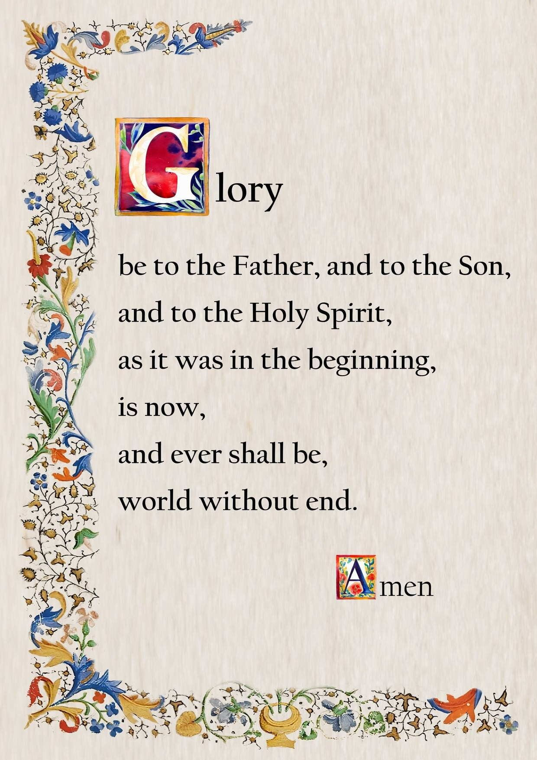

Slide 6
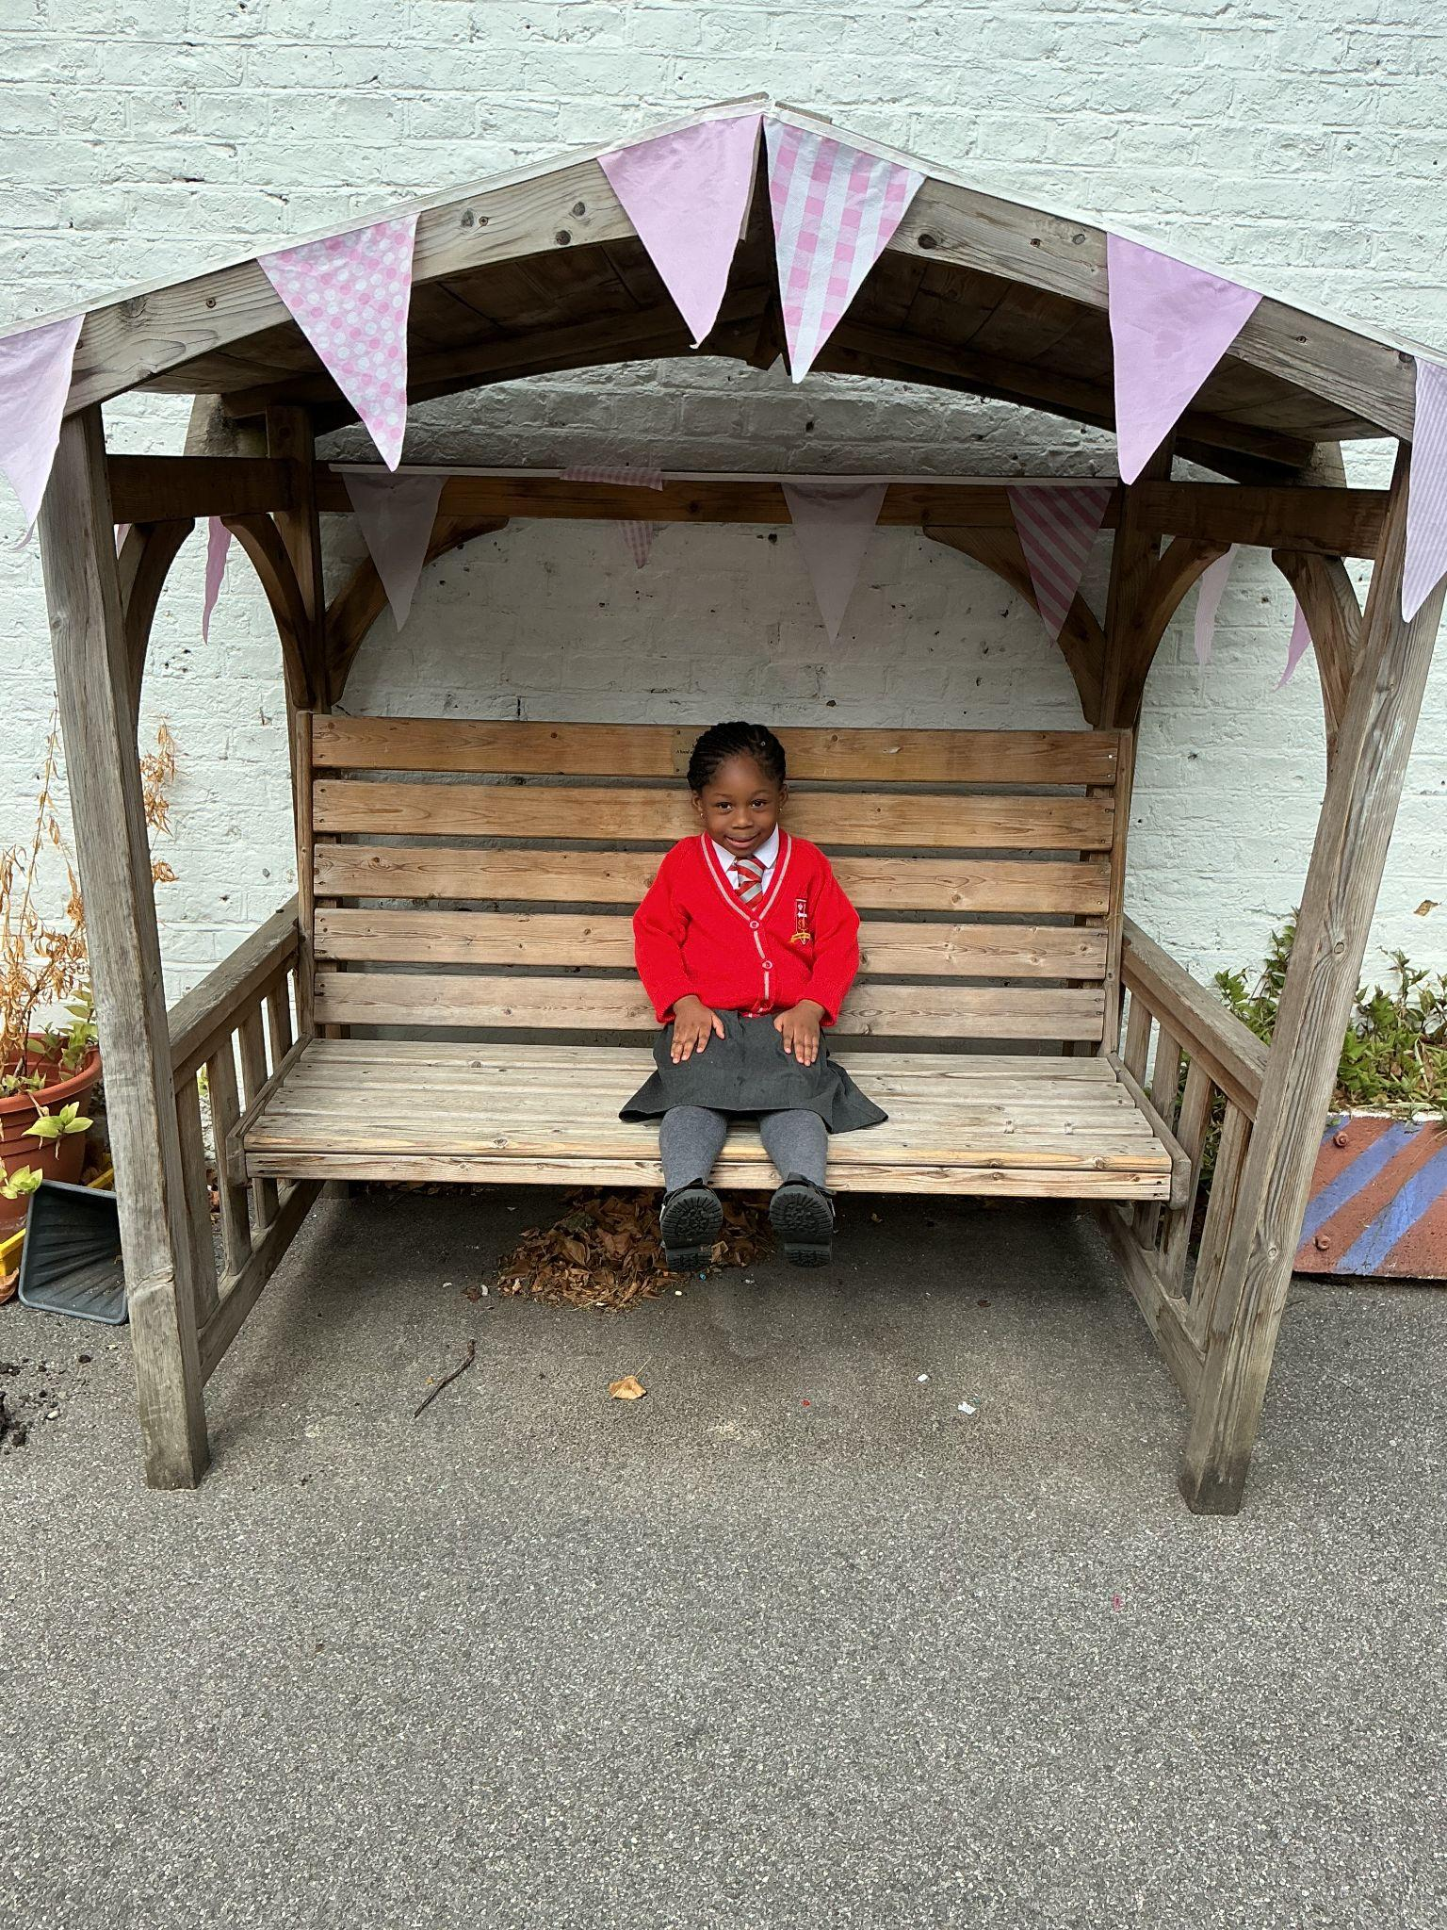
EYFS
For her amazing start to our school and showing role model behaviour.
Miss Barker

Slide 7
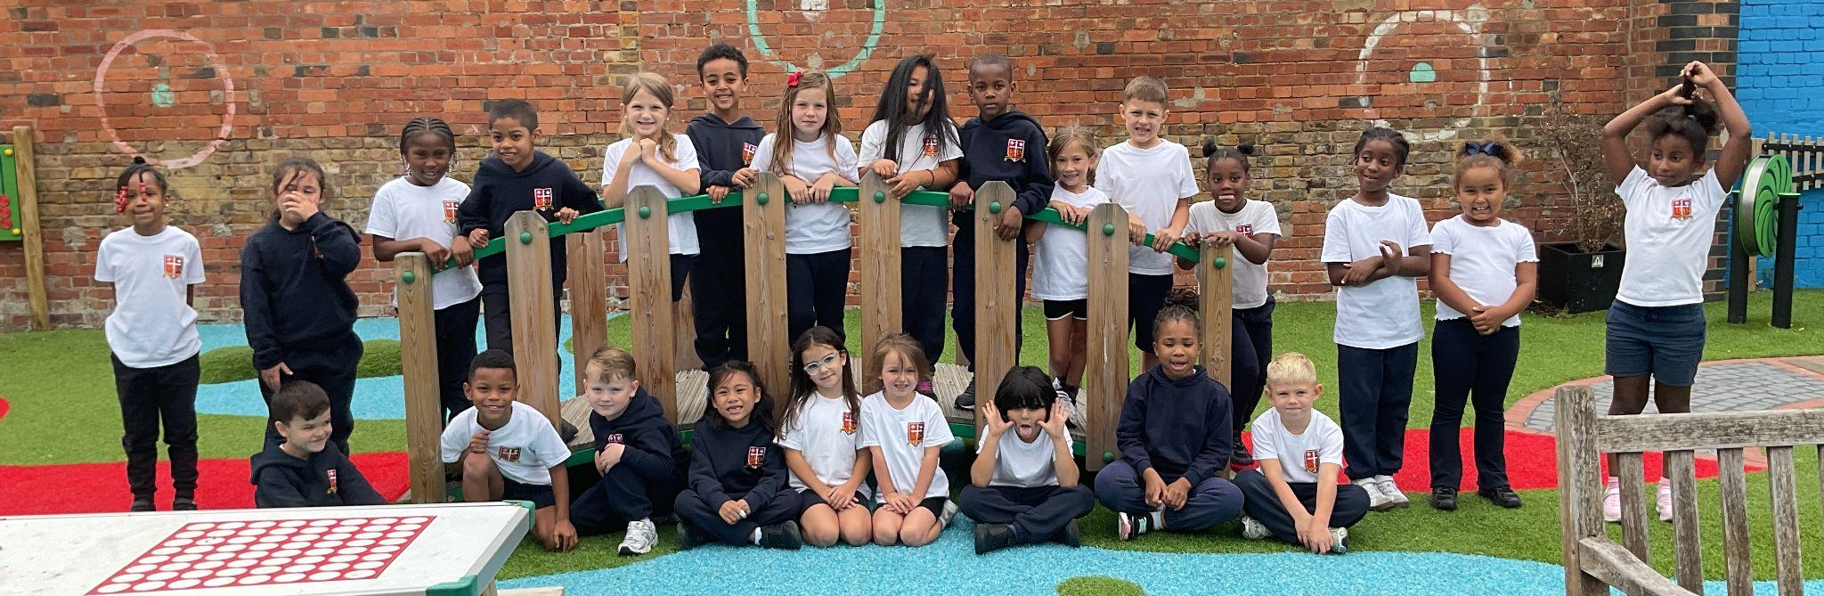
Year 1 and 2
For adapting to their new class format and routines of the day!
Miss Sweet

Slide 8
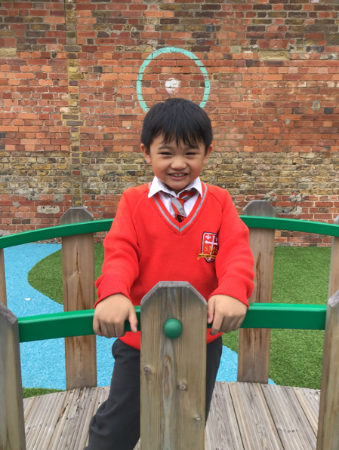
Year 3
For settling into KS2 so brilliantly! Being a role model, contributing in lessons and putting his best effort into all his work.
Miss Flashman

Slide 9
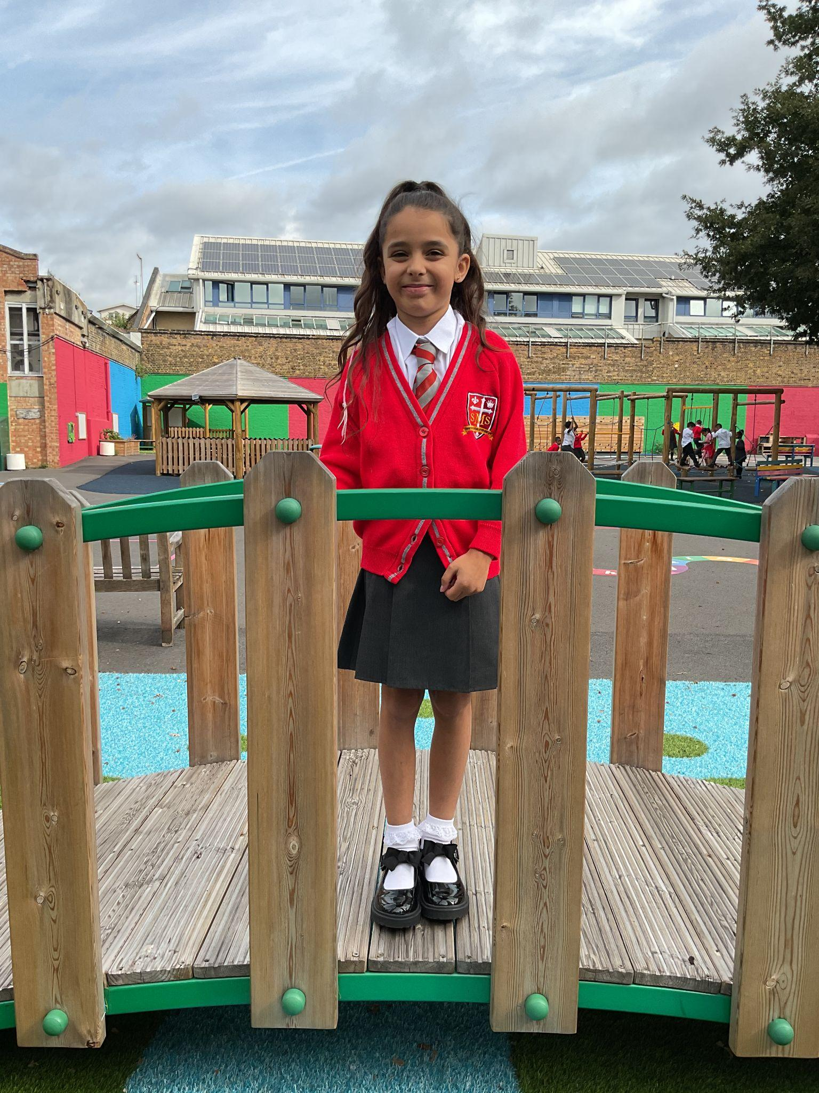
Year 4
For setting an excellent example to her classmates, through diligence in her independent work and her co-operative, respectful actions.
Mr Whear

Slide 10
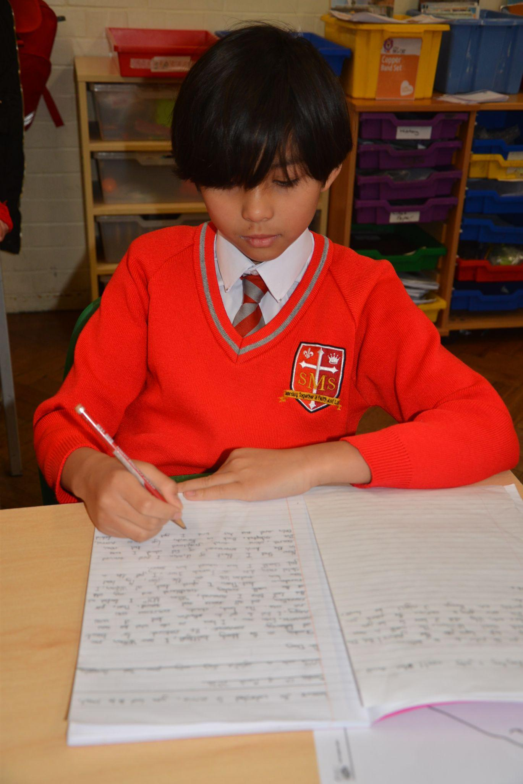
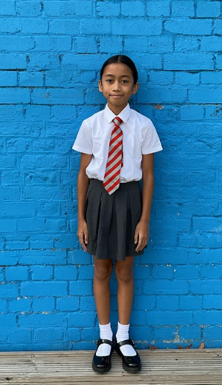
Year 5
For being an excellent role model in Year 5 by making positive choices, having excellent listening skills and high-quality book work across all subjects.
Miss O’Mara

Slide 11
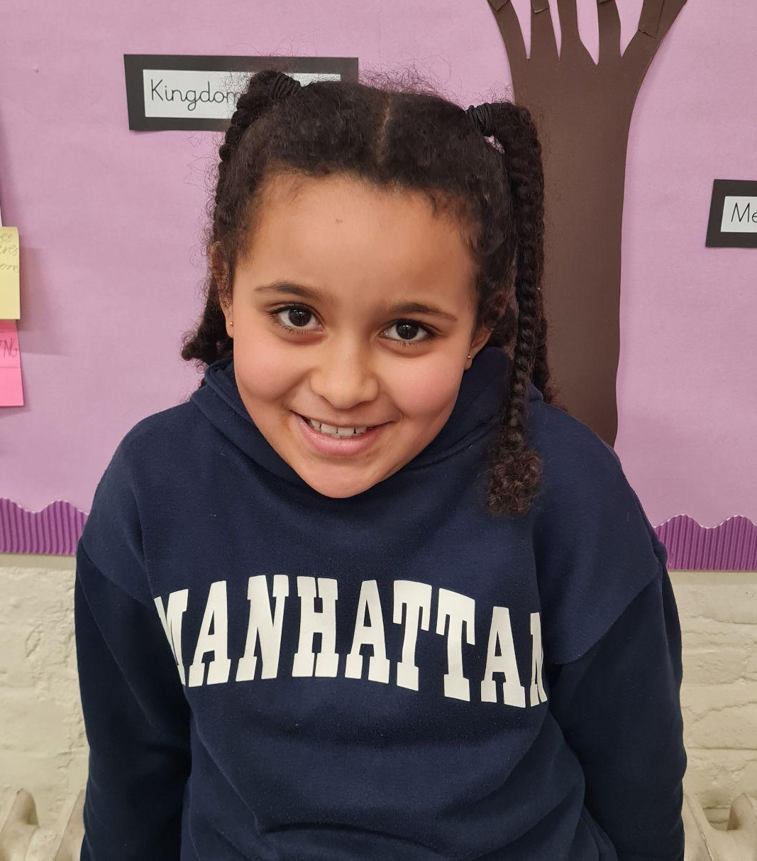
Year 6
For being a shining light in and out of class. Alessia has participated actively on all fronts and shared wonderful learning whilst maintaining excellent effort, behaviour and manners.
Mr Cherfi

Slide 12


STAR READER
Y1 - Not this week
Y2 - Not this week
Y3 - Not this week
Y4 - Deontae
Y5 - Not this week
Y6 - Poppy

Slide 13
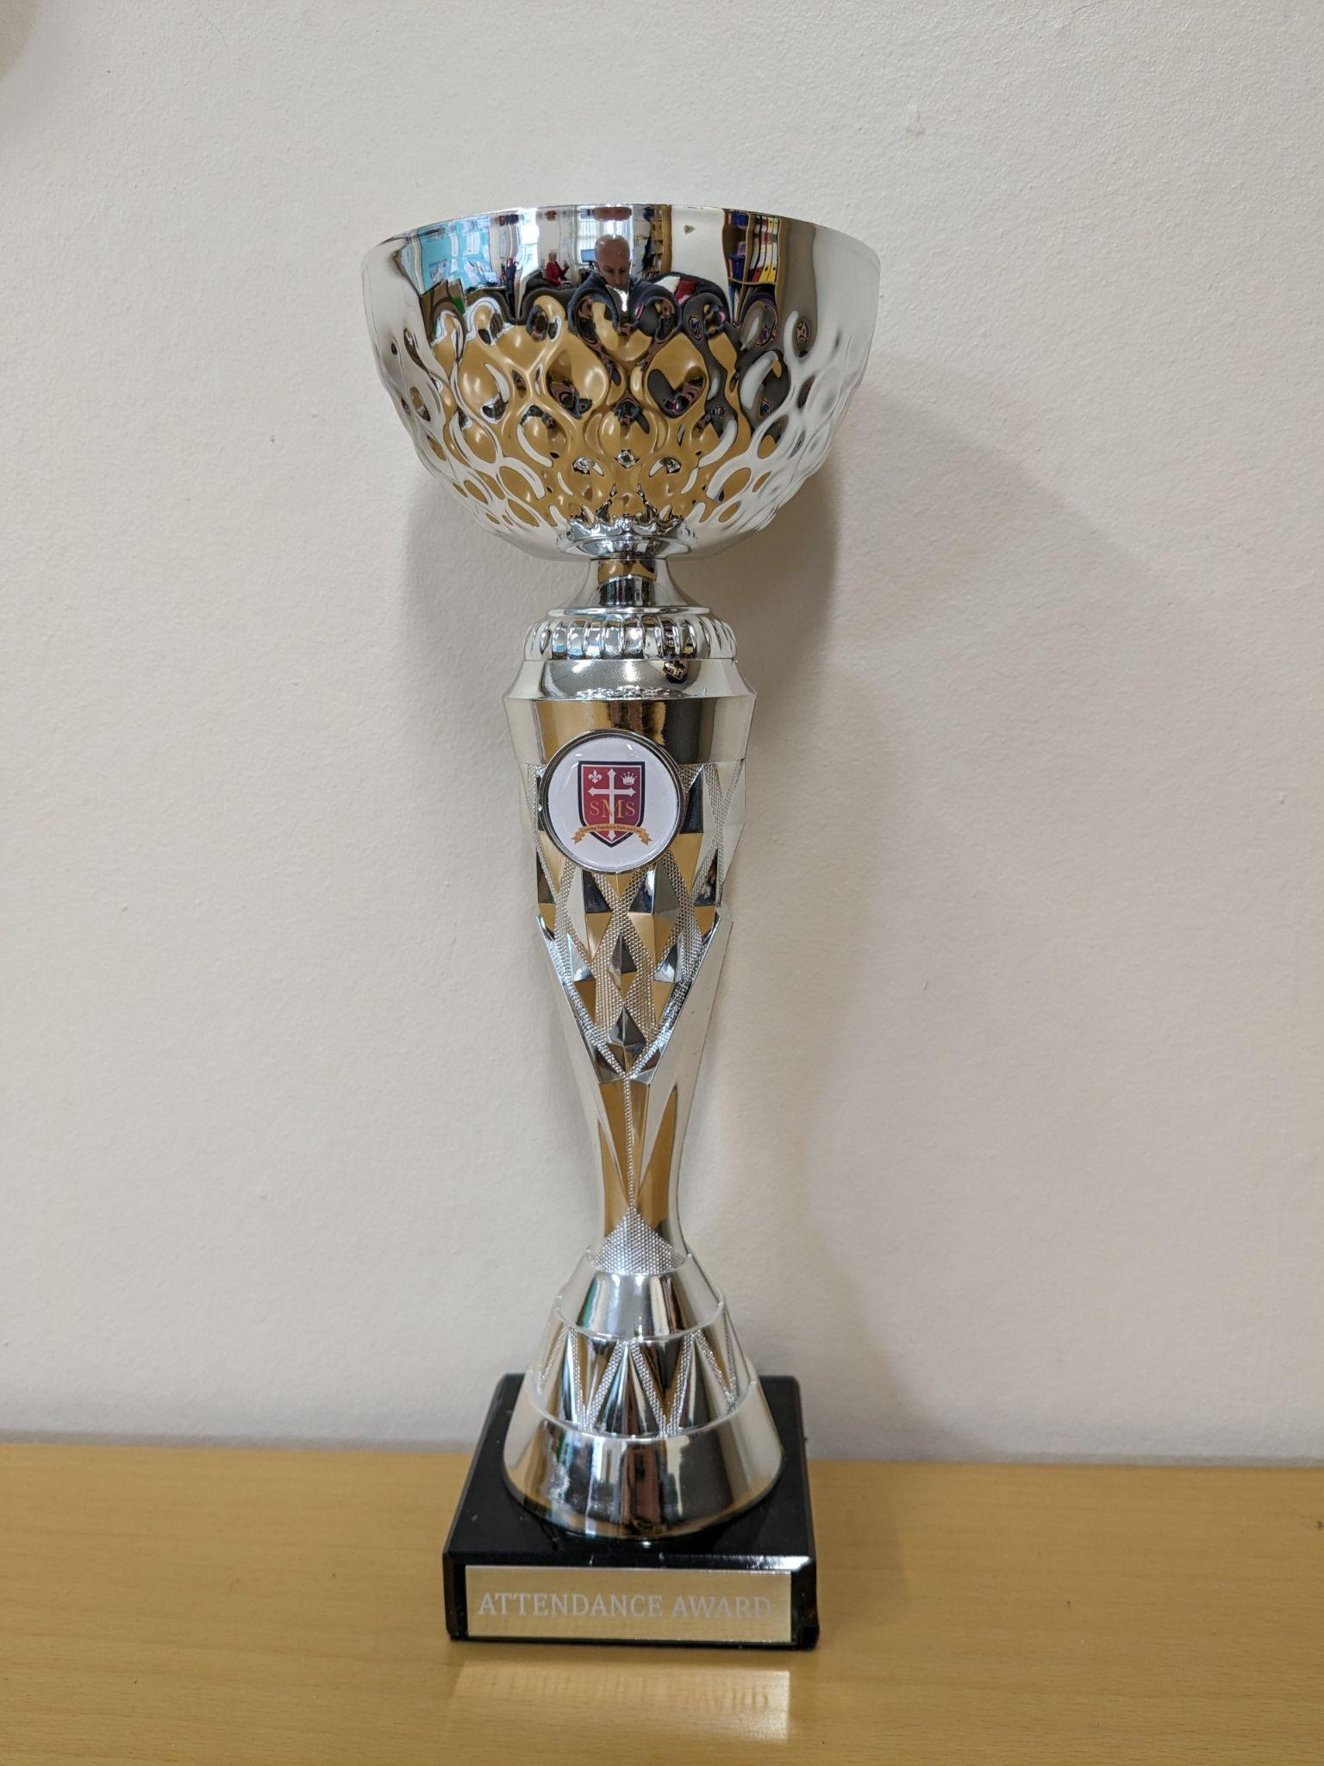
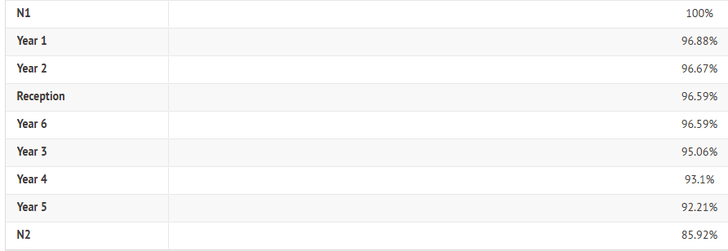
Attendance Weekly Leaders Summer Term:
Winners of the Pitch this Friday - Nursery & Year 1

Slide 14
Whole School
Star of the Week
Friday 11th September 2026

