Slide 1




Whole School
Star of the Week
Friday 12th December 2025

Slide 2


Our Father who art in Heaven
Hallowed be Thy Name
Thy Kingdom come
Thy will be done on Earth as it is in Heaven
Give us this day our daily bread
And forgive us our trespasses
As we forgive those who trespass against us
And lead us not into temptation
But deliver us from evil
Amen

Slide 3
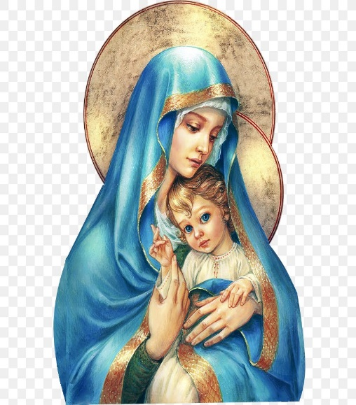
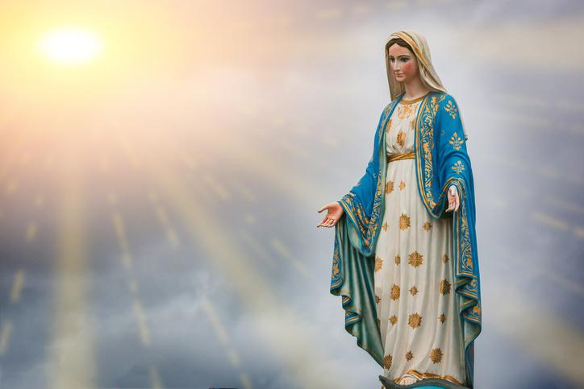
Hail Mary, Full of Grace
The Lord is with Thee
Blessed are Thou amongst women
And Blessed is the fruit of Thy womb, Jesus
Holy Mary , Mother of God
Pray for us sinners
Now and in the hour of our death
Amen

Slide 4
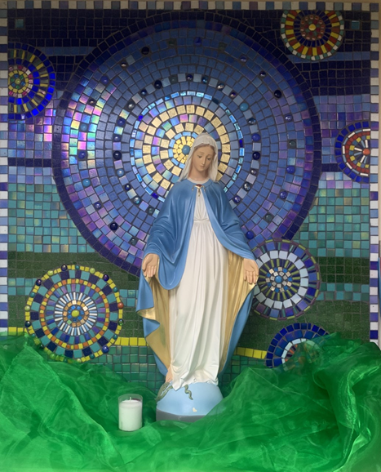
St Mary’s School Prayer
O Holy Mary,
Mother and Patron of our school,
Turn your eyes of mercy towards us,
that we may love God
With all our hearts!
May we imitate the tenderness
of your Son, Jesus,
showing love and respect
For each person
and ourselves as children of God.
Guided by the Holy Spirit,
May we create the school,
where Mercy and Compassion
Is the centre of our lives.
Amen

Slide 5
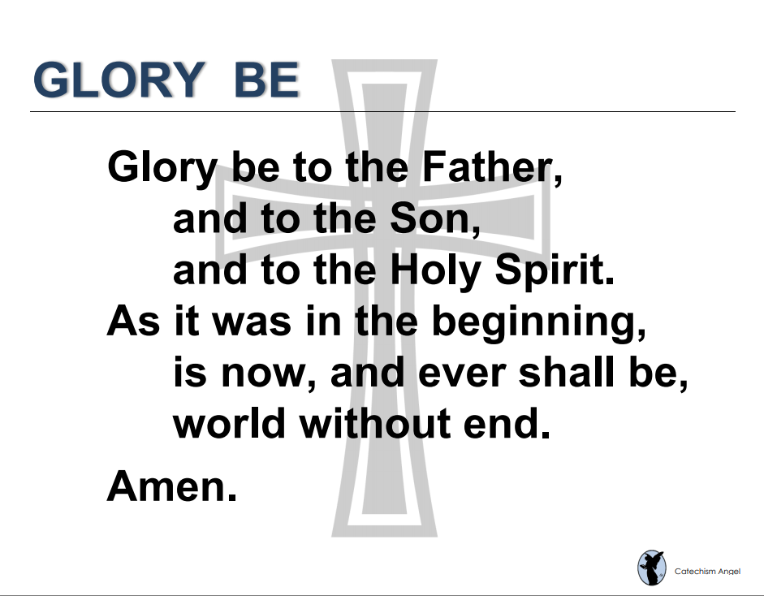

Slide 6
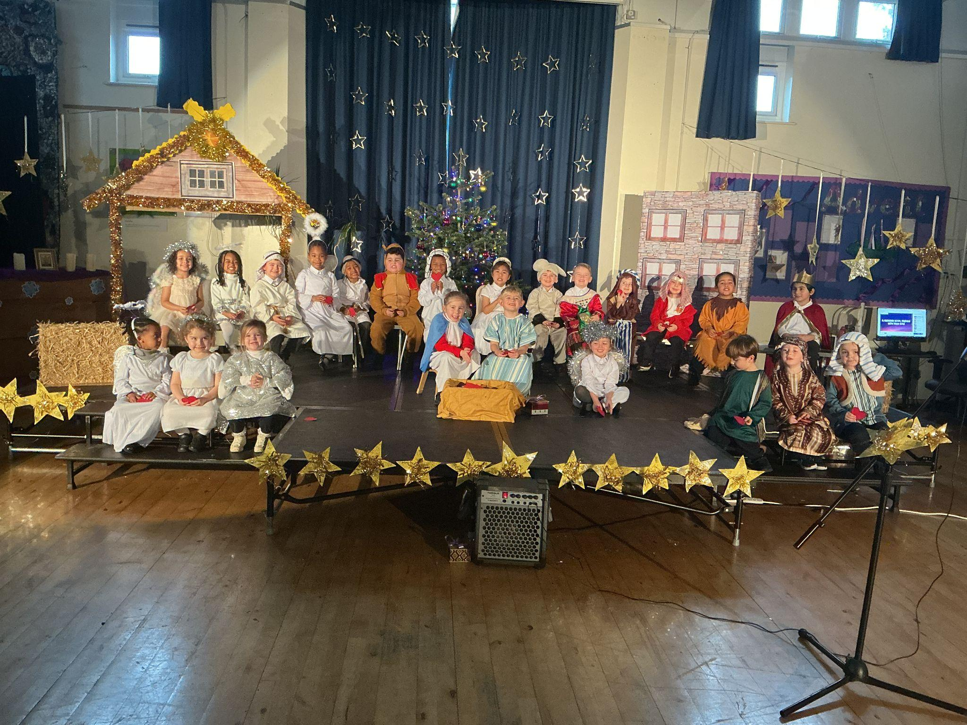
EYFS
Nursery and Reception
Whole Class
For their amazing performance in the Nativity
Miss Barker

Slide 7
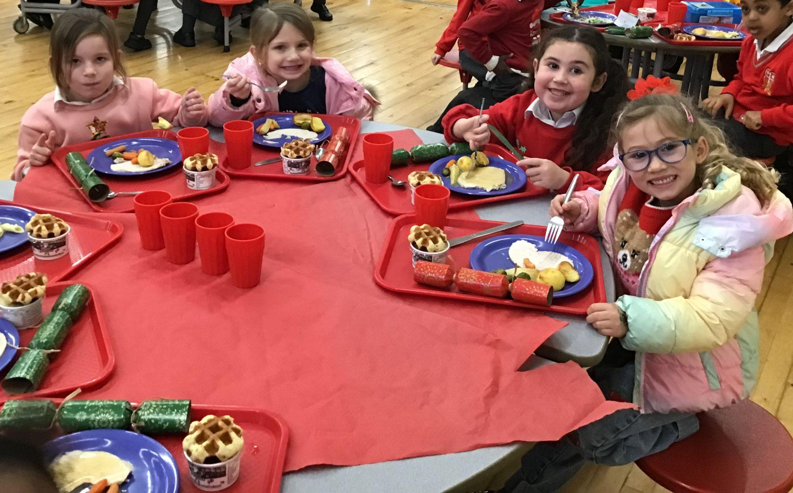
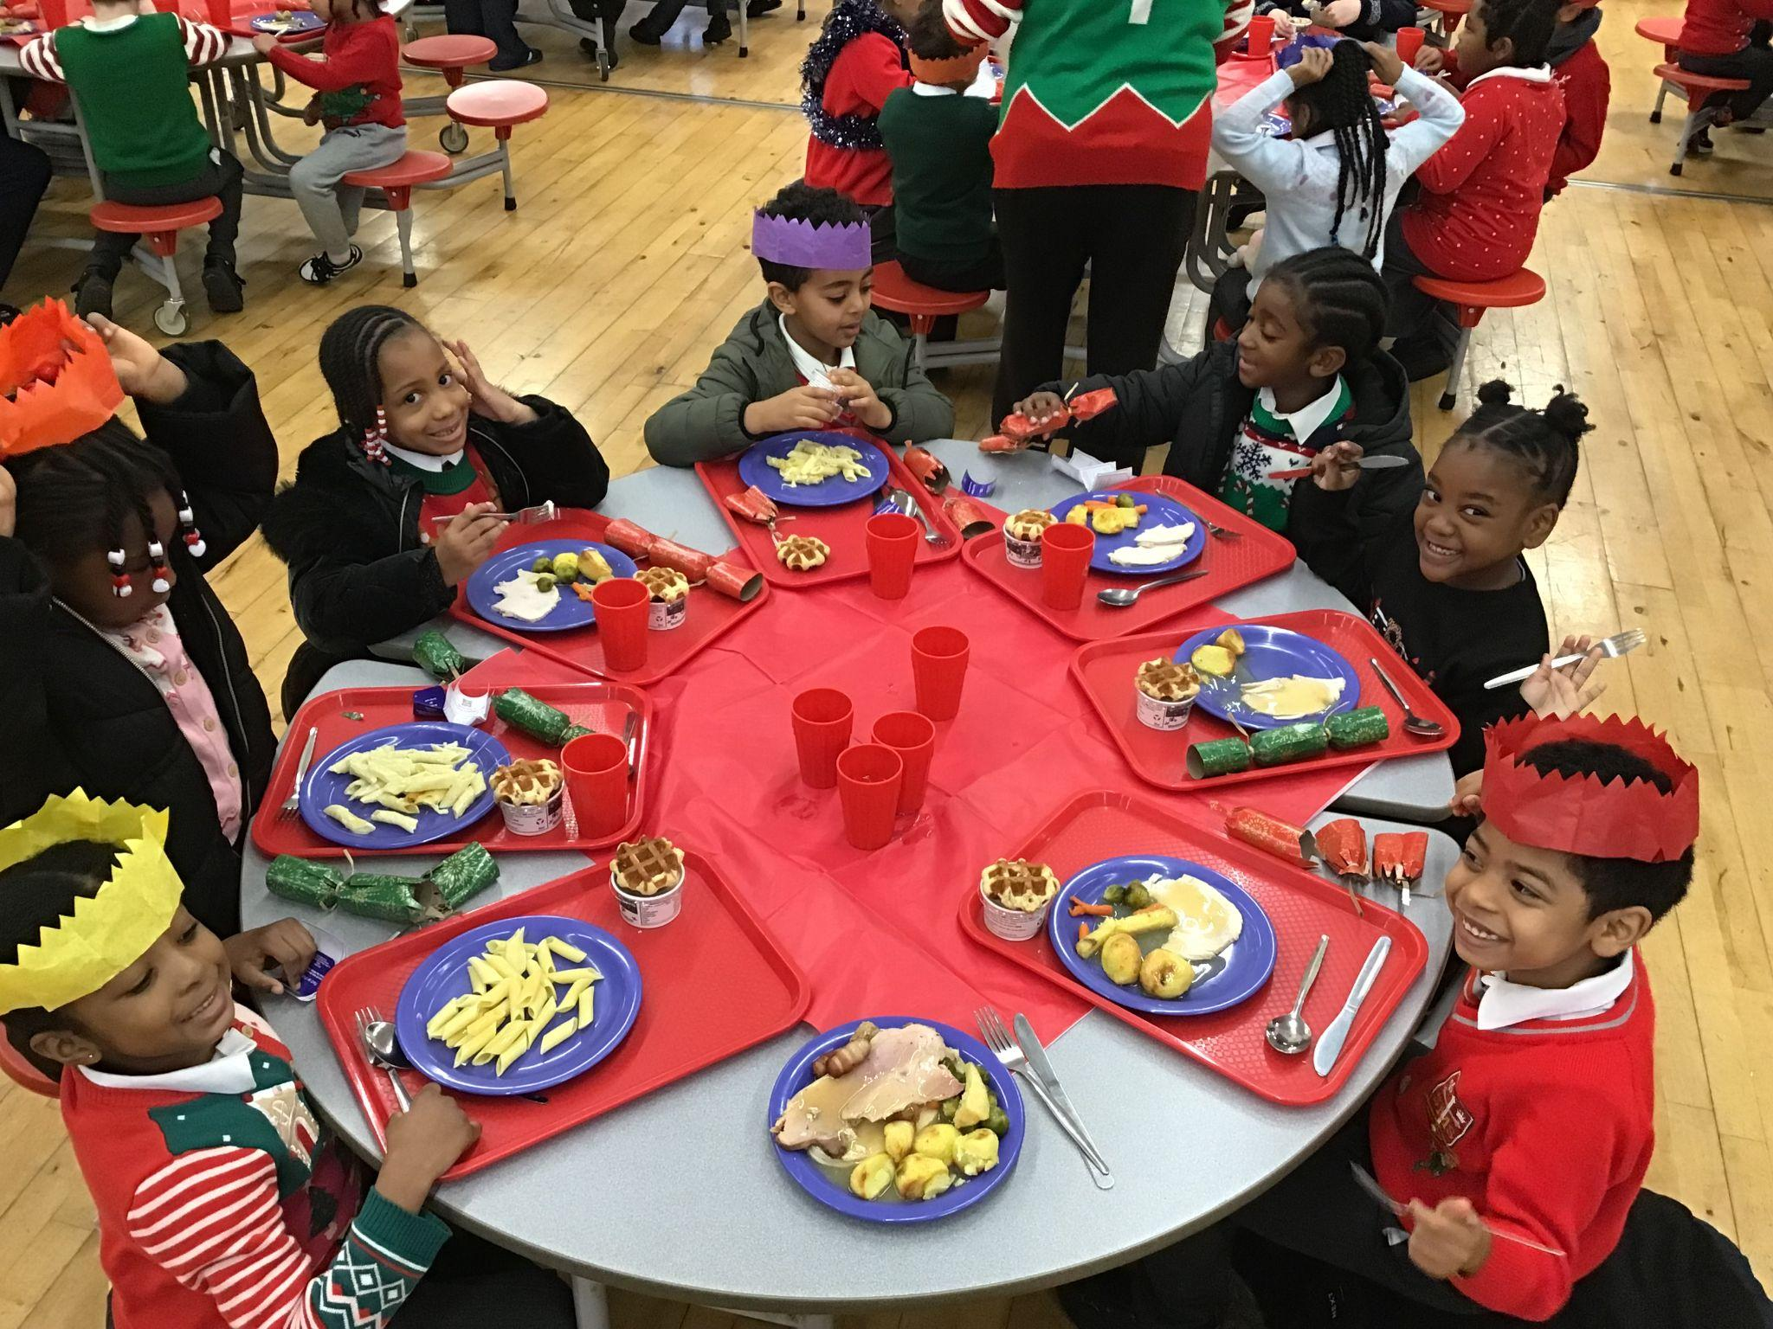
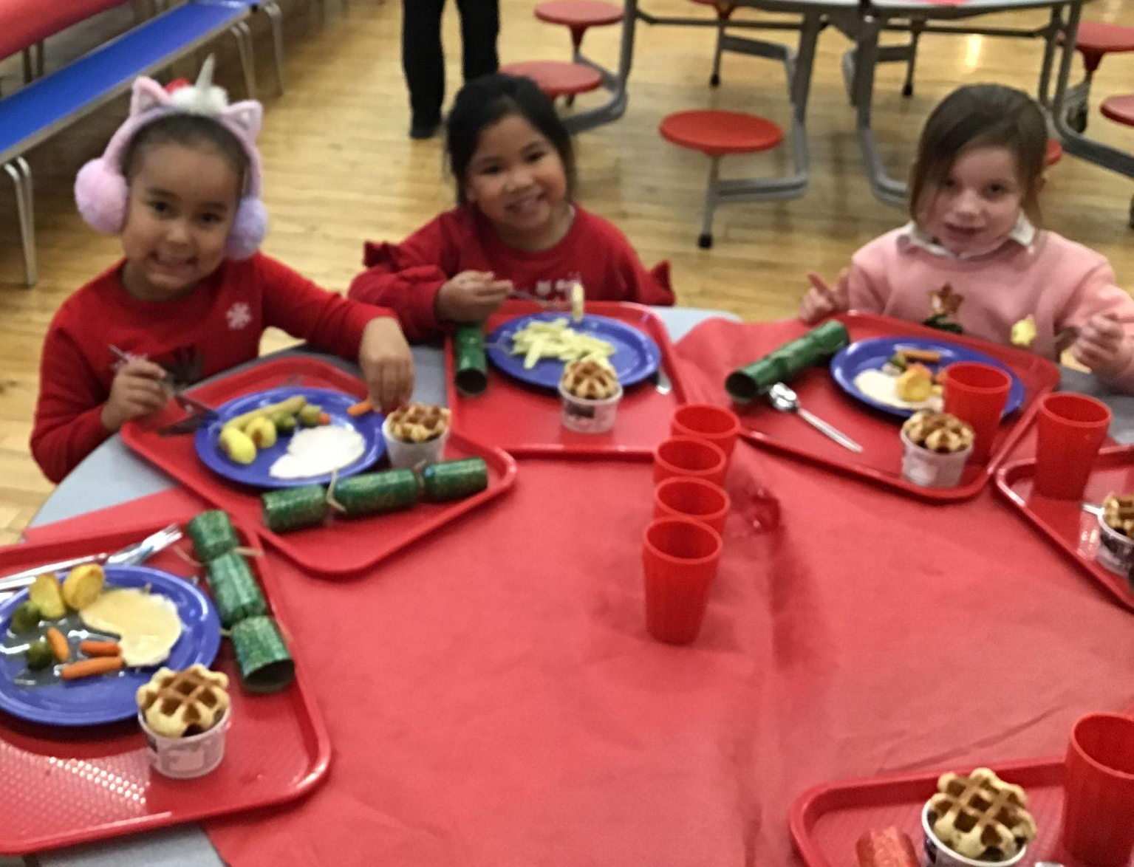
Year 1
Whole Class
For being such a fun, friendly class and welcoming me into St Mary’s!
Miss Flashman

Slide 8
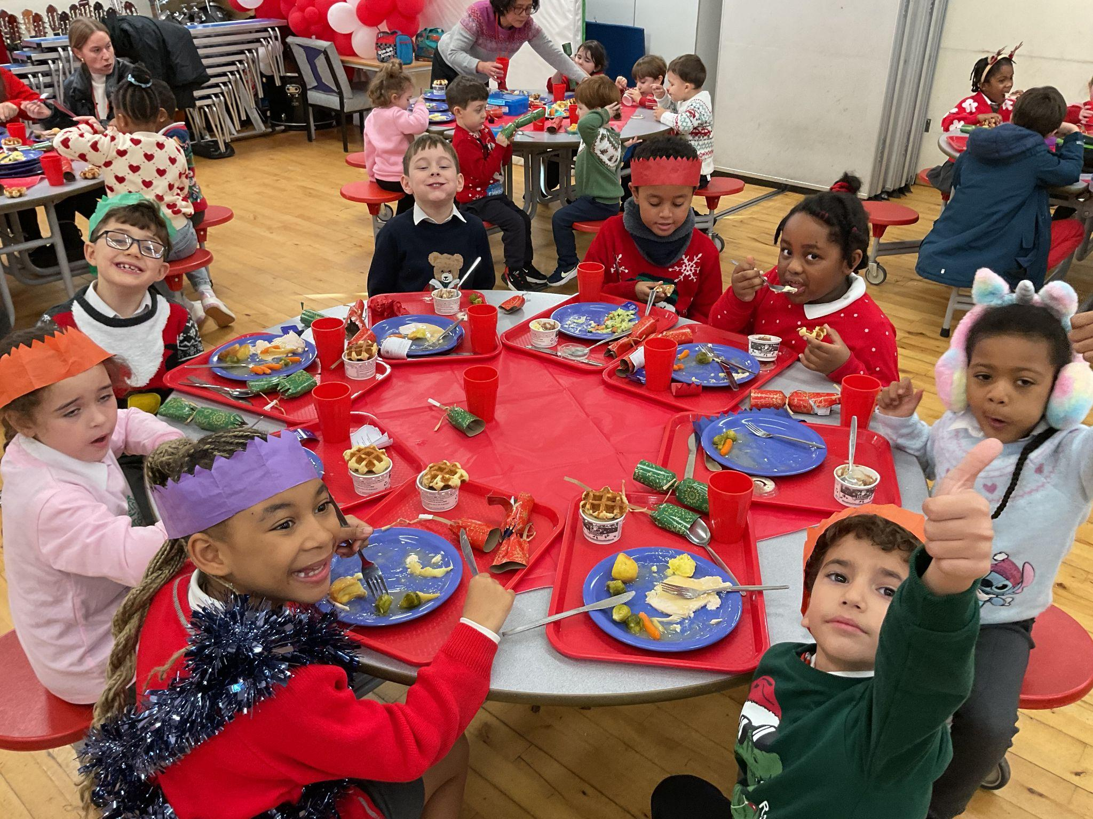
Year 2
Whole Class
For their fantastic effort in Nativity practise!
Miss Sweet

Slide 9
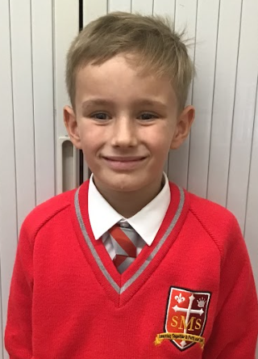
Year 3
For huge improvements in focus and improving his handwriting.
Mr. Larke

Slide 10
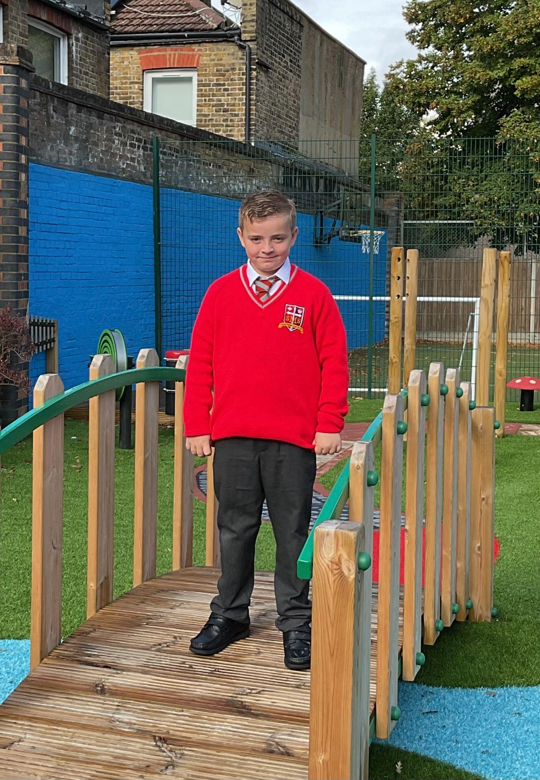
Year 4
For having a truly positive attitude to his work, particularly in writing and maths where he has challenged himself to great effect.
Mr Whear

Slide 11
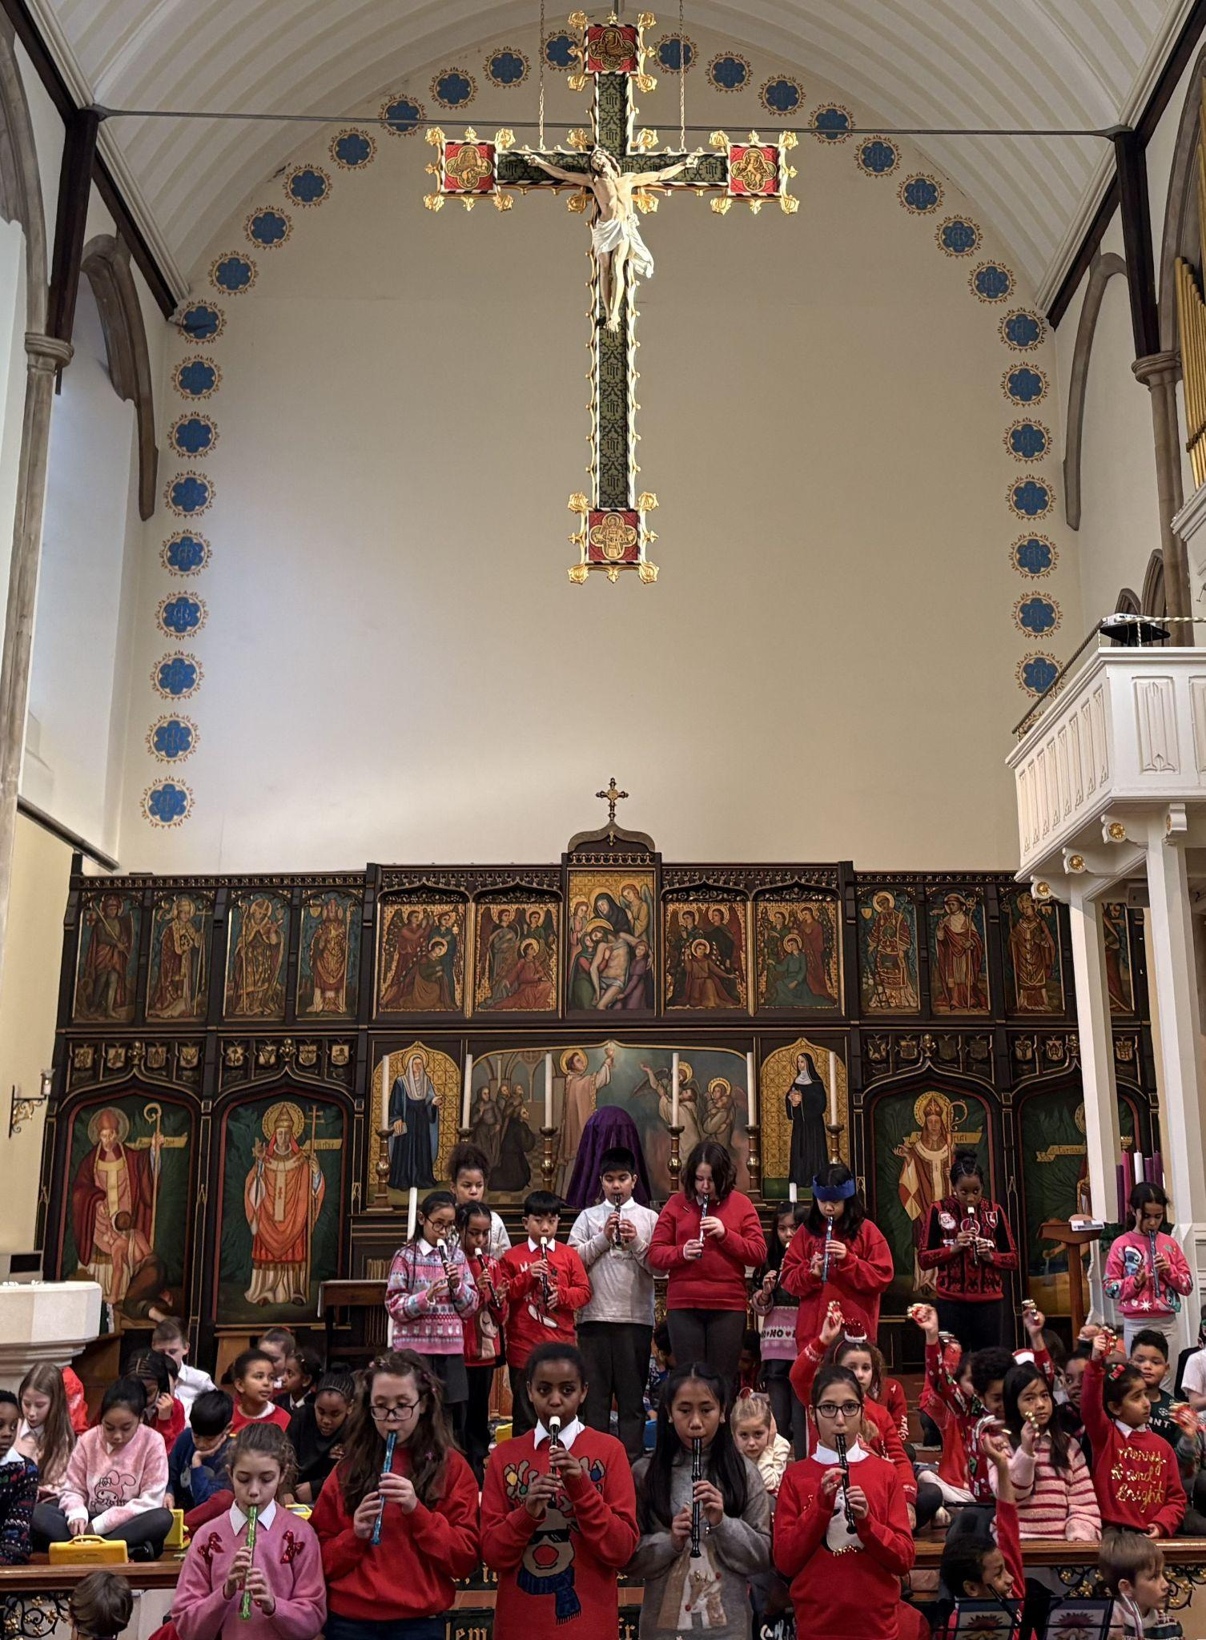
Year 5
Whole Class
For excellent behaviour and performance at the Town Hall

Slide 12

Year 6
For being an excellent participant in class. Always willing to show how attentive and focused he is.
Mr Cherfi & Mr Quinlan

Slide 13



Star Readers
Y1 - Whole class!
Y2 - Aniyah
Y3 - Azahrye’
Y4 - Grae
Y5 - Deborah
Y6 - Ana-Clara

Slide 14
Whole School
Star of the Week
Friday 12th December 2025

