Slide 1



Whole School
Star of the Week
Friday 12th June 2026

Slide 2
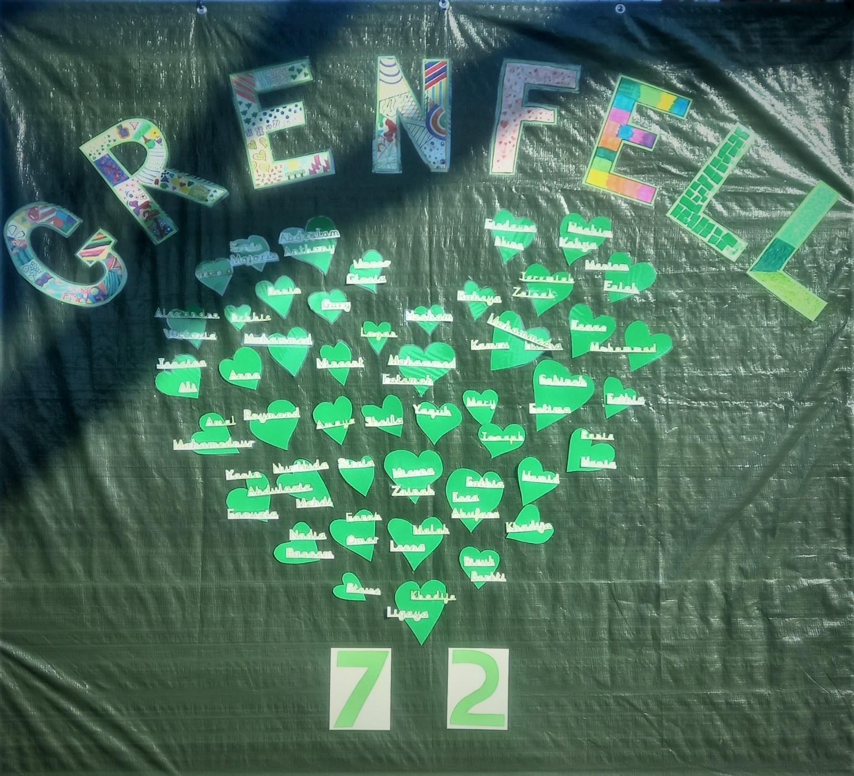
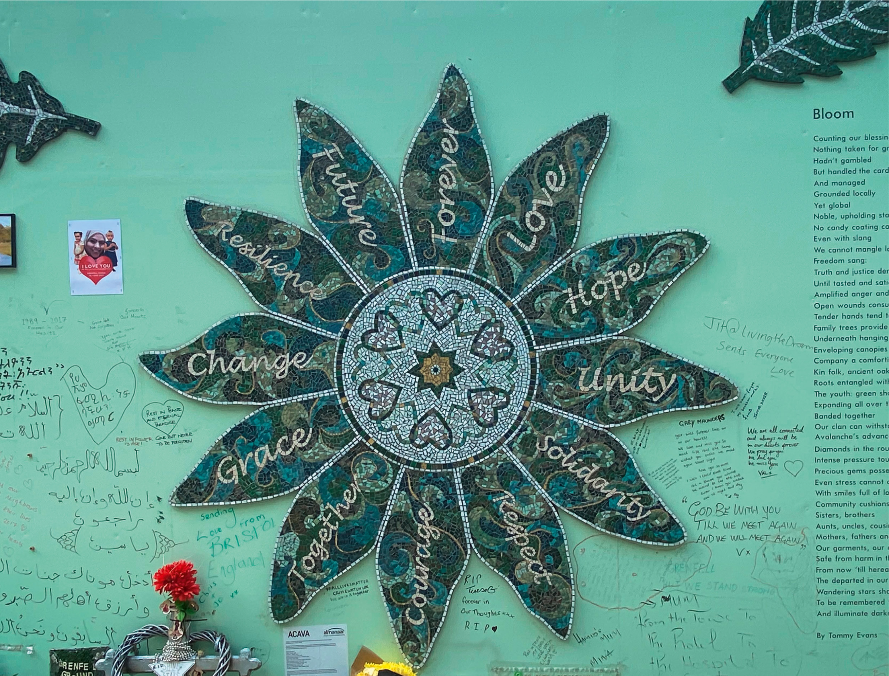
Forever in our hearts.
Remembering in Prayer.
Sunday 14th June

Slide 3
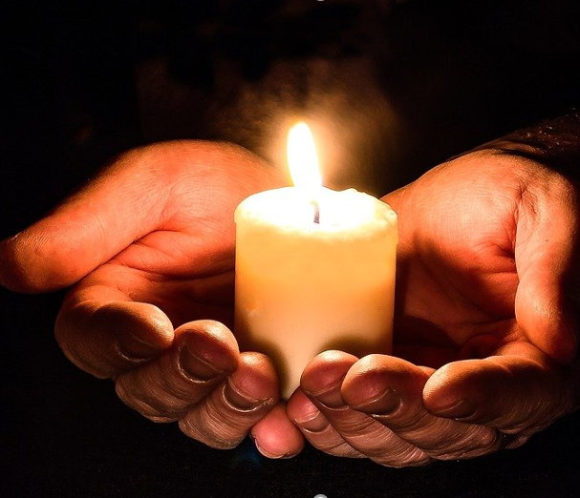
As we gather together, we pray for all those who have suffered because of the Grenfell Tower fire nine years ago.
We pray for all the residents of Grenfell Tower. We pray particularly for those who have suffered injury, those who have died, and all the residents who were left without a home, families who lost their loved ones and the entire community that has been affected.
We will now have 72 seconds of silence for 72 lives lost.

Slide 4

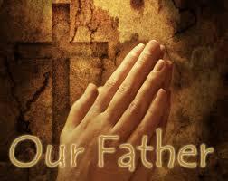
Our Father who art in Heaven
Hallowed be Thy Name
Thy Kingdom come
Thy will be done on Earth as it is in Heaven
Give us this day our daily bread
And forgive us our trespasses
As we forgive those who trespass against us
And lead us not into temptation
But deliver us from evil
Amen

Slide 5
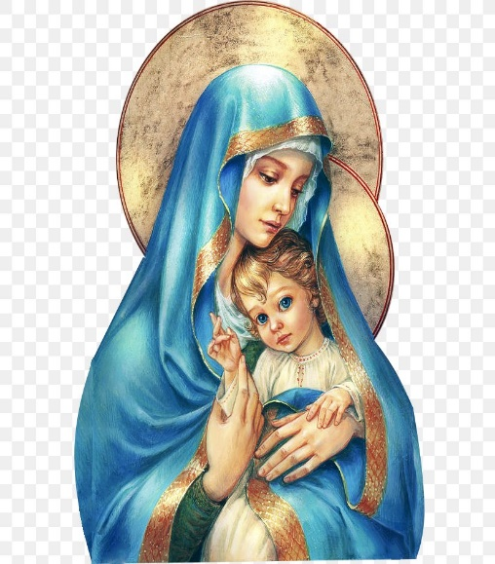
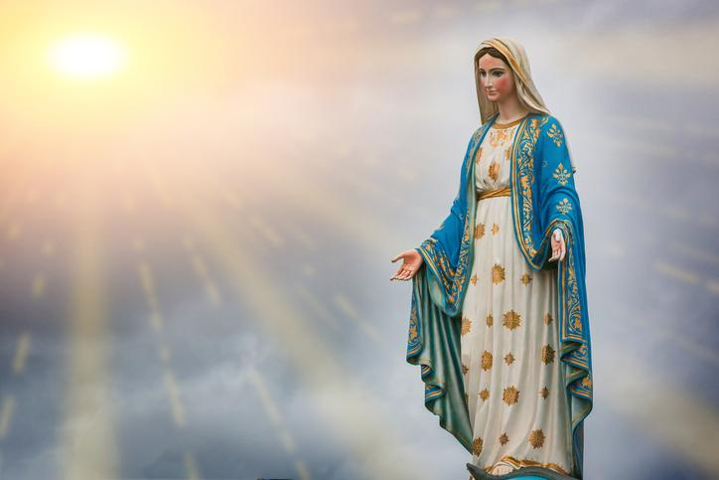
Hail Mary, Full of Grace
The Lord is with Thee
Blessed are Thou amongst women
And Blessed is the fruit of Thy womb, Jesus
Holy Mary , Mother of God
Pray for us sinners
Now and in the hour of our death
Amen

Slide 6
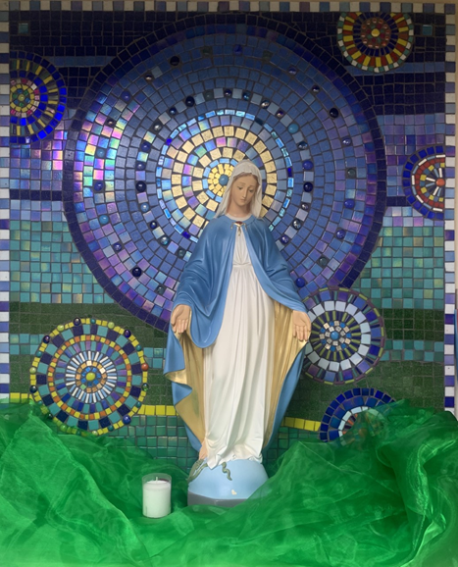
St Mary’s School Prayer
O Holy Mary,
Mother and Patron of our school,
Turn your eyes of mercy towards us,
that we may love God
With all our hearts!
May we imitate the tenderness
of your Son, Jesus,
showing love and respect
For each person
and ourselves as children of God.
Guided by the Holy Spirit,
May we create the school,
where Mercy and Compassion
Is the centre of our lives.
Amen

Slide 7
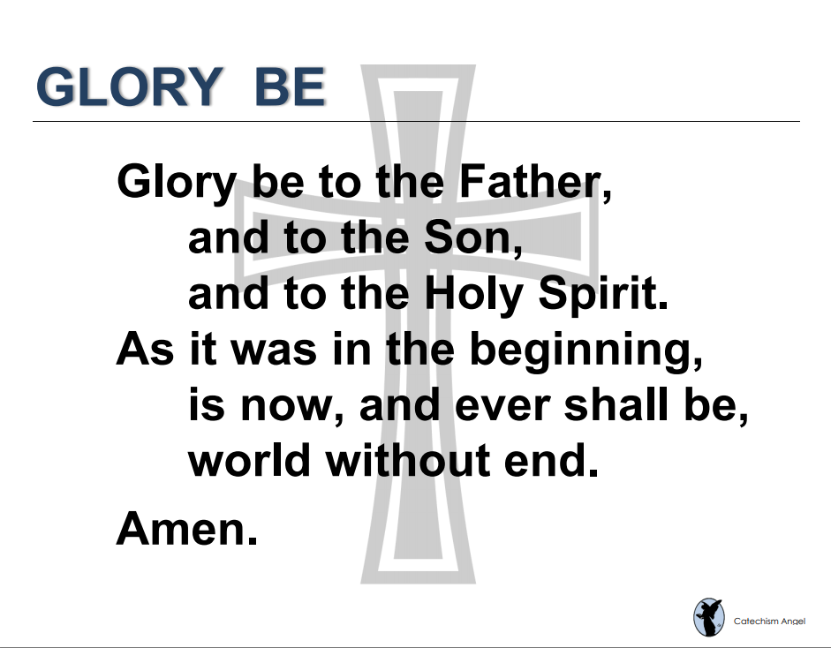

Slide 8
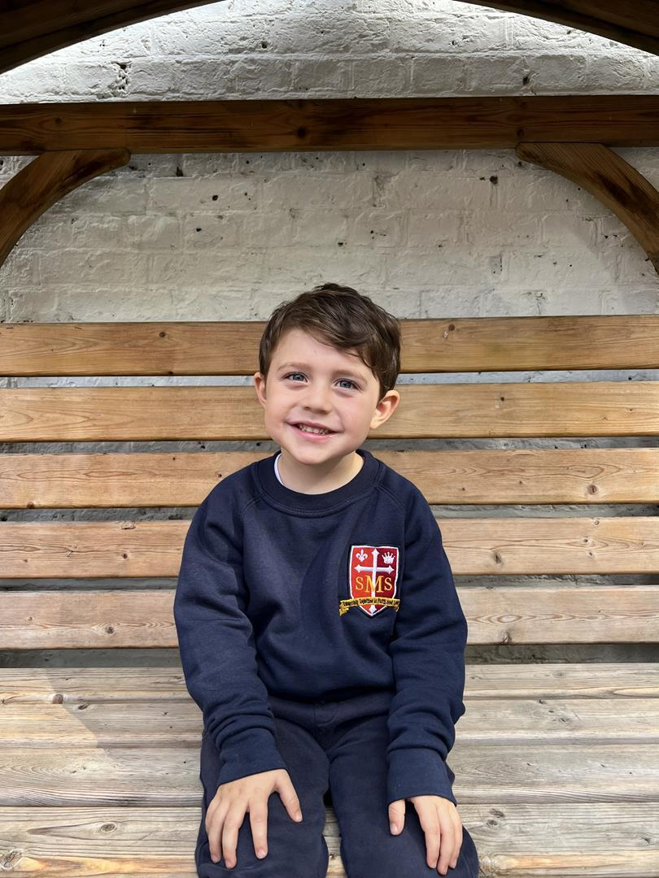
EYFS
Nursery
For his amazing effort with listening and attention this week and working very hard in class.
Miss Barker

Slide 9
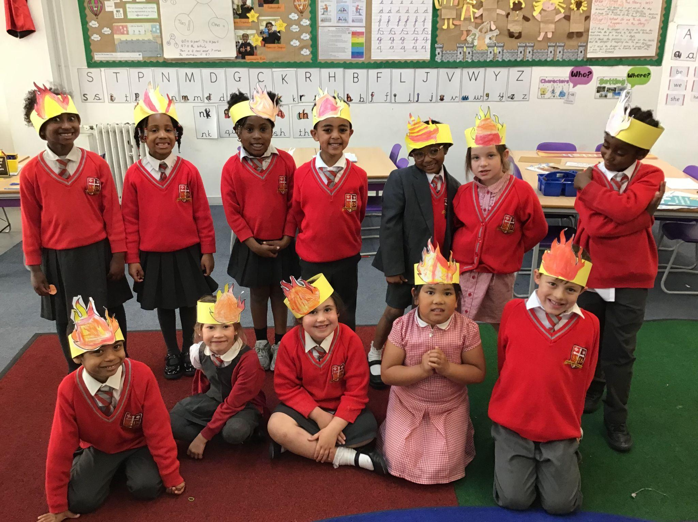
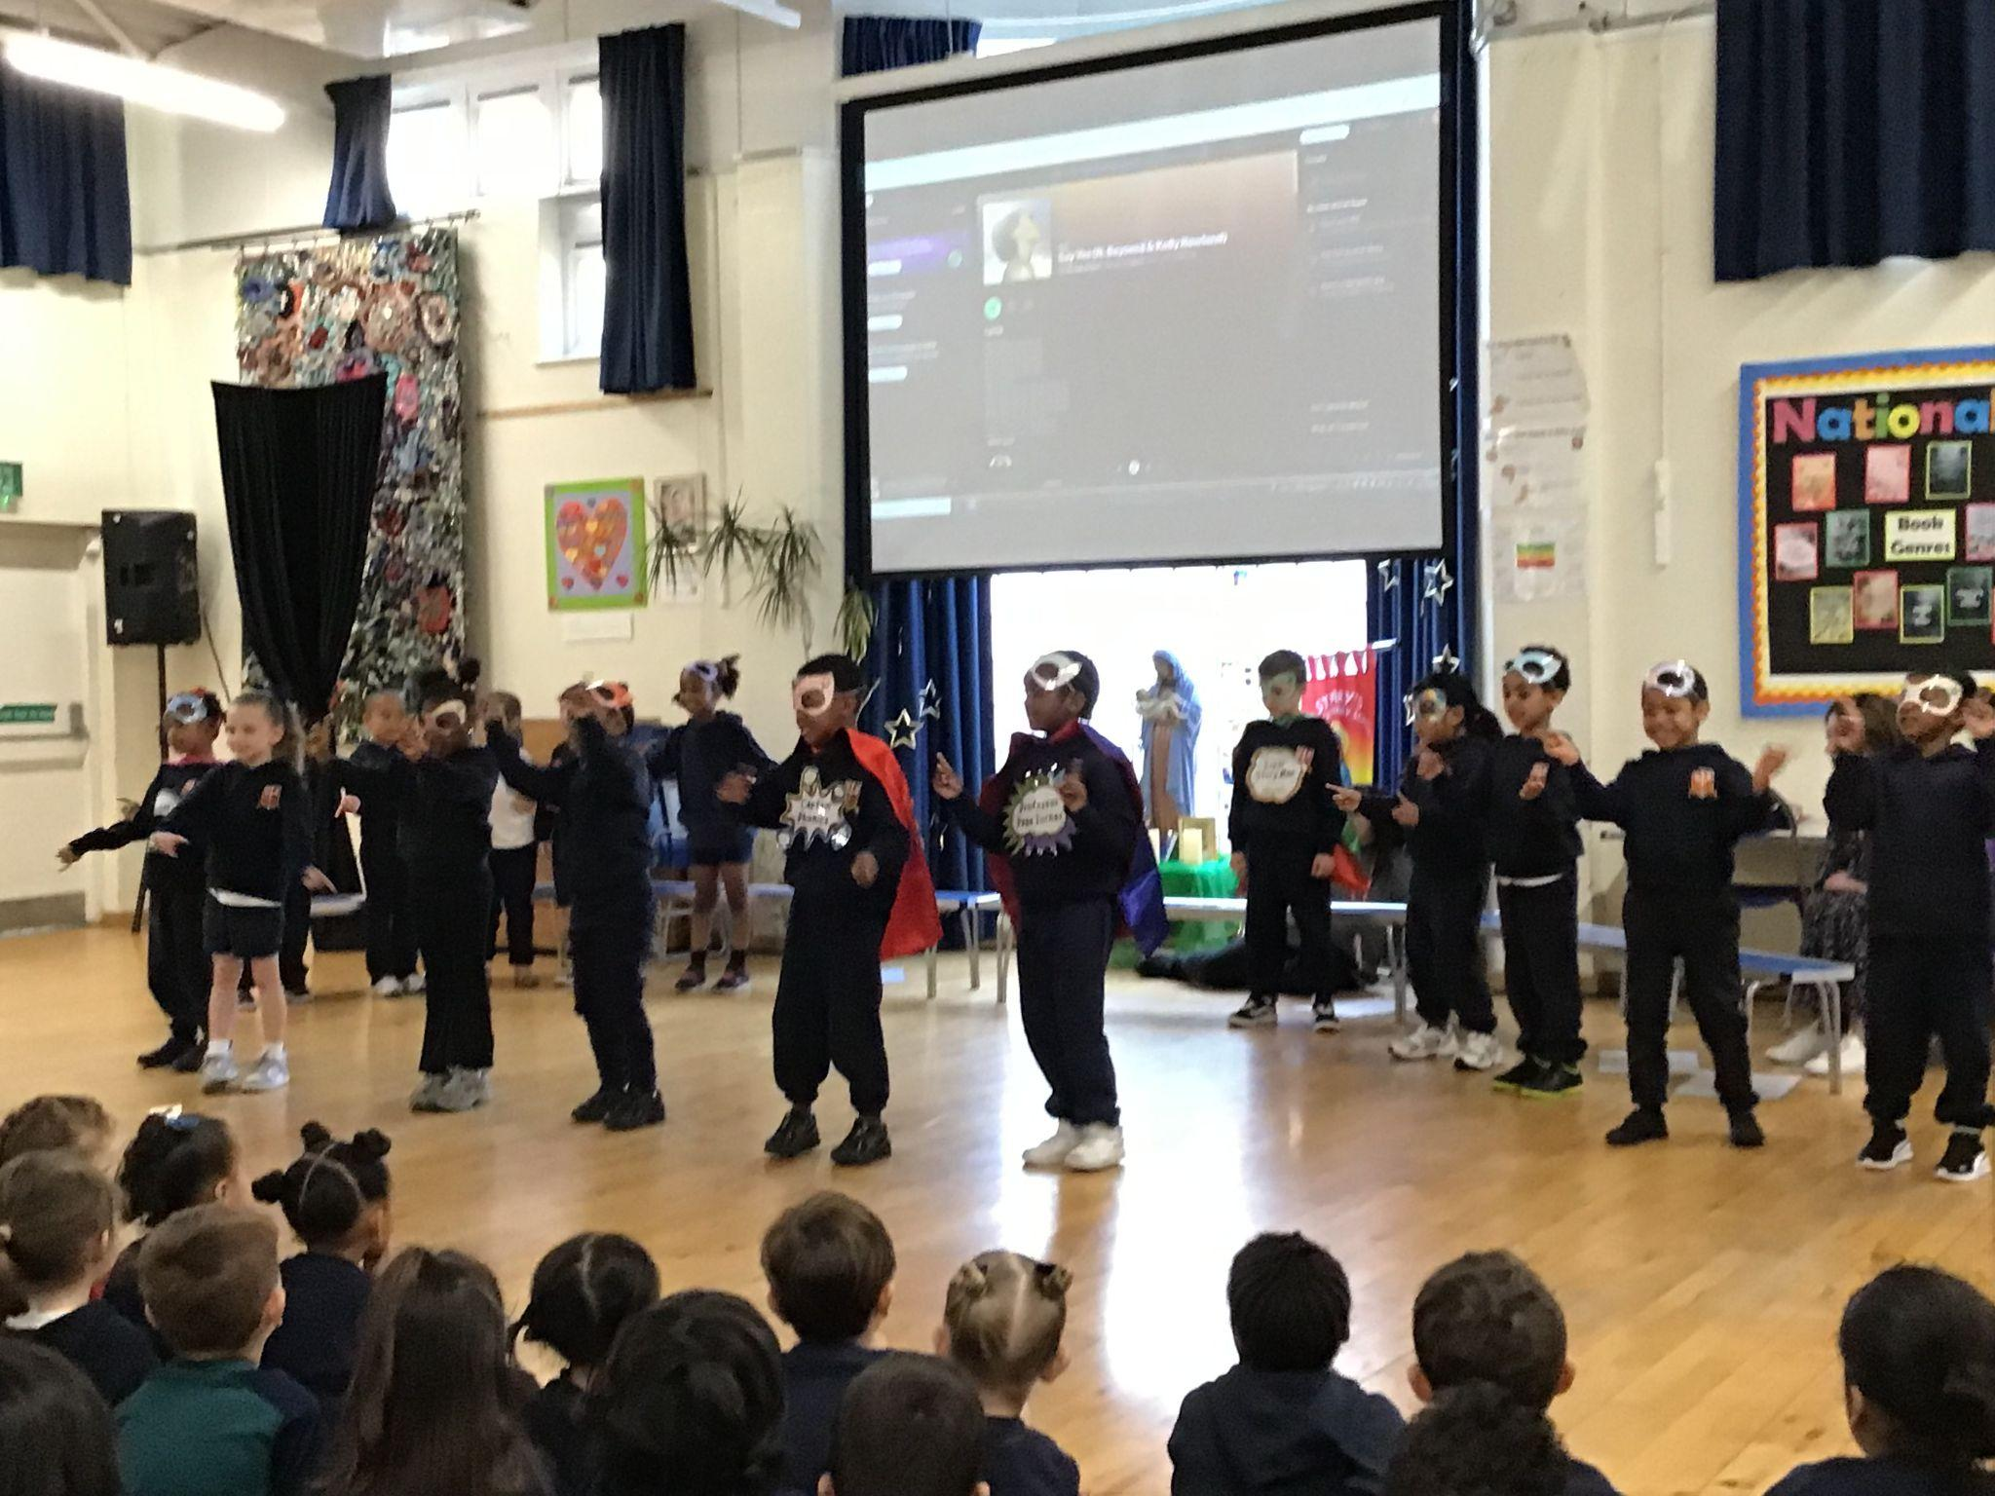
Year 1
WHOLE CLASS
Phenomenal Phonics Stars
Miss Flashman

Slide 10
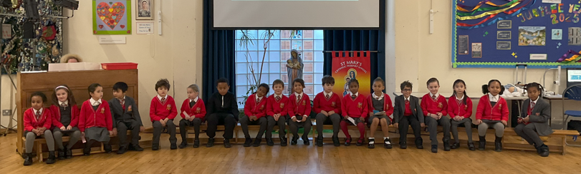
Year 2
Whole Class!
For their amazing efforts in their end of year assessments!
Miss Sweet

Slide 11
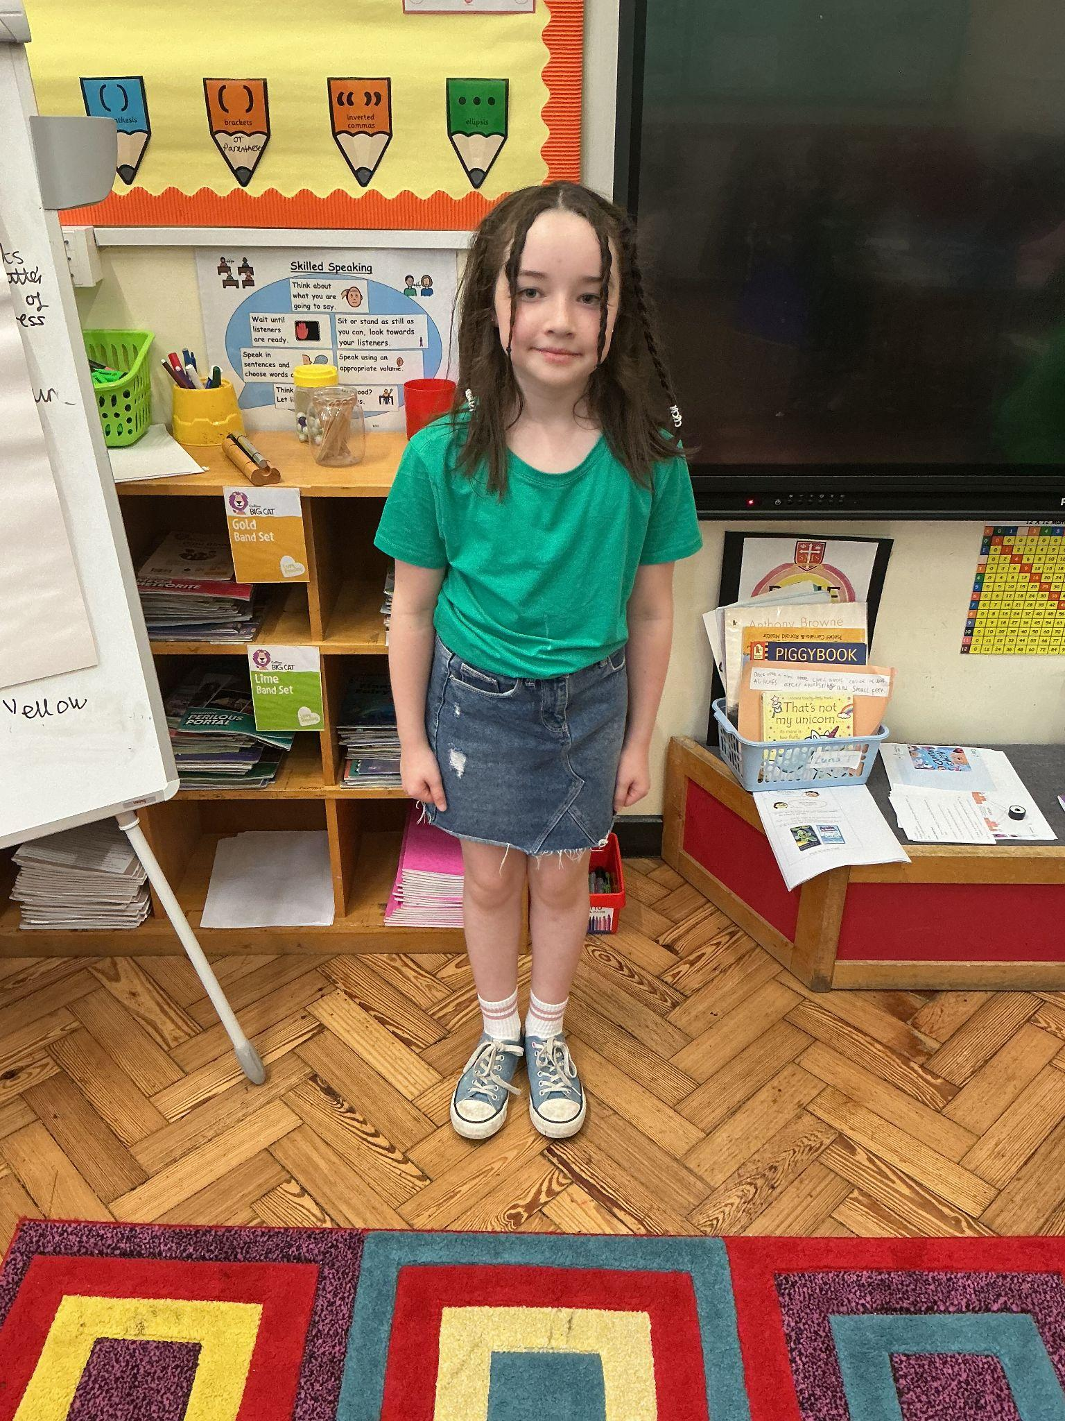
Year 3
You’re a role model to the rest of your peers. You’ve shone this week and I’m really proud of you!
Miss Hickey

Slide 12
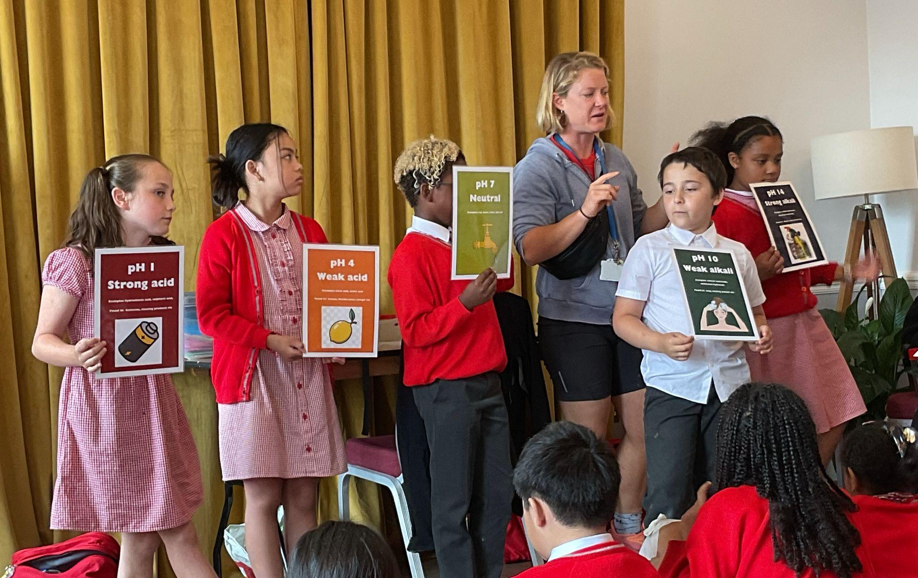
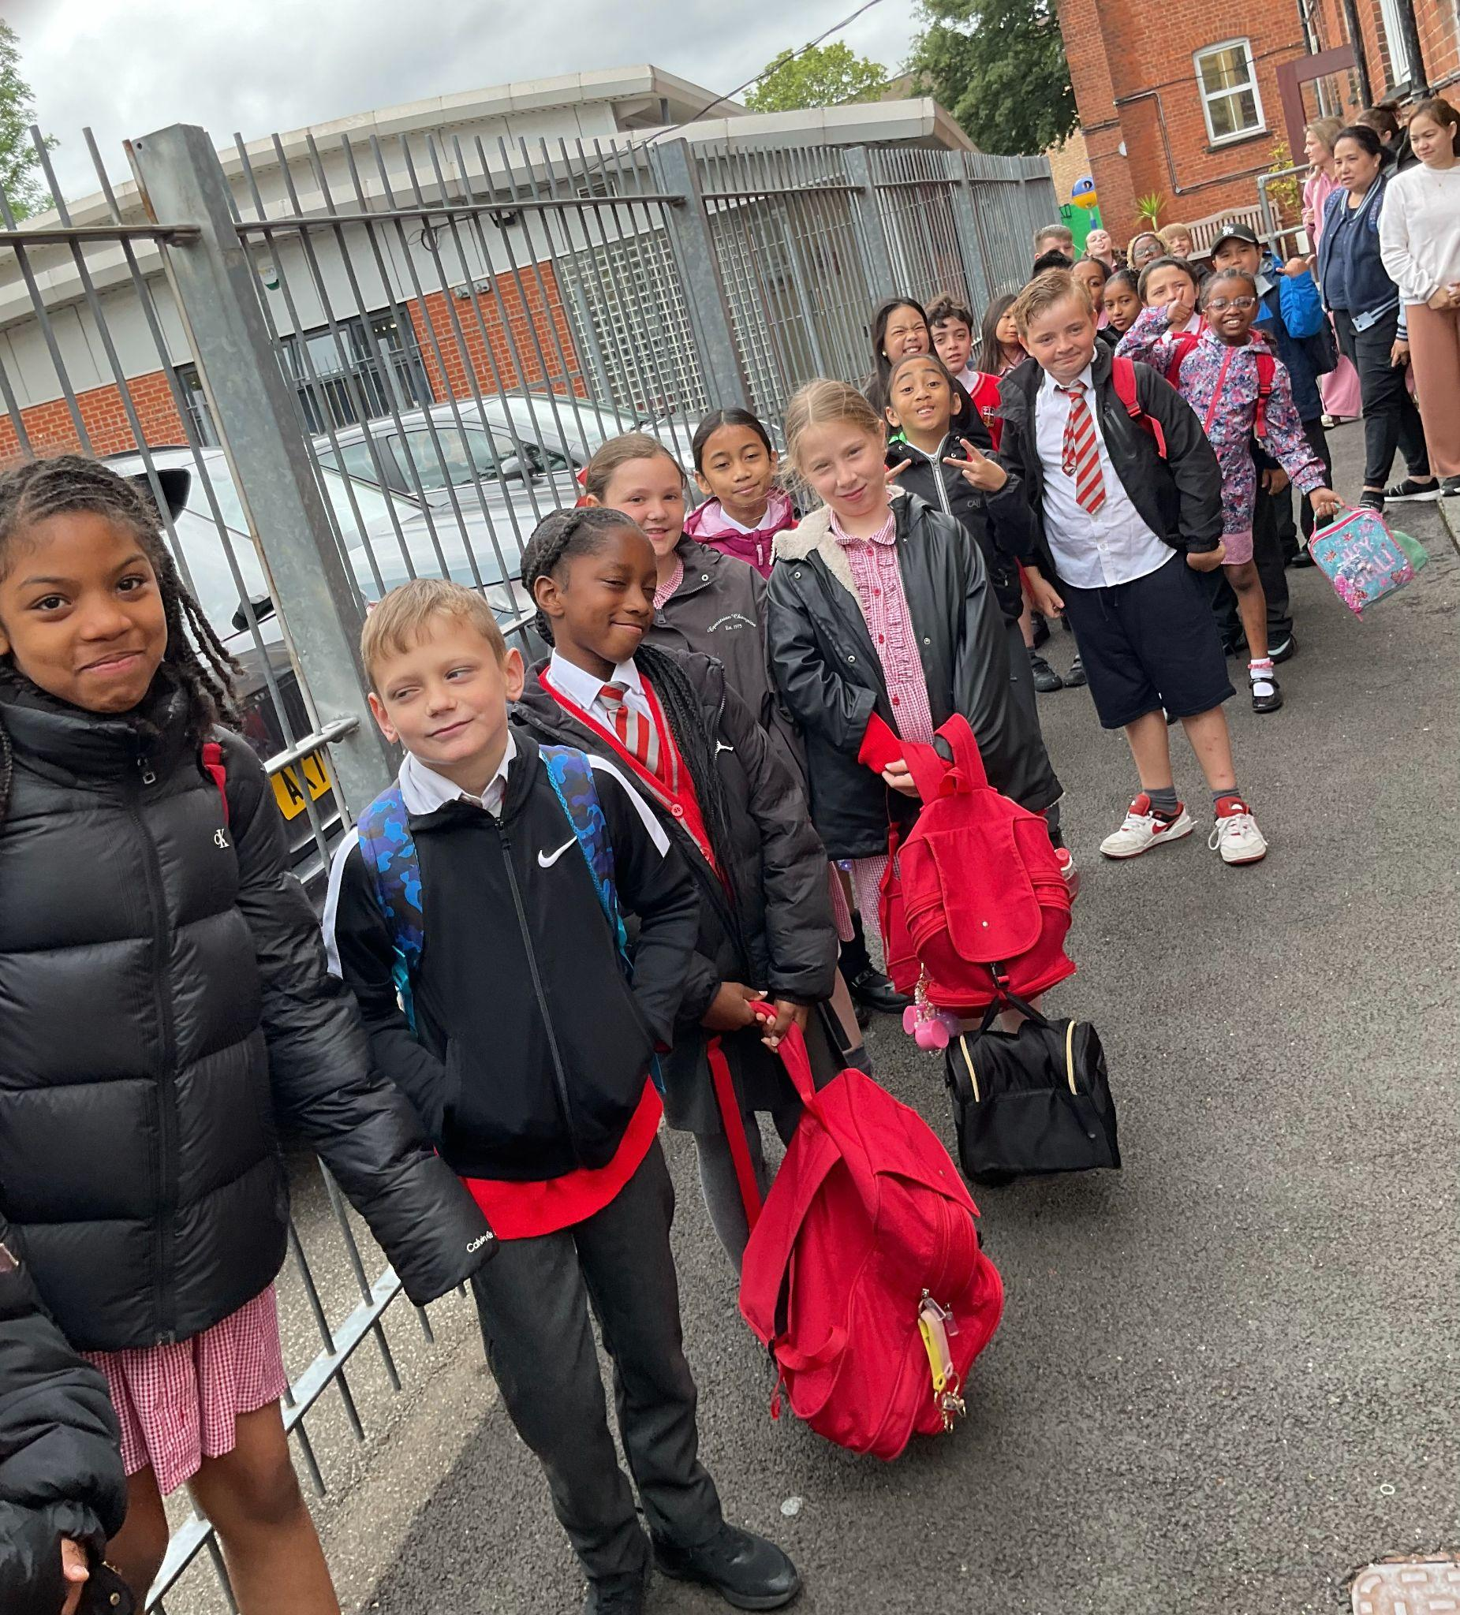
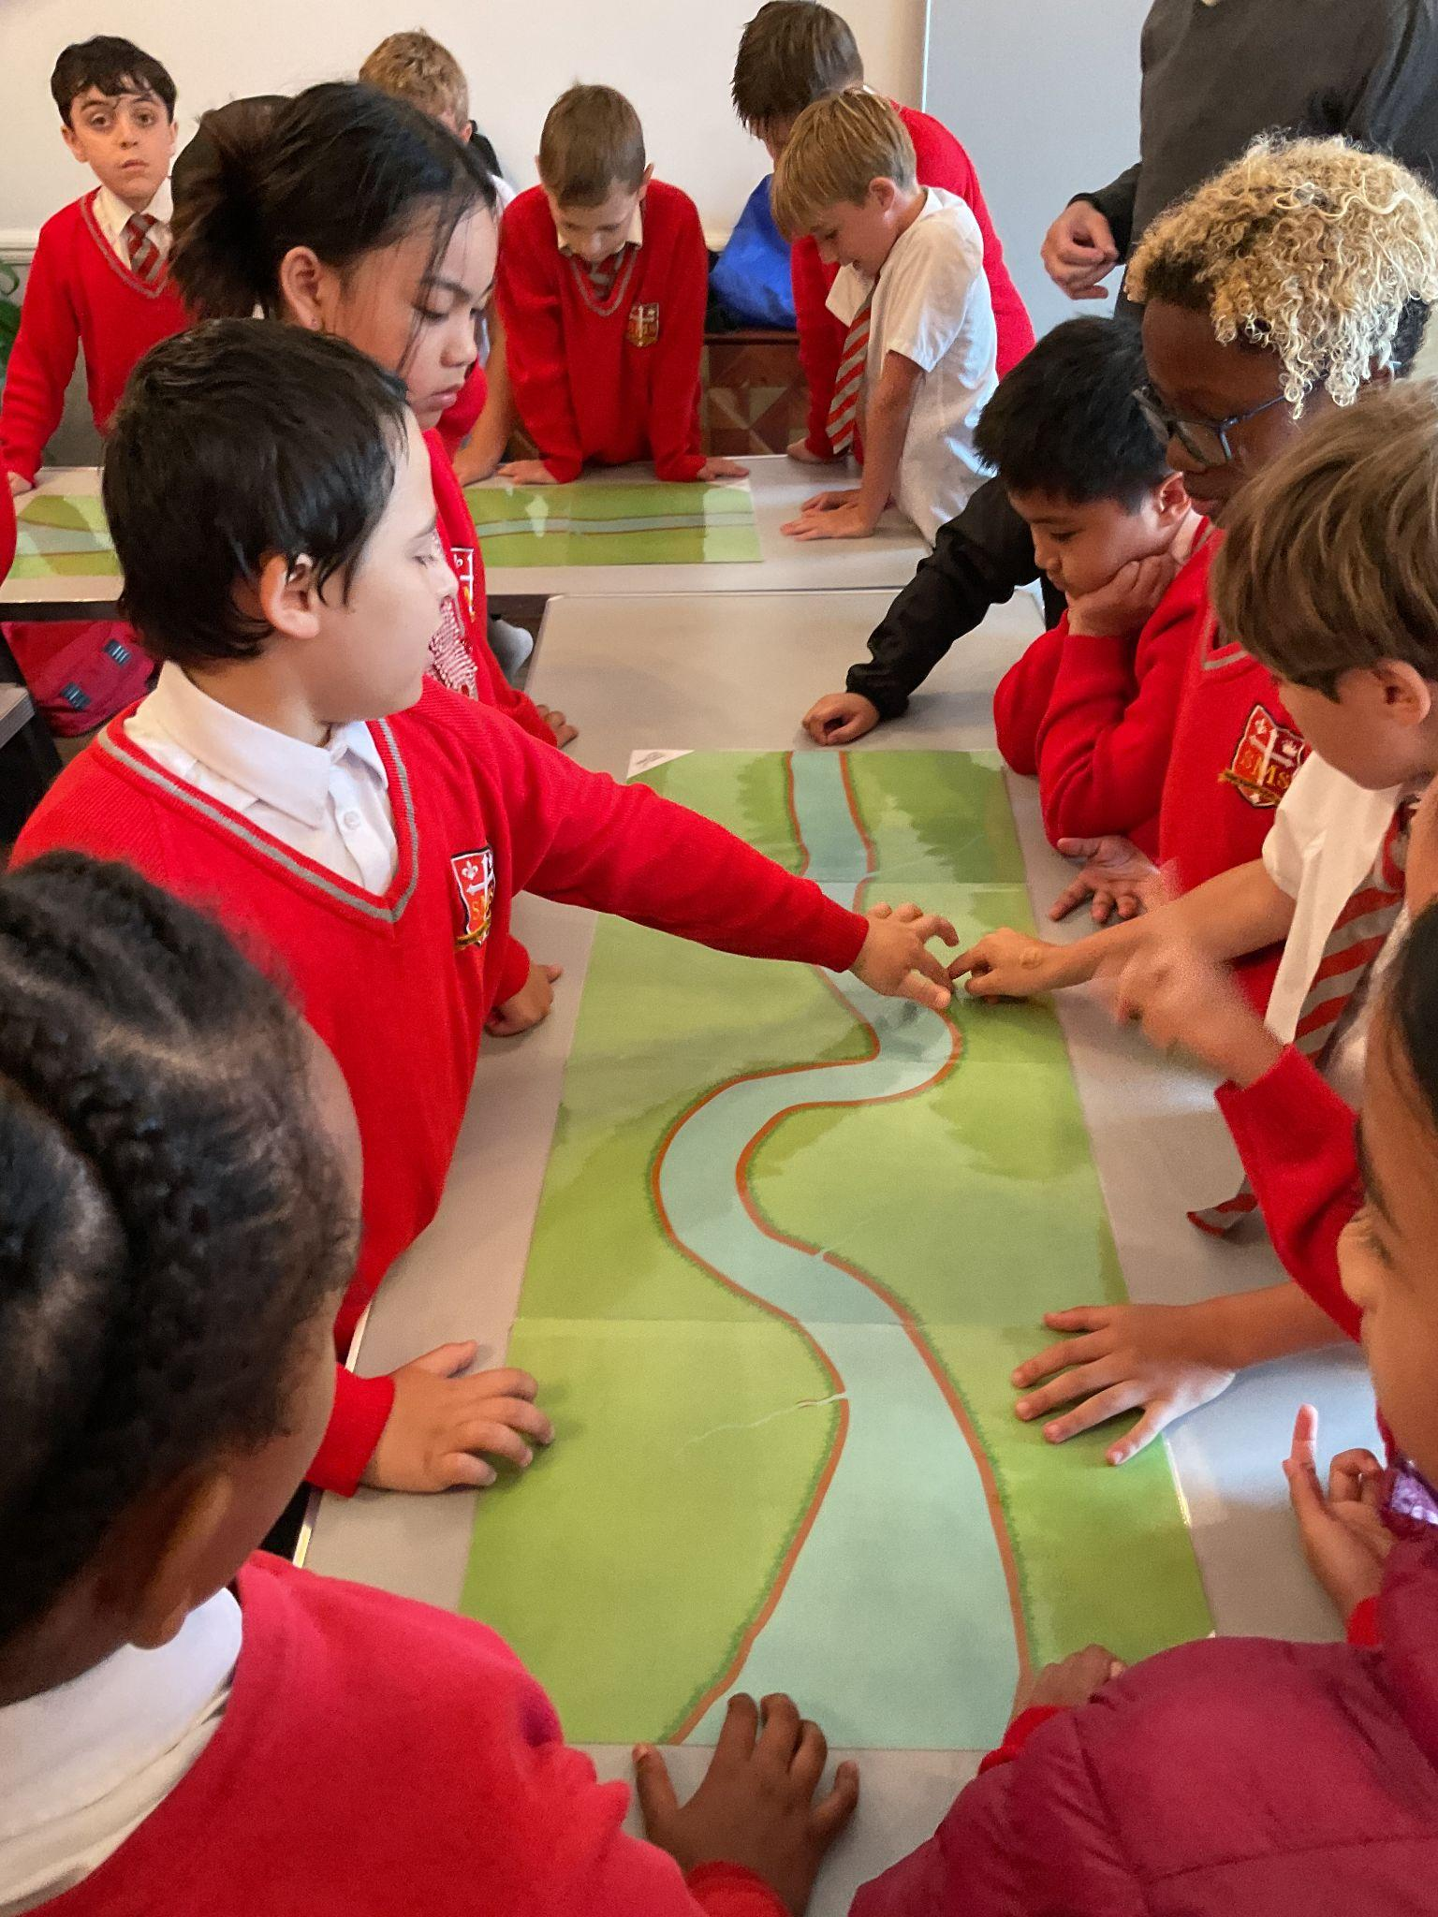
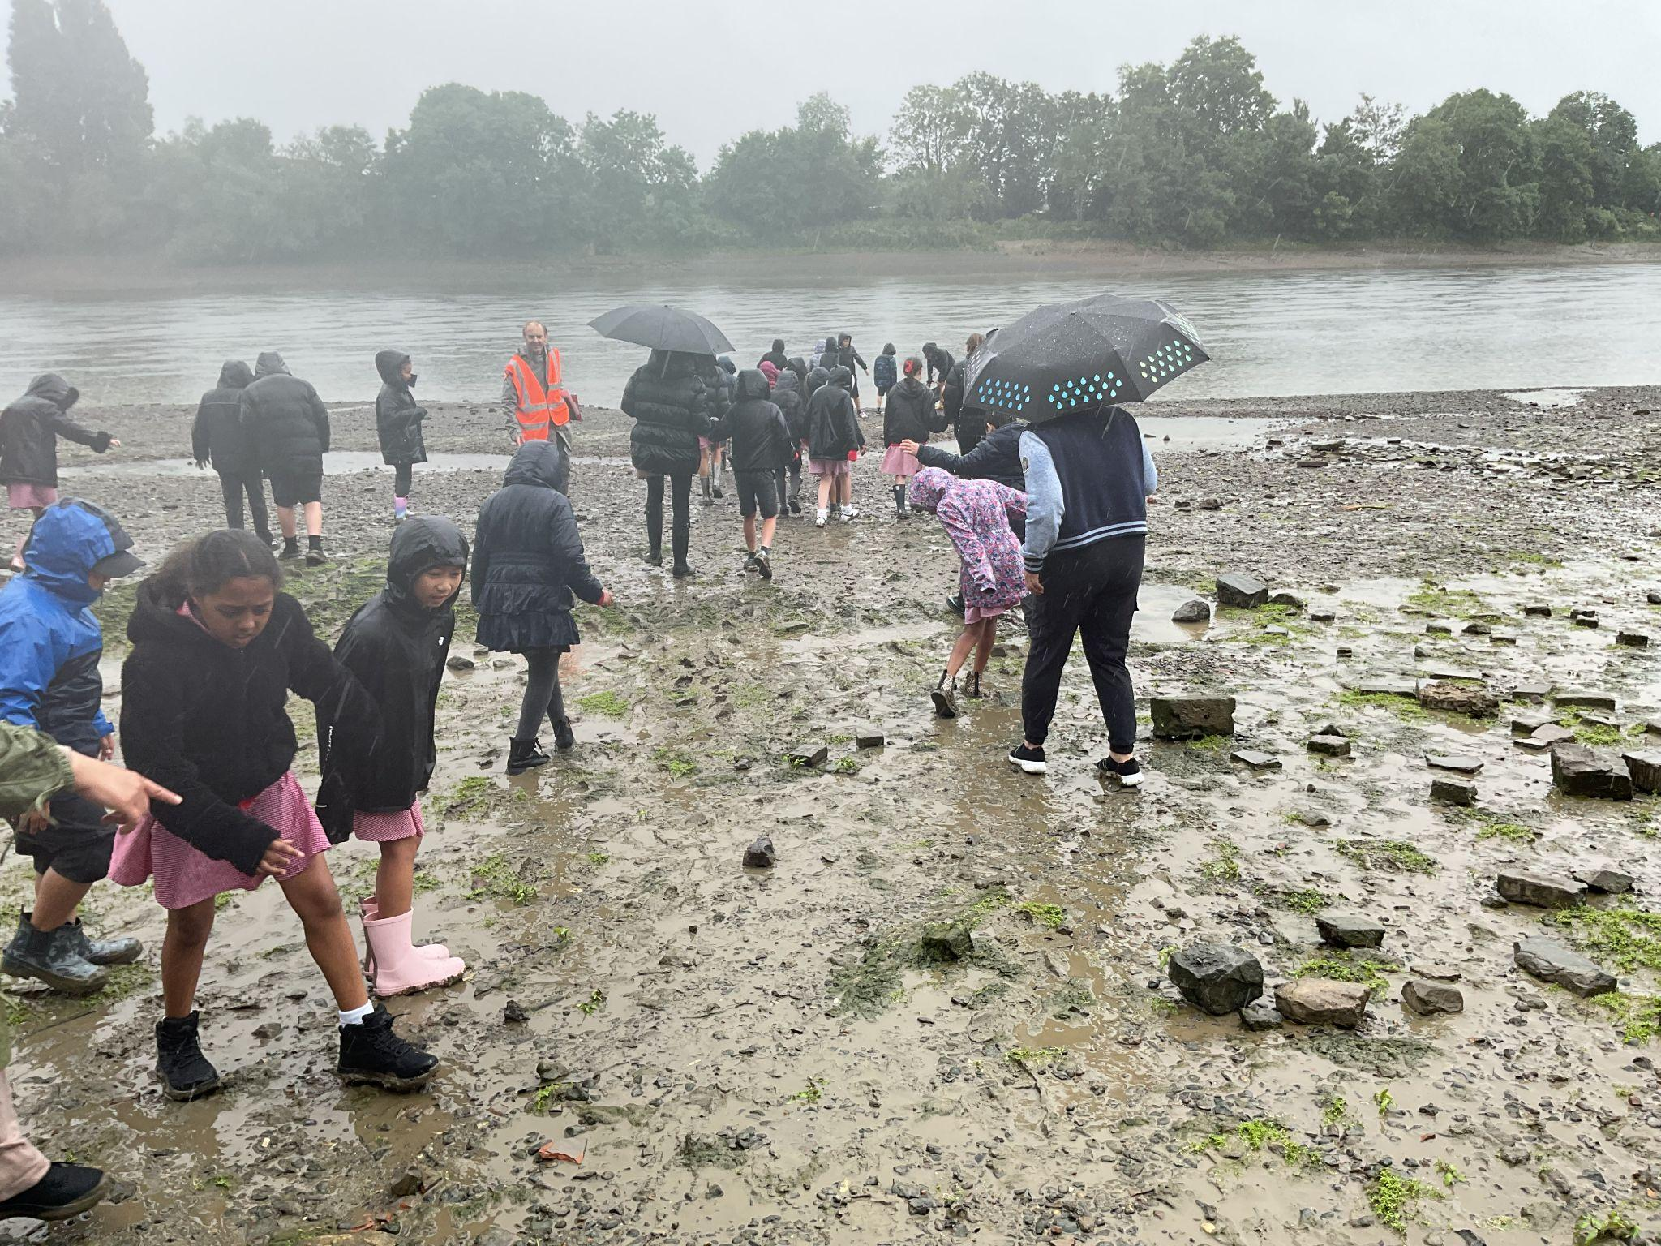
Year 4
The Whole Class, for working so hard this week on our times table check and assembly
Mr Whear

Slide 13
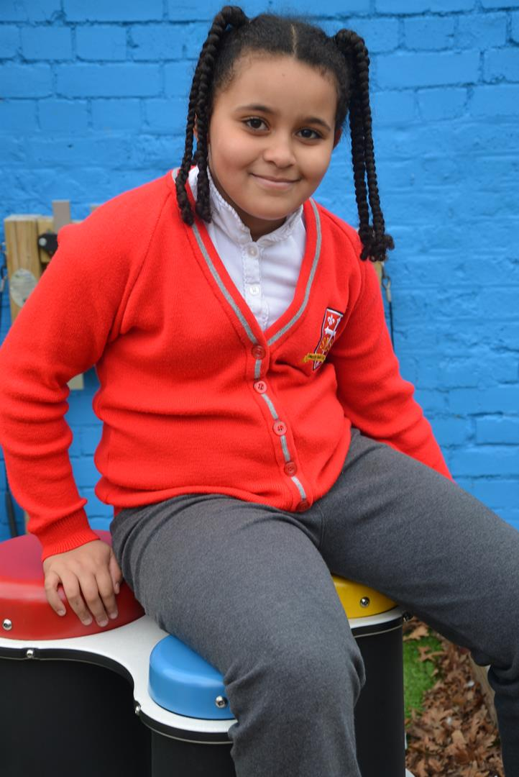
Year 5
Alessia you have shown a massive change in how you approach your work and behaviour this week. You are really taking ownership of your own learning, and it shows! Everyone who has worked with you over the last few days has gone out of their way to say something fantastic about you. Keep it up!
Ms Bakali

Slide 14
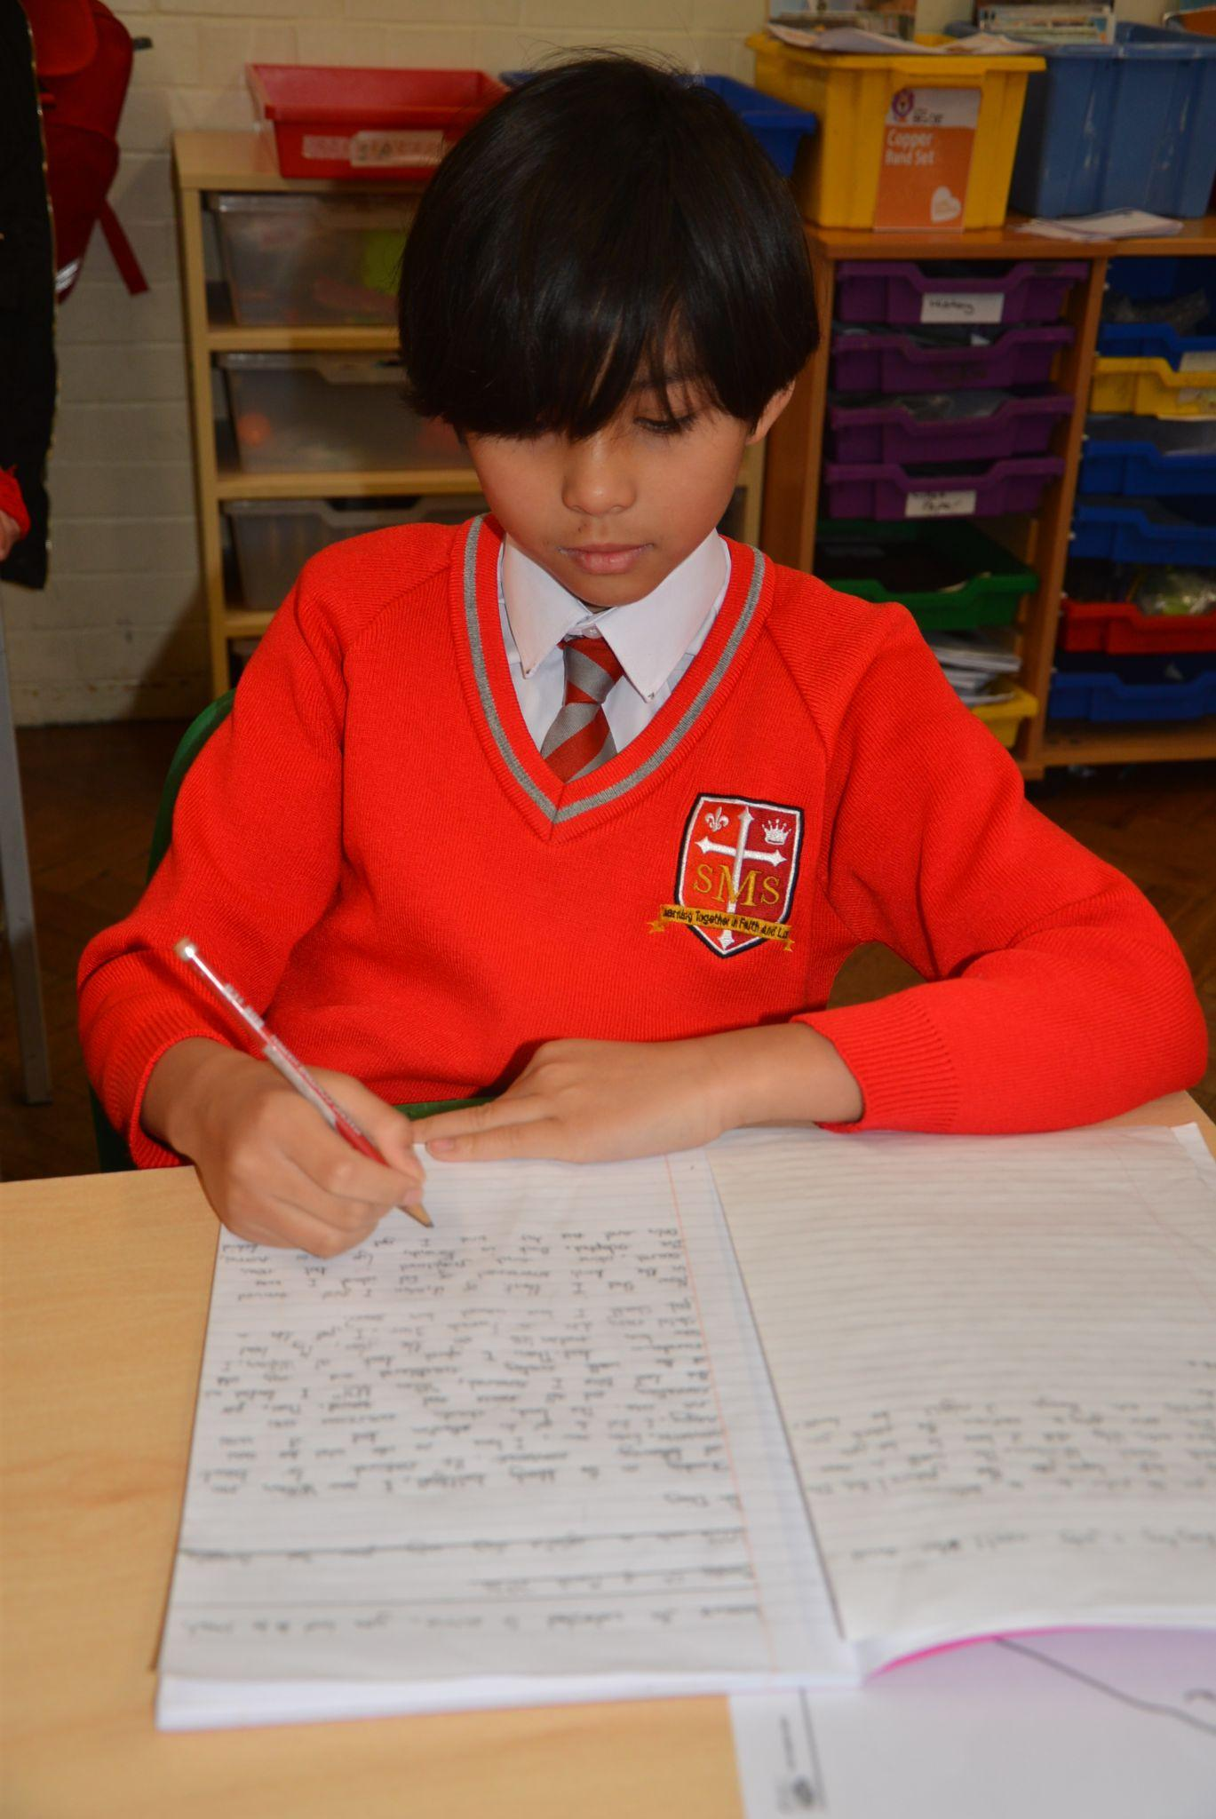
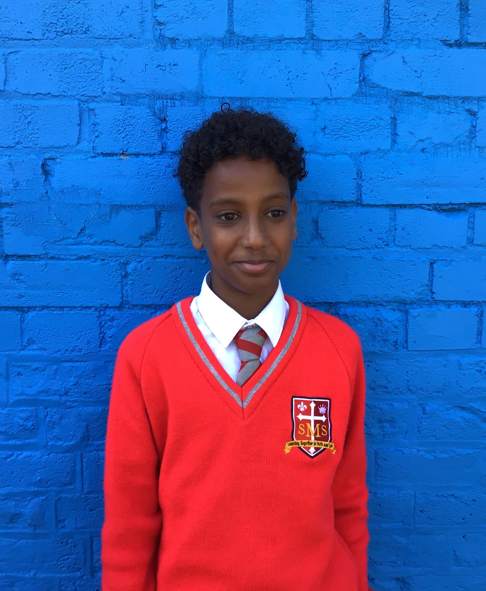
Year 6
For a recognisable change in approach and behaviour. Every teacher that has worked with him this week has had something positive to say.
Mr Cherfi

Slide 15



Star Readers
Y1 - All of Year 1 (superhero decoding)
Y2 - Ineesha
Y3 - Victor
Y4 - Callie
Y5 - Nathaniel
Y6 - Isaiah

Slide 16
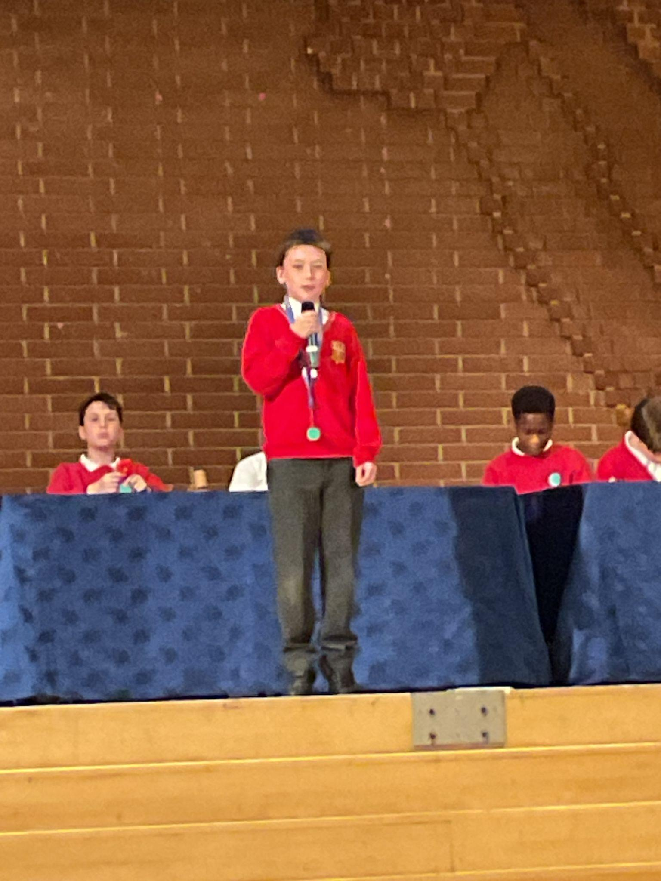
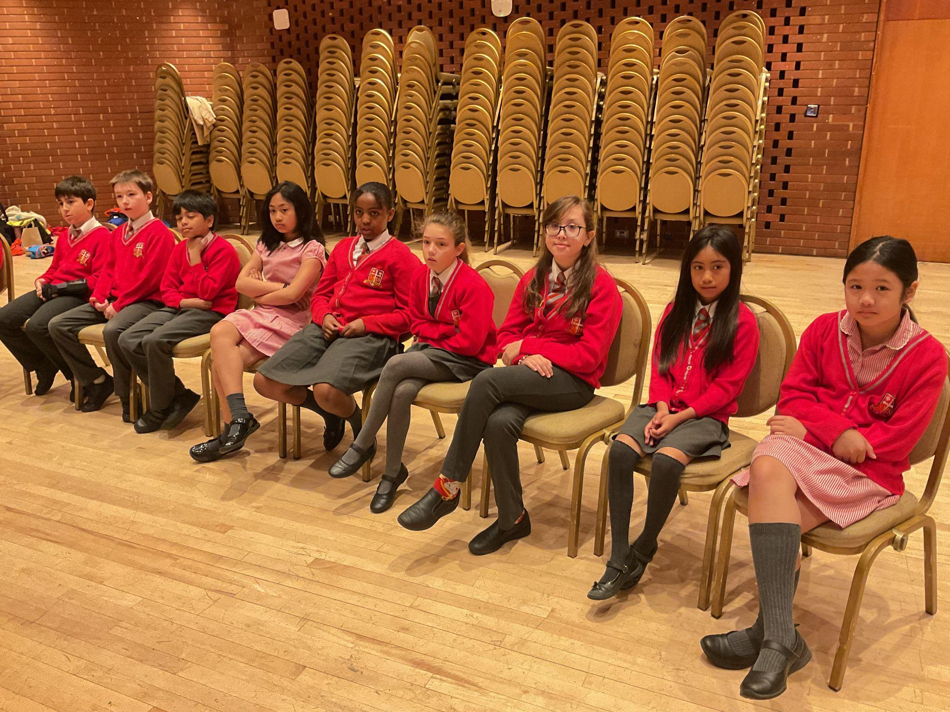
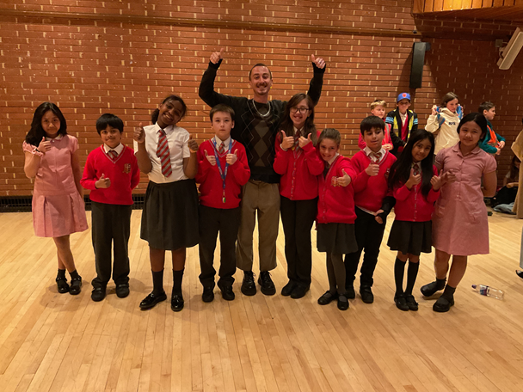
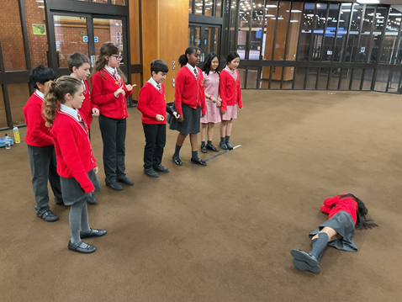
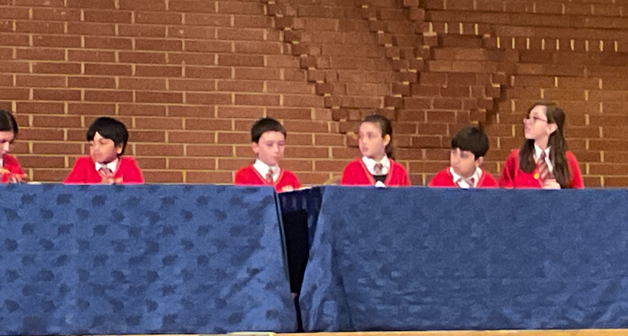

Slide 17
Year 5 Debate
On Tuesday, 9 children from year 5 visited Kensington Town Hall for an exciting workshop and debating competition with the English Speaking Union
What We Did
· Debating Workshop: We learned how to use our voices and body language to make strong arguments.
· The Big Debate: Our team competed against St Barnabas on the motion "This House believes that zoos should not be banned."
· Our Team Roles: We had four speakers, a timekeeper, an MC, and a question-and-answer team.
Why We Loved It
· New Skills: We practiced public speaking and gained a lot of confidence.
· School Pride: Everyone felt incredibly proud to represent St Mary’s.
· Future Plans: It was an amazing experience, and we cannot wait to do it again!

Slide 18

Handwriters of the week
Mimi Year 5
Elly Year 5
Isla - Y3

Slide 19

Olly
Year 2
Arthur
Year 5
Caleb
Year5
Jacob L
Andre
Year 4
Harry
Zoe

Slide 20
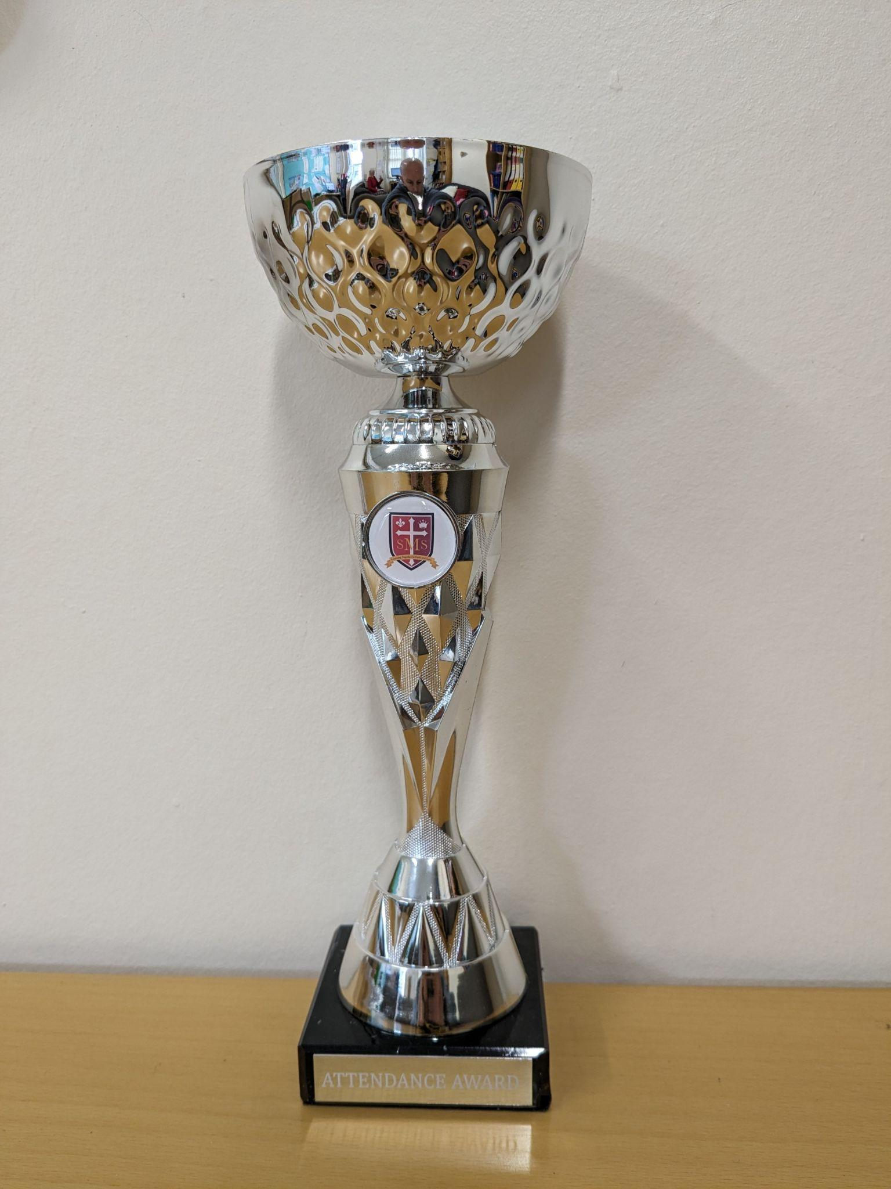
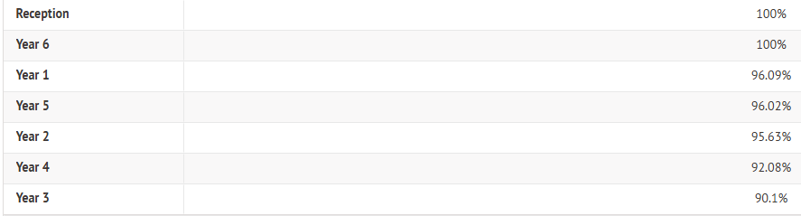
Attendance Weekly Leaders Summer Term:
Winners of the Pitch this Friday - Reception and Year 6!

Slide 21
Whole School
Star of the Week
Friday 12th June 2026

