Slide 1




Whole School
Star of the Week
Friday 13th February 2026

Slide 2


Our Father who art in Heaven
Hallowed be Thy Name
Thy Kingdom come
Thy will be done on Earth as it is in Heaven
Give us this day our daily bread
And forgive us our trespasses
As we forgive those who trespass against us
And lead us not into temptation
But deliver us from evil
Amen

Slide 3
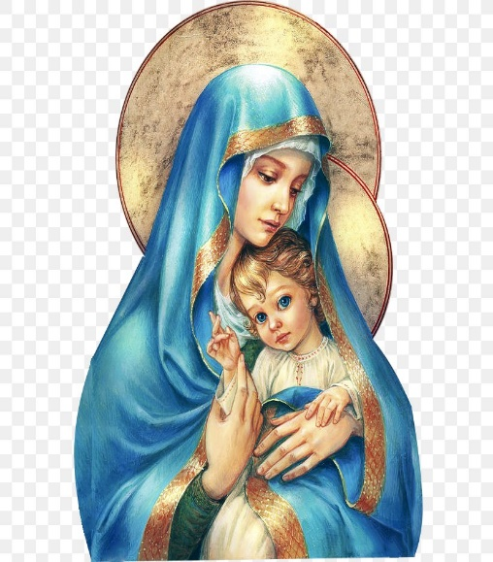
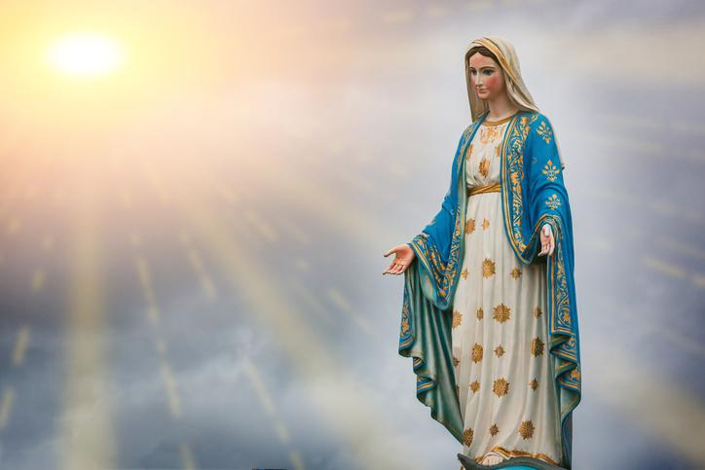
Hail Mary, Full of Grace
The Lord is with Thee
Blessed are Thou amongst women
And Blessed is the fruit of Thy womb, Jesus
Holy Mary , Mother of God
Pray for us sinners
Now and in the hour of our death
Amen

Slide 4
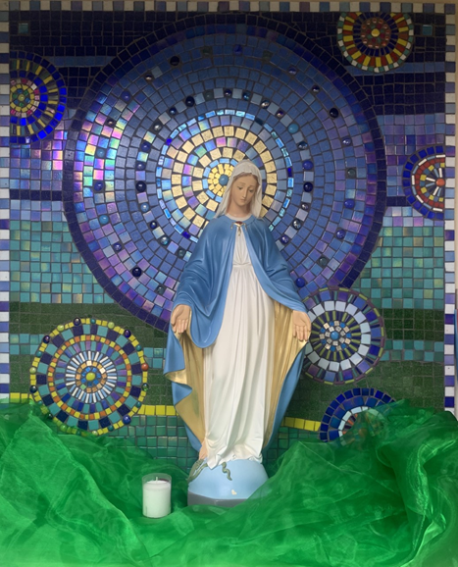
St Mary’s School Prayer
O Holy Mary,
Mother and Patron of our school,
Turn your eyes of mercy towards us,
that we may love God
With all our hearts!
May we imitate the tenderness
of your Son, Jesus,
showing love and respect
For each person
and ourselves as children of God.
Guided by the Holy Spirit,
May we create the school,
where Mercy and Compassion
Is the centre of our lives.
Amen

Slide 5
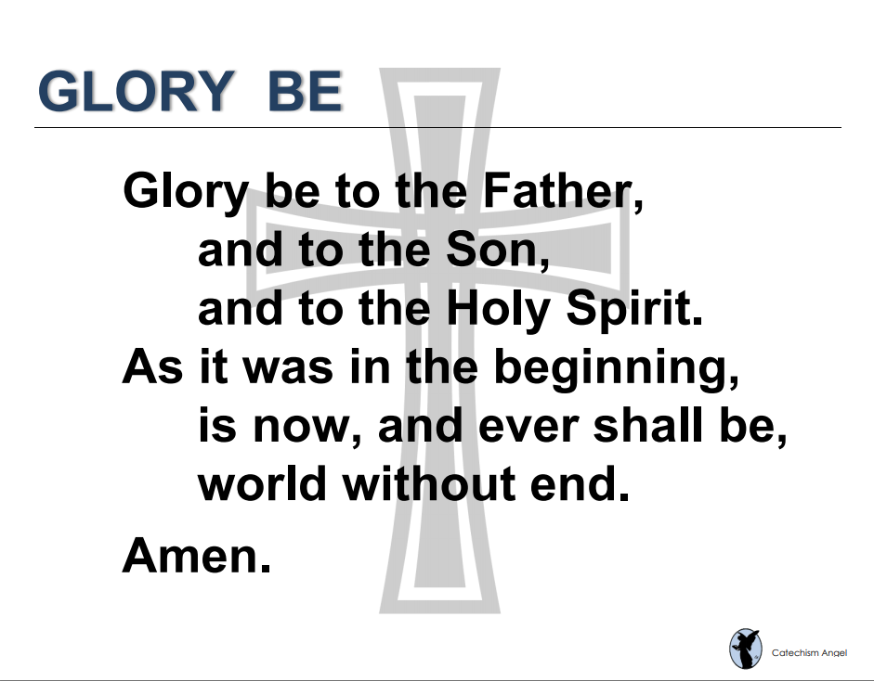

Slide 6
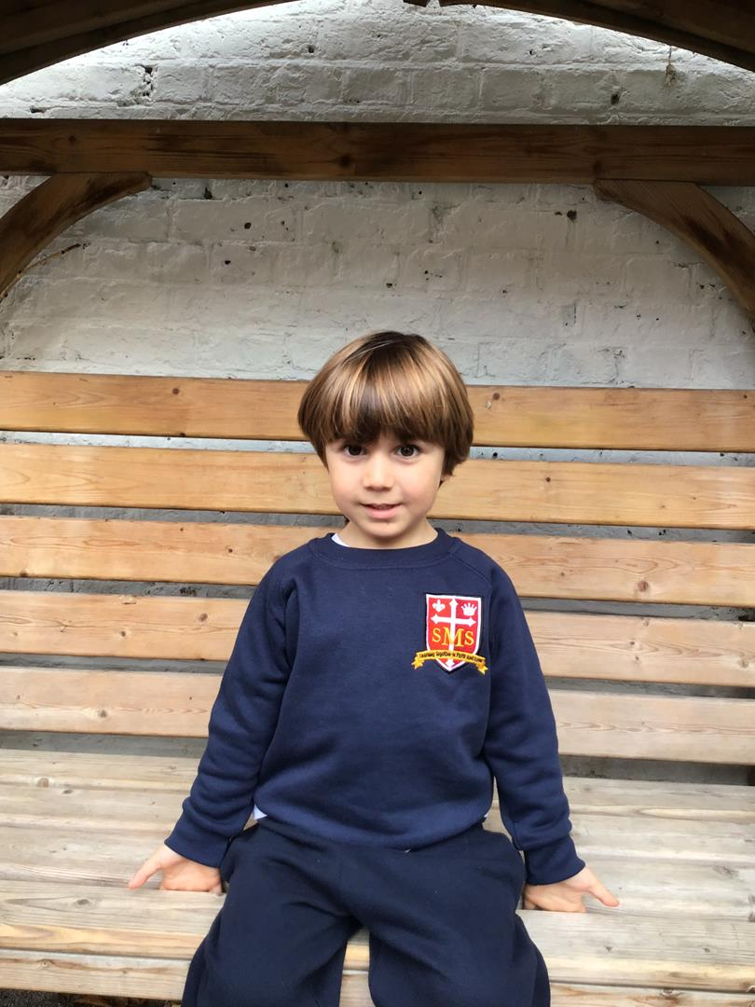
Nursery
For having a fantastic week learning in class and sharing his accomplishments at parents evening, well done!
Miss Barker

Slide 7
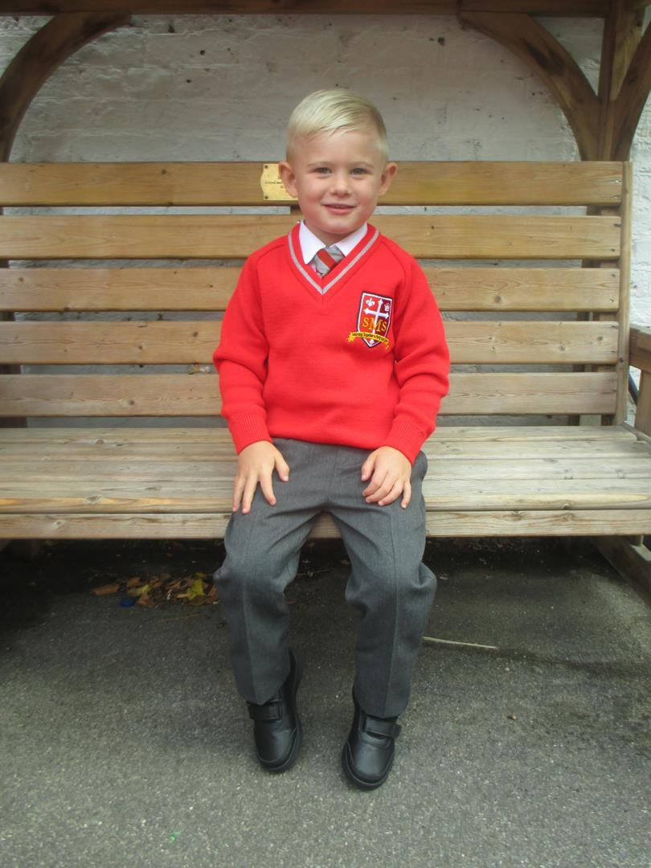
Reception
For his amazing effort in Literacy and self reflecting on his work.
Miss Barker

Slide 8
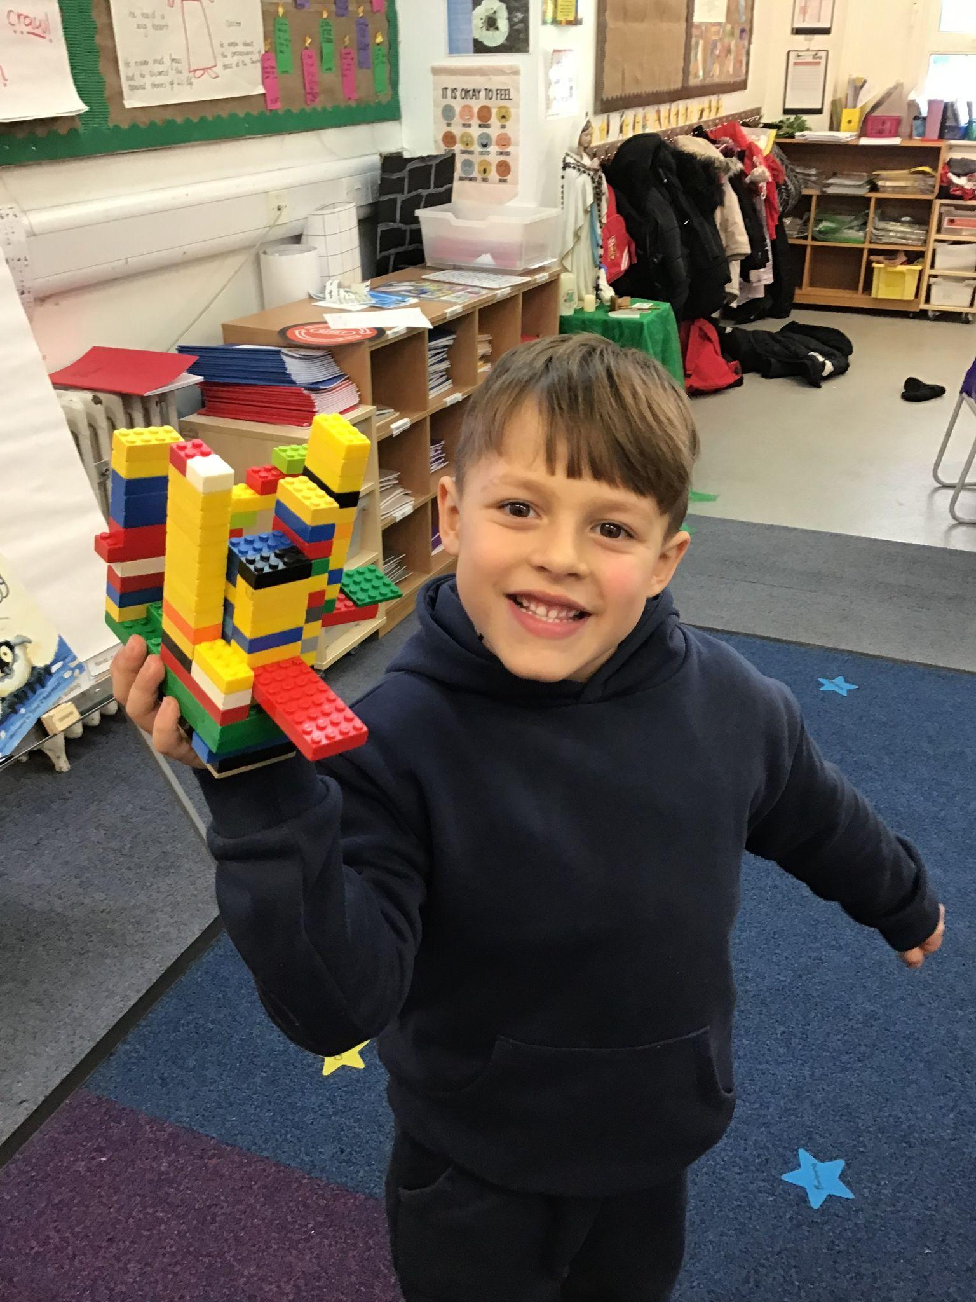
Year 1
For setting into our class so beautifully after recently moving all the way from Brazil!
Miss Flashman

Slide 9
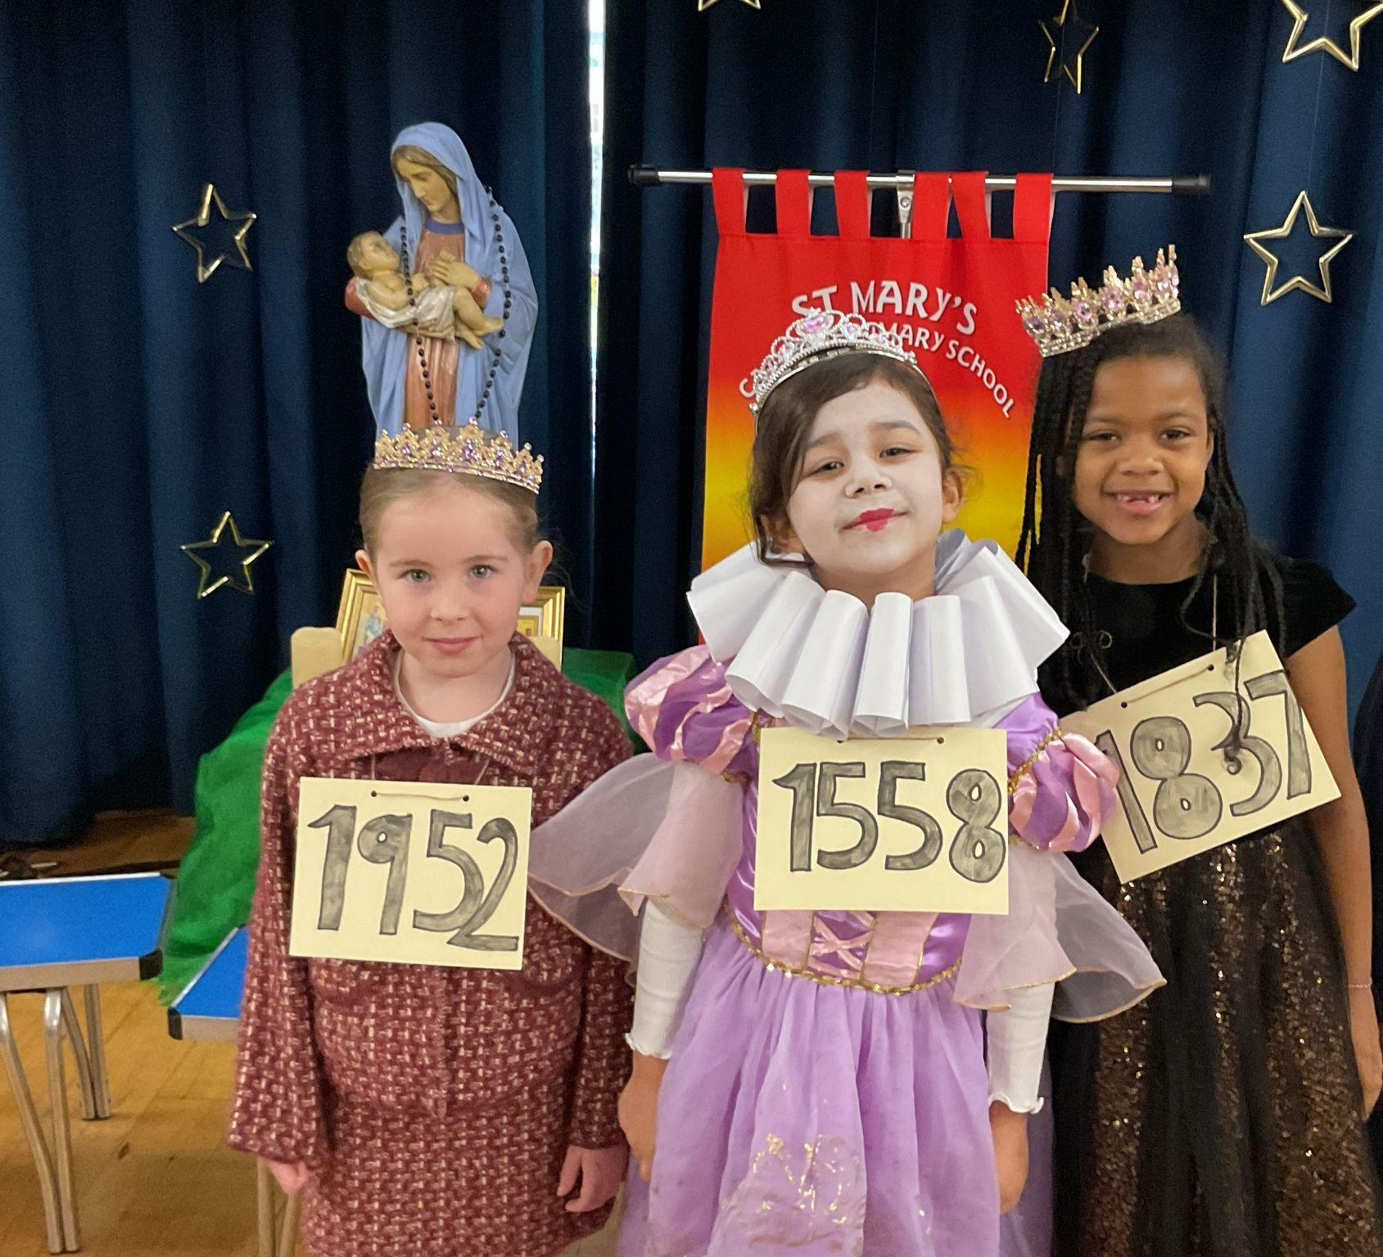
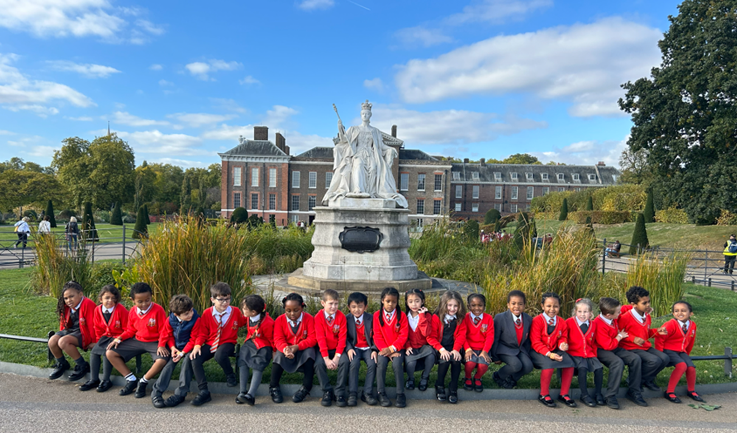
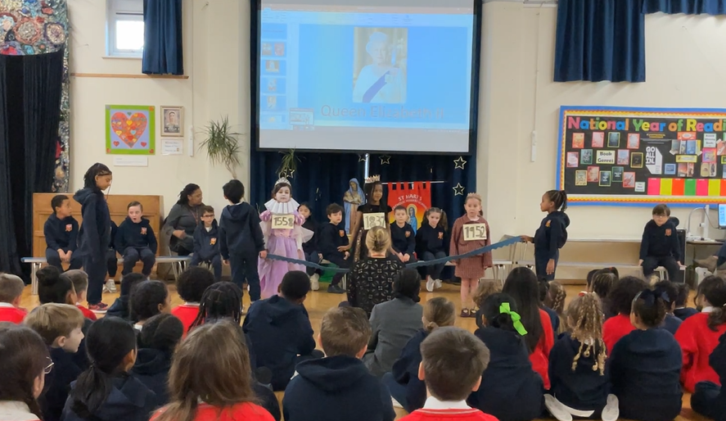
Year 2
Whole Class
For their incredible assembly on Significant Queens!
Miss Sweet

Slide 10
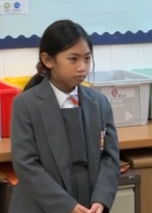
Year 3
For consistent effort, application and positivity.
Mr. Larke

Slide 11
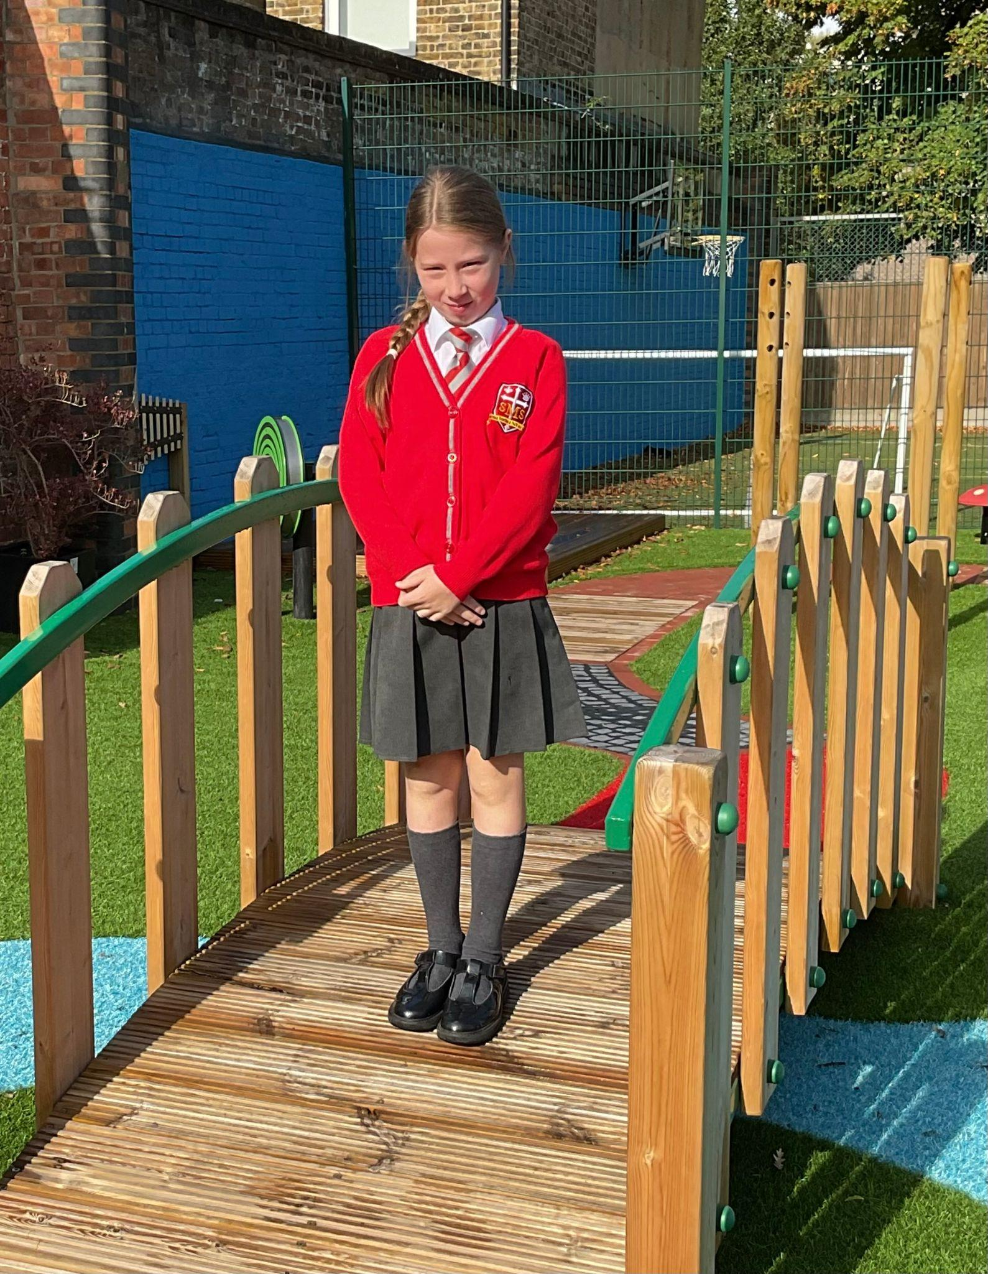
Year 4
For contributing consistently to class discussion and learning.
Mr Whear

Slide 12
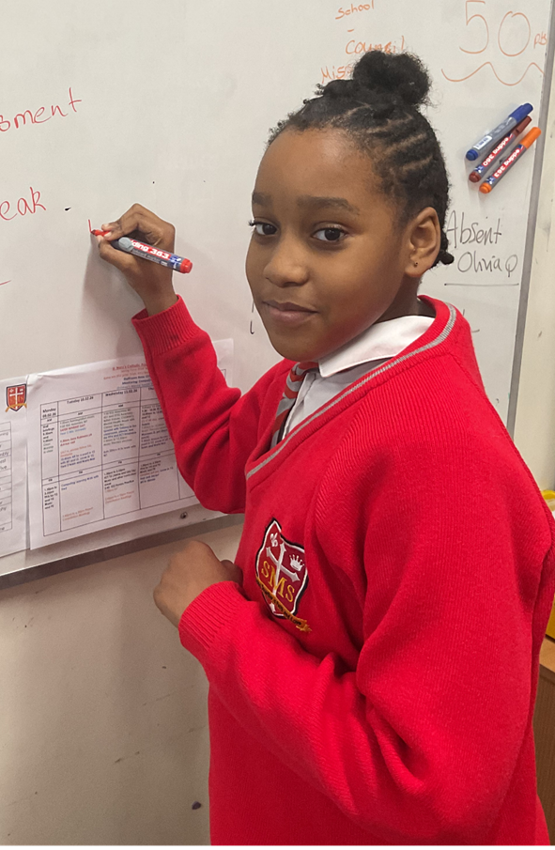
Year 5
For an amazing attitude to our learning and consistently
Mrs.Bakali

Slide 13
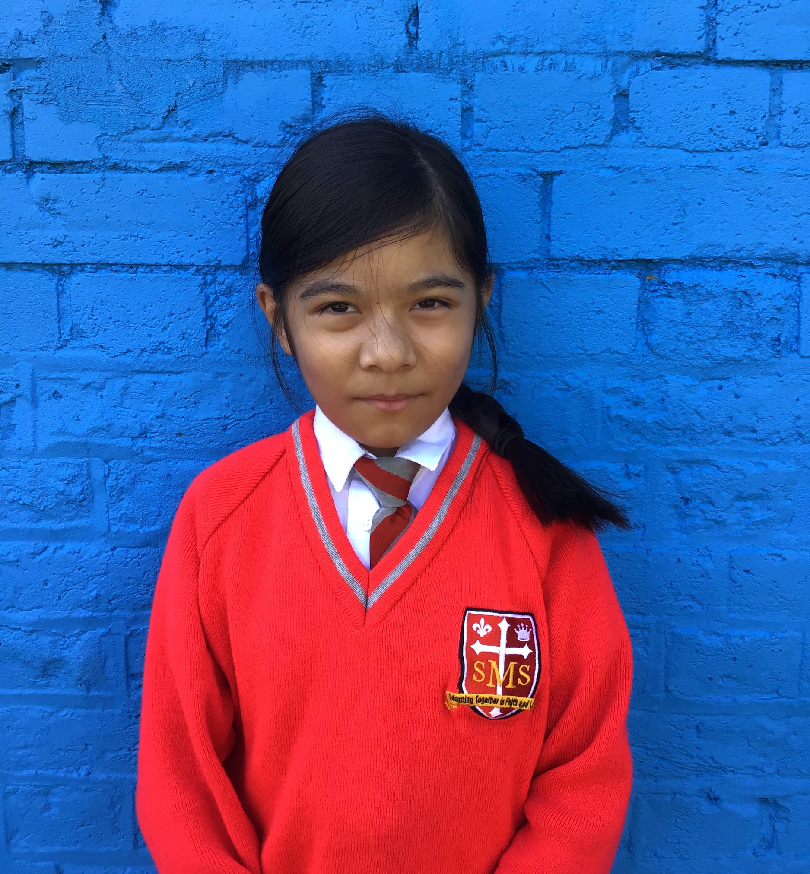
Year 6
For showing great enthusiasm and effort this week.
Mr Cherfi

Slide 14



Star Readers
Y1 - Cecilia
Y2 - Jack
Y3 - Major
Y4 - Rhenn
Y5 - Alessia
Y6 - Jeorgina

Slide 15
Whole School
Star of the Week
Friday 13th February 2026

