Slide 1
Whole School
Star of the Week
Friday 13th June 2025

Slide 2
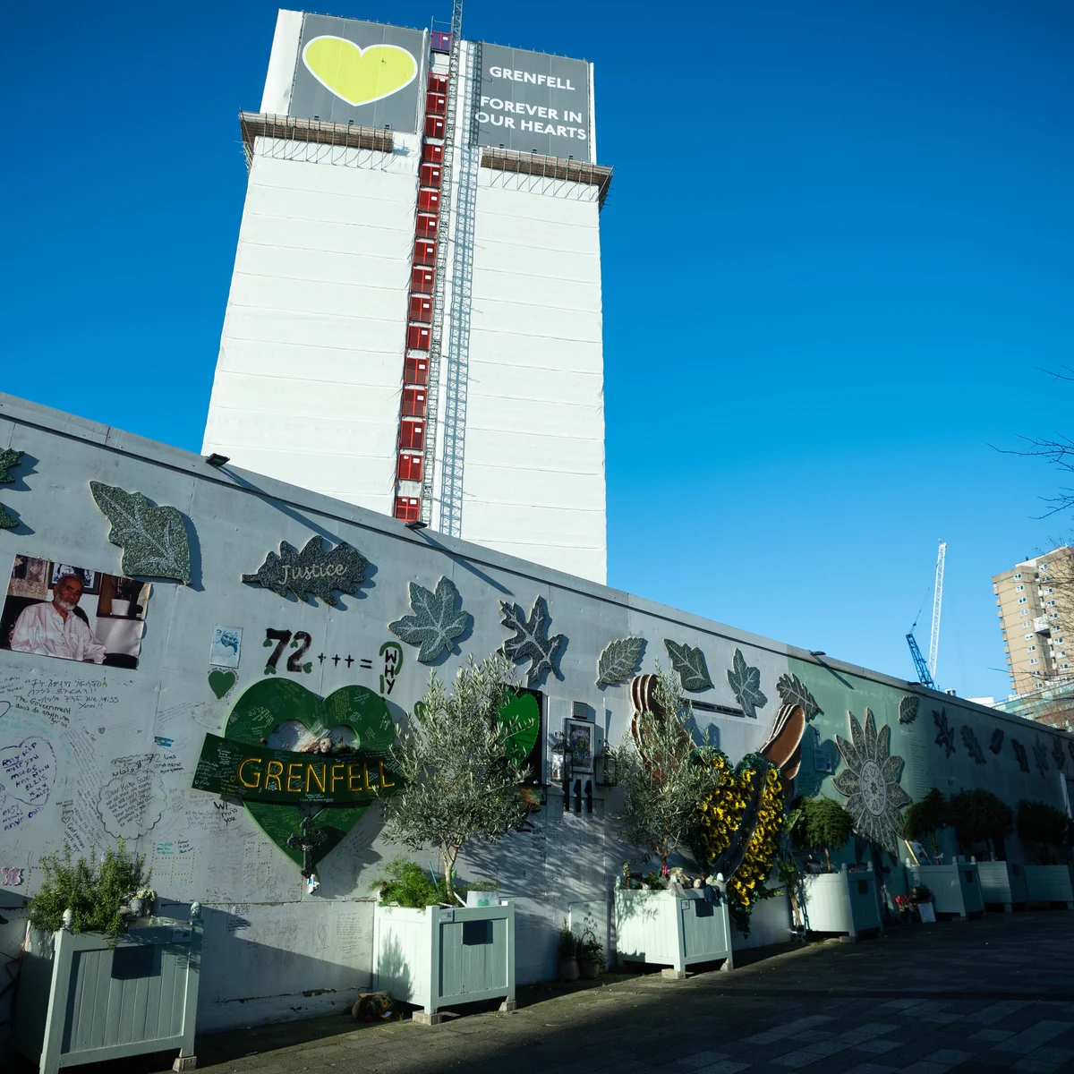
14th June 2025 8th Anniversary of the Grenfell Fire

Slide 3
Our Father who art in Heaven
Hallowed be Thy Name
Thy Kingdom come
Thy will be done on Earth as it is in Heaven
Give us this day our daily bread
And forgive us our trespasses
As we forgive those who trespass against us
And lead us not into temptation
But deliver us from evil
Amen

Slide 4
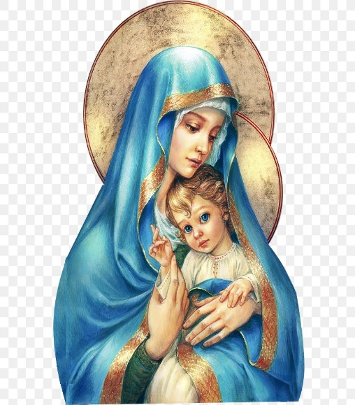
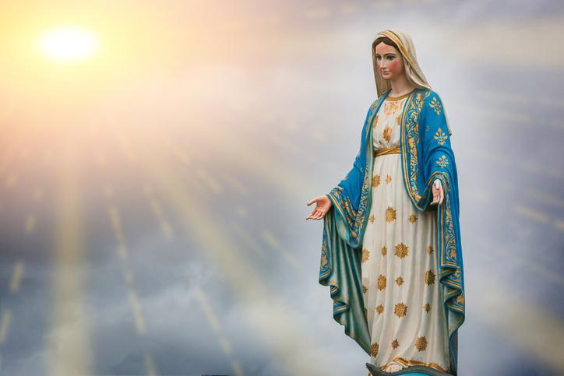
Hail Mary, Full of Grace
The Lord is with Thee
Blessed are Thou amongst women
And Blessed is the fruit of Thy womb, Jesus
Holy Mary , Mother of God
Pray for us sinners
Now and in the hour of our death
Amen

Slide 5
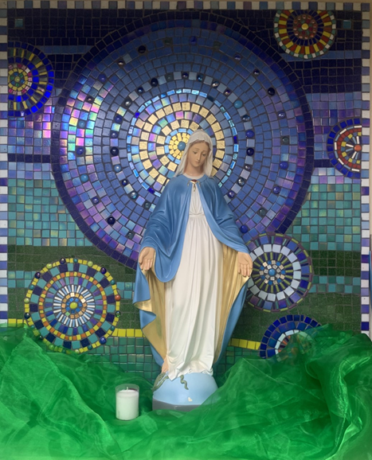
St Mary’s School Prayer
O Holy Mary,
Mother and Patron of our school,
Turn your eyes of mercy towards us,
that we may love God
With all our hearts!
May we imitate the tenderness
of your Son, Jesus,
showing love and respect
For each person
and ourselves as children of God.
Guided by the Holy Spirit,
May we create the school,
where Mercy and Compassion
Is the centre of our lives.
Amen

Slide 7
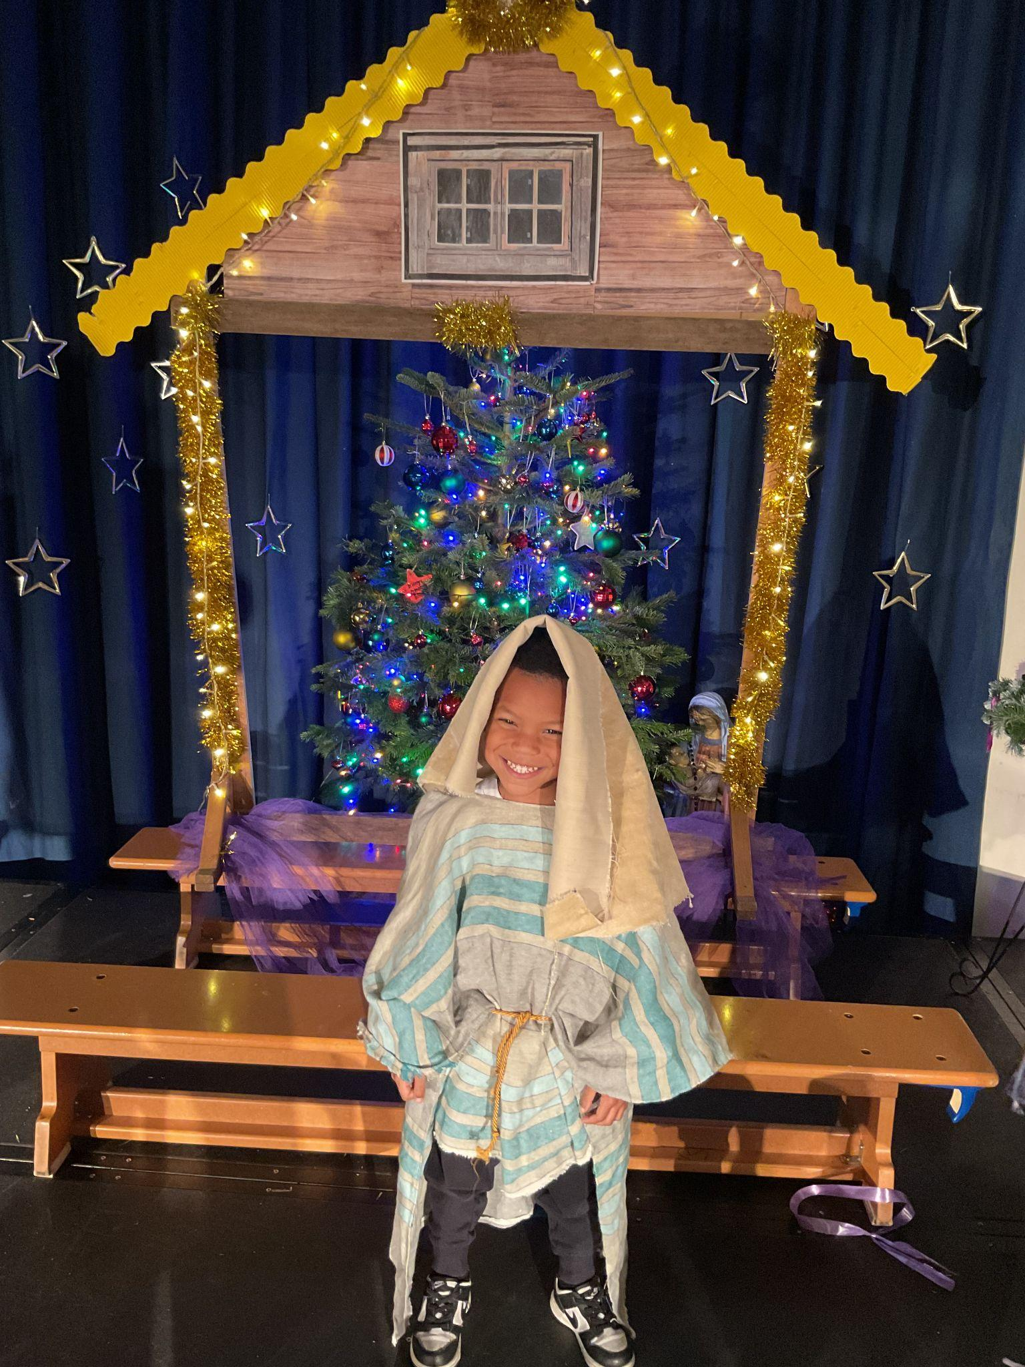
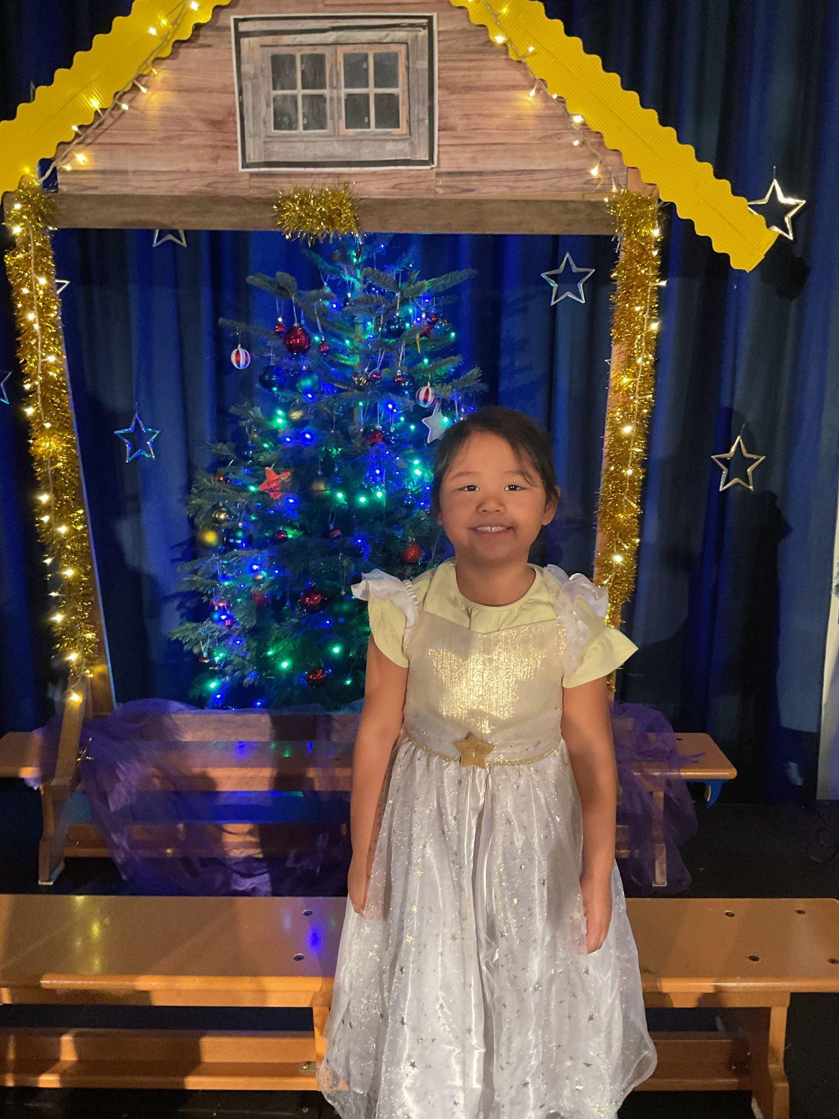
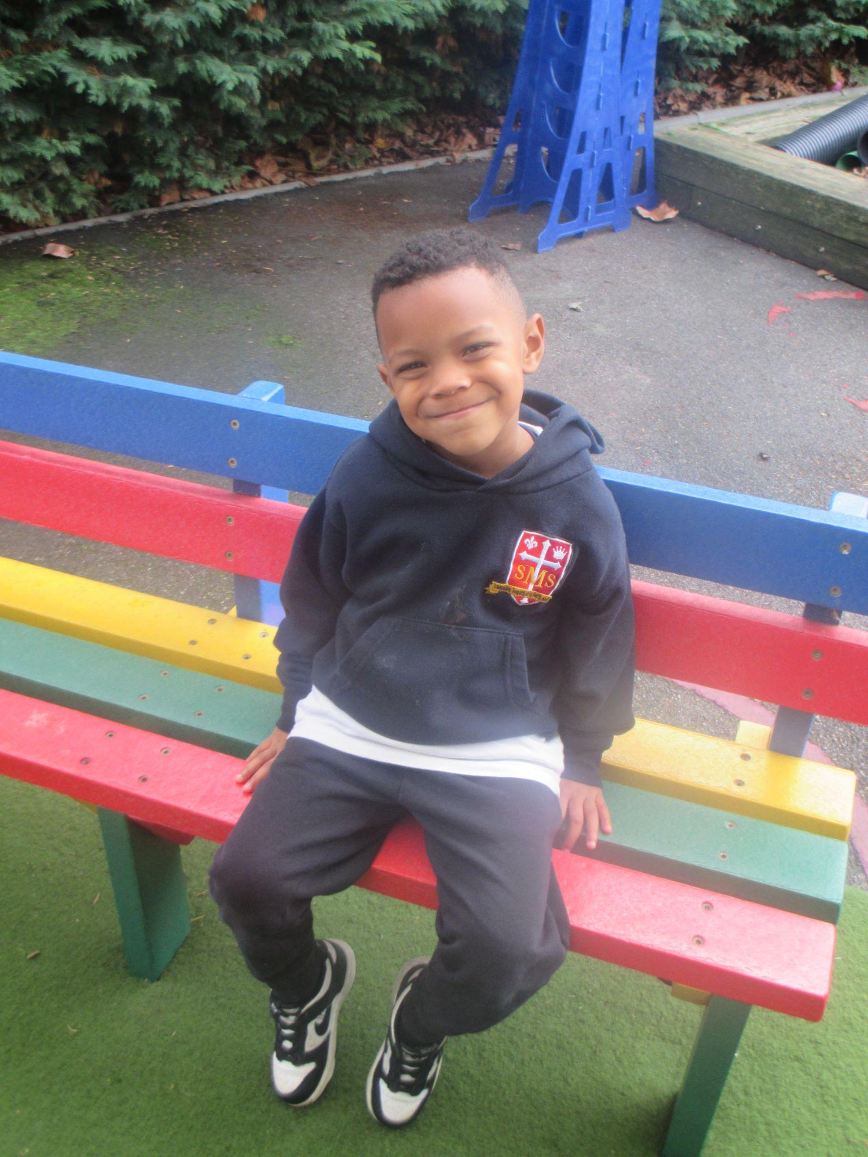
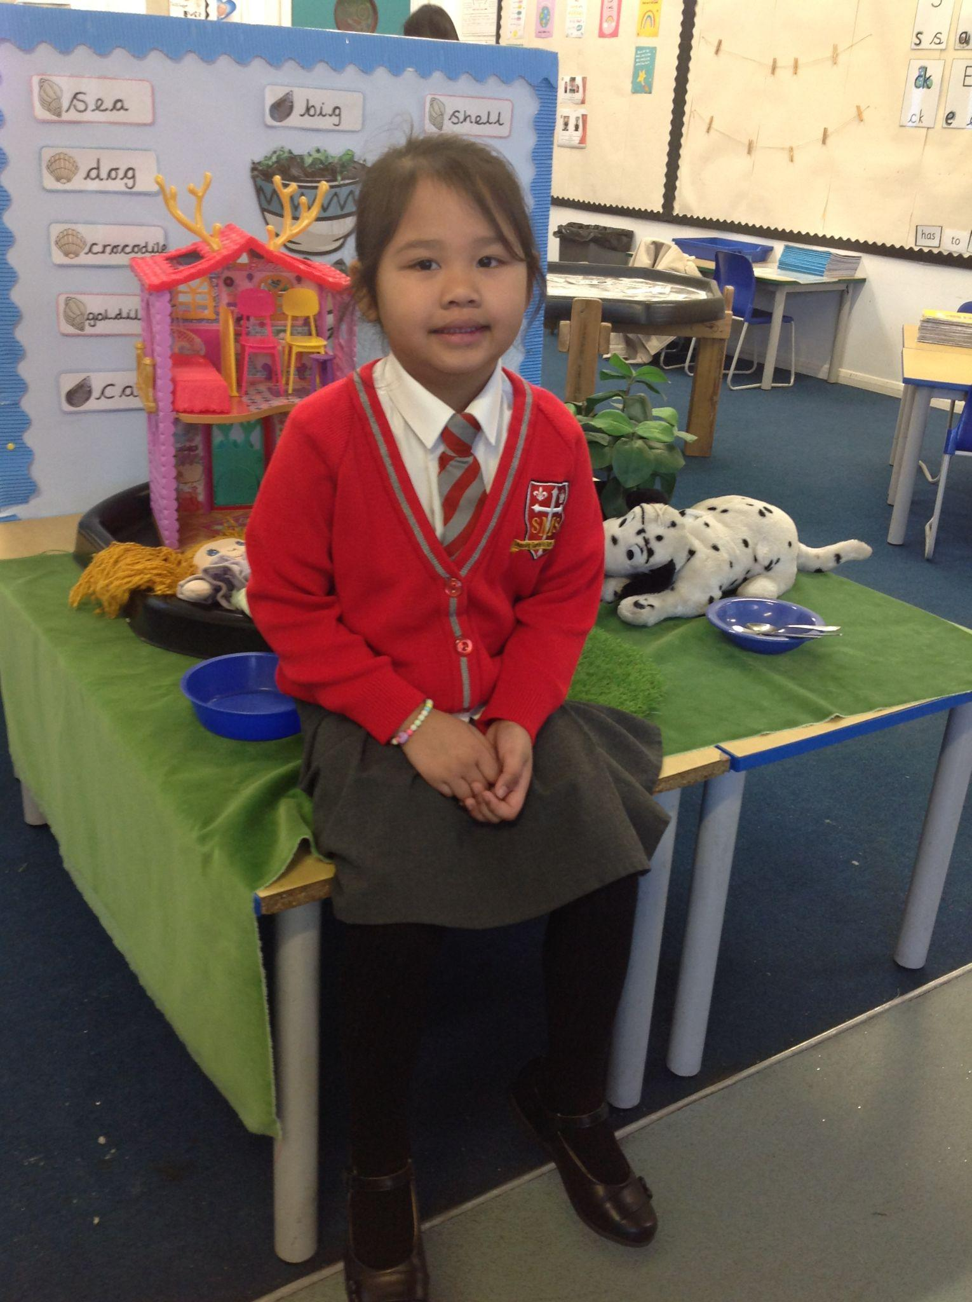
Early Years
Nursery - For his amazing enthusiasm and progress in Literacy.
Reception- For consistently showing role model behaviour and making huge progress this year.
Miss Barker

Slide 8
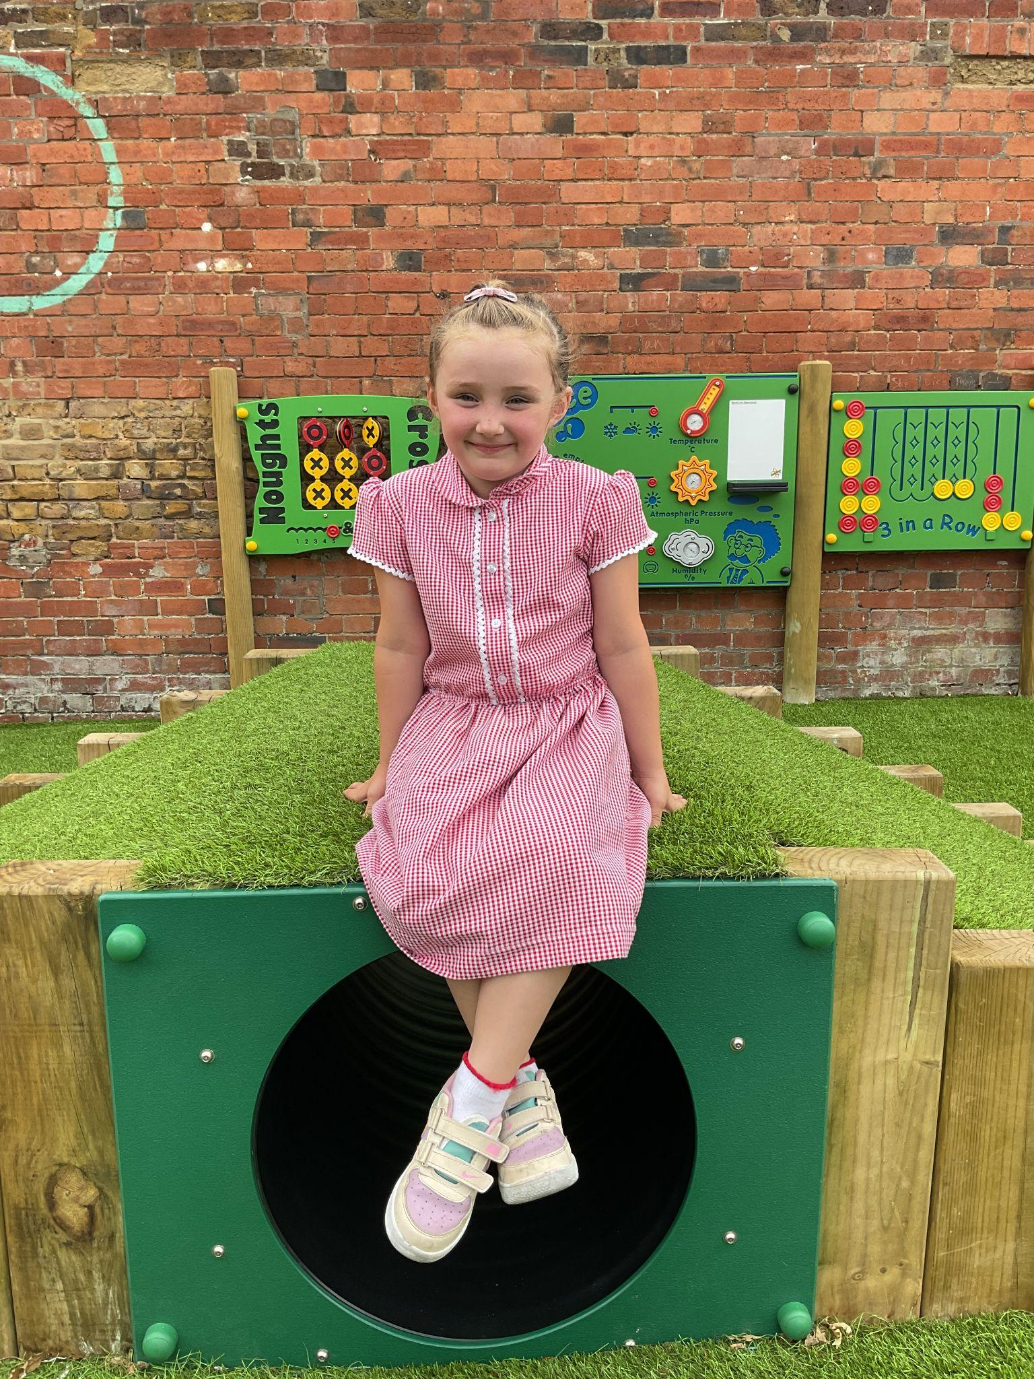
Year 1
For having a great first week at St. Mary’s!
Miss Sweet

Slide 9
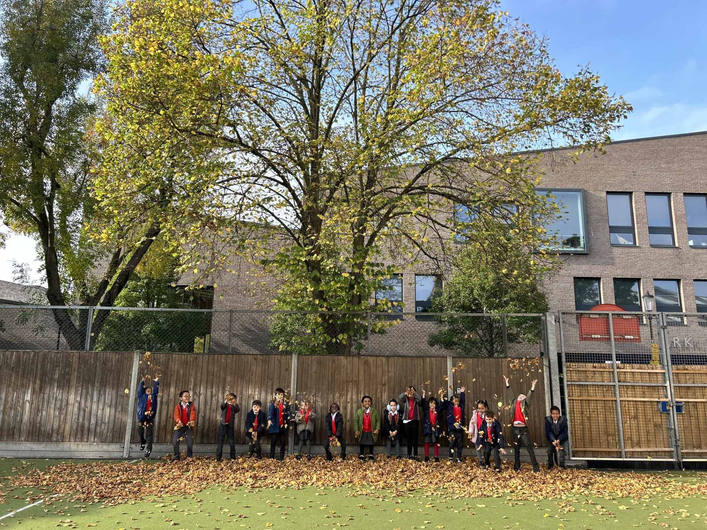
Also… a huge well done to the whole of Year 1 in completing their Phonics screening check! I am so proud of each and every one of you!
Miss Sweet

Slide 10
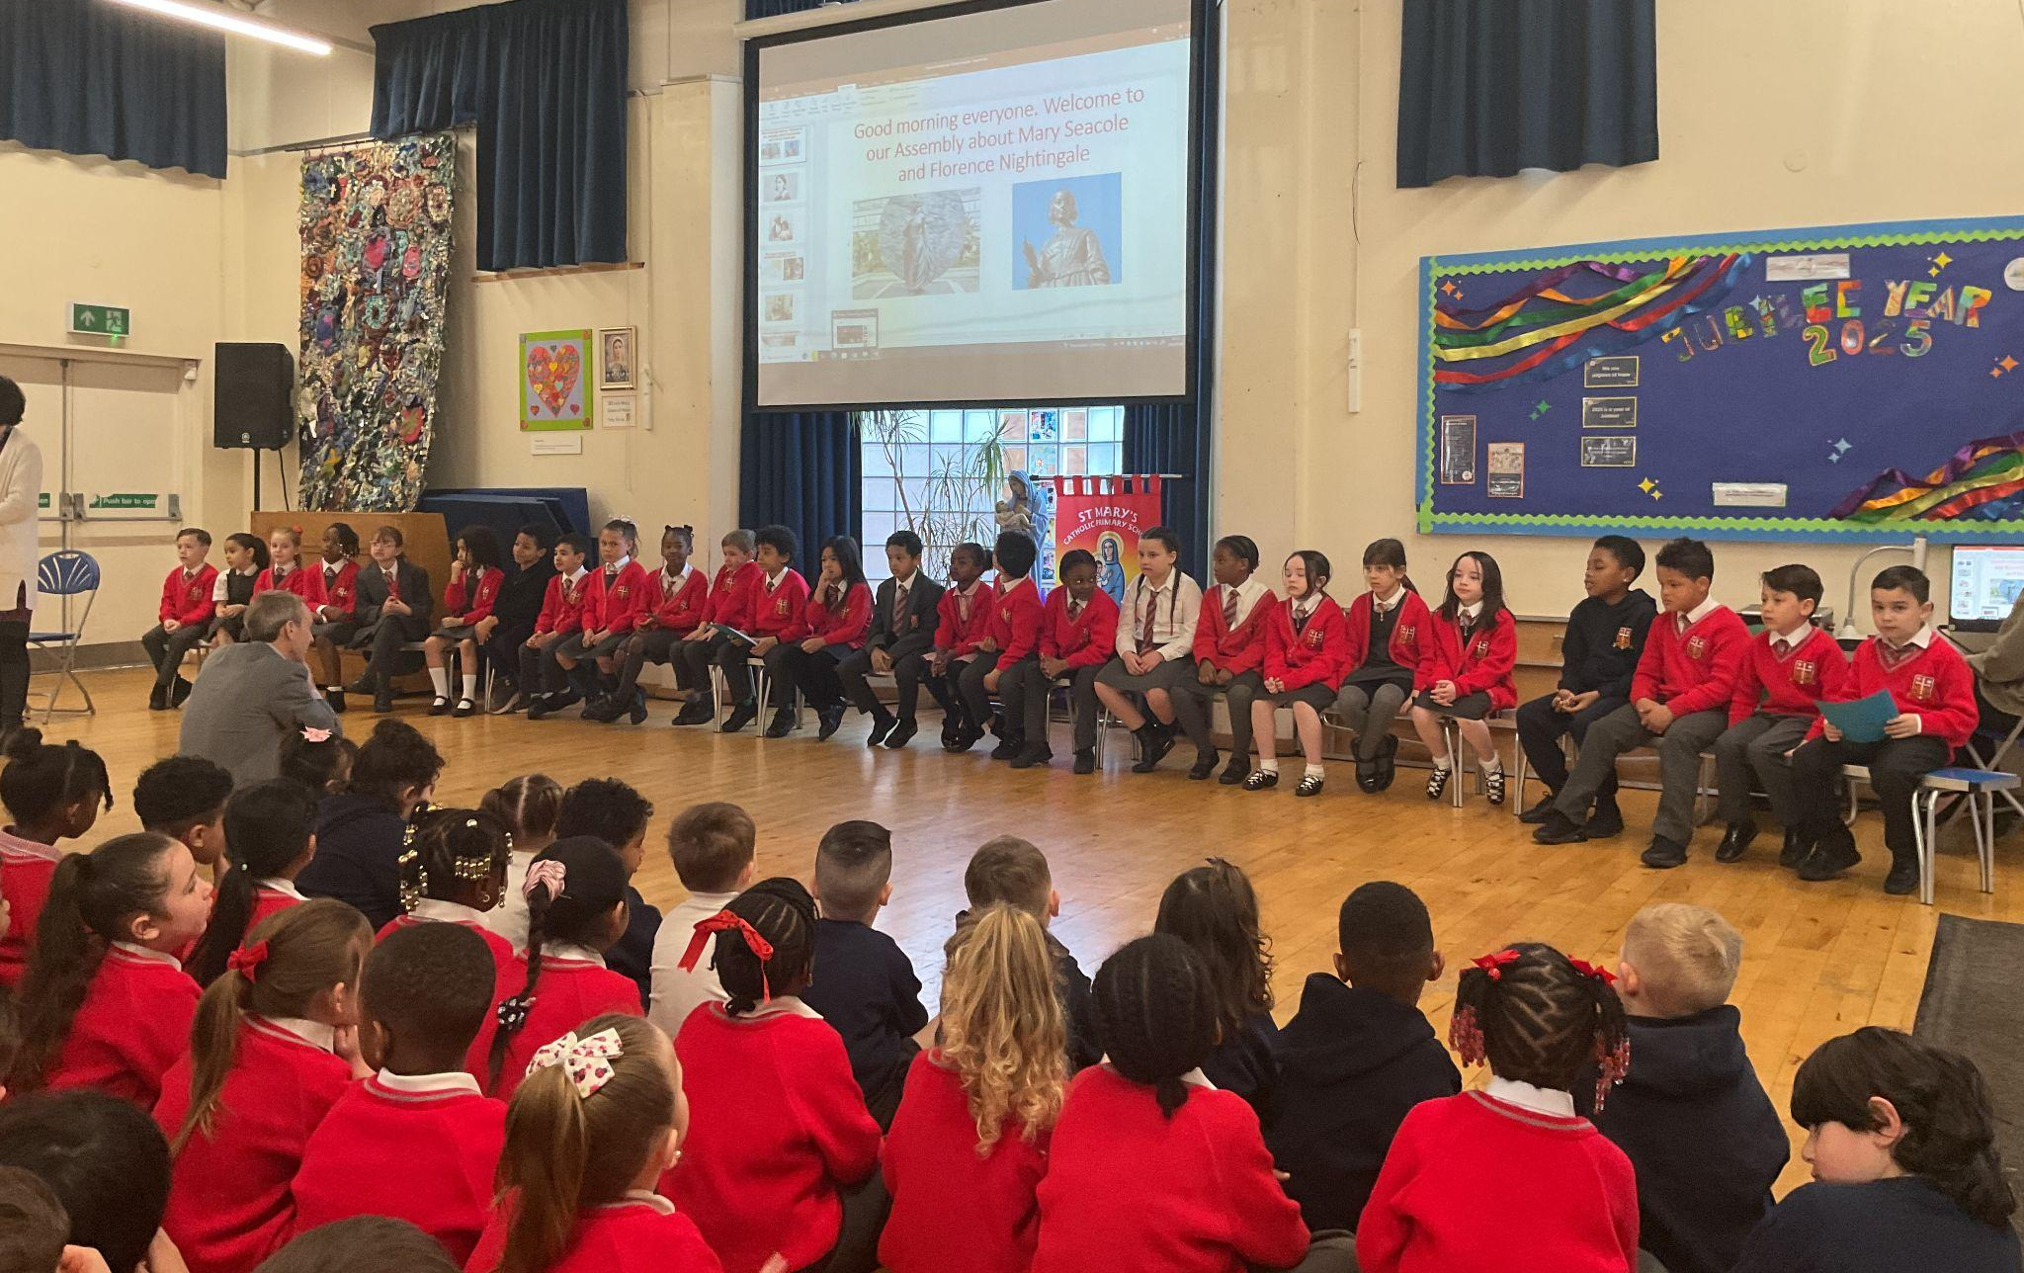
Year 2
Whole Class
For working hard in a short space of time on their Assembly and trying their best in their assessments.
Mr Whear

Slide 11
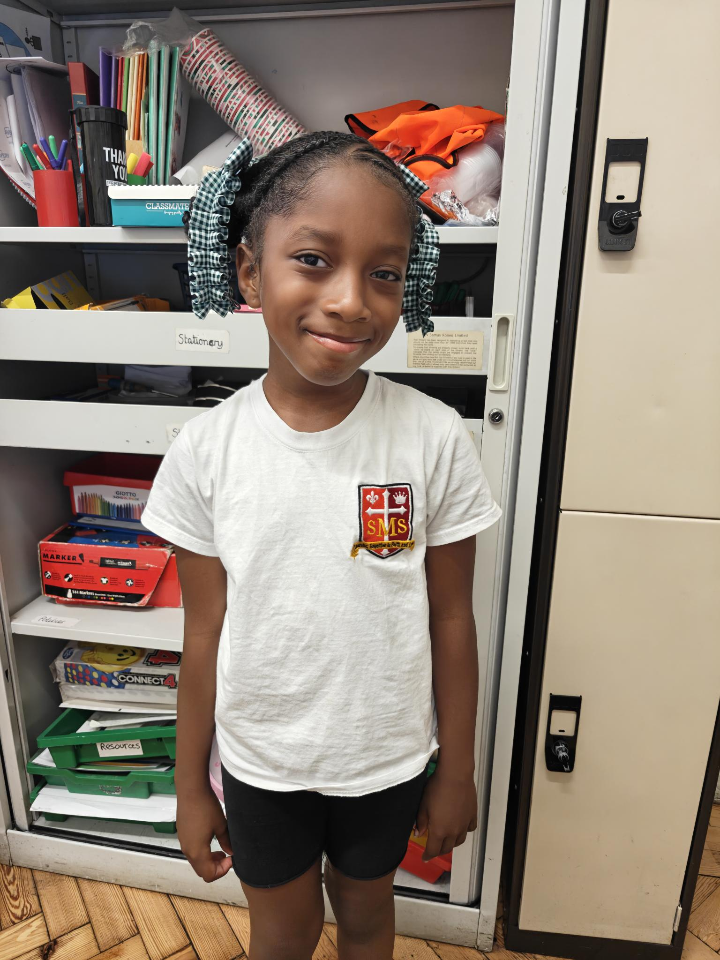
Year 3
For her excellent contributions in class discussions this week and being eager to complete her work independently.
Miss Medioli

Slide 12
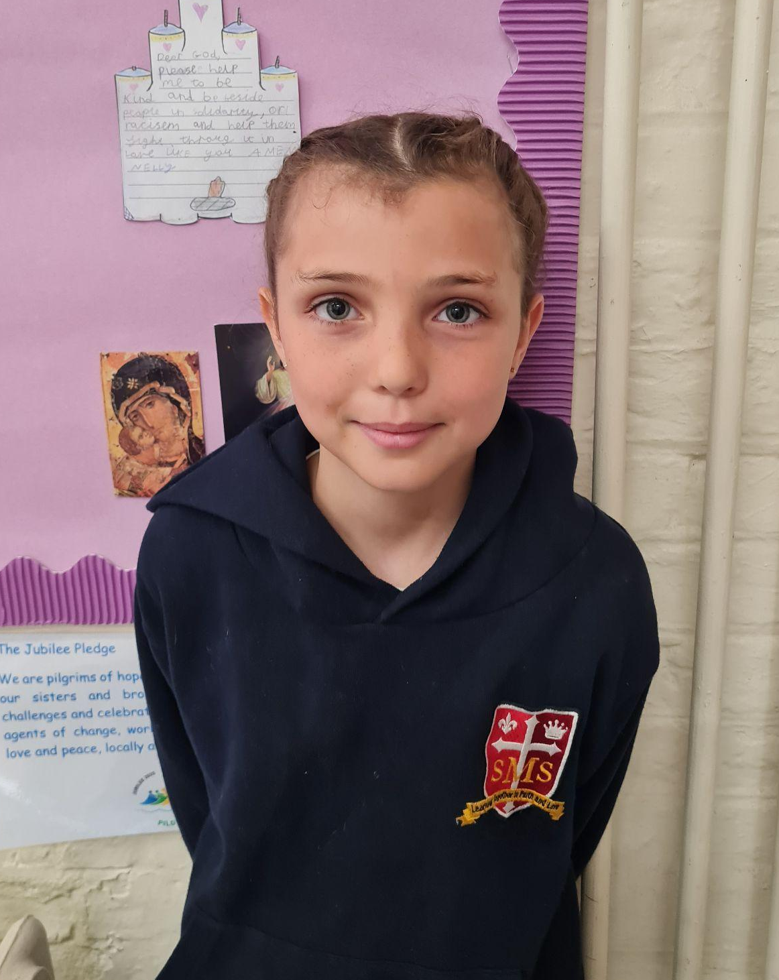
Year 4
For the excellent effort she had put into her handwriting this term.
Miss Forrest

Slide 13
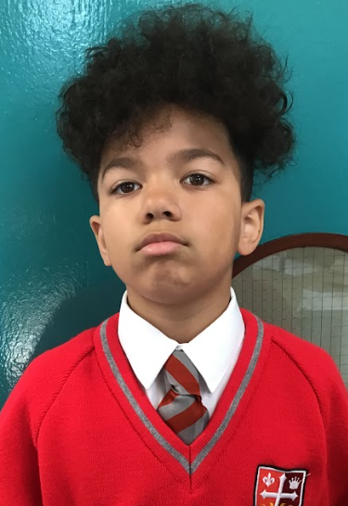
Year 5
For excellent positivity and taking responsibility this week!
Mr Larke

Slide 14
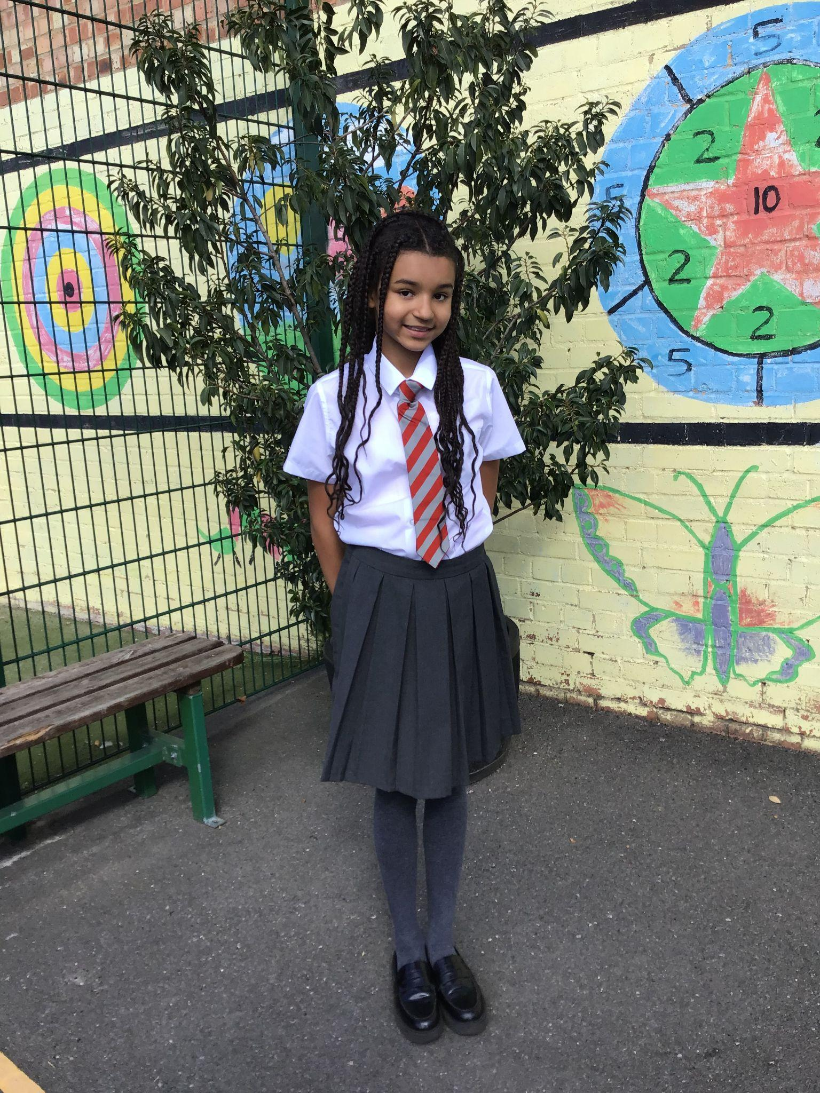
Year 6
Victoria
Your sunny attitude, kind heart, and great sense of humour make you a true star in our class
Mr Fowle & Mr Cherfi

Slide 15
Star Readers
Y1 - Noel
Y2 - Fraser
Y3 - Alfie
Y4 - Makda
Y5 - Zyann
Y6 - Naz

Slide 16
Ryan - Year 3
Andre - Year 3
Olly Y1
Arthur - Year 4
Ms Medioli
Regina - Year 5
Mrs Tusting

Slide 17
Whole School
Star of the Week
Friday 13th June 2025

