Slide 1
Whole School
Star of the Week
Friday 14th March 2025

Slide 2
Our Father who art in Heaven
Hallowed be Thy Name
Thy Kingdom come
Thy will be done on Earth as it is in Heaven
Give us this day our daily bread
And forgive us our trespasses
As we forgive those who trespass against us
And lead us not into temptation
But deliver us from evil
Amen

Slide 3
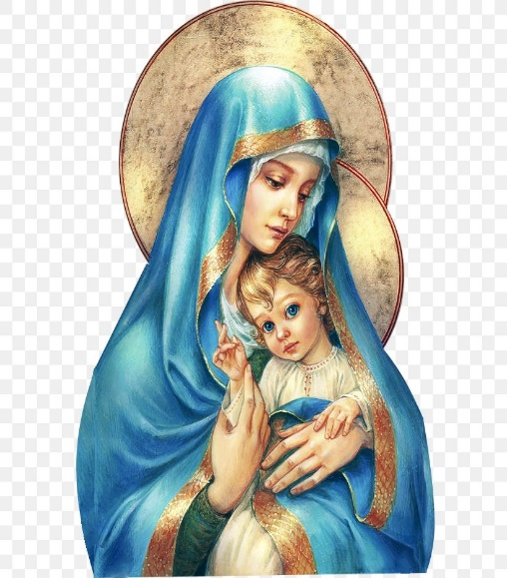
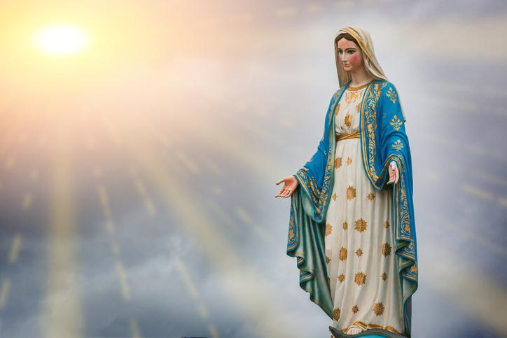
Hail Mary, Full of Grace
The Lord is with Thee
Blessed are Thou amongst women
And Blessed is the fruit of Thy womb, Jesus
Holy Mary , Mother of God
Pray for us sinners
Now and in the hour of our death
Amen

Slide 4
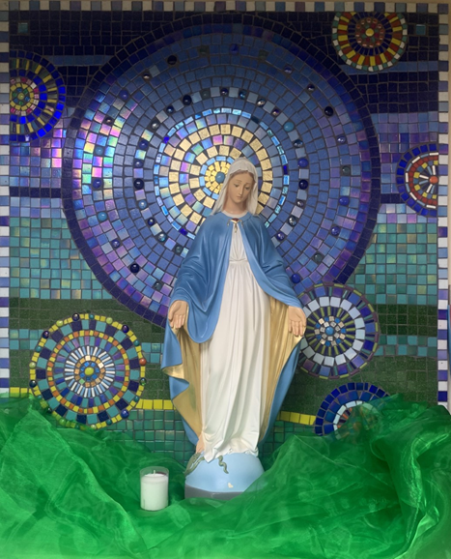
St Mary’s School Prayer
O Holy Mary,
Mother and Patron of our school,
Turn your eyes of mercy towards us,
that we may love God
With all our hearts!
May we imitate the tenderness
of your Son, Jesus,
showing love and respect
For each person
and ourselves as children of God.
Guided by the Holy Spirit,
May we create the school,
where Mercy and Compassion
Is the centre of our lives.
Amen

Slide 6
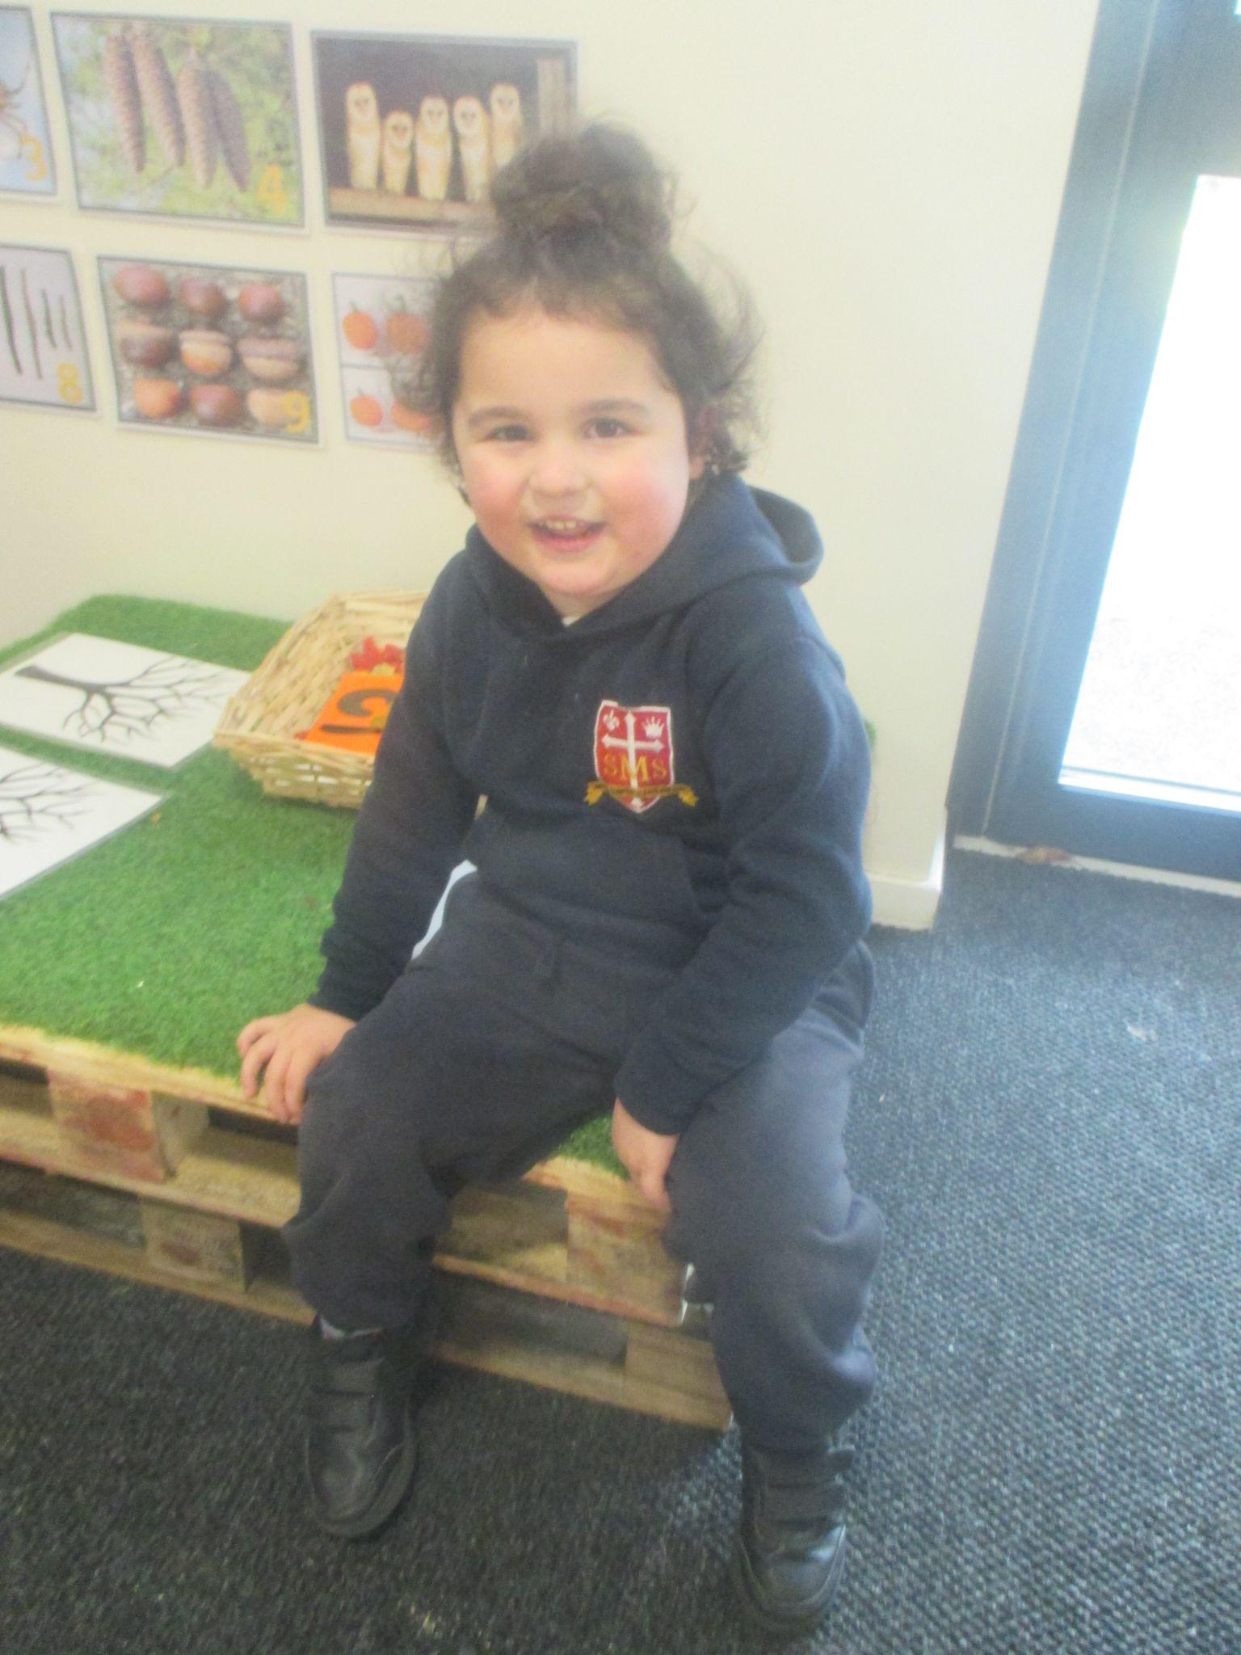
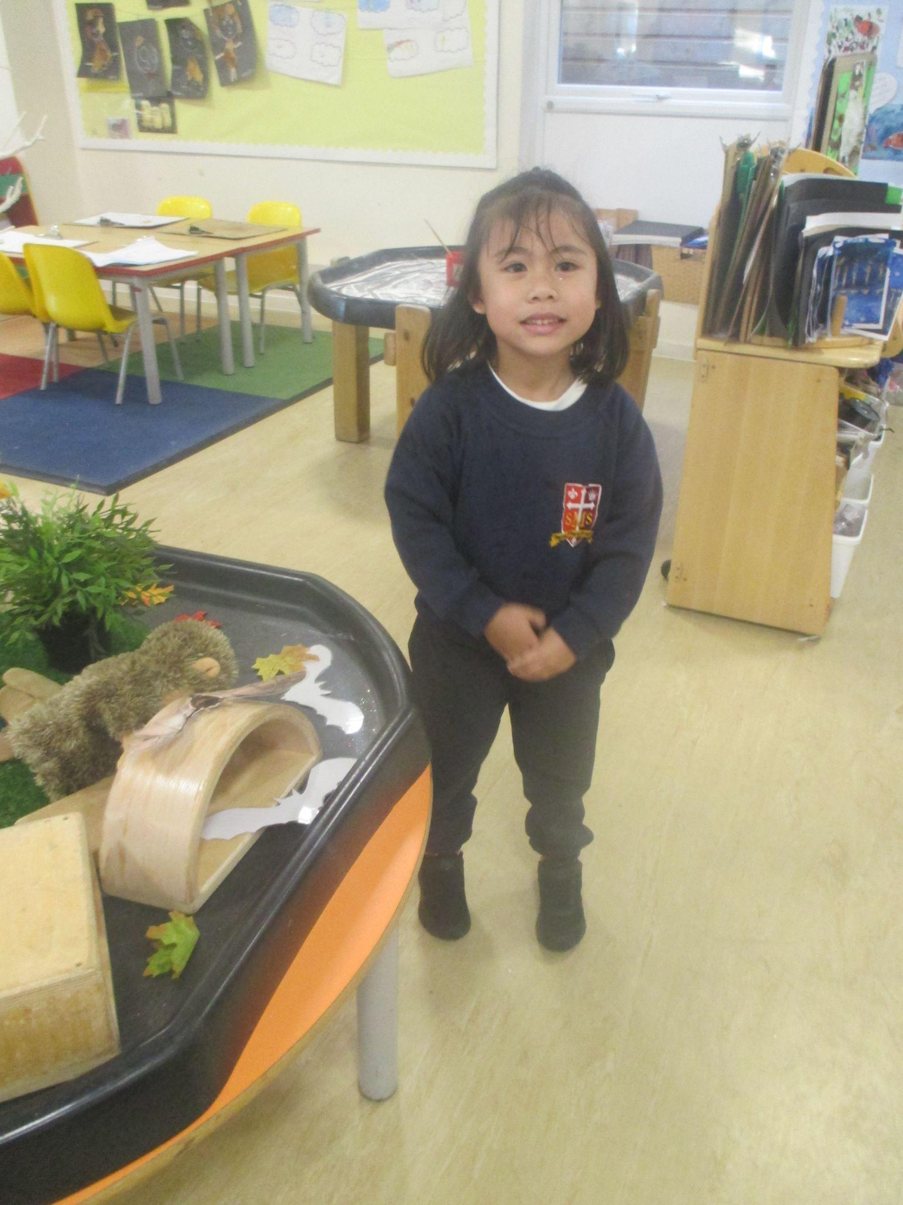
Early Years-
Child 1 - for being a calm role model this week and engaging in Literacy lessons.
Child 2 - For always making the right choices and building her confidence to use her voice in class.
Miss Barker

Slide 7
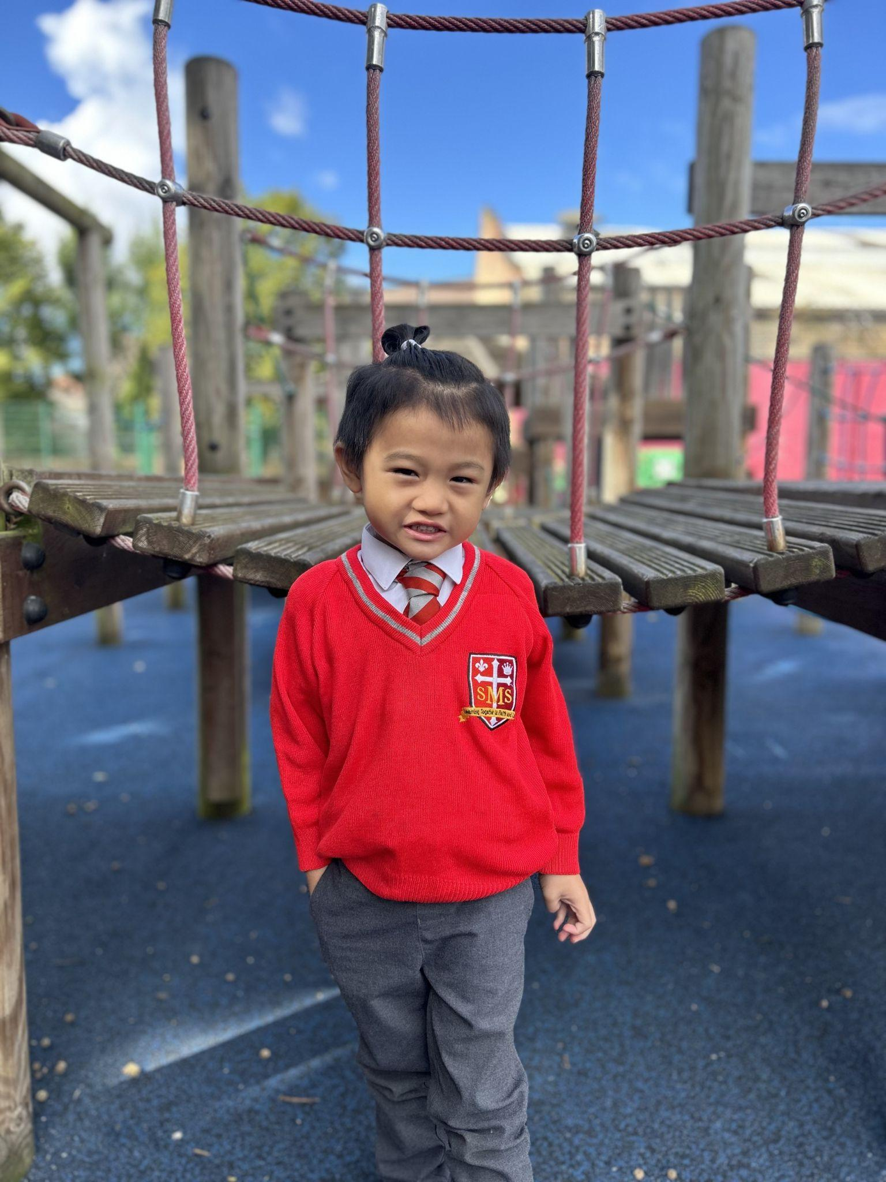
Year 1
For using his voice more in class and trying his best in phonics!
Miss Sweet

Slide 8
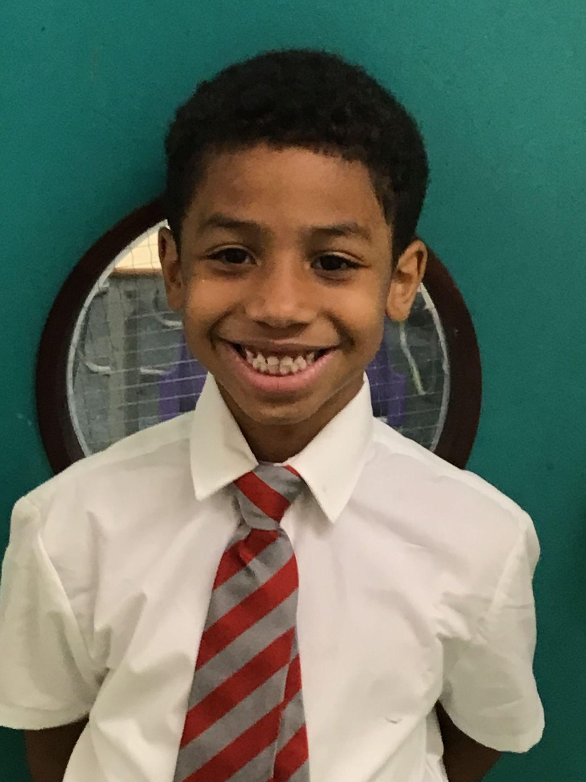
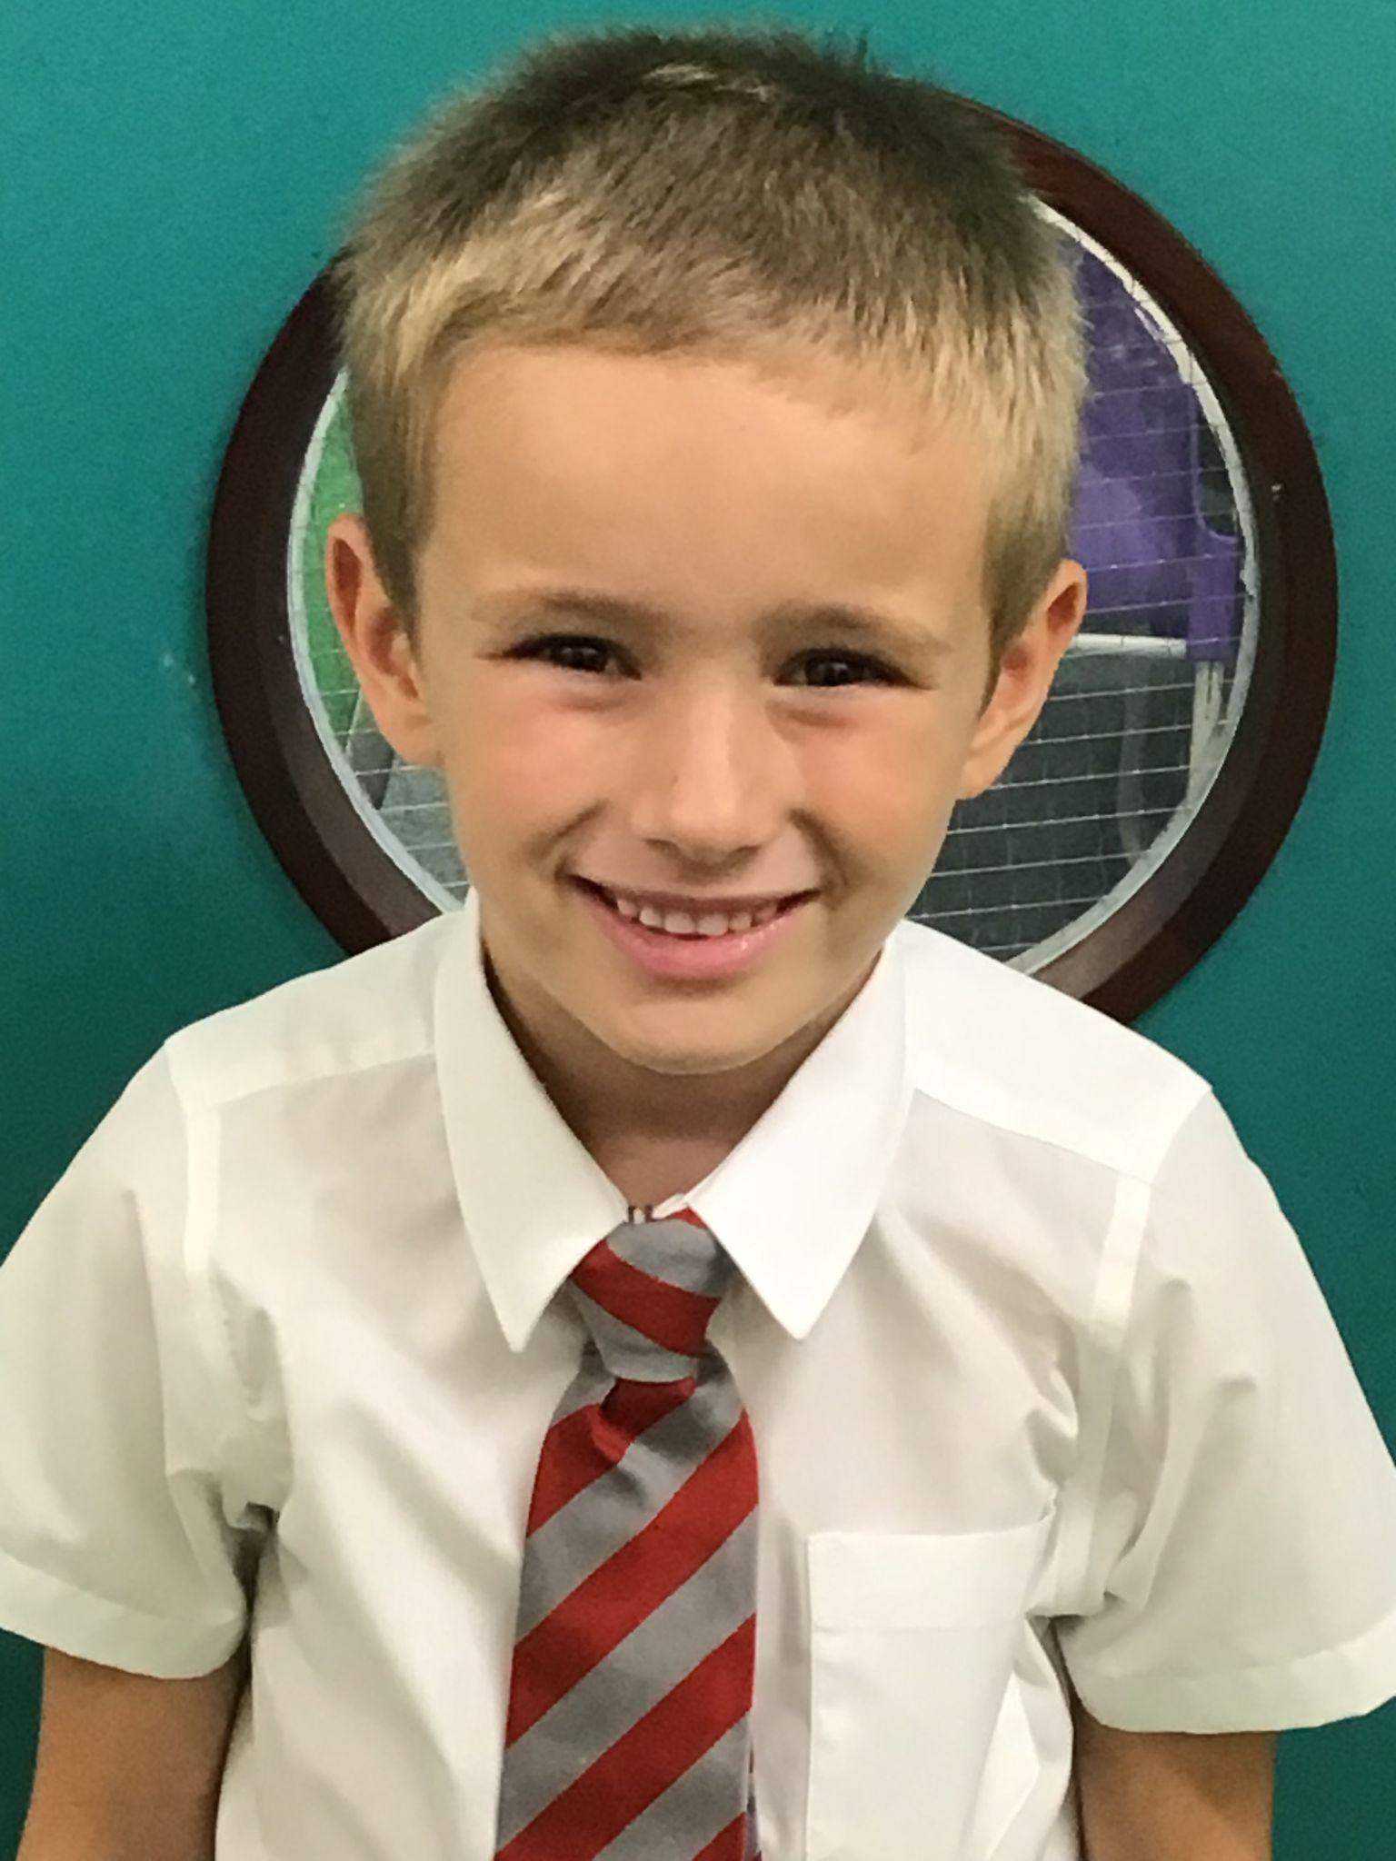
Year 2
Pupil 1- for showing a really positive attitude to his learning across all subjects.
Pupil 2- for an outstanding effort in his Reading Assessments and for excellent contributions to other subjects, particularly RE and History.
Mr Whear

Slide 9
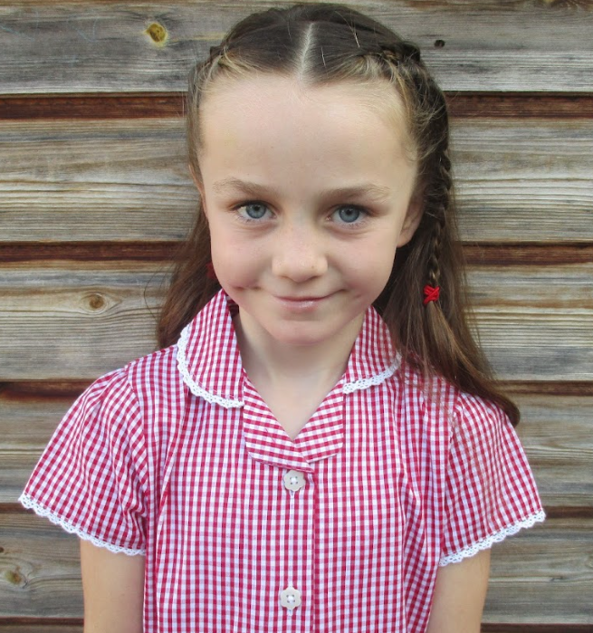
Year 3
For putting an incredible amount of effort into their assessments, which can be seen in their test results this week!
Miss Medioli

Slide 10
Year 4
For their hard work which has paid off in their excellent Spring assessment results.
Miss Forrest

Slide 11
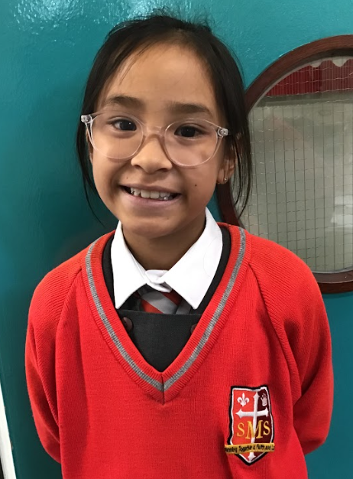
Year 5
For exemplary behaviour this week
Mr Larke

Slide 12
Year 6
For being exemplary students and approaching the last two weeks with real tenacity and dedication.
Mr Cherfi and Mr Fowle

Slide 13
Star Readers
Y1 - Yoel
Y2 - Mia and John
Y3 - Alfie and Noah
Y4 - Elly and Poppy
Y5 - Gideon
Y6 - Noah

Slide 14
Jacob - Y6
Amarah Y5
Isaiah Y5

Slide 15
Whole School
Star of the Week
Friday 14th March 2025

