Slide 1




Whole School
Star of the Week
Friday 14th November 2025

Slide 2


Our Father who art in Heaven
Hallowed be Thy Name
Thy Kingdom come
Thy will be done on Earth as it is in Heaven
Give us this day our daily bread
And forgive us our trespasses
As we forgive those who trespass against us
And lead us not into temptation
But deliver us from evil
Amen

Slide 3
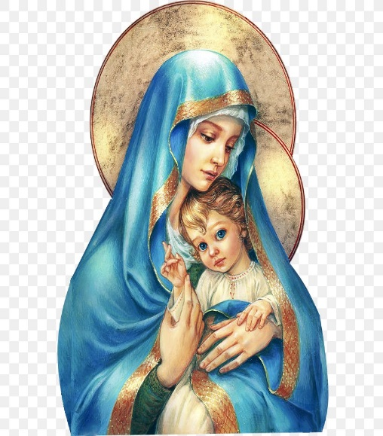
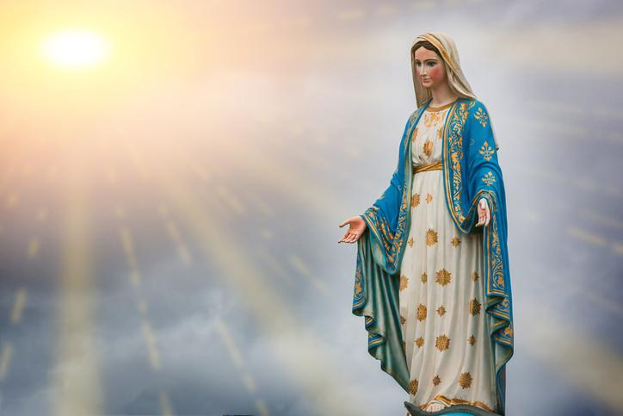
Hail Mary, Full of Grace
The Lord is with Thee
Blessed are Thou amongst women
And Blessed is the fruit of Thy womb, Jesus
Holy Mary , Mother of God
Pray for us sinners
Now and in the hour of our death
Amen

Slide 4
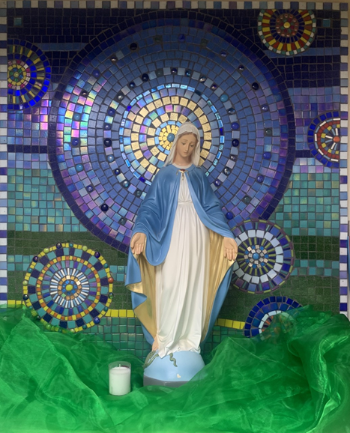
St Mary’s School Prayer
O Holy Mary,
Mother and Patron of our school,
Turn your eyes of mercy towards us,
that we may love God
With all our hearts!
May we imitate the tenderness
of your Son, Jesus,
showing love and respect
For each person
and ourselves as children of God.
Guided by the Holy Spirit,
May we create the school,
where Mercy and Compassion
Is the centre of our lives.
Amen

Slide 5
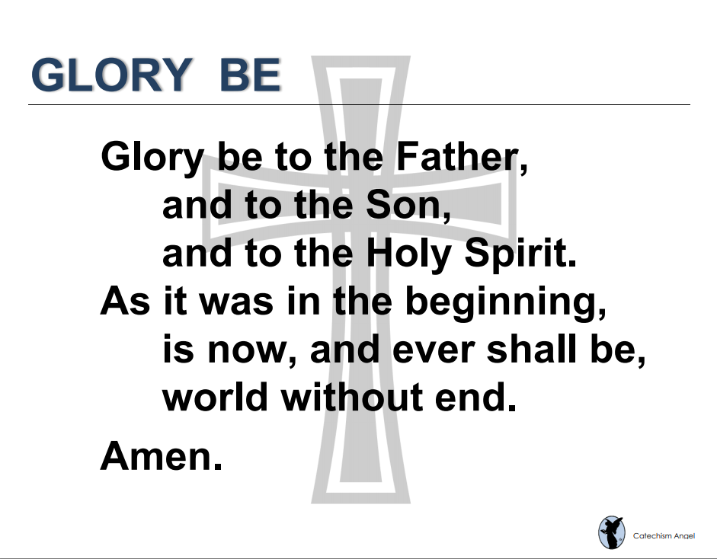

Slide 6
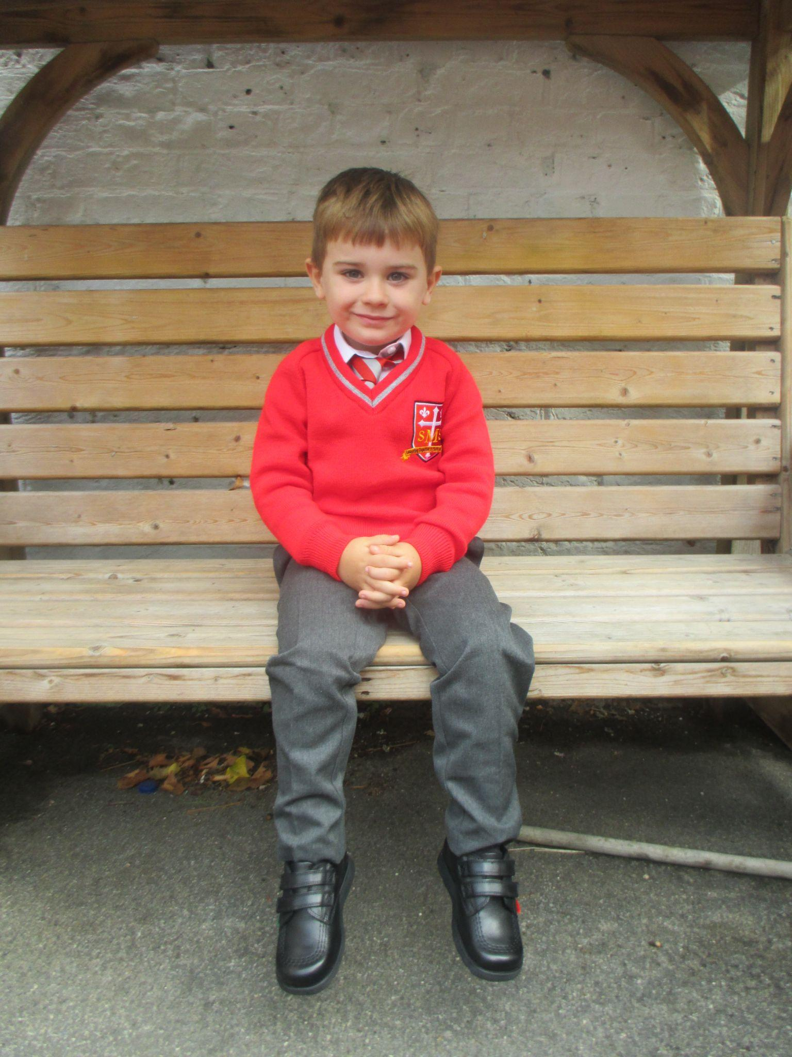
EYFS
Reception
For having an amazing week in class and showing role model behaviour.
Miss Barker

Slide 7
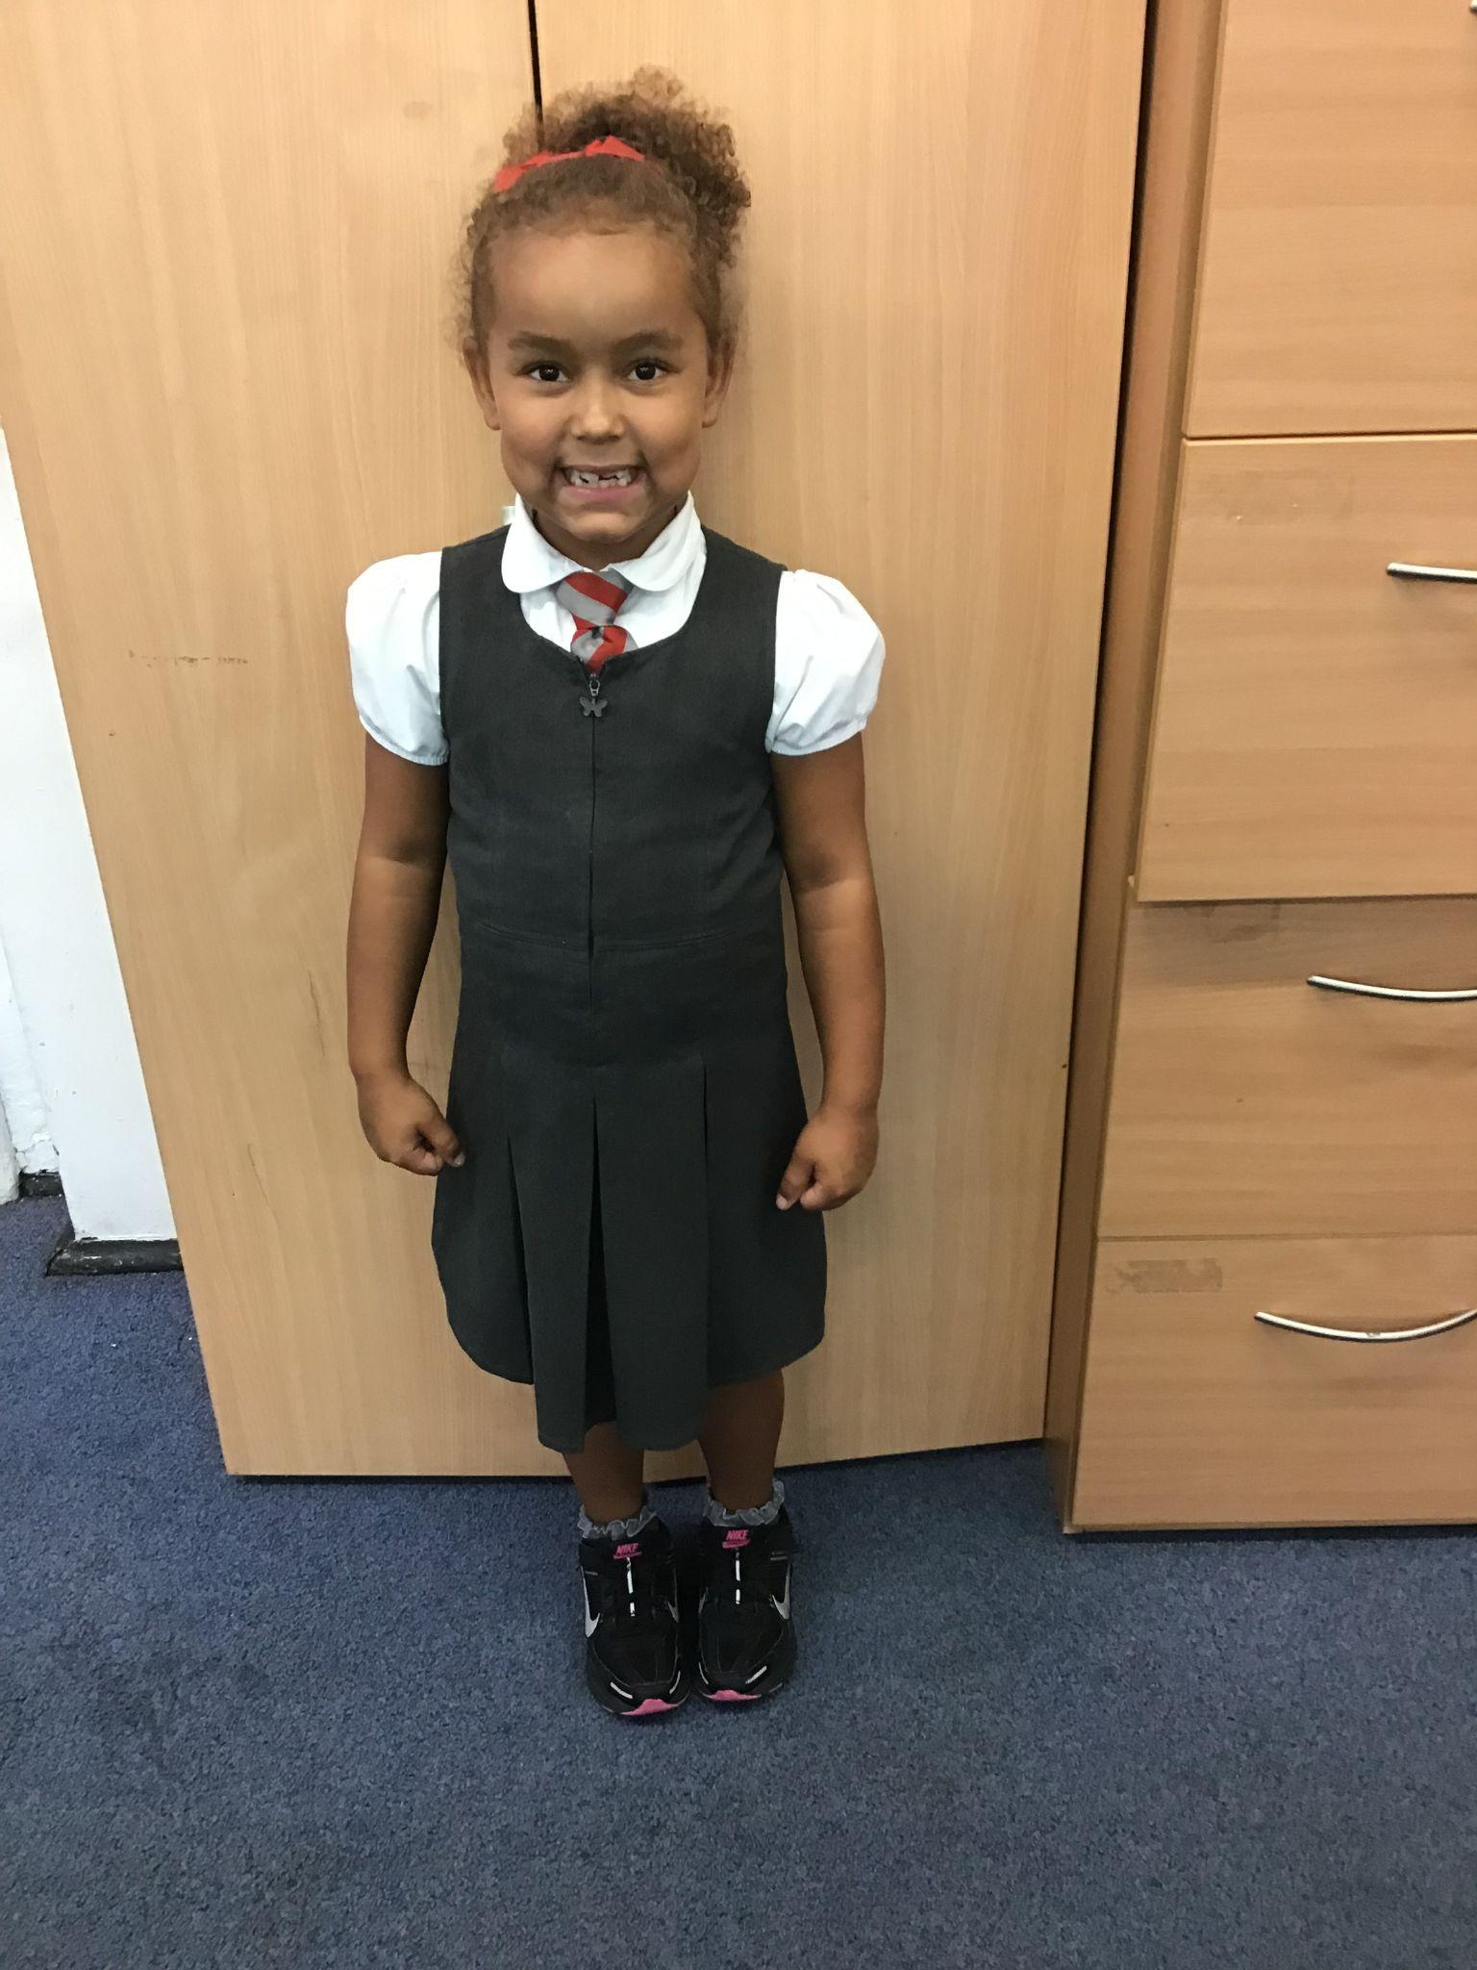
Year 1
For excellent engagement on the carpet. Showing eagerness to learn and understand.
Ms Begam

Slide 8
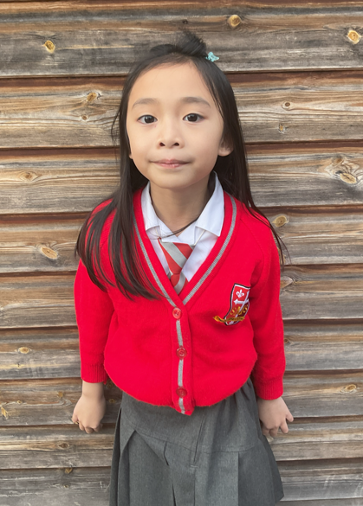
Year 2
For having a great start to St. Mary’s and using her voice!
Miss Sweet

Slide 9
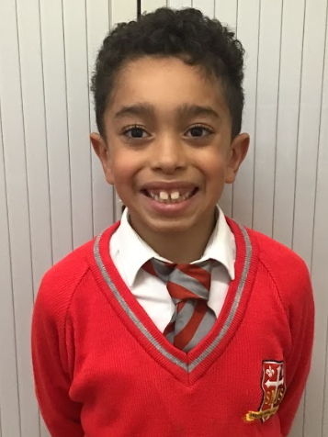
Year 3
For taking responsibility and showing what he is capable of.
Mr. Larke

Slide 10
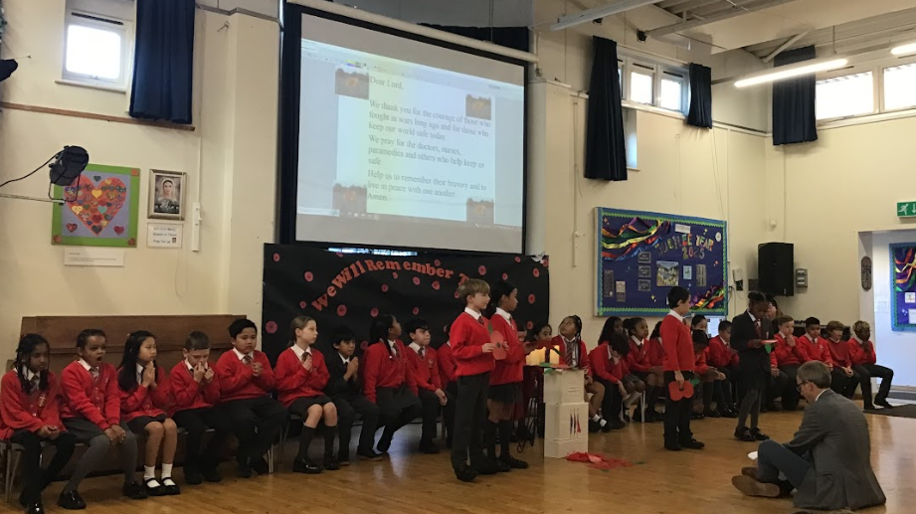
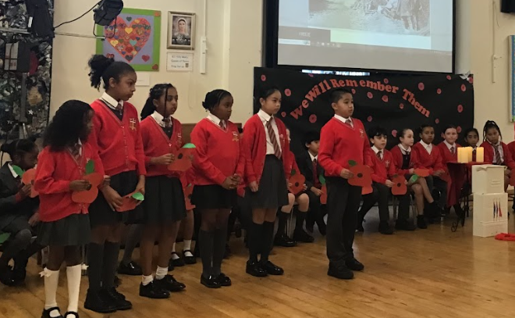
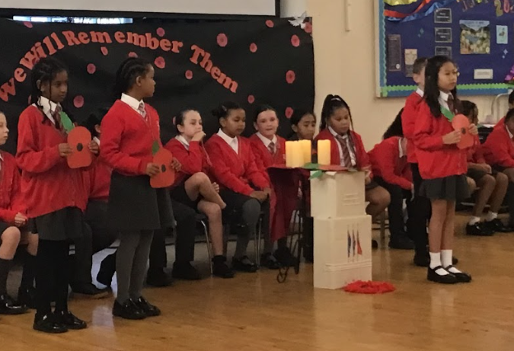
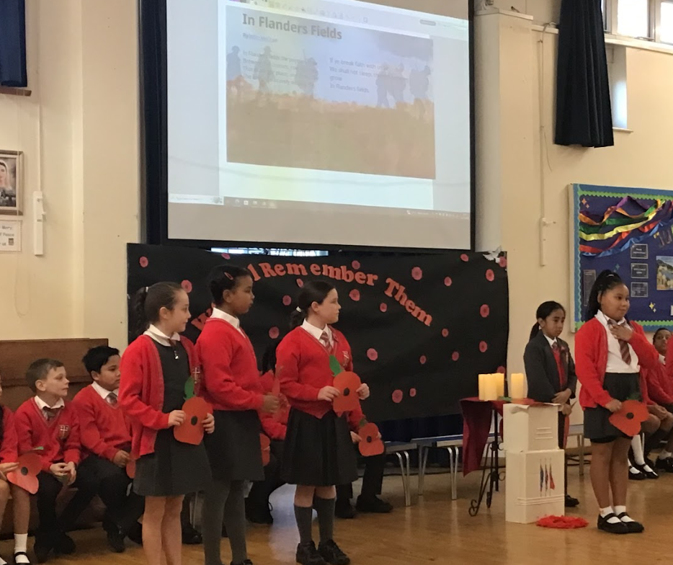
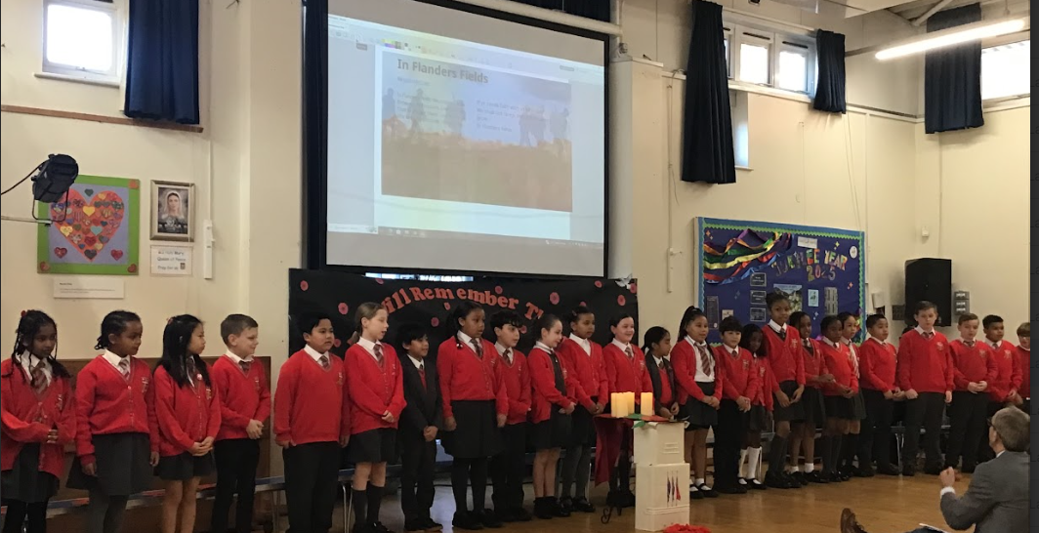
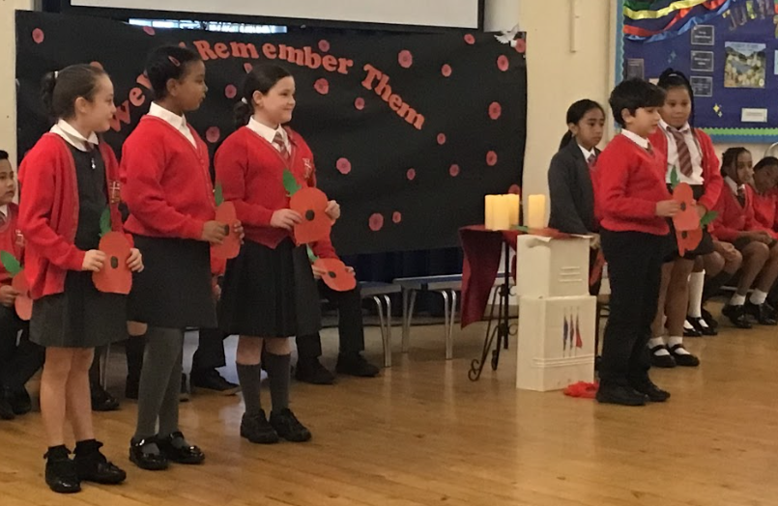
Year 4 - The Whole Class
For capturing and expressing the meaning and solemnity of Remembrance Day
Mr Whear

Slide 11

Year 5
Mr. Carey
For being responsible in her learning and listening to advice and feedback.

Slide 12

Year 6
For showing great responsibility and applying herself fully across multiple subjects.
Mr Cherfi & Mr Quinlan

Slide 13



Star Readers
Y1 - Lillie-mae
Y2 - Torrah-Leigh
Y3 - Novena
Y4 - Dilyet
Y5 - Mimi
Y6 - Gideon

Slide 14

Zamarah - Y6

Slide 15
Whole School
Star of the Week
Friday 14th November 2025

