Slide 1



Whole School
Star of the Week
Friday 15th May 2026

Slide 2


Our Father who art in Heaven
Hallowed be Thy Name
Thy Kingdom come
Thy will be done on Earth as it is in Heaven
Give us this day our daily bread
And forgive us our trespasses
As we forgive those who trespass against us
And lead us not into temptation
But deliver us from evil
Amen

Slide 3
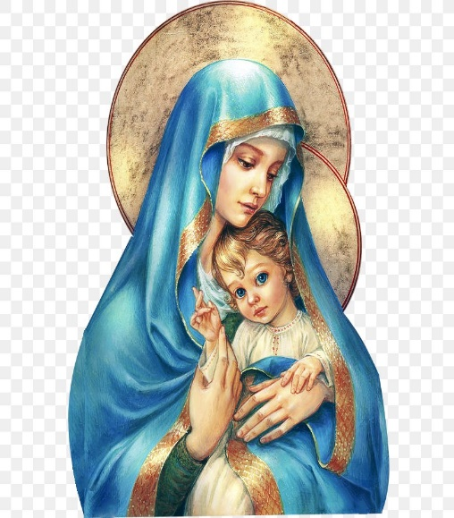
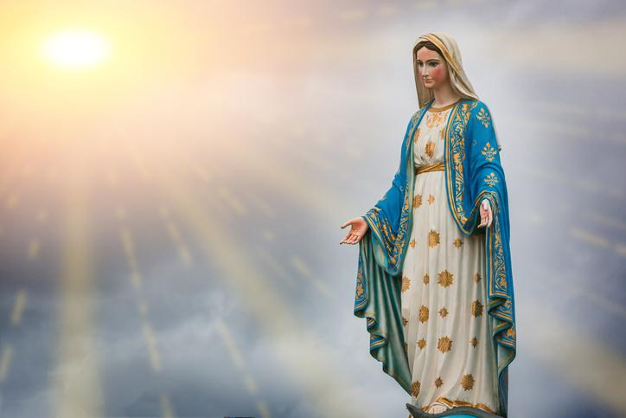
Hail Mary, Full of Grace
The Lord is with Thee
Blessed are Thou amongst women
And Blessed is the fruit of Thy womb, Jesus
Holy Mary , Mother of God
Pray for us sinners
Now and in the hour of our death
Amen

Slide 4
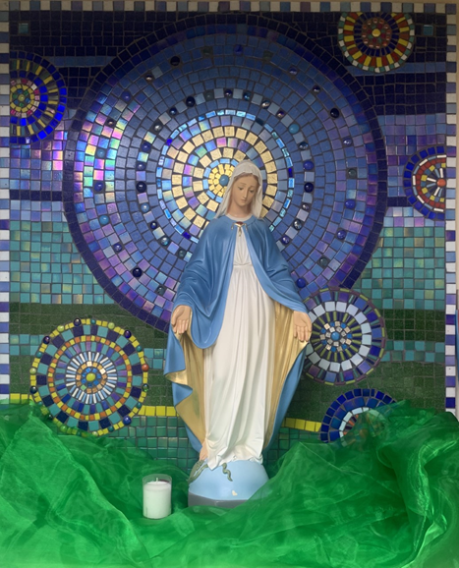
St Mary’s School Prayer
O Holy Mary,
Mother and Patron of our school,
Turn your eyes of mercy towards us,
that we may love God
With all our hearts!
May we imitate the tenderness
of your Son, Jesus,
showing love and respect
For each person
and ourselves as children of God.
Guided by the Holy Spirit,
May we create the school,
where Mercy and Compassion
Is the centre of our lives.
Amen

Slide 5
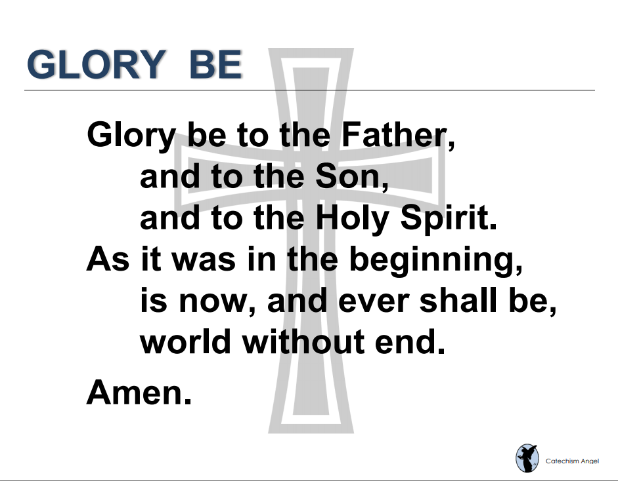

Slide 6
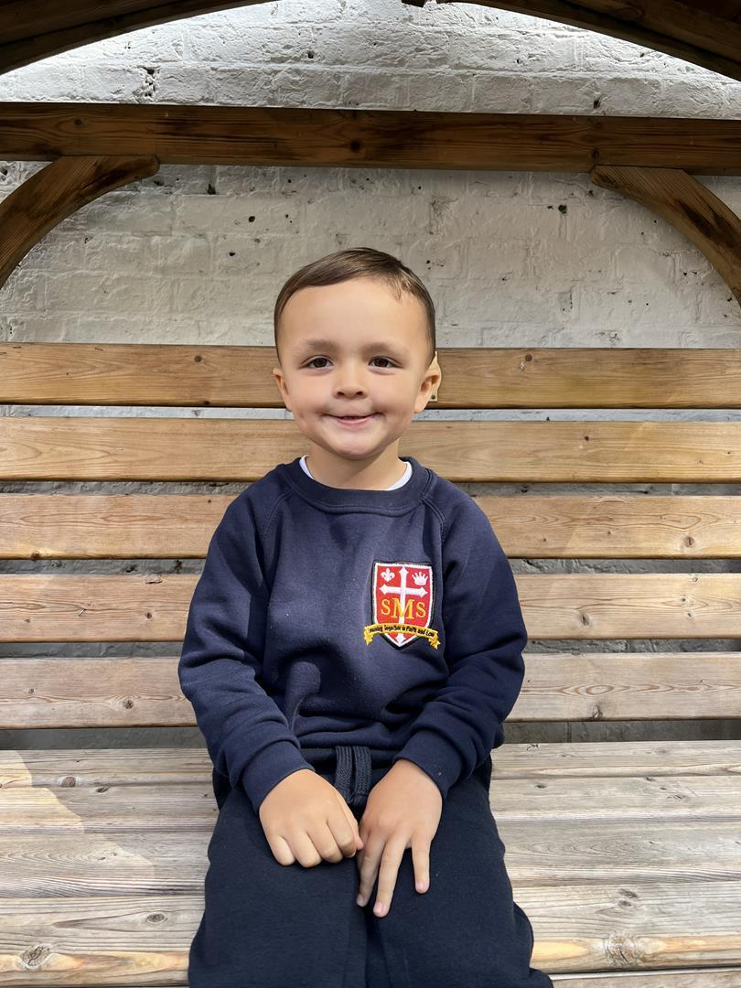
Nursery
For being a very positive child this week in class, engaging in activities with focussed learning and playing alongside his friends.
Miss Barker

Slide 7
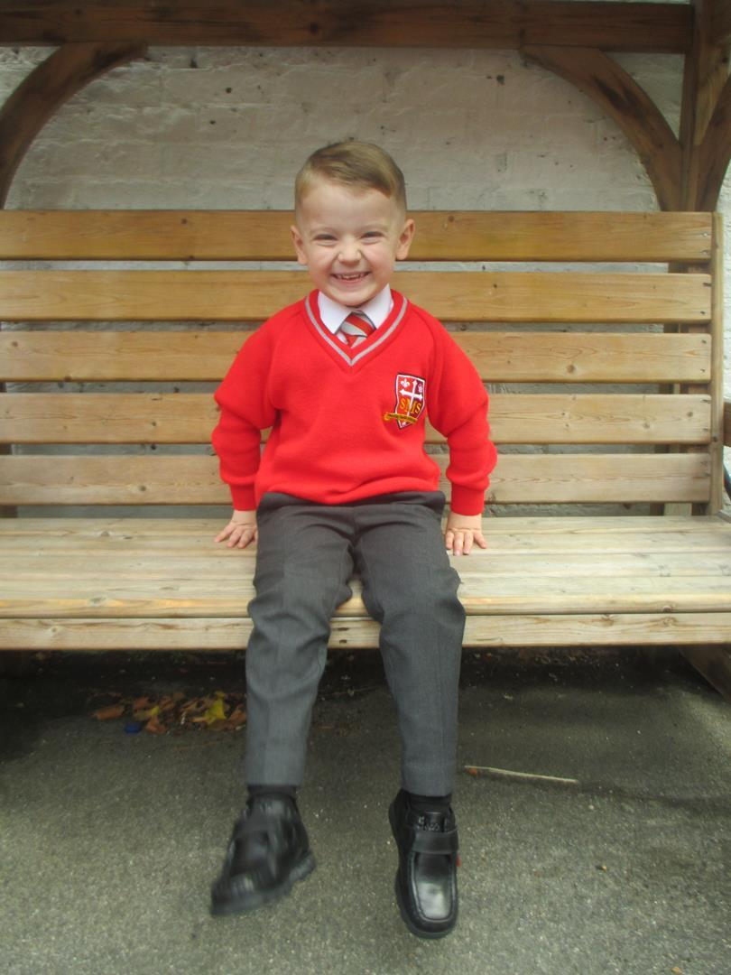
Reception
For continuing to show role model behaviour more frequently and engaging more in class discussions.
Miss Barker

Slide 8
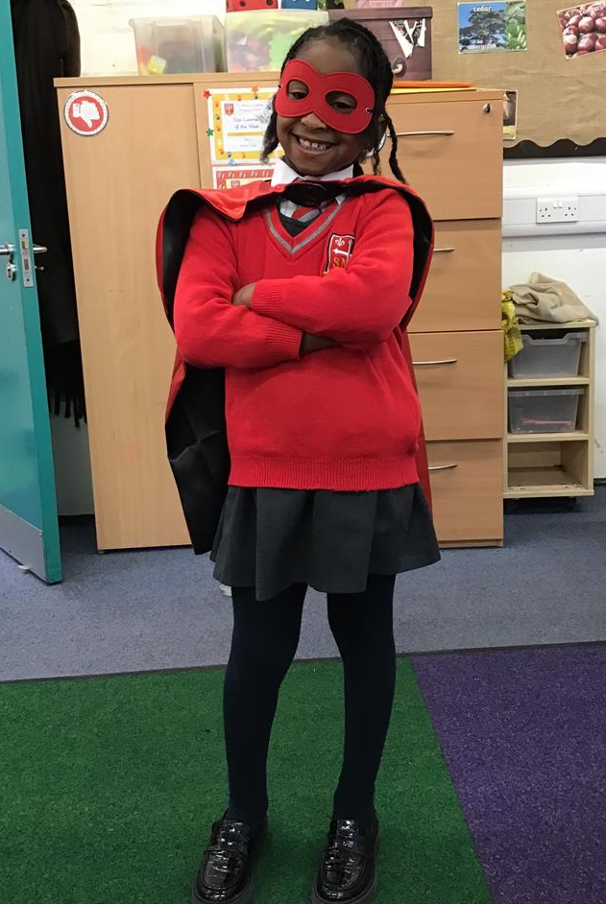
Year 1
For showing resilience when things are tricky and working hard to stay focused in the classroom.
Miss Flashman

Slide 9
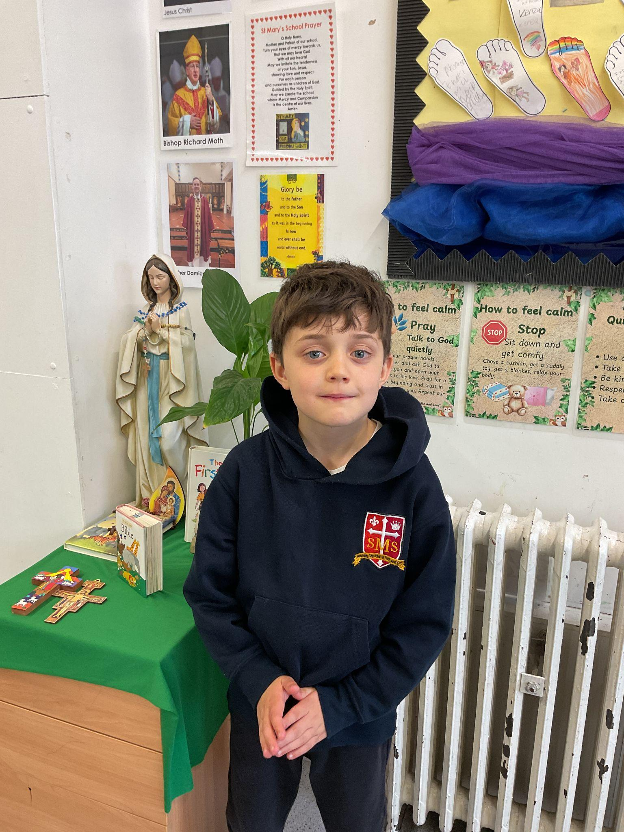
Year 2
For taking responsibility for his learning!
Miss Sweet

Slide 10
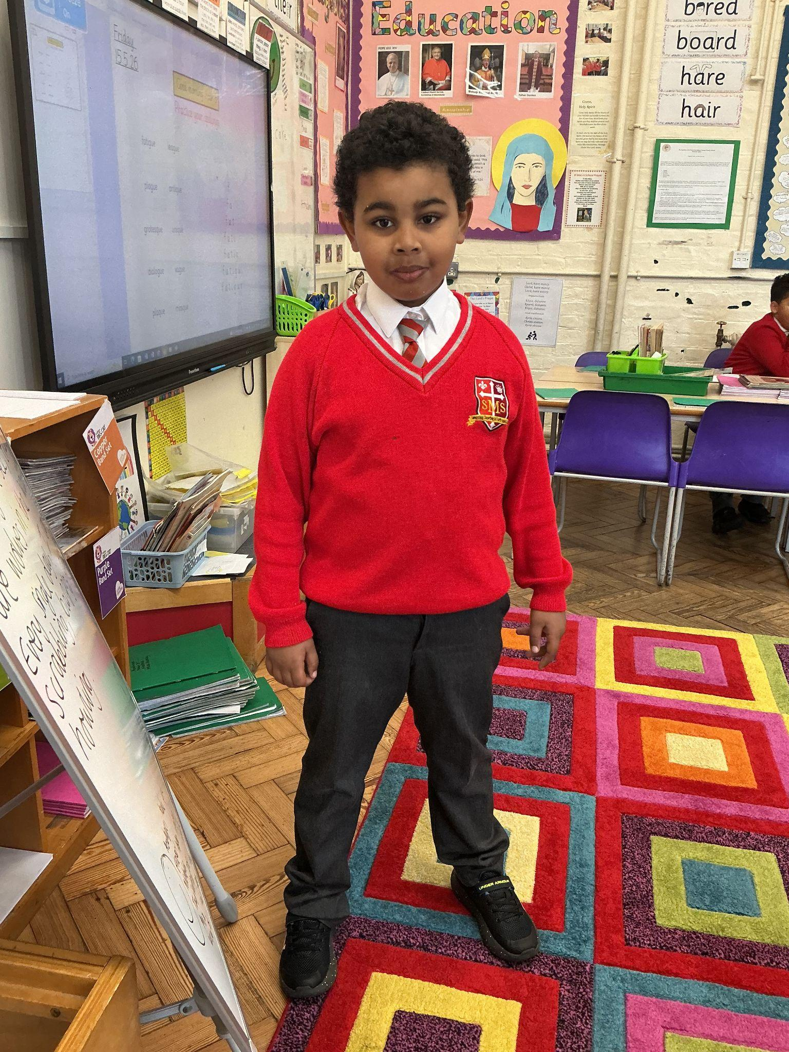
Year 3
This is so well deserved. You have most definitely had your best week yet since I started teaching you. I have been so proud. You have worked so hard in lessons, followed instructions and handled difficult times like a champion. Well done Yhya!
Miss Hickey

Slide 11
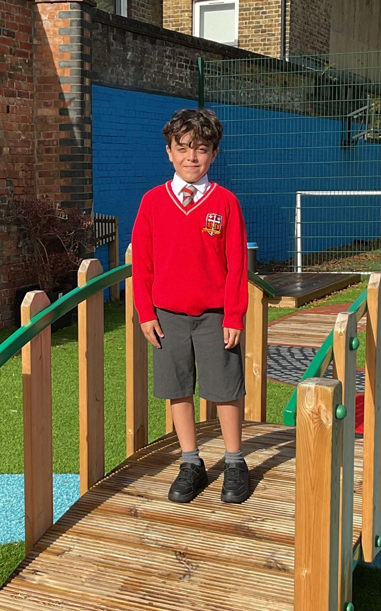
Year 4
For striving for excellence at all times and across all areas of the school life
Mr Whear

Slide 12
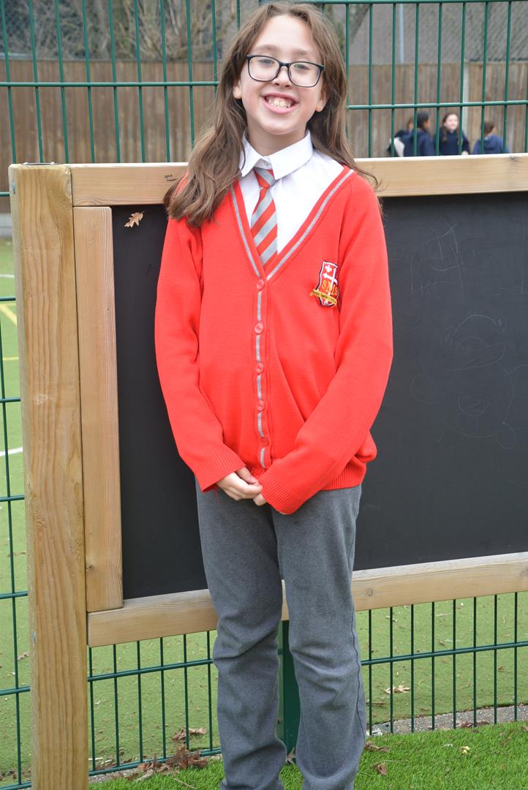
Year 5
For being an absolute joy to have in our classroom and a fantastic role model for Year 5 and the whole school. For being an independent learner and thinker who always brings a wonderful attitude to her learning, inspiring everyone around her to do their very best. For living out our school values every single day, and we are incredibly proud to celebrate her hard work and positivity today!
Mrs Bakali

Slide 13
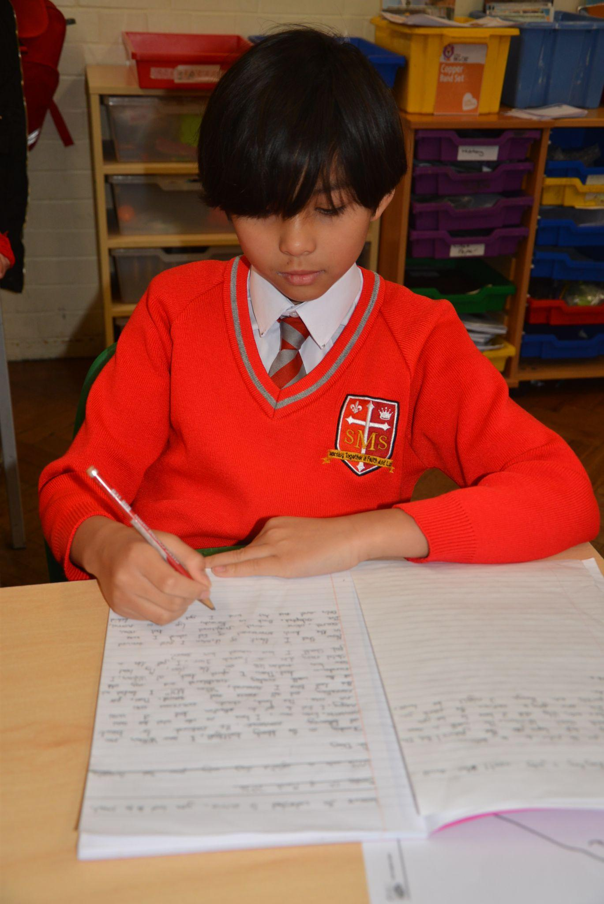

Year 6
Whole Class
For the culmination of a beautiful journey and the exceptional effort applied by every single child.
Mr Cherfi

Slide 14



Star Readers
Y1 - Lillie-Mae
Y2 - Albie
Y3 - Luna B
Y4 - Noah
Y5 - Alby
Y6 - Not this week

Slide 15

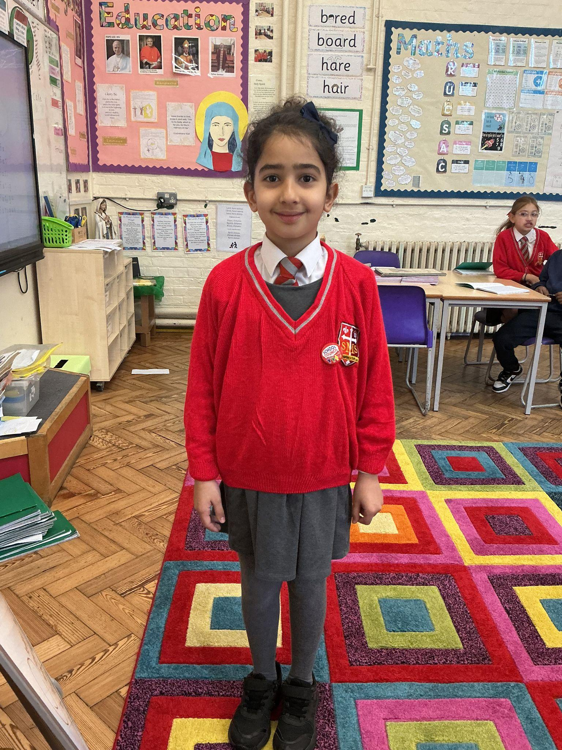
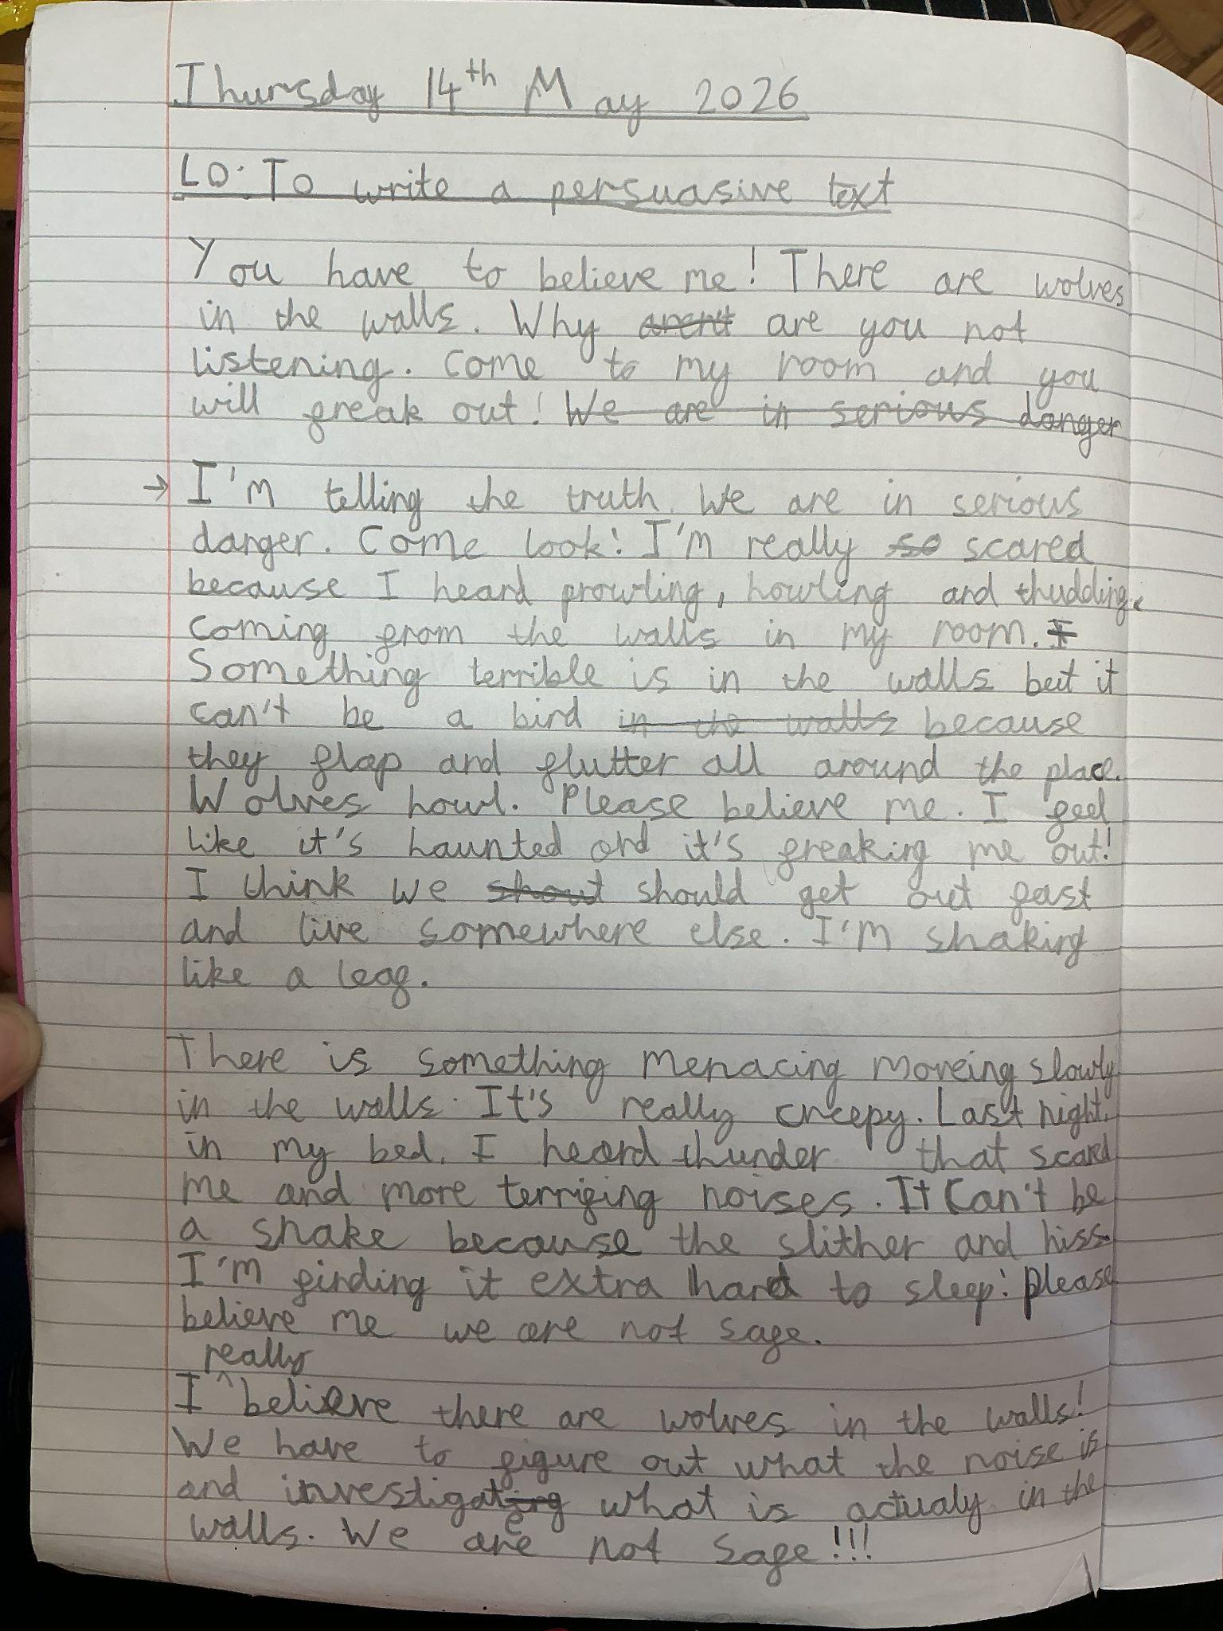
Handwriting Award
Y3

Slide 16

Asia-Rae Y4
Billie Nursery
Mariam Y4
Vanna Y4
Azrayah Y4

Slide 17
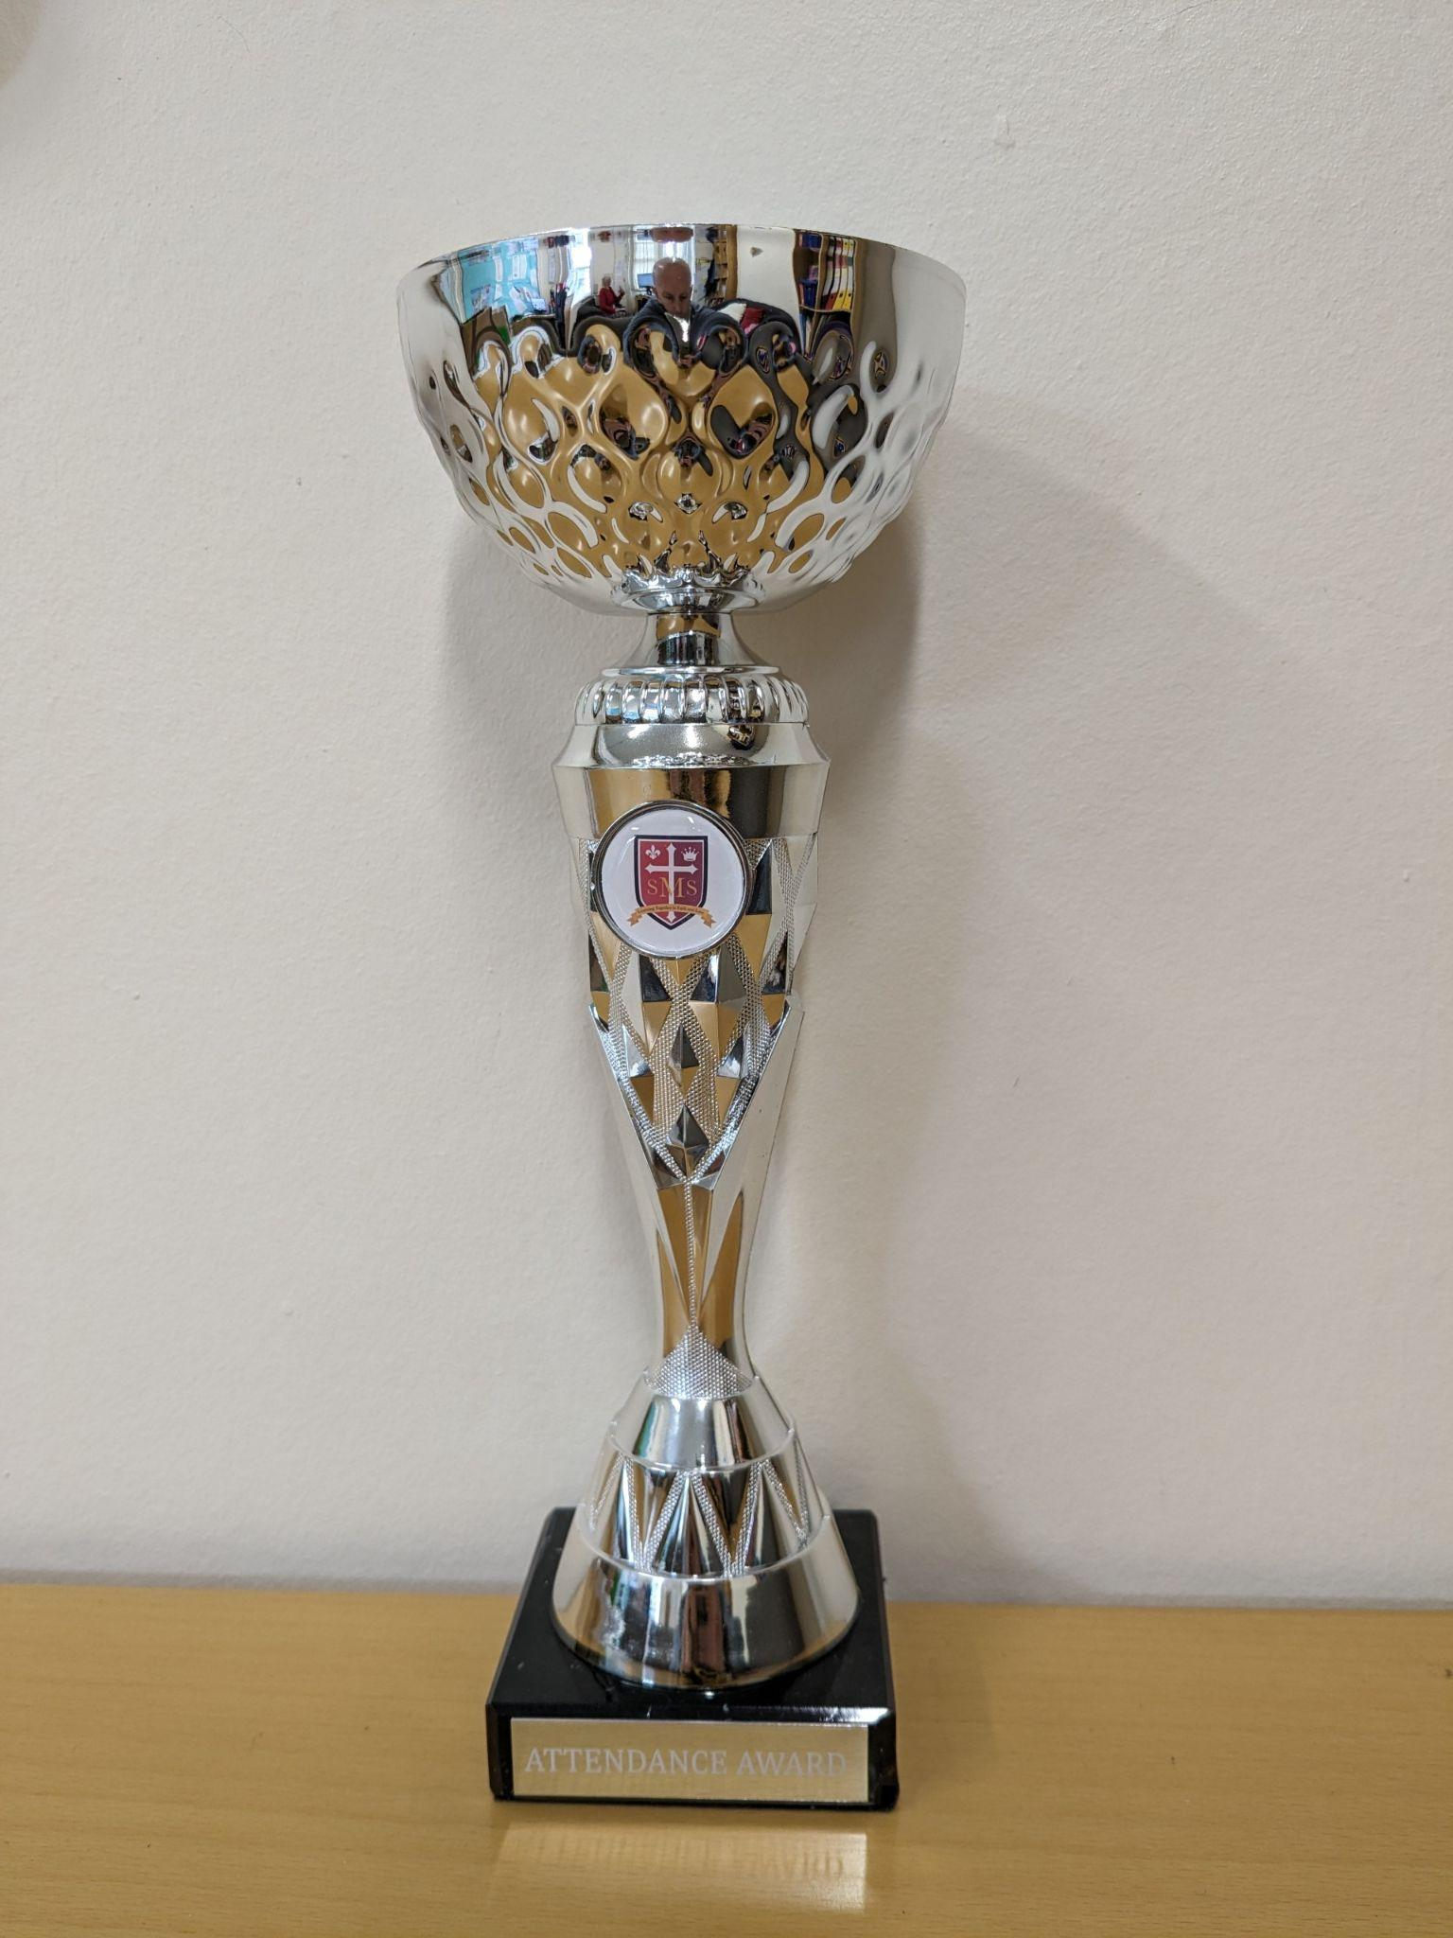
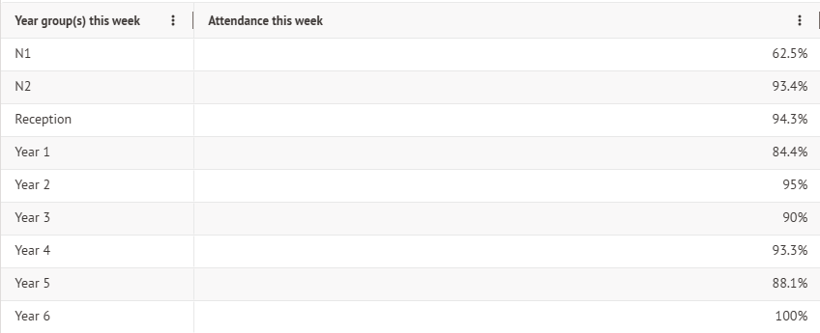
Attendance Weekly Leaders Summer Term:
Winners of the Pitch on Friday -

Slide 18
Whole School
Star of the Week
Friday 15th May 2026

