Slide 1
Whole School
Star of the Week
Friday 16th May 2025

Slide 2
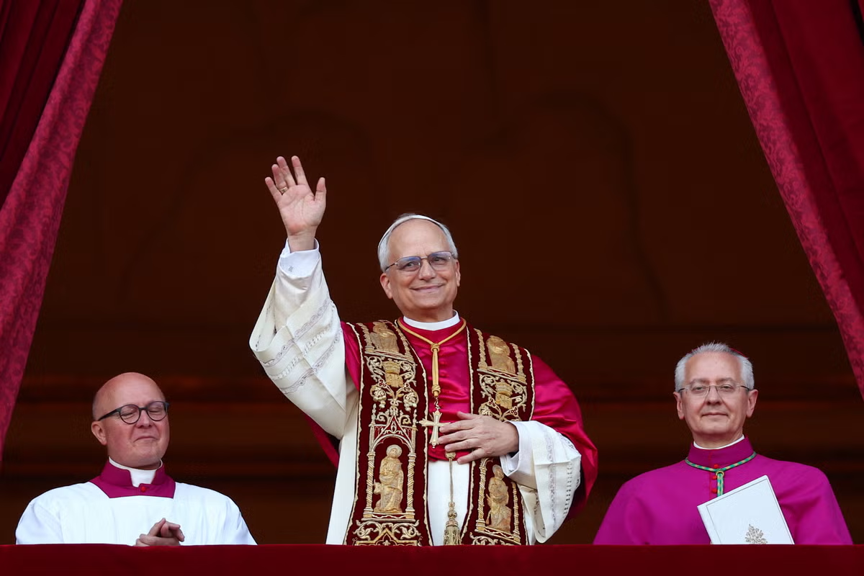
Habemus Papem
We have a new Pope
Cardinal Robert Provost who took the name Leo XIV

Slide 3
Our Father who art in Heaven
Hallowed be Thy Name
Thy Kingdom come
Thy will be done on Earth as it is in Heaven
Give us this day our daily bread
And forgive us our trespasses
As we forgive those who trespass against us
And lead us not into temptation
But deliver us from evil
Amen

Slide 4
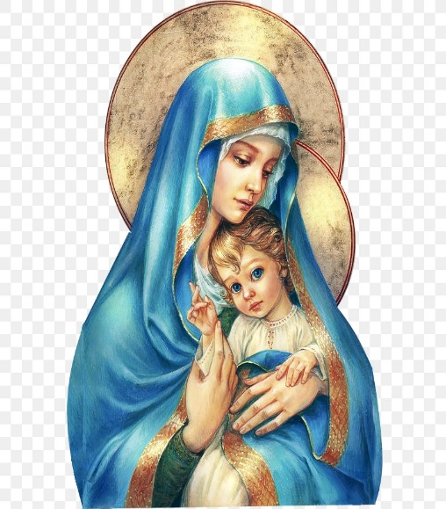
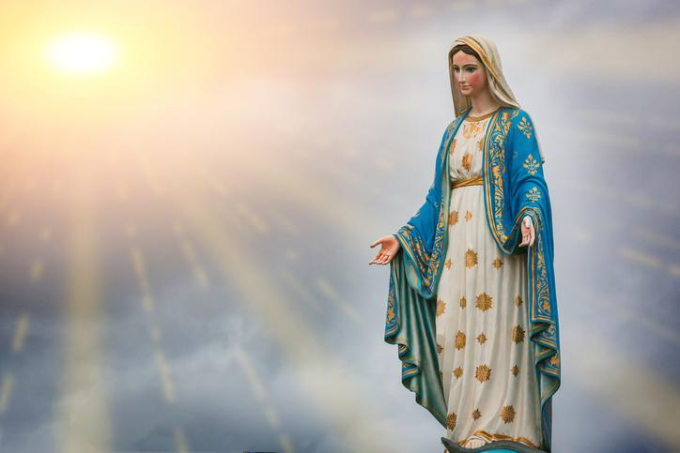
Hail Mary, Full of Grace
The Lord is with Thee
Blessed are Thou amongst women
And Blessed is the fruit of Thy womb, Jesus
Holy Mary , Mother of God
Pray for us sinners
Now and in the hour of our death
Amen

Slide 5
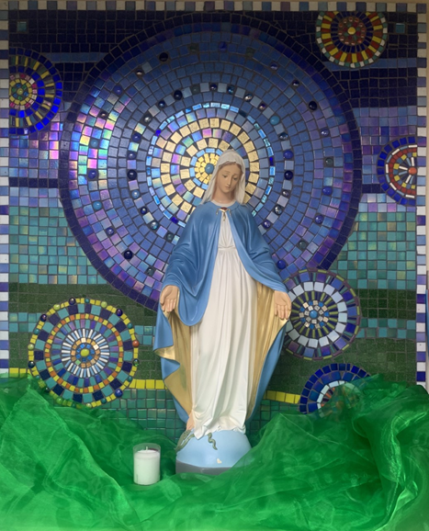
St Mary’s School Prayer
O Holy Mary,
Mother and Patron of our school,
Turn your eyes of mercy towards us,
that we may love God
With all our hearts!
May we imitate the tenderness
of your Son, Jesus,
showing love and respect
For each person
and ourselves as children of God.
Guided by the Holy Spirit,
May we create the school,
where Mercy and Compassion
Is the centre of our lives.
Amen

Slide 7
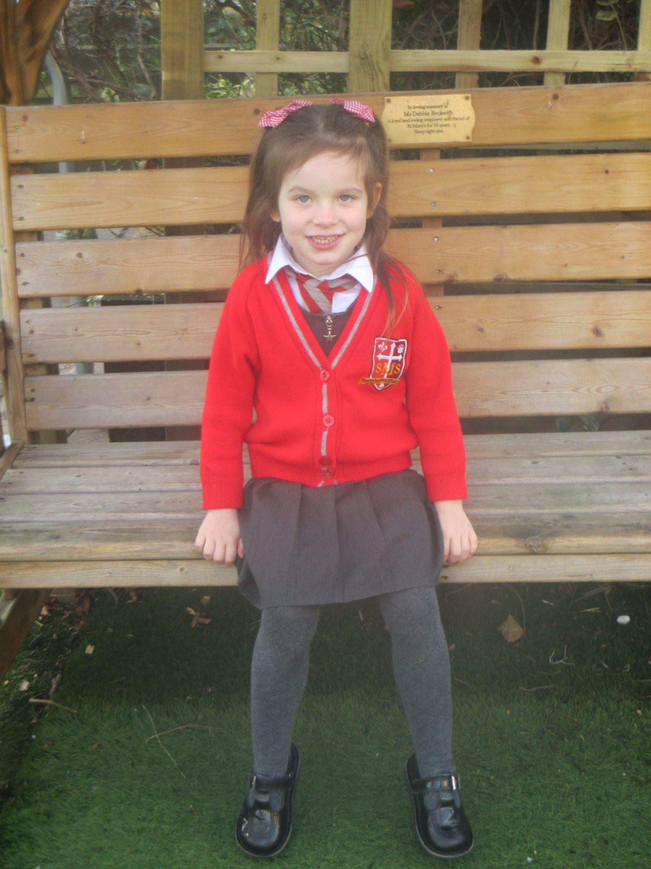
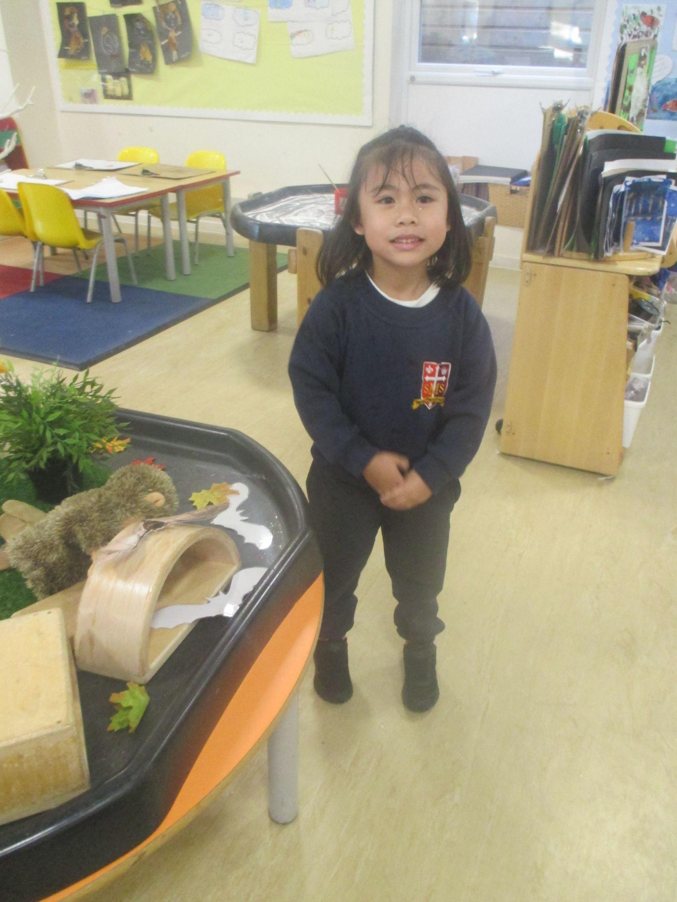
Early Years
Nursery: for always being a kind pupil and building confidence projecting her voice.
Reception: for showing avgreat enthusiasm
Miss Barker

Slide 8
Year 1
For engaging in play with his peers and the adults, and trying really hard to use his words.
Miss Sweet

Slide 9
Year 2
For showing that when we focus hard and put lots of effort into achieving a goal, we can attain it!
Mr Whear

Slide 10
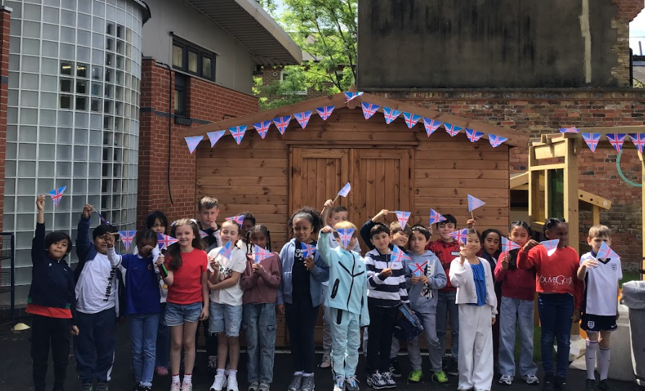
Year 3
Everyone!
For a flawless assembly despite not having much time to prepare.
Miss Medioli

Slide 11
Year 4
For showing our St Mary’s values every day in the classroom and putting 100% into every learning task, even if it seems challenging.
Miss Forrest

Slide 12
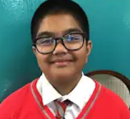
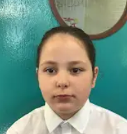
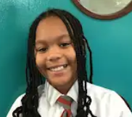
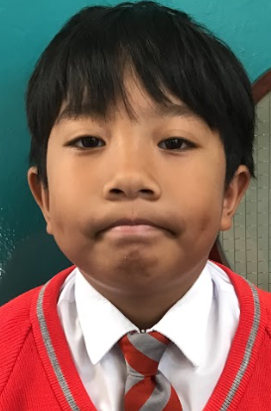
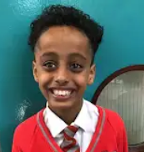
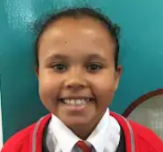
Year 5
For representing St. Mary’s superbly.
Mr Larke

Slide 13
Star Readers
Y1 - Naomi
Y2 - Major
Y3 - Mariam
Y4 - Nelly
Y5 - Mohamed

Slide 14
Whole School
Star of the Week
Friday 16th May 2025

