Slide 1

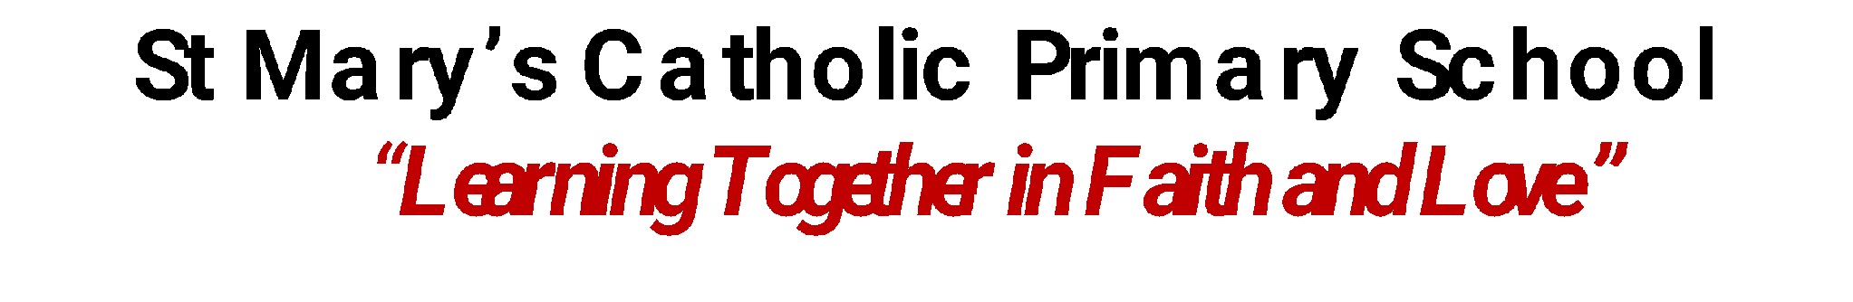

Whole School
Star of the Week
Friday 16th October, 2026

Slide 2
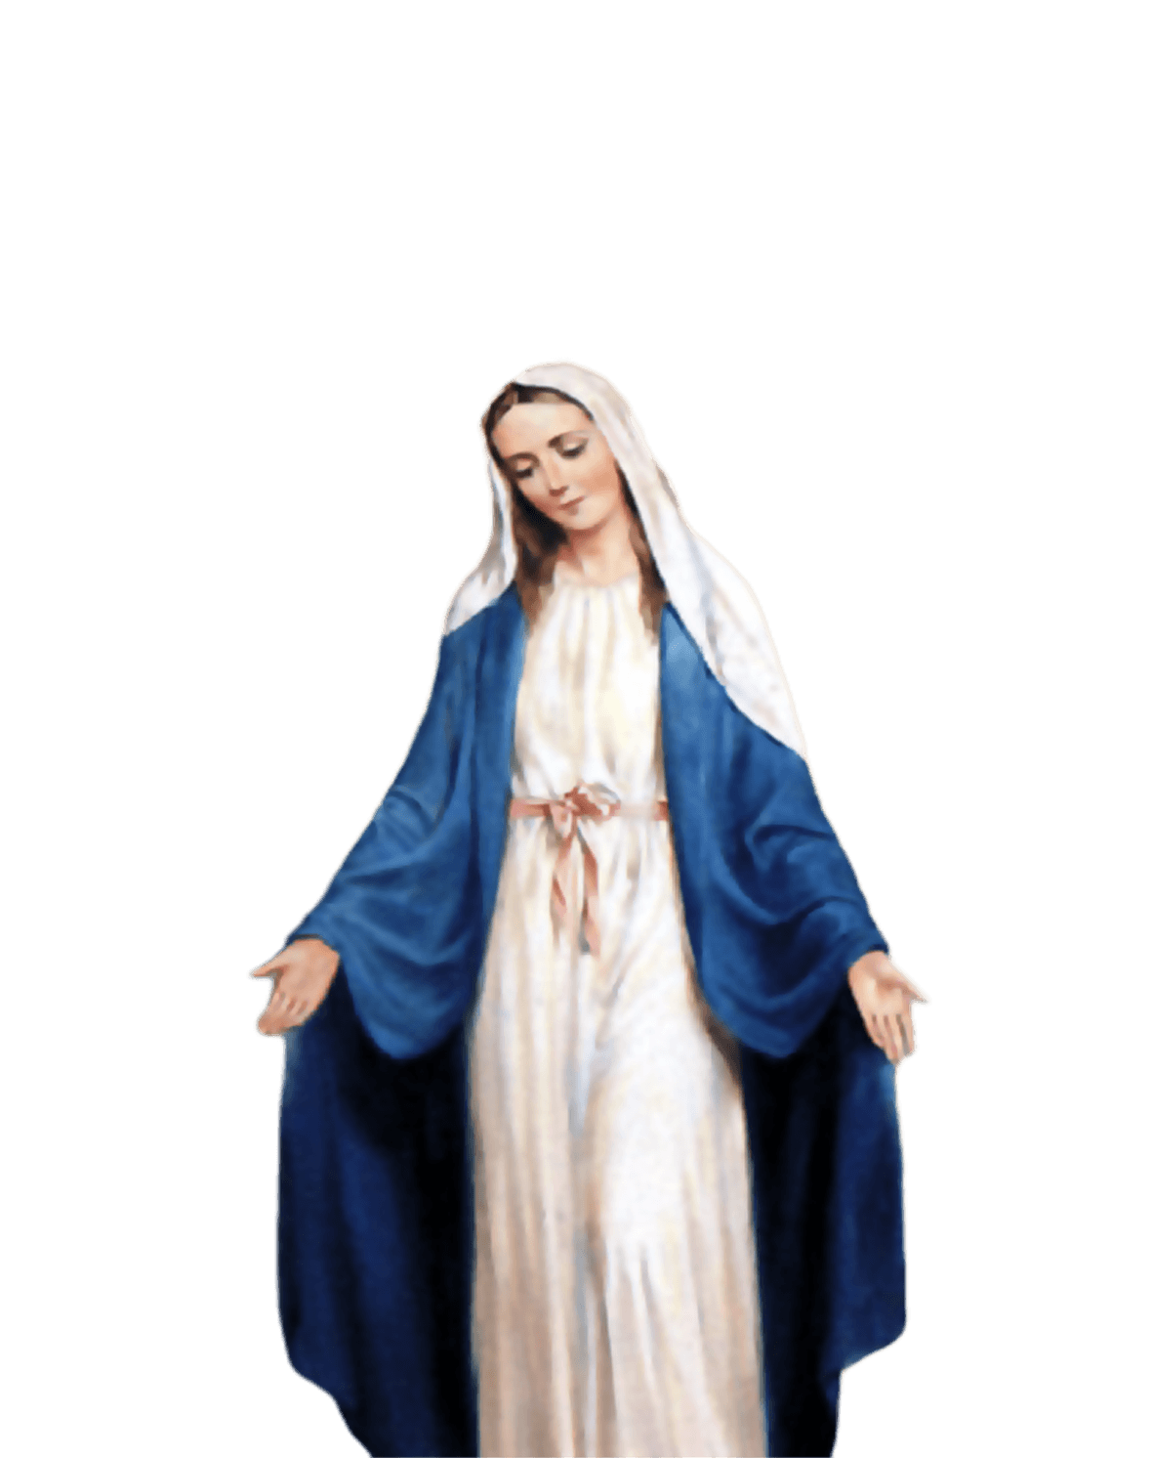
ST MARY’S SCHOOL PRAYER
O Holy Mary,
Mother and Patron of our school,
Turn your eyes of mercy towards us,
that we may love God
With all our hearts!
May we imitate the tenderness
of your Son, Jesus,
showing love and respect
For each person
and ourselves as children of God.
Guided by the Holy Spirit,
May we create the school,
where Mercy and Compassion
Is the centre of our lives.
Amen

Slide 3
EYFS
Kree
For his amazing attention and listening this week and for really trying hard with his learning and joining in. He is becoming more confident to communicate his voice in larger groups.
Miss Barker

Slide 4
Year 1/2
George
For being a superstar for Miss Bakali last week and achieving fantastic results in his assessments!
Miss Sweet and Miss Bakali

Slide 5
Year 3
Lexi-Mai
For her fantastic curiosity and determination to truly understand the ‘why’ behind her learning, always going the extra mile to challenge herself independently!
Miss Flashman

Slide 6
Year 4
Novena
For her unfailingly positive attitude, enthusiasm in all subjects and displaying much-improved listening skills this week. Novena has shown increased responsibility this week. Keep it up!
Mr Whear

Slide 7
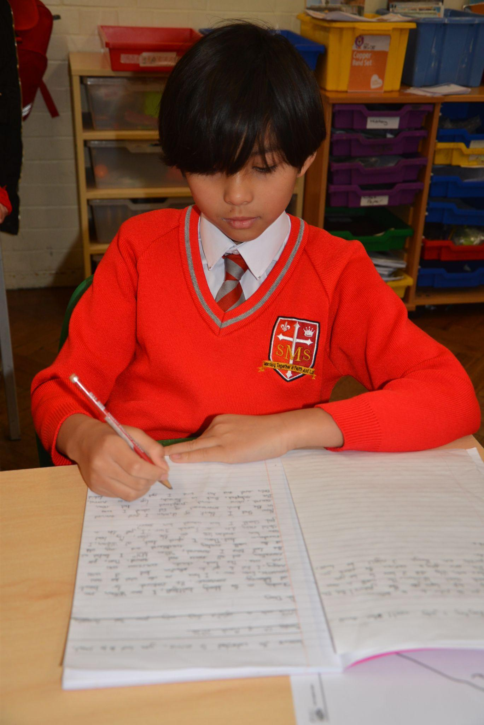
Year 5
Gut
For showing fantastic progress in making positive choices and taking greater responsibility. This week, he was a wonderful role model by welcoming our new pupil to Year 5, showing kindness, enthusiasm and leadership.
Miss O’Mara

Slide 8
Year 6
Cali
For consistently showing exemplary levels of kindness, responsibility and effort. Her achievements across her learning and assessments has been exceptional.
Mr Cherfi

Slide 9



STAR READER
Y1/2 - Jahmiel
Y3 - Kai
Y4 - Sarah
Y5 - Savannah & Grae
Y6 - Nelly

Slide 10
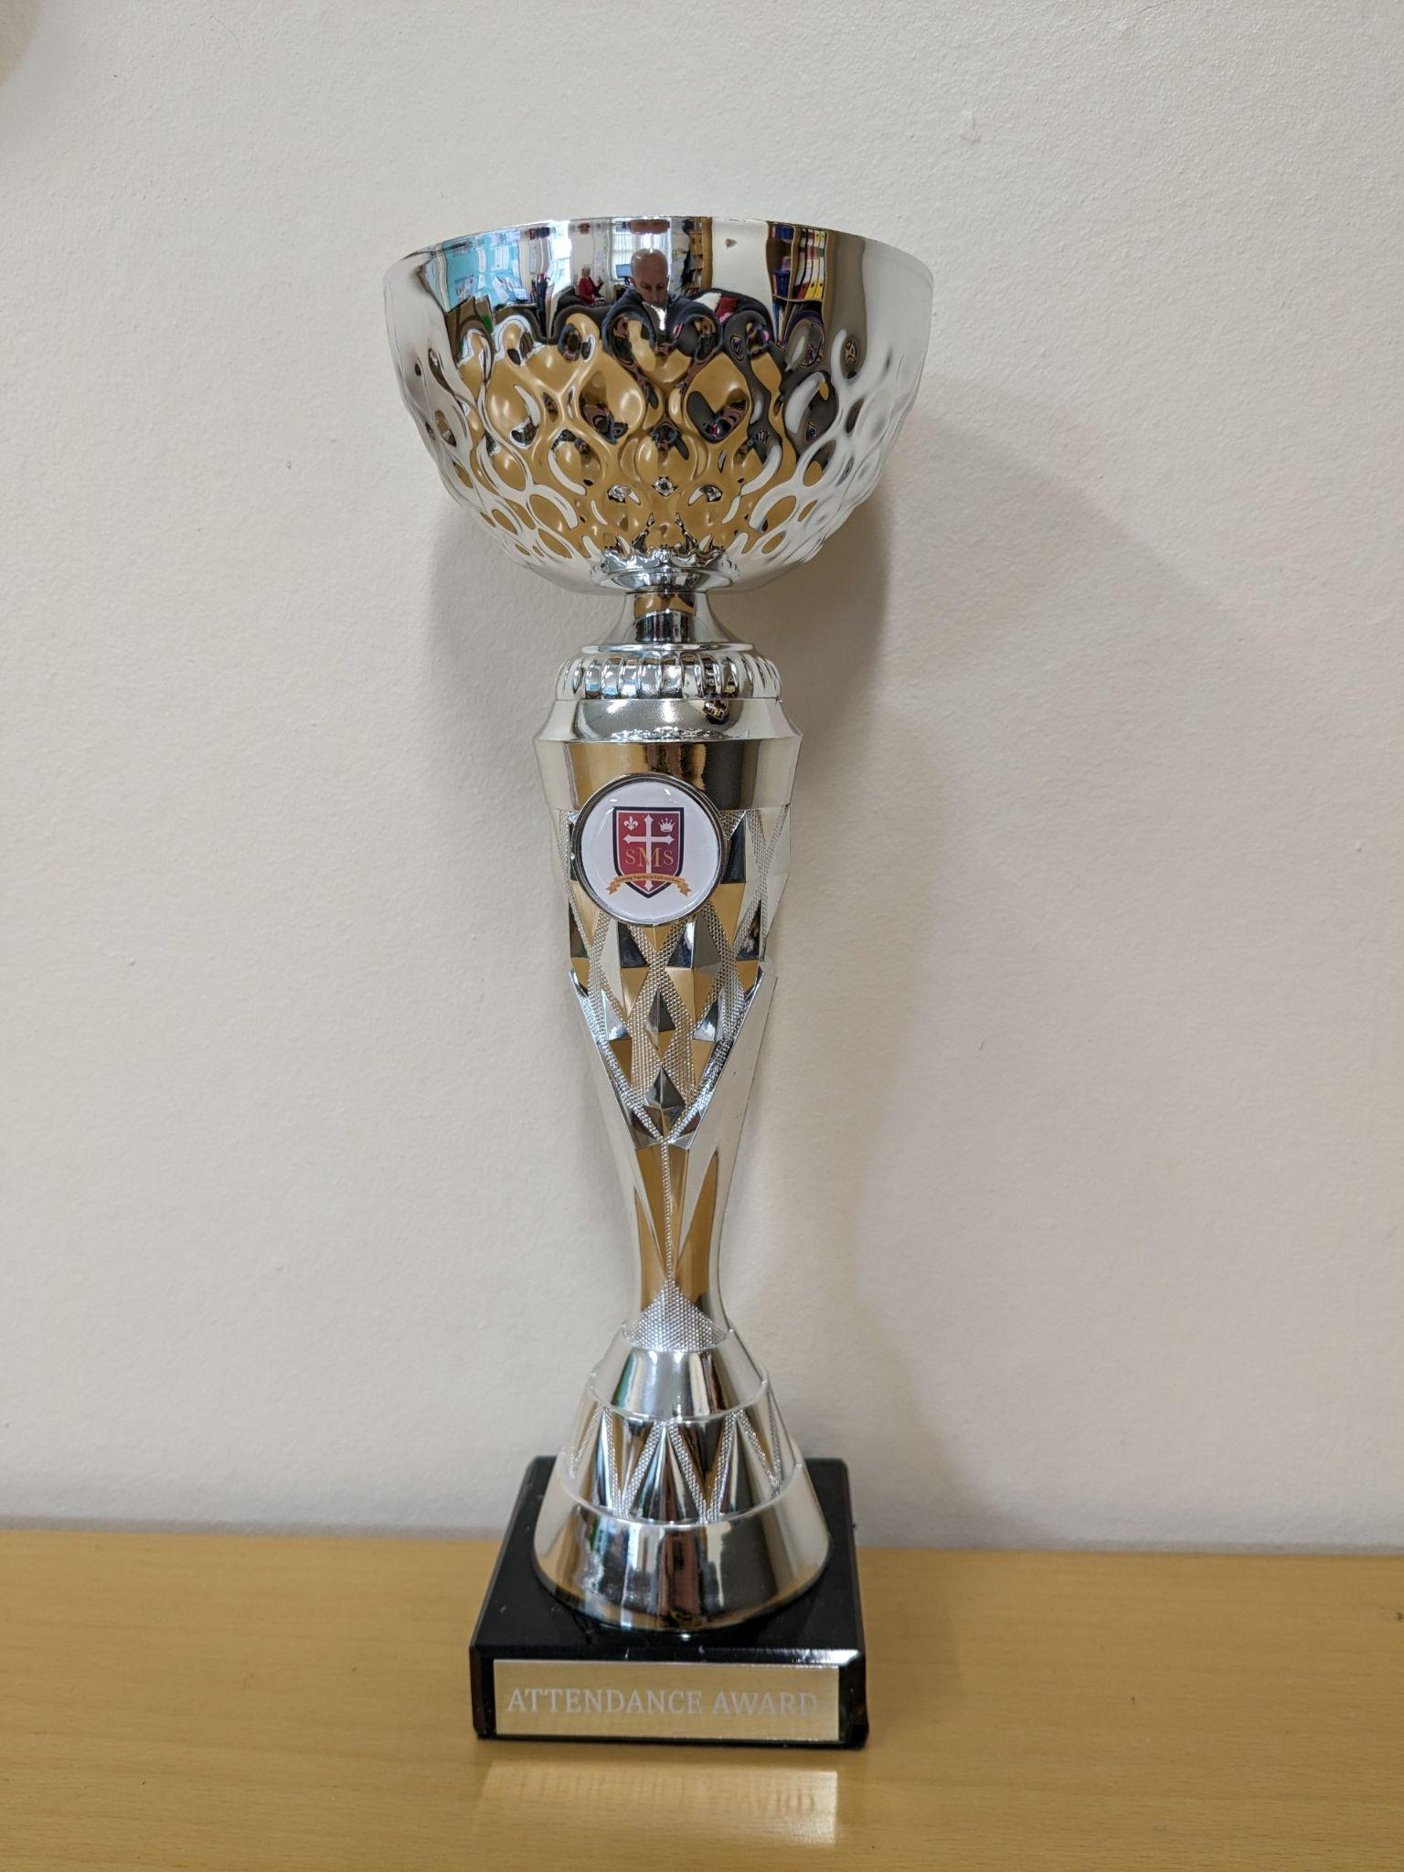
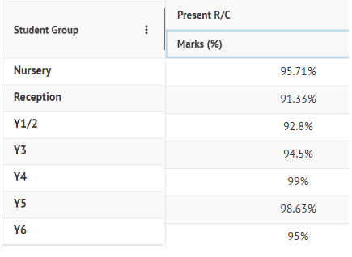
Attendance Weekly Leader:

Slide 11
Attendance Weekly Leader:
Attendance Winners for this week:
Year 4
With 99% attendance

Slide 12
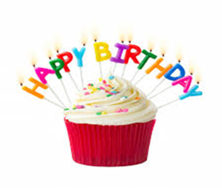
Noel - Year 3
Maria Y4

Slide 13
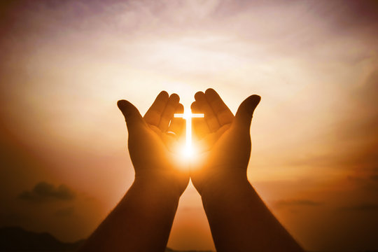
Let us pray.
"Dear God, thank you for loving us and forgiving us when we make mistakes. Forgiveness can be very hard for us to do on our own. Please give us big hearts full of your love, and help us to choose to forgive others just like you forgive us. Amen."

