Slide 1



Whole School
Star of the Week
Friday 18th September 2026

Slide 2
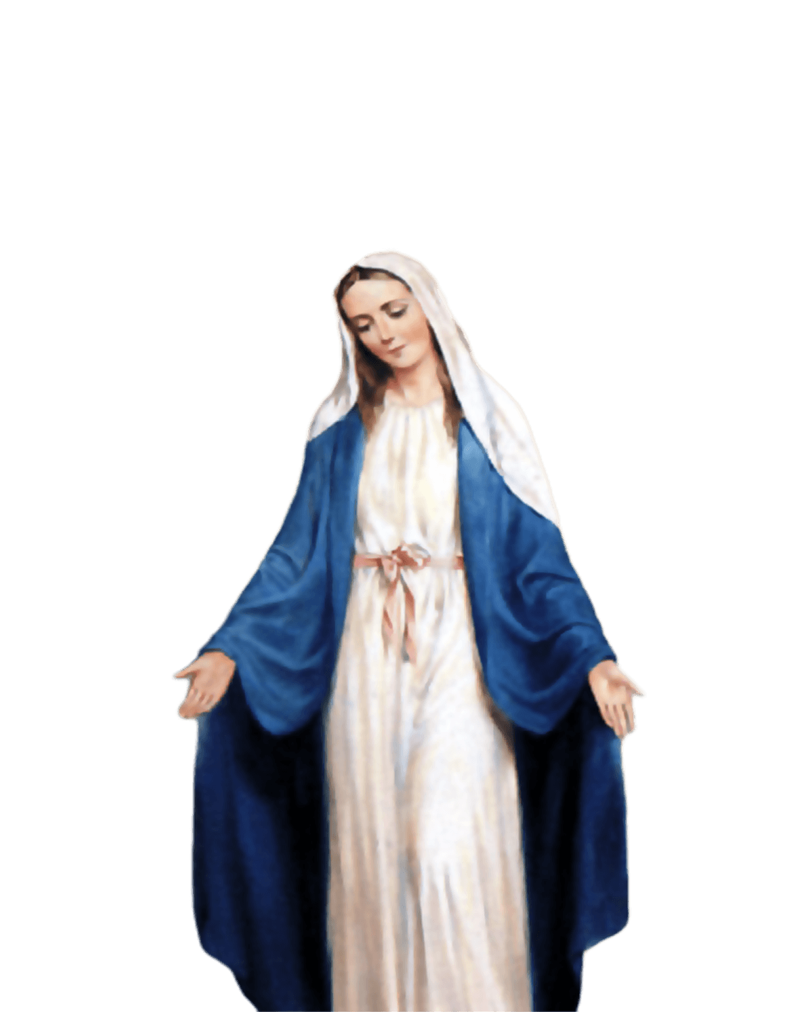
ST MARY’S SCHOOL PRAYER
O Holy Mary,
Mother and Patron of our school,
Turn your eyes of mercy towards us,
that we may love God
With all our hearts!
May we imitate the tenderness
of your Son, Jesus,
showing love and respect
For each person
and ourselves as children of God.
Guided by the Holy Spirit,
May we create the school,
where Mercy and Compassion
Is the centre of our lives.
Amen

Slide 3
EYFS
Kobi
For his amazing effort this week in listening and following instructions
Miss Barker

Slide 4
Year 3
Farah
For settling into KS2 so brilliantly! Being a role model, asking curious questions, and putting her best effort into all her work.
Miss Flashman

Slide 5
Year 4
Zoe
For being an excellent model - showing respect, kindness, tolerance, responsibility and cooperation at all times - and displaying excellent listening skills.
Mr Whear

Slide 6
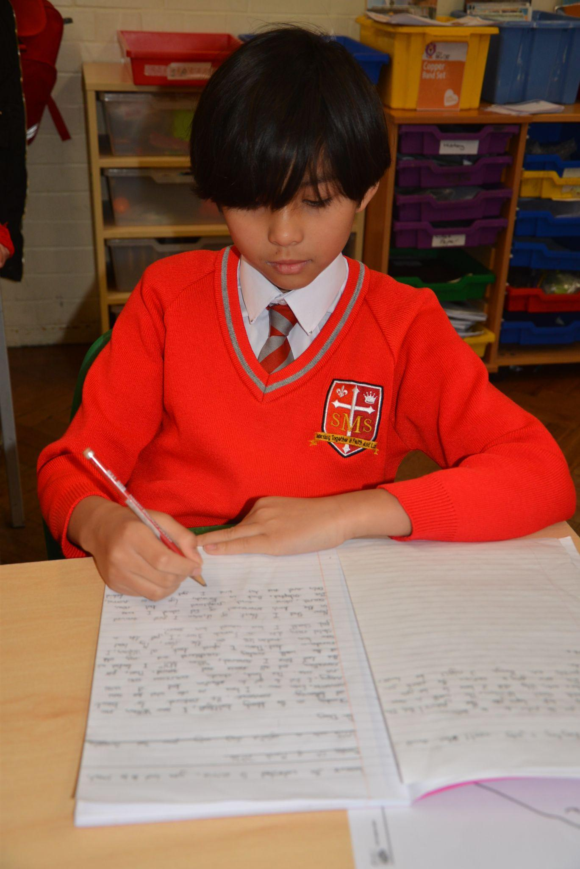
Year 5
Teddie
For working extremely hard on his handwriting to create a wonderful character description and for always being in the right place, at the right time and doing the right activity.
Miss O’Mara

Slide 7
Year 6
Franzen
For showing great resilience all week and pushing her learning forward to another level.
Mr Cherfi

Slide 8



STAR READER
Y3 - Olly
Y4 - Harry
Y5 - Rakeb
Y6 - Deborah

Slide 9

Nicholas - Year 4
Deborah - Y6
Jayden - Year 5
Cecilia - Year 2
Renai-Mae - Year 4
Yusuf - Year 6
Nicholas - Year 4

Slide 10
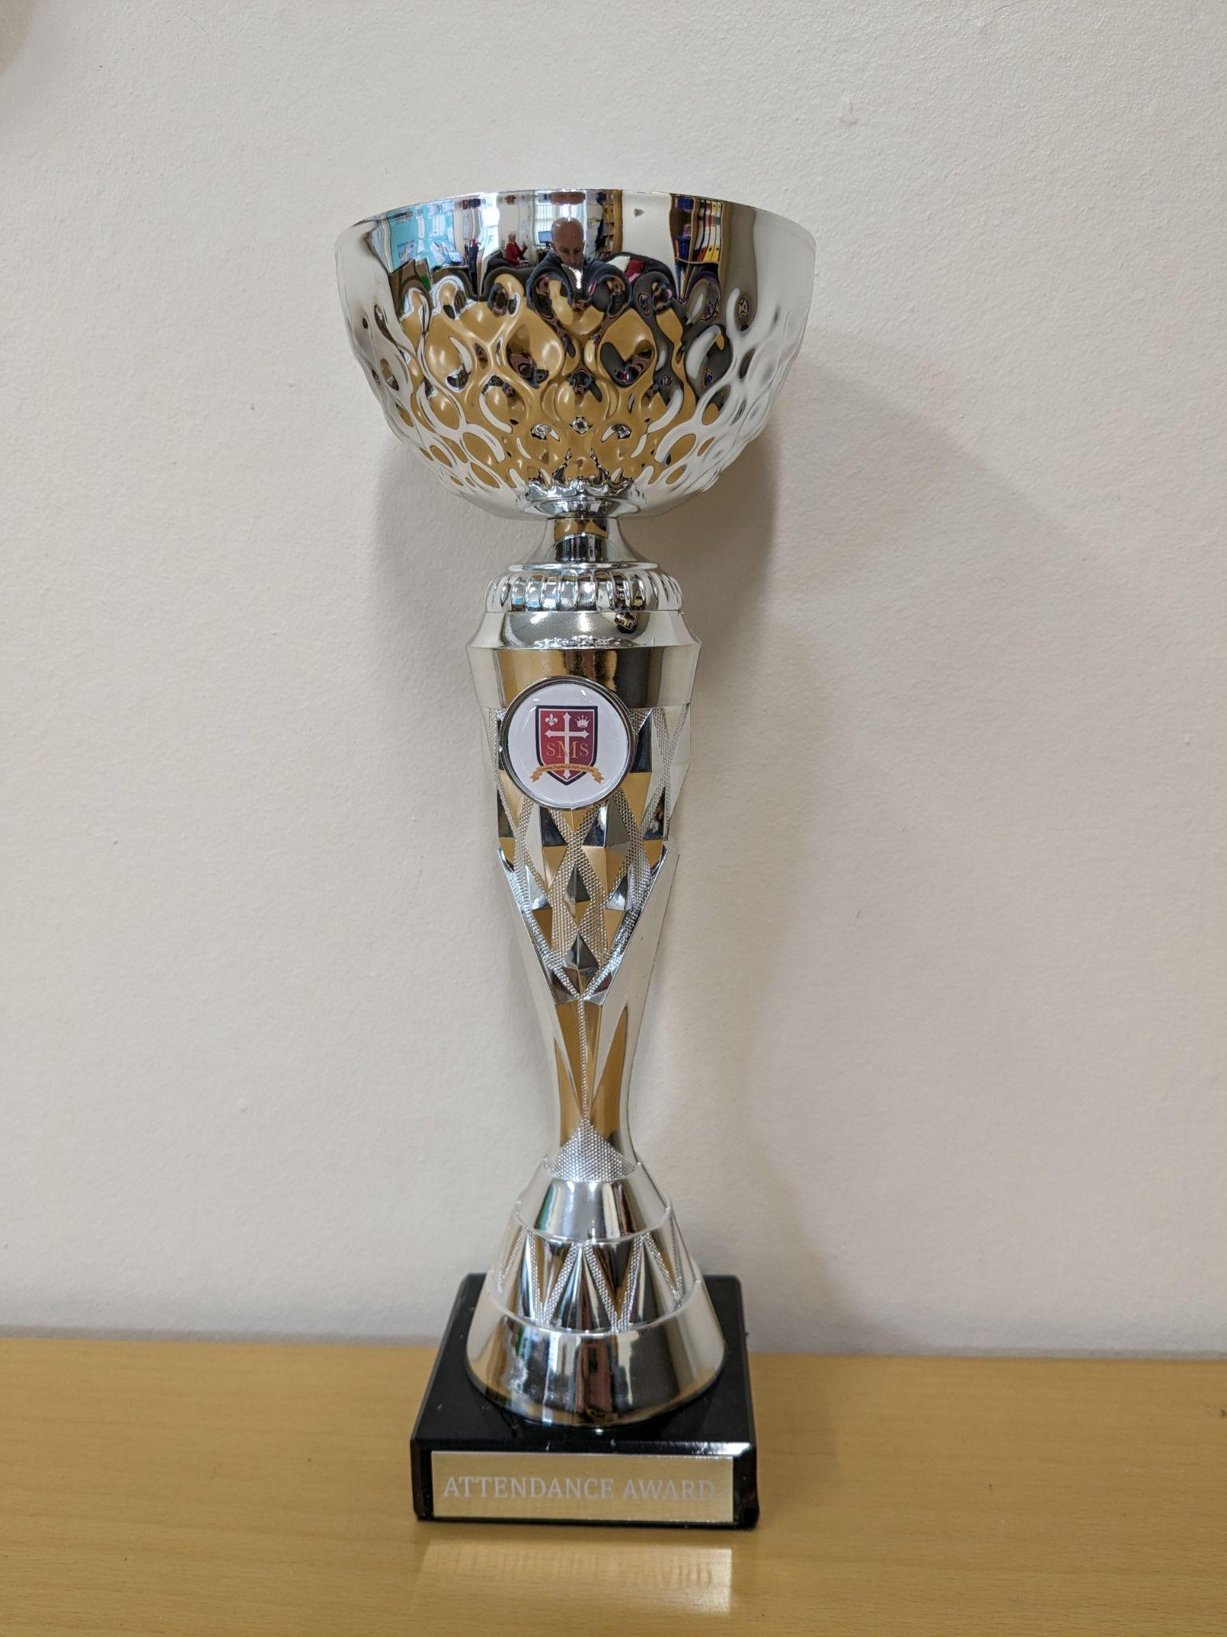
Attendance Weekly Leaders
Attendance Winners for this week:
Year 3 with 100%

Slide 11
Whole School
Star of the Week
Friday 18th September 2026

Slide 12

Gospel
Matthew 18:21-35
‘I do not say to you seven times, but seventy times seven.’

Slide 13

Let us pray.
"Dear God, thank you for loving us and forgiving us when we make mistakes. Forgiveness can be very hard for us to do on our own. Please give us big hearts full of your love, and help us to choose to forgive others just like you forgive us. Amen."

