Slide 1



Whole School
Star of the Week
Friday 19th June 2026

Slide 2
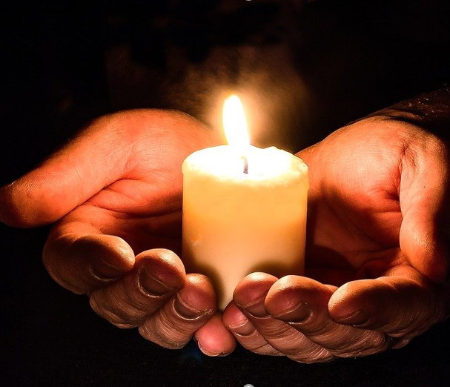
As we gather together, we pray for all those who have suffered because of the Grenfell Tower fire nine years ago.
We pray for all the residents of Grenfell Tower. We pray particularly for those who have suffered injury, those who have died, and all the residents who were left without a home, families who lost their loved ones and the entire community that has been affected.
We will now have 72 seconds of silence for 72 lives lost.

Slide 3

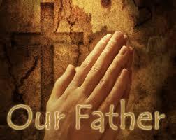
Our Father who art in Heaven
Hallowed be Thy Name
Thy Kingdom come
Thy will be done on Earth as it is in Heaven
Give us this day our daily bread
And forgive us our trespasses
As we forgive those who trespass against us
And lead us not into temptation
But deliver us from evil
Amen

Slide 4
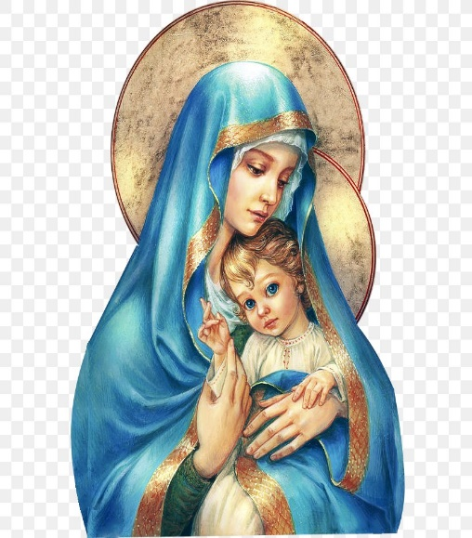
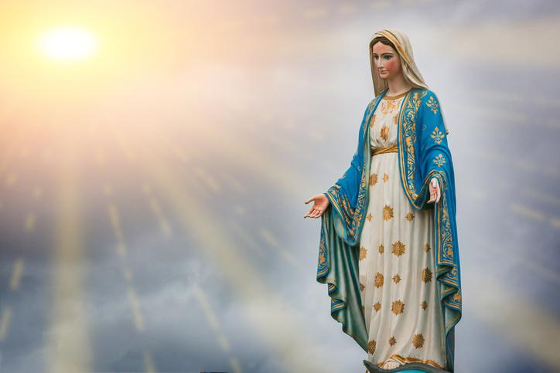
Hail Mary, Full of Grace
The Lord is with Thee
Blessed are Thou amongst women
And Blessed is the fruit of Thy womb, Jesus
Holy Mary , Mother of God
Pray for us sinners
Now and in the hour of our death
Amen

Slide 5
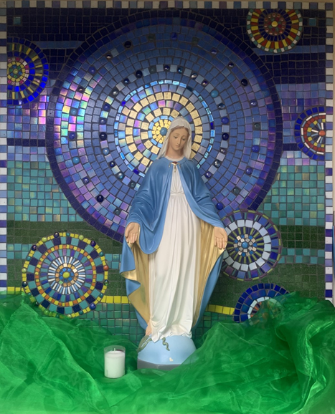
St Mary’s School Prayer
O Holy Mary,
Mother and Patron of our school,
Turn your eyes of mercy towards us,
that we may love God
With all our hearts!
May we imitate the tenderness
of your Son, Jesus,
showing love and respect
For each person
and ourselves as children of God.
Guided by the Holy Spirit,
May we create the school,
where Mercy and Compassion
Is the centre of our lives.
Amen

Slide 6
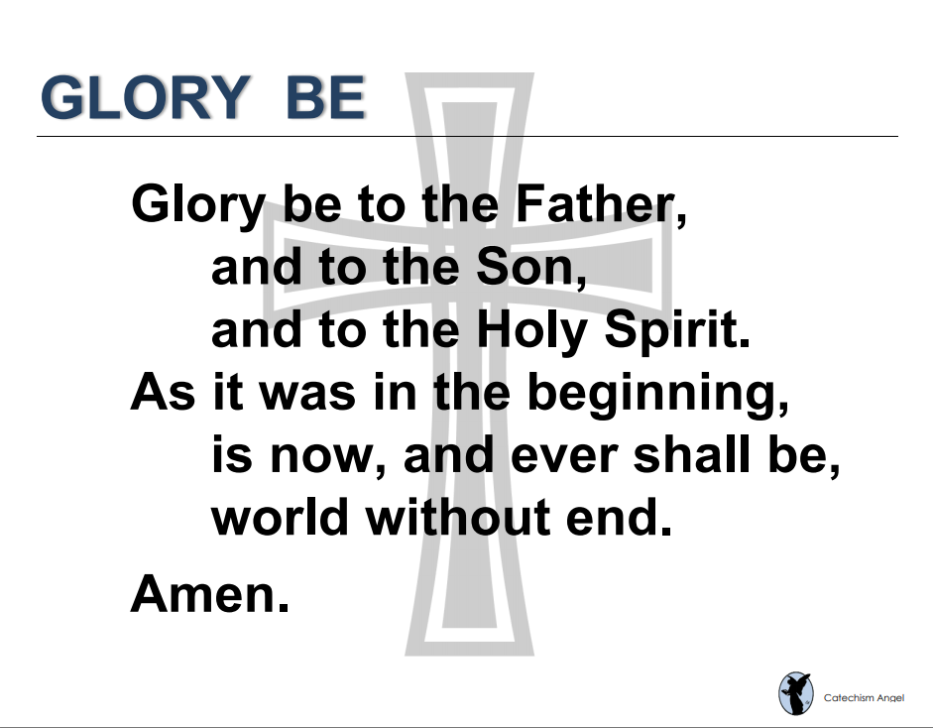

Slide 7
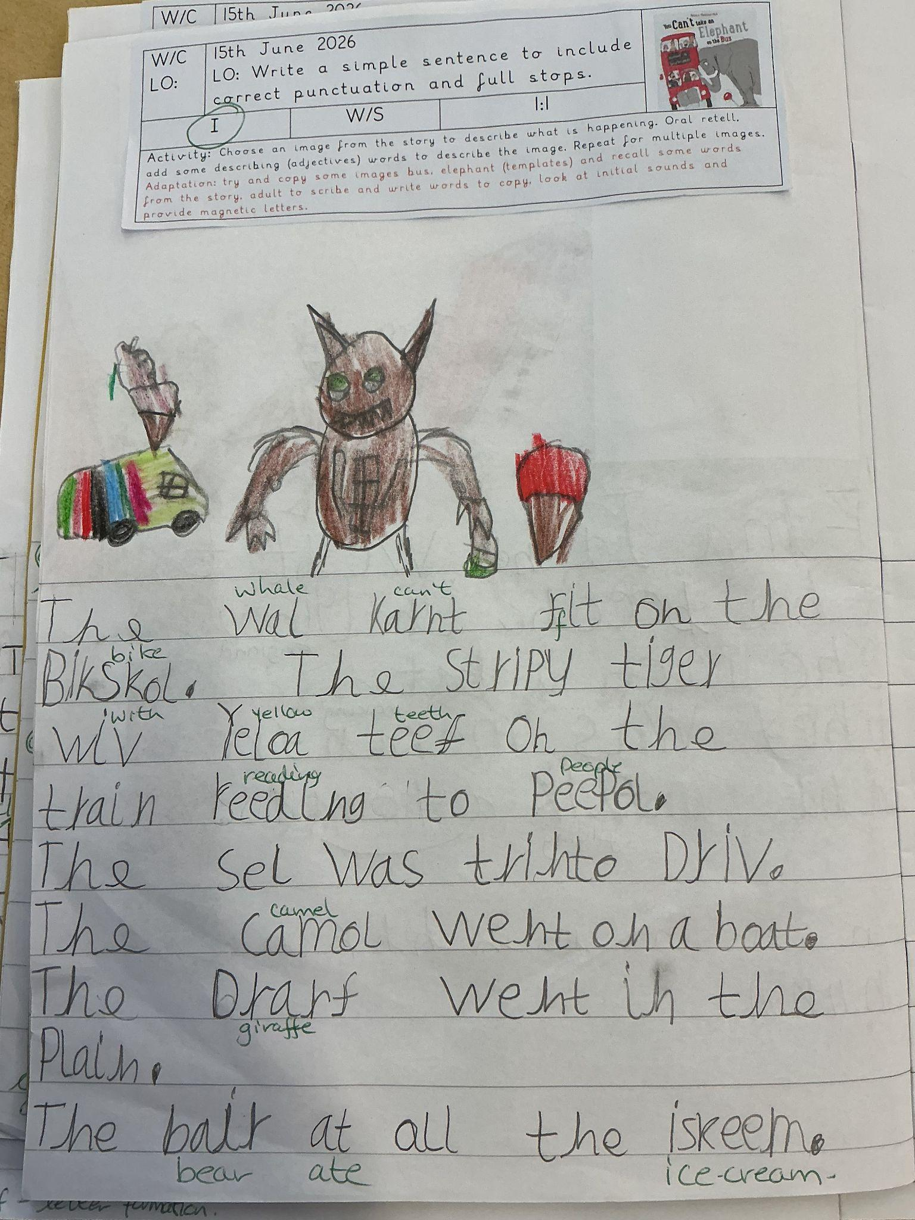
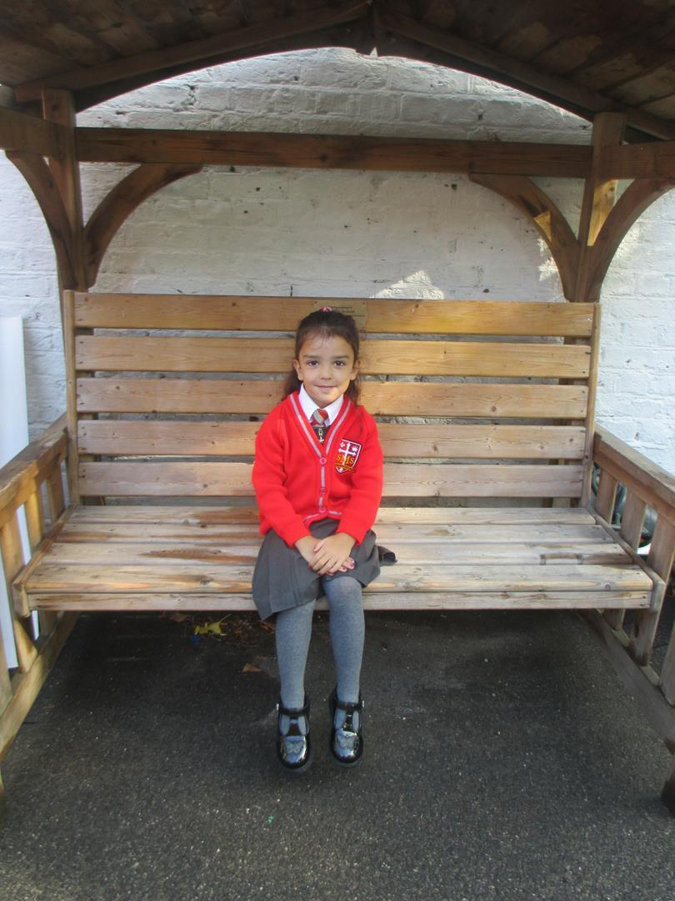
Reception
For her excellent writing this week in both Literacy and RE lessons. We are all so proud of you!
Miss Barker

Slide 8
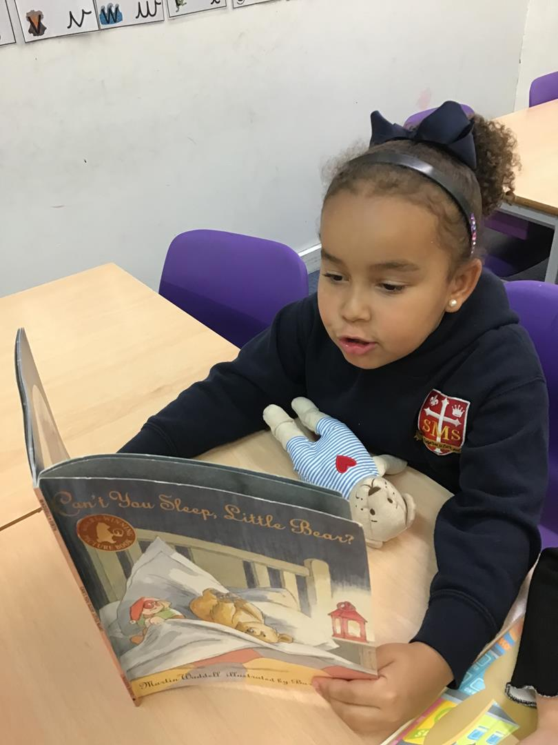
Year 1
For having such a positive week, being a super helper and bringing Football fun and knowledge to our class!
Miss Flashman

Slide 9
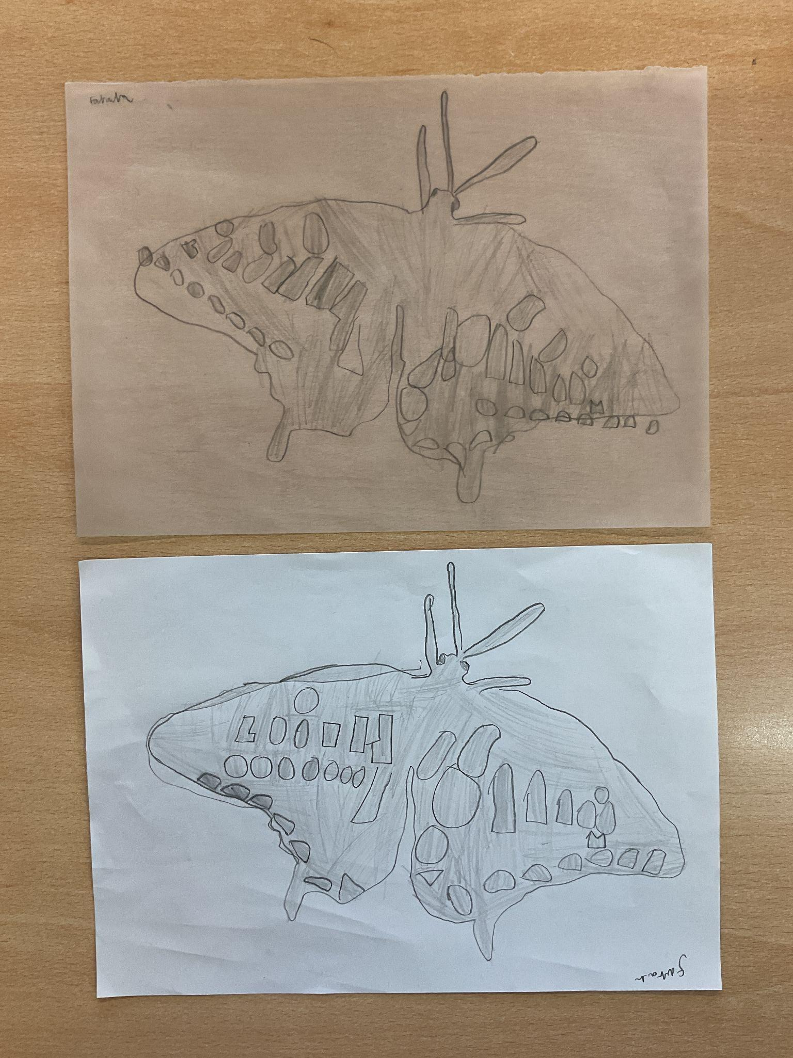
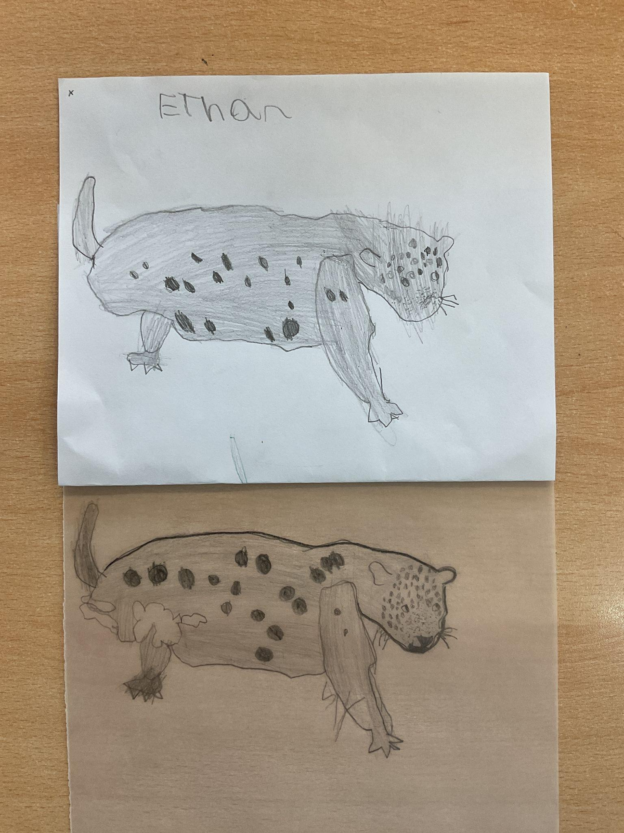
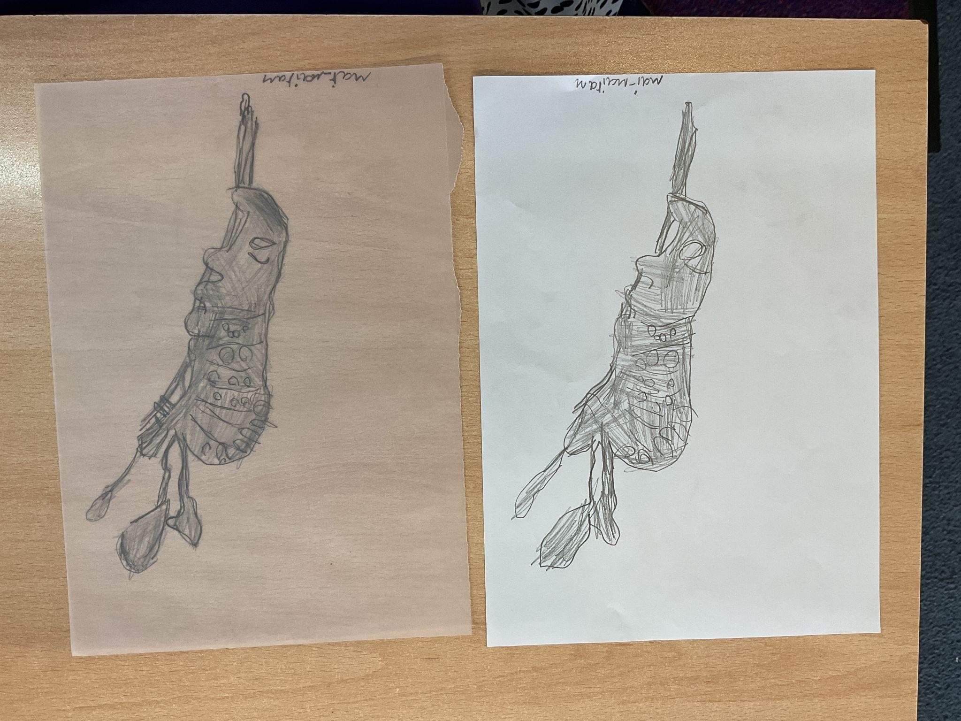
Year 2
For their detailed artwork and learning how to print from a picture.
VERY IMPRESSIVE!
Mrs Cummings

Slide 10
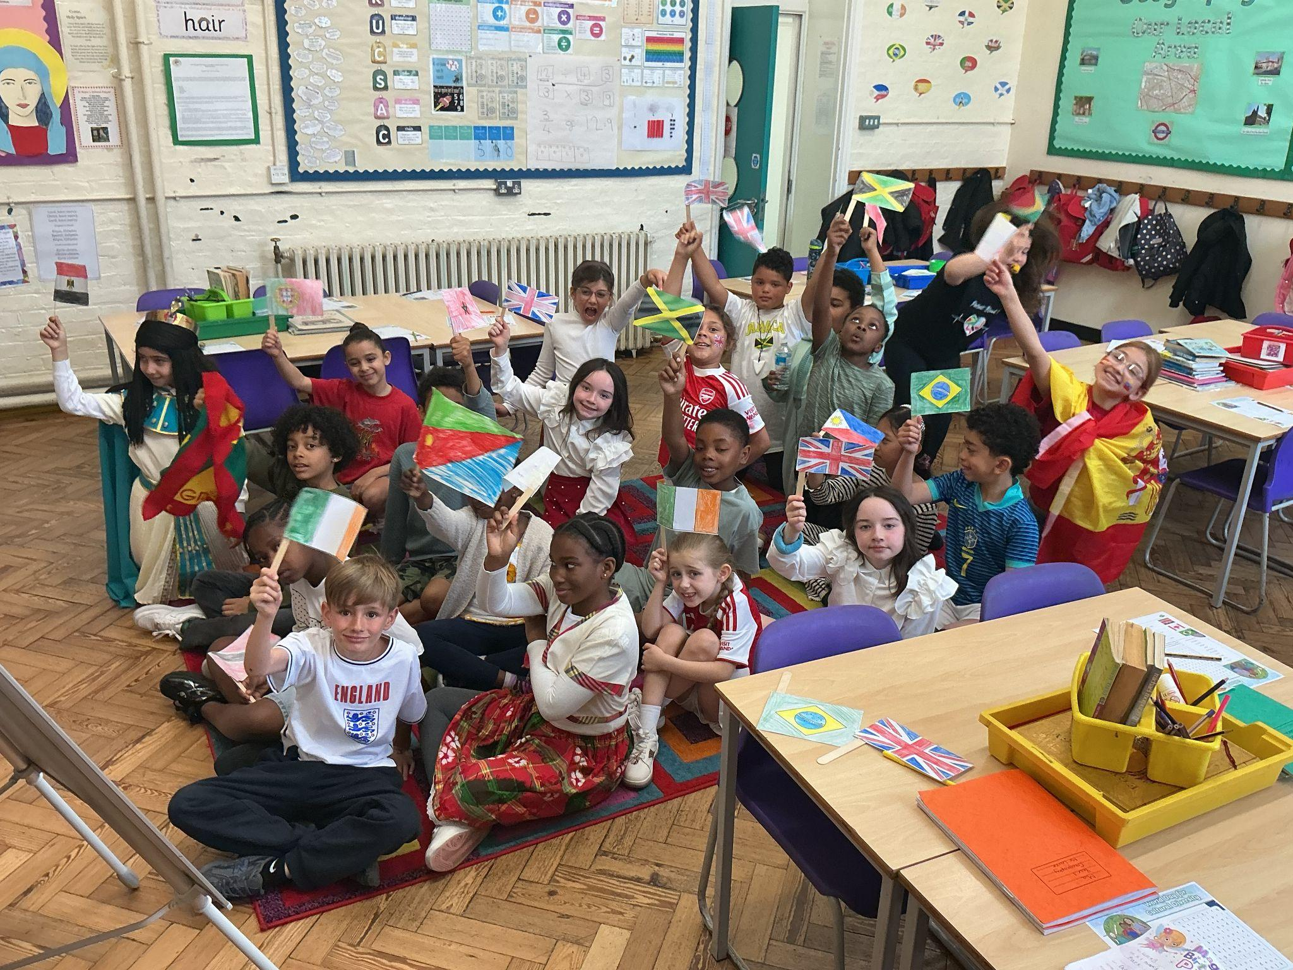
Year 3
Whole Class
For working really hard in your assessments and a fabulous class assembly!
Miss Hickey

Slide 11
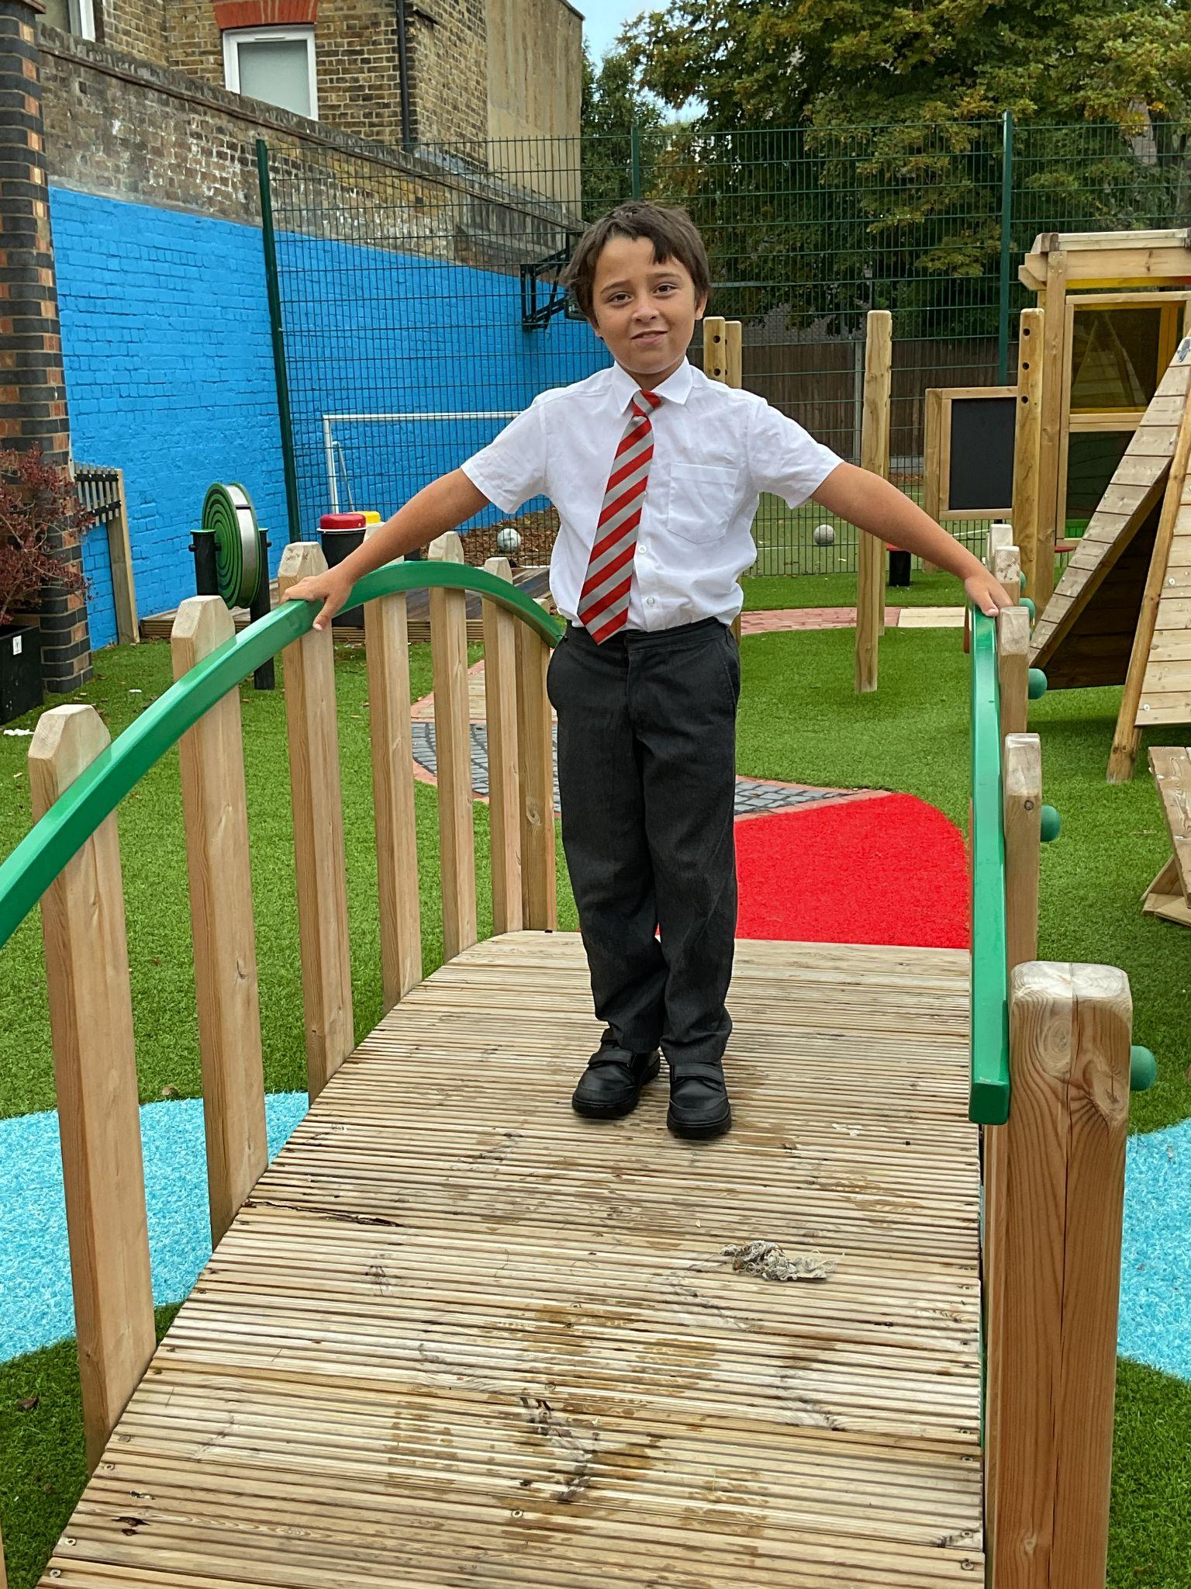
Year 4
For putting it altogether: working hard, controlling his emotions and adopting a positive approach to group activities.
Mr Whear

Slide 12
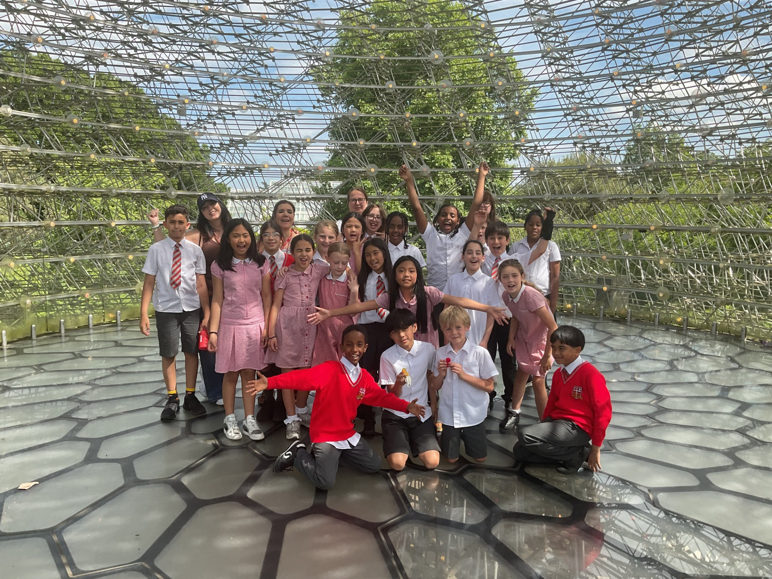
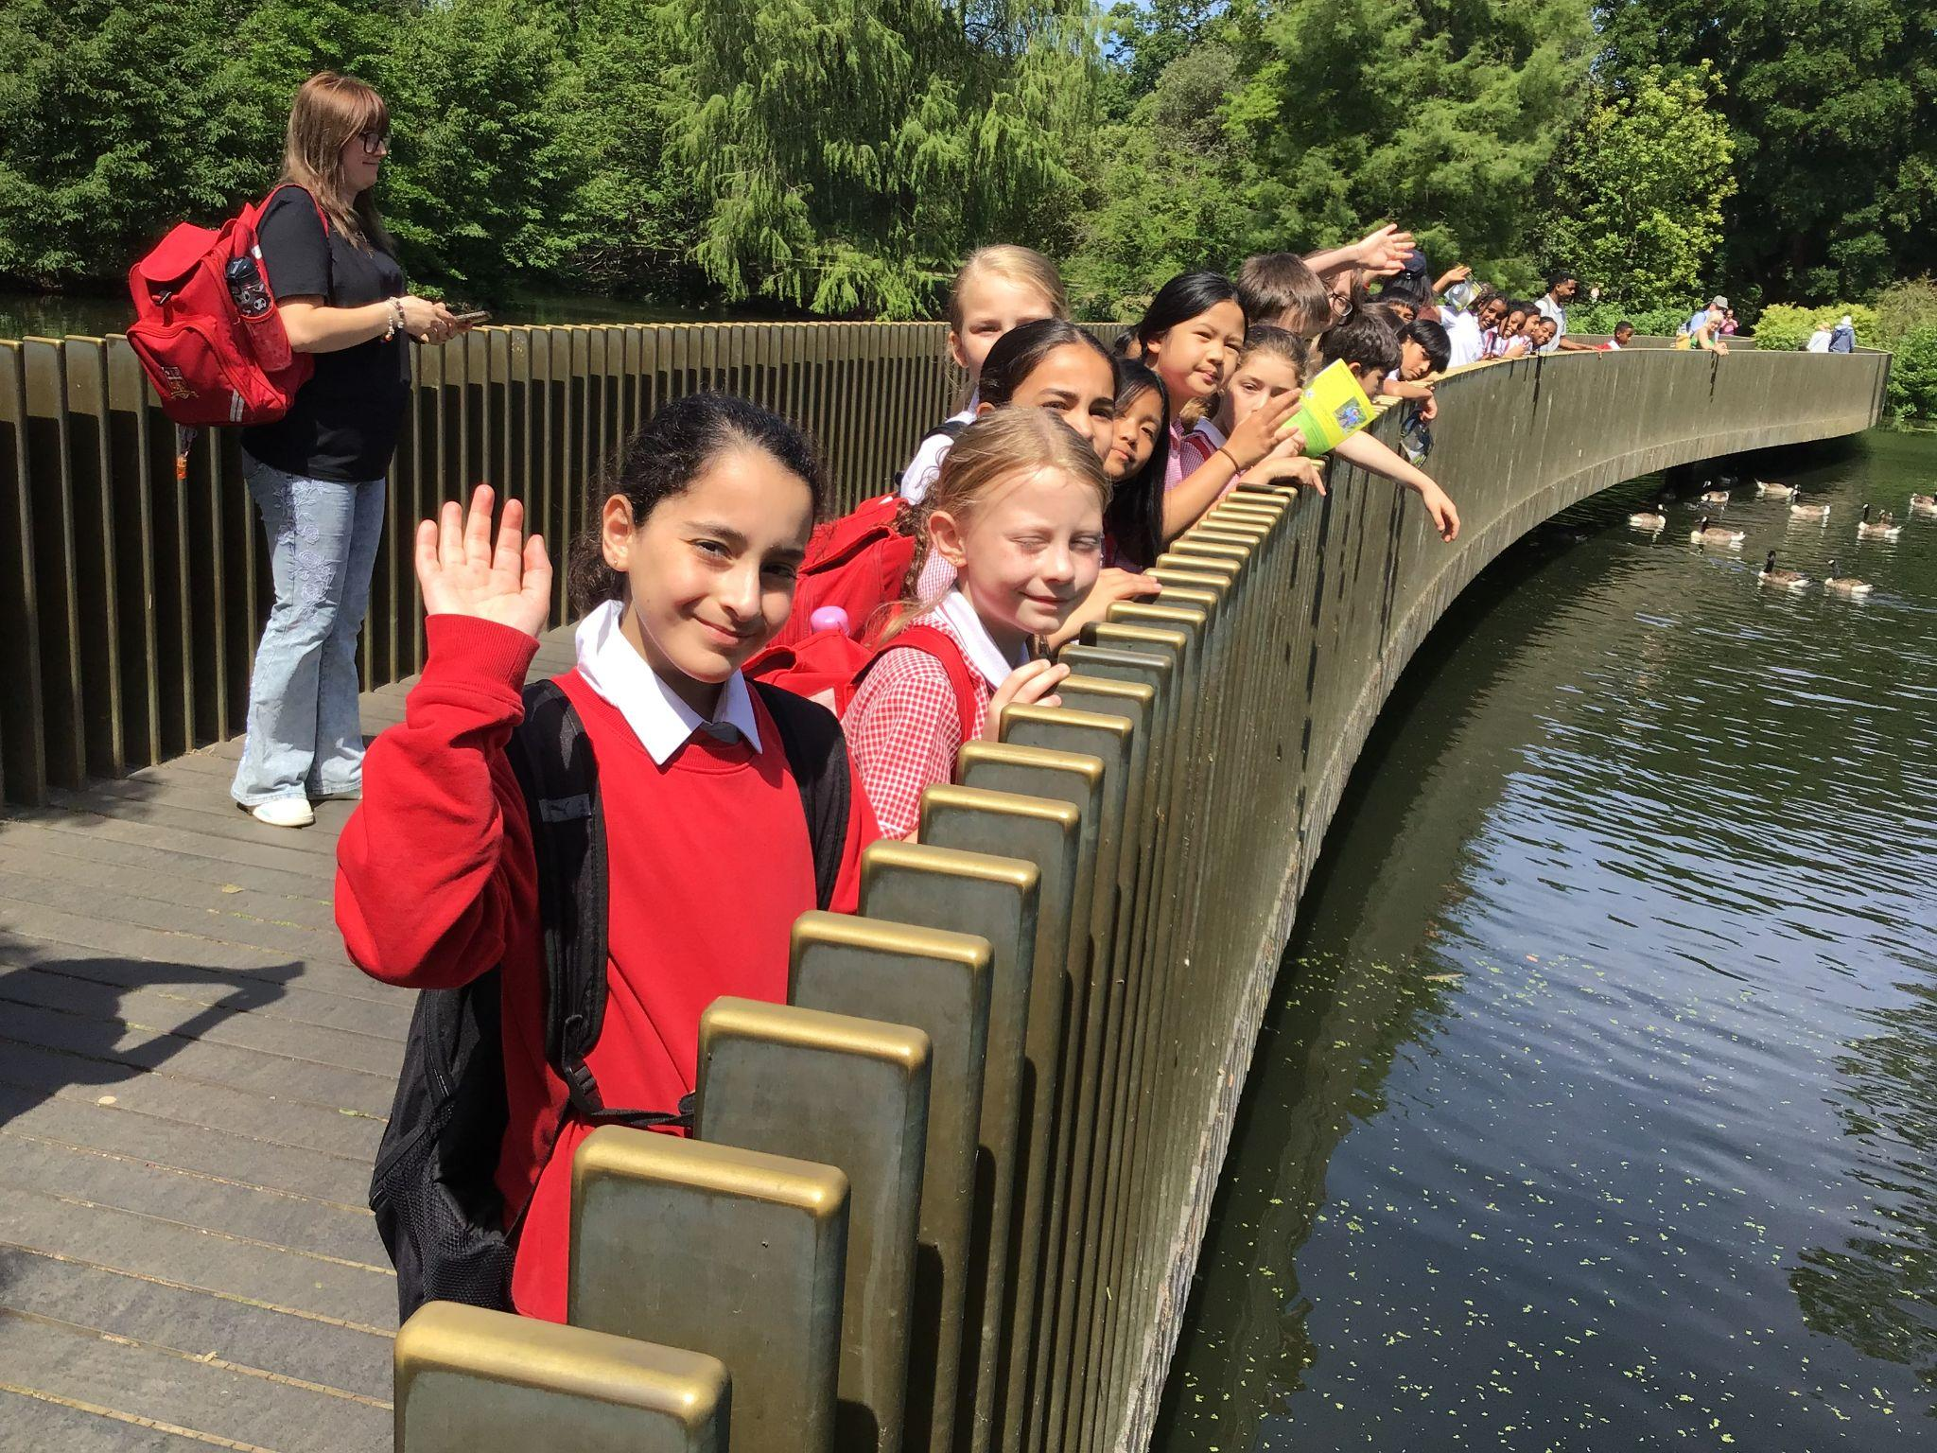
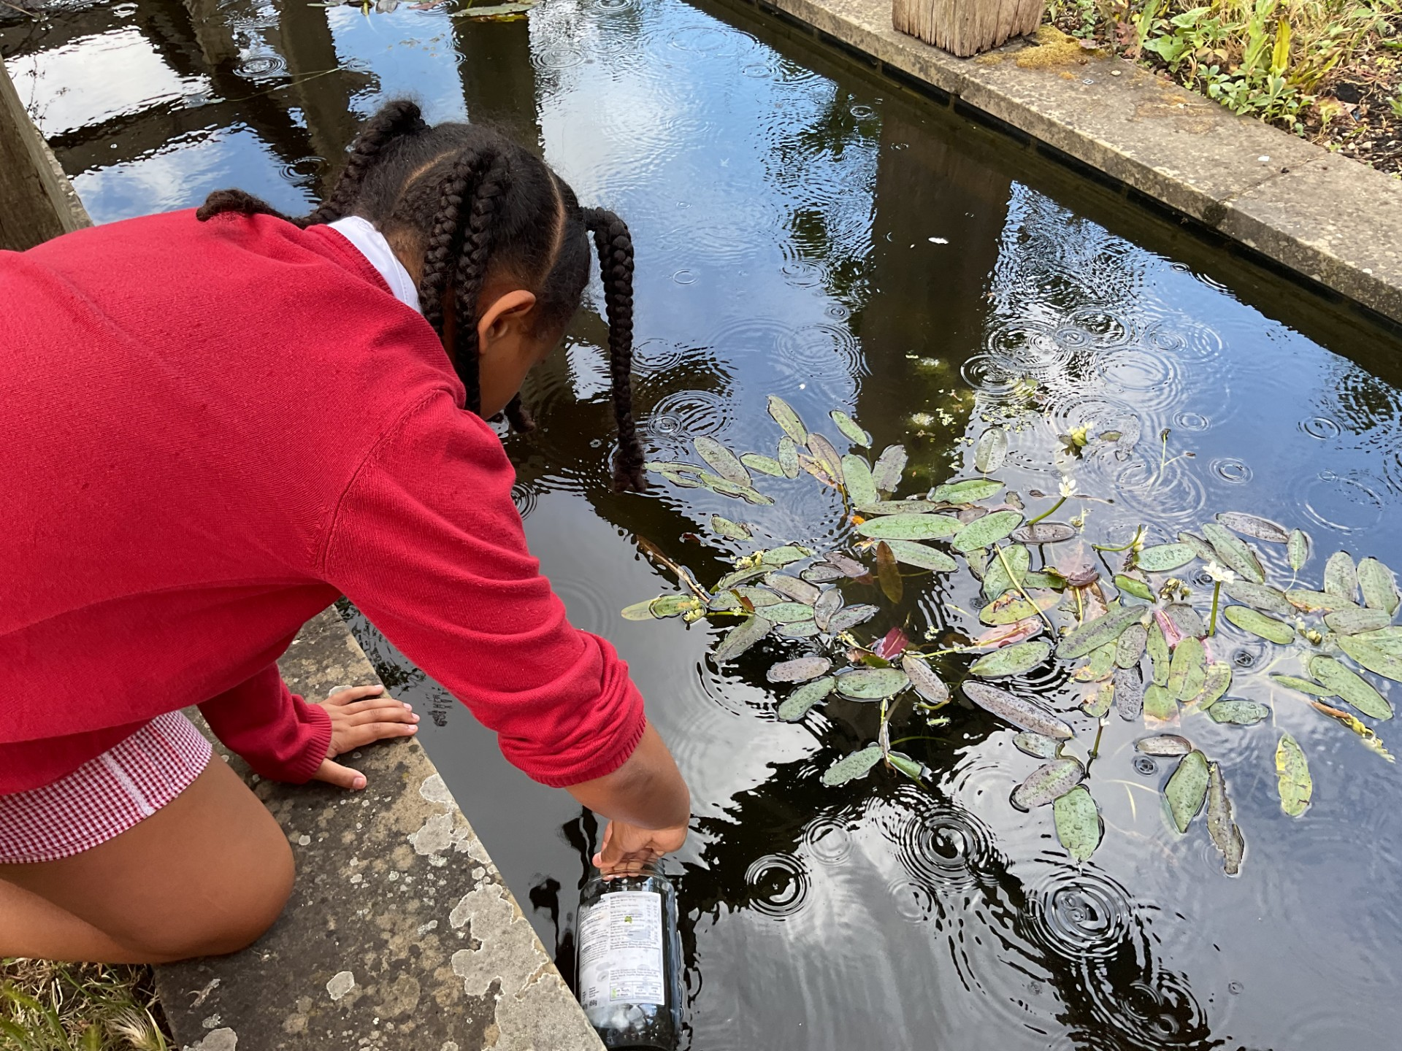
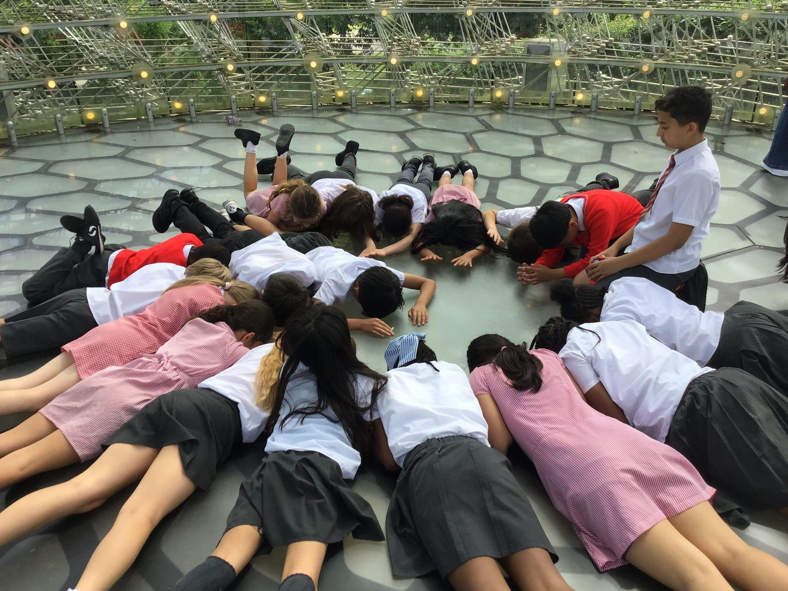
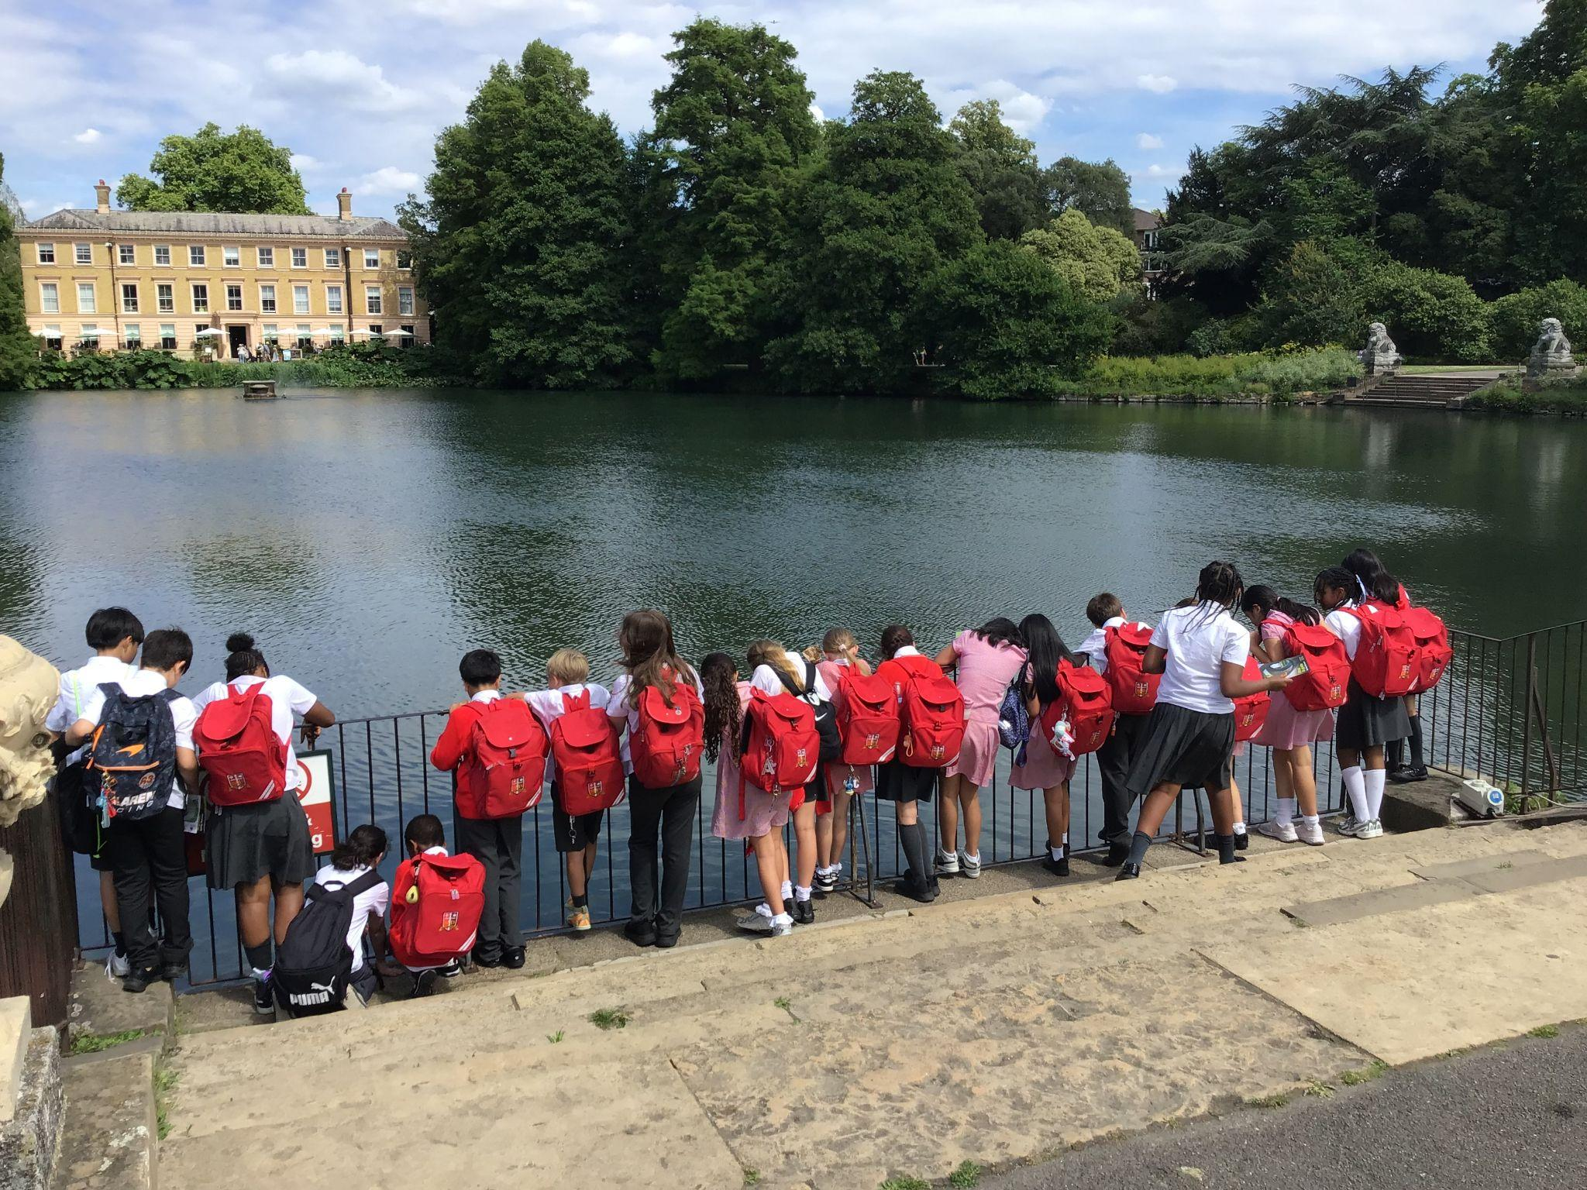
Year 5 were real-world scientists, exploring life cycles and nature first-hand. They investigated Living Things and Their Environment at Kew Gardens and compared it to native species at our local Voysey Gardens. This hands-on experience perfectly brought their science curriculum to life!
Year 5 Super Scientists!

Slide 13
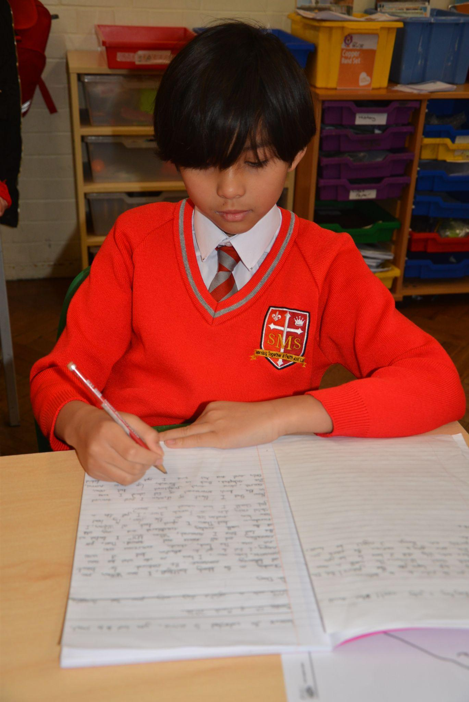
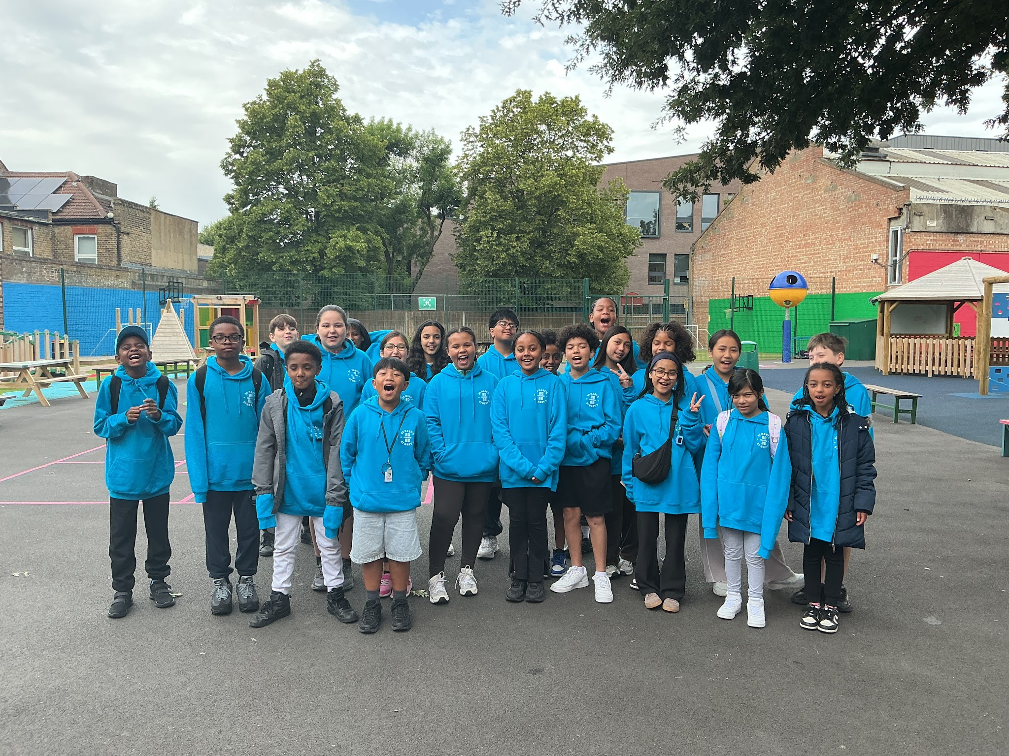
Year 6
Whole Class
For representing the school brilliantly during our Residential Trip
Mr Cherfi

Slide 14


Star Readers
Y1 - Giniayah
Y2 - Kai
Y3 - Whole Class
Y4 - Savannah
Y5 - Chloe and Mimi
Y6 - Not this week

Slide 15

Kai
Year 2
Regina
Year 6
Mrs Tusting
Lola
Year 3
Kurtny
Year 2

Slide 16
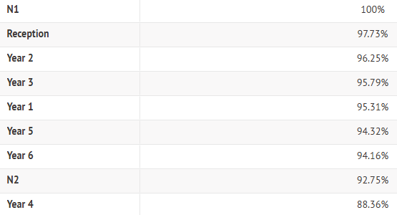
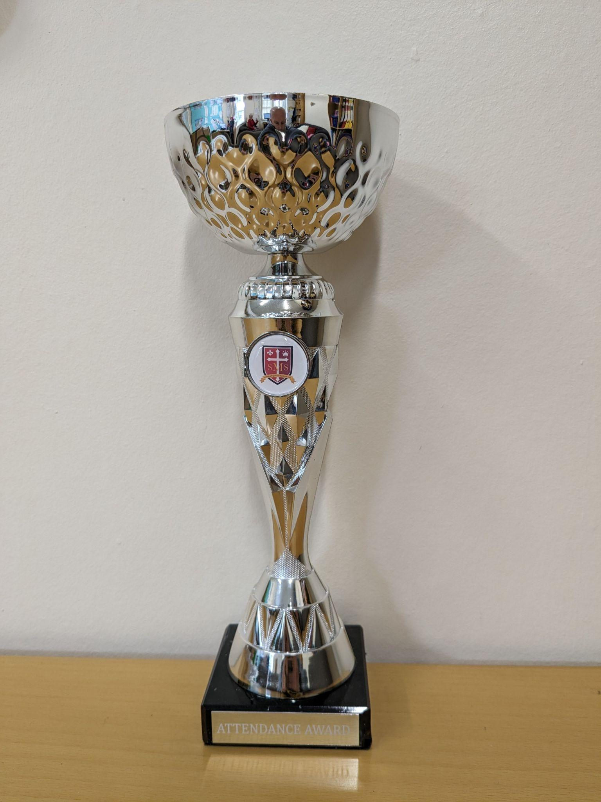
Attendance Weekly Leaders Summer Term:
Winners of the Pitch this Friday - Nursery

Slide 17
Whole School
Star of the Week
Friday 19th June 2026

