Slide 1



Whole School
Star of the Week
Friday 1st May 2026

Slide 2

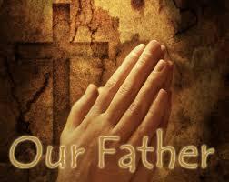
Our Father who art in Heaven
Hallowed be Thy Name
Thy Kingdom come
Thy will be done on Earth as it is in Heaven
Give us this day our daily bread
And forgive us our trespasses
As we forgive those who trespass against us
And lead us not into temptation
But deliver us from evil
Amen

Slide 3
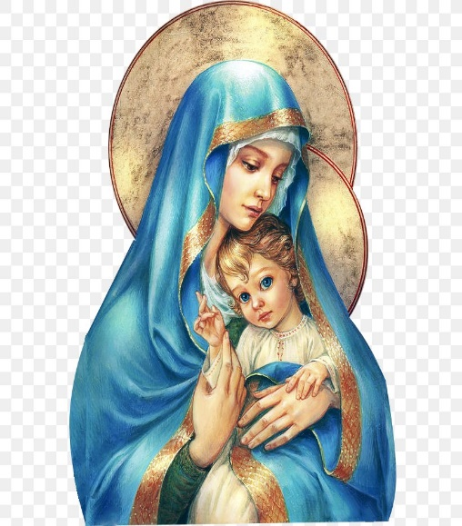
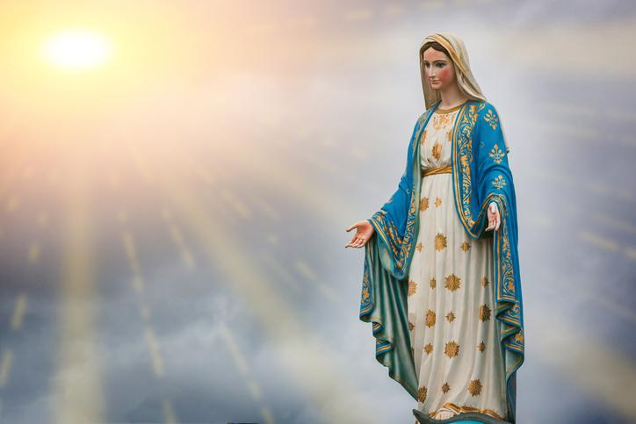
Hail Mary, Full of Grace
The Lord is with Thee
Blessed are Thou amongst women
And Blessed is the fruit of Thy womb, Jesus
Holy Mary , Mother of God
Pray for us sinners
Now and in the hour of our death
Amen

Slide 4
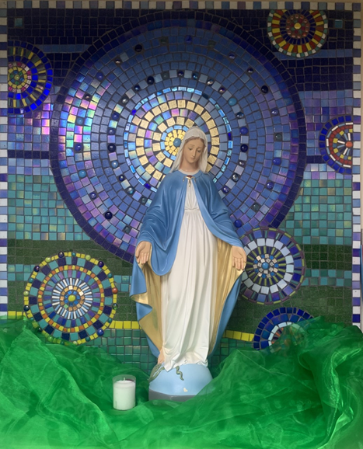
St Mary’s School Prayer
O Holy Mary,
Mother and Patron of our school,
Turn your eyes of mercy towards us,
that we may love God
With all our hearts!
May we imitate the tenderness
of your Son, Jesus,
showing love and respect
For each person
and ourselves as children of God.
Guided by the Holy Spirit,
May we create the school,
where Mercy and Compassion
Is the centre of our lives.
Amen

Slide 5
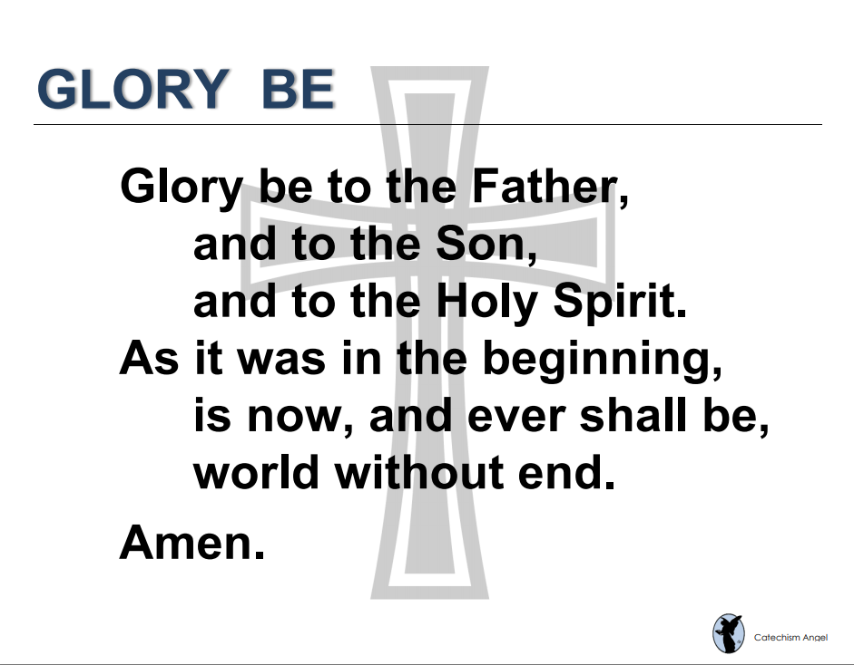

Slide 6
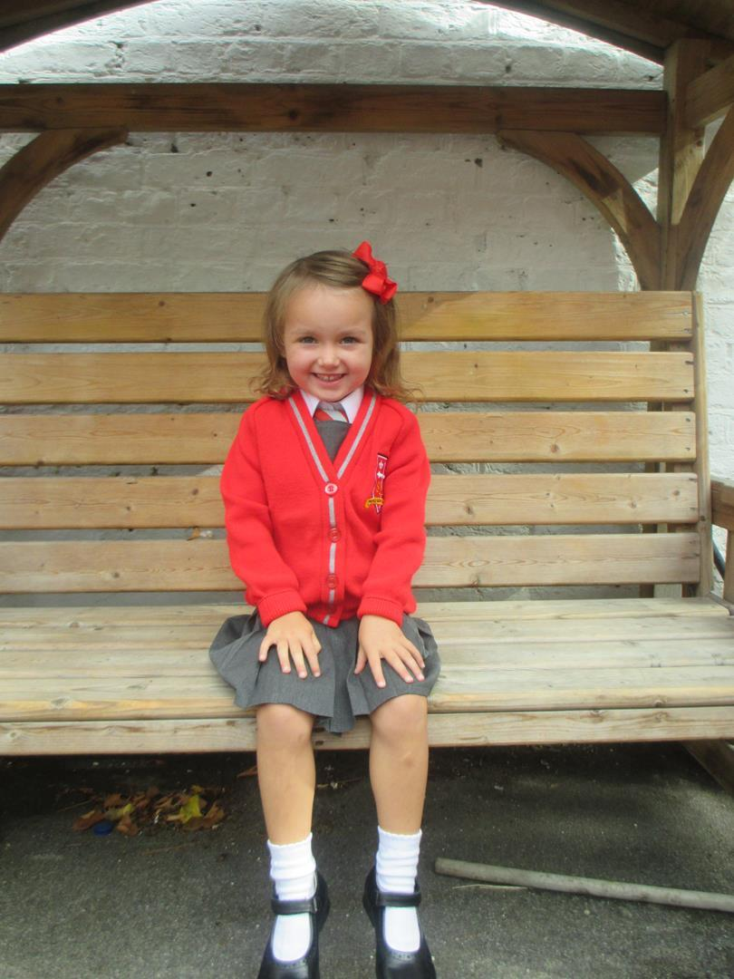
Reception
For making a huge improvement in her reading and writing.
Miss Barker

Slide 7
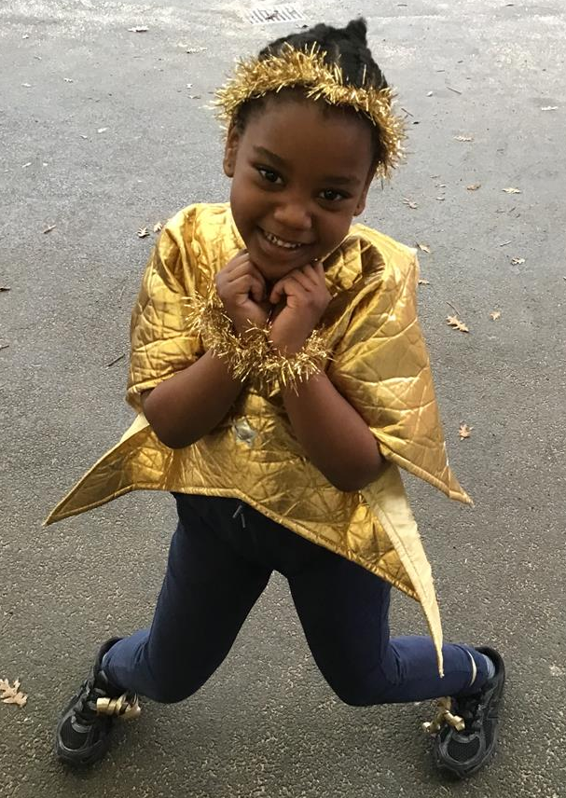
Year 1
For bringing her bubbly personality and infectious smile to our classroom, brightening everyone’s day. She has been working really hard to stay focused on her learning and should be very proud of her progress.
Miss Flashman

Slide 8
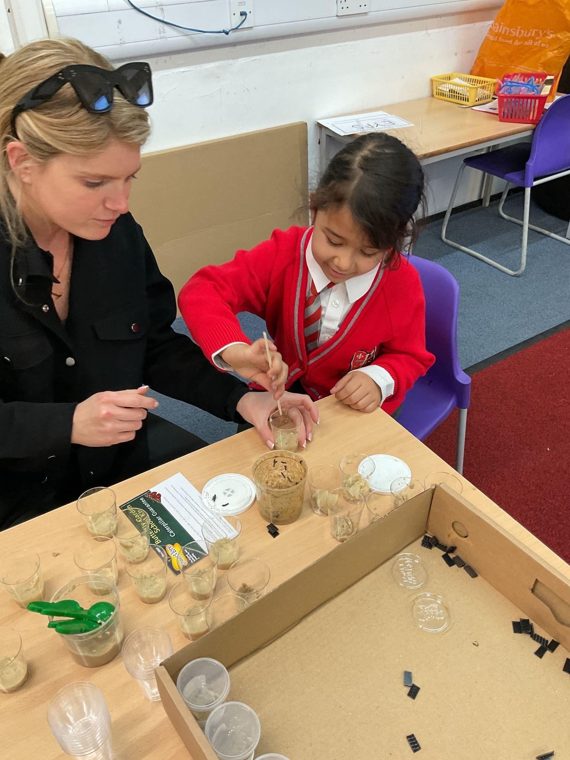
Year 2
For persevering with her writing in order to improve her work!
Miss Sweet

Slide 9
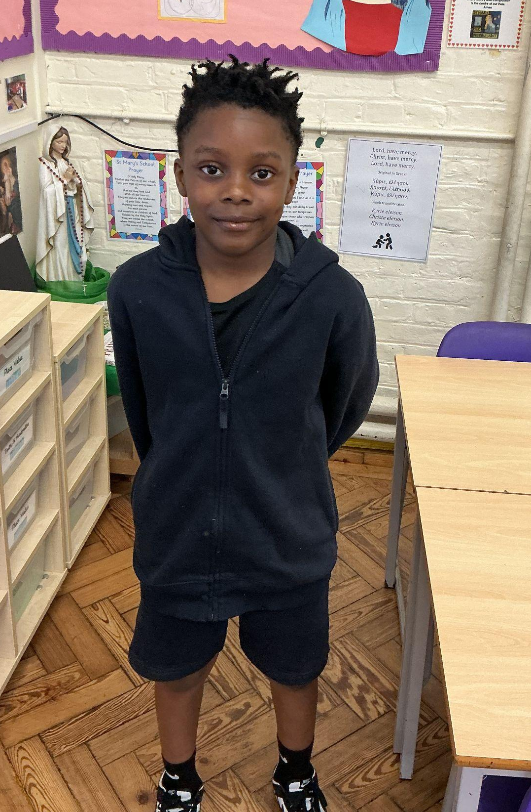
Year 3
You’ve really impressed me this week with your readiness to learn, you’re respectful and polite attitude and the amount of effort you’ve been putting into your work. Well done!
Miss Hickey

Slide 10
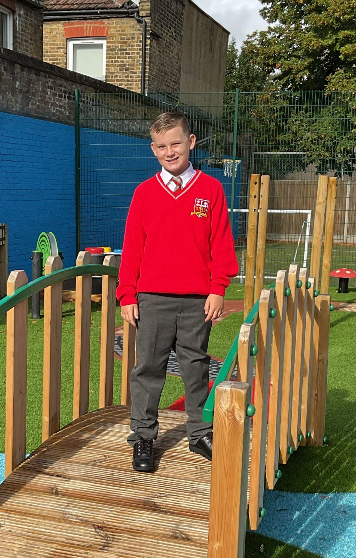
Year 4
For persevering across all of his learning and taking risks.
Mr Whear

Slide 11
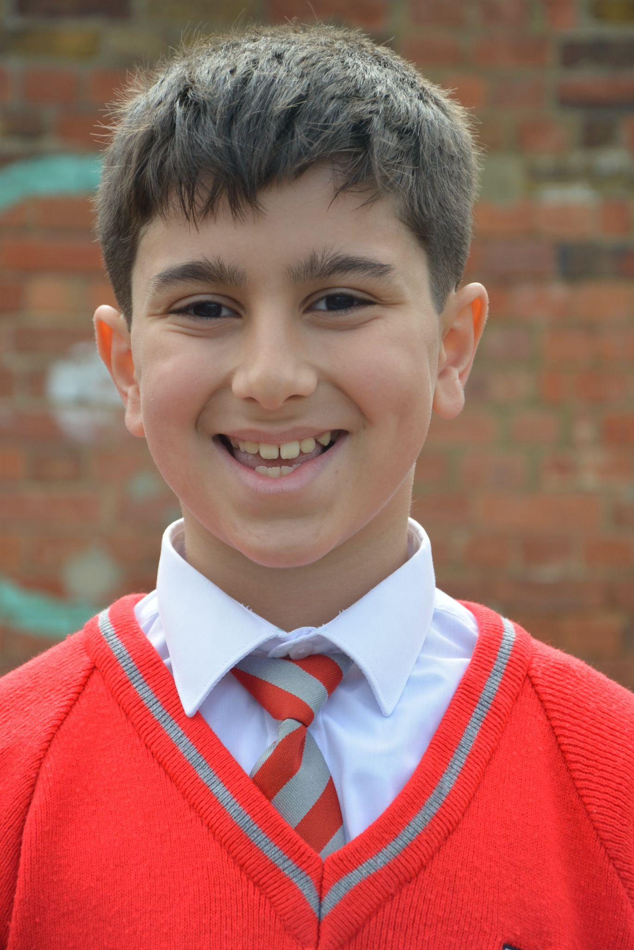
Year 5
A brilliant week and attitude to learning - making the right choices and working really hard to improve in all areas of our learning journey.
Mrs Bakali

Slide 12
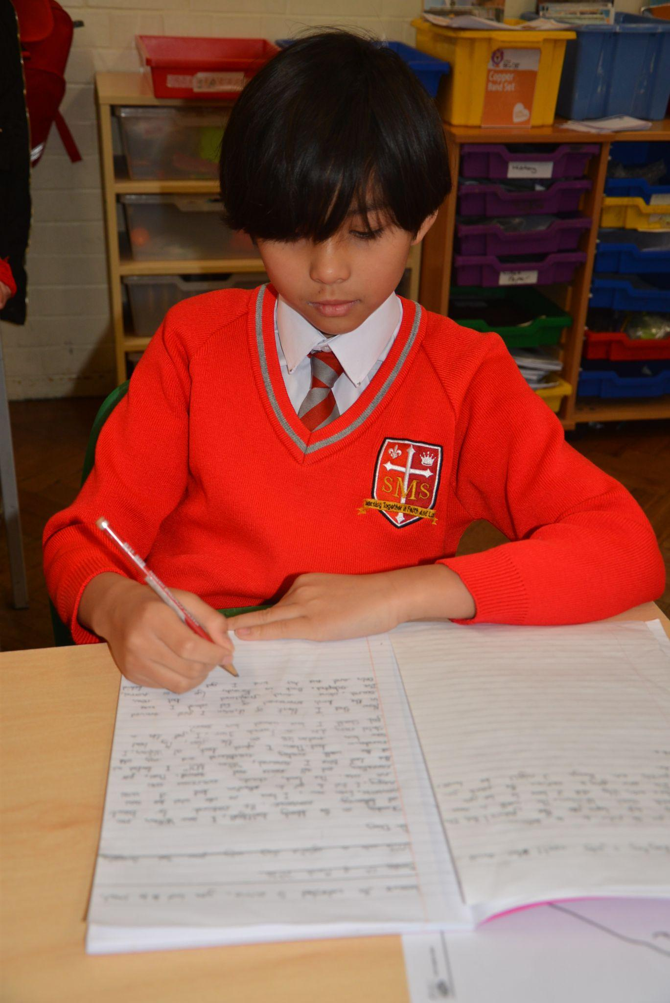
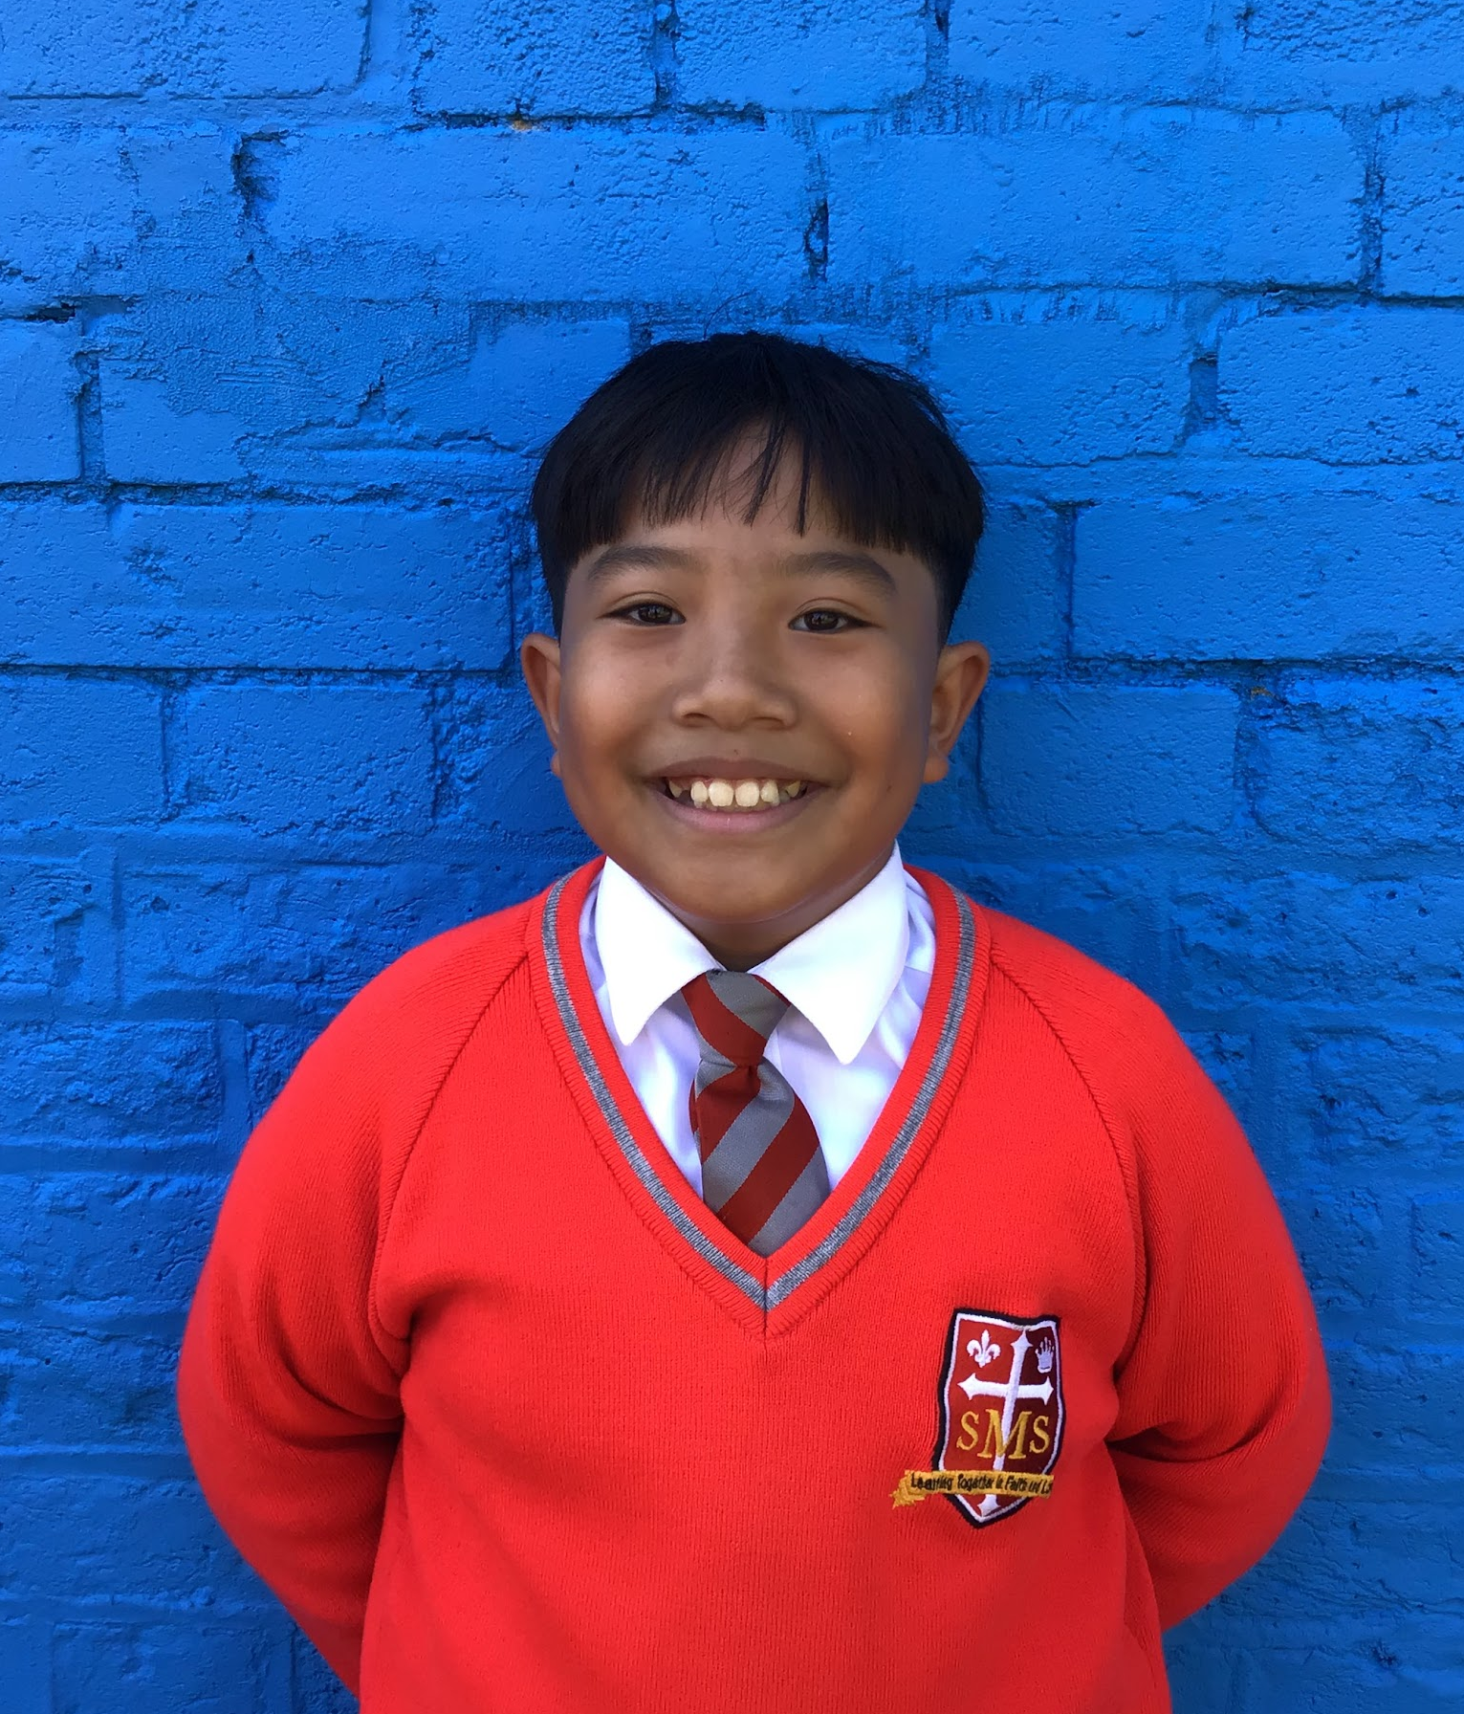
Year 6
For always being willing to take on responsibility and assist the wider school. He is becoming an exemplary prefect.
Mr Cherfi

Slide 13



Star Readers
Y1 - Myla
Y2 - Torrah-Leigh
Y3 - Kadie
Y4 - Not this week
Y5 - Yusuf
Y6 - Nicholas

Slide 14

Ana Clara - Y6
Kian - Y5
St George’s Day
Mrs Ferguson

Slide 15
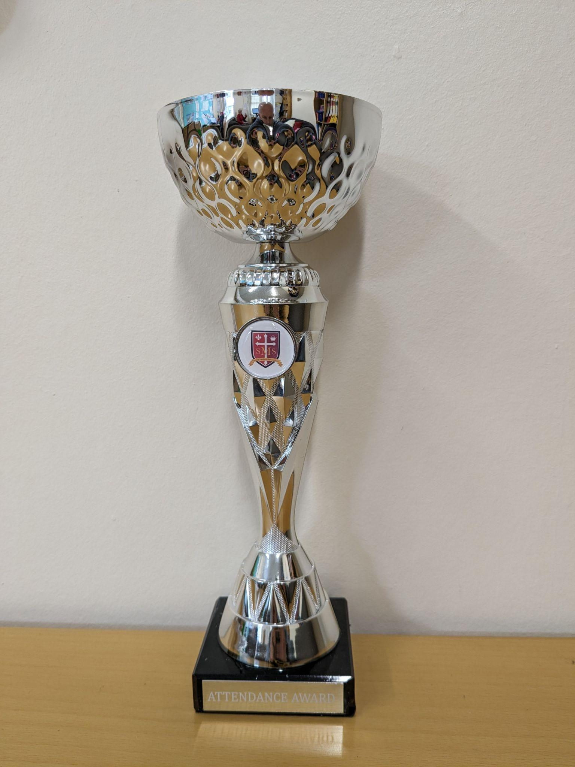
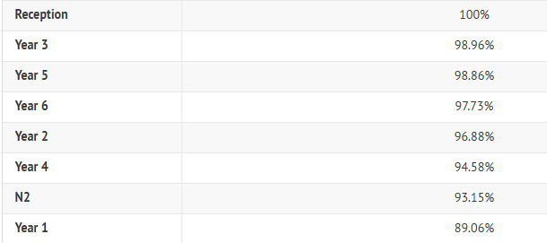
Attendance Weekly Leaders Summer Term:
Winners of the Pitch on Friday - Reception and Year 3

Slide 16
Whole School
Star of the Week
Friday 1st May 2026

