Slide 1
Whole School
Star of the Week
Friday 20th June 2025

Slide 2
Our Father who art in Heaven
Hallowed be Thy Name
Thy Kingdom come
Thy will be done on Earth as it is in Heaven
Give us this day our daily bread
And forgive us our trespasses
As we forgive those who trespass against us
And lead us not into temptation
But deliver us from evil
Amen

Slide 3
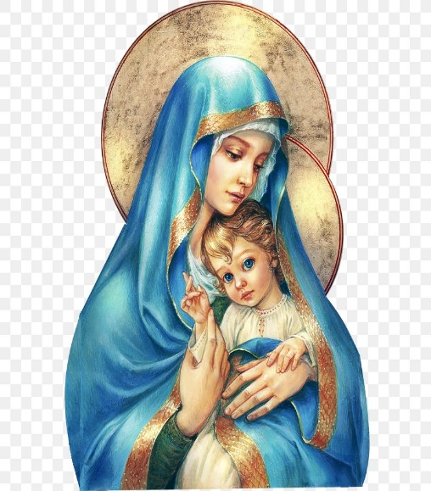
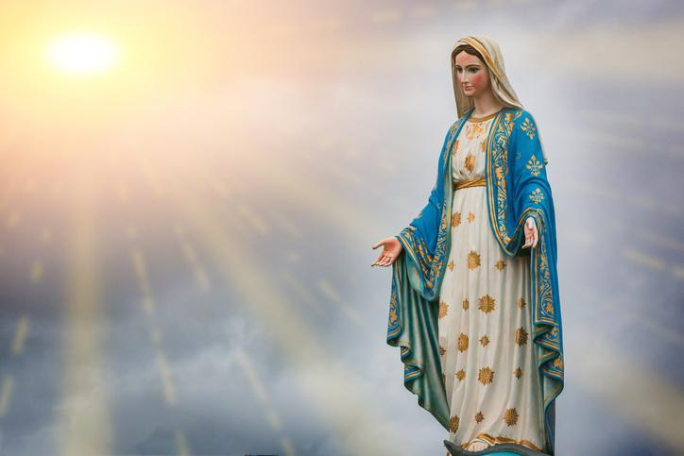
Hail Mary, Full of Grace
The Lord is with Thee
Blessed are Thou amongst women
And Blessed is the fruit of Thy womb, Jesus
Holy Mary , Mother of God
Pray for us sinners
Now and in the hour of our death
Amen

Slide 4
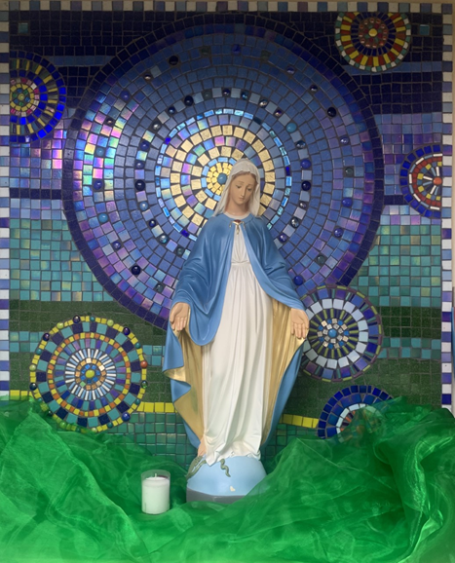
St Mary’s School Prayer
O Holy Mary,
Mother and Patron of our school,
Turn your eyes of mercy towards us,
that we may love God
With all our hearts!
May we imitate the tenderness
of your Son, Jesus,
showing love and respect
For each person
and ourselves as children of God.
Guided by the Holy Spirit,
May we create the school,
where Mercy and Compassion
Is the centre of our lives.
Amen

Slide 6
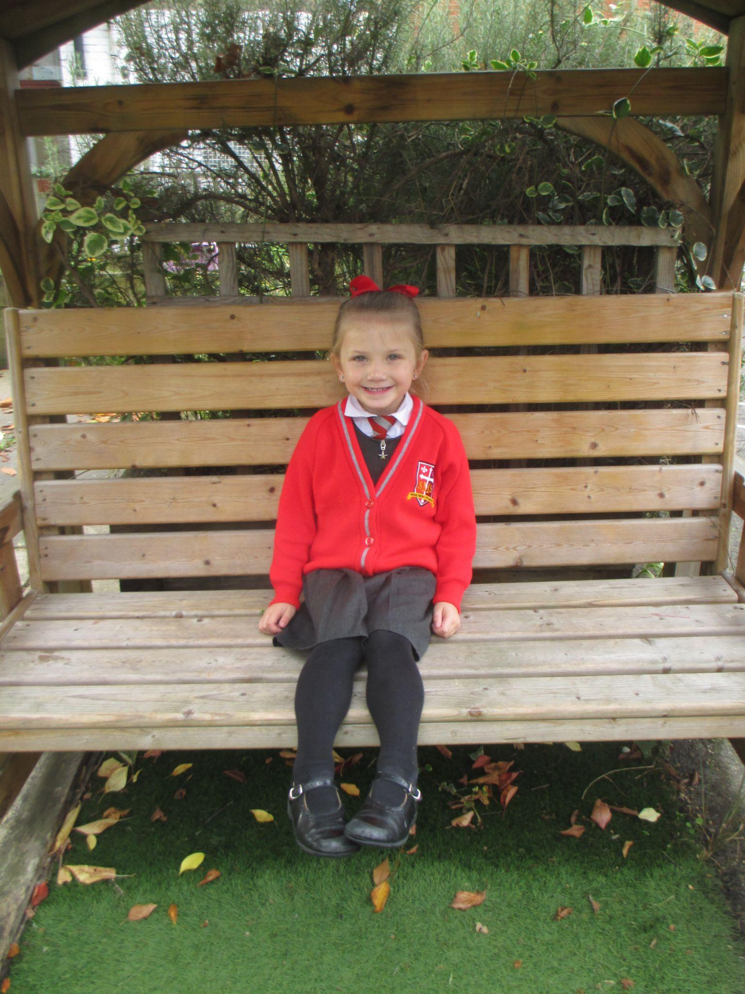
Early Years
Reception
For her amazing effort in assessments this week and for trying her best at independent learning.
Miss Barker

Slide 7
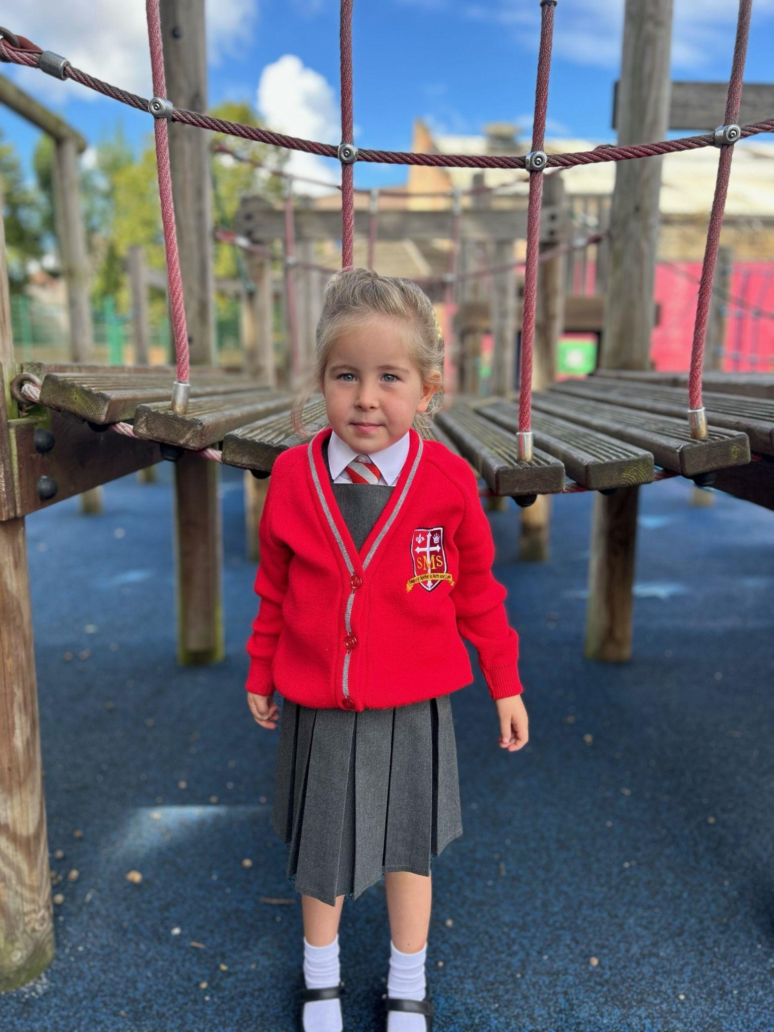
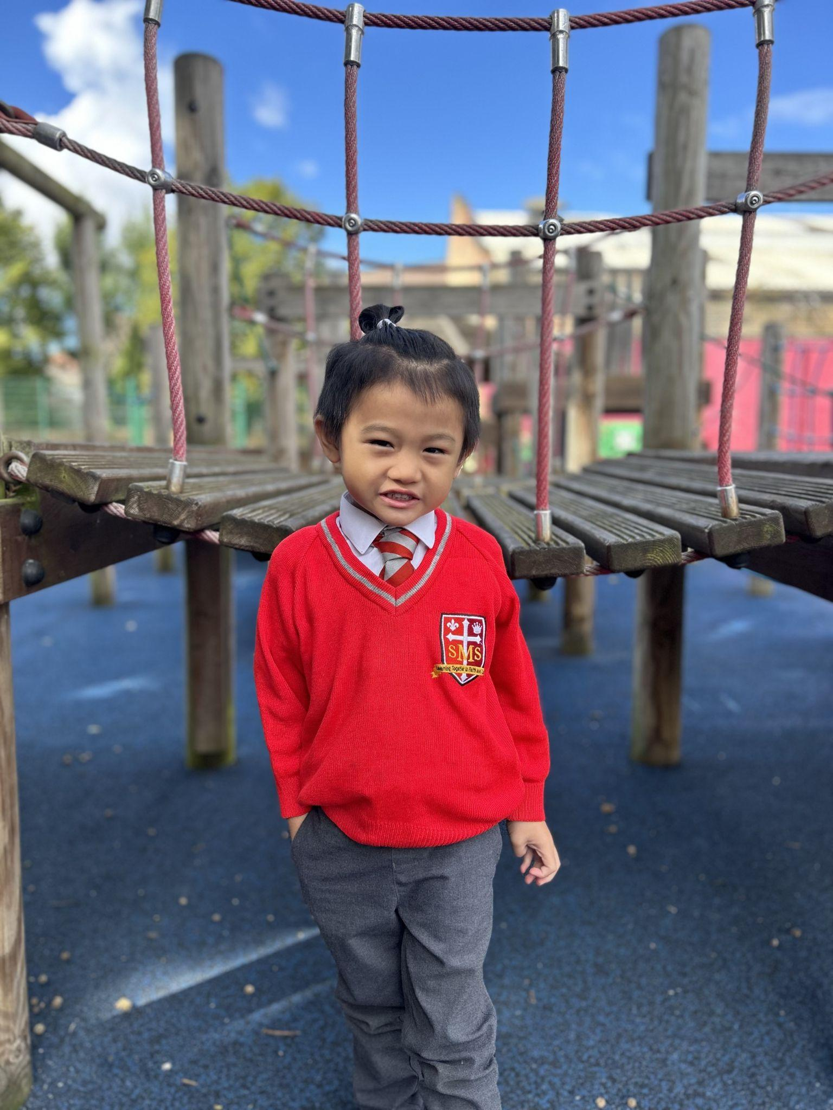
Year 1
For being role models to their peers and always doing the right thing!
Miss Sweet

Slide 8
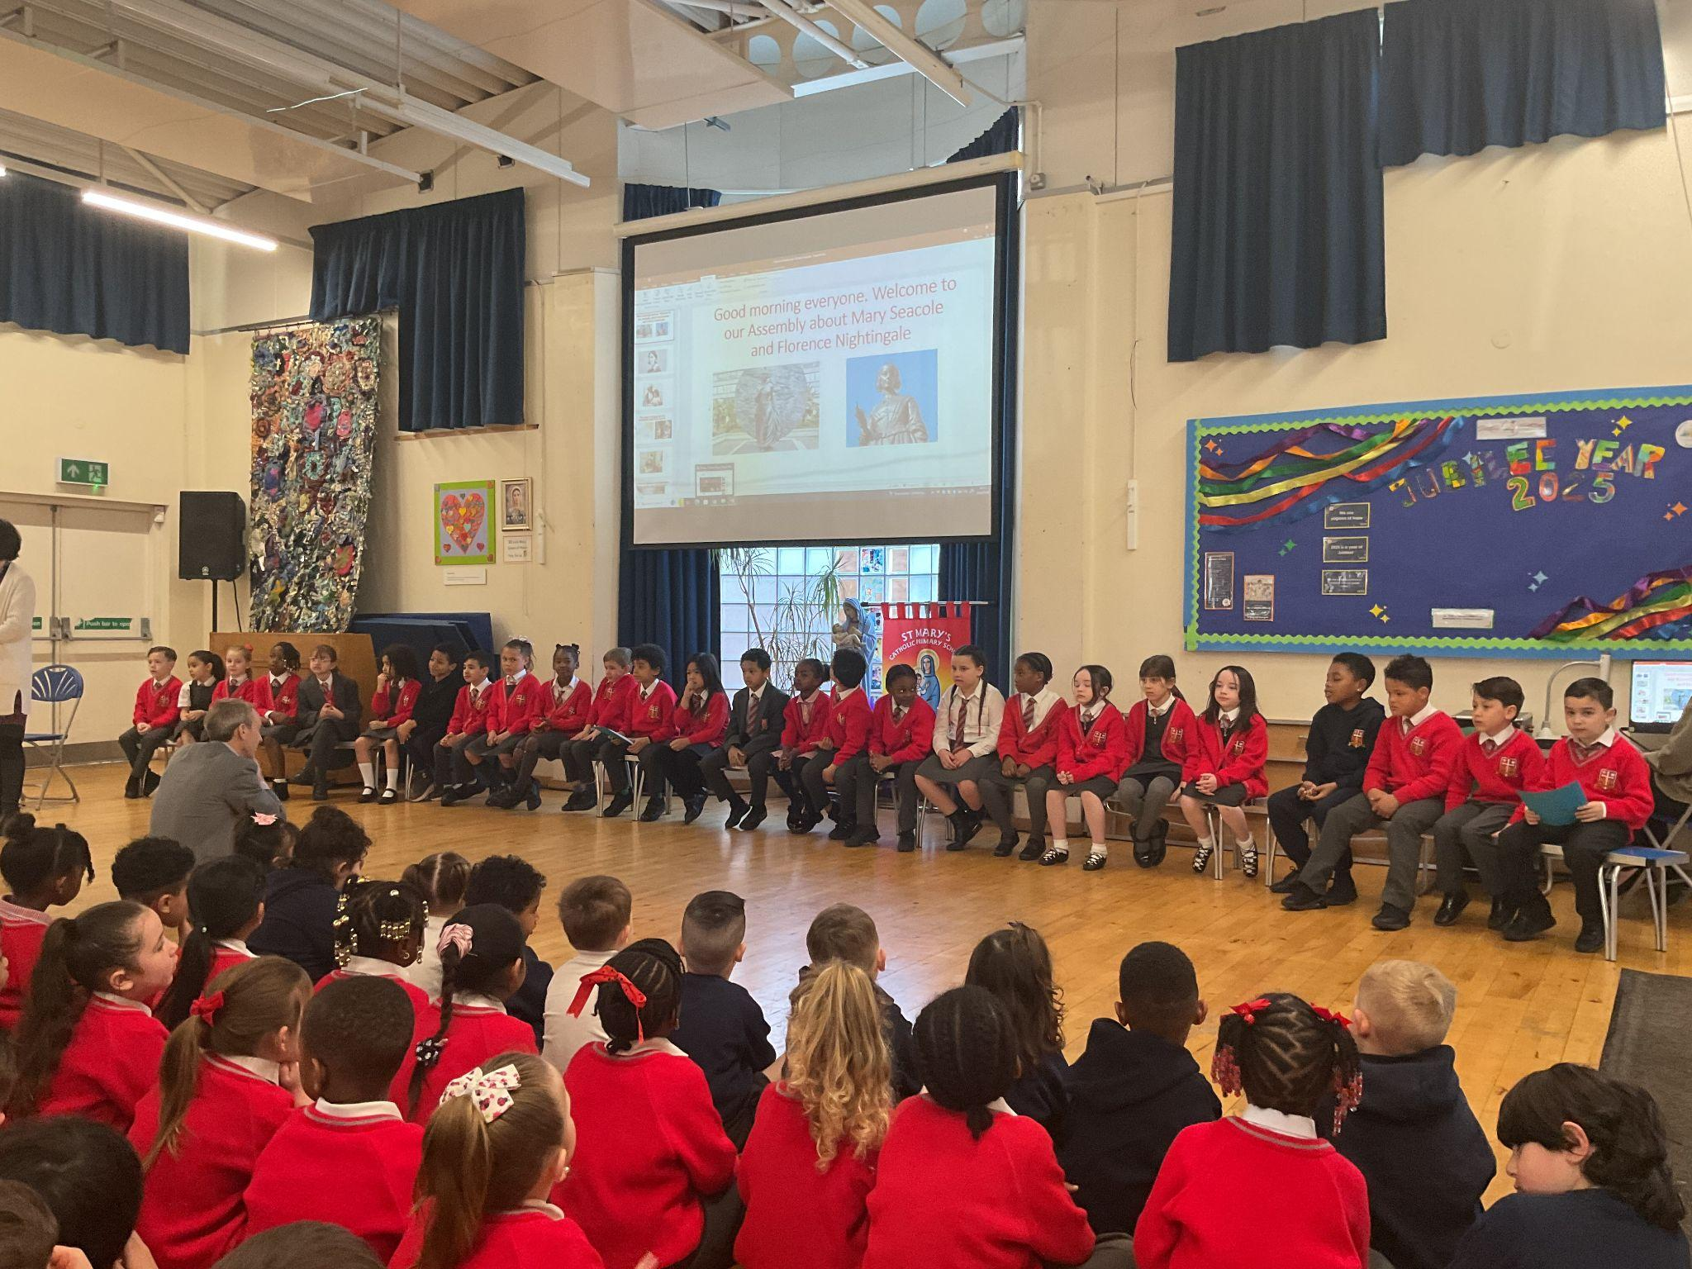
Year 2
For working hard this year which has resulted in strong performances in their summer assessments.
Mr Whear

Slide 9
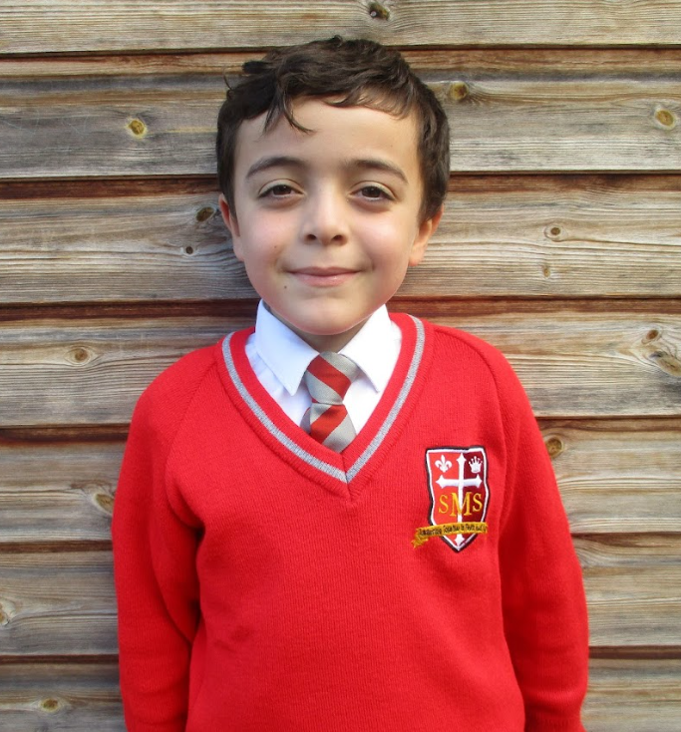
Year 3
Big shout out to the whole class as well, but a big congratulations to Jayden for getting full marks on his arithmetics assessment!
Miss Medioli

Slide 10
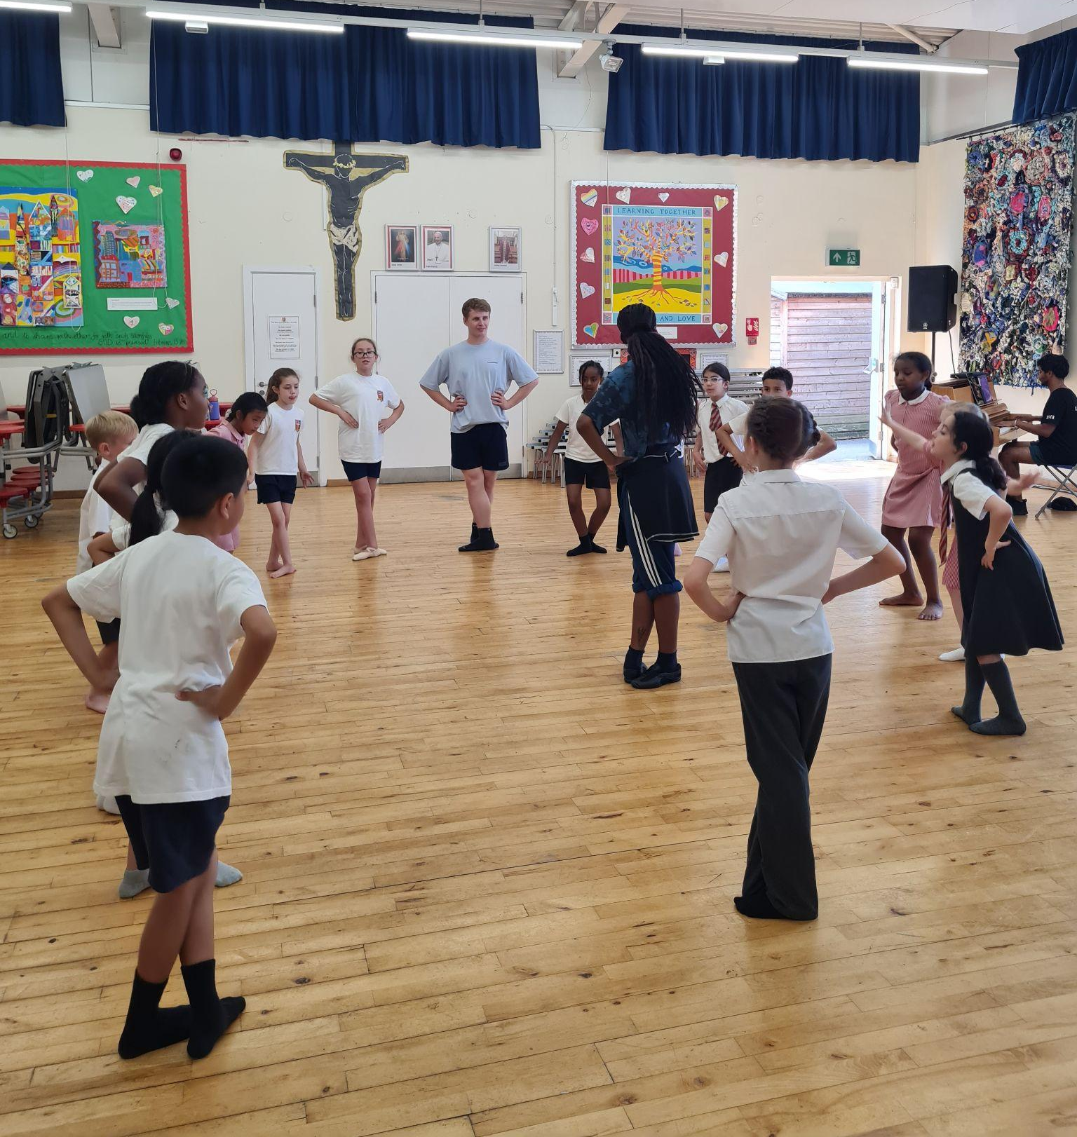
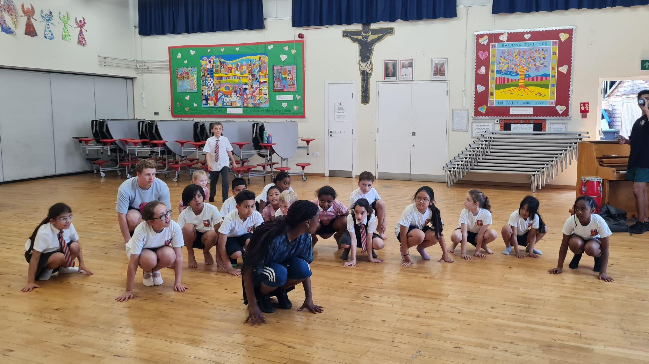
Year 4
The Whole Class
For their engaged, positive attitudes during our ballet workshop along with their hard work over assessment week.
Miss Forrest

Slide 11
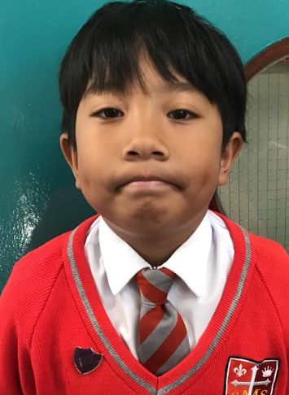
Year 5
For excellent focus and improved assessment scores.
Mr Larke

Slide 12
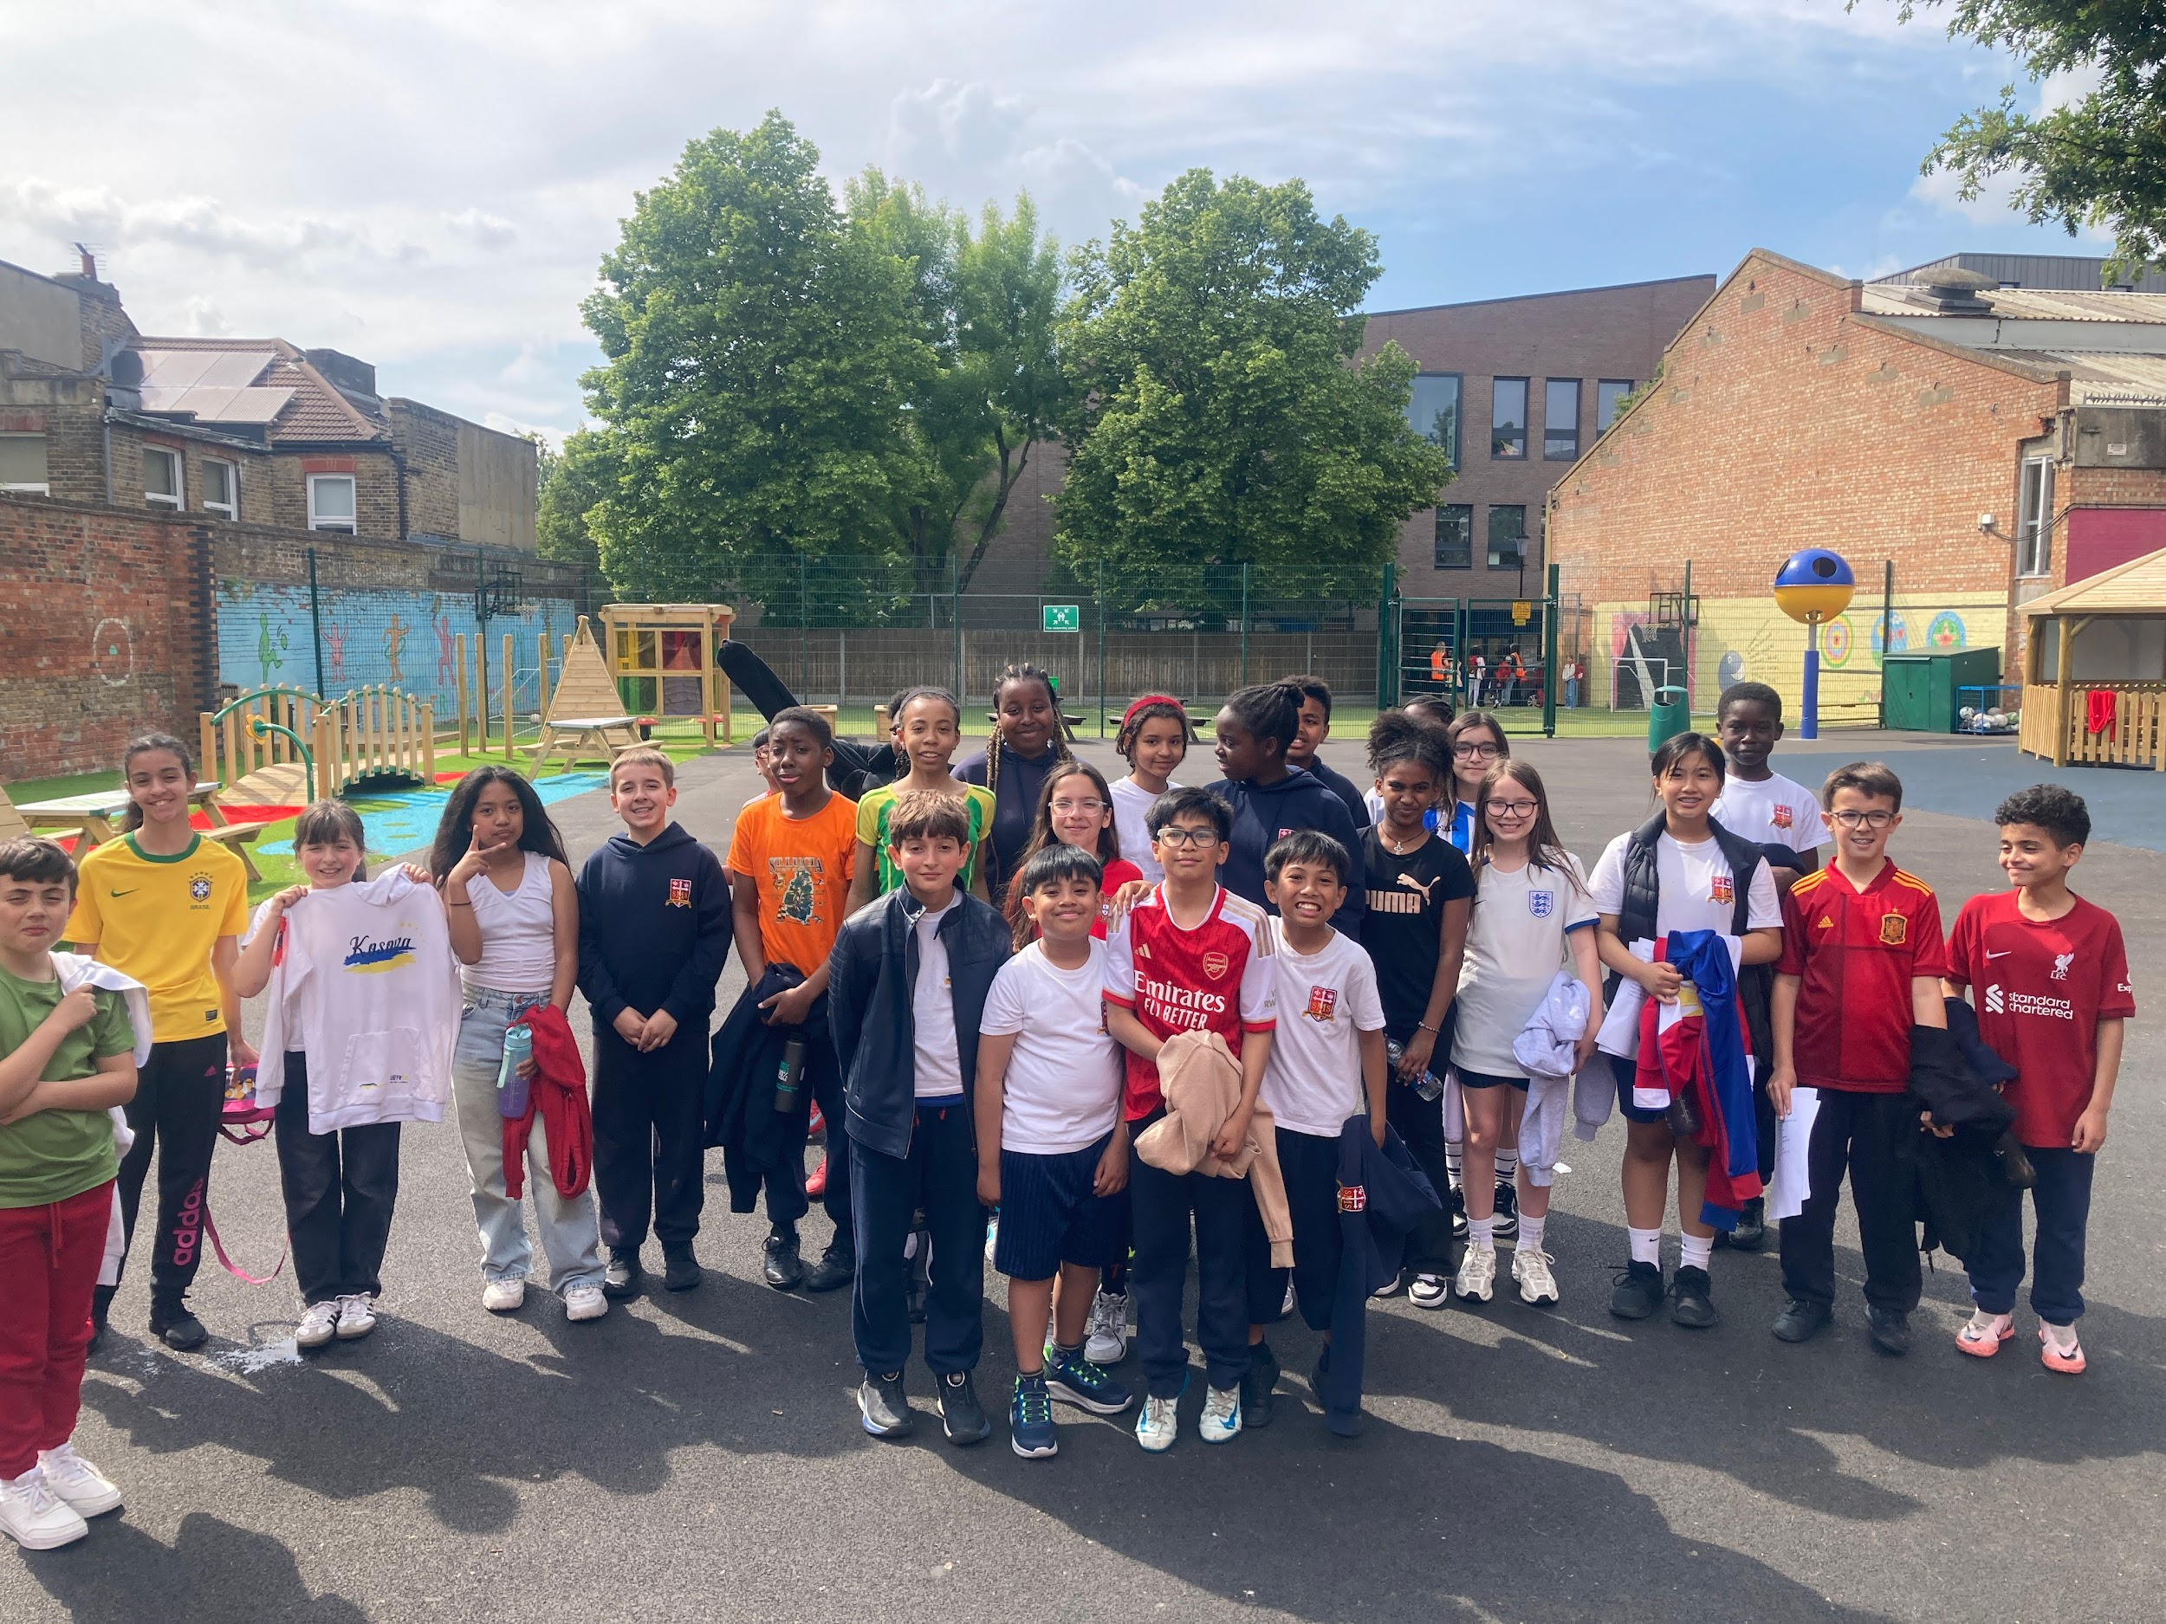
Year 6
Whole Class For great application in their rehearsals for the end of year production.
Mr Fowle & Mr Cherfi

Slide 13
Star Readers
Y1 - No one this week
Y2 - Tay’Vion
Y3 - Matthew
Y4 - Elly
Y5 - Amy
Y6 - Yaffet

Slide 14
Kai Year 1
Lola Year 2
Sebastian Y6
Stefan Y6

Slide 15
Whole School
Star of the Week
Friday 20th June 2025

