Slide 1




Whole School
Star of the Week
Friday 20th March 2026

Slide 2

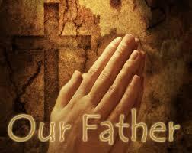
Our Father who art in Heaven
Hallowed be Thy Name
Thy Kingdom come
Thy will be done on Earth as it is in Heaven
Give us this day our daily bread
And forgive us our trespasses
As we forgive those who trespass against us
And lead us not into temptation
But deliver us from evil
Amen

Slide 3
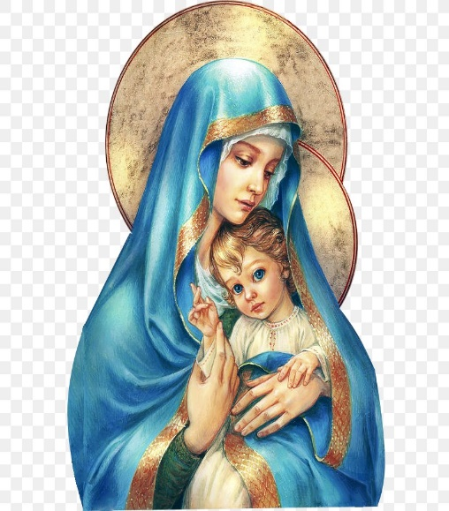
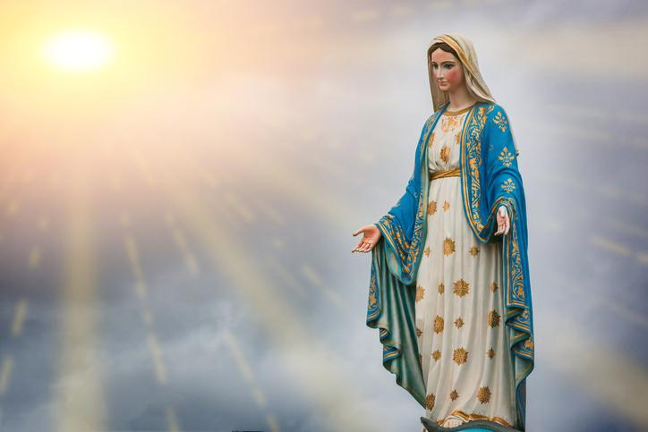
Hail Mary, Full of Grace
The Lord is with Thee
Blessed are Thou amongst women
And Blessed is the fruit of Thy womb, Jesus
Holy Mary , Mother of God
Pray for us sinners
Now and in the hour of our death
Amen

Slide 4
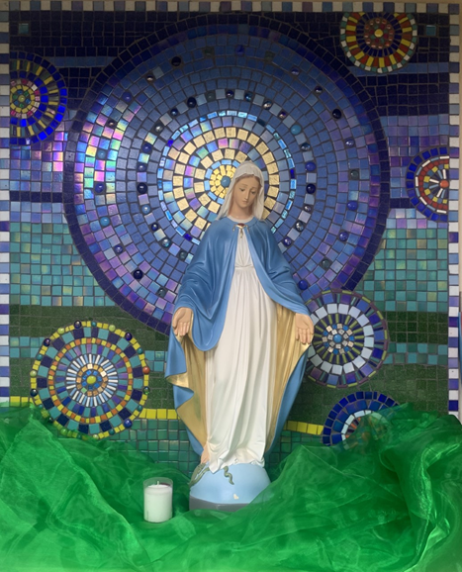
St Mary’s School Prayer
O Holy Mary,
Mother and Patron of our school,
Turn your eyes of mercy towards us,
that we may love God
With all our hearts!
May we imitate the tenderness
of your Son, Jesus,
showing love and respect
For each person
and ourselves as children of God.
Guided by the Holy Spirit,
May we create the school,
where Mercy and Compassion
Is the centre of our lives.
Amen

Slide 5
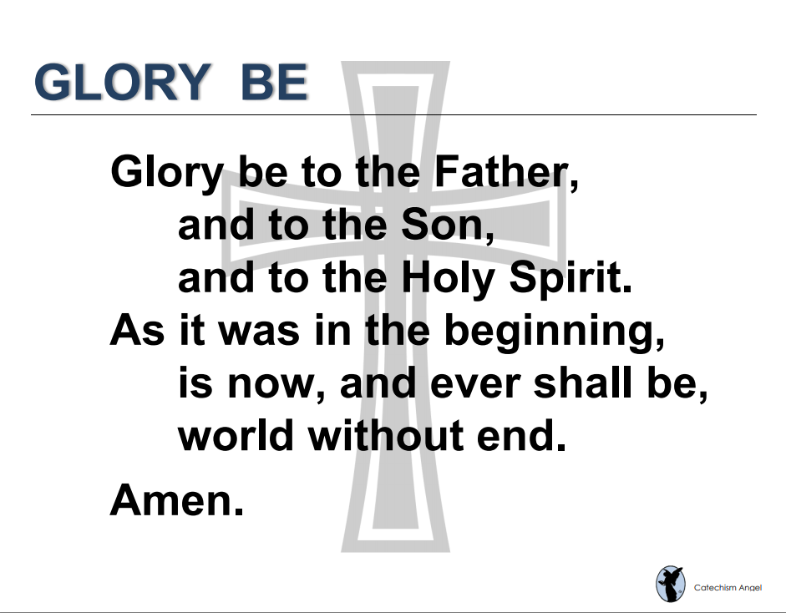

Slide 6
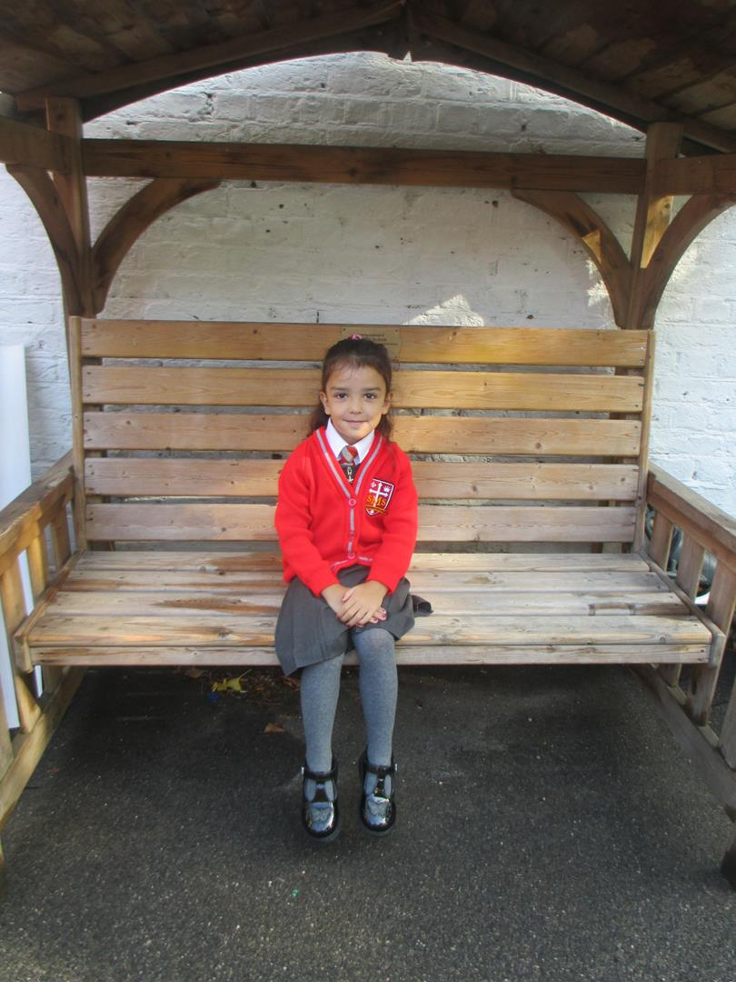
Reception
Matilda
For showing a deeper understanding of Lent in RE lessons and discussing the miracles of Jesus.
Miss Barker

Slide 7
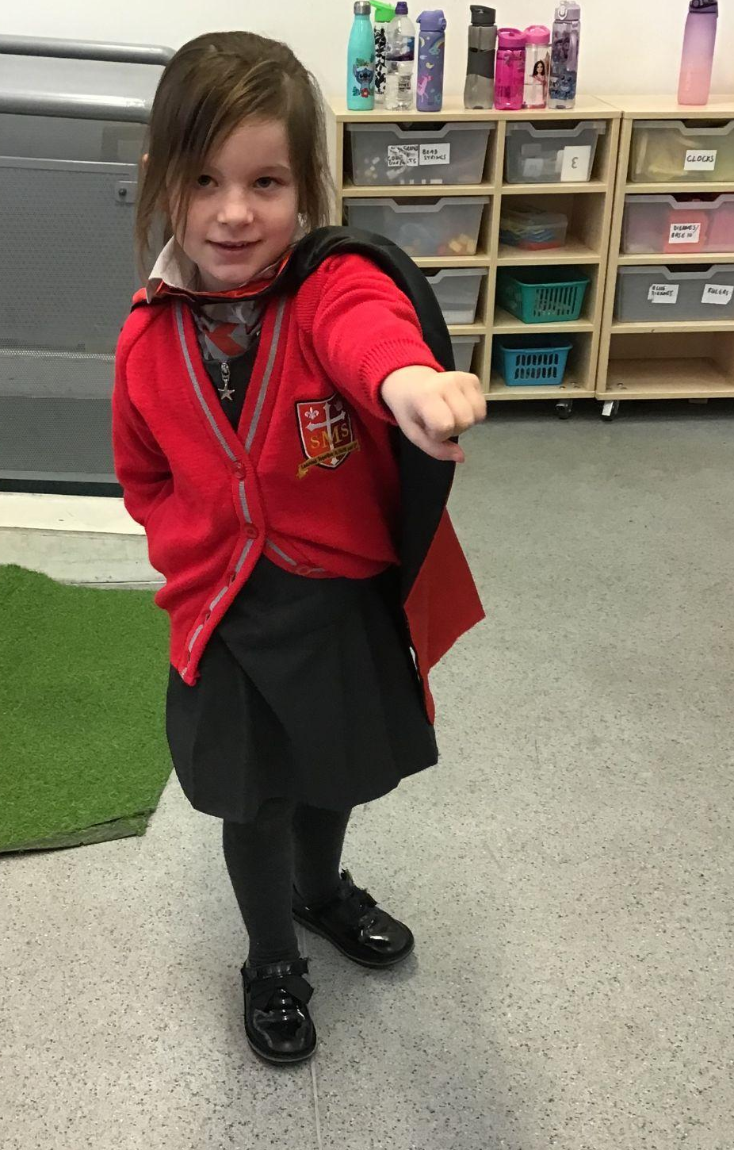
Year 1
For putting so much effort into her work and growing in confidence that she can do hard things!
Miss Flashman

Slide 8
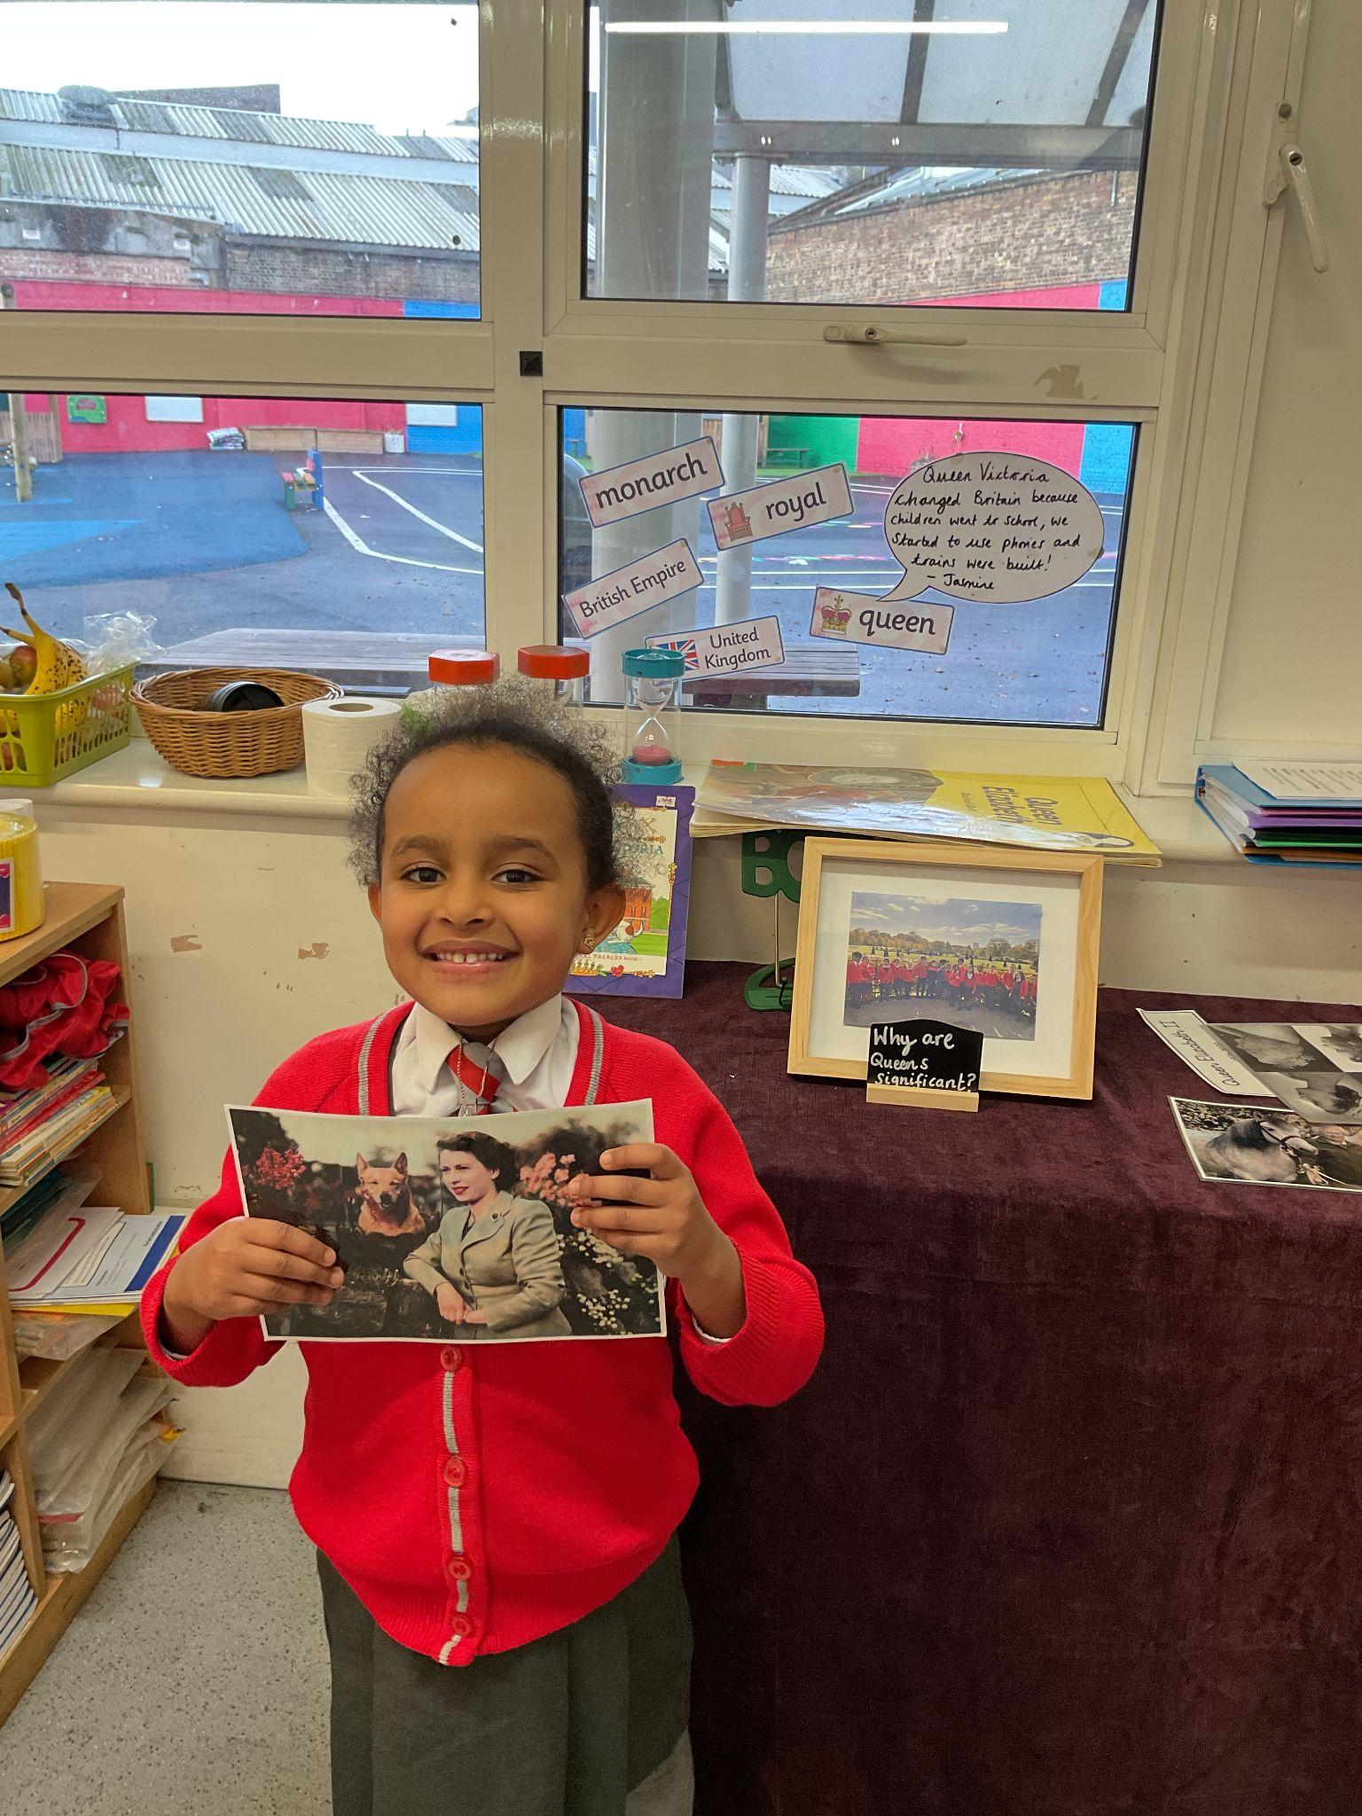
Year 2
For using her voice more in class and being brave!
Miss Sweet

Slide 9
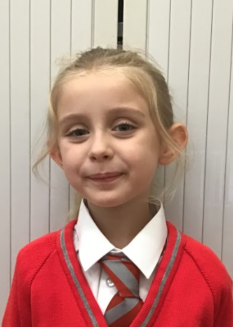
Year 3
For a showing what a positive approach to school life can really achieve.
Mr. Larke

Slide 10
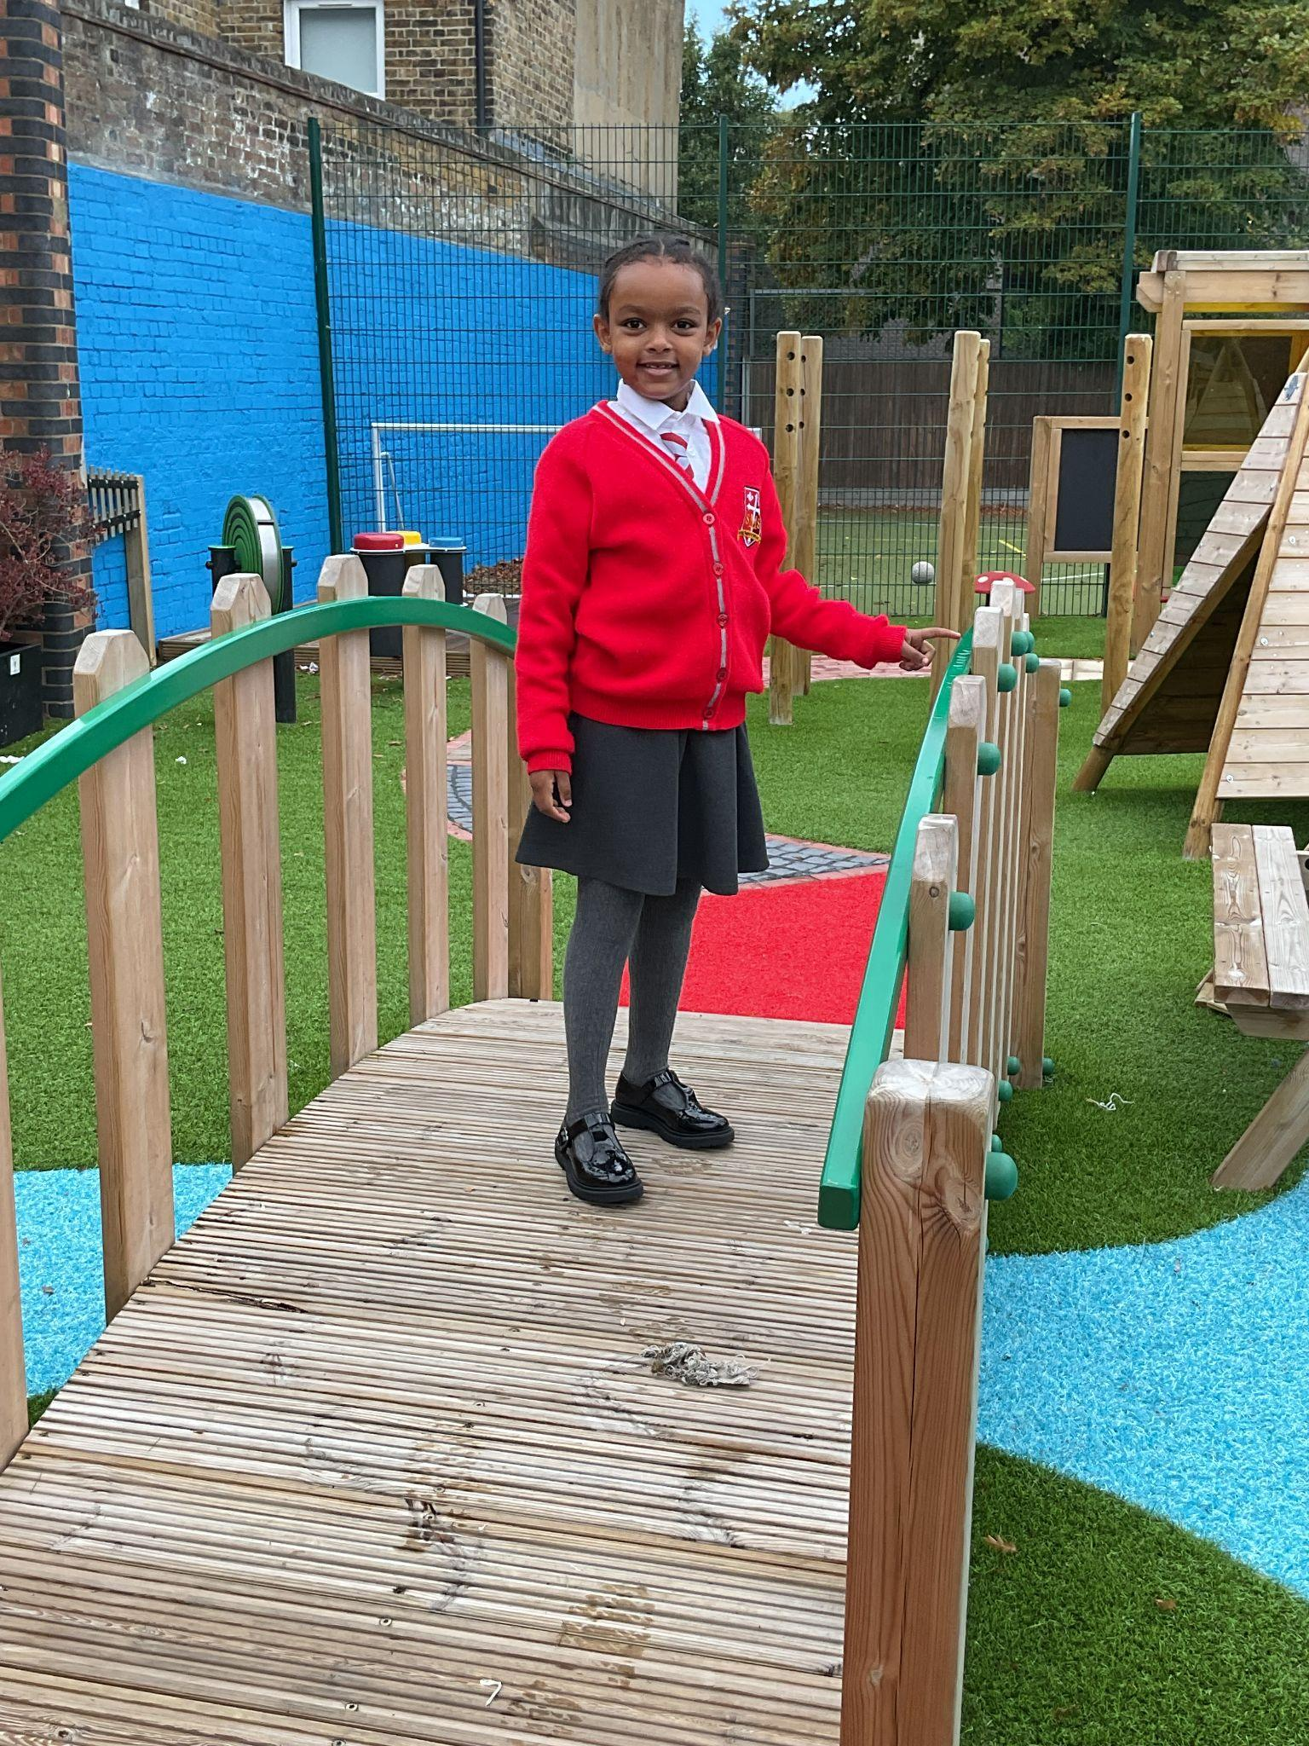
Year 4
For living out, in her every day life, our school values and corporal acts of mercy
Mr Whear

Slide 11
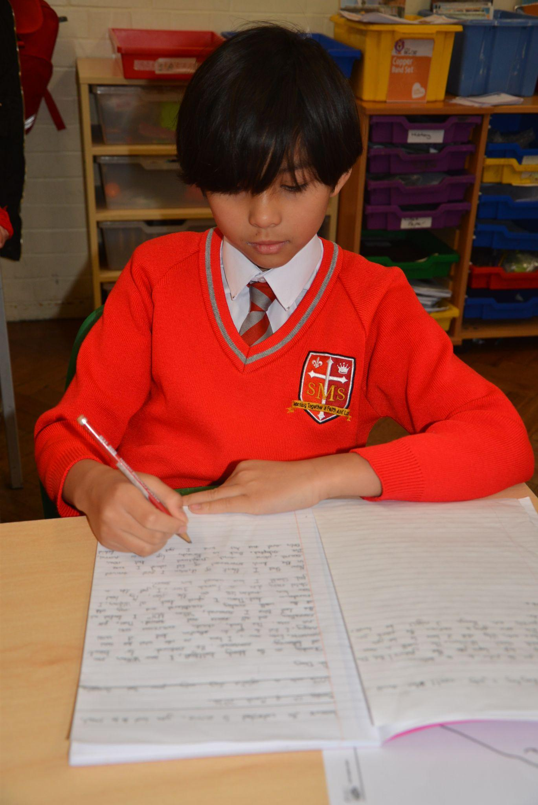
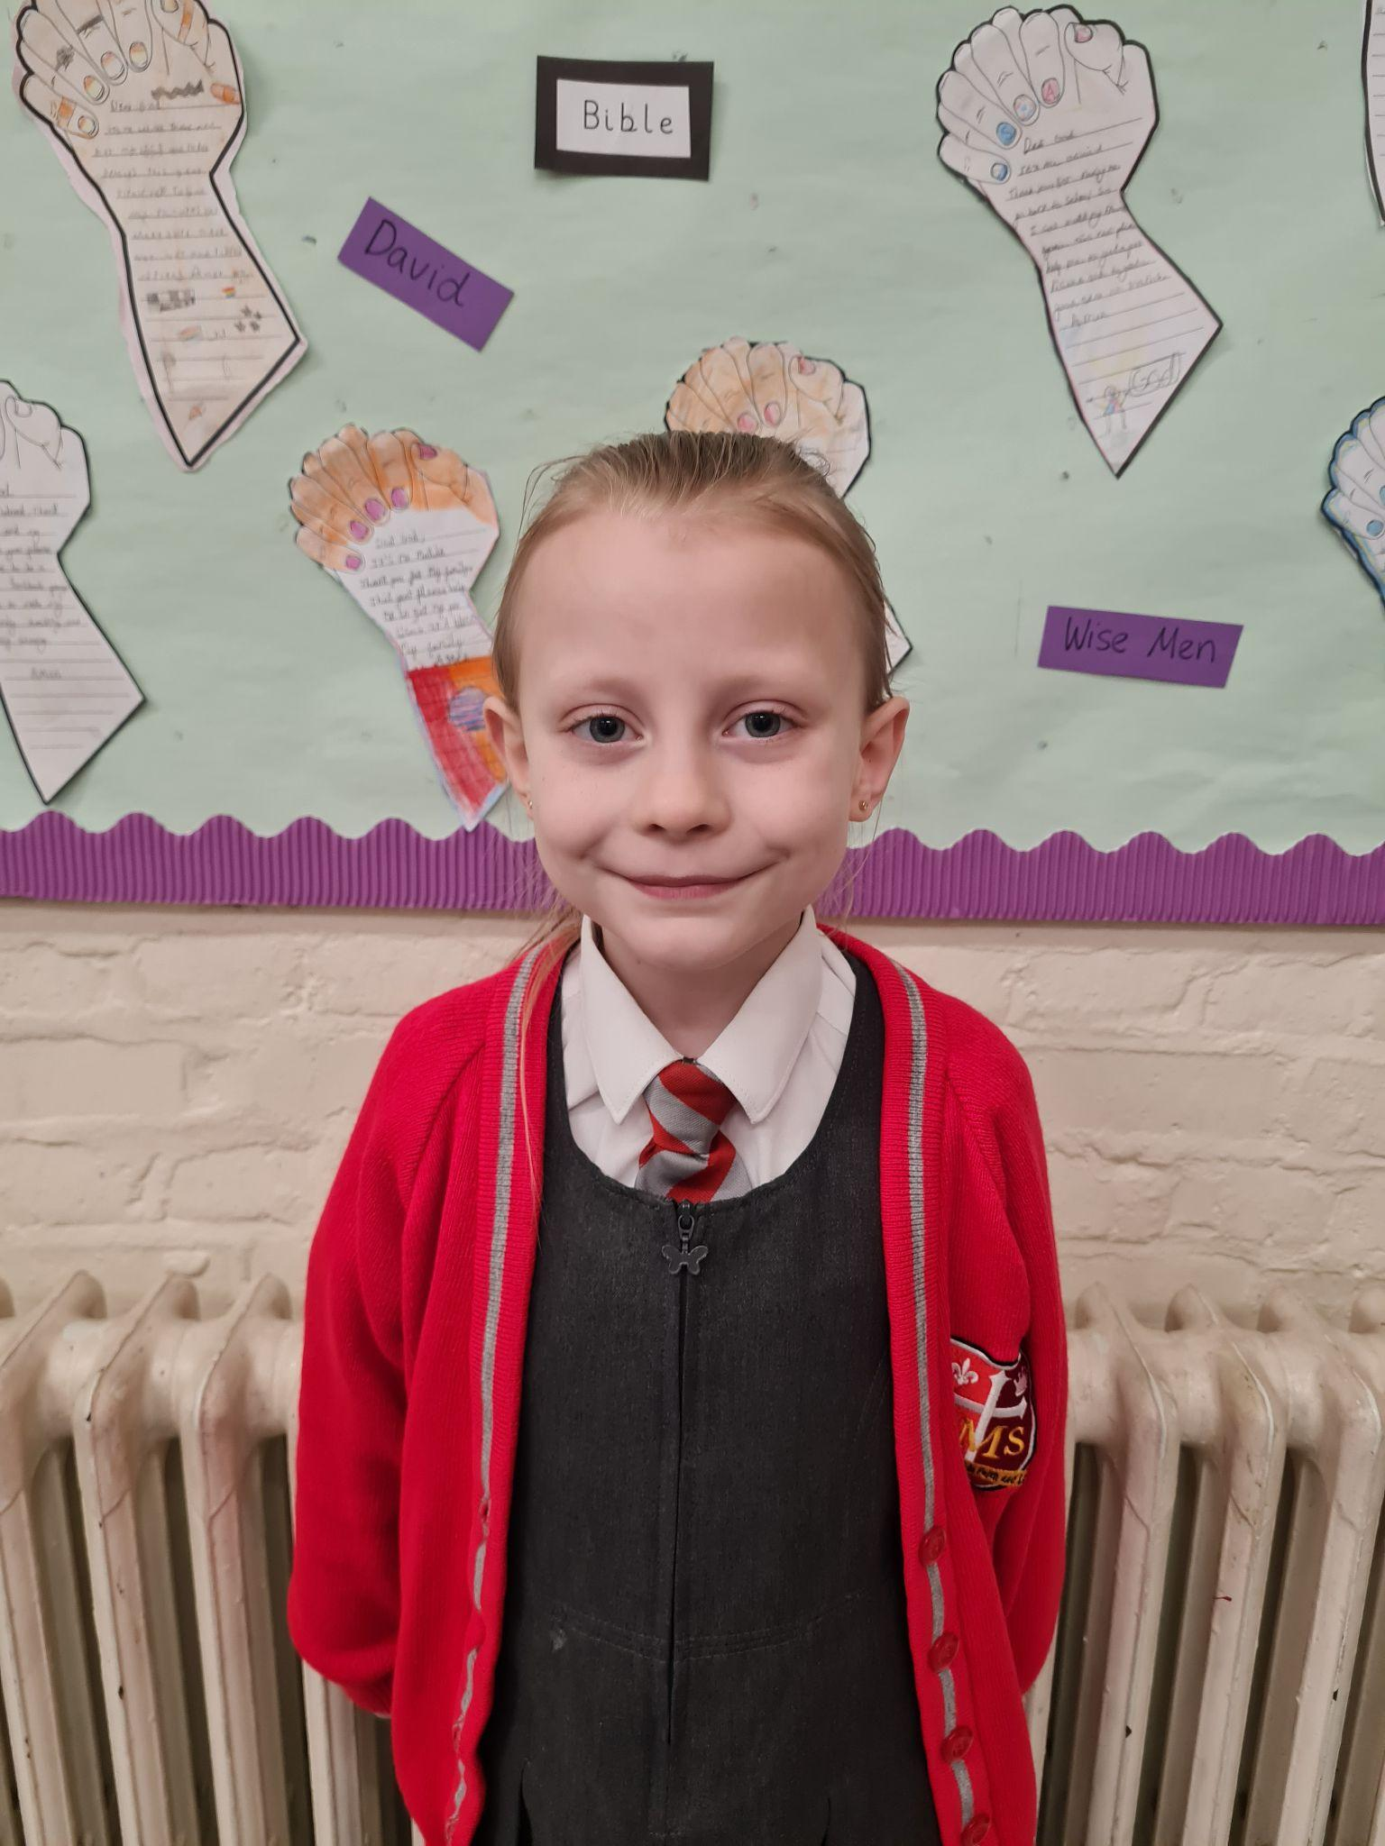
Year 5
For showing a resilient and positive attitude to learning. Julia approaches her learning in
A calm and thoughtful manner. Well Done Julia!
Ms Bakali

Slide 12
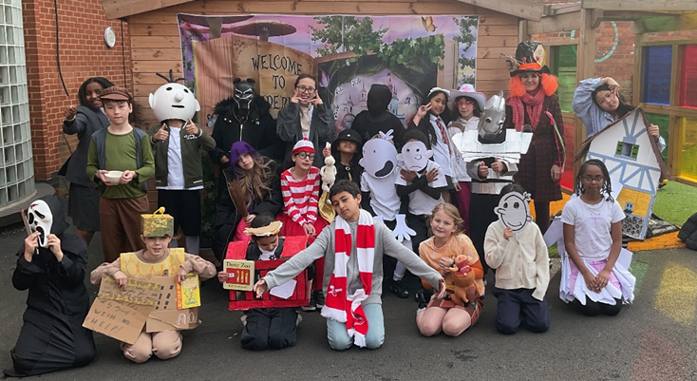
Year 5
Whole class
For brilliant and creative costumes
especially Cali and Alice in wonderland costume!
Fantastic!
Mrs Bakali

Slide 13



Star Readers
Y1 - Khalil
Y2 -George
Y3 - Asher
Y4 - Holly
Y5 - Deborah

Slide 14

Amarah - Y6
Luna - Y3
Alessia - Y5
George - Yr 4
Mr Jack

Slide 15
Whole School
Star of the Week
Friday 20th March 2026

