Slide 1
Whole School
Star of the Week
Friday 21st March 2025

Slide 2
Our Father who art in Heaven
Hallowed be Thy Name
Thy Kingdom come
Thy will be done on Earth as it is in Heaven
Give us this day our daily bread
And forgive us our trespasses
As we forgive those who trespass against us
And lead us not into temptation
But deliver us from evil
Amen

Slide 3
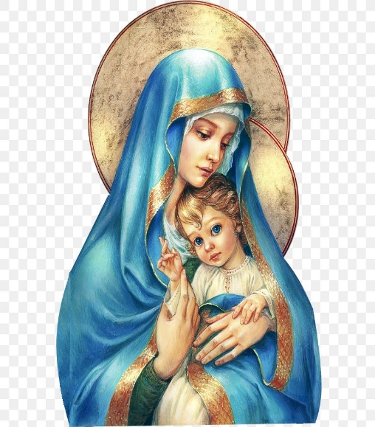
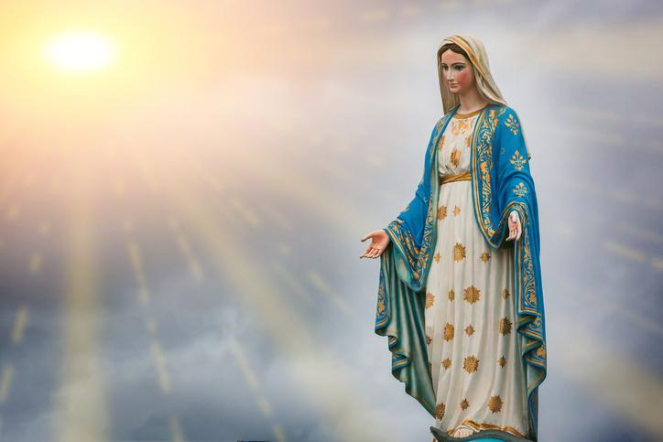
Hail Mary, Full of Grace
The Lord is with Thee
Blessed are Thou amongst women
And Blessed is the fruit of Thy womb, Jesus
Holy Mary , Mother of God
Pray for us sinners
Now and in the hour of our death
Amen

Slide 4
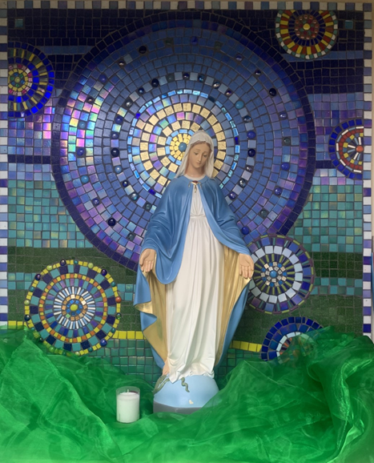
St Mary’s School Prayer
O Holy Mary,
Mother and Patron of our school,
Turn your eyes of mercy towards us,
that we may love God
With all our hearts!
May we imitate the tenderness
of your Son, Jesus,
showing love and respect
For each person
and ourselves as children of God.
Guided by the Holy Spirit,
May we create the school,
where Mercy and Compassion
Is the centre of our lives.
Amen

Slide 6
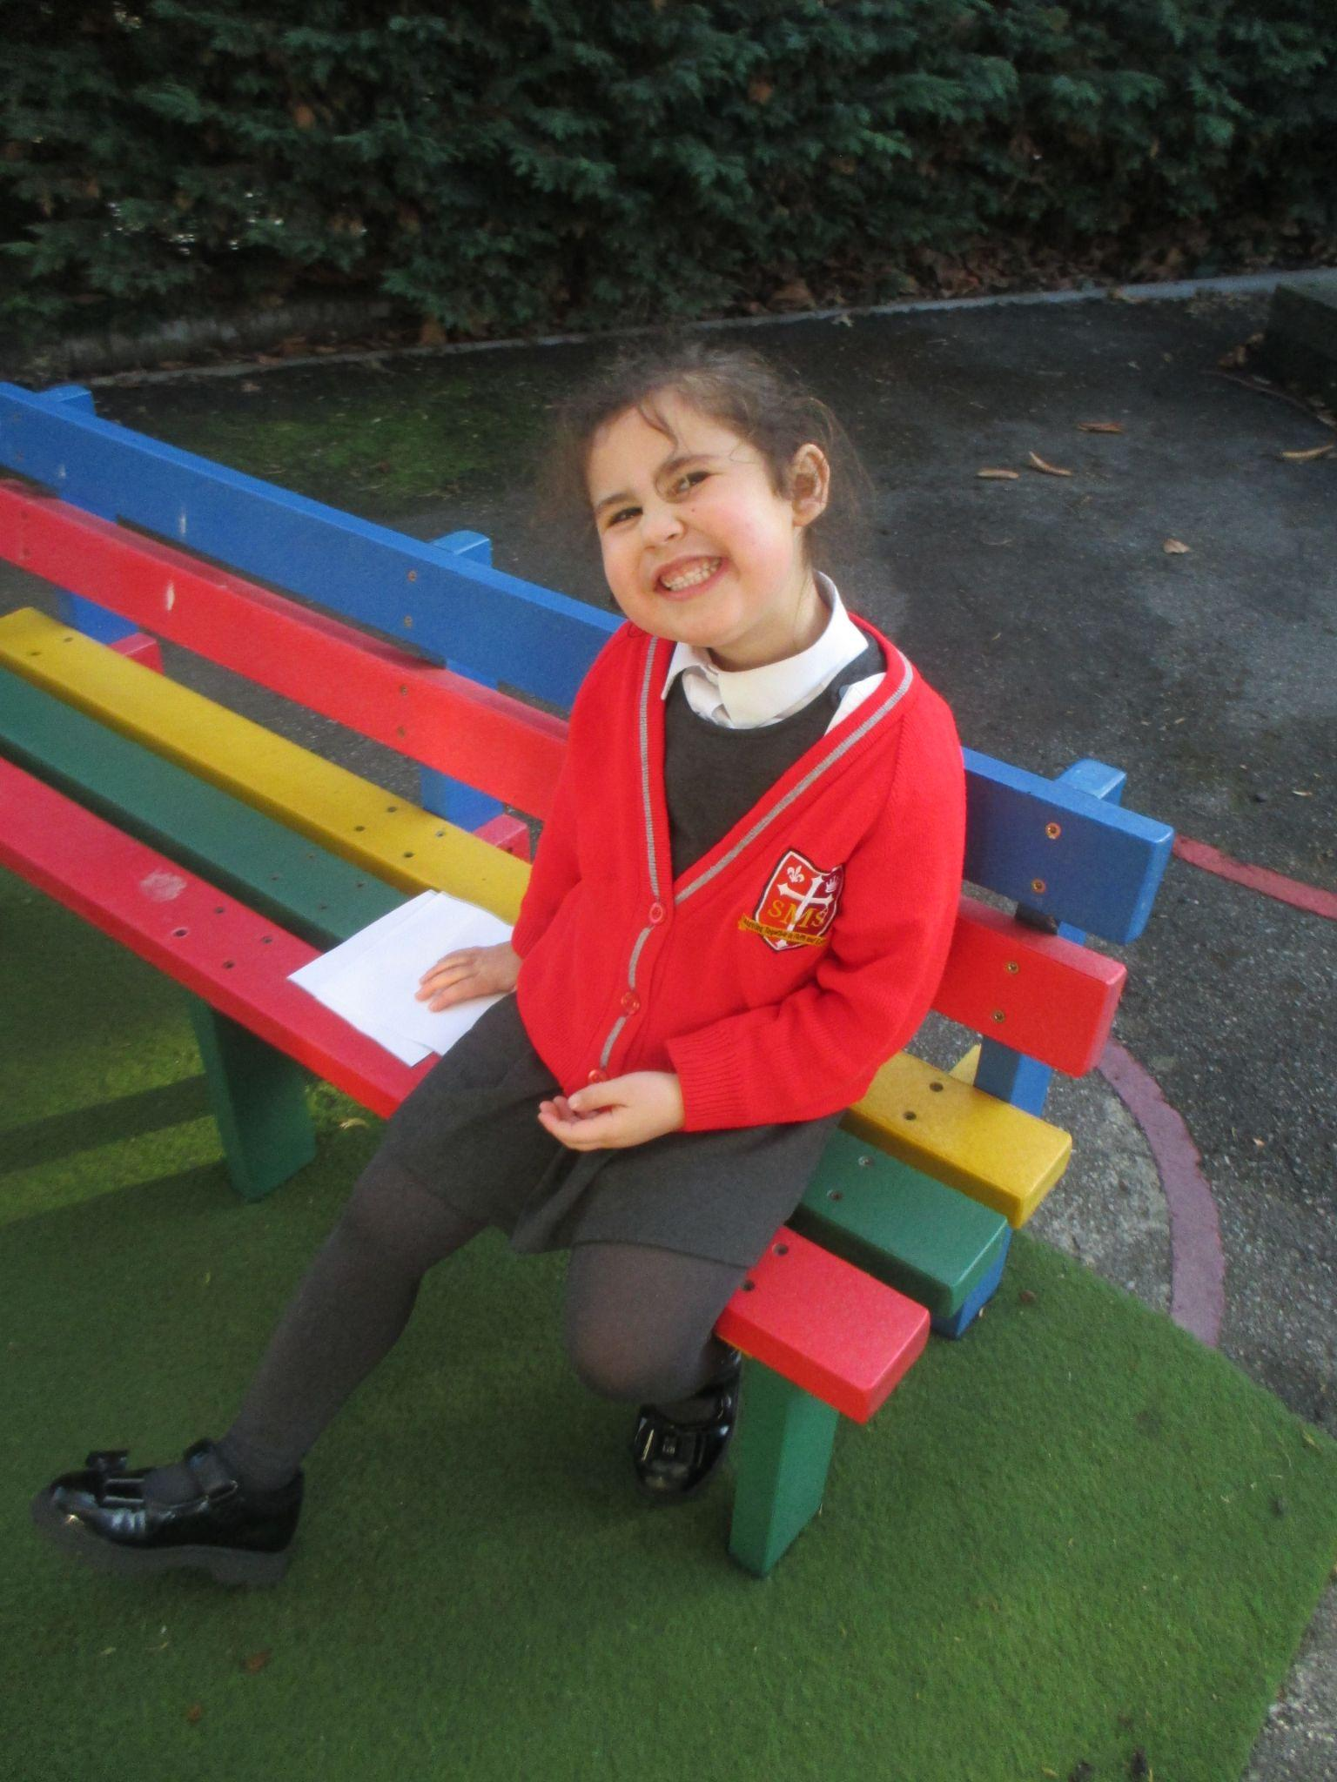
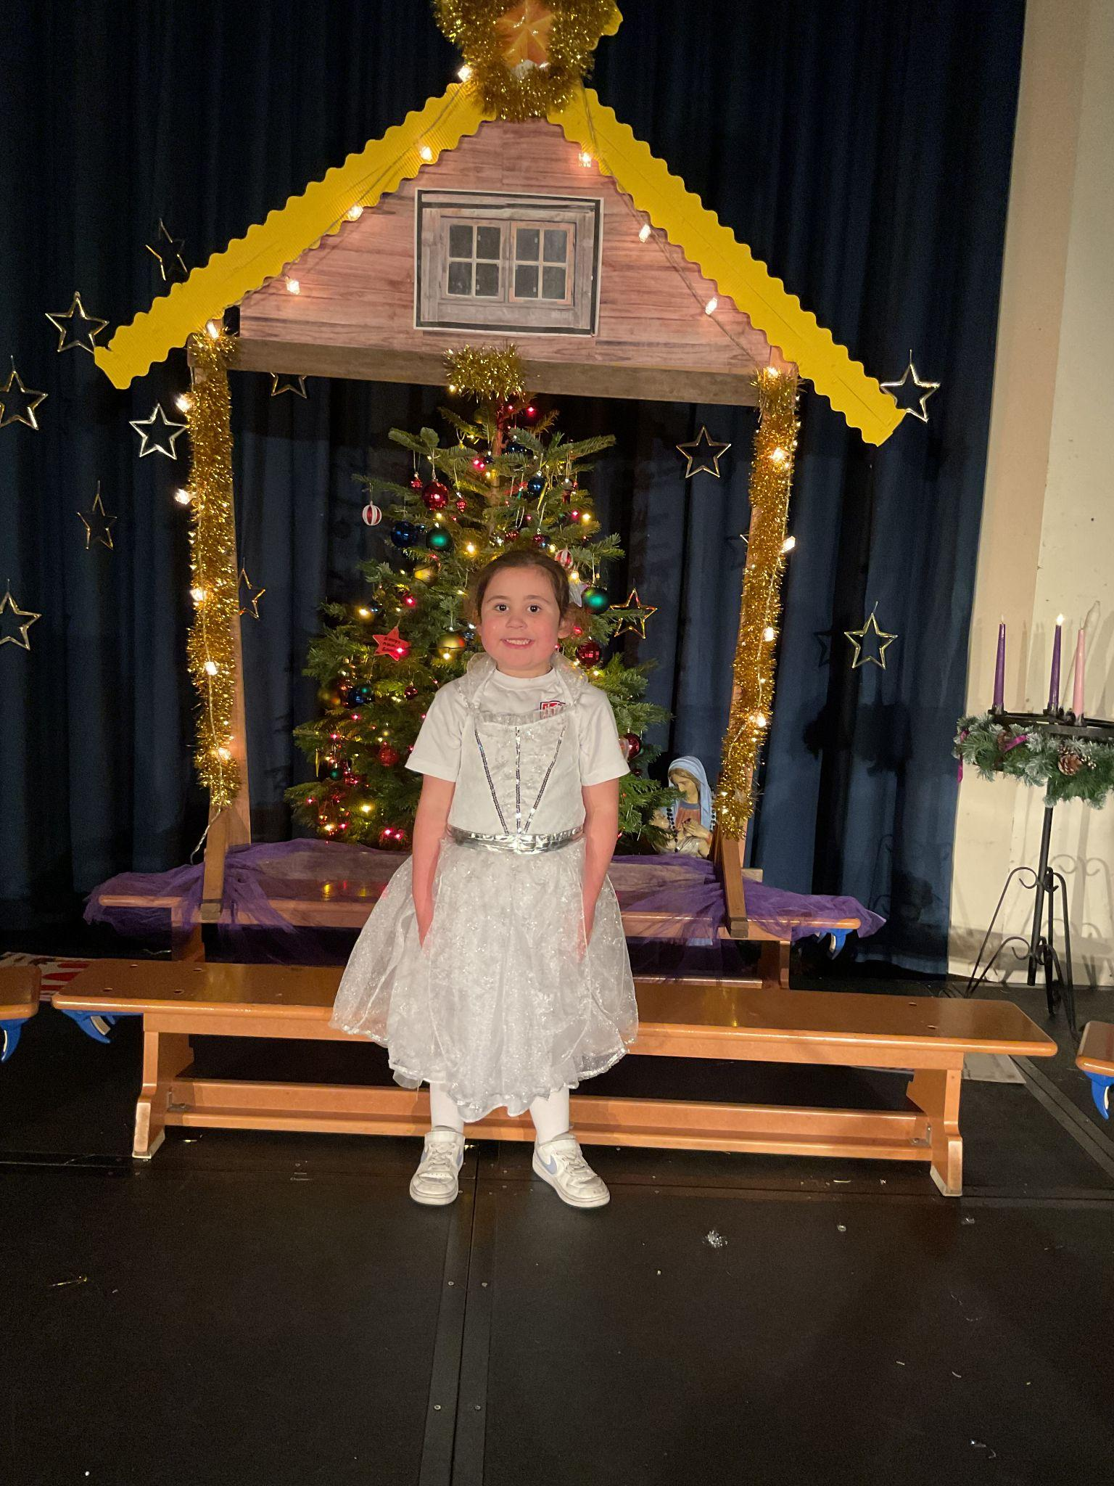
Early Years-
for showing a positive role model this week and trying really hard in Literacy lessons.
Miss Barker

Slide 7
Year 1
For trying his best in all areas of his learning particularly in his reading and phonics!
Miss Sweet

Slide 8
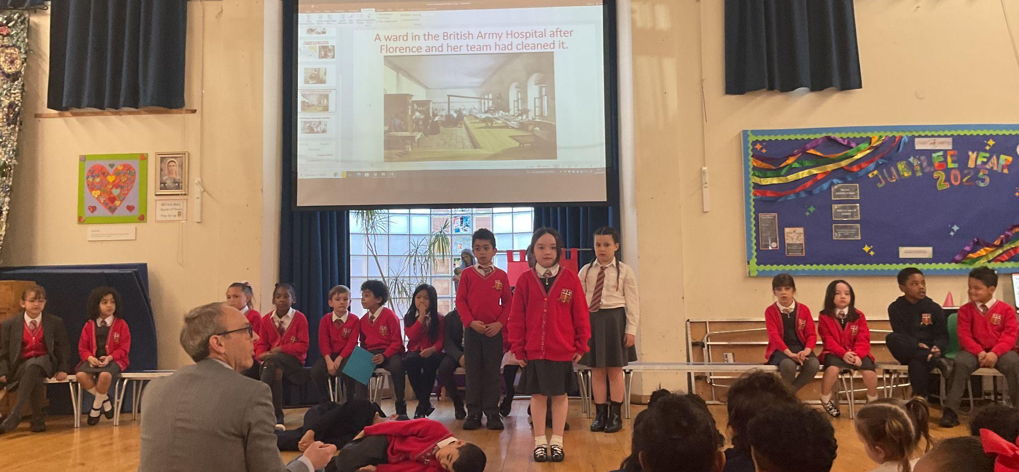
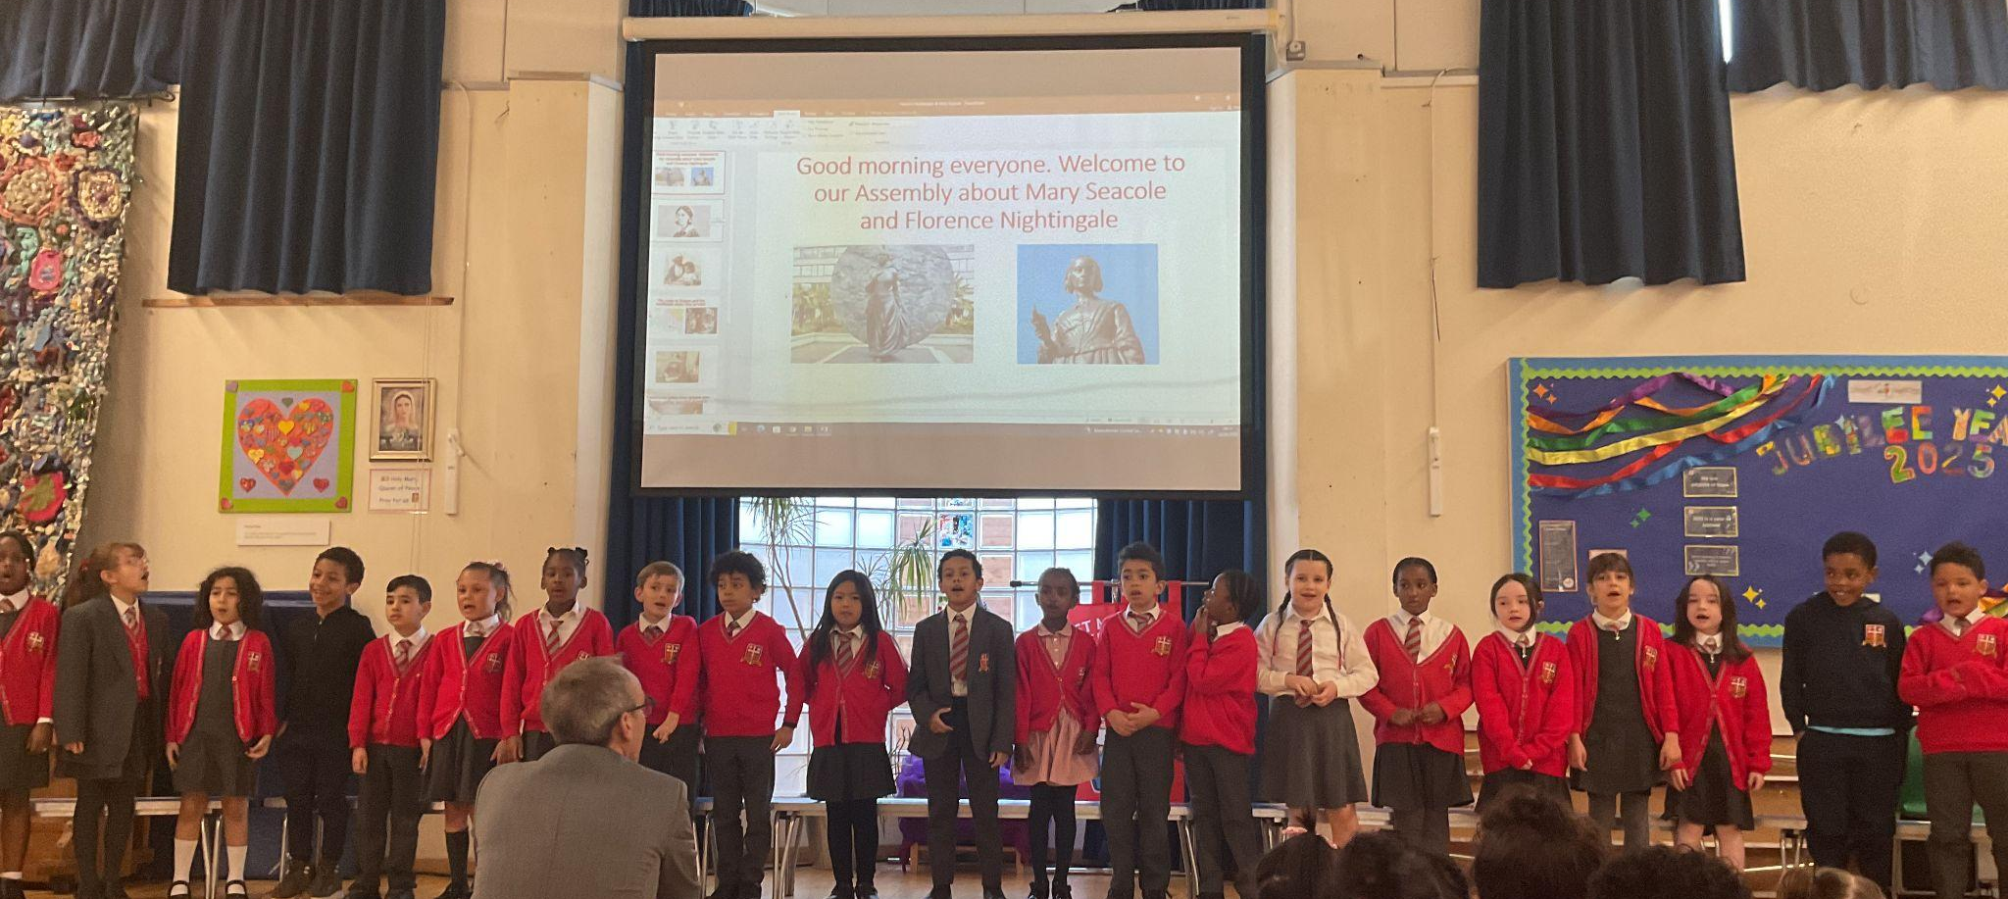
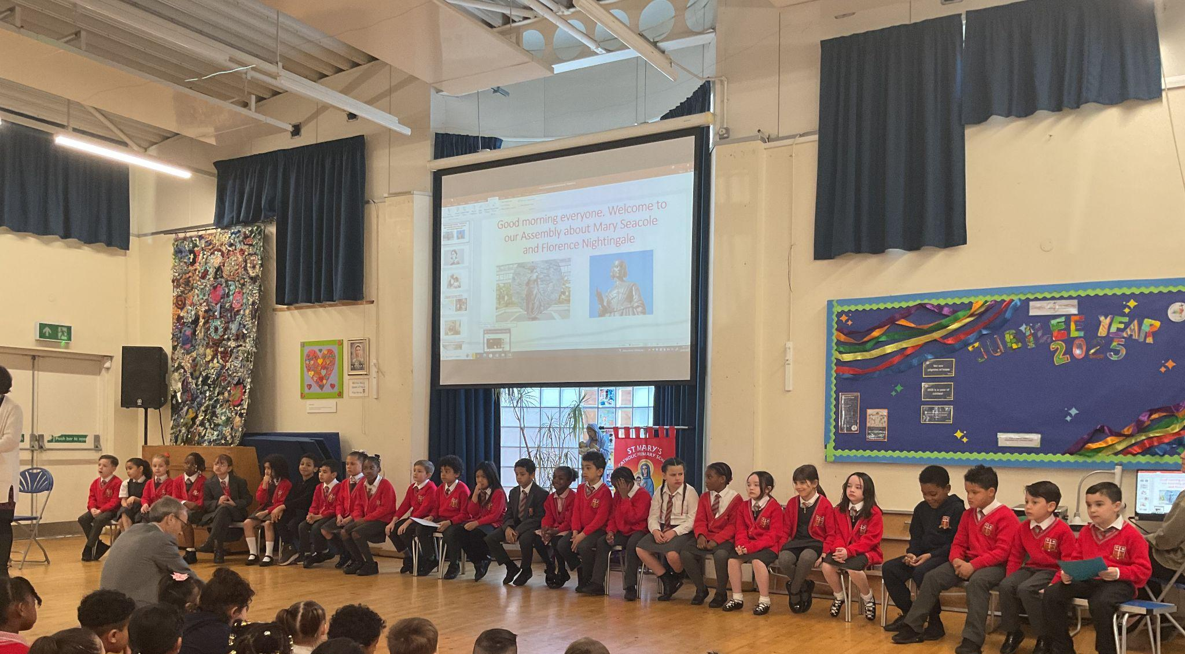
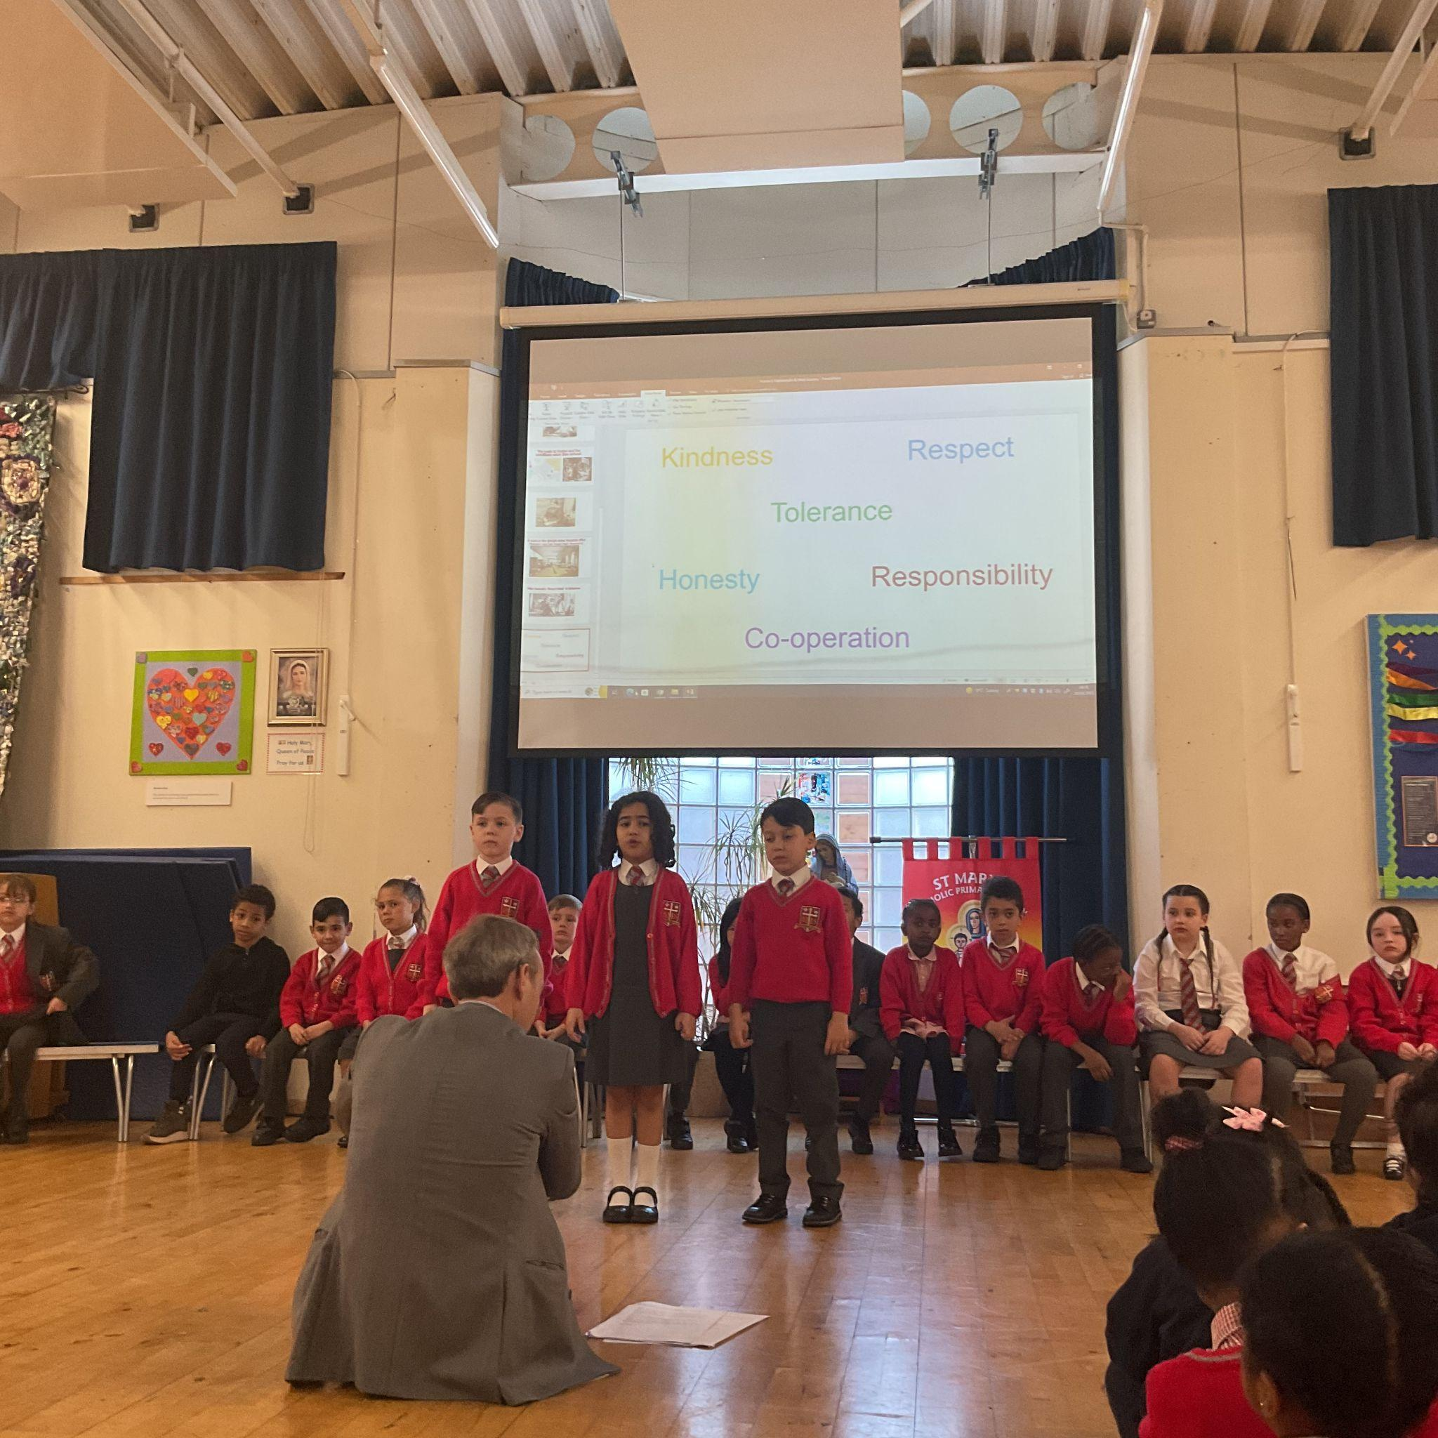
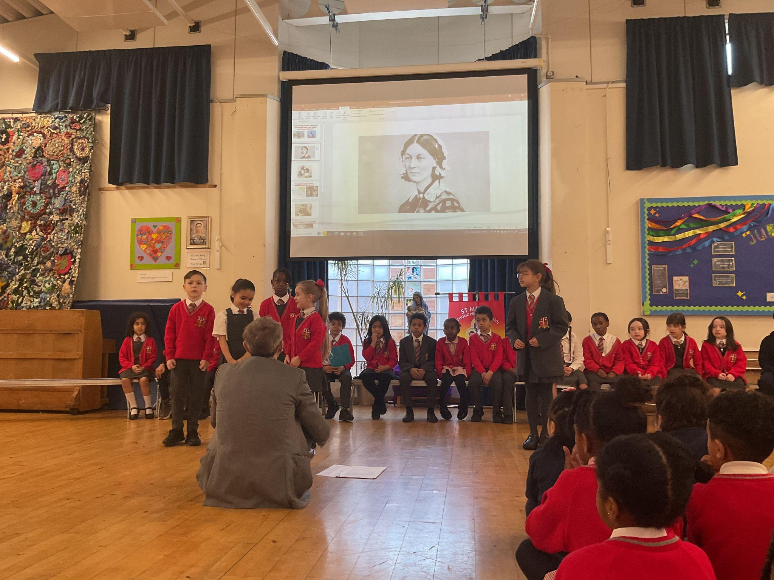
Year 2
The Whole Class
For showing that working hard as a team brings great results.
Mr Whear

Slide 9
Year 3
For making an effort to independently complete her work even when she is lacking in confidence.
Miss Medioli

Slide 10
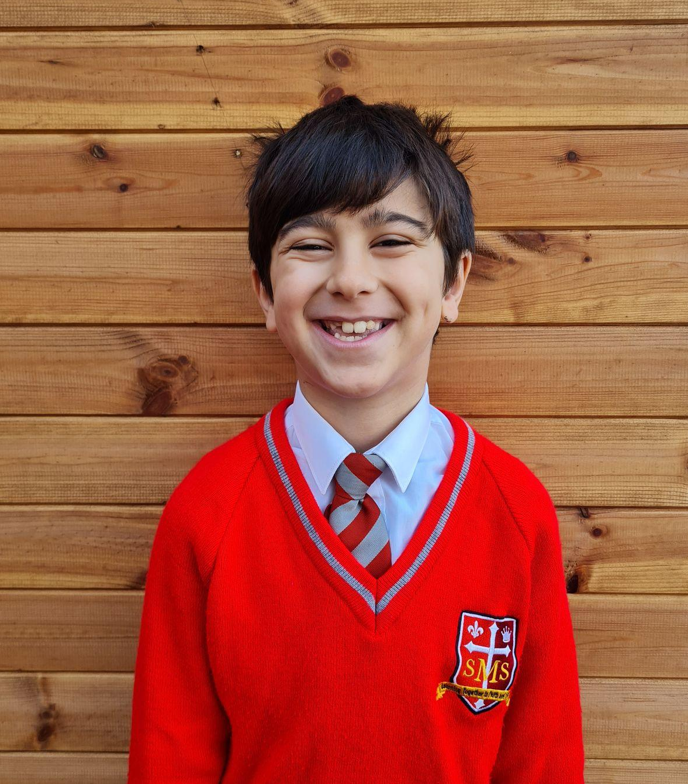
Year 4
For their excellent progress in writing so far this year, especially their recent stories about Kensuke’s Kingdom.
Miss Forrest

Slide 11
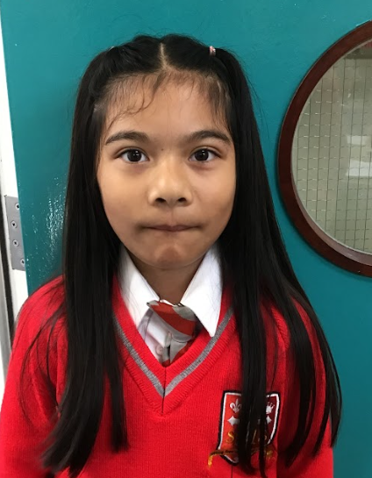
Year 5
For exemplary behaviour this week.
Mr Larke

Slide 12
Year 6
For brilliant participation in class and strong application in lessons.
Mr Cherfi and Mr Fowle

Slide 13
Star Readers
Y1 - Ineesha
Y2 - Fraser
Y3 - Guttemberg
Y4 - Nathaniel
Y5 - Zyann
Y6 - N/A

Slide 14
Alessia - Y4
George - Y3
Layla - Y6
Luna - Y2

Slide 15
Whole School
Star of the Week
Friday 14th March 2025

