Slide 1

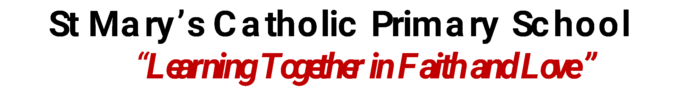


Whole School
Star of the Week
Friday 21st November 2025

Slide 2

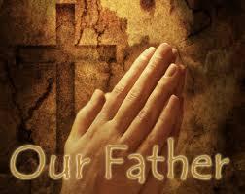
Our Father who art in Heaven
Hallowed be Thy Name
Thy Kingdom come
Thy will be done on Earth as it is in Heaven
Give us this day our daily bread
And forgive us our trespasses
As we forgive those who trespass against us
And lead us not into temptation
But deliver us from evil
Amen

Slide 3
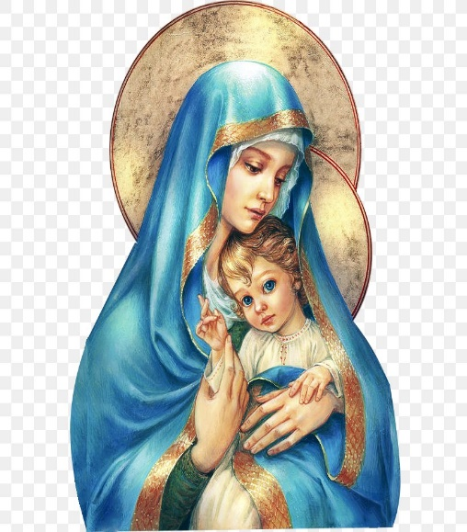
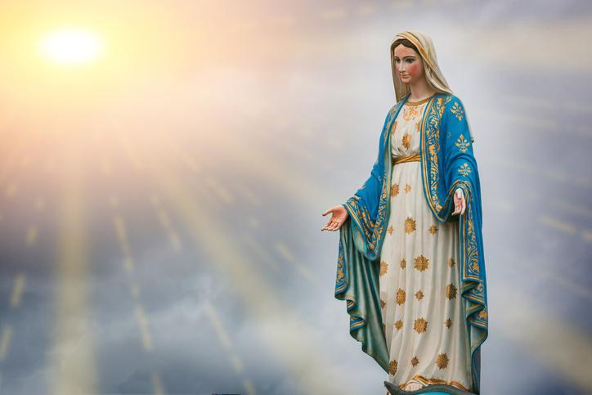
Hail Mary, Full of Grace
The Lord is with Thee
Blessed are Thou amongst women
And Blessed is the fruit of Thy womb, Jesus
Holy Mary , Mother of God
Pray for us sinners
Now and in the hour of our death
Amen

Slide 4
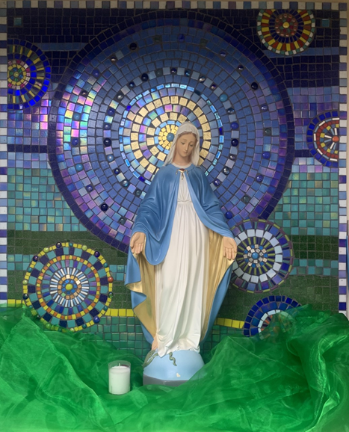
St Mary’s School Prayer
O Holy Mary,
Mother and Patron of our school,
Turn your eyes of mercy towards us,
that we may love God
With all our hearts!
May we imitate the tenderness
of your Son, Jesus,
showing love and respect
For each person
and ourselves as children of God.
Guided by the Holy Spirit,
May we create the school,
where Mercy and Compassion
Is the centre of our lives.
Amen

Slide 5
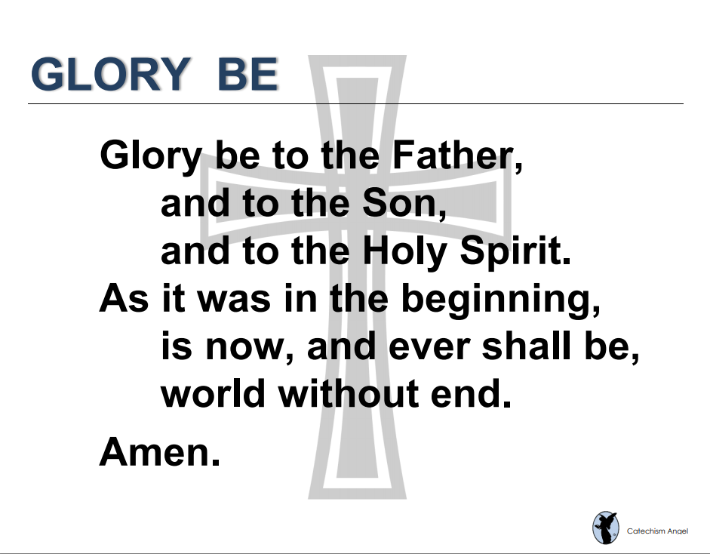

Slide 6
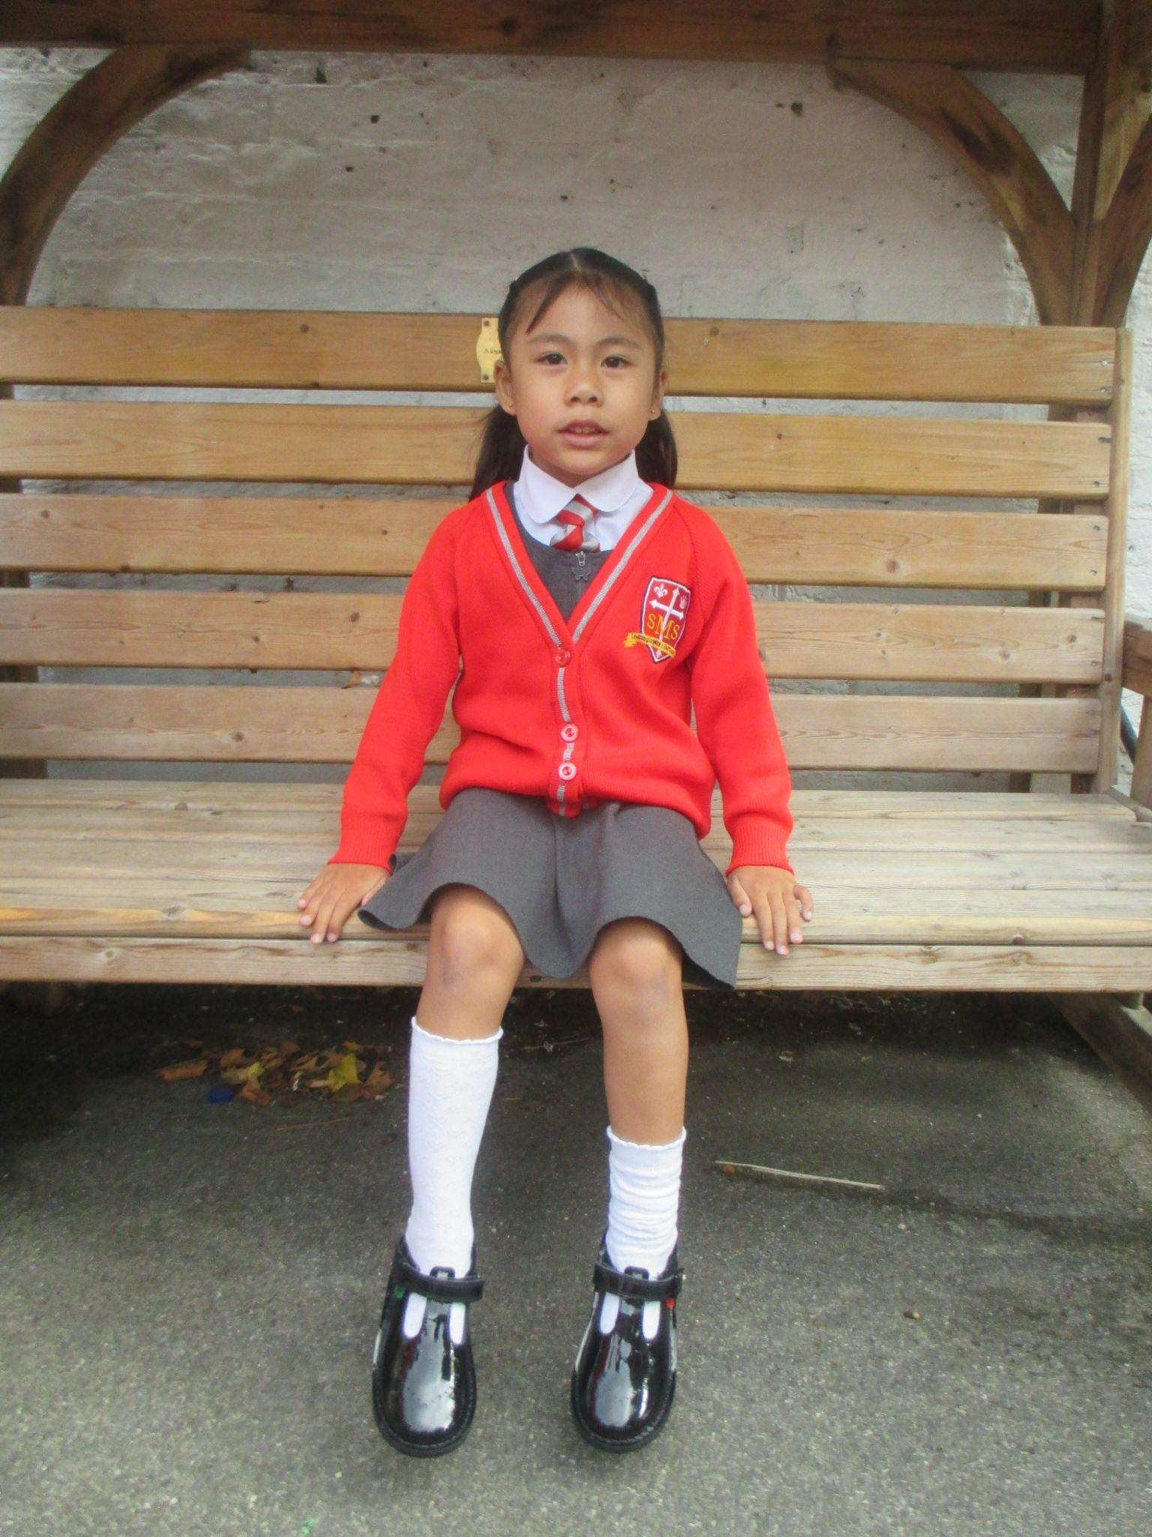
EYFS
Reception
For working hard in all areas of learning and becoming more confident in class.
Miss Barker

Slide 7
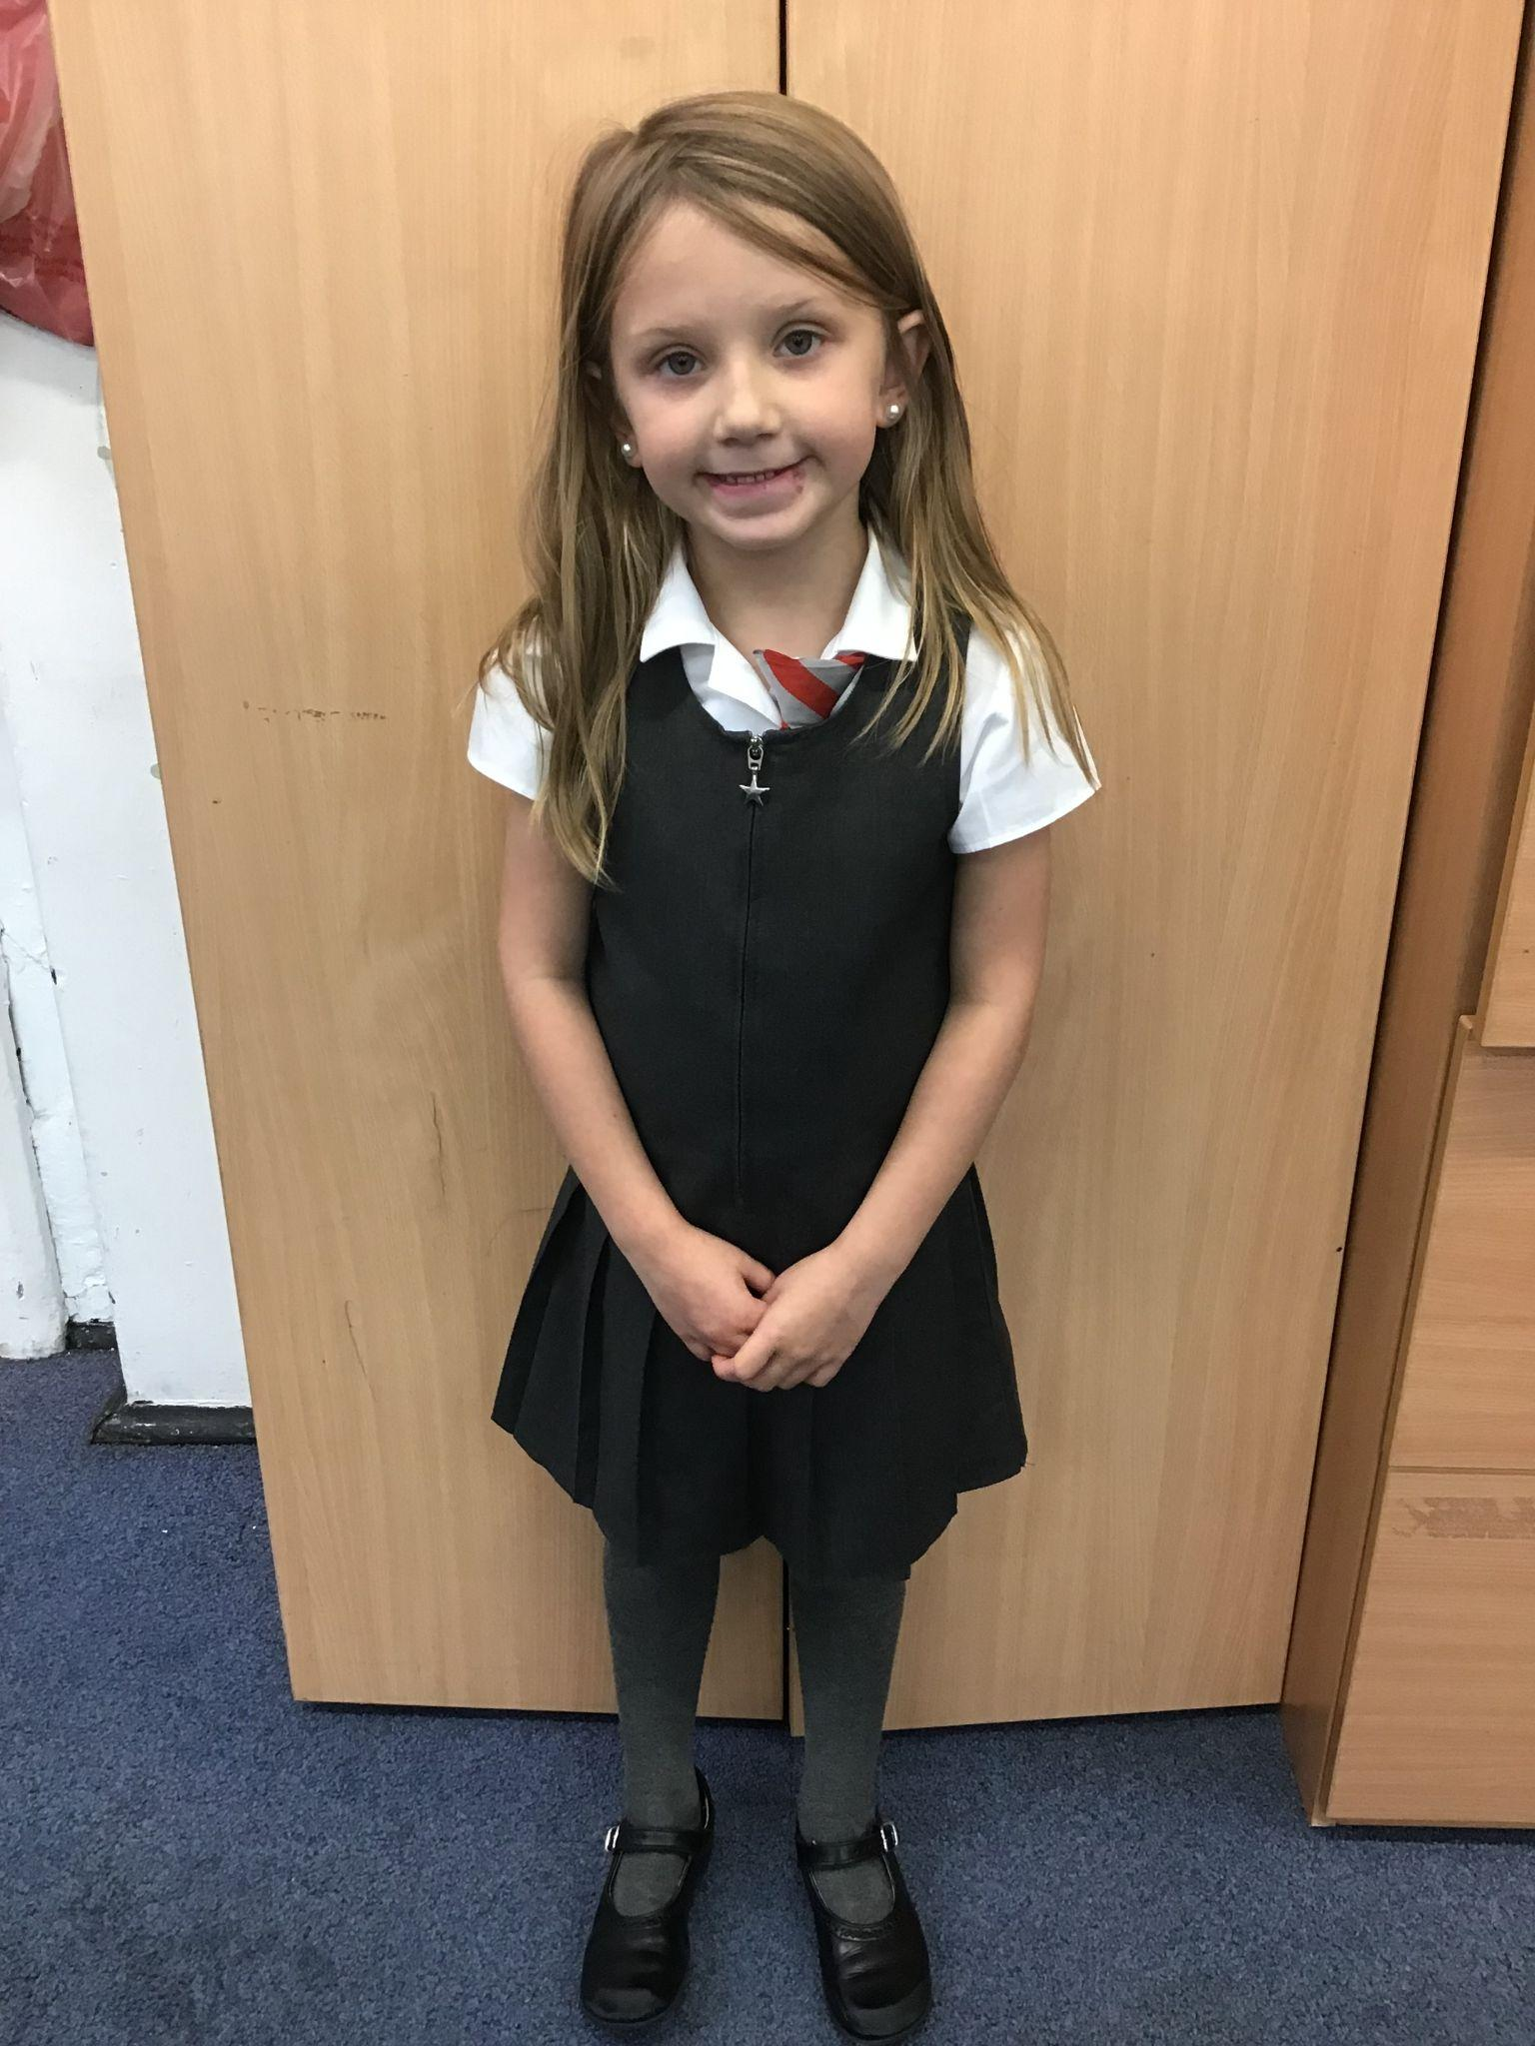
Year 1
For always showing her hard work and effort in every lesson, and doing the right thing the first time, being a role model to everyone else.

Slide 8
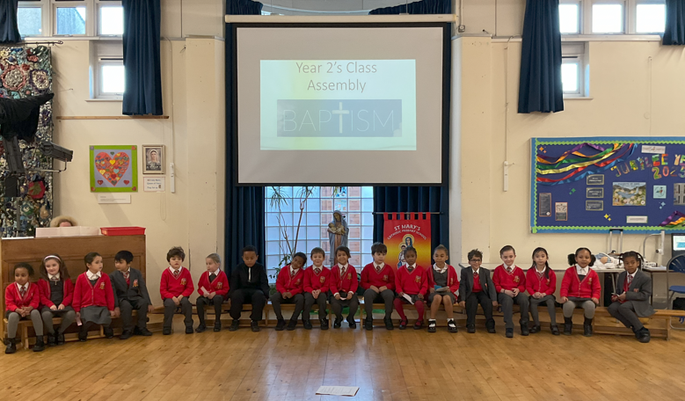
Year 2
Whole Class
For their fantastic assembly on Baptism!
Miss Sweet

Slide 9
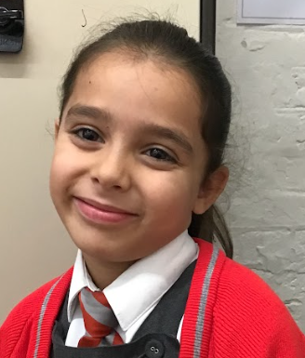
Year 3
For consistent effort and application in all her learning.
Mr. Larke

Slide 10
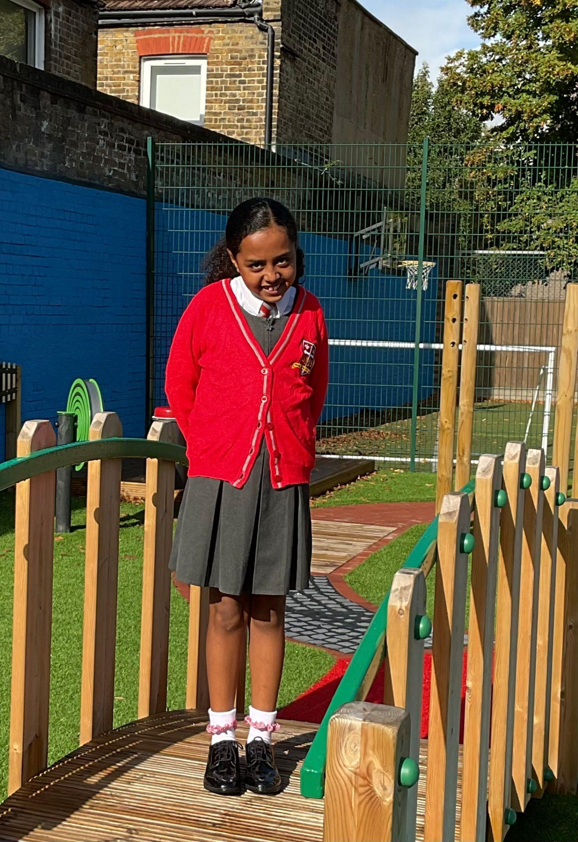
Year 4
Mr Whear
For listening to feedback, resolving to improve and producing
some fabulous work in multiplication

Slide 11
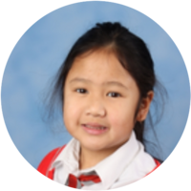
Year 5
For her hard work and engagement and always challenging herself in her learning and seeking feedback.
Mr. Carey

Slide 12
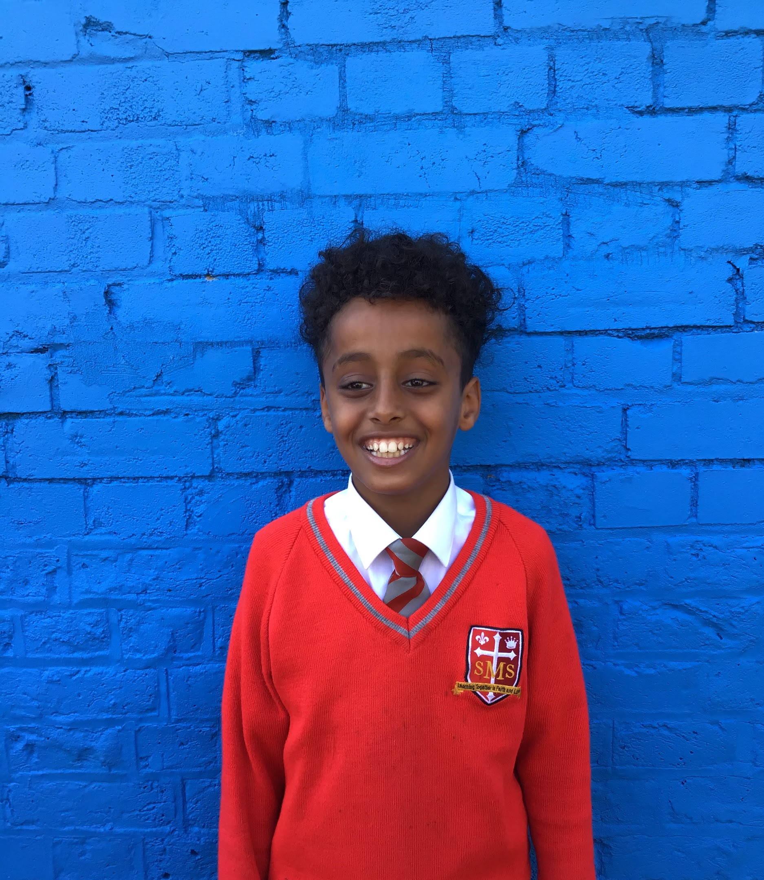
Year 6
For showing a real hunger for self-improvement and taking on constructive criticism brilliantly
Mr Cherfi & Mr Quinlan

Slide 13



Star Readers
Y1 - Giniayah
Y2 - No reader this week
Y3 - Mia
Y4 - Delilah
Y5 - Alby
Y6 - Beza

Slide 14

Mrs Mikielewicz
Evie - Y3
Tegan - Year 1
Grae - Year 4
Callie-Mae - Y4
Isla - Year 3

Slide 15
Whole School
Star of the Week
Friday 21st November 2025

