Slide 1



Whole School
Star of the Week
Friday 22nd May 2026

Slide 2


Our Father who art in Heaven
Hallowed be Thy Name
Thy Kingdom come
Thy will be done on Earth as it is in Heaven
Give us this day our daily bread
And forgive us our trespasses
As we forgive those who trespass against us
And lead us not into temptation
But deliver us from evil
Amen

Slide 3
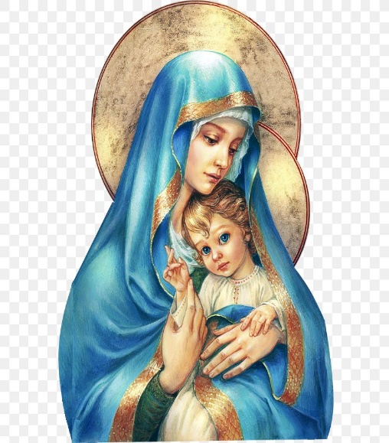
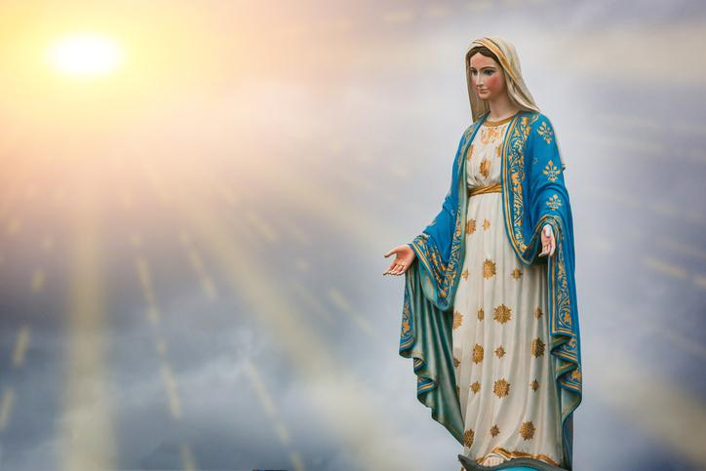
Hail Mary, Full of Grace
The Lord is with Thee
Blessed are Thou amongst women
And Blessed is the fruit of Thy womb, Jesus
Holy Mary , Mother of God
Pray for us sinners
Now and in the hour of our death
Amen

Slide 4
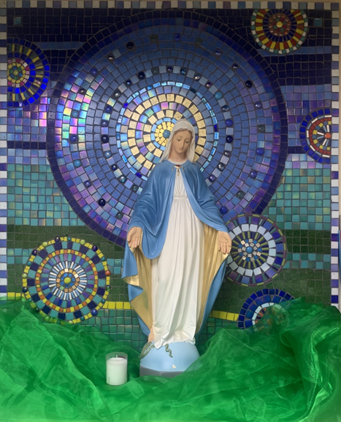
St Mary’s School Prayer
O Holy Mary,
Mother and Patron of our school,
Turn your eyes of mercy towards us,
that we may love God
With all our hearts!
May we imitate the tenderness
of your Son, Jesus,
showing love and respect
For each person
and ourselves as children of God.
Guided by the Holy Spirit,
May we create the school,
where Mercy and Compassion
Is the centre of our lives.
Amen

Slide 5
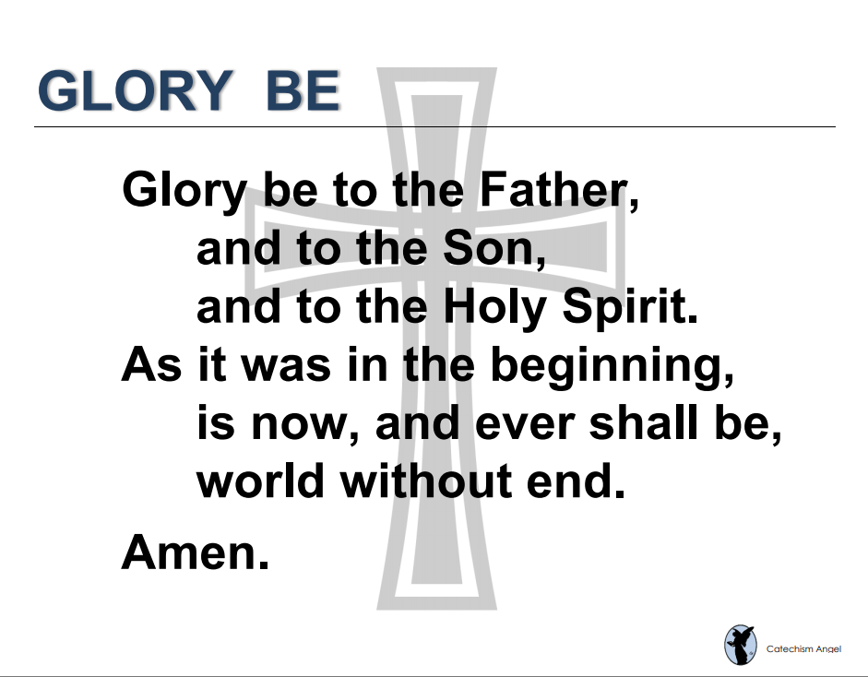

Slide 6
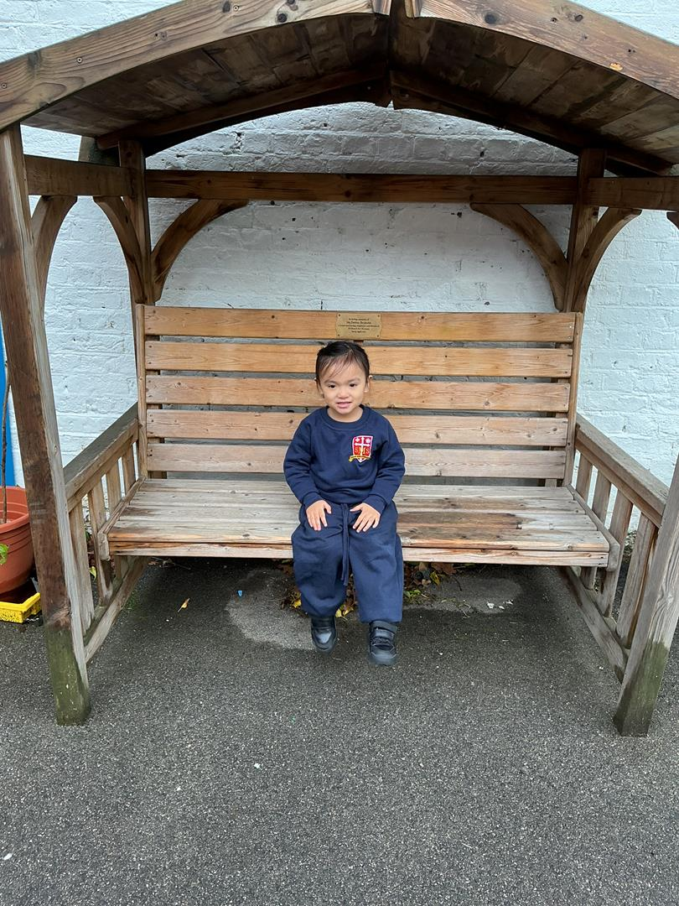
Nursery
For having a great week in Nursery, joining in with all her lessons and following all of our classroom rules.
Miss Barker

Slide 7
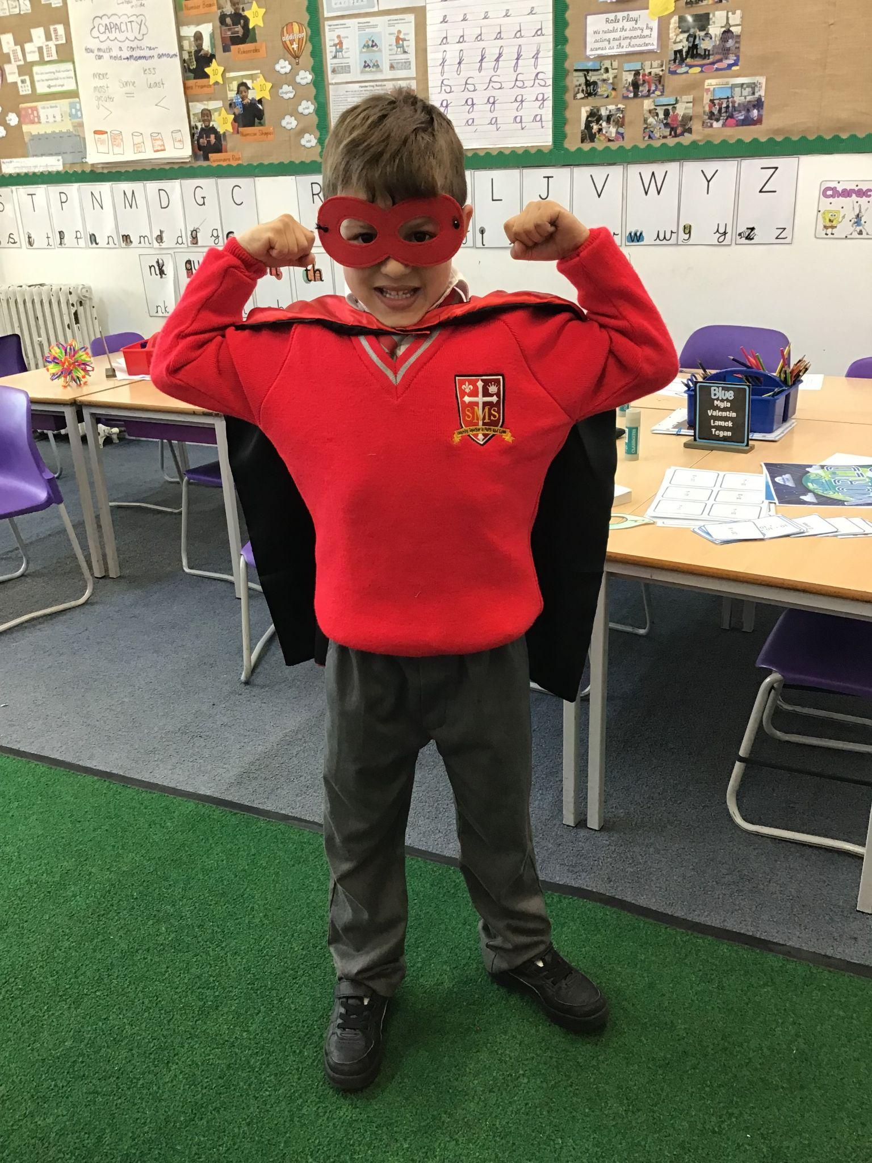
Year 1
For making strides in his learning and working hard to finish tasks to the best of his ability.
Miss Flashman

Slide 8
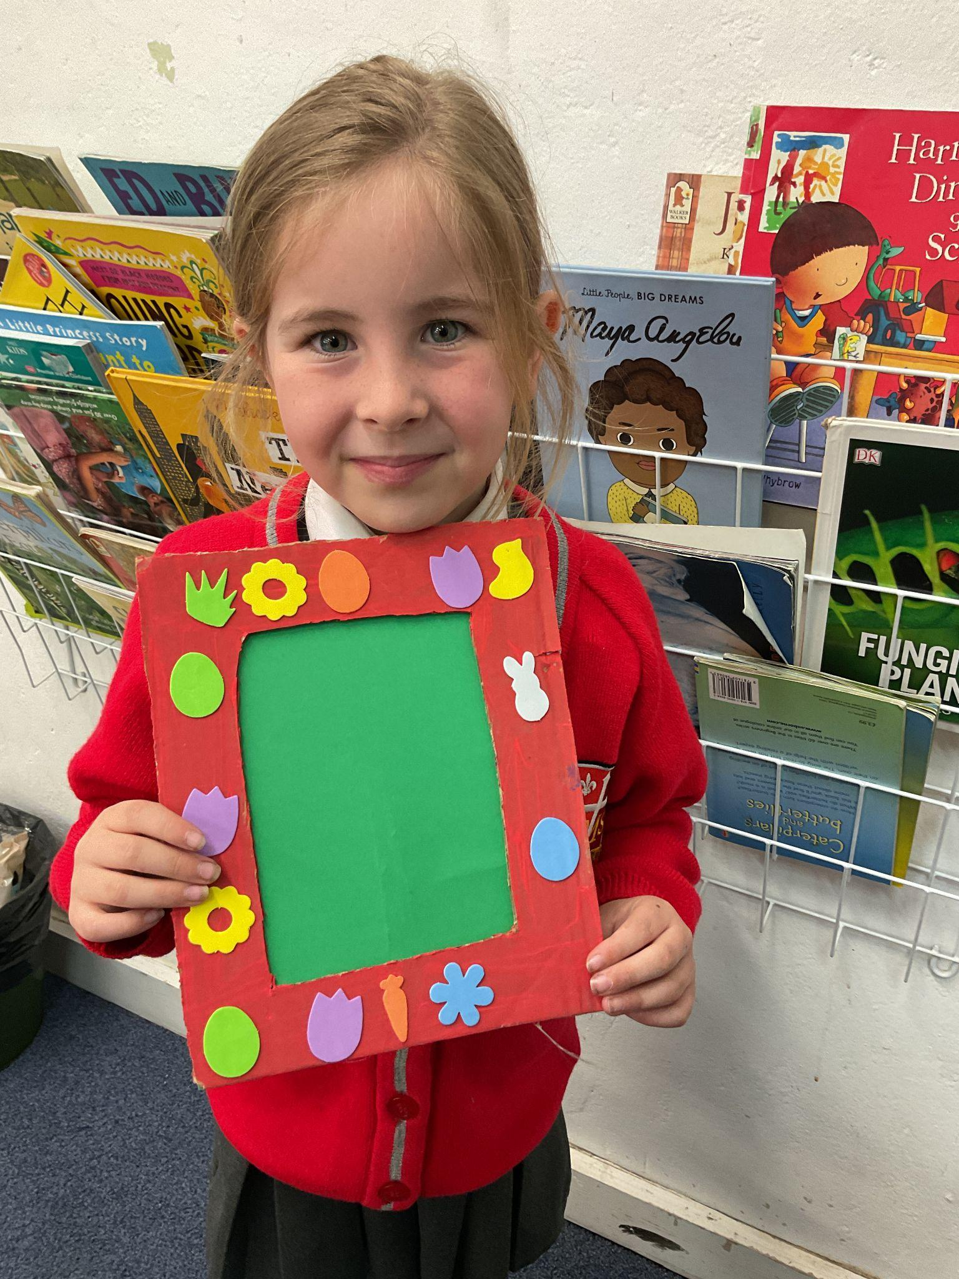
Year 2
For being a reliable and trustworthy student no matter what!
Miss Sweet

Slide 9
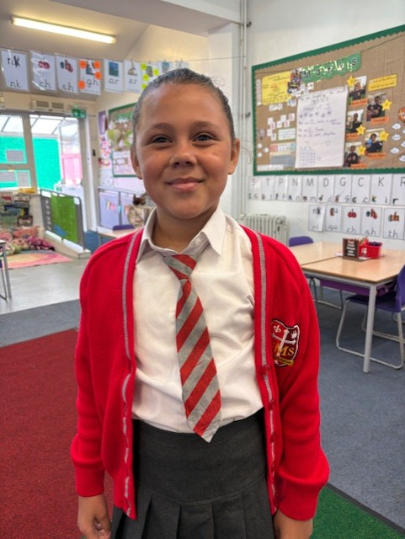
Year 3
For being such a lovely friend to all and her positive attitude to learning.
Miss Hickey

Slide 10
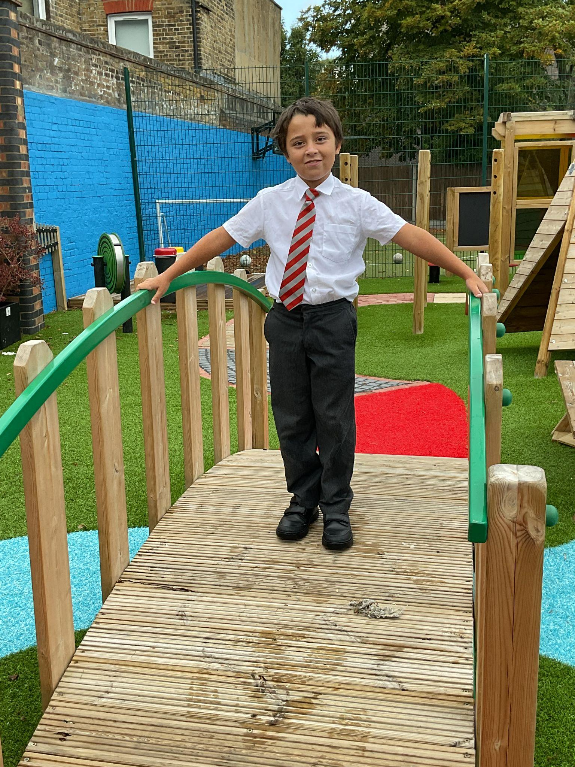
Year 4
For working so hard to make the right choices
Mr Whear

Slide 11
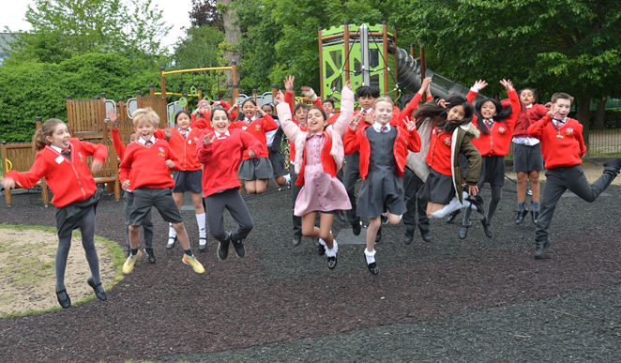


Year 5
Absolutely Fantastic!
Mrs Bakali

Slide 12
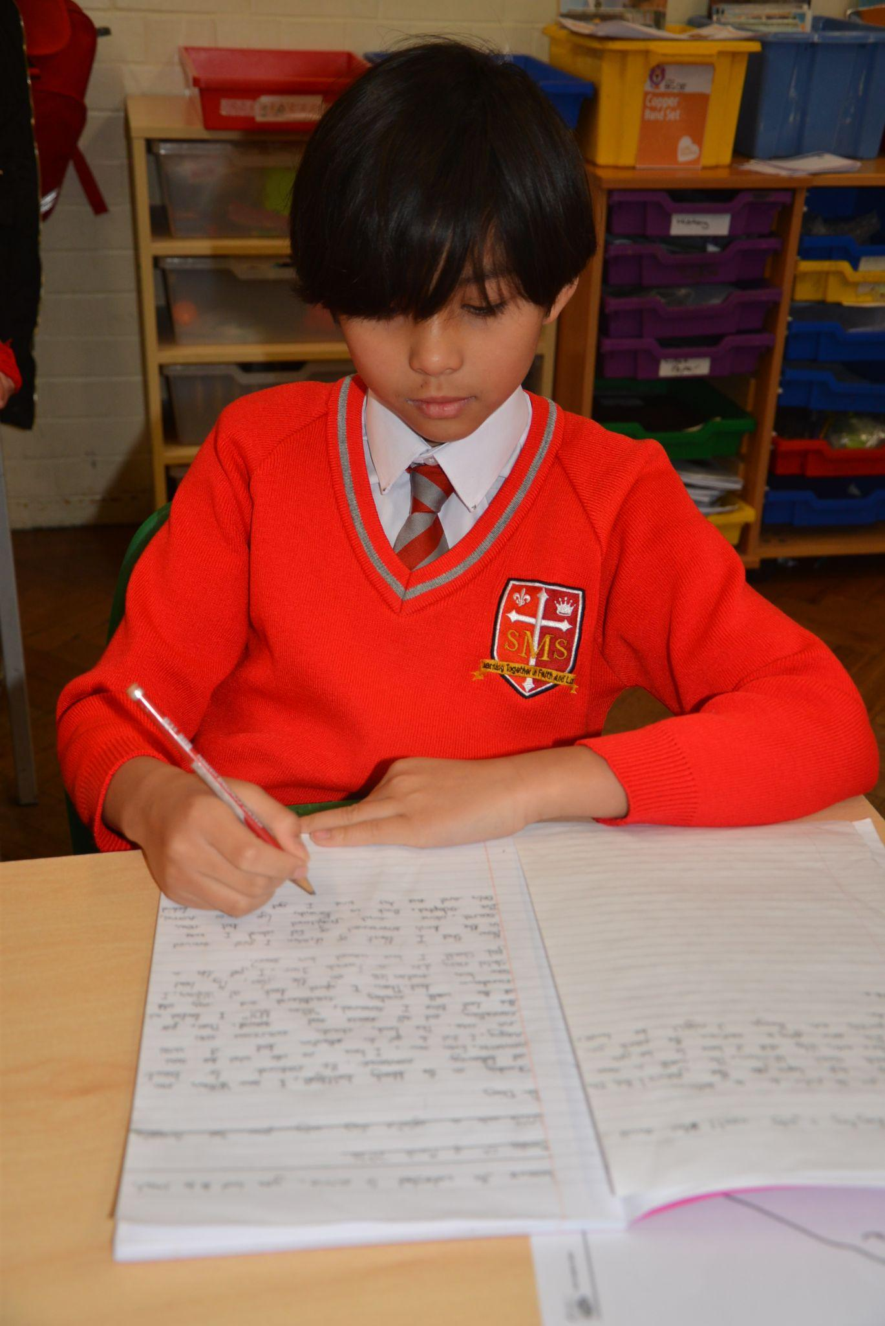
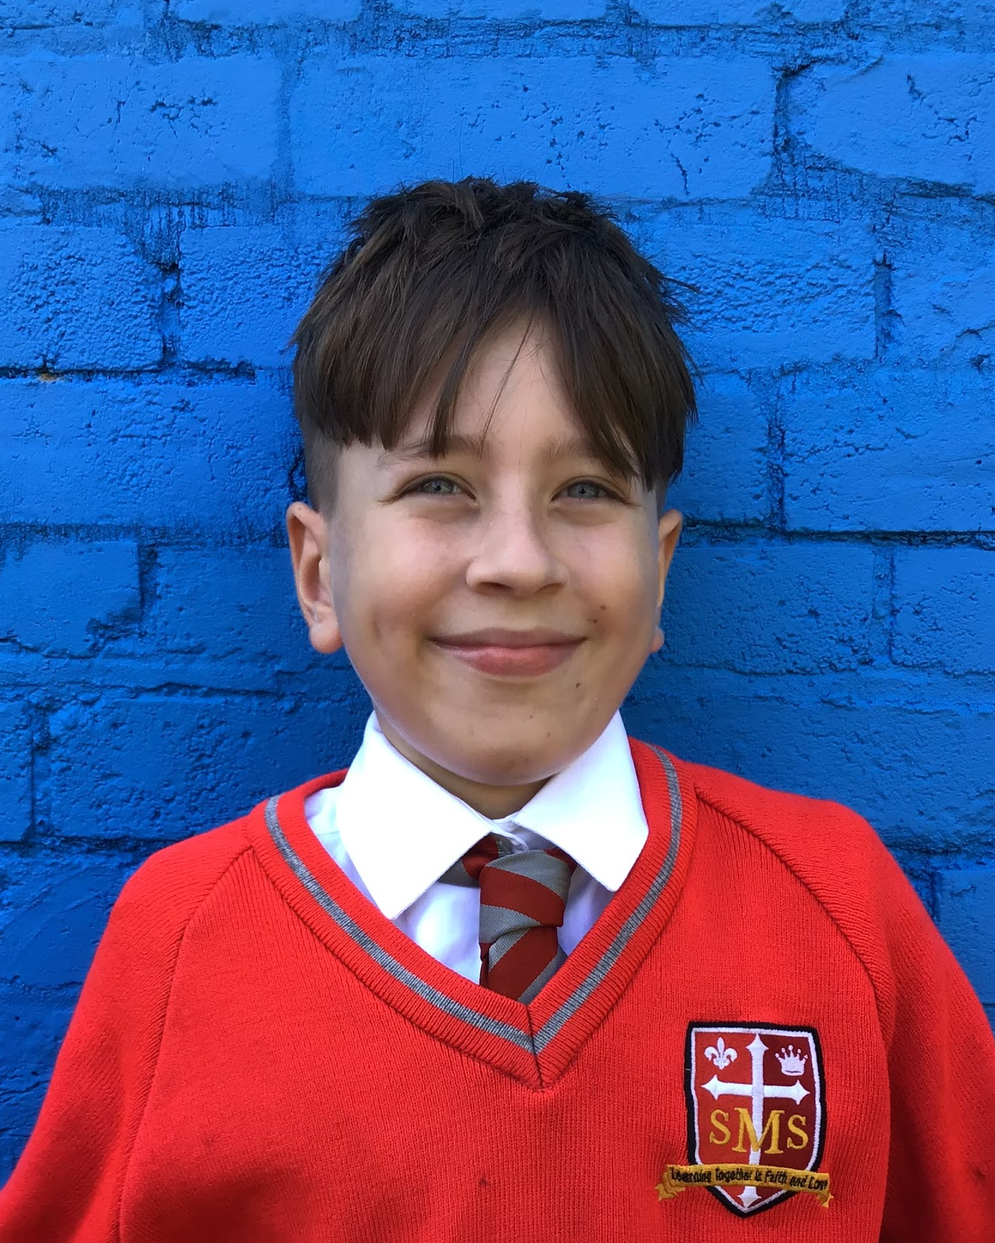
Year 6
For excellent improvement in effort across all lessons. Keep asking wonderful questions to support your learning.
Mr Cherfi

Slide 13



Star Readers
Y1 - Isadora
Y2 - Not this week :(
Y3 - Anya
Y4 - Andre
Y5 - Nevaeh
Y6 - Adrien & Jericho

Slide 14

Makda
Mimi
Sofia
Azahrye Y3

Slide 15
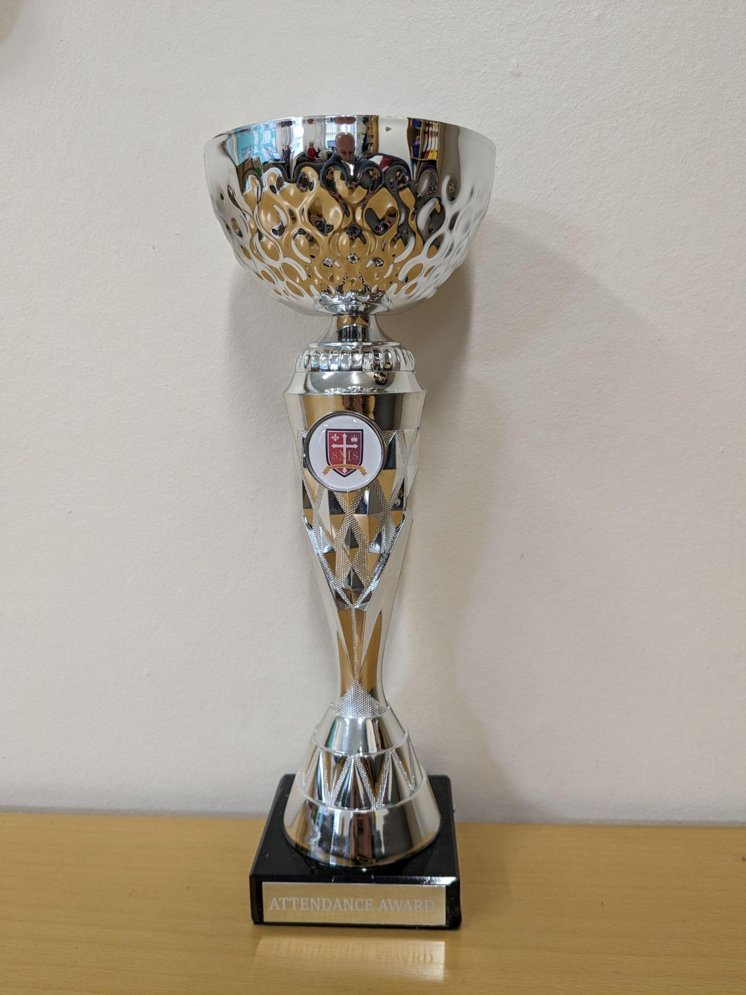
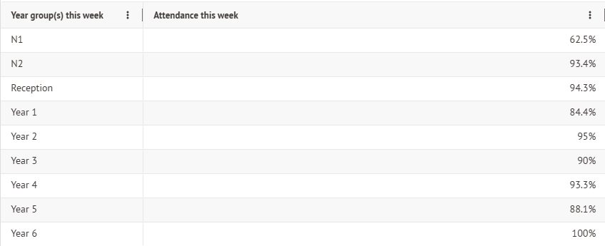
Attendance Weekly Leaders Summer Term:
Winners of the Pitch on Friday -

Slide 16
Whole School
Star of the Week
Friday 15th May 2026

