Slide 1




Whole School
Star of the Week
Friday 23rd January 2026

Slide 2


Our Father who art in Heaven
Hallowed be Thy Name
Thy Kingdom come
Thy will be done on Earth as it is in Heaven
Give us this day our daily bread
And forgive us our trespasses
As we forgive those who trespass against us
And lead us not into temptation
But deliver us from evil
Amen

Slide 3
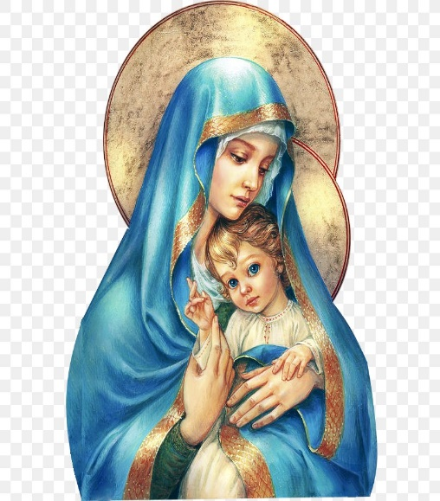
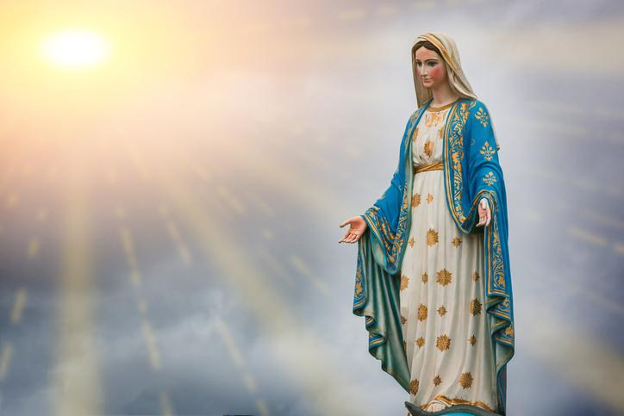
Hail Mary, Full of Grace
The Lord is with Thee
Blessed are Thou amongst women
And Blessed is the fruit of Thy womb, Jesus
Holy Mary , Mother of God
Pray for us sinners
Now and in the hour of our death
Amen

Slide 4
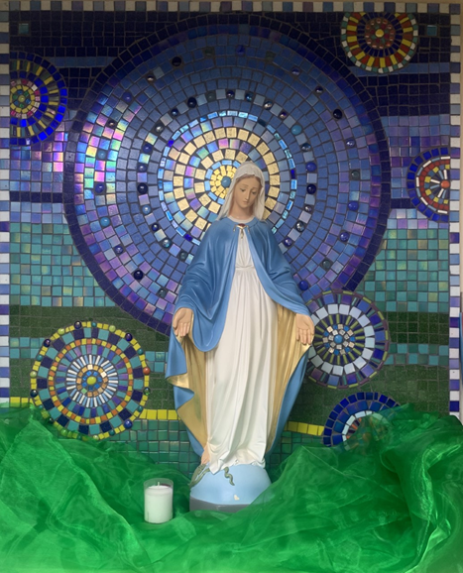
St Mary’s School Prayer
O Holy Mary,
Mother and Patron of our school,
Turn your eyes of mercy towards us,
that we may love God
With all our hearts!
May we imitate the tenderness
of your Son, Jesus,
showing love and respect
For each person
and ourselves as children of God.
Guided by the Holy Spirit,
May we create the school,
where Mercy and Compassion
Is the centre of our lives.
Amen

Slide 5
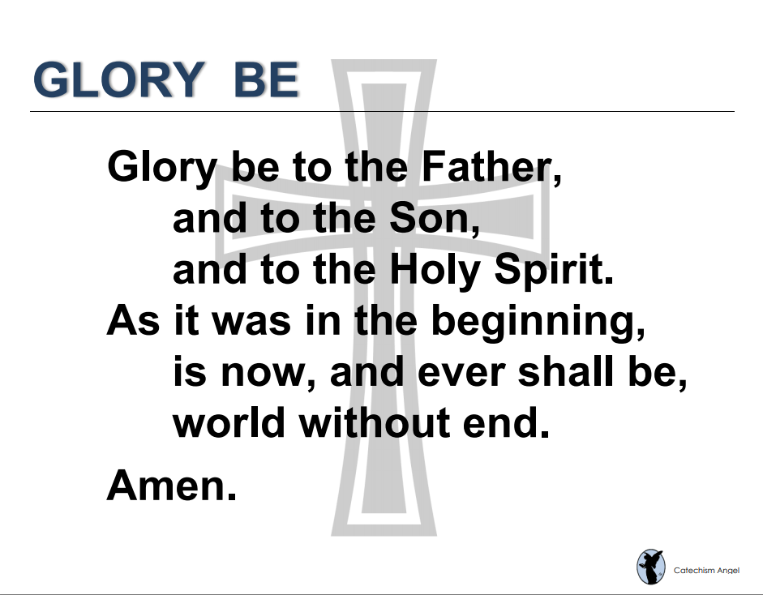

Slide 6
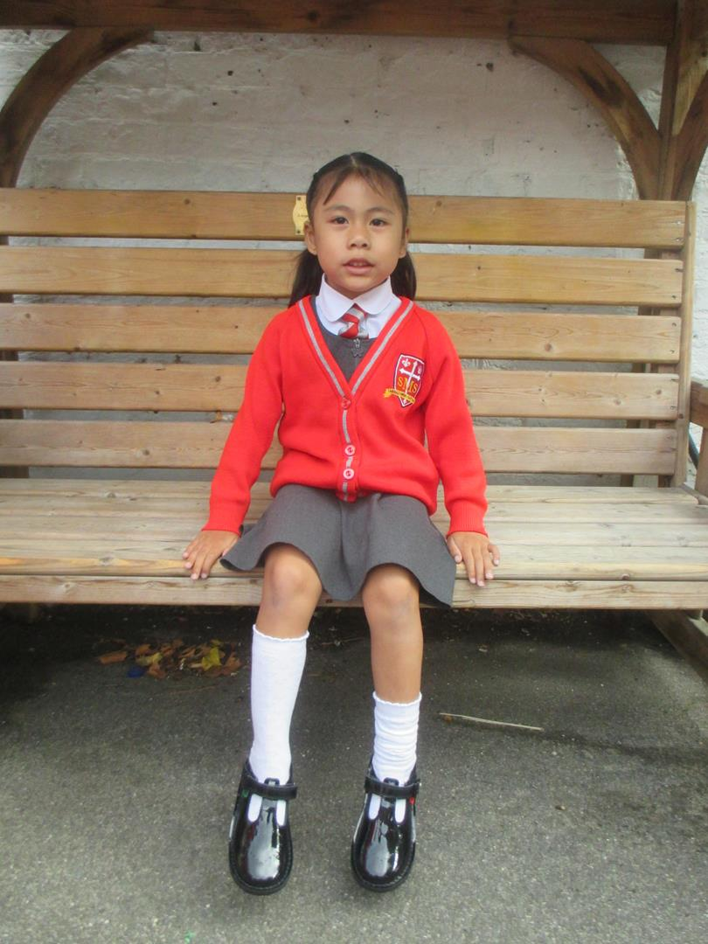
Reception
For becoming more confident and independent in her learning.
Miss Barker

Slide 7
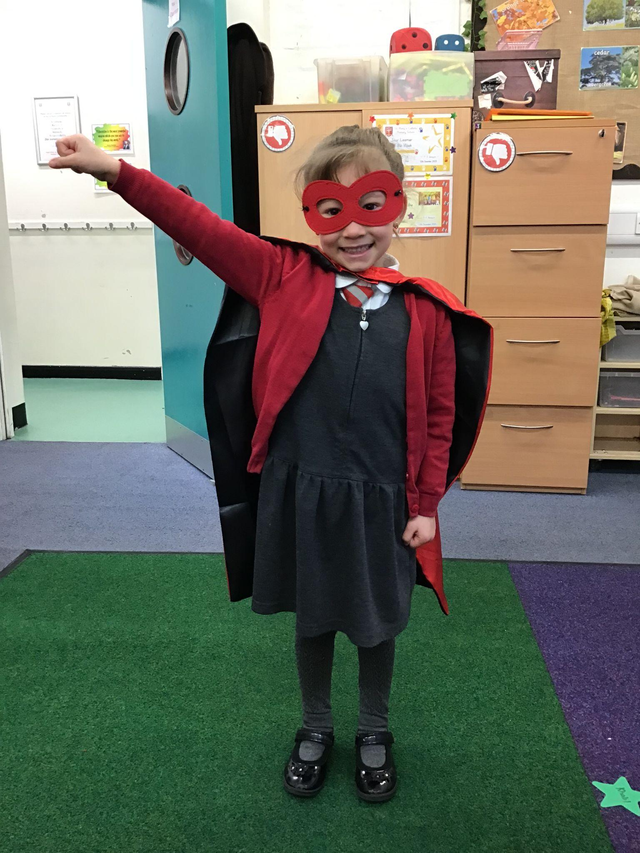
Year 1
For being a kind, caring role model to her peers and helping our new classmate settle in using her Portuguese expertise!
Miss Flashman

Slide 8
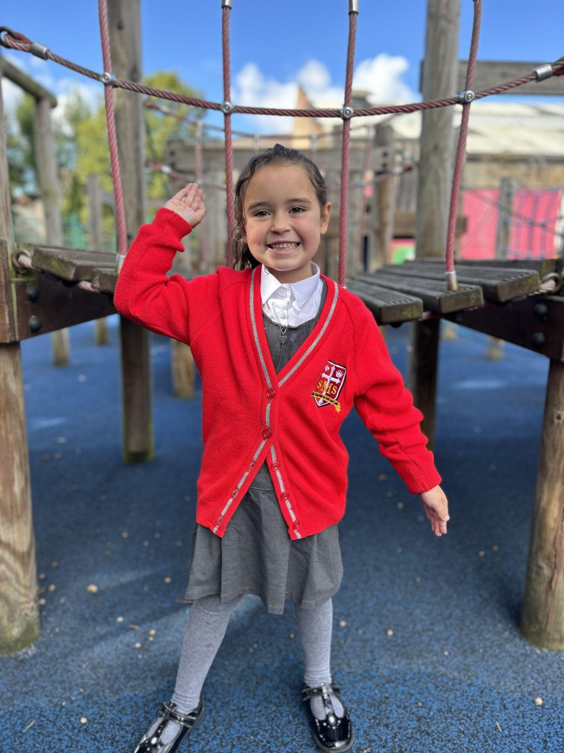
Year 2
For her fantastic knowledge recall in History!
Miss Sweet

Slide 9
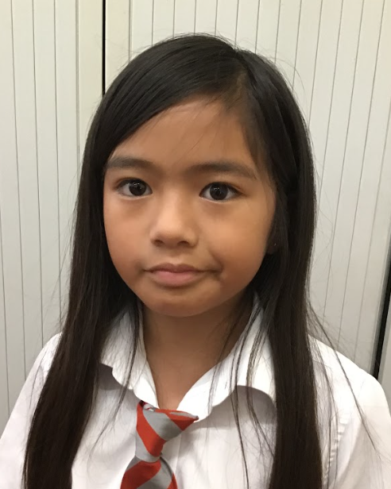
Year 3
For consistent effort in everything she does.
Mr. Larke

Slide 10
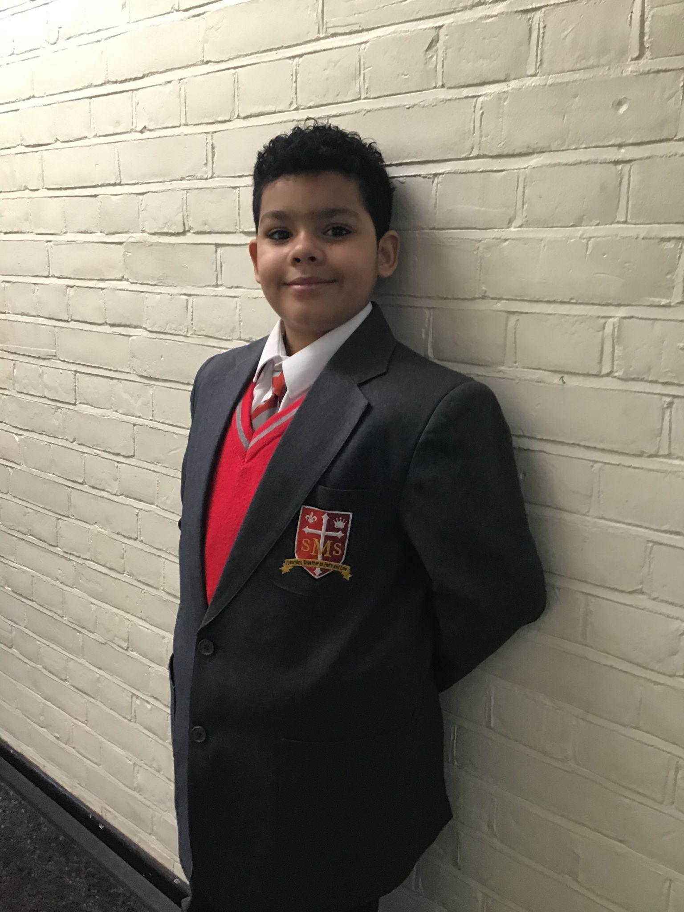
Ricardo
For confident and eloquent contributions to our lessons, particularly in RE.
Mr Whear

Slide 11
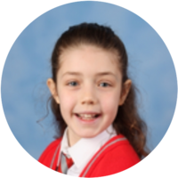
Year 5

Slide 12

Year 6
For great enthusiasm and application across all subjects. He is also a great help around the school and takes his prefect responsibilities seriously.
Mr Cherfi & Mr Quinlan

Slide 13



Star Readers
Y1 - Melaysia
Y2 - No reader this week :(
Y3 - Fraser
Y4 - Matthew
Y5 - N/A
Y6 - Carlos

Slide 14
Whole School
Star of the Week
Friday 23rd January 2026

