Slide 1
Whole School
Star of the Week
Friday 23rd May 2025

Slide 2
Our Father who art in Heaven
Hallowed be Thy Name
Thy Kingdom come
Thy will be done on Earth as it is in Heaven
Give us this day our daily bread
And forgive us our trespasses
As we forgive those who trespass against us
And lead us not into temptation
But deliver us from evil
Amen

Slide 3
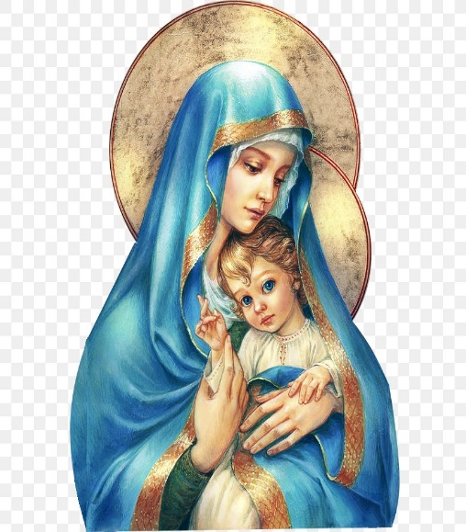
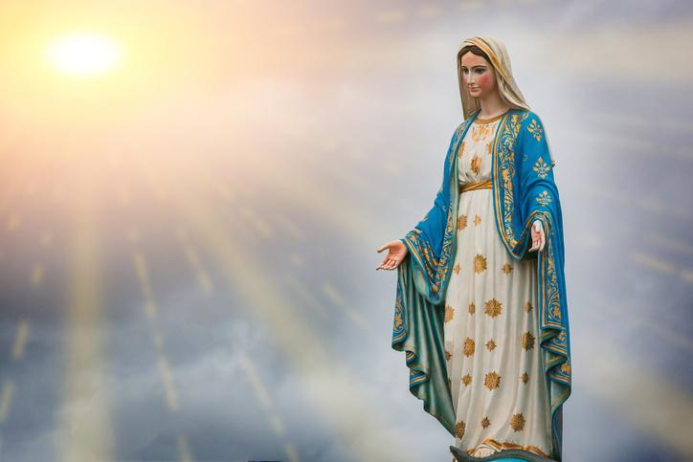
Hail Mary, Full of Grace
The Lord is with Thee
Blessed are Thou amongst women
And Blessed is the fruit of Thy womb, Jesus
Holy Mary , Mother of God
Pray for us sinners
Now and in the hour of our death
Amen

Slide 4
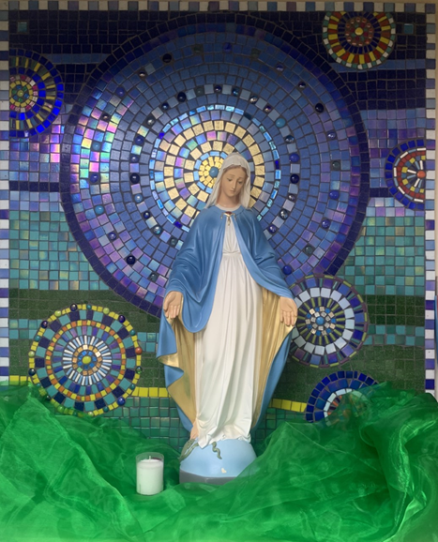
St Mary’s School Prayer
O Holy Mary,
Mother and Patron of our school,
Turn your eyes of mercy towards us,
that we may love God
With all our hearts!
May we imitate the tenderness
of your Son, Jesus,
showing love and respect
For each person
and ourselves as children of God.
Guided by the Holy Spirit,
May we create the school,
where Mercy and Compassion
Is the centre of our lives.
Amen

Slide 6
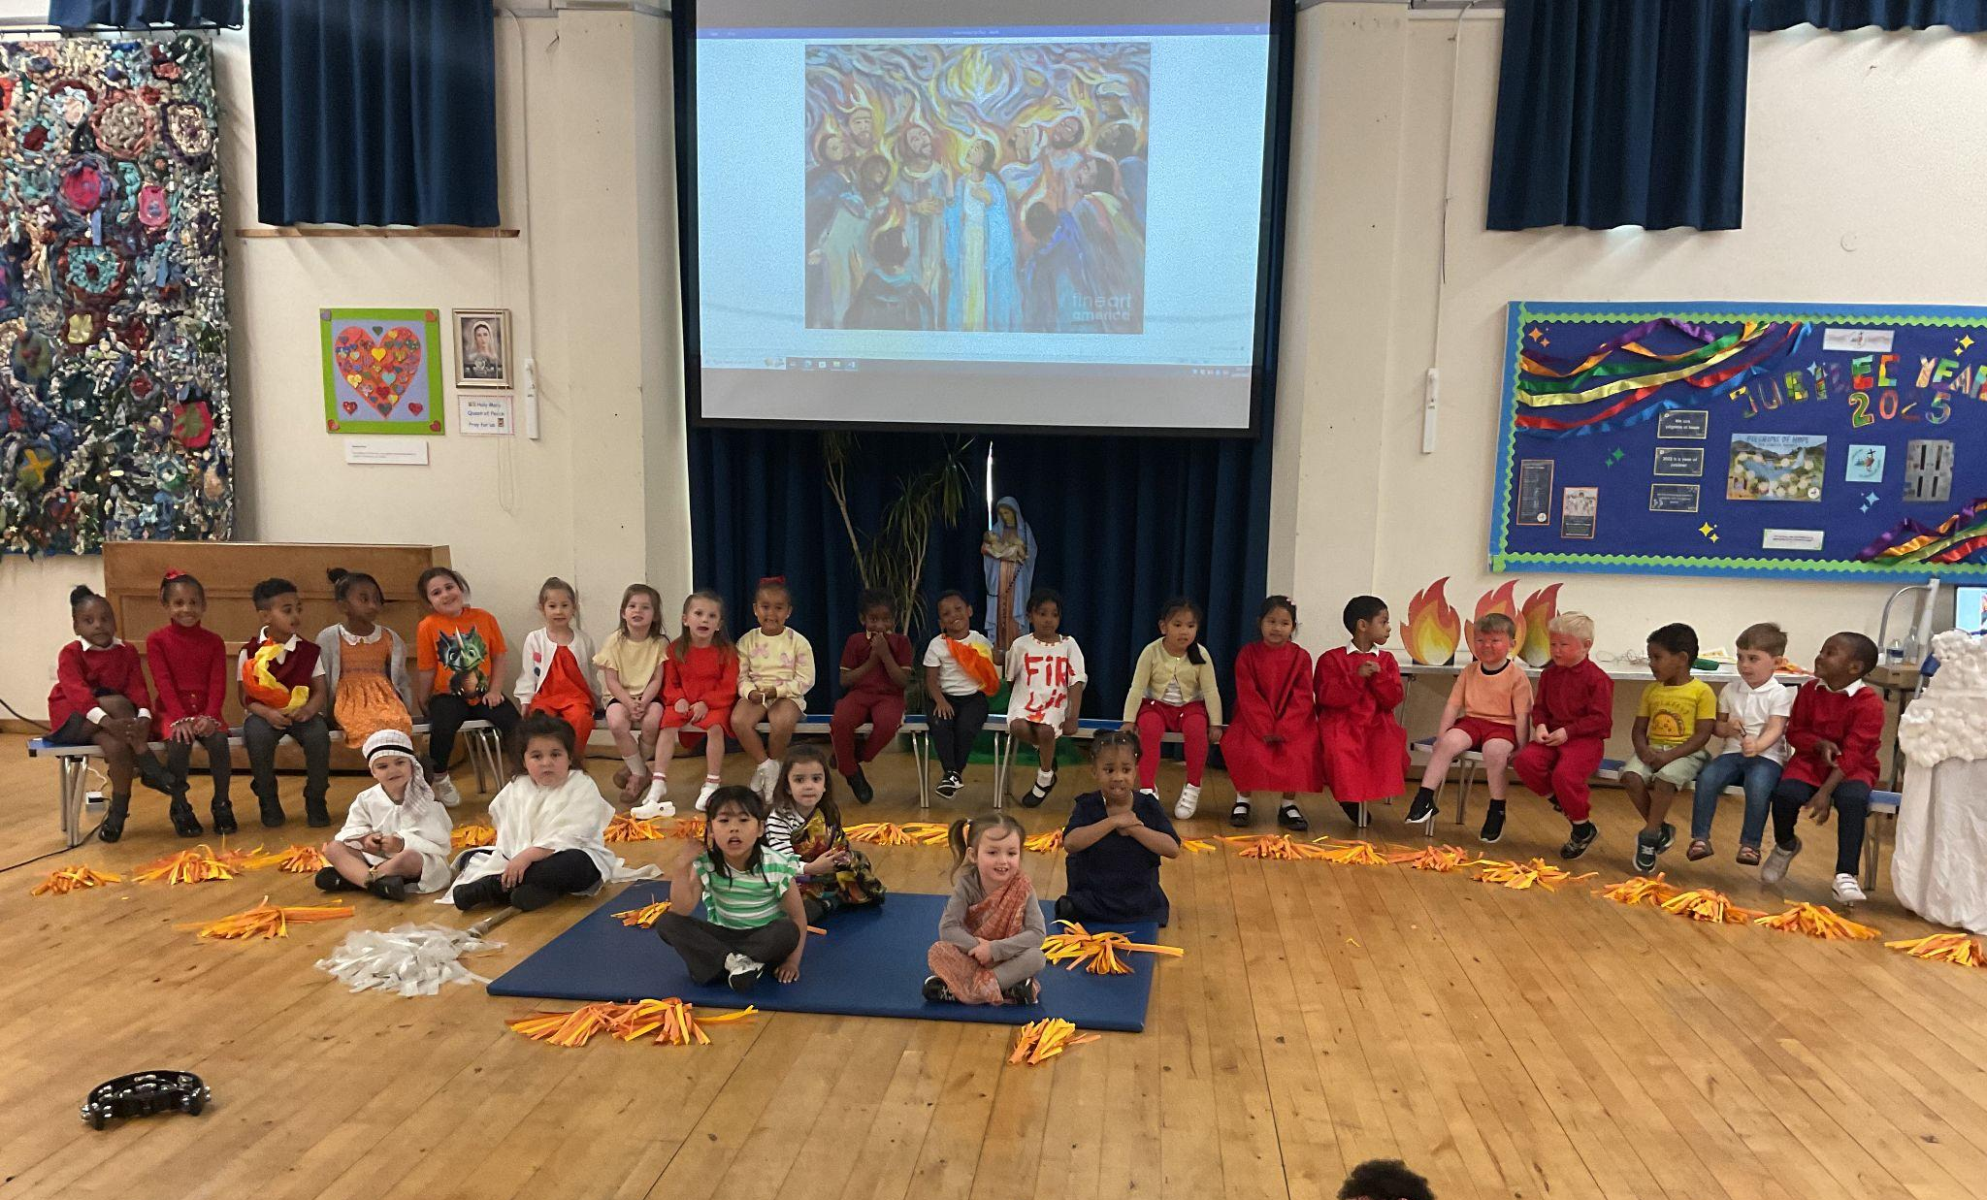
Early Years-
All Children!!
For their most amazing assembly performance and retelling of Pentecost and Jesus’ ascension. We are all beyond proud!
Miss Barker

Slide 7
Year 1
For her fantastic Rainbow Fish book and her fabulous poem!
Miss Sweet

Slide 8
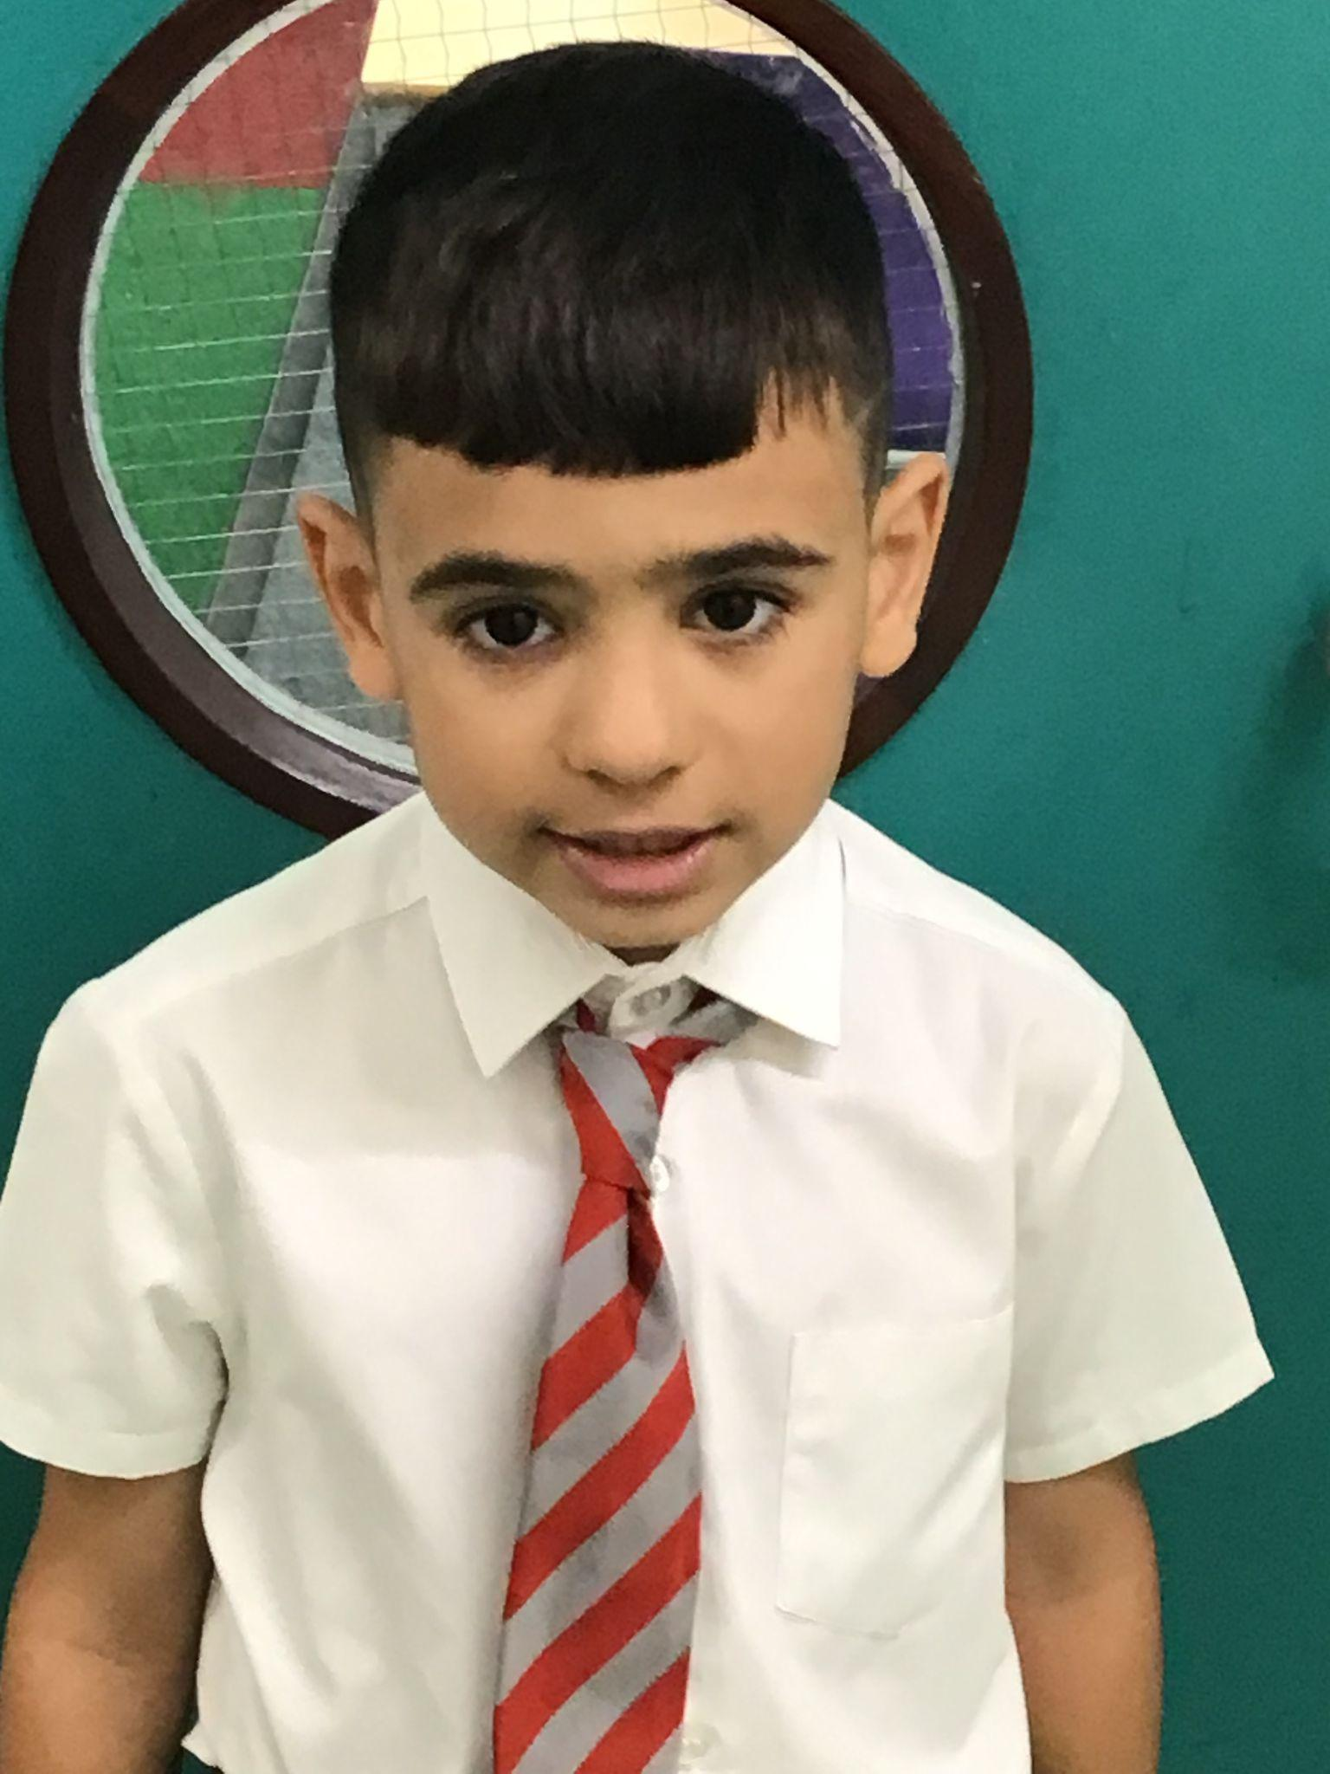
Year 2
For working hard at all of his subjects and showing a huge improvement in his listening and speaking skills.
Mr Whear

Slide 9
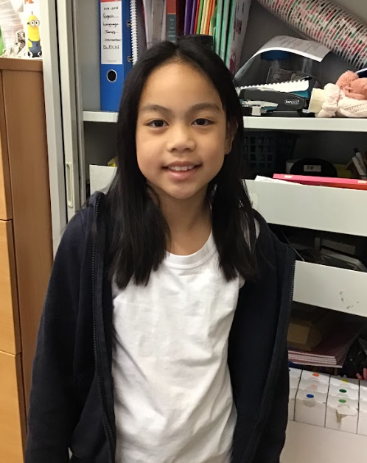
Year 3
For being a consistently hard working, responsible and kind member of year 3!,
Miss Medioli

Slide 10
Year 4
For her mature, responsible behaviour and diligent work ethic every single day.
Miss Forrest

Slide 11
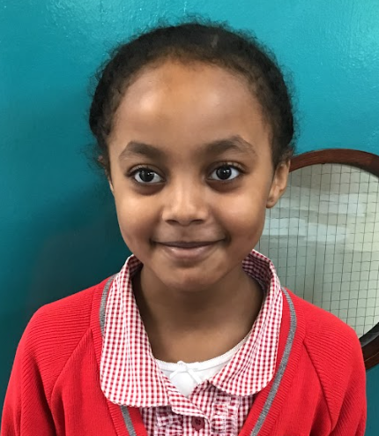
Year 5
For positive behaviour this and being a role model
Mr Larke

Slide 12
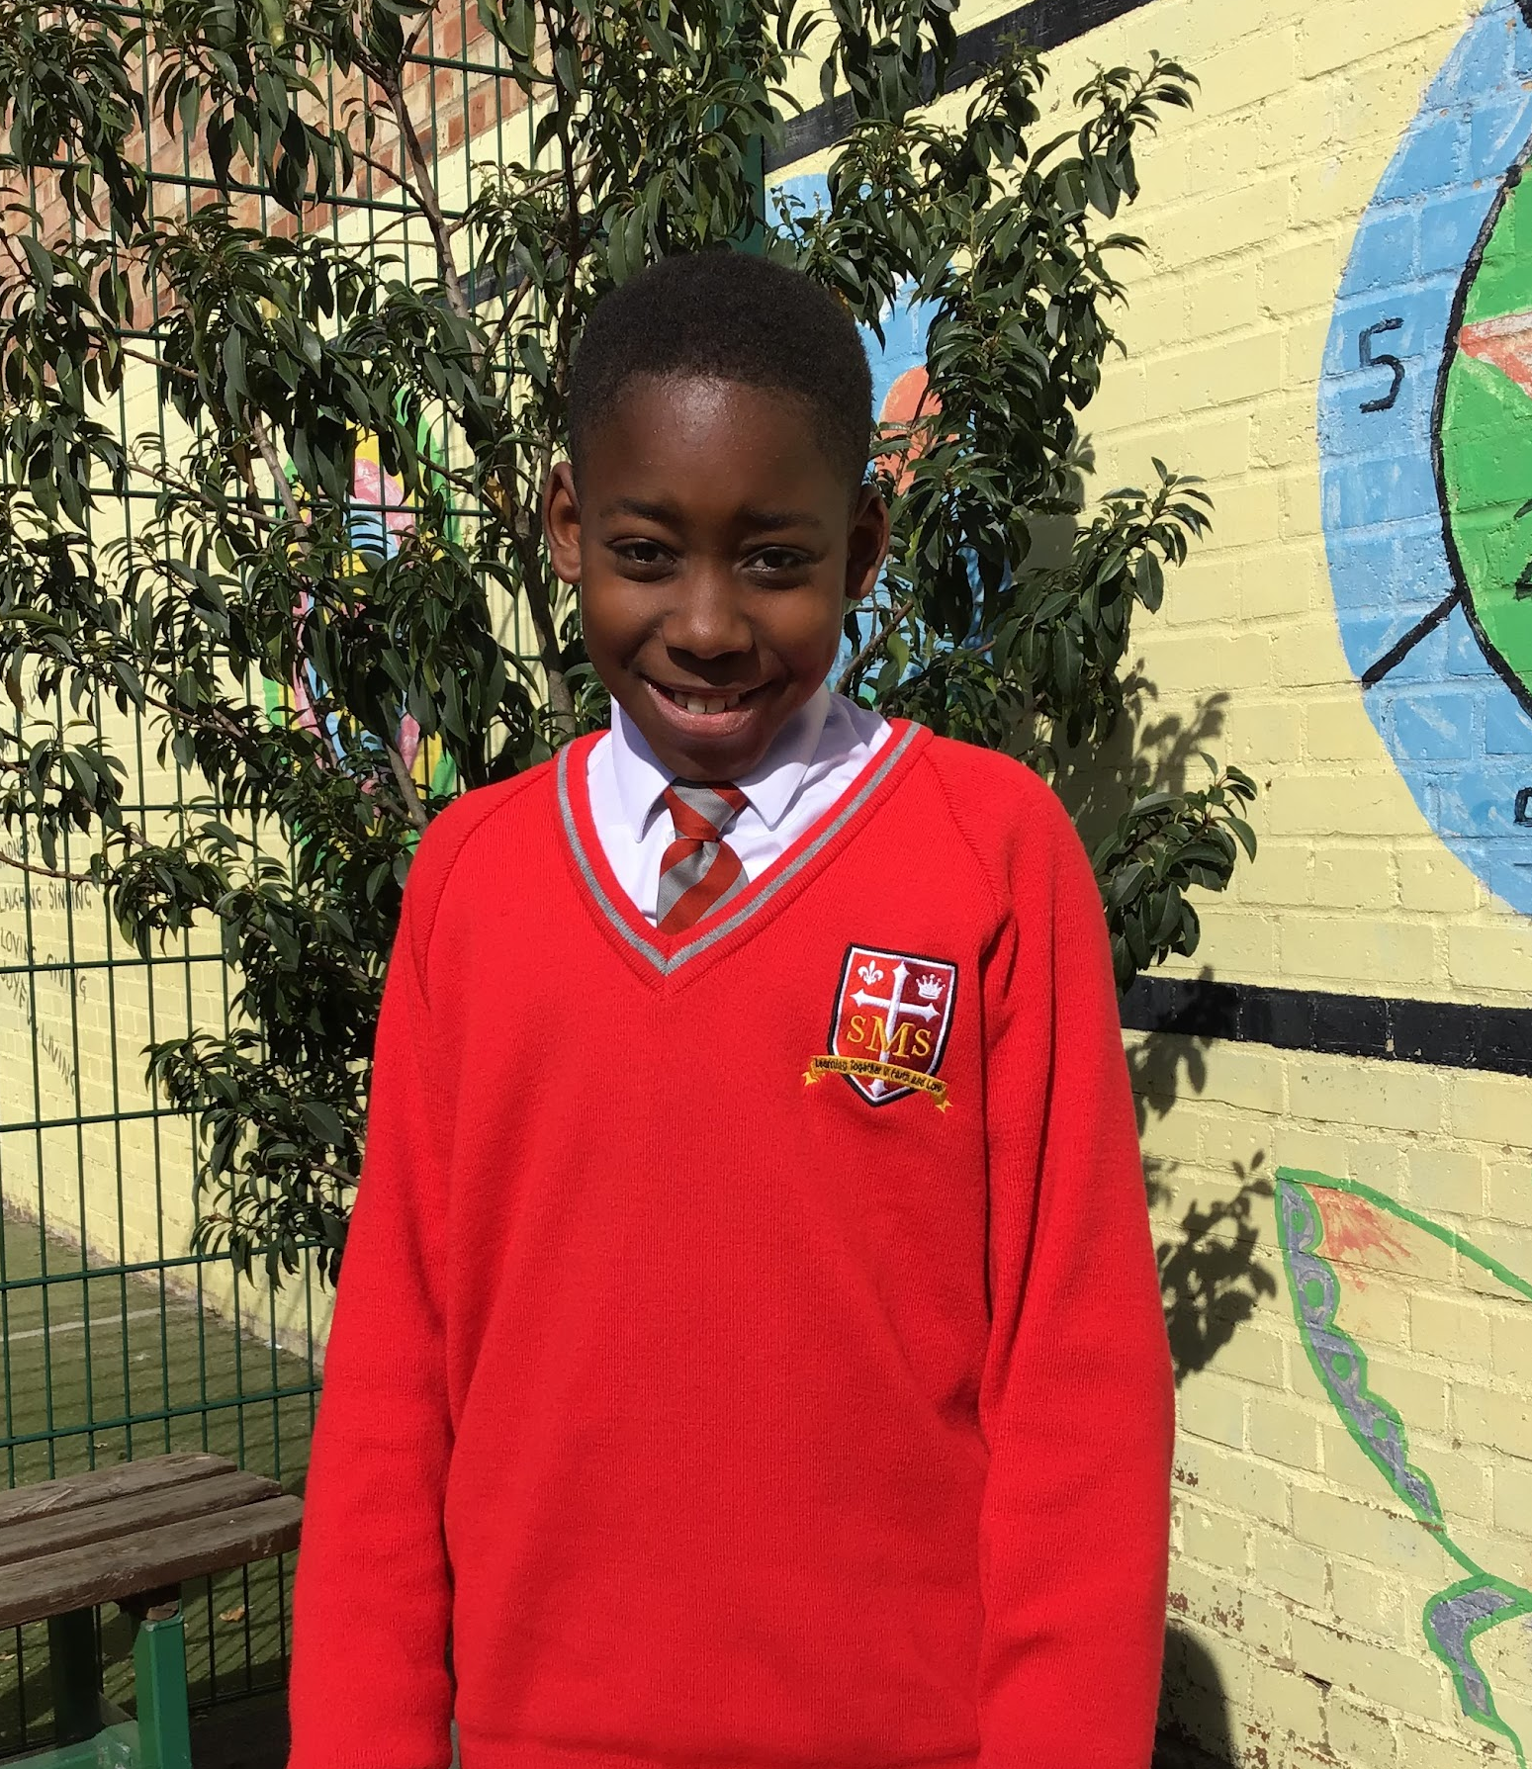
Year 6
Both these students have had an exceptional week. Layla produced an excellent piece of English writing and Kymani participated brilliantly in History.
Mr Cherfi & Mr Fowle

Slide 13
Star Readers
Y1 - Albie
Y2 - Renai-Mae
Y3 - Thirdy
Y4 - Yusuf
Y5 - Nazrawi
Y6 - Sienna M

Slide 14
N- Jacob L
Y4 - Makda
Y2 - Azahrye
Y4 - Mimi
Y4 - Sofia
N- Jacob L
Y6 - Danny
Y5 - Gideon
Y5 - Tommy

Slide 15
Whole School
Star of the Week
Friday 23rd May 2025

