Slide 1



Whole School
Star of the Week
Friday 23rd October 2026

Slide 2
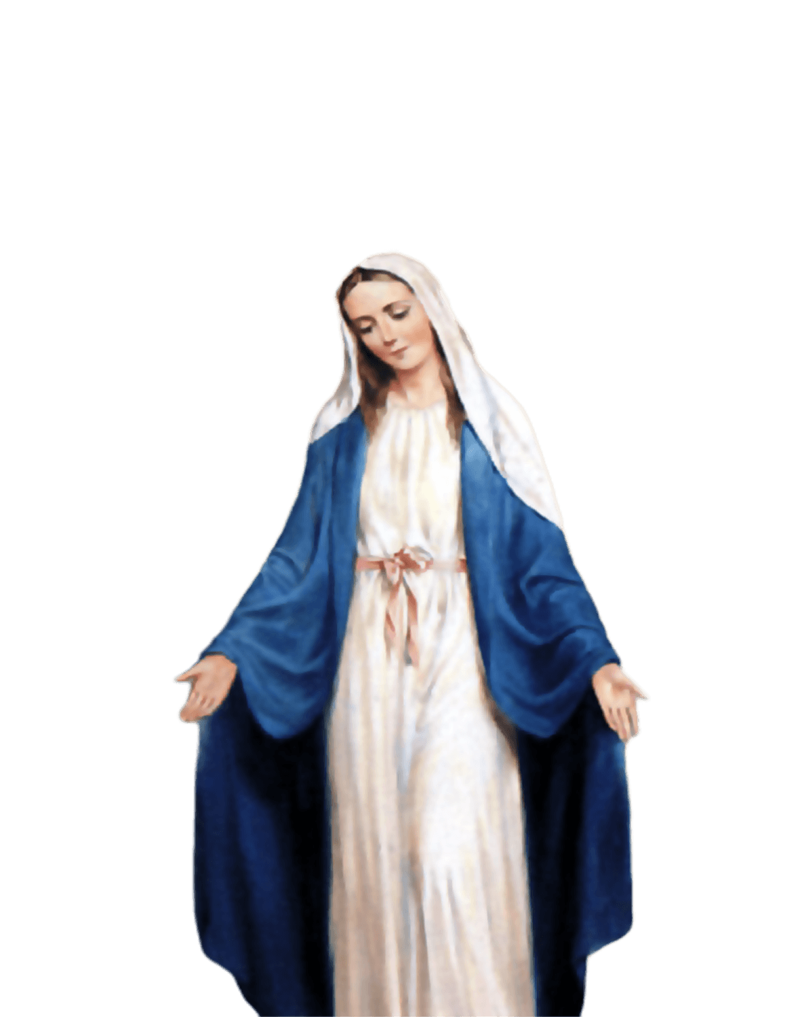
ST MARY’S SCHOOL PRAYER
O Holy Mary,
Mother and Patron of our school,
Turn your eyes of mercy towards us,
that we may love God
With all our hearts!
May we imitate the tenderness
of your Son, Jesus,
showing love and respect
For each person
and ourselves as children of God.
Guided by the Holy Spirit,
May we create the school,
where Mercy and Compassion
Is the centre of our lives.
Amen

Slide 3
Noah
Reception
For his exceptional effort with his writing this week in Literacy and using all his phonics knowledge and skills.
Miss Barker

Slide 4
Year 2
Lamek
For putting lots of effort into his learning and being a great role model for his peers.
Miss Sweet and Ms Bakali

Slide 5
Year 3
Albie
For his wonderful curiosity, thoughtful questions and deep thinking during our Science lessons! He shows a fantastic enthusiasm for learning and always strives to deepen his understanding of the world around him. A true young scientist!
Miss Flashman

Slide 6
Year 4
Azahry’e
For showing leadership on his table and more widely, and demonstrating our School Values in practice, at Church and through helping another pupil in the right with clear, calm and sensible explanation.
Mr Whear

Slide 7
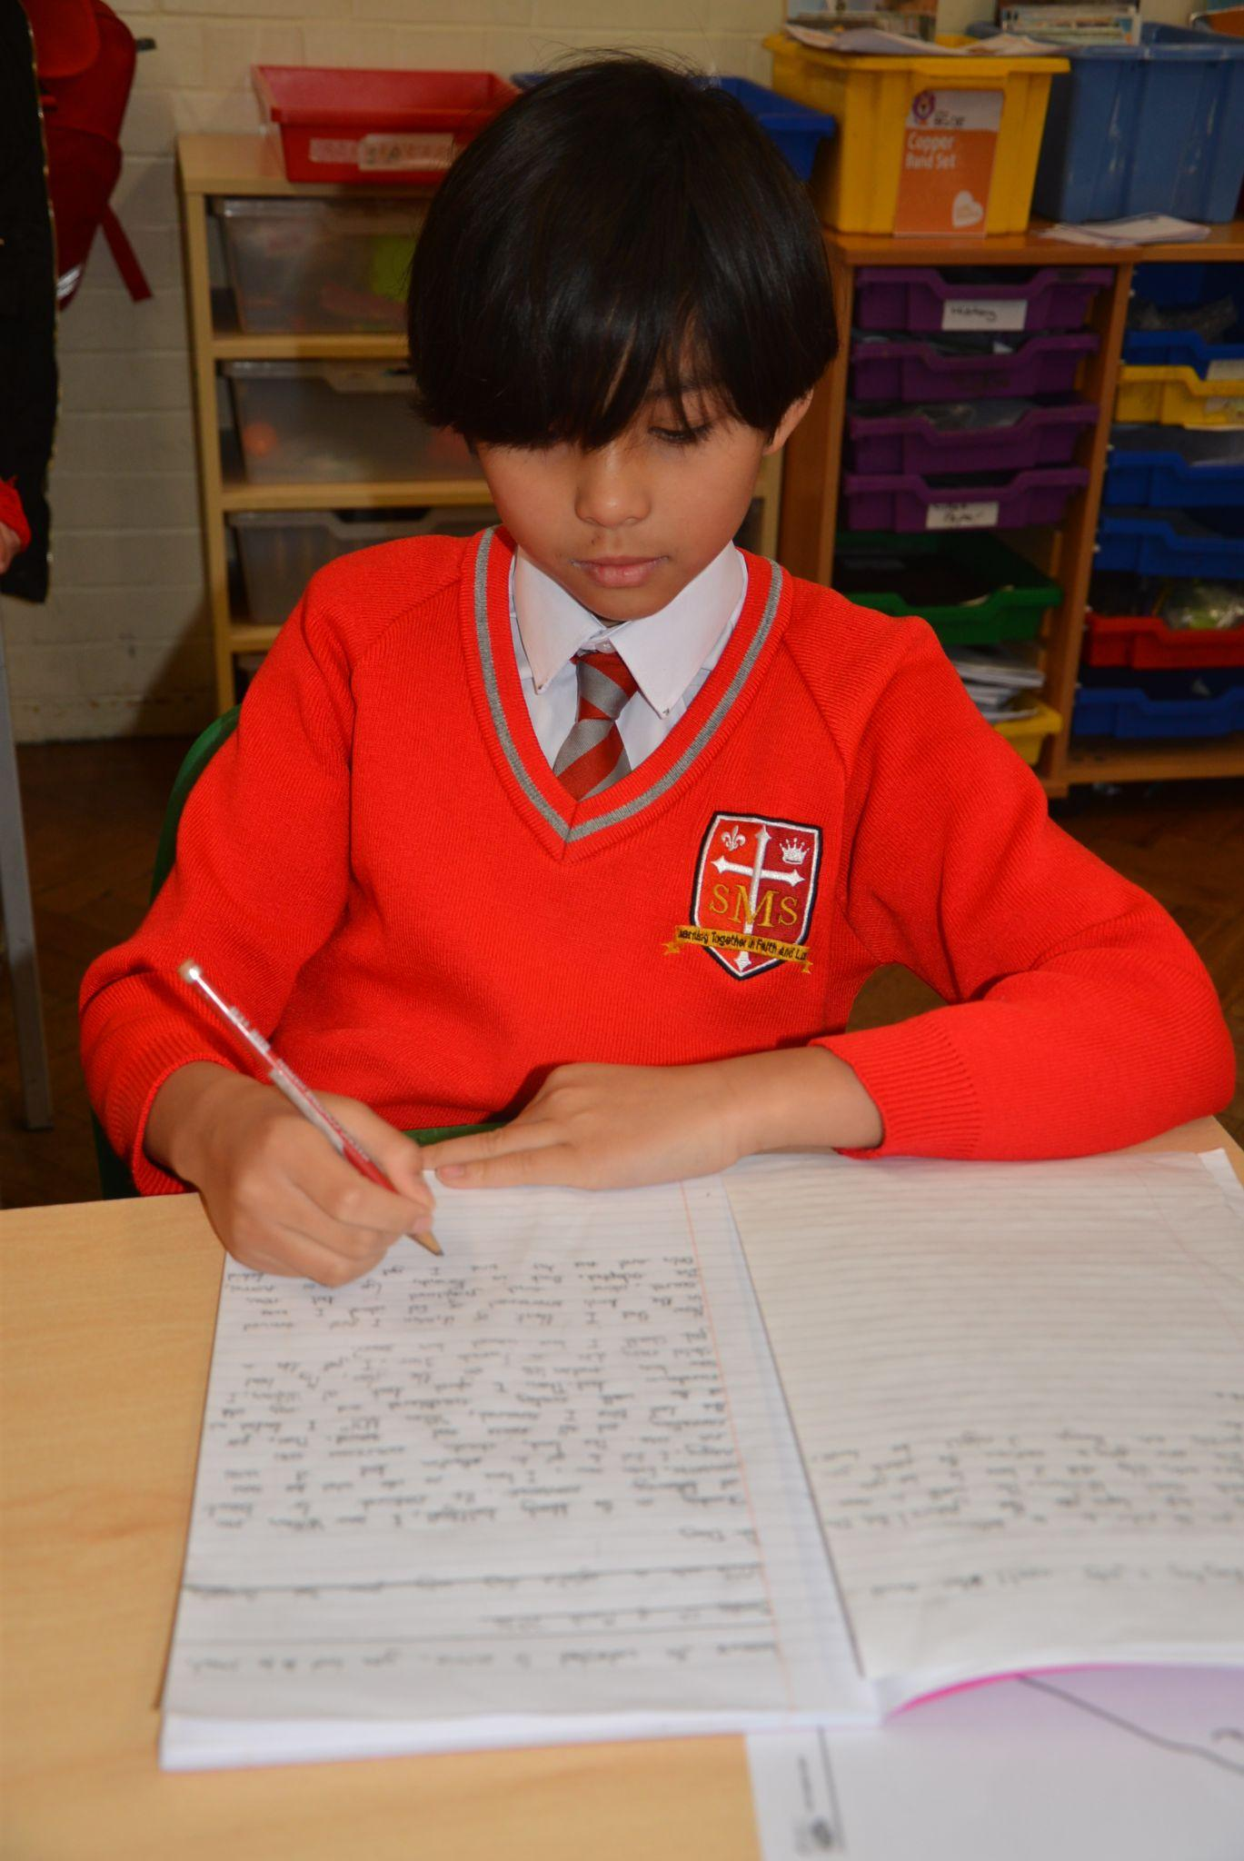
Year 5
Azrayah-Mai
For showing growing maturity in making positive choices, taking responsibility for her actions and building positive relationships with others. Azzie has been putting our RE learning about Reconciliation into practice by recognising the importance of saying sorry, making amends and working towards forgiveness.
Miss O’Mara

Slide 8
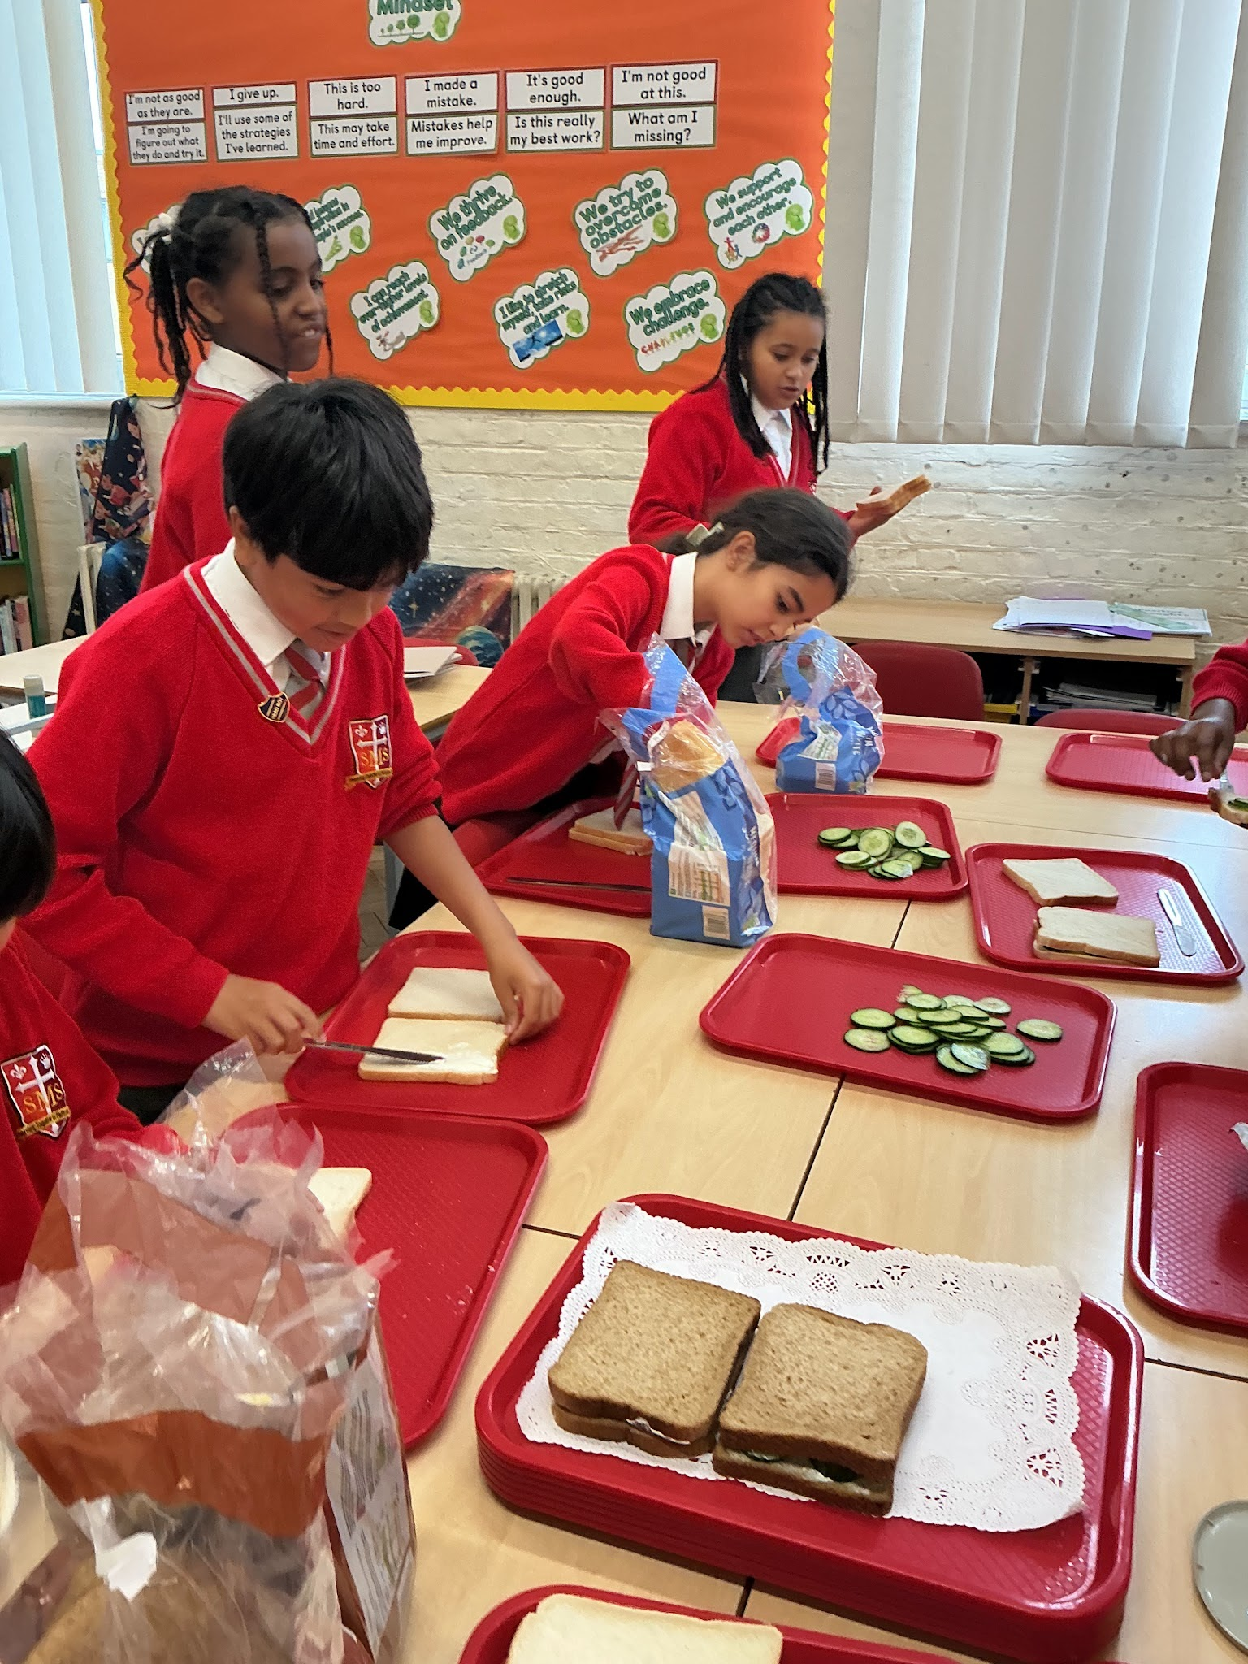
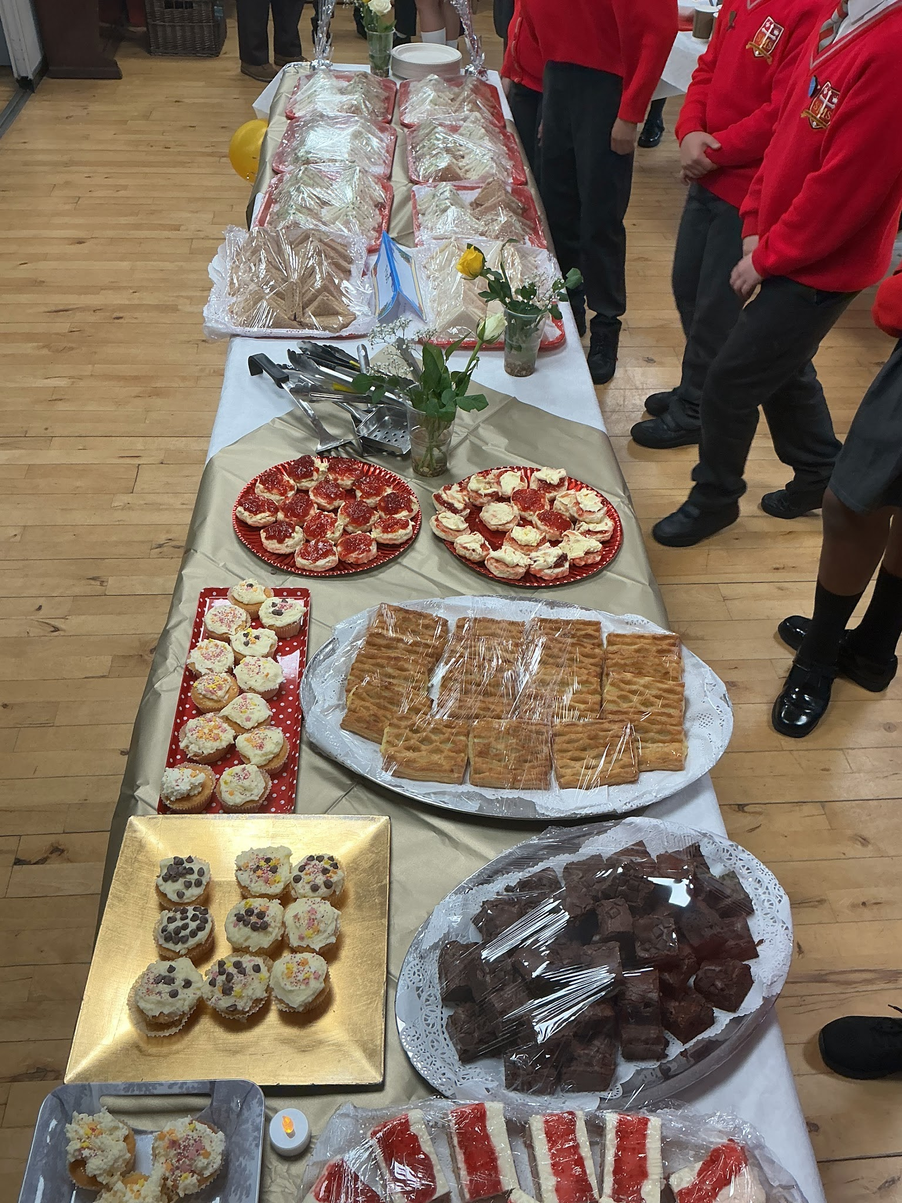
Year 6
Whole Class
For all their effort and poise during the Grandparent’s Afternoon Tea. It was heartening to see the children’s care, dedication and willingness to serve throughout. They should feel very proud and look back on the day fondly.
Mr Cherfi

Slide 9



STAR READER
Y1/2 - Ivy
Y3 - Aniyah
Y4 - Zema
Y5 - Jayden
Y6 - Nevaeh

Slide 10
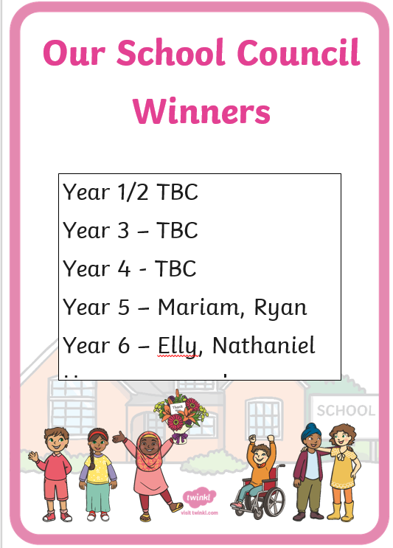

Slide 11
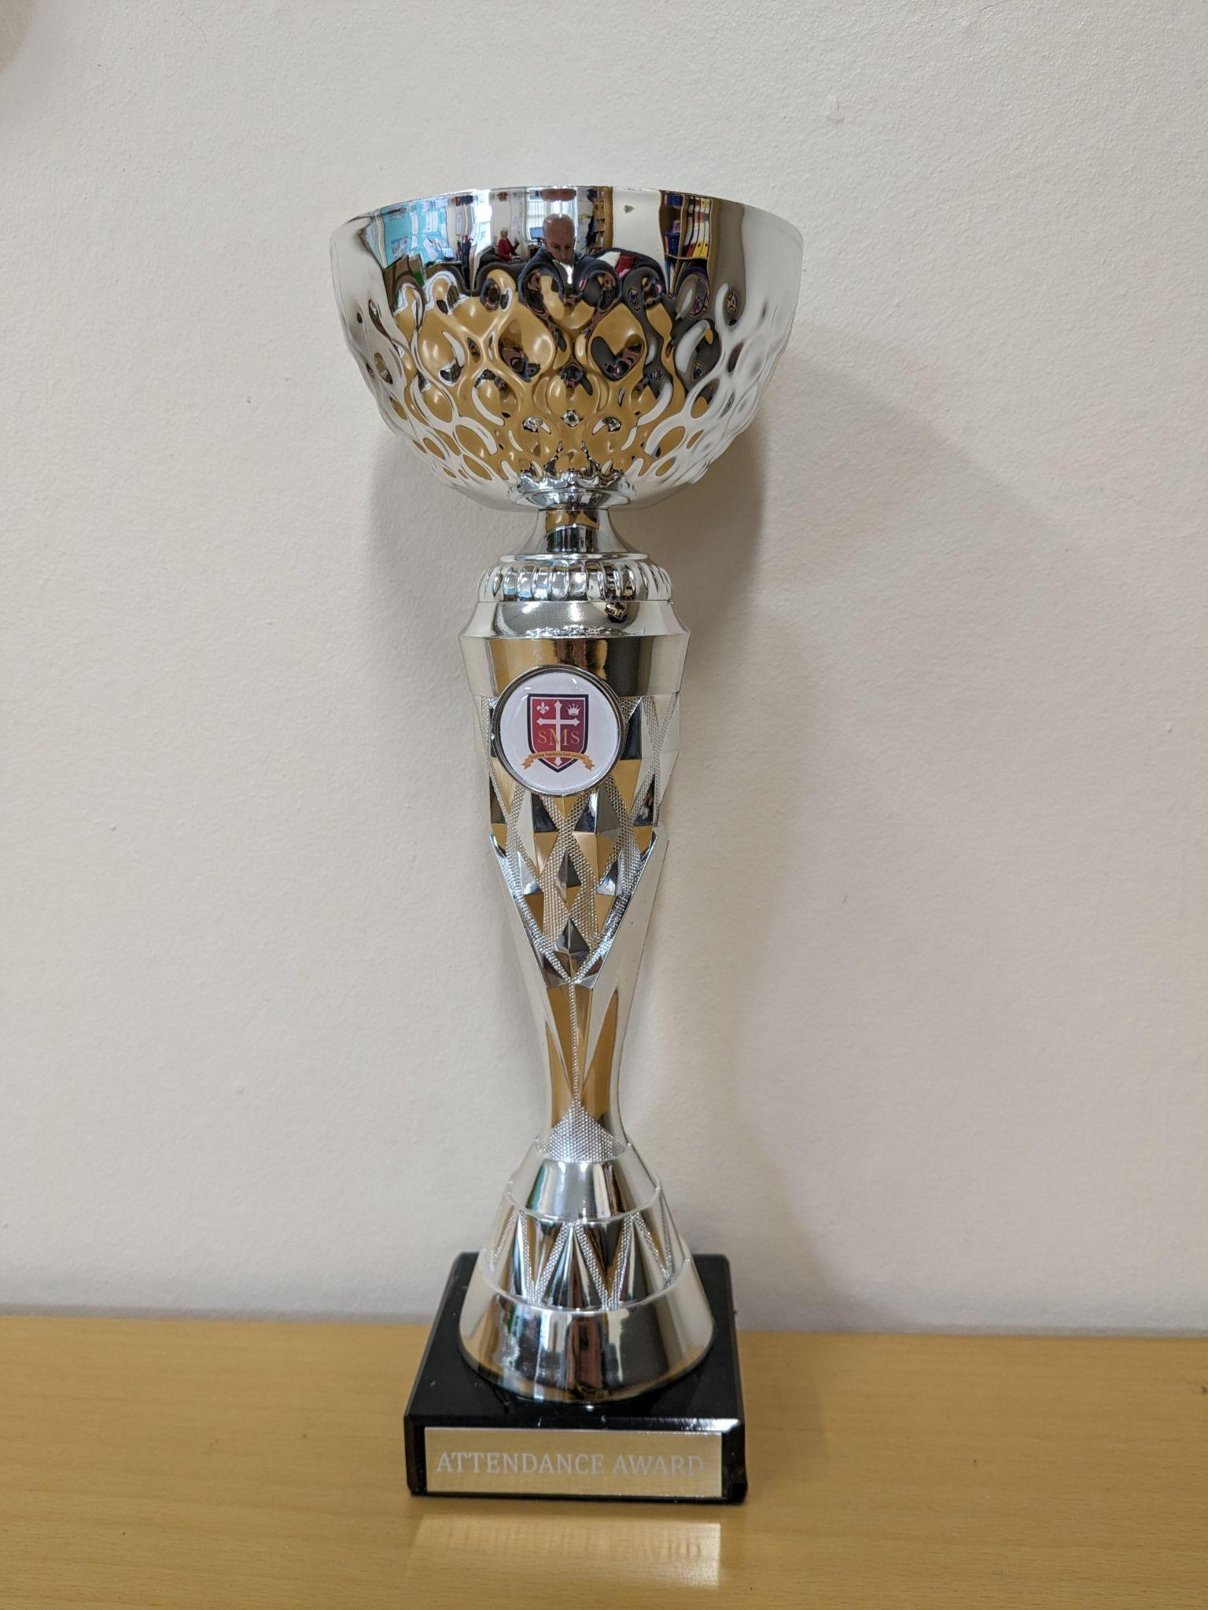
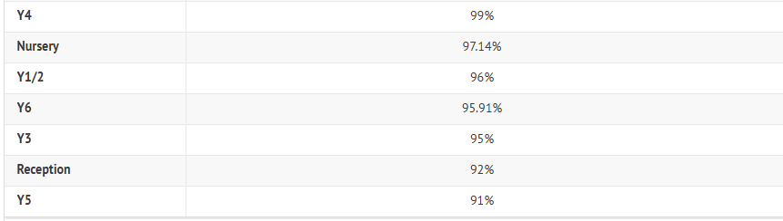
Attendance Weekly Leaders

Slide 12
Attendance Weekly Leader:
Attendance Winners for this week:
Year 4
With 99% attendance

Slide 13

Punctuality Weekly Leader:
Winners for this week:
Year 4

Slide 14

Mia - Year 4
Holly - Year 5
Ethan - Year 3
Zema - Year 4
Torah-Leigh - Year 3

Slide 15
Whole School
Star of the Week
Friday 23rd October 2026

Slide 16

Let us pray.
"Dear God, thank you for loving us and forgiving us when we make mistakes. Forgiveness can be very hard for us to do on our own. Please give us big hearts full of your love, and help us to choose to forgive others just like you forgive us. Amen."

