Slide 1




Whole School
Star of the Week
Friday 24th April 2026

Slide 2


Our Father who art in Heaven
Hallowed be Thy Name
Thy Kingdom come
Thy will be done on Earth as it is in Heaven
Give us this day our daily bread
And forgive us our trespasses
As we forgive those who trespass against us
And lead us not into temptation
But deliver us from evil
Amen

Slide 3
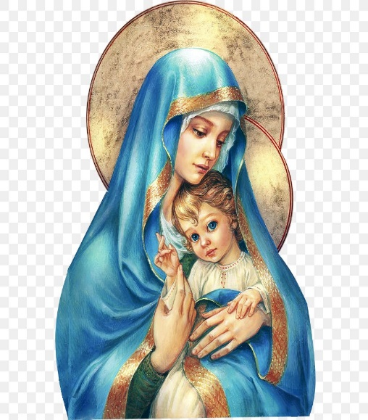
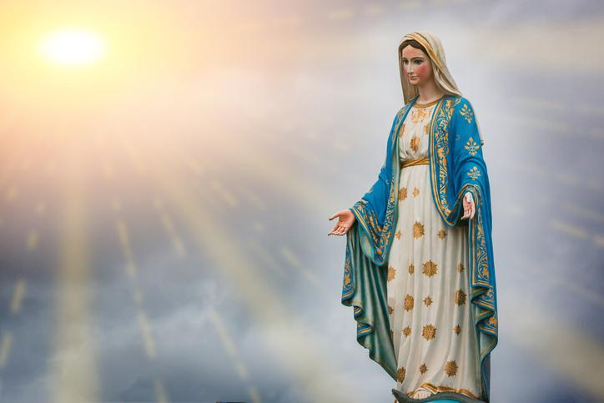
Hail Mary, Full of Grace
The Lord is with Thee
Blessed are Thou amongst women
And Blessed is the fruit of Thy womb, Jesus
Holy Mary , Mother of God
Pray for us sinners
Now and in the hour of our death
Amen

Slide 4
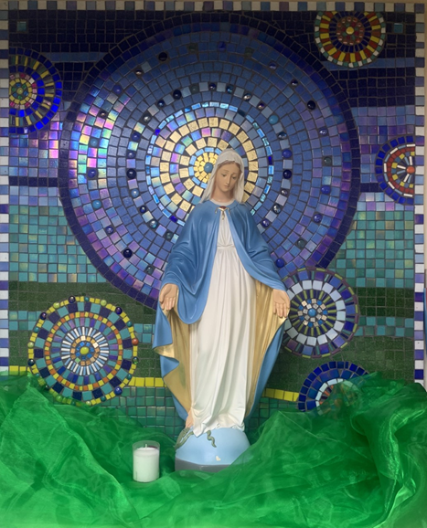
St Mary’s School Prayer
O Holy Mary,
Mother and Patron of our school,
Turn your eyes of mercy towards us,
that we may love God
With all our hearts!
May we imitate the tenderness
of your Son, Jesus,
showing love and respect
For each person
and ourselves as children of God.
Guided by the Holy Spirit,
May we create the school,
where Mercy and Compassion
Is the centre of our lives.
Amen

Slide 5


Slide 6
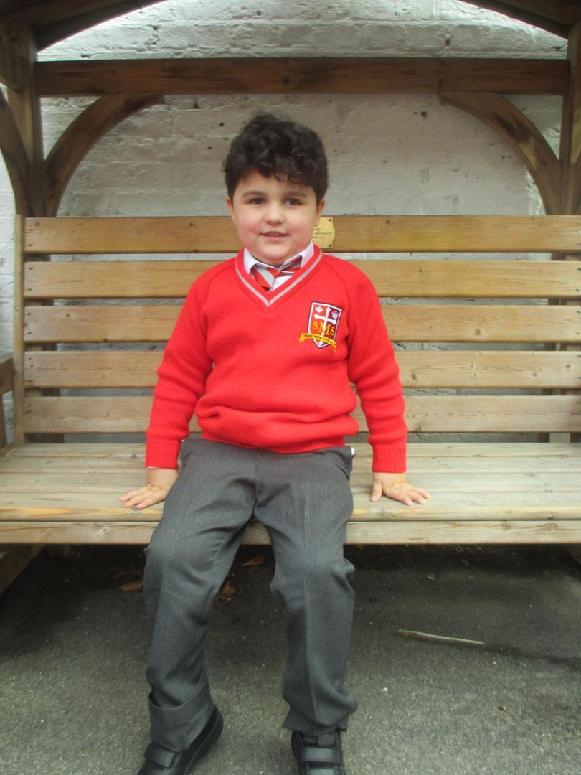
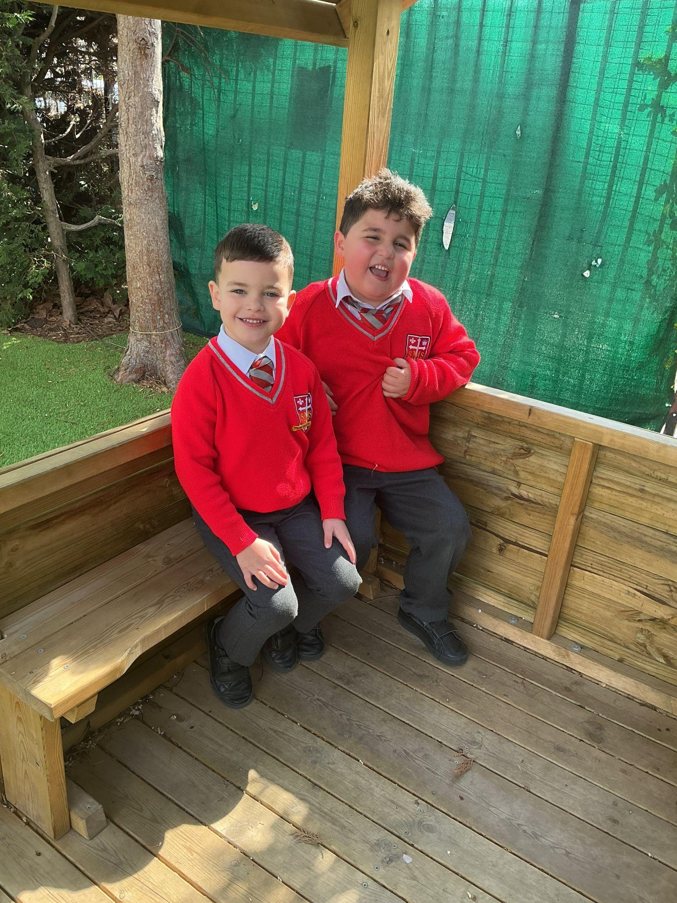
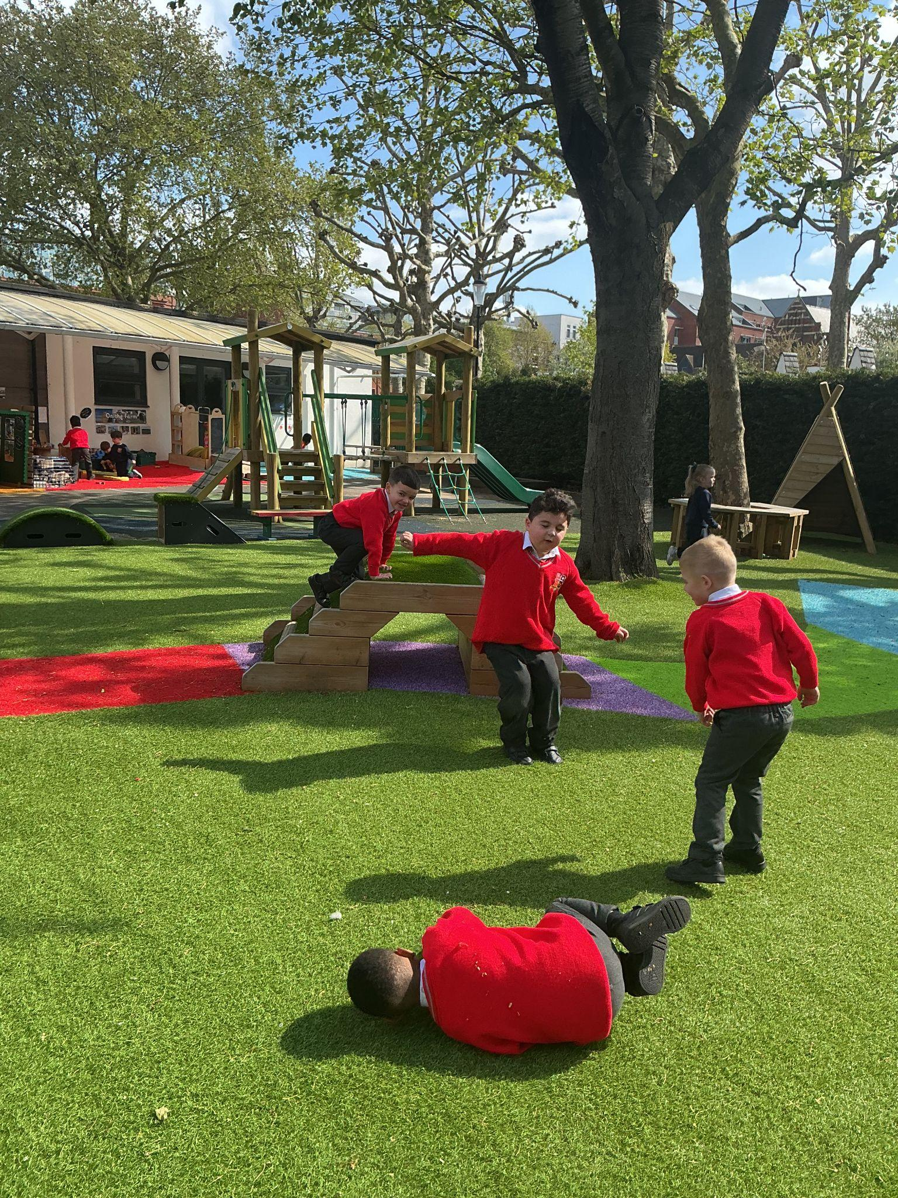
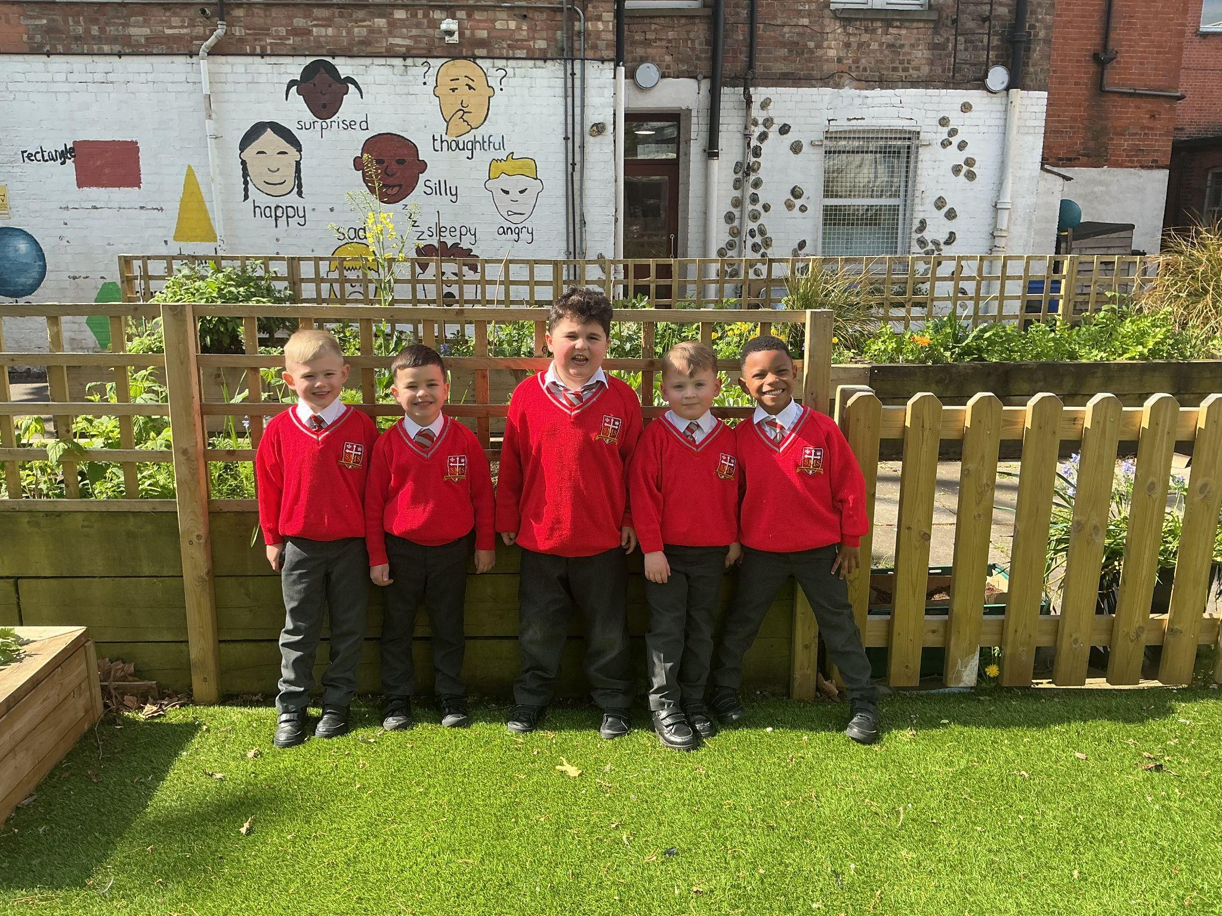
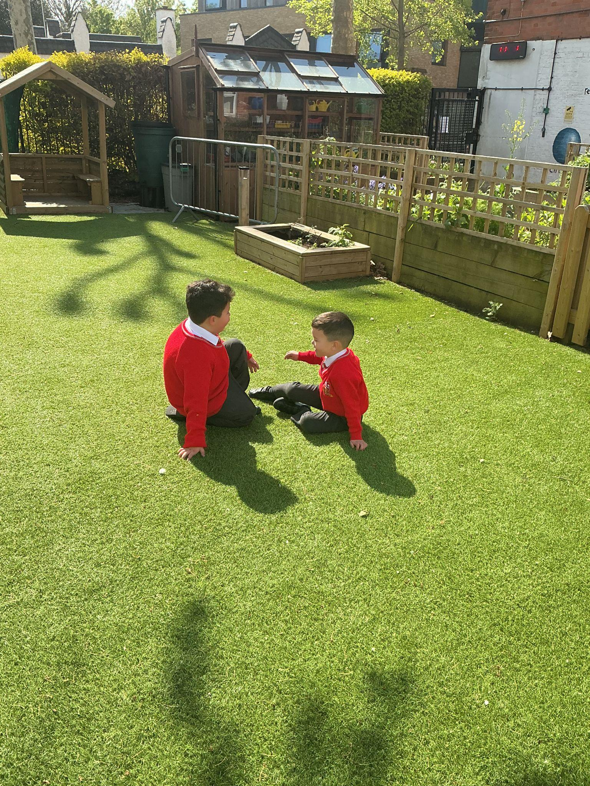
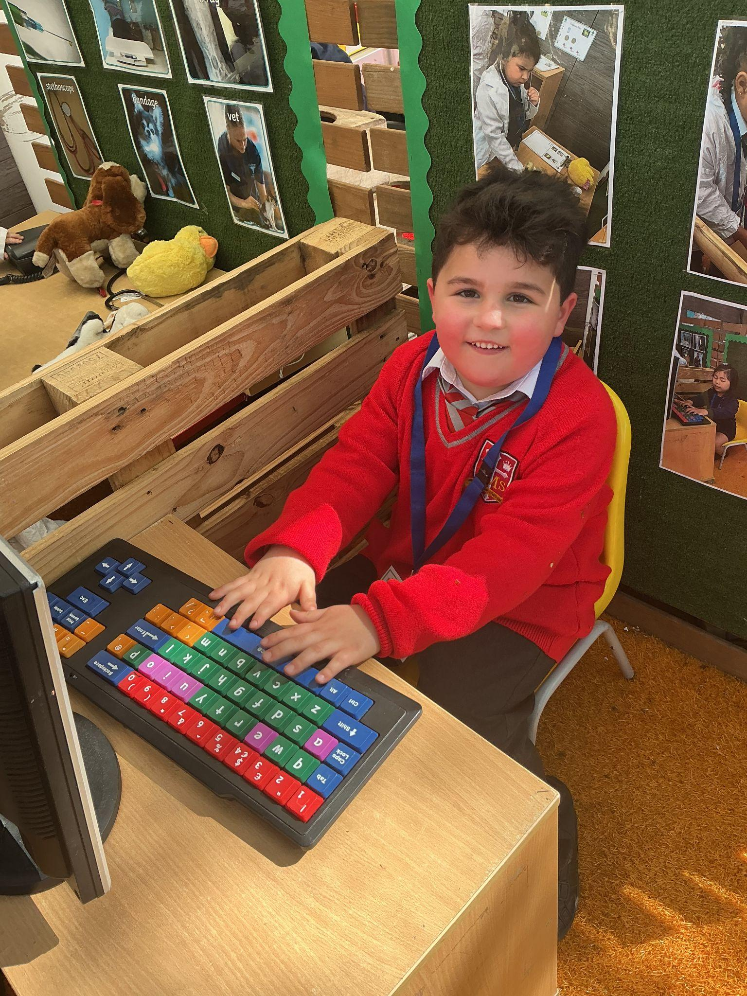
Reception
For being the kindest and happiest boy the past two years in EYFS and making so much progress with his development in all areas of learning. We will miss you.
Miss Barker, Mrs Duggan, Miss Gana, Mrs M and Mrs Cummings

Slide 7
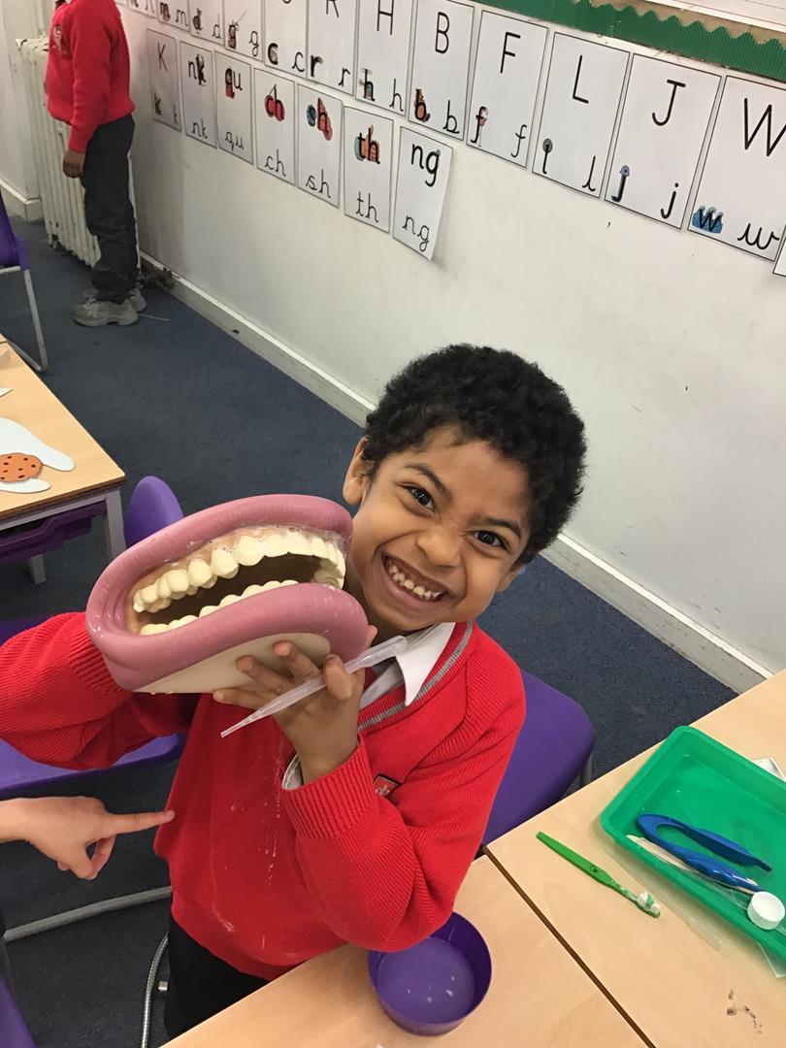
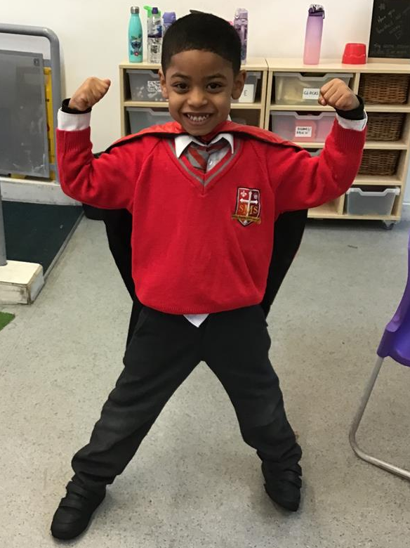
Year 1
For working so hard to make positive choices in bthe classroom and coming back to school with a wonderful attitude to learning.
Miss Flashman

Slide 8
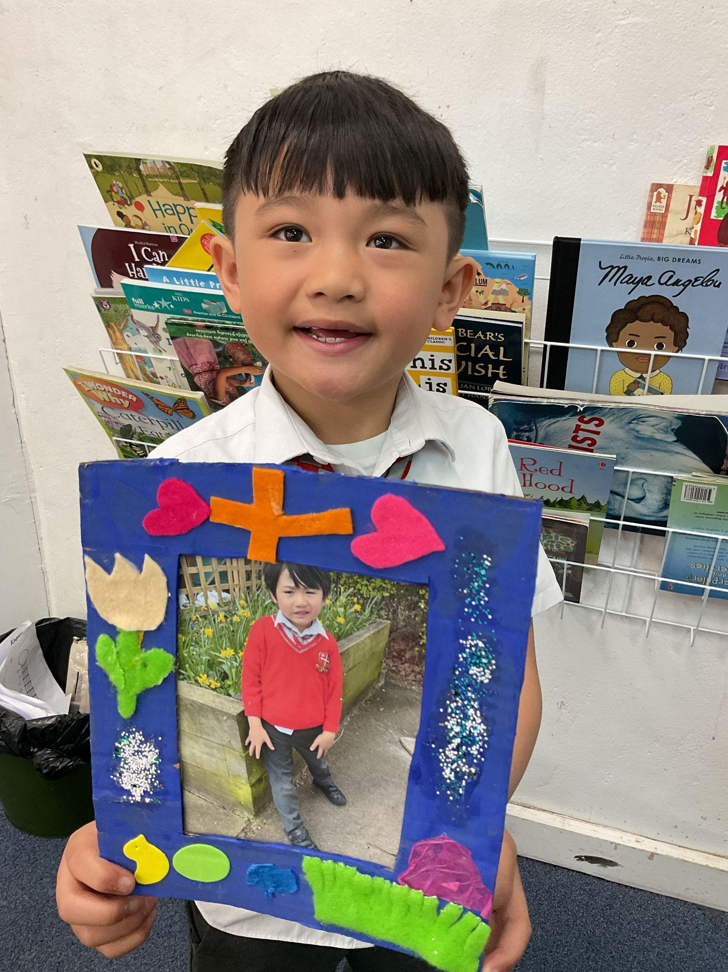
Year 2
For his improved oracy skills, this pupil has been contributing to whole class discussions and is now standing up to read his work aloud!
Miss Sweet

Slide 9
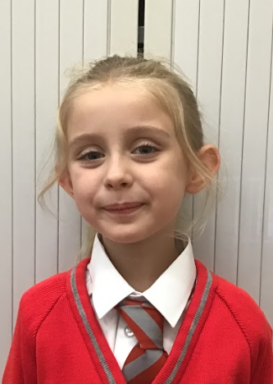
Year 3
For always being ready to learn and giving every lesson your all! You set a fantastic example to everyone around you and consistently try your very best in everything you do. Keep shining!
Miss Hickey

Slide 10
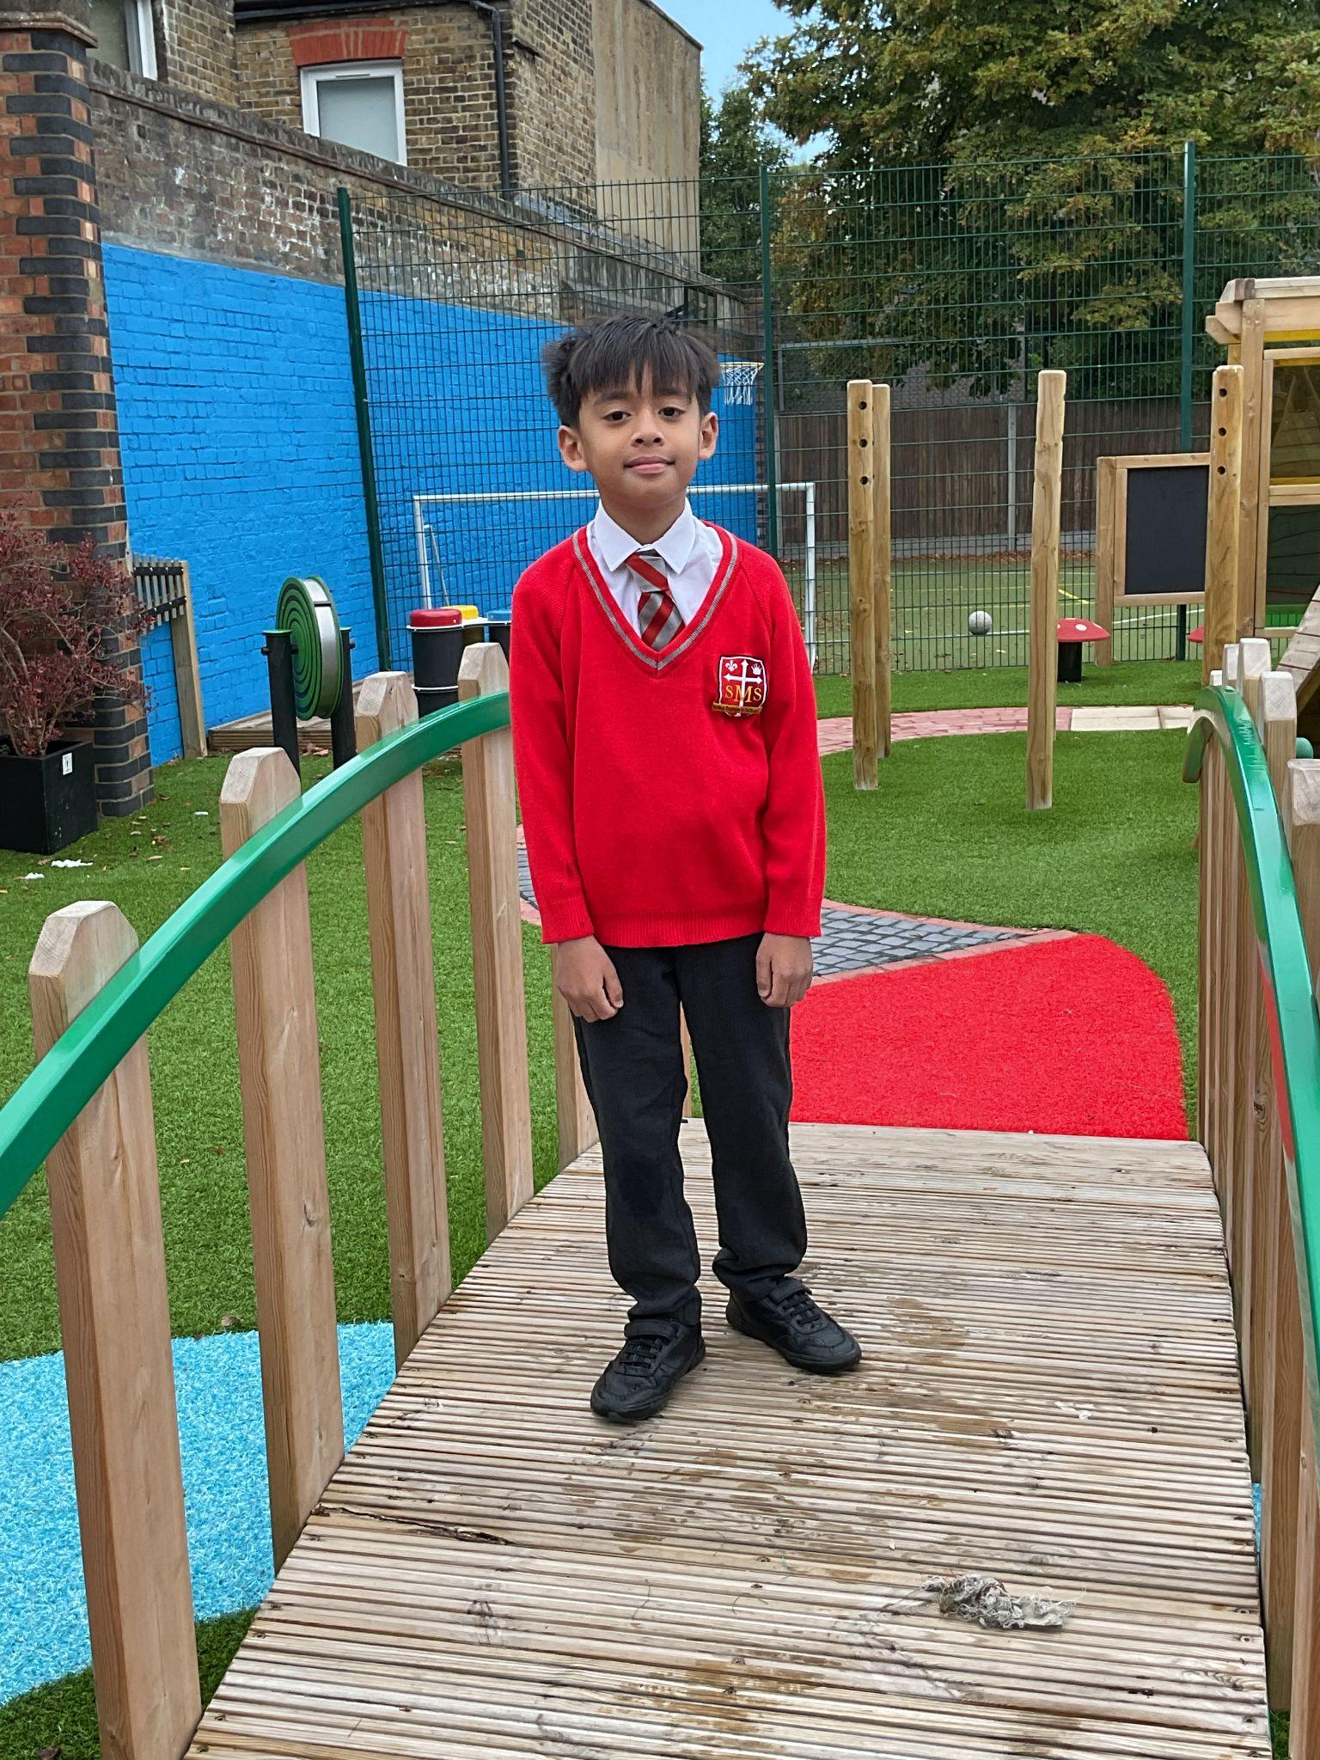
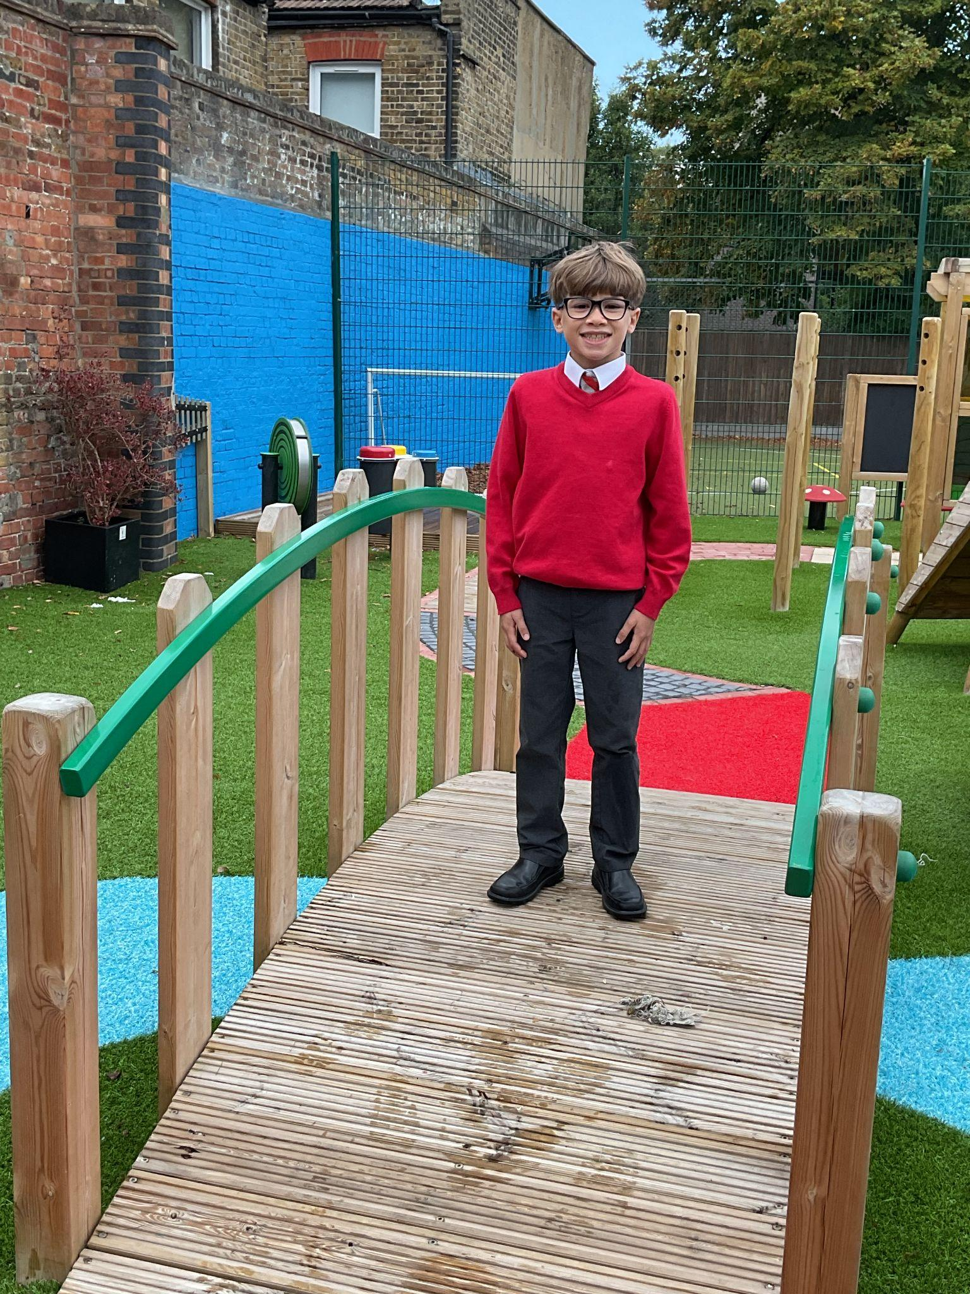
Year 4
For wanting to improve and then doing it!
Handwriting, concentration on independent work and contributions in class
Listening and behaviour choices
Mr Whear

Slide 11
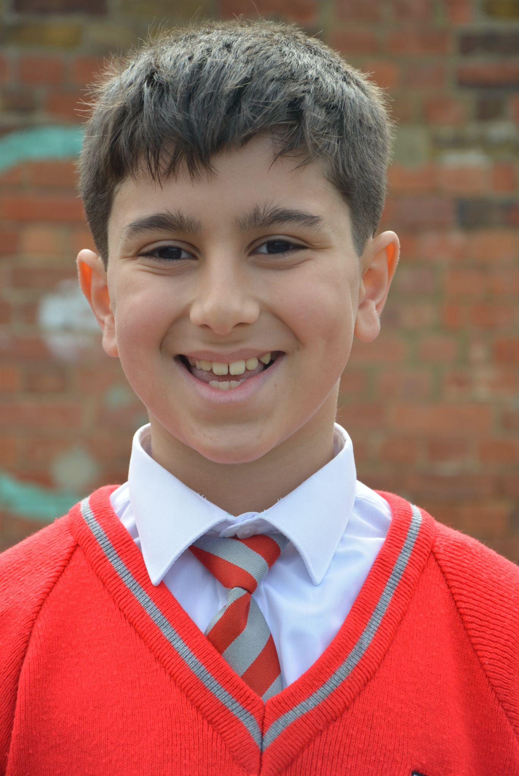
Year 5
A brilliant week and attitude to learning - making the right choices and working really hard to improve in all areas of our learning journey.
Mrs Bakali

Slide 12
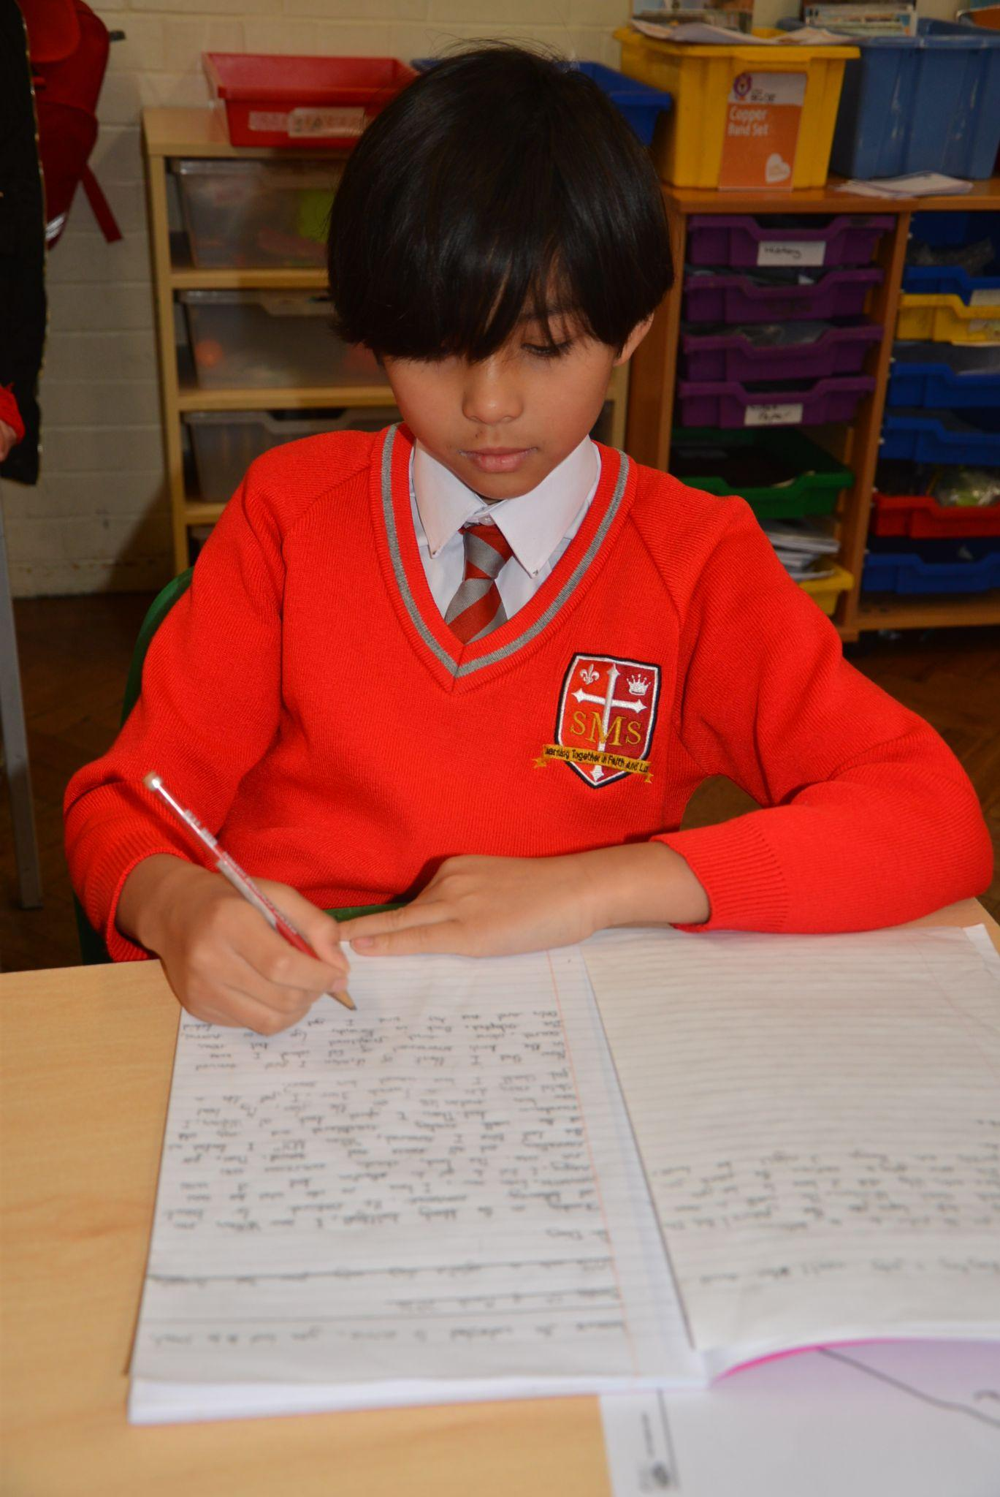
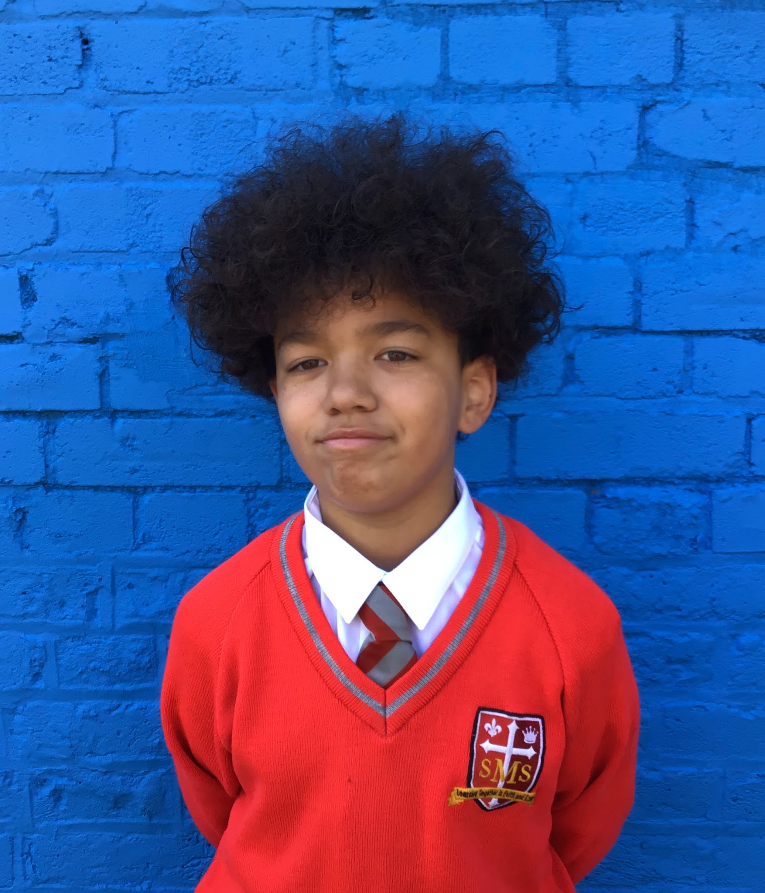
Year 6
For exceptional improvement in attendance, behaviour, attitude and learning.
Mr Cherfi

Slide 13



Star Readers
Y1 - Lamek
Y2 - Mai-Mariam
Y3 - Sarah
Y4 - Not this week
Y5 - Yusuf
Y6 - Eden

Slide 14

Ayda - Y1
Elly - Y5
Anika - Y1
Kian - Y5
St George’s Day
Mrs Bakali

Slide 15
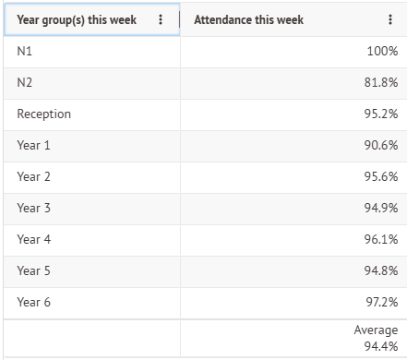
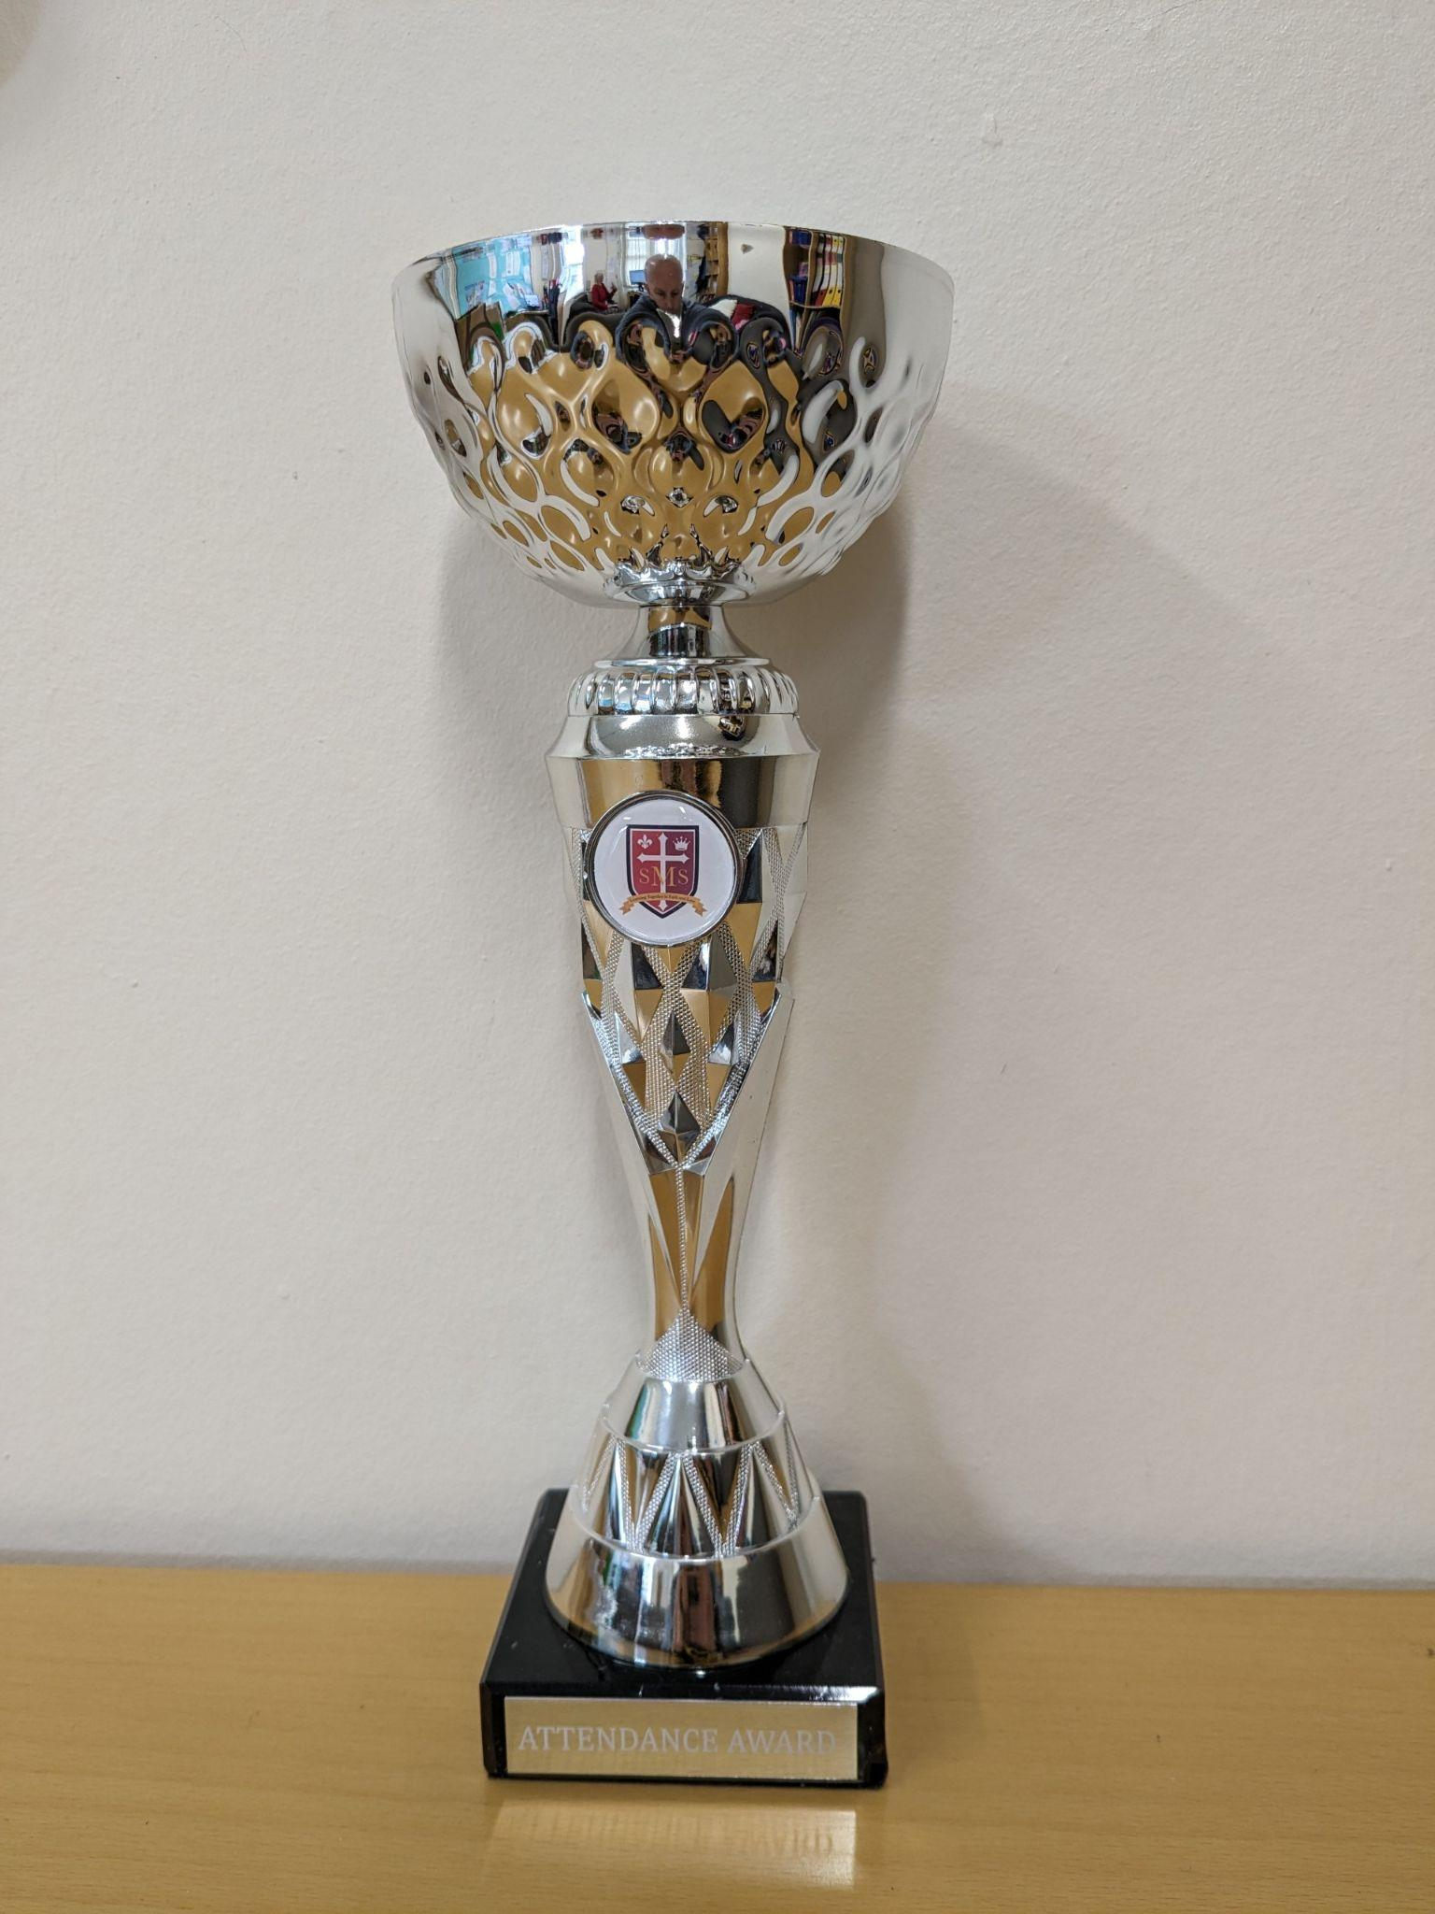
Attendance Weekly Leaders Summer Term:

Slide 16
Whole School
Star of the Week
Friday 20th March 2026

