Slide 1




Whole School
Star of the Week
Friday 24th October 2025

Slide 2


Our Father who art in Heaven
Hallowed be Thy Name
Thy Kingdom come
Thy will be done on Earth as it is in Heaven
Give us this day our daily bread
And forgive us our trespasses
As we forgive those who trespass against us
And lead us not into temptation
But deliver us from evil
Amen

Slide 3
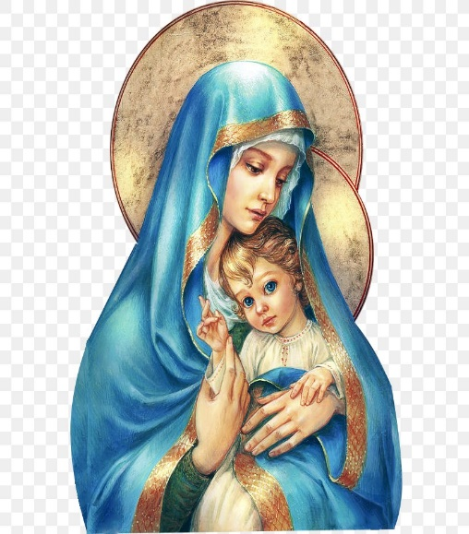
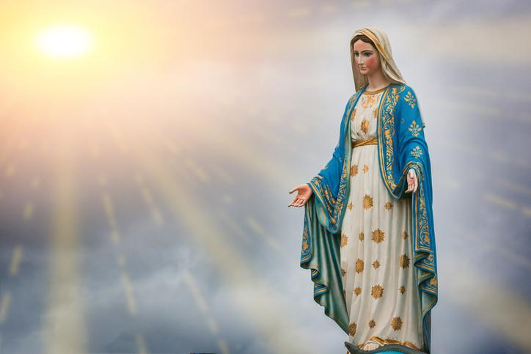
Hail Mary, Full of Grace
The Lord is with Thee
Blessed are Thou amongst women
And Blessed is the fruit of Thy womb, Jesus
Holy Mary , Mother of God
Pray for us sinners
Now and in the hour of our death
Amen

Slide 4
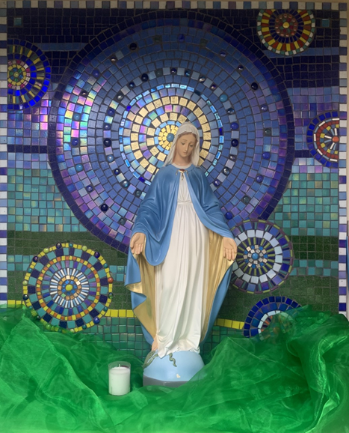
St Mary’s School Prayer
O Holy Mary,
Mother and Patron of our school,
Turn your eyes of mercy towards us,
that we may love God
With all our hearts!
May we imitate the tenderness
of your Son, Jesus,
showing love and respect
For each person
and ourselves as children of God.
Guided by the Holy Spirit,
May we create the school,
where Mercy and Compassion
Is the centre of our lives.
Amen

Slide 5
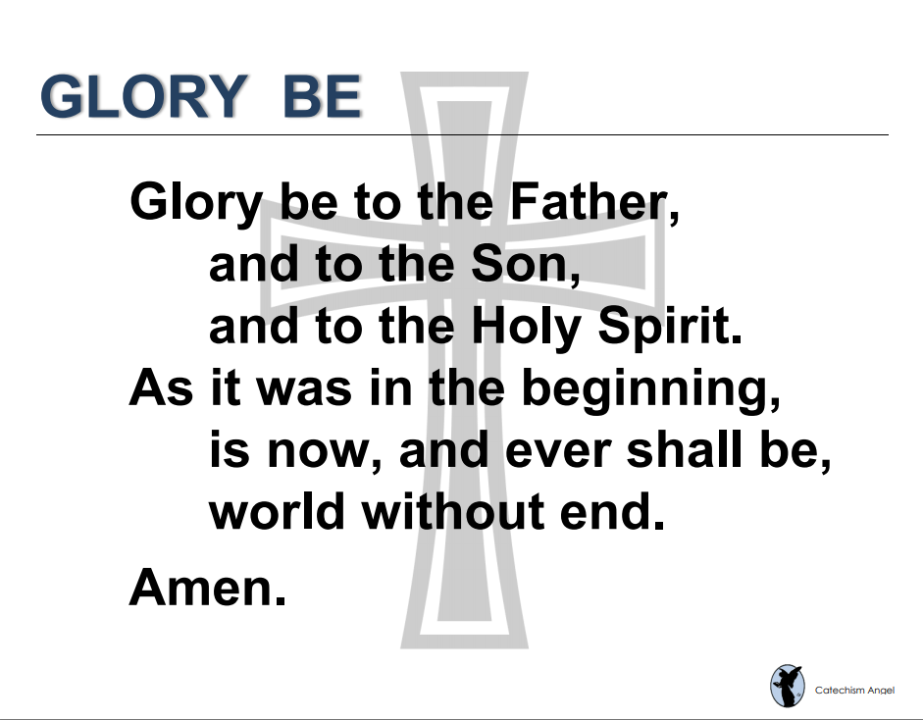

Slide 6
EYFS- Both Classes
Nursery and Reception
For the most seamless transition into new routines and new settings.
Miss Barker

Slide 7
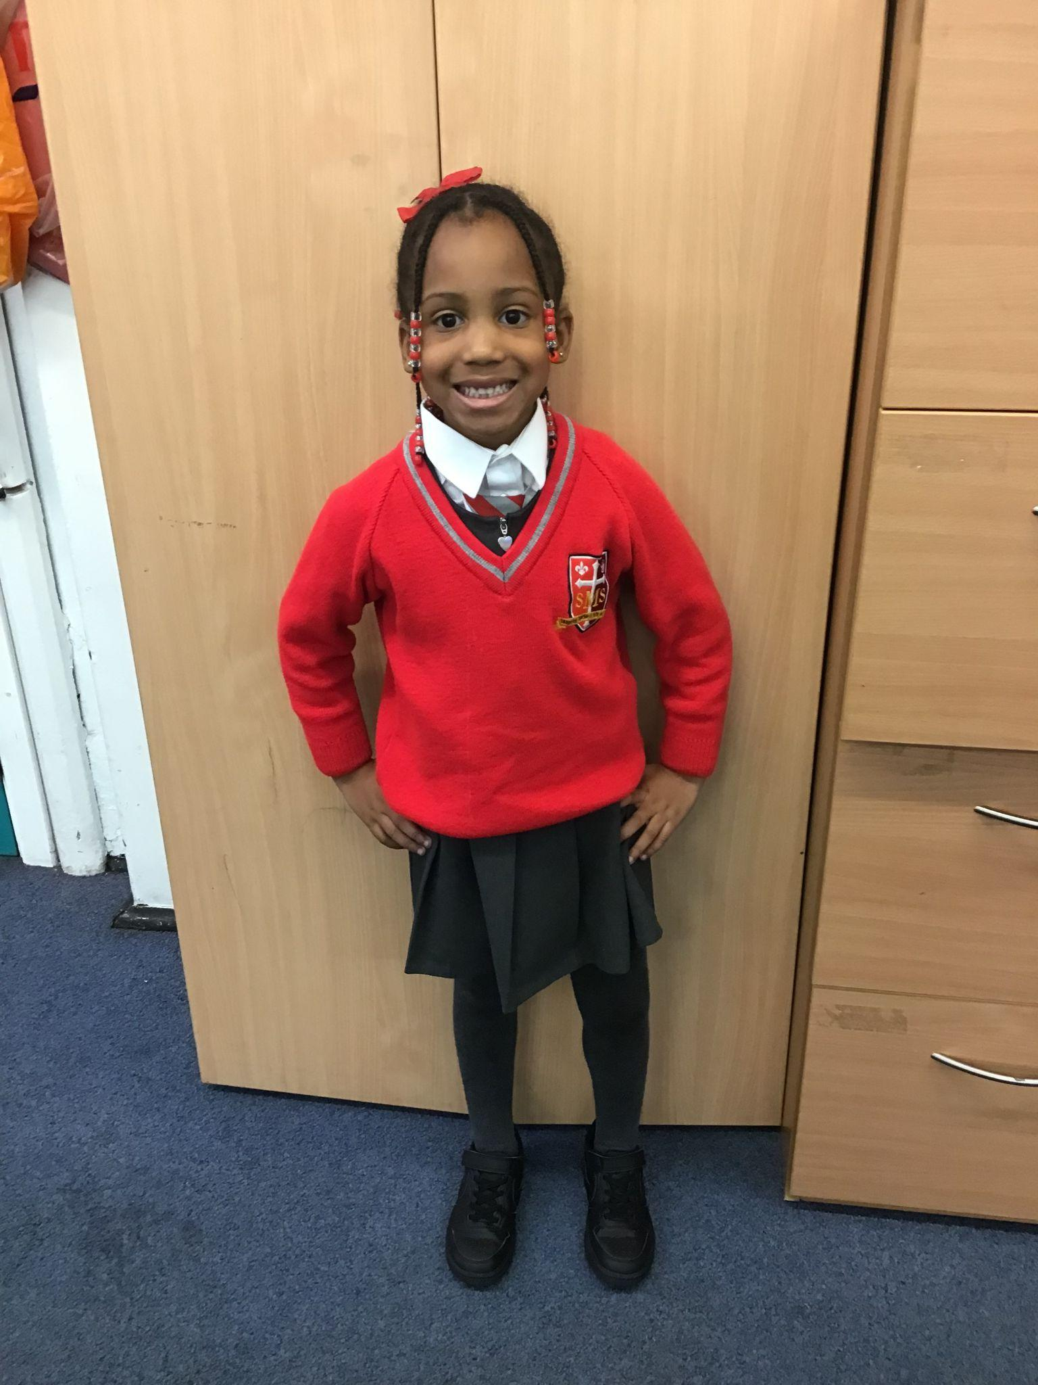
Year 1
For always trying her best in her writing, using her phonics sounds to spell words and being independent.
Miss Begum

Slide 8
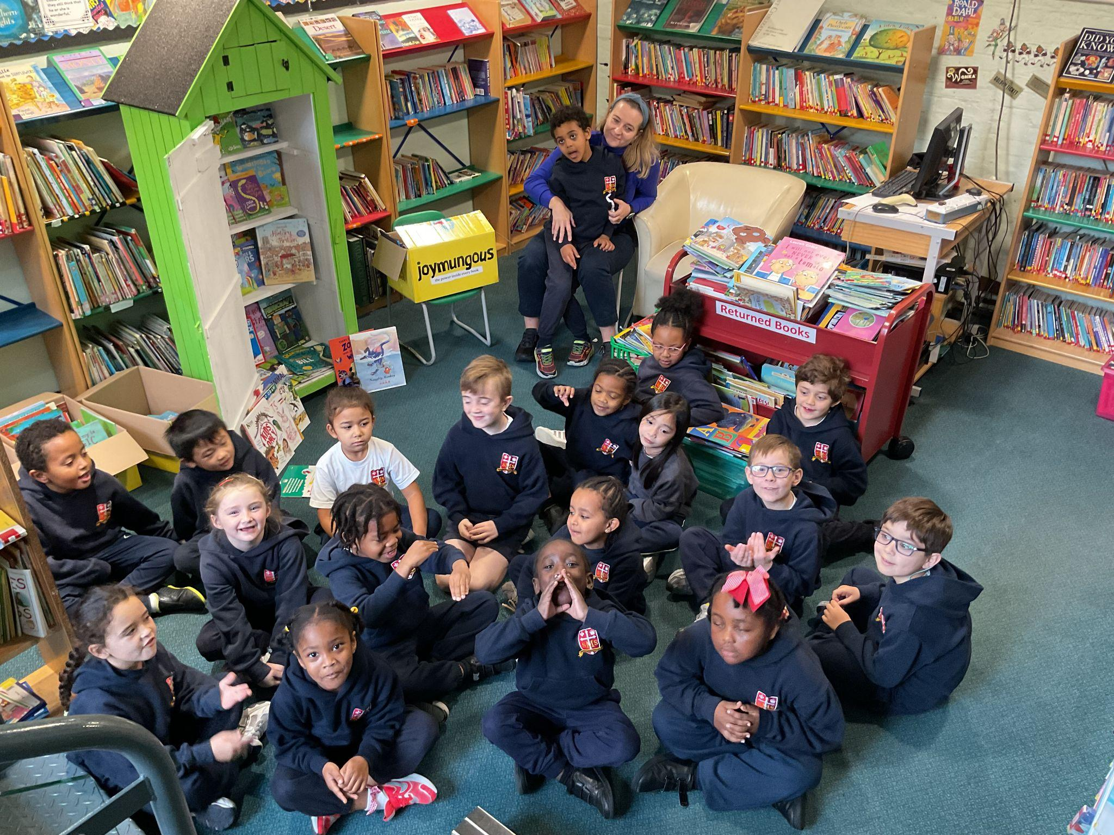
Year 2
All of Year 2 for their amazing effort in their assessments and also in the performance for the Grandparents Afternoon Concert. The singing and playing of musical instruments was beautiful.
Miss Sweet and Mrs Cummings

Slide 9

Year 3
On a trip!
Mr. Larke

Slide 10
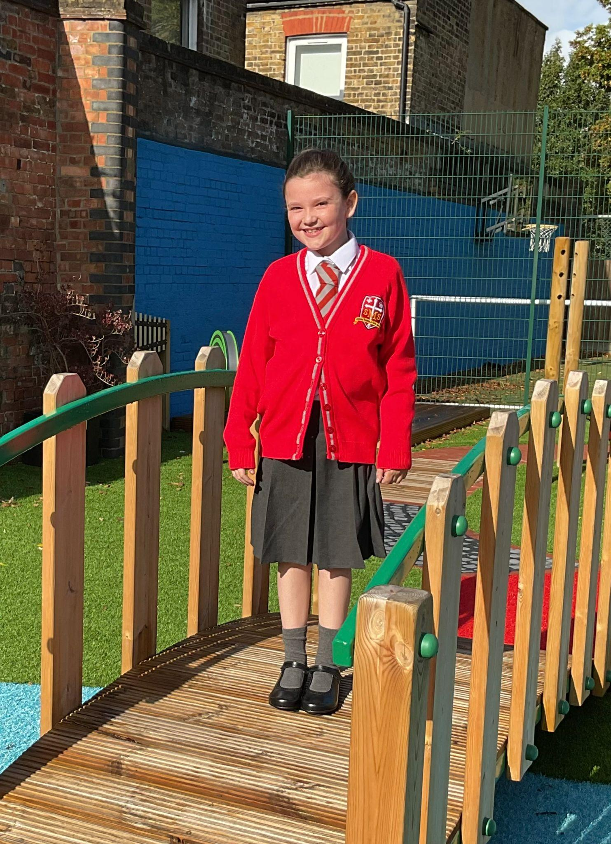
Year 4
For showing us how, with resilience and determination, we can beat adversity
Mr Whear

Slide 11
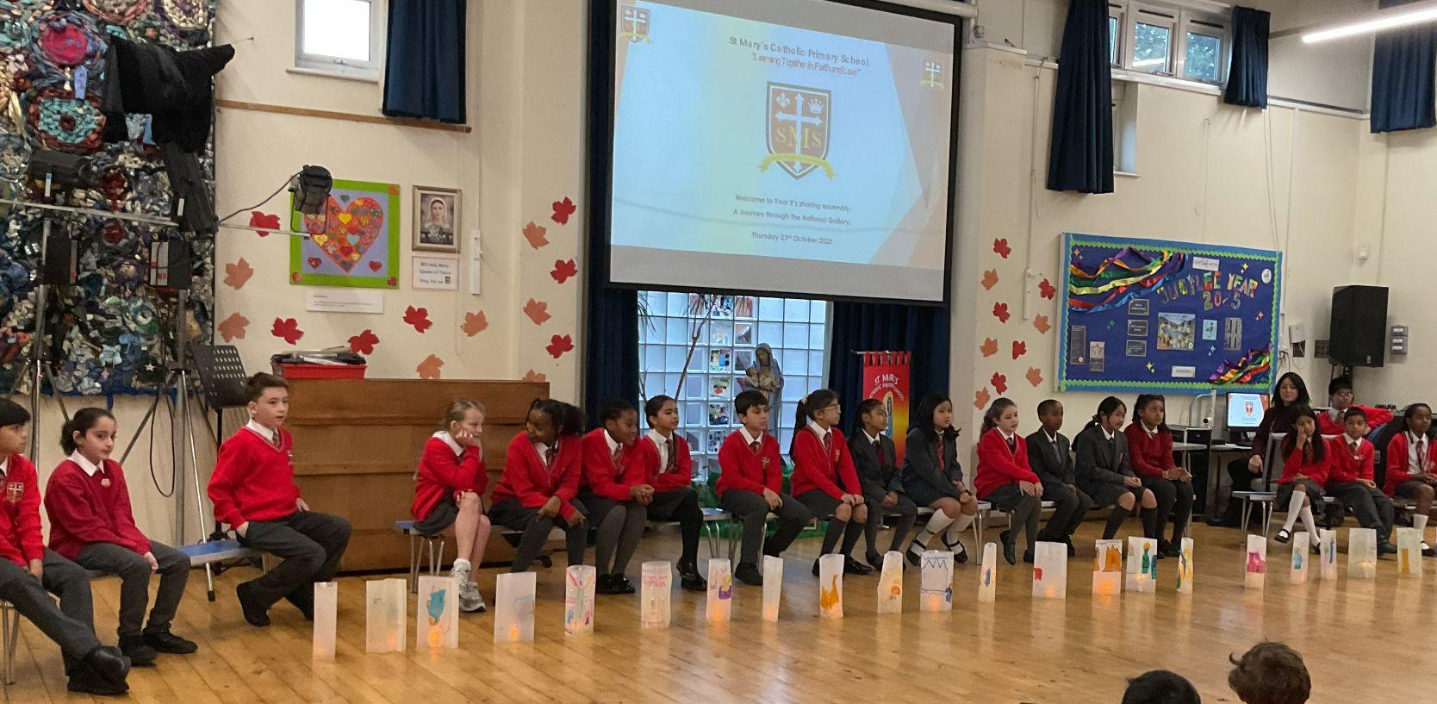
Year 5
Whole Class Award
For all their hard work and resilience and patience in practising while participating in our class assembly.
Mr. Carey

Slide 12
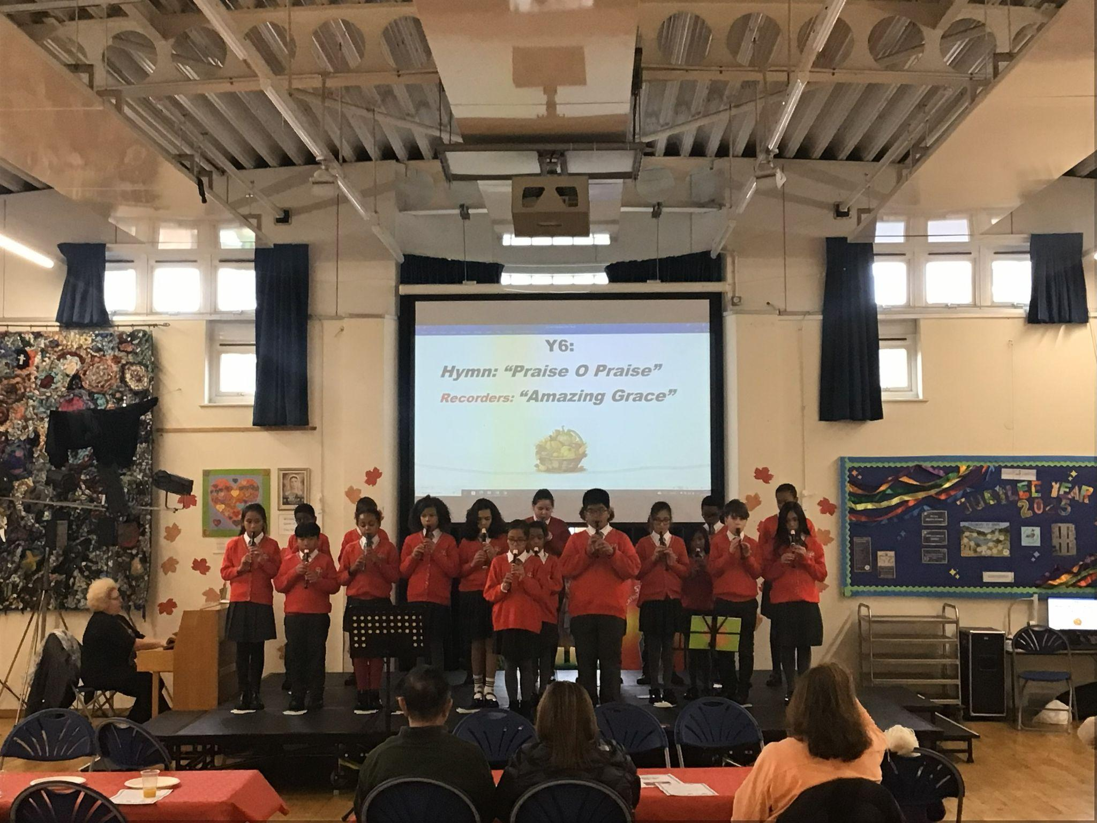
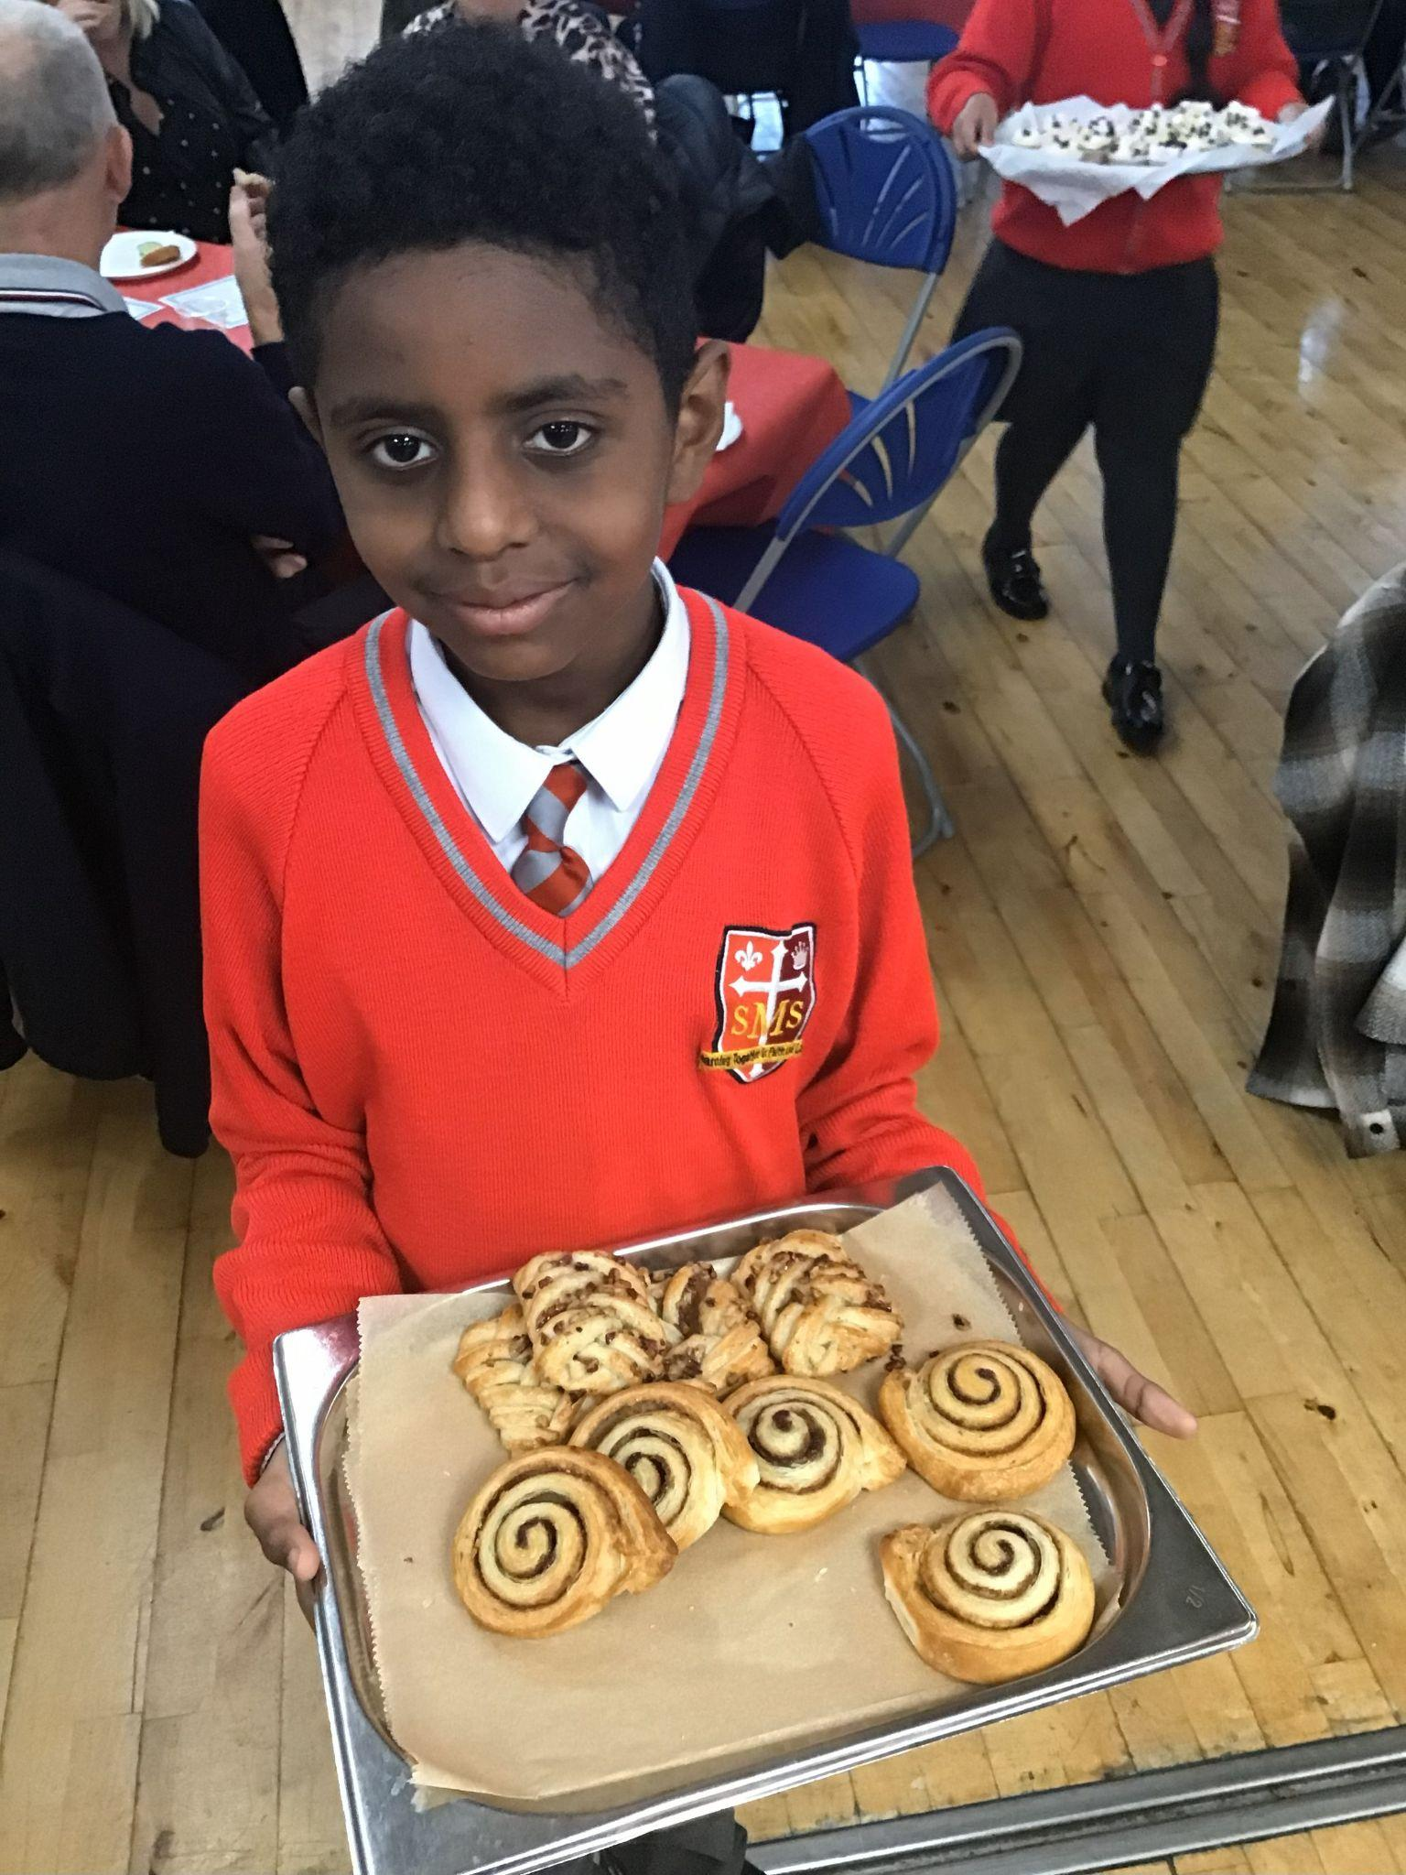
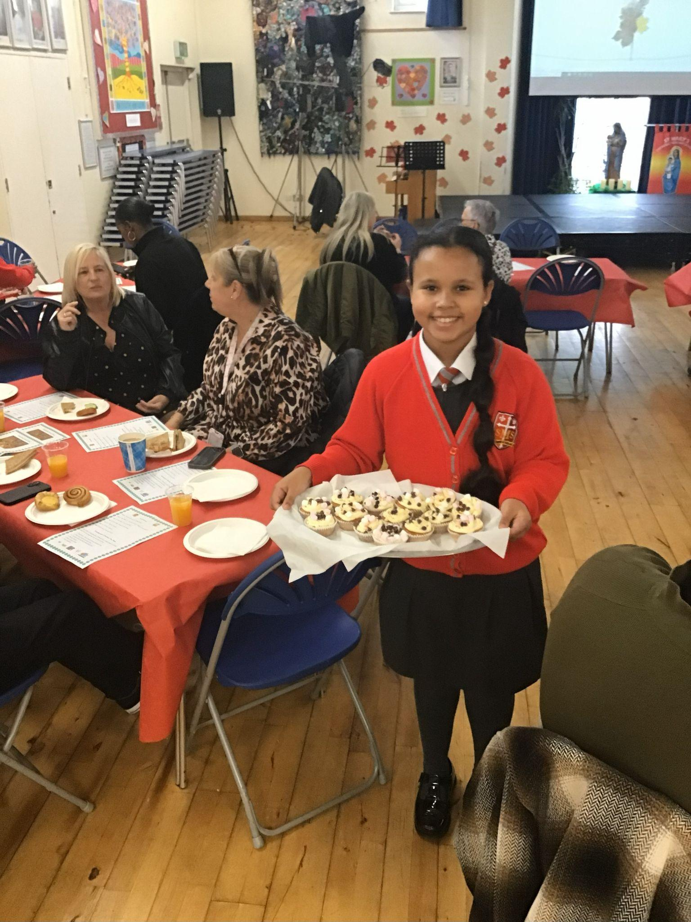
Year 6
Whole Class
For an amazing week in which they served and performed for our school grandparents with great attention and care.
Mr Cherfi & Mr Quinlan

Slide 13



Star Readers
Y1 - Malayah
Y2 - Lexi
Y3 - (Next Week)
Y4 - Matthew
Y5 - Mimi
Y6 - Zyann

Slide 14

Torrah-Leigh - Yr 2
George - R
Alayah - Nursery
Denis - R
Louie - Nursery

Slide 15
Whole School
Star of the Week
Friday 10th October 2025

