Slide 1

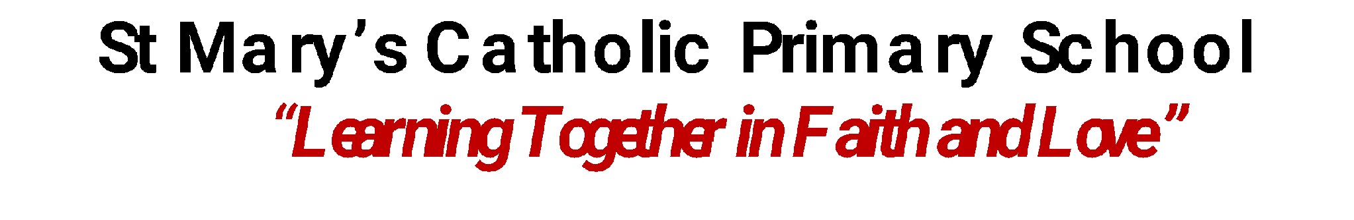

Whole School
Star of the Week
Friday 25th September, 2026

Slide 2
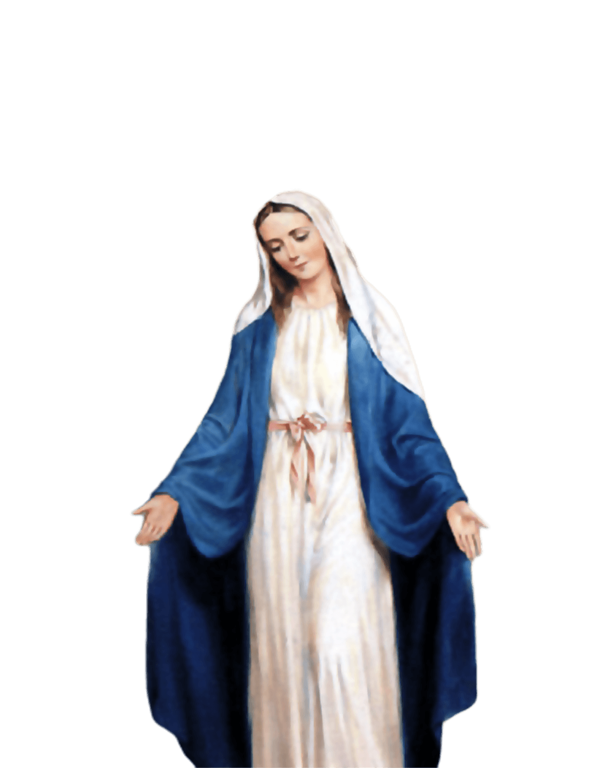
ST MARY’S SCHOOL PRAYER
O Holy Mary,
Mother and Patron of our school,
Turn your eyes of mercy towards us,
that we may love God
With all our hearts!
May we imitate the tenderness
of your Son, Jesus,
showing love and respect
For each person
and ourselves as children of God.
Guided by the Holy Spirit,
May we create the school,
where Mercy and Compassion
Is the centre of our lives.
Amen

Slide 3
EYFS
Kenza
For her amazing progress in phonics and handwriting.
Miss Barker

Slide 4
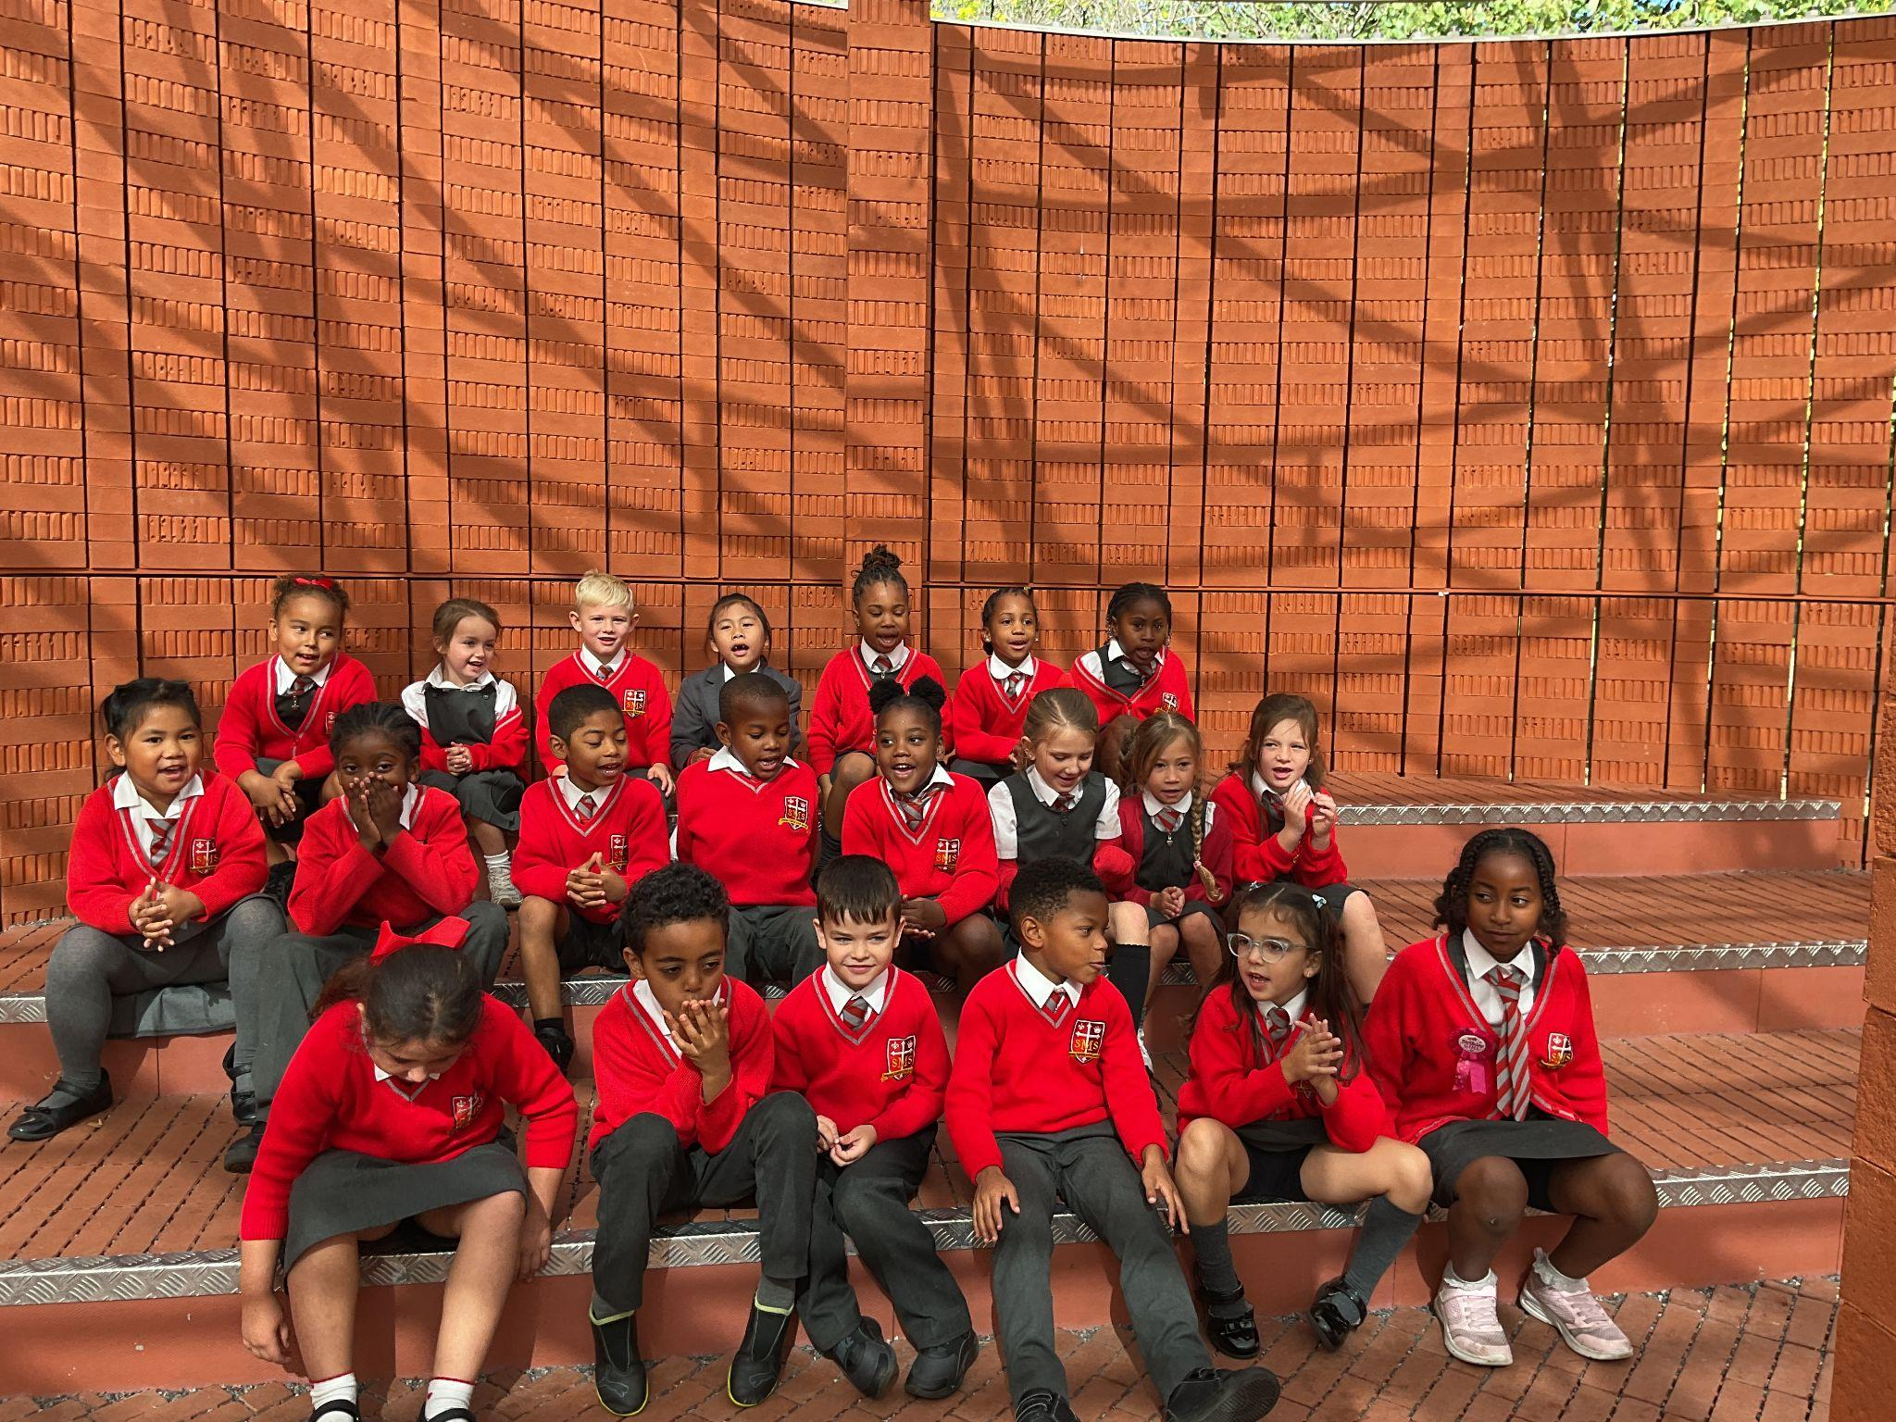
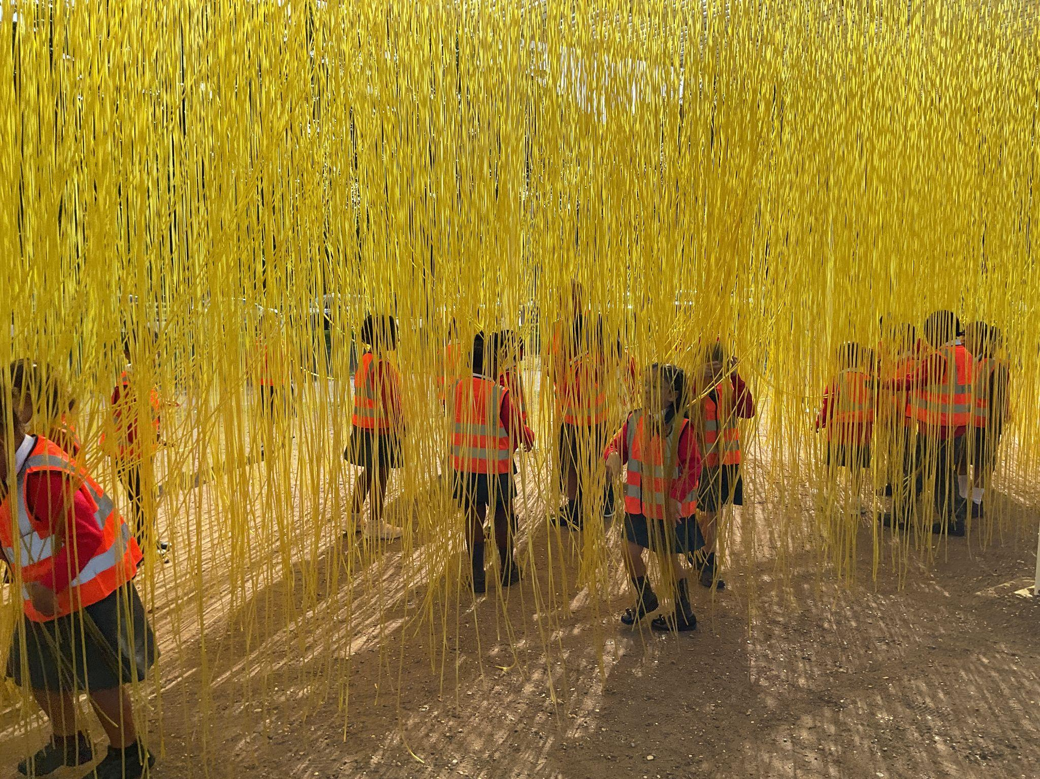
Year 1/2
Whole Class
We are thrilled to share that our Year 1/2 trip to the Serpentine Gallery's Summer Pavilion was a massive success! This trip was a wonderful addition to our art learning. Alongside exploring the unique installations, the children had a wonderful time collecting leaves in the grounds, which we will be using for our art project!
Miss Sweet and Mrs Bakali

Slide 5
Year 3
Aniyah
For bringing her sunshine personality, positivity, and hard work ethic into our classroom environment.
Miss Flashman

Slide 6
Year 4
Zema
For her exemplary behaviour. Zema is a shining role model in all she does from the moment she arrives to when she leaves.
Mr Whear

Slide 7
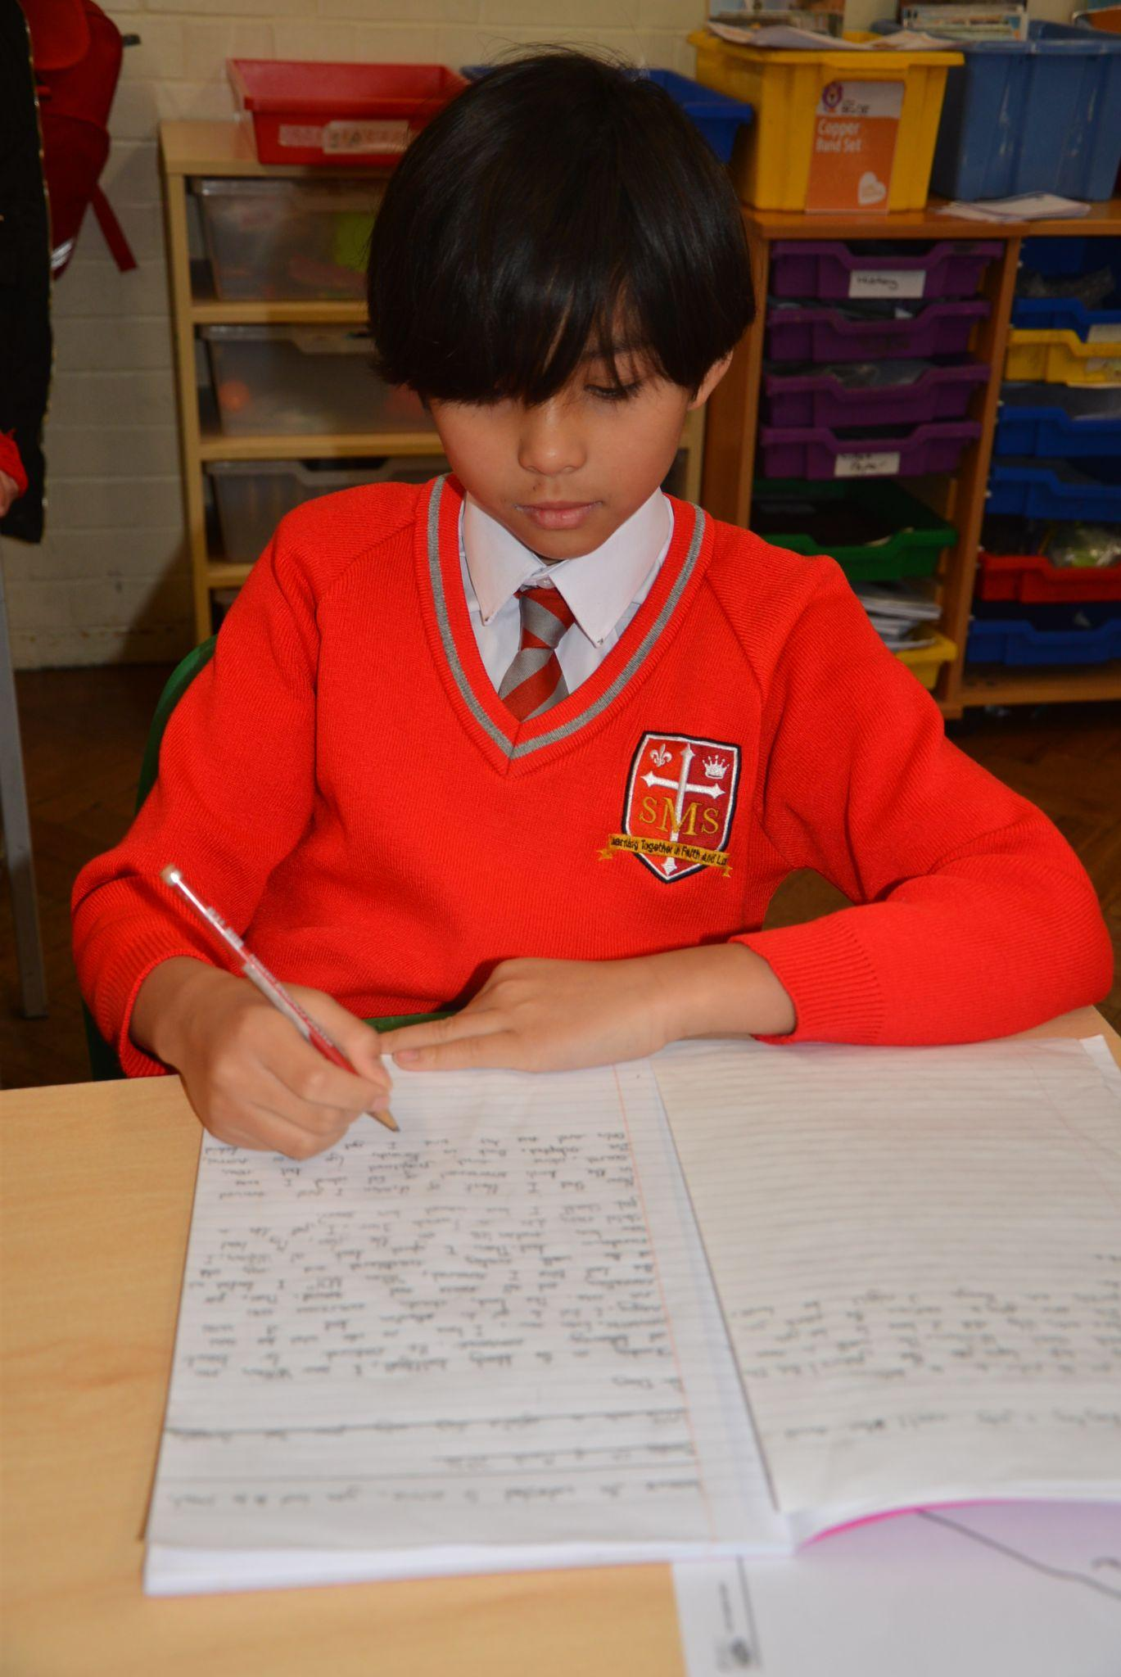
Year 5
Ryan
For trying his best in every aspect of class and delivering a wonderful speech for the Student Representative Council.
Miss O’Mara

Slide 8



STAR READER
Y1
Y2 - Lamek
Y3 - Kurtny
Y4 - Azahry’e
Y5 - Kareema
Y6 - Not This Week

Slide 9
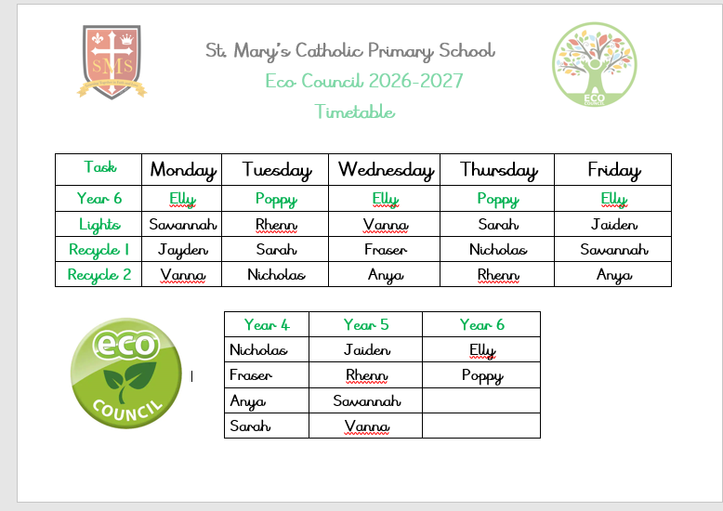

Slide 10
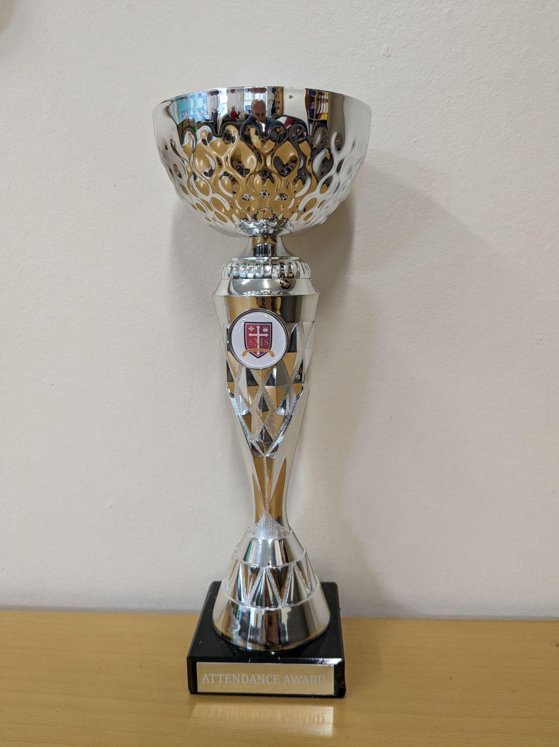
Attendance Weekly Leaders
Attendance Winners for this week:
Nursery
With 100% attendance

Slide 11

Nicholas - Year 4
Holly - Year 5

Slide 12
Whole School
Star of the Week
Friday 18th September 2026

Slide 13

Gospel
Matthew 18:21-35
‘I do not say to you seven times, but seventy times seven.’

Slide 14
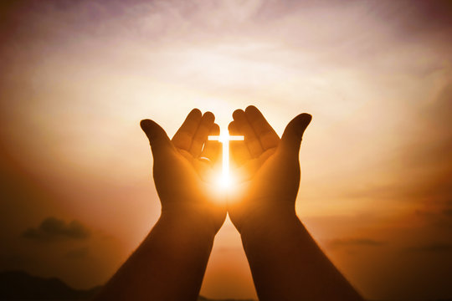
Let us pray.
"Dear God, thank you for loving us and forgiving us when we make mistakes. Forgiveness can be very hard for us to do on our own. Please give us big hearts full of your love, and help us to choose to forgive others just like you forgive us. Amen."

