Slide 1




Whole School
Star of the Week
Friday 27th February 2026

Slide 2


Our Father who art in Heaven
Hallowed be Thy Name
Thy Kingdom come
Thy will be done on Earth as it is in Heaven
Give us this day our daily bread
And forgive us our trespasses
As we forgive those who trespass against us
And lead us not into temptation
But deliver us from evil
Amen

Slide 3
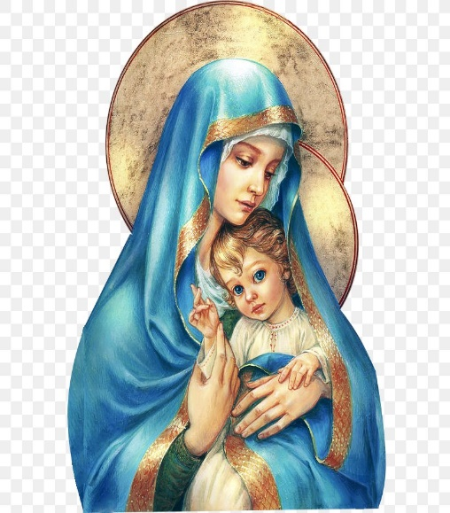
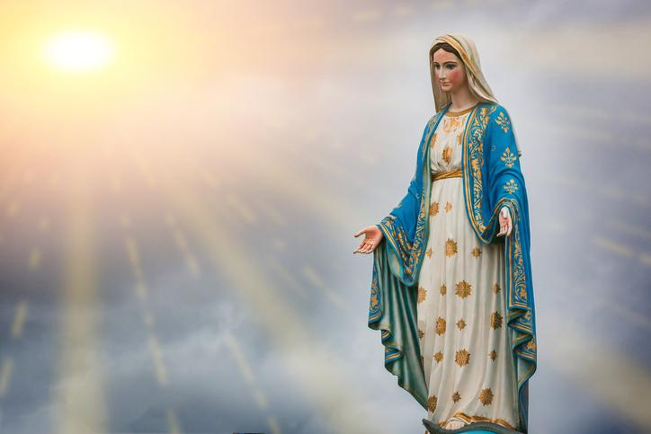
Hail Mary, Full of Grace
The Lord is with Thee
Blessed are Thou amongst women
And Blessed is the fruit of Thy womb, Jesus
Holy Mary , Mother of God
Pray for us sinners
Now and in the hour of our death
Amen

Slide 4
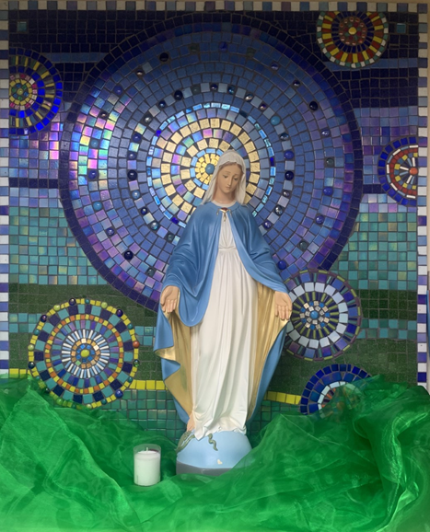
St Mary’s School Prayer
O Holy Mary,
Mother and Patron of our school,
Turn your eyes of mercy towards us,
that we may love God
With all our hearts!
May we imitate the tenderness
of your Son, Jesus,
showing love and respect
For each person
and ourselves as children of God.
Guided by the Holy Spirit,
May we create the school,
where Mercy and Compassion
Is the centre of our lives.
Amen

Slide 5
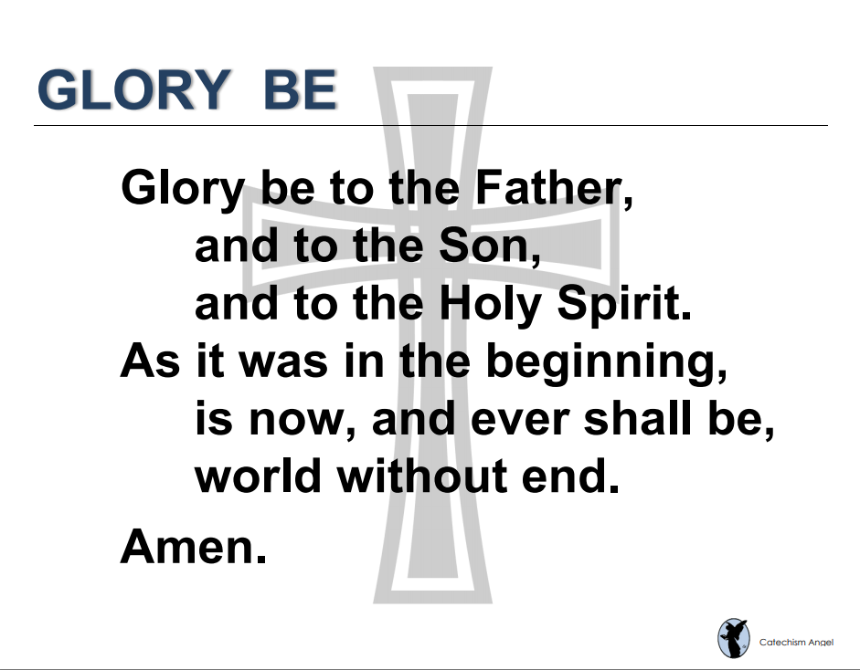

Slide 6
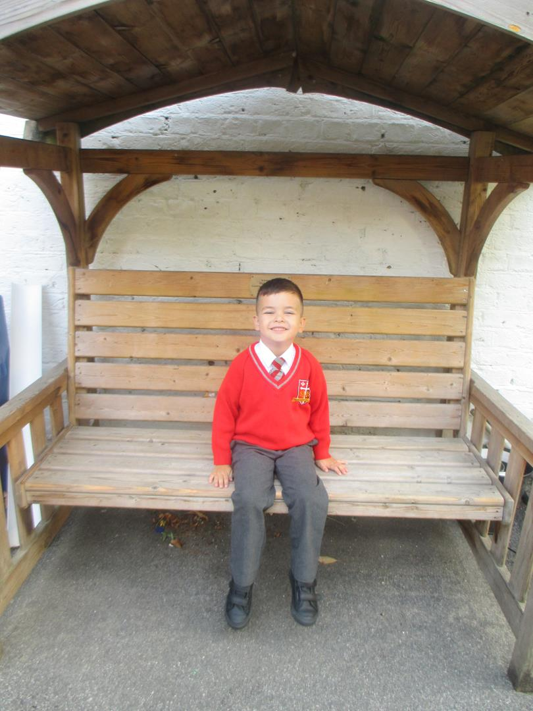
Reception
For his amazing effort this week and concentration in independent maths activities.
Miss Barker

Slide 7
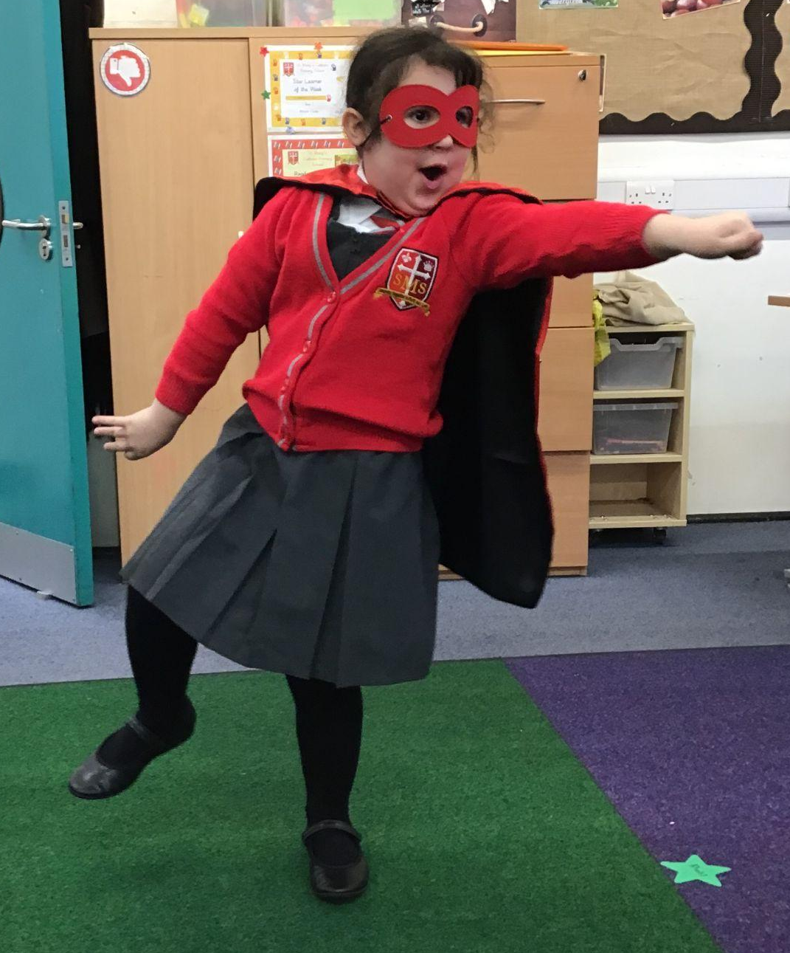
Year 1
For putting so much effort into her work and making positive choices!
Miss Flashman

Slide 8
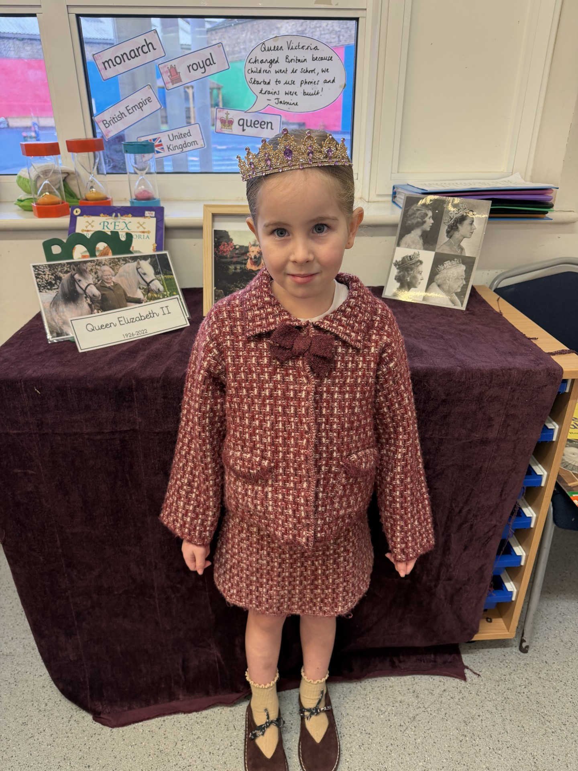
Year 2
For being an absolute superstar everyday!
Miss Sweet

Slide 9
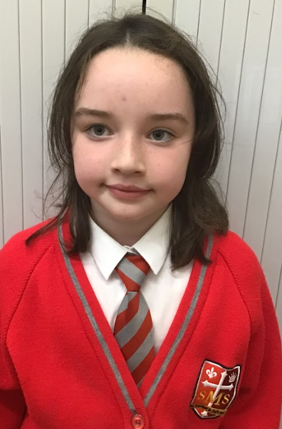
Year 3
For a huge improvement in everything she does.
Mr. Larke

Slide 10
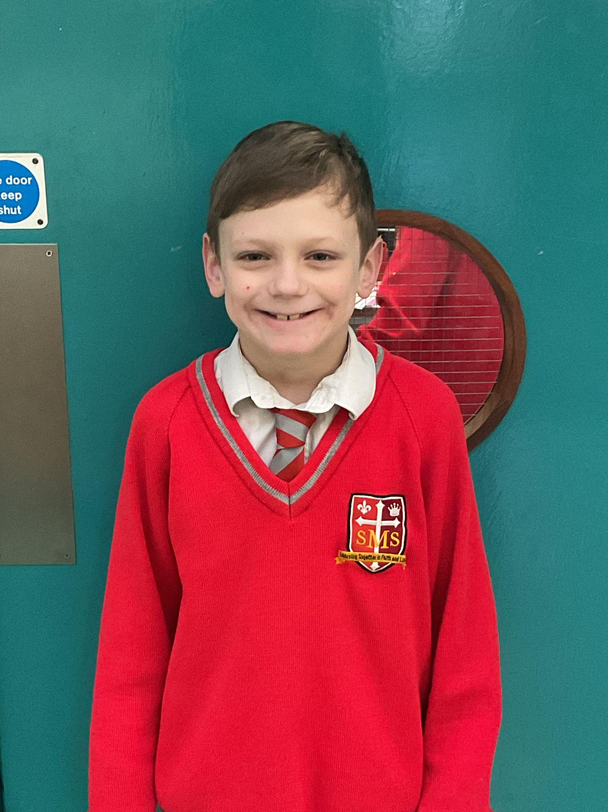
Year 4
For his hard work and willingness to have a go.
Mr Whear

Slide 11
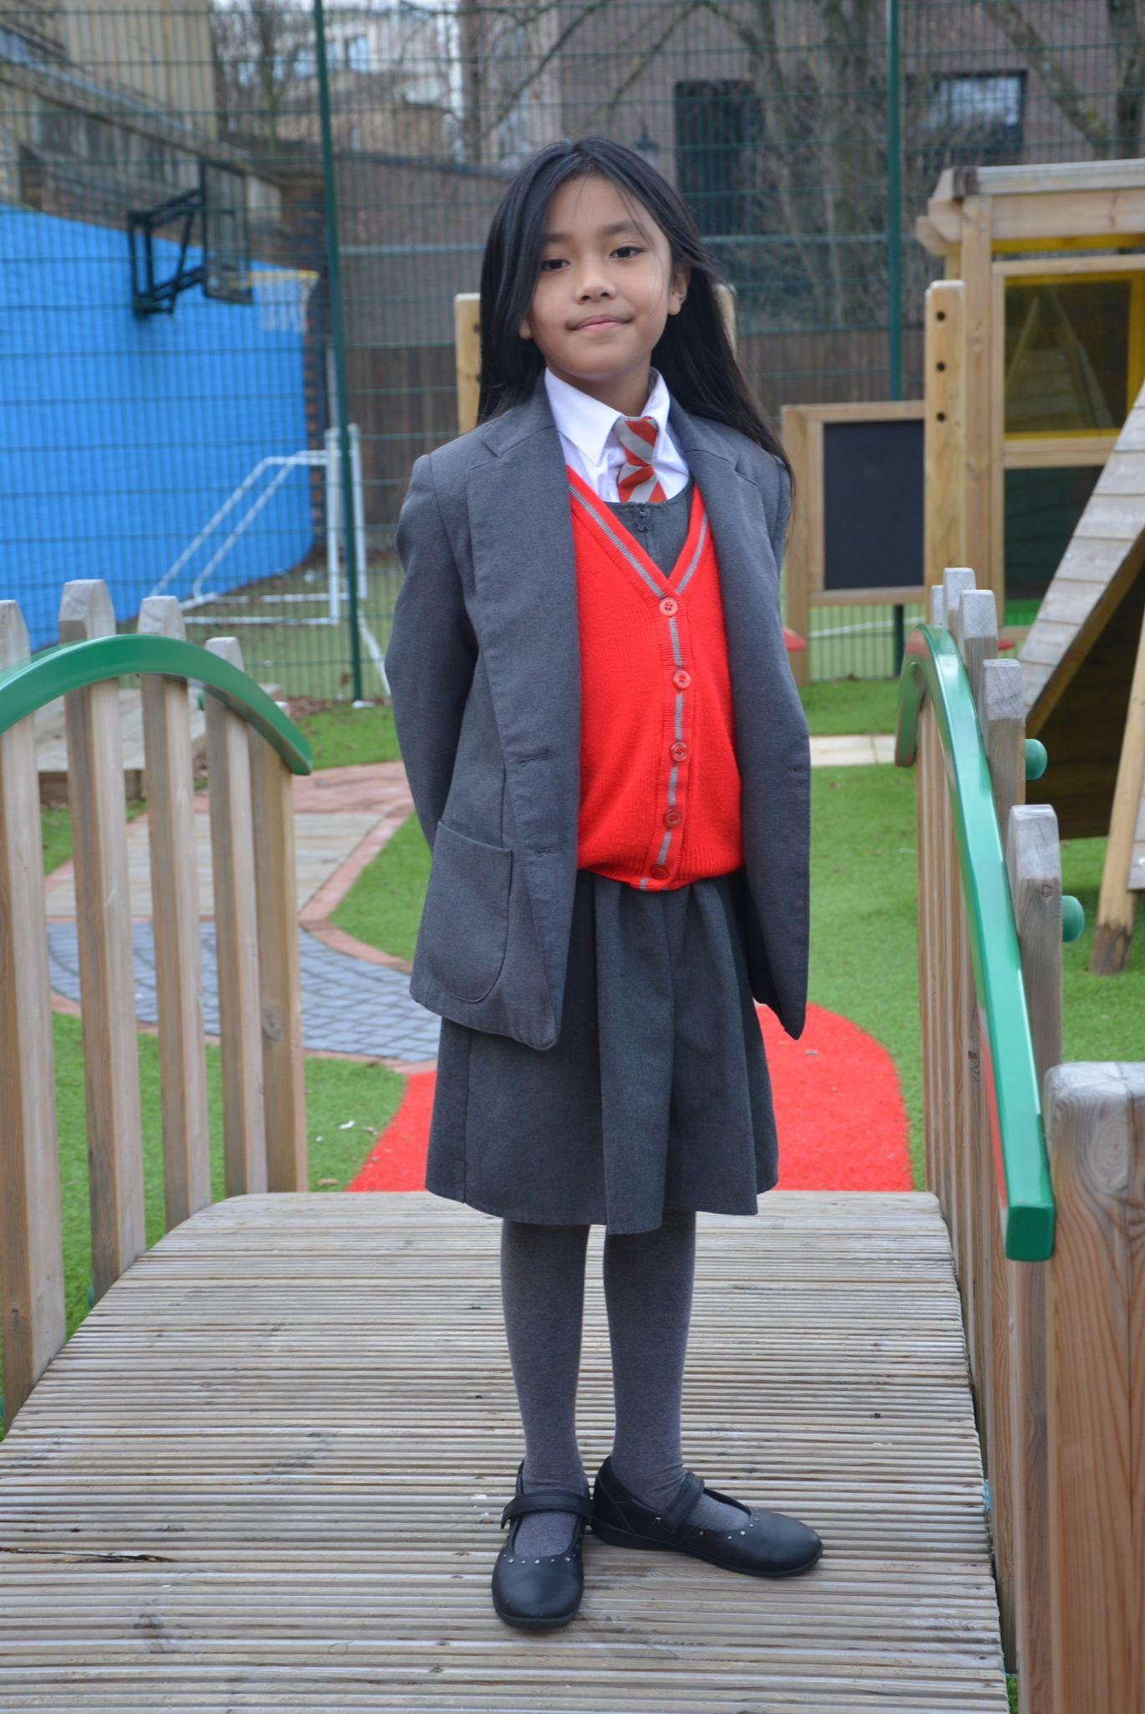
Year 5
For exceptional work in our Design and Technology (DT) lesson; producing a fantastic prototype from card to create simple automata.
Franzen, your positive energy and attitude to the task was absolutely spot on! Keep it up!
Ms Bakali
Mrs.Bakali

Slide 12
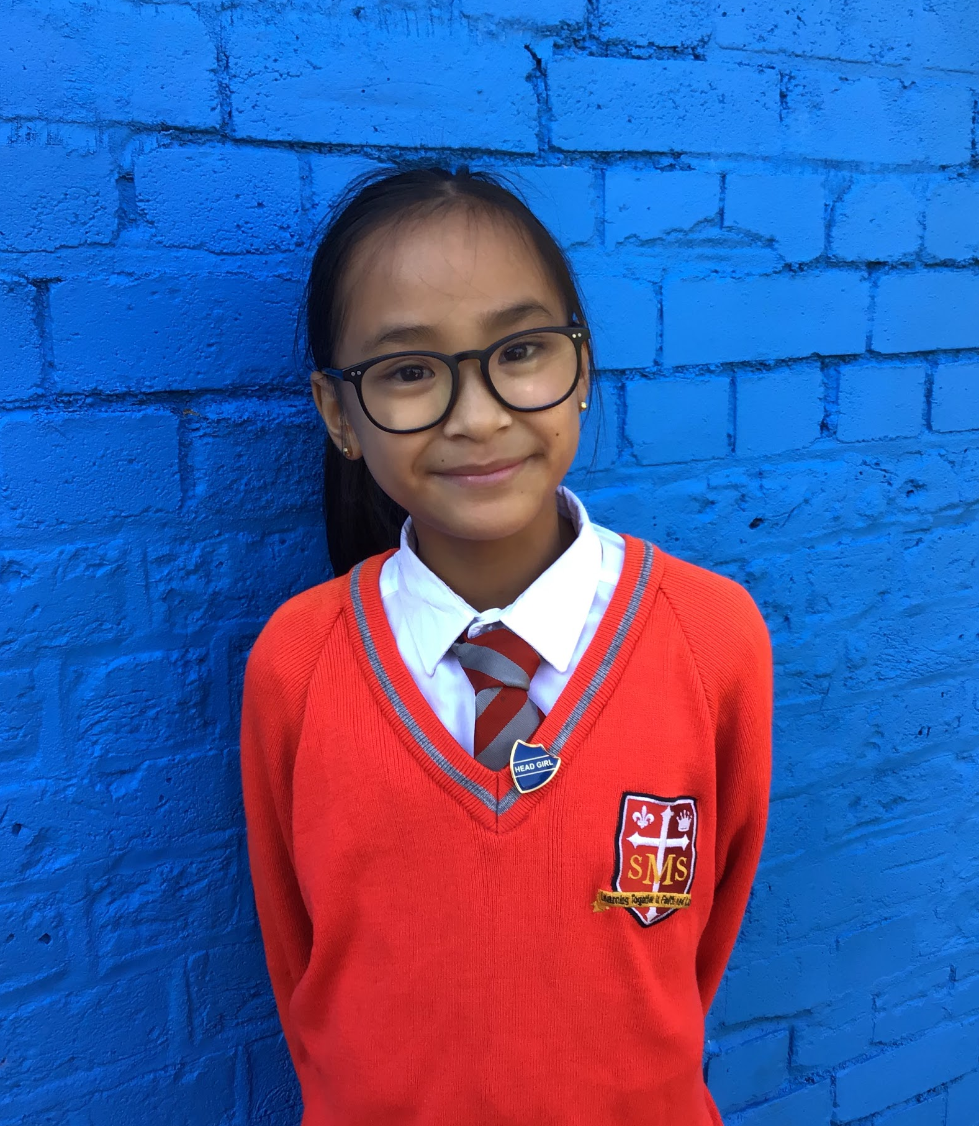
Year 6
For her exceptional hard work in all areas of her school life.
Mr Cherfi

Slide 13



Star Readers
Y1 - Malayah
Y2 - Kurtny
Y3 - Novena
Y4 - George
Y5 - Nelly
Y6 - Zamarah

Slide 14

Nazrawi - Y6
Albie - Y2

Slide 15
Whole School
Star of the Week
Friday 27th February 2026

