Slide 1
Whole School
Star of the Week
Friday 27th June 2025

Slide 2
Our Father who art in Heaven
Hallowed be Thy Name
Thy Kingdom come
Thy will be done on Earth as it is in Heaven
Give us this day our daily bread
And forgive us our trespasses
As we forgive those who trespass against us
And lead us not into temptation
But deliver us from evil
Amen

Slide 3
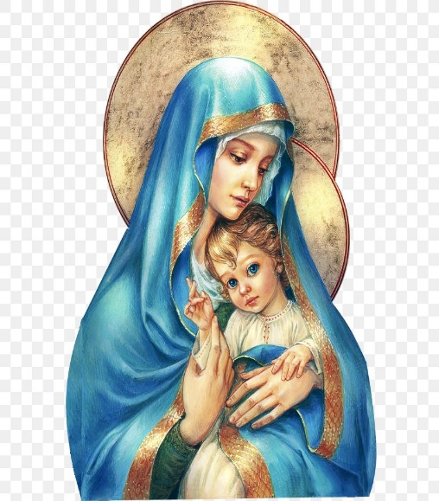
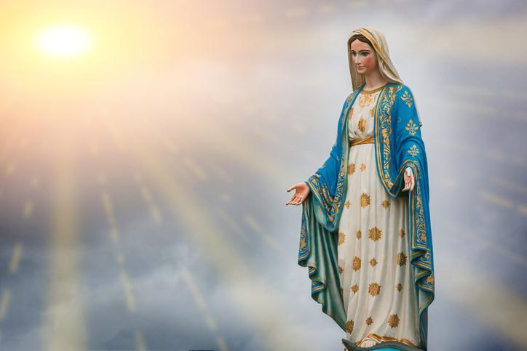
Hail Mary, Full of Grace
The Lord is with Thee
Blessed are Thou amongst women
And Blessed is the fruit of Thy womb, Jesus
Holy Mary , Mother of God
Pray for us sinners
Now and in the hour of our death
Amen

Slide 4
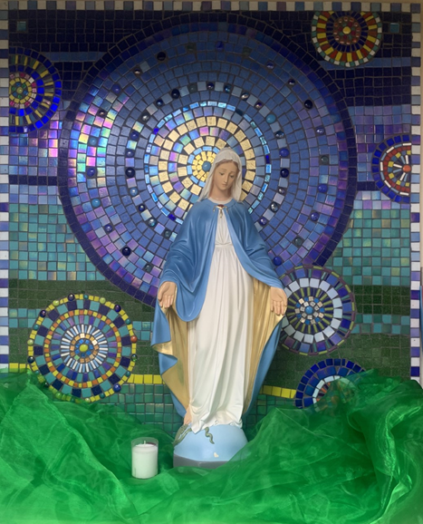
St Mary’s School Prayer
O Holy Mary,
Mother and Patron of our school,
Turn your eyes of mercy towards us,
that we may love God
With all our hearts!
May we imitate the tenderness
of your Son, Jesus,
showing love and respect
For each person
and ourselves as children of God.
Guided by the Holy Spirit,
May we create the school,
where Mercy and Compassion
Is the centre of our lives.
Amen

Slide 6
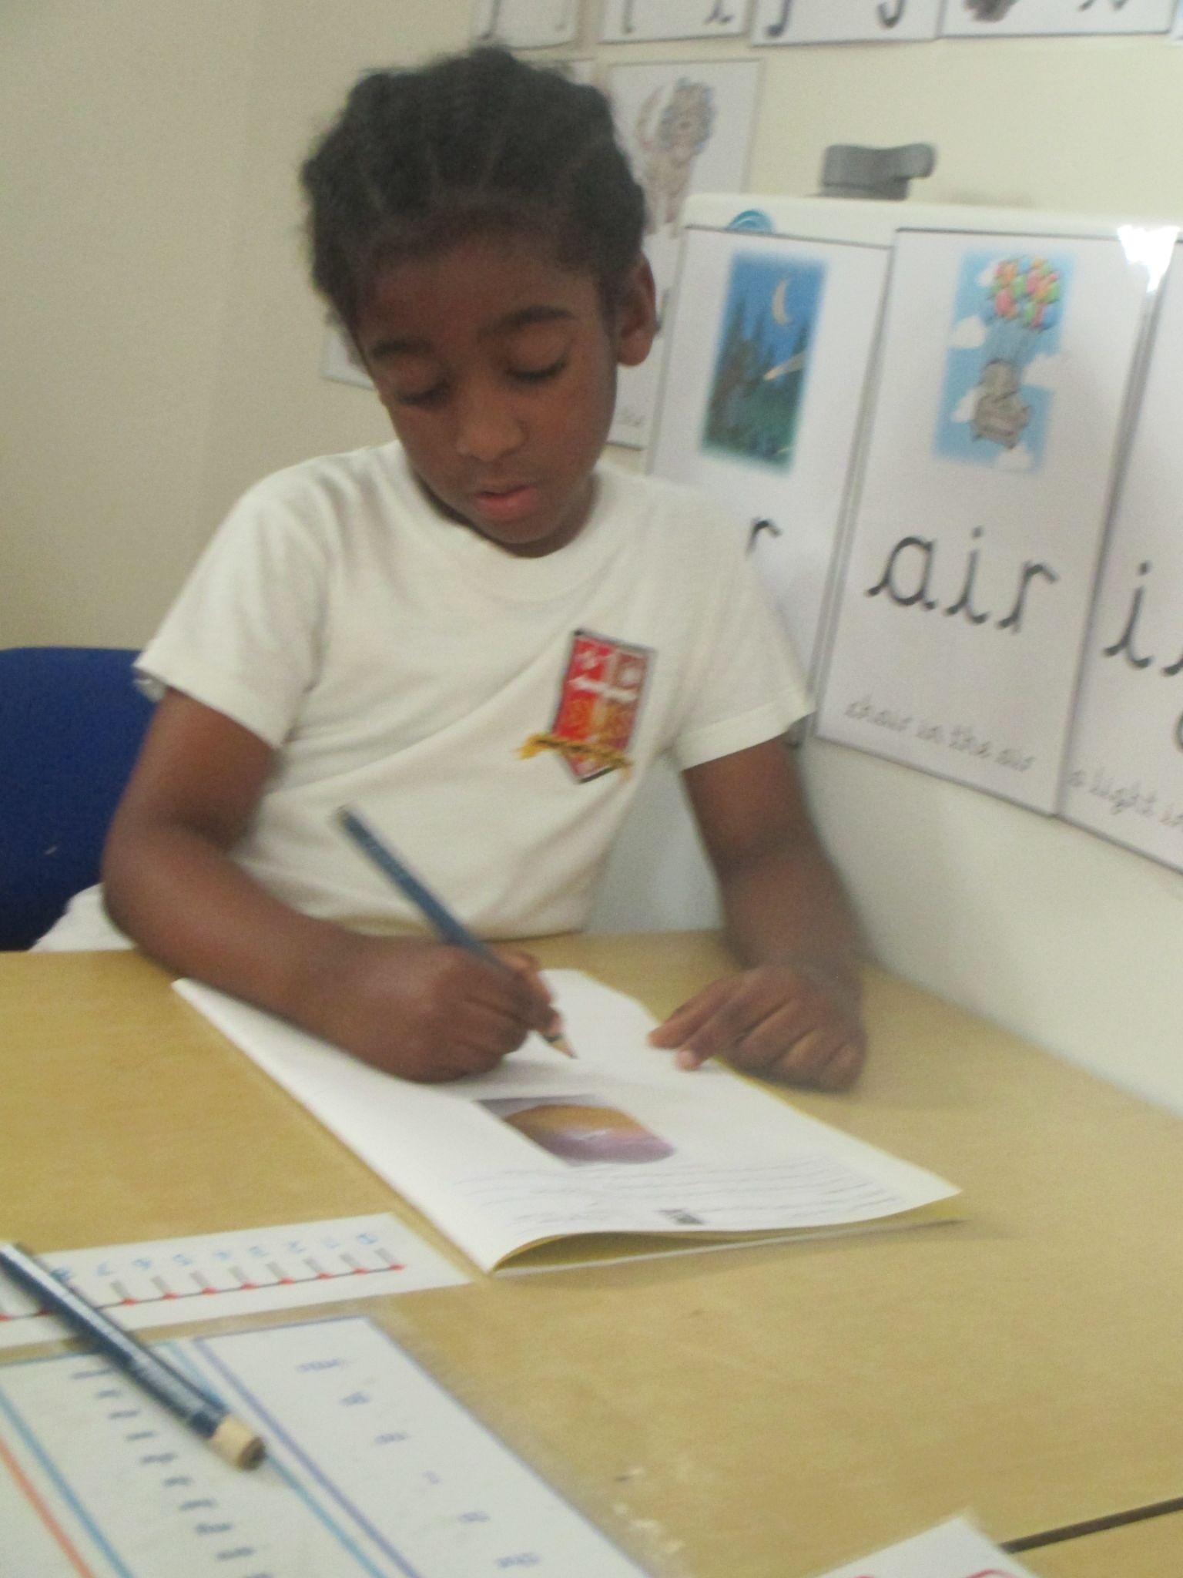
Reception
For his amazing effort at independent writing.
Miss Barker

Slide 7
Year 1
For taking ownership of his learning!
Miss Sweet

Slide 8
Year 2
For being a role model in how he has listened over the last two weeks and shown maturity in his learning.
Mr Whear

Slide 9
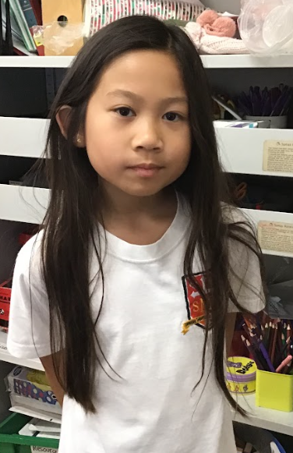
Year 3
For being a role model for kindness and responsibility, and always persevering with her work.
Miss Medioli

Slide 10
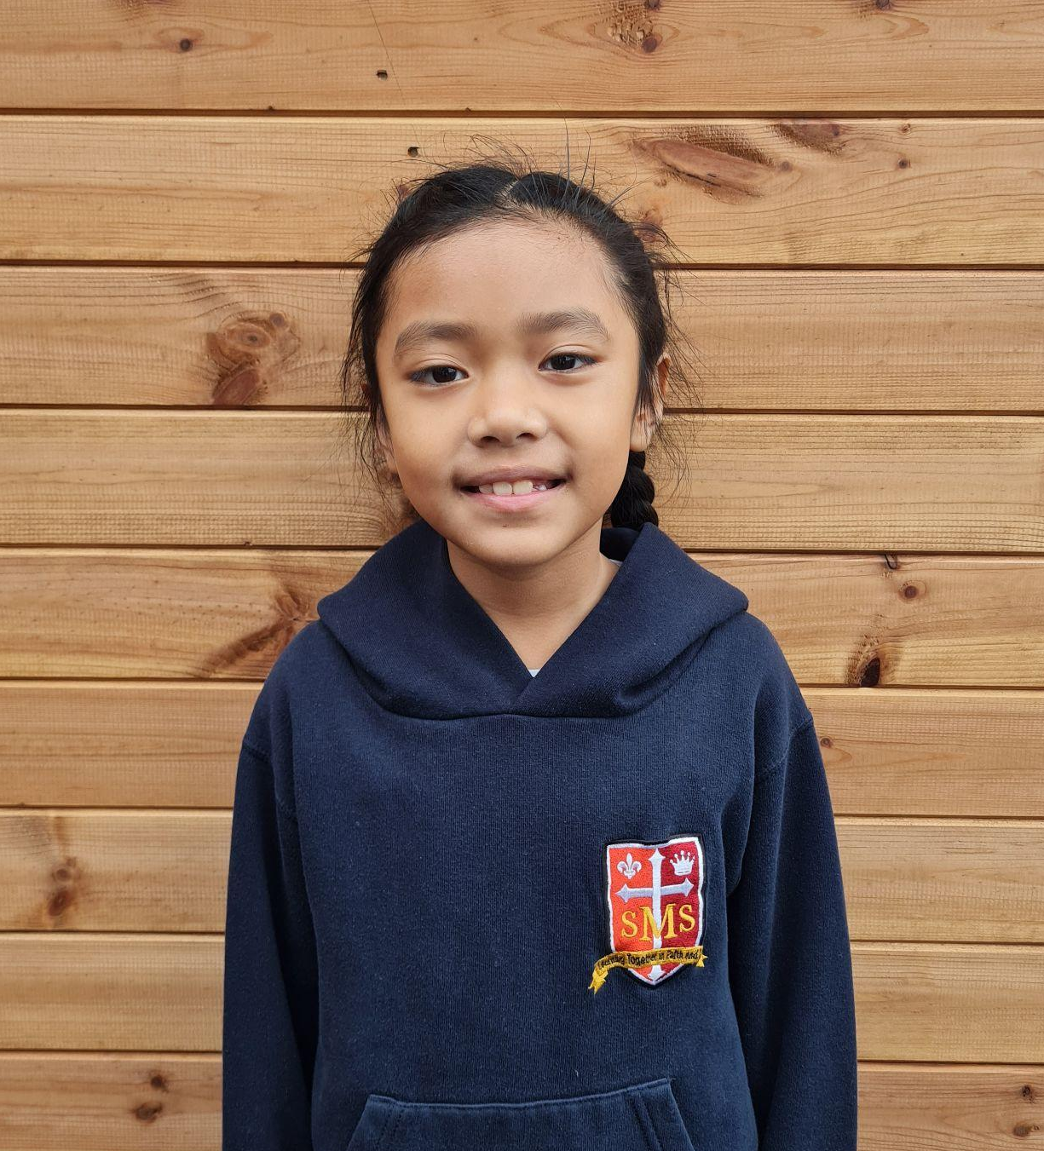
Year 4
For their excellent focus and effort in all work this week, particularly in writing
Miss Forrest

Slide 11
Year 5
The Whole Class
For performing like West End Superstars!
Mr Larke

Slide 12
Star Readers
Y1 - Torrah-Leigh
Y2 - Luna
Y3 - Savannah
Y4 - Alby
Y5 - Tommy
Y6 - Stefan

Slide 13
Y5 - Yael
Y4 - Nelly
Y4 - Alby
Y1 - Naomi
Y1 - Ineesha
Y2 - Novena
Y4 - Cali
Ms Cacheiro

Slide 14
Whole School
Star of the Week
Friday 27th June 2025

