Slide 1
Whole School
Star of the Week
Friday 28th March 2025

Slide 2
Our Father who art in Heaven
Hallowed be Thy Name
Thy Kingdom come
Thy will be done on Earth as it is in Heaven
Give us this day our daily bread
And forgive us our trespasses
As we forgive those who trespass against us
And lead us not into temptation
But deliver us from evil
Amen

Slide 3
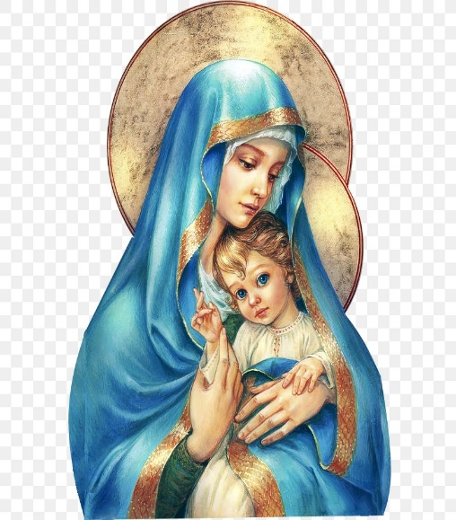
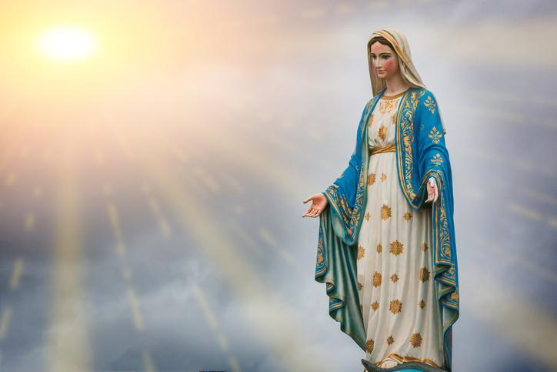
Hail Mary, Full of Grace
The Lord is with Thee
Blessed are Thou amongst women
And Blessed is the fruit of Thy womb, Jesus
Holy Mary , Mother of God
Pray for us sinners
Now and in the hour of our death
Amen

Slide 4
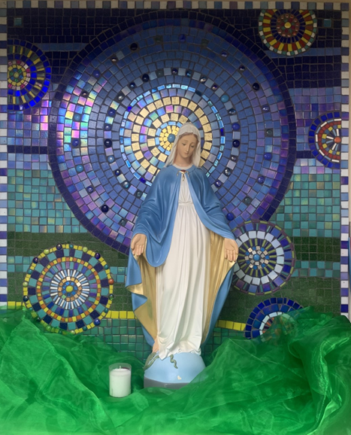
St Mary’s School Prayer
O Holy Mary,
Mother and Patron of our school,
Turn your eyes of mercy towards us,
that we may love God
With all our hearts!
May we imitate the tenderness
of your Son, Jesus,
showing love and respect
For each person
and ourselves as children of God.
Guided by the Holy Spirit,
May we create the school,
where Mercy and Compassion
Is the centre of our lives.
Amen

Slide 6
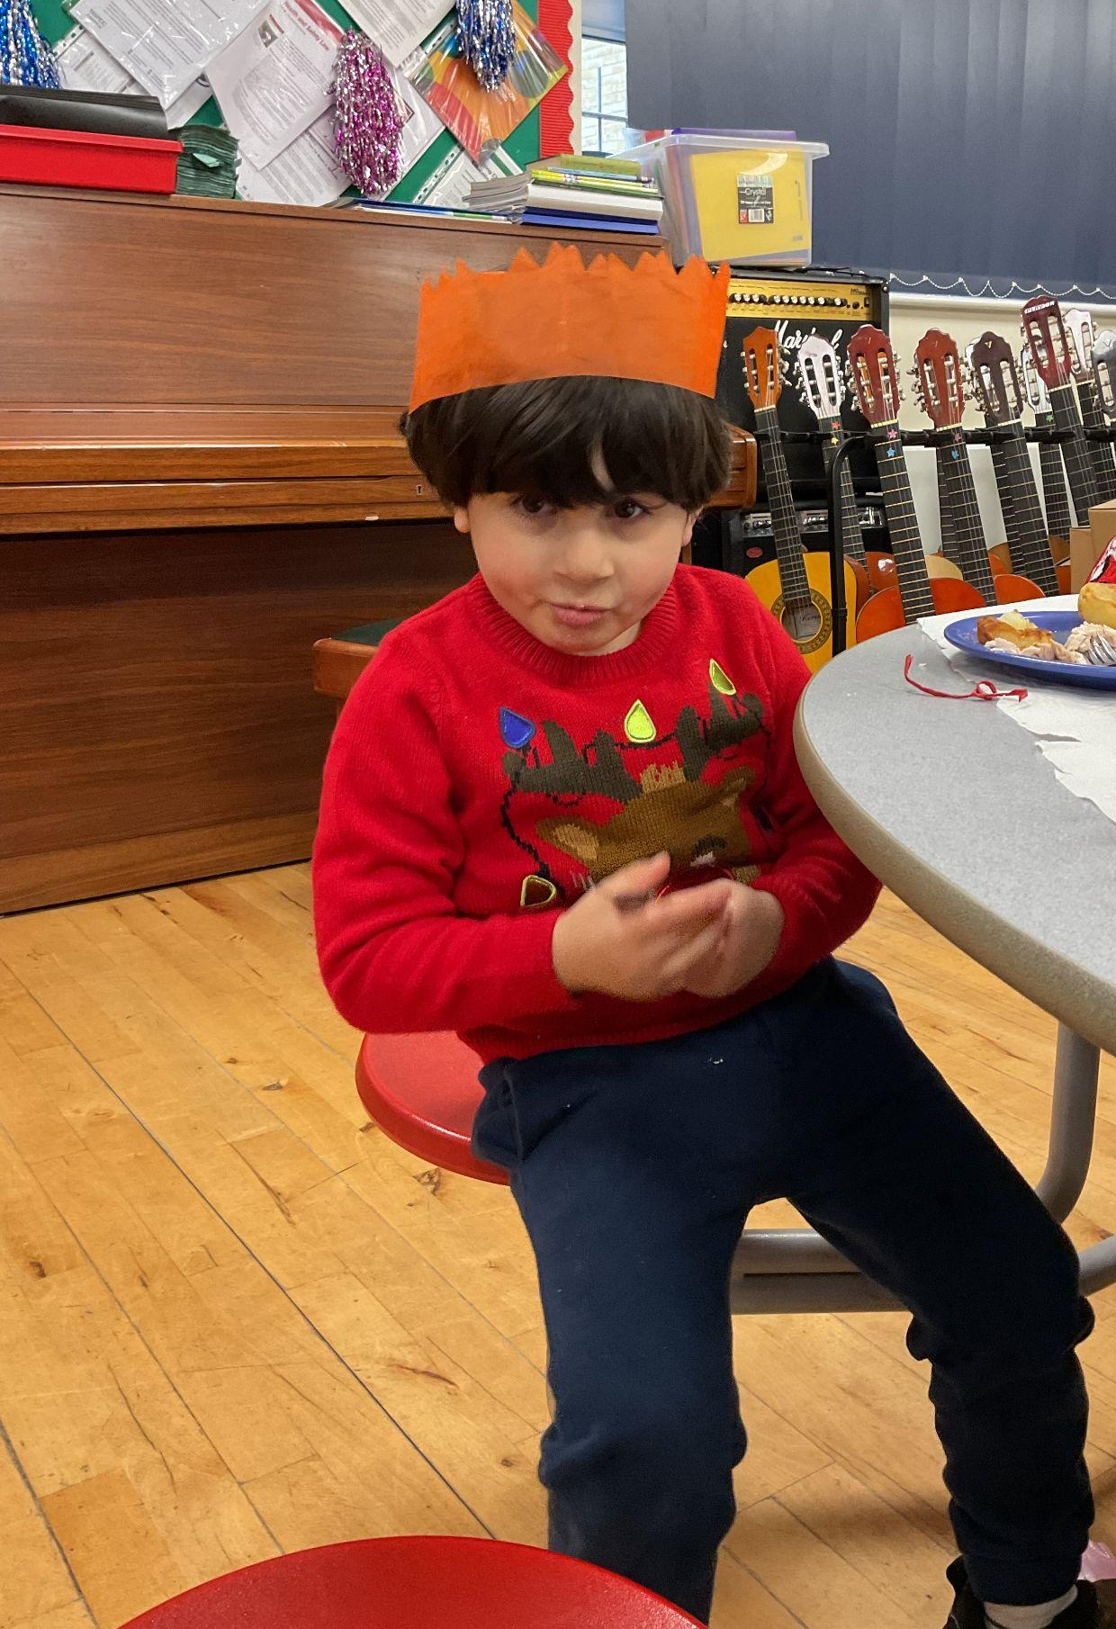
Early Years-
Nursery- For having a great week in Nursery and engaging in the provision.
Reception- For making a huge effort this week to focus in whole class lessons and attempting more independent writing activities.
Miss Barker

Slide 7
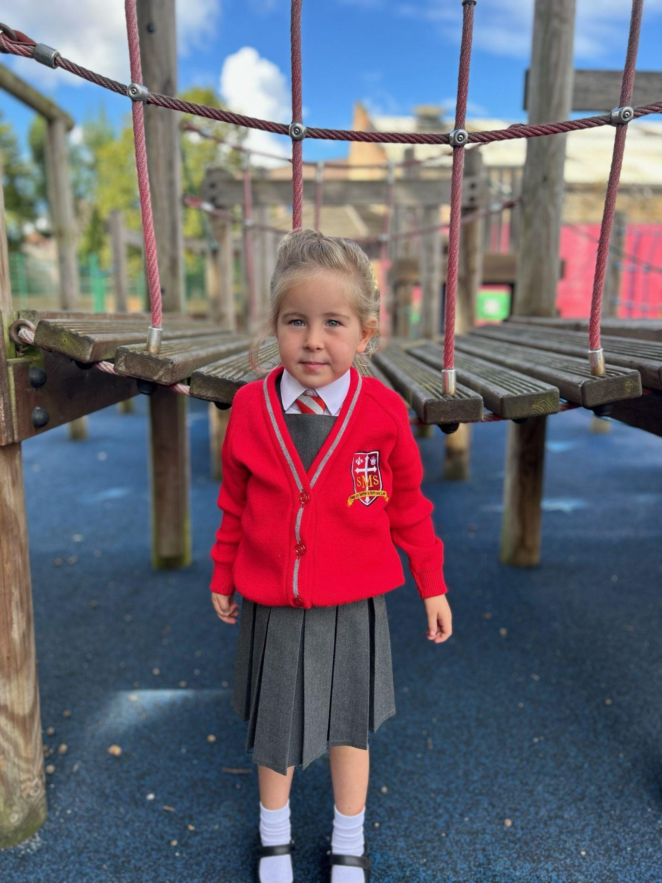
Year 1
For always following instructions and being a role model to the rest of the class.
Miss Sweet

Slide 8
Year 2
For being a role model in class, trying his hardest in all subjects and making excellent contributions in science and RE.
Mr Whear

Slide 9
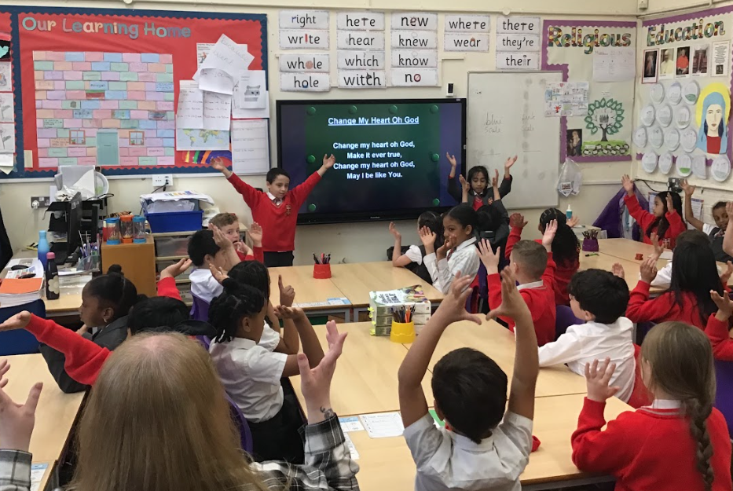
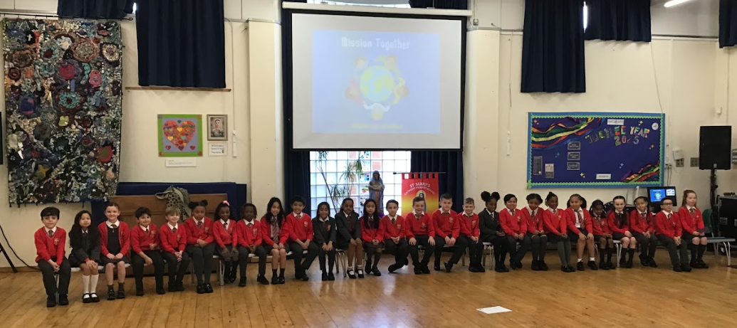
Year 3
For working incredibly hard leading up to our class assembly and performing beautifully.
Miss Medioli

Slide 10
Year 4
For his hard work and excellent progress he has made in writing.
Miss Forrest

Slide 11
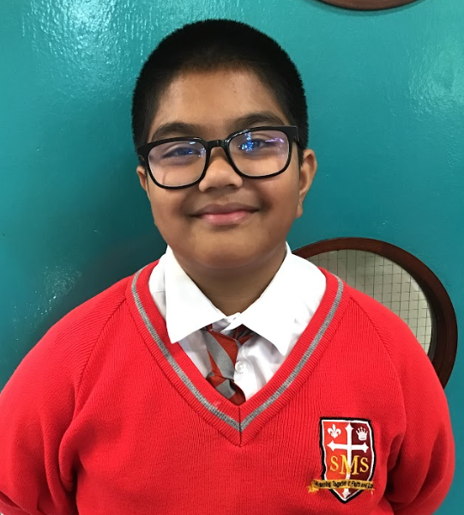
Year 5
For showing that focus and determination pays off
Mr Larke

Slide 12
Star Readers
Y1 - Darius
Y2 -
Y3 - Fatima
Y4 - Mimi
Y5 - Layla

Slide 13
Zyann - Y5

Slide 14
Whole School
Star of the Week
Friday 14th March 2025

