Slide 1




Whole School
Star of the Week
Friday 28th November 2025

Slide 2


Our Father who art in Heaven
Hallowed be Thy Name
Thy Kingdom come
Thy will be done on Earth as it is in Heaven
Give us this day our daily bread
And forgive us our trespasses
As we forgive those who trespass against us
And lead us not into temptation
But deliver us from evil
Amen

Slide 3
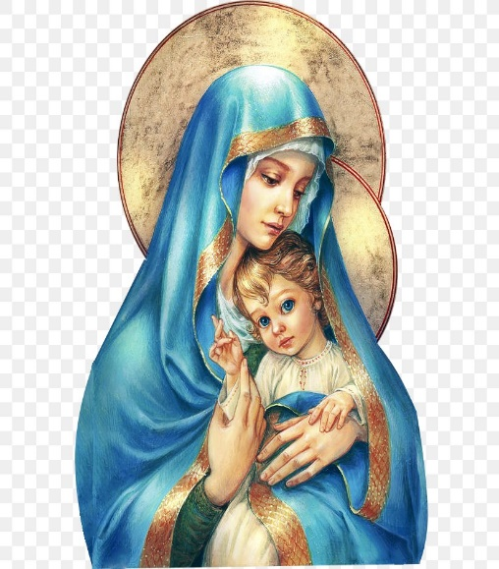
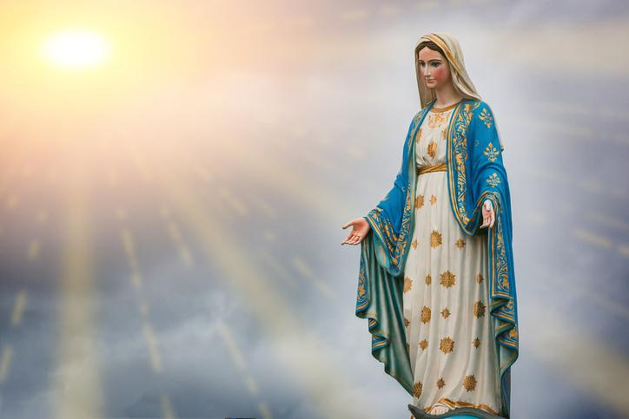
Hail Mary, Full of Grace
The Lord is with Thee
Blessed are Thou amongst women
And Blessed is the fruit of Thy womb, Jesus
Holy Mary , Mother of God
Pray for us sinners
Now and in the hour of our death
Amen

Slide 4
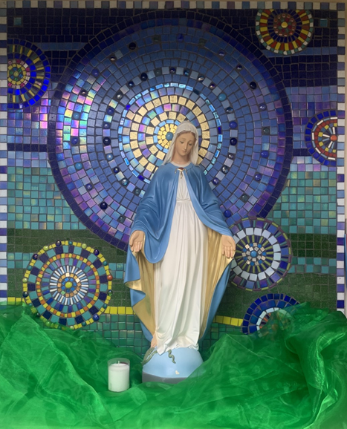
St Mary’s School Prayer
O Holy Mary,
Mother and Patron of our school,
Turn your eyes of mercy towards us,
that we may love God
With all our hearts!
May we imitate the tenderness
of your Son, Jesus,
showing love and respect
For each person
and ourselves as children of God.
Guided by the Holy Spirit,
May we create the school,
where Mercy and Compassion
Is the centre of our lives.
Amen

Slide 5
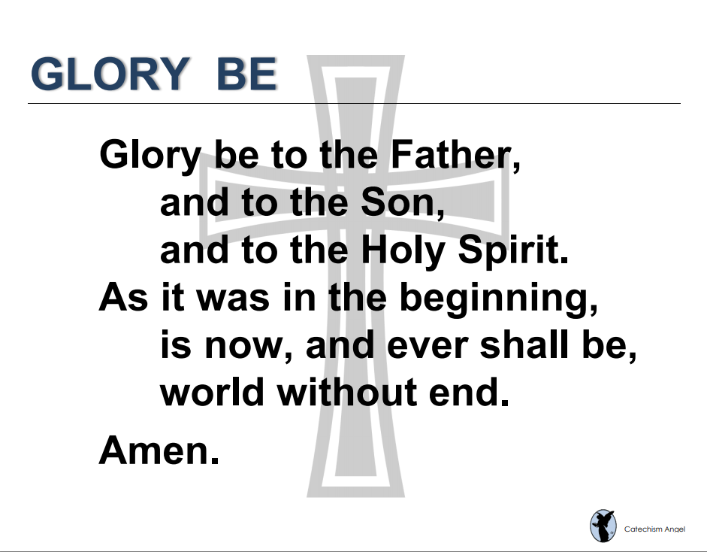

Slide 6
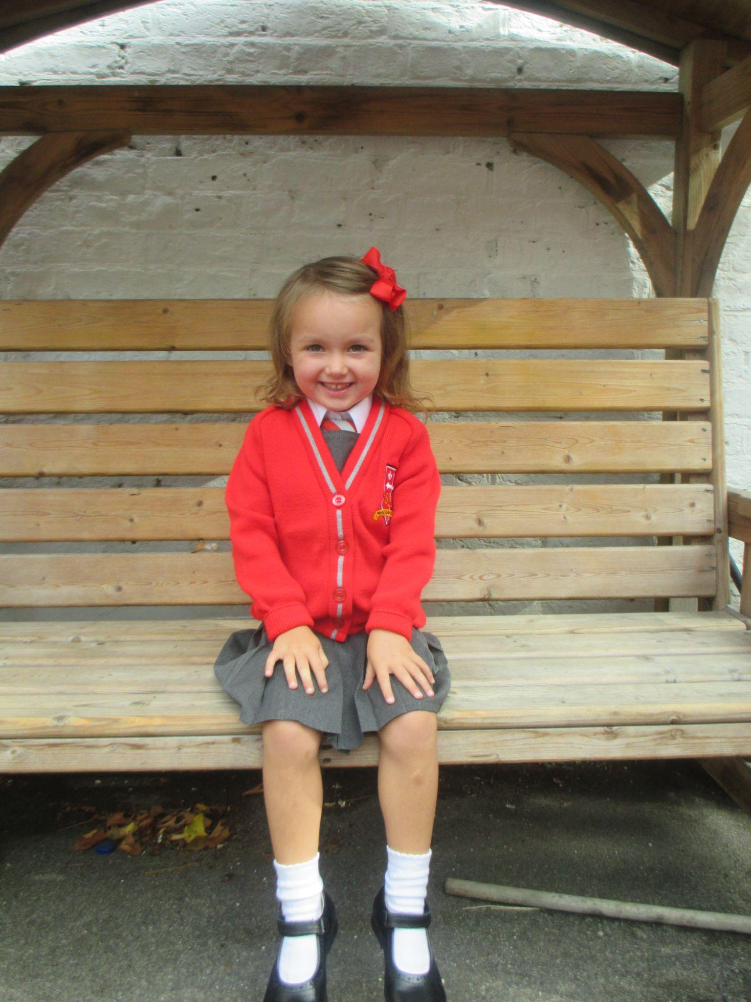
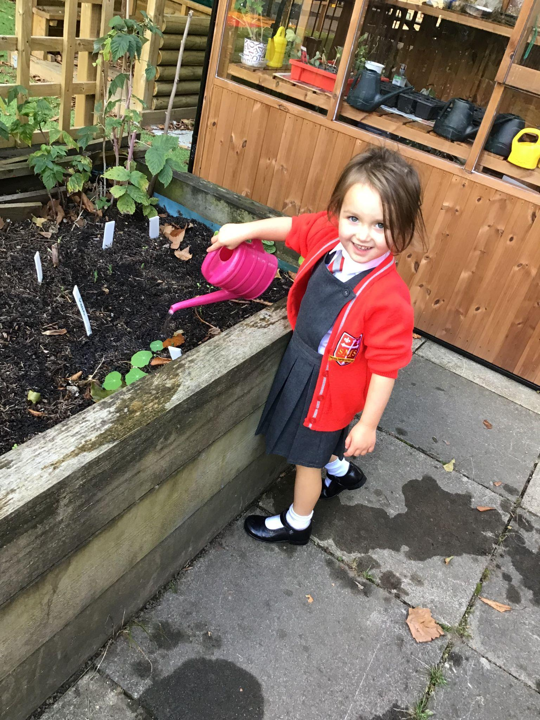
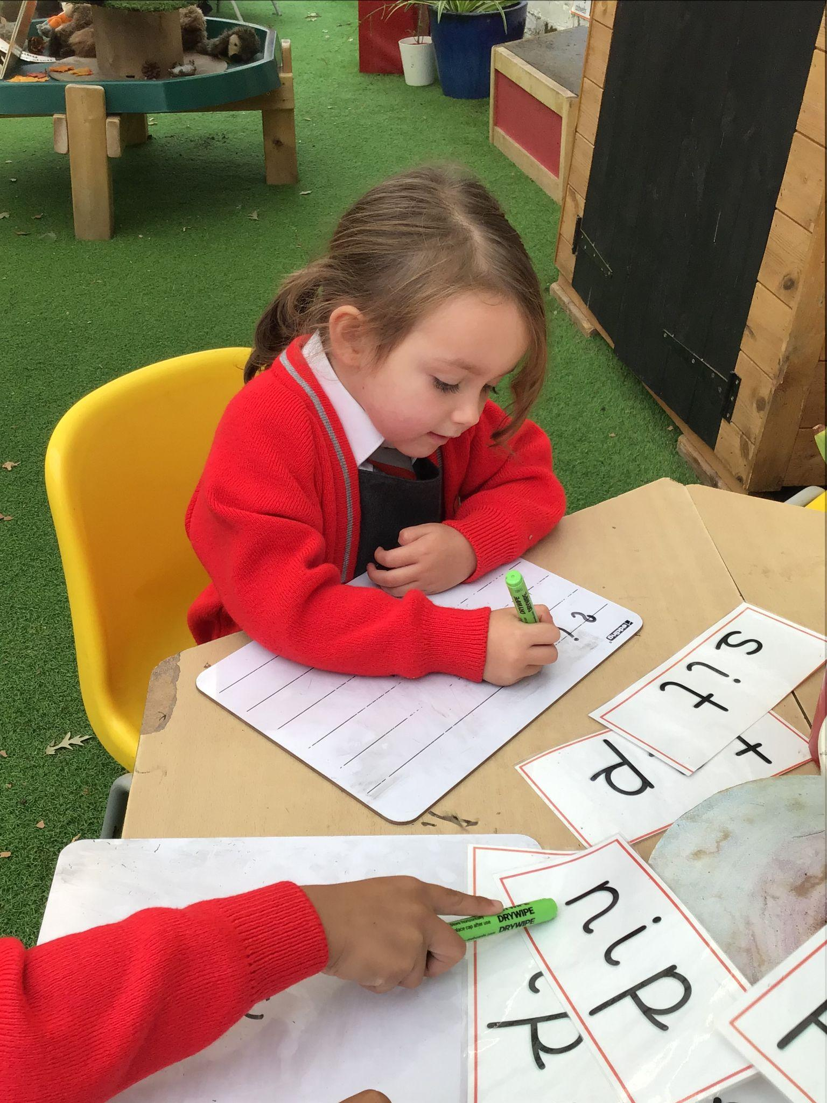
EYFS
Reception
For having a fabulous week and beginning to learn her lines for the Nativity and speak with much more confidence.
Miss Barker

Slide 7
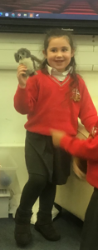
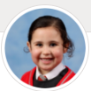
Year 1
For a fantastic week, showing her really good progress in doing the right thing and a good attitude to learning.

Slide 8
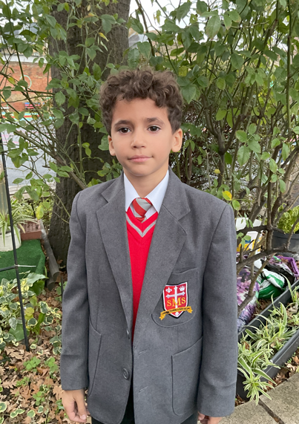
Year 2
For being a tolerant friend and taking responsibility for his learning.
Miss Sweet

Slide 9
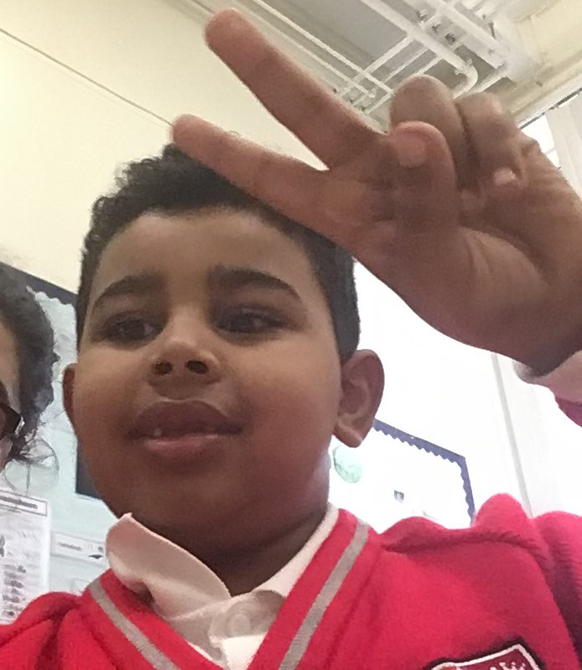
Year 3
For having a superb week in terms of effort and work produced.
Mr. Larke

Slide 10
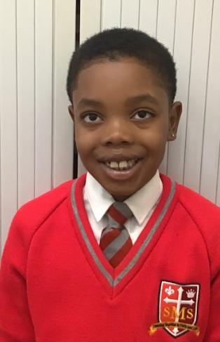
Year 3
For taking responsibility for his learning.
Mr. Larke

Slide 11

Year 4
For consistently trying her hardest and wanting to stretch herself in all subjects, even when the going gets tough.
Mr Whear

Slide 12
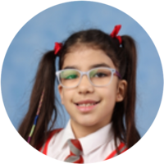
Year 5
For her resilience and perseverance in all her learning.
Mr. Carey

Slide 13
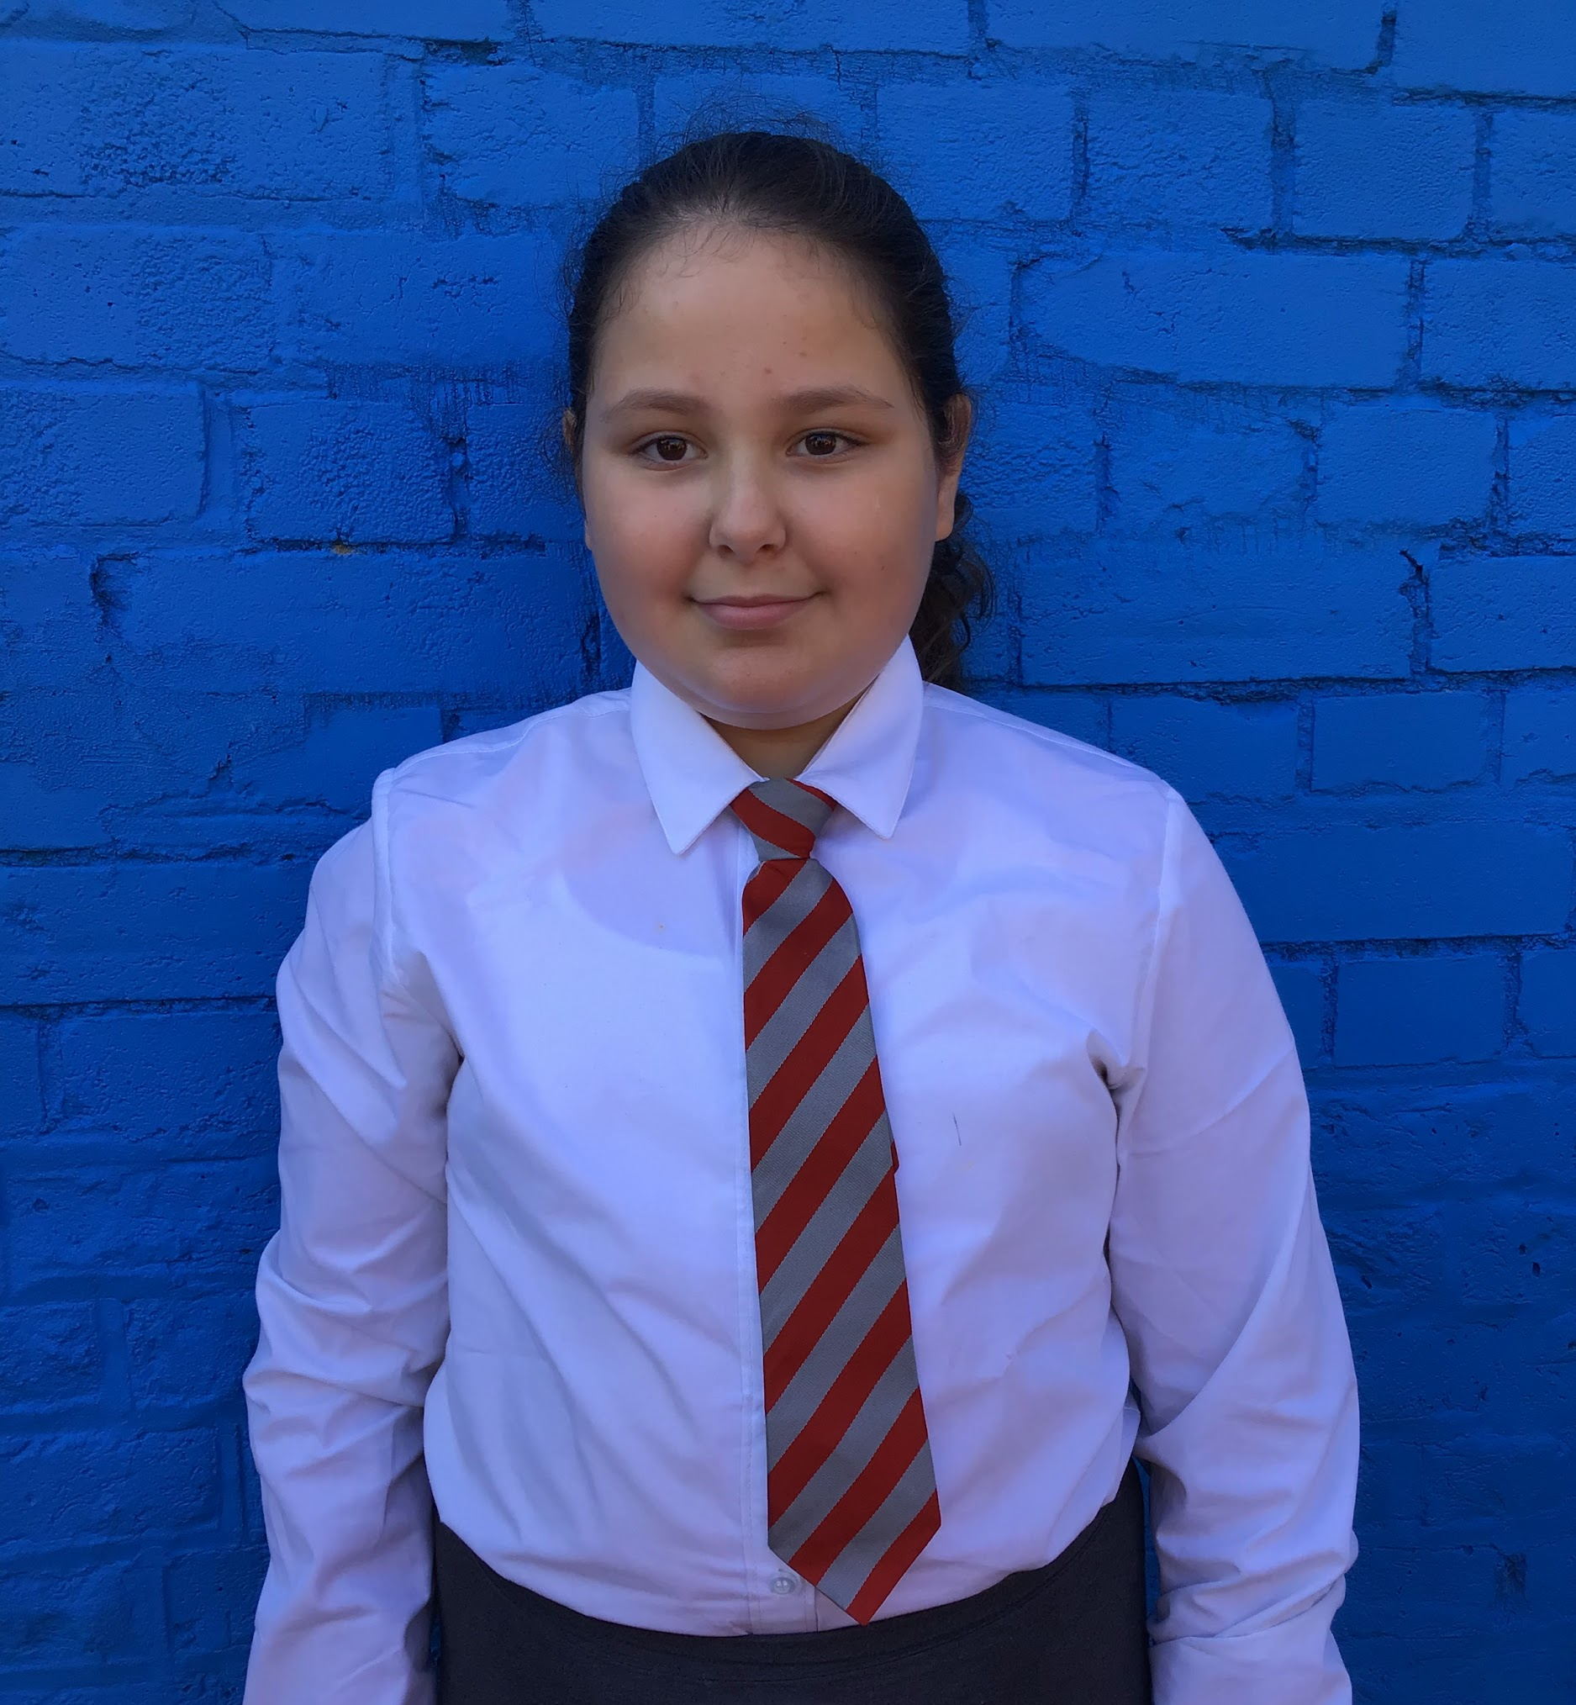
Year 6
Layla has been exemplary this week. Her attitude for learning is a standout strength and her behaviour is consistently improving.
Mr Cherfi & Mr Quinlan

Slide 14



Star Readers
Y1 - Joshua
Y2 - Lexi
Y3 - Double next week
Y4 - Rakeb
Y5 - Nevaeh
Y6 - N/A

Slide 15
Whole School
Star of the Week
Friday 28th November 2025

