Slide 1



Whole School
Star of the Week
Friday 2nd October, 2026

Slide 2
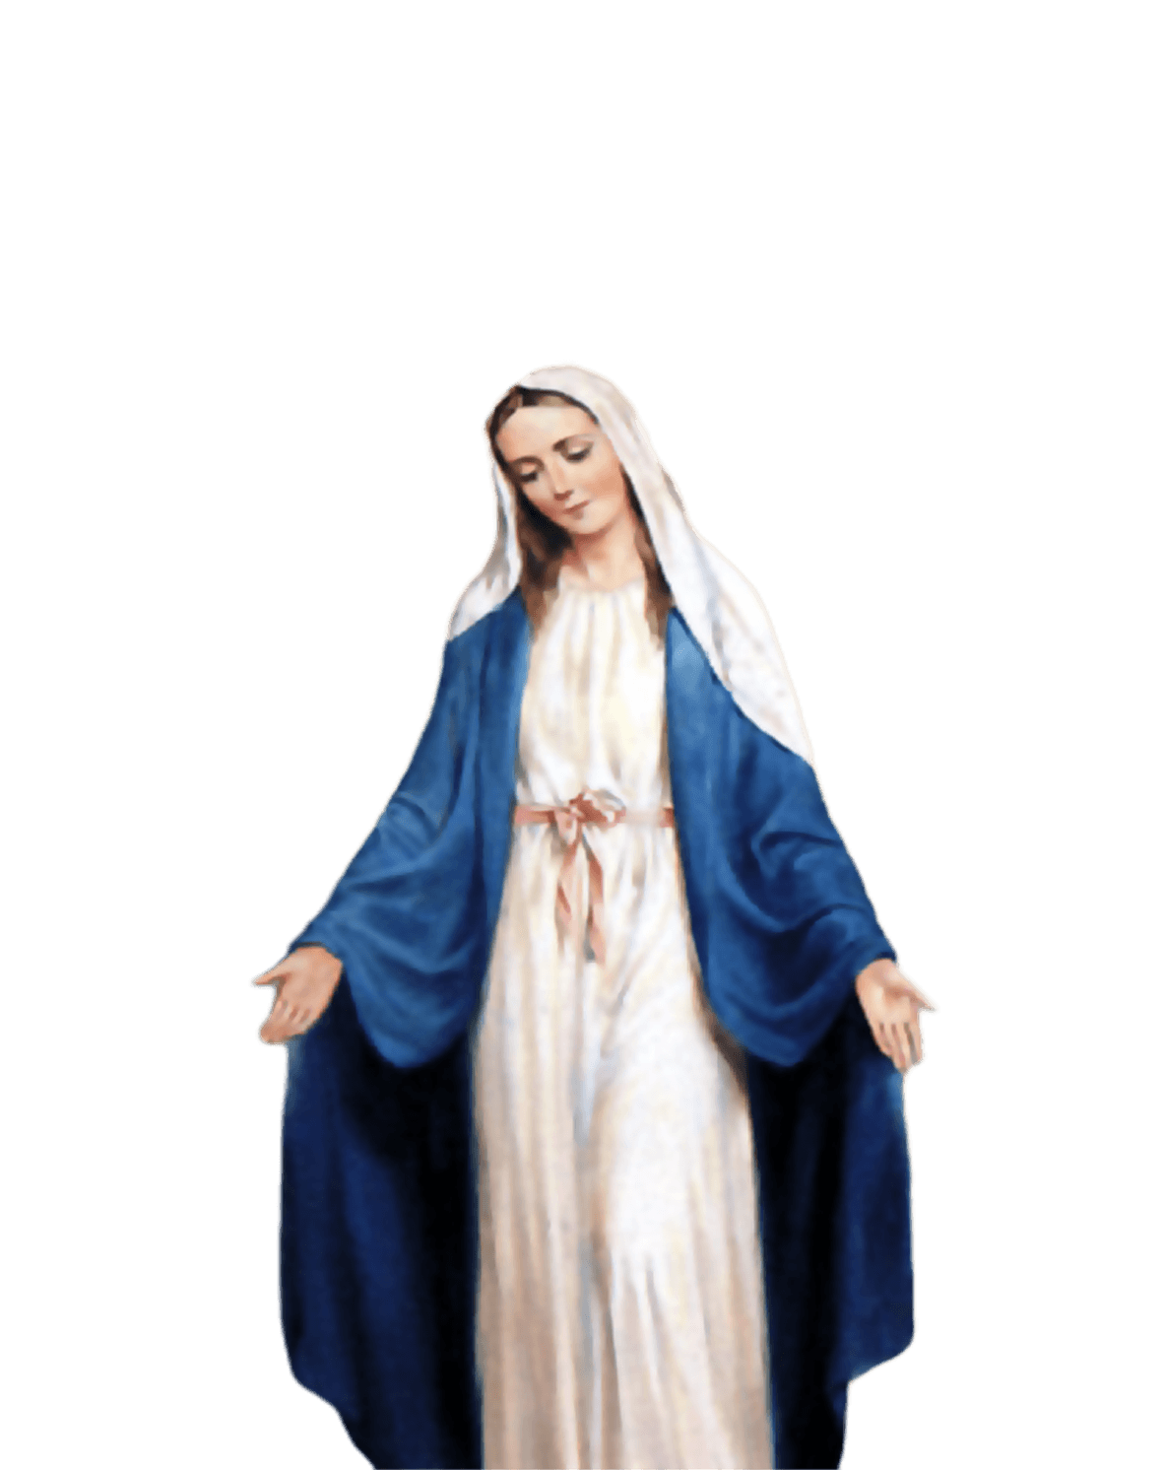
ST MARY’S SCHOOL PRAYER
O Holy Mary,
Mother and Patron of our school,
Turn your eyes of mercy towards us,
that we may love God
With all our hearts!
May we imitate the tenderness
of your Son, Jesus,
showing love and respect
For each person
and ourselves as children of God.
Guided by the Holy Spirit,
May we create the school,
where Mercy and Compassion
Is the centre of our lives.
Amen

Slide 3
EYFS
Micaela
For her effort in learning and being a role model to all her peers and new children starting our school.
Miss Barker

Slide 4
Year 1
Vanessa
Huge congratulations to Vanessa for being a superstar role model this week! She is a fantastic listener who always follows our rules. Vanessa works incredibly hard, gets right on with her tasks, and shows everyone how to be a wonderful friend. Keep shining!
Miss Sweet and Mrs Bakali

Slide 5
Year 3
Pippa
For setting such a great example to her peers! Always helping others, being in the right place at the right time, and completing work to the best of her ability.
Miss Flashman

Slide 6
Year 4
Kadie
For her attentive listening and diligence in her independent work.
Mr Whear

Slide 7
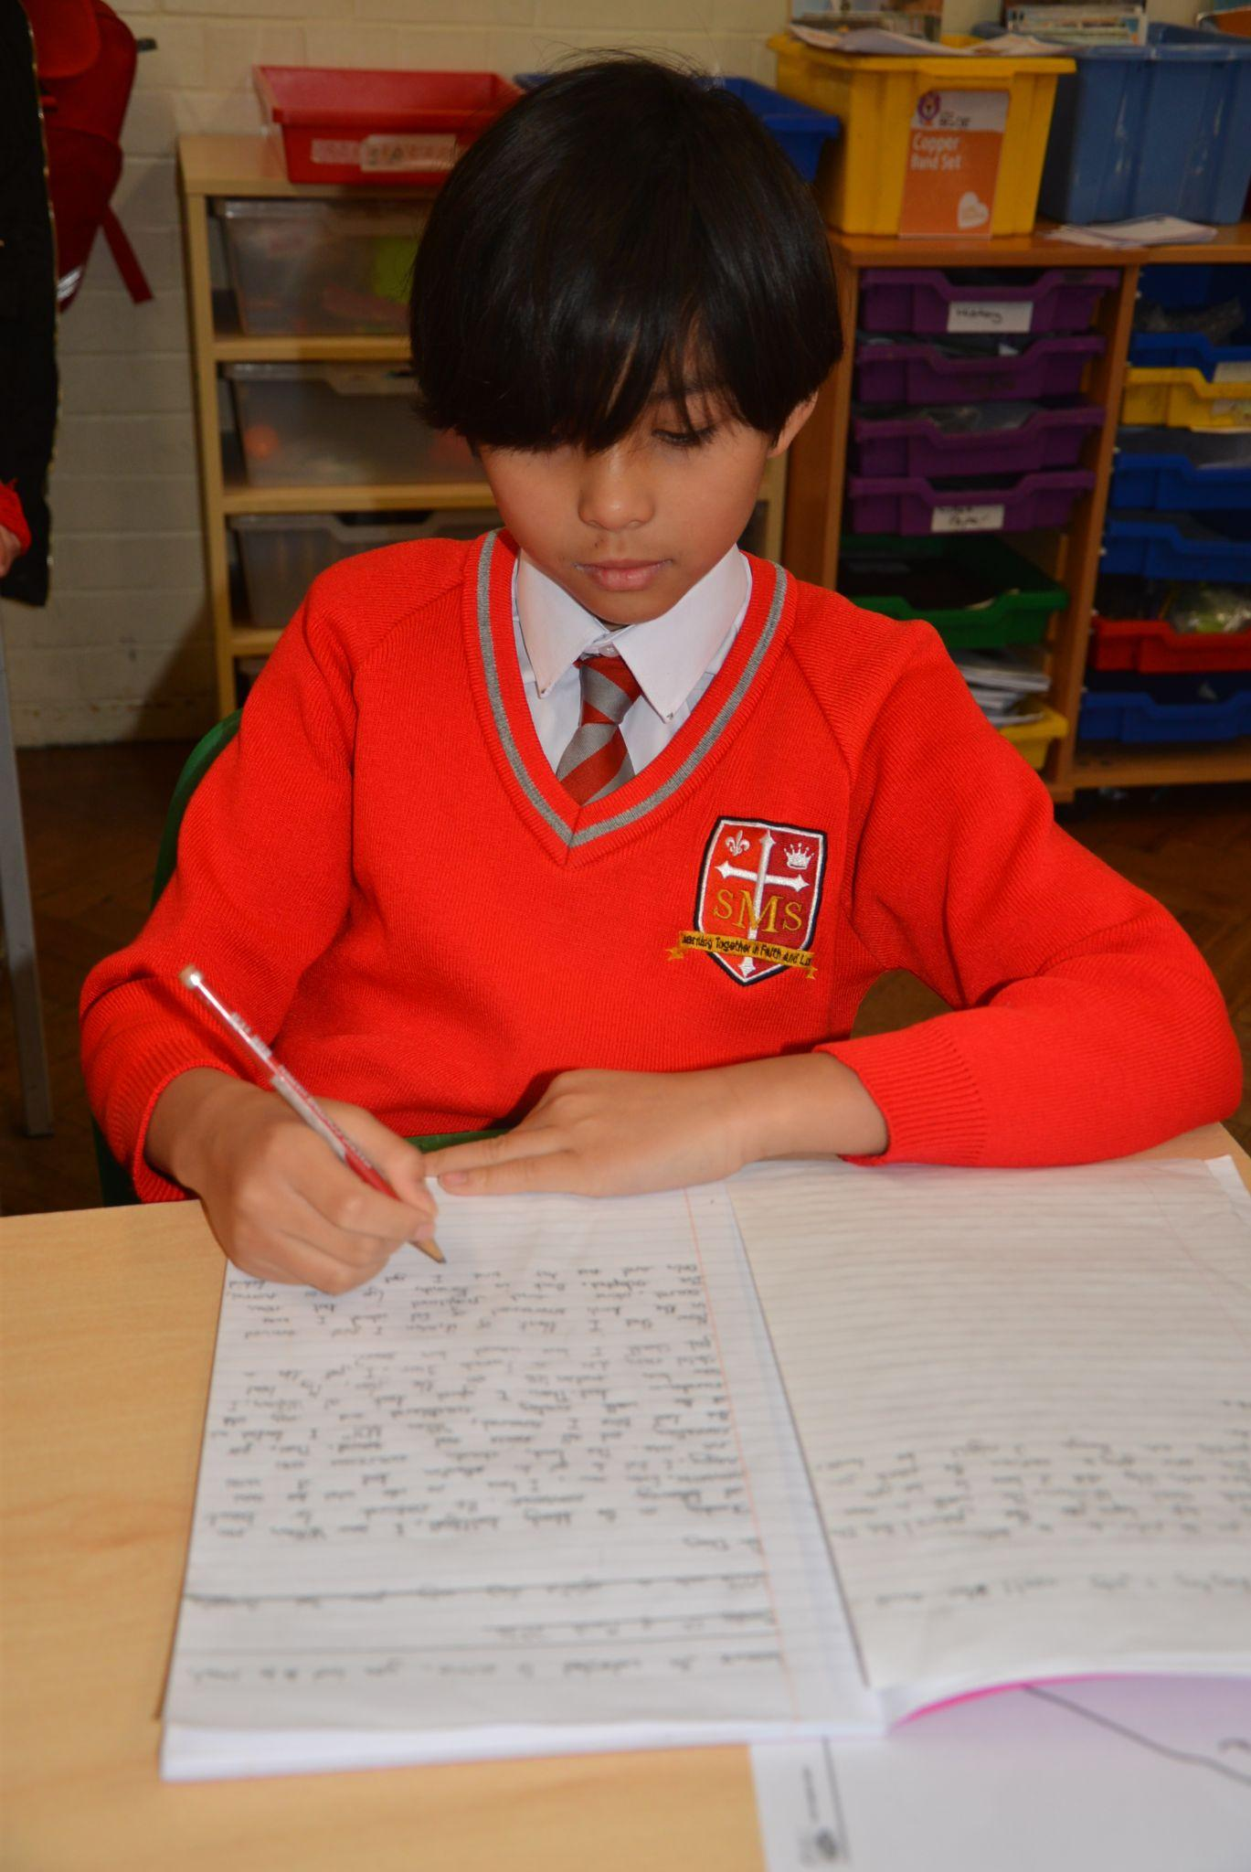
Year 5
Delilah
Fantastic work ethic, positive choices and excellent listening. She has also produced a wonderful Geography poster, third-person narrative and demonstrated a great understanding of the column method in Maths.
Miss O’Mara

Slide 8
Year 6
Elly & Nevaeh
For excellent application in class and becoming increasingly independent learners. Both children contribute immensely to lessons and participate keenly.
Mr Cherfi

Slide 9



STAR READER
Y1/2 - Sienna
Y3 - Albie
Y4 - Luna
Y5 - Harry
Y6 - Alessia

Slide 10
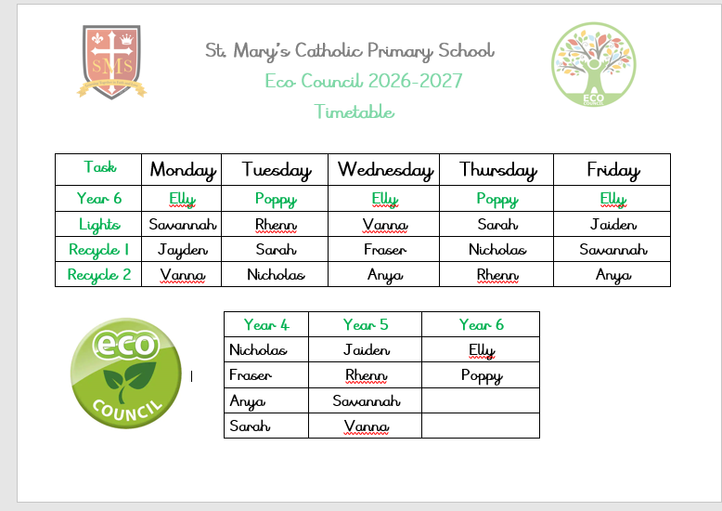

Slide 11
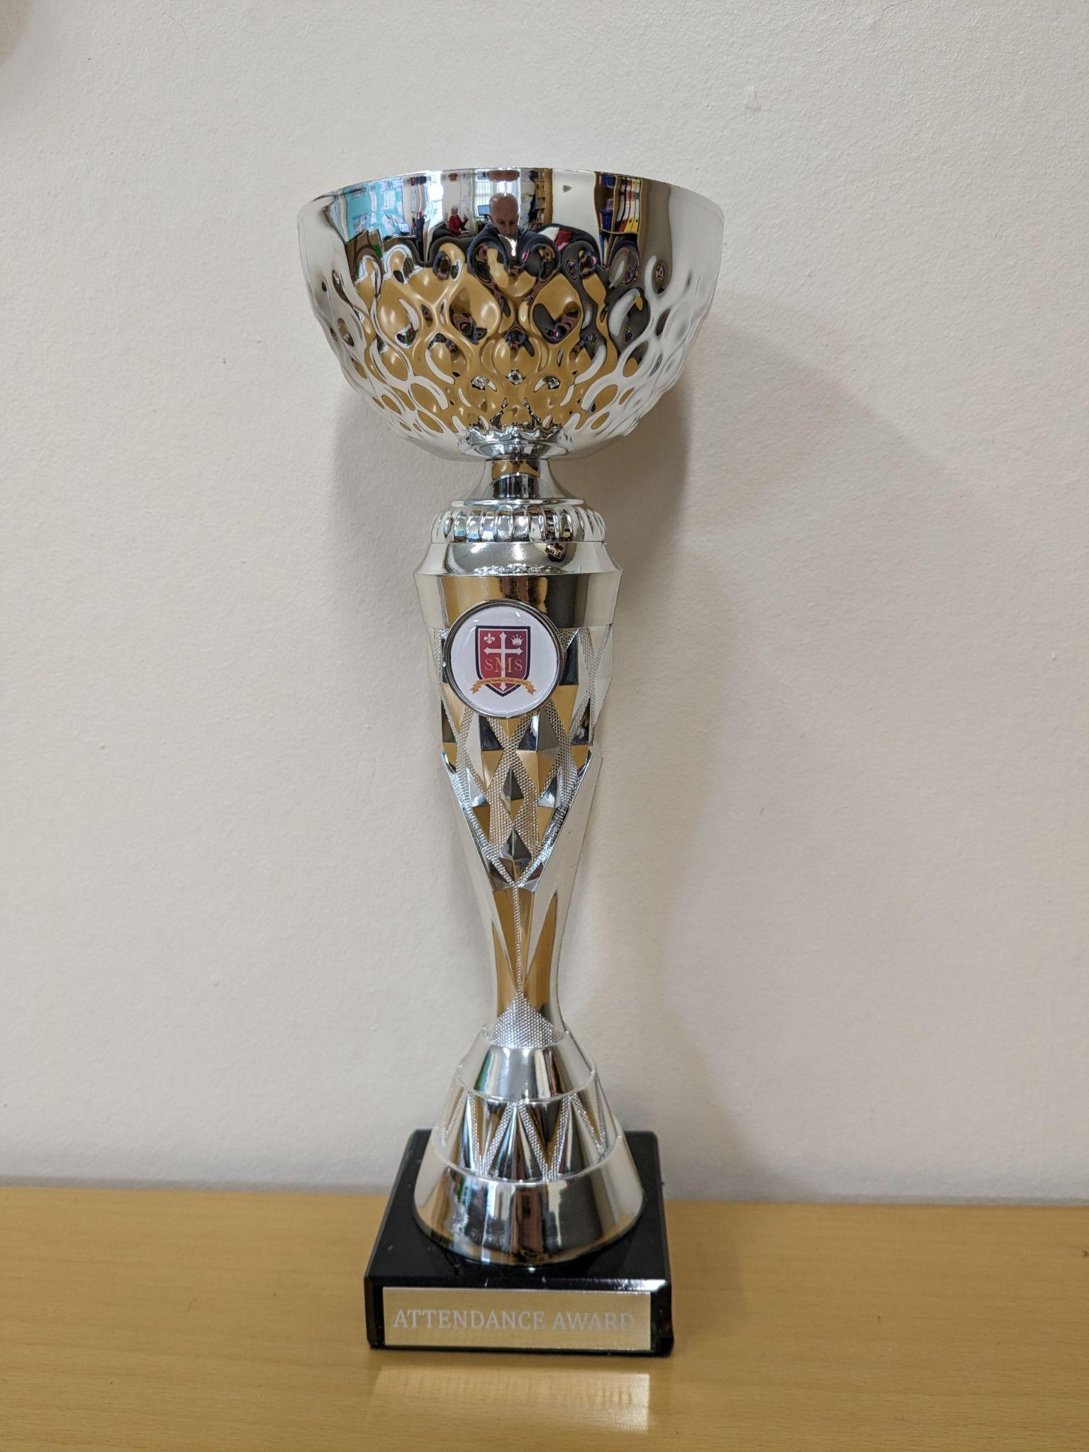
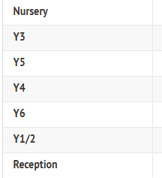
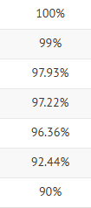
Attendance Weekly Leader:

Slide 12
Attendance Weekly Leader:
Attendance Winners for this week:
Nursery
With 100% attendance

Slide 13

Savannah - Year 5
Melaysia - Year 2

Slide 14
Whole School
Star of the Week
Friday 2nd October 2026

Slide 15

Gospel
Matthew 18:21-35
‘I do not say to you seven times, but seventy times seven.’

Slide 16
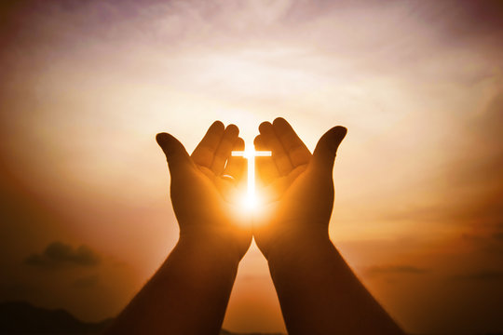
Let us pray.
"Dear God, thank you for loving us and forgiving us when we make mistakes. Forgiveness can be very hard for us to do on our own. Please give us big hearts full of your love, and help us to choose to forgive others just like you forgive us. Amen."

