Slide 1

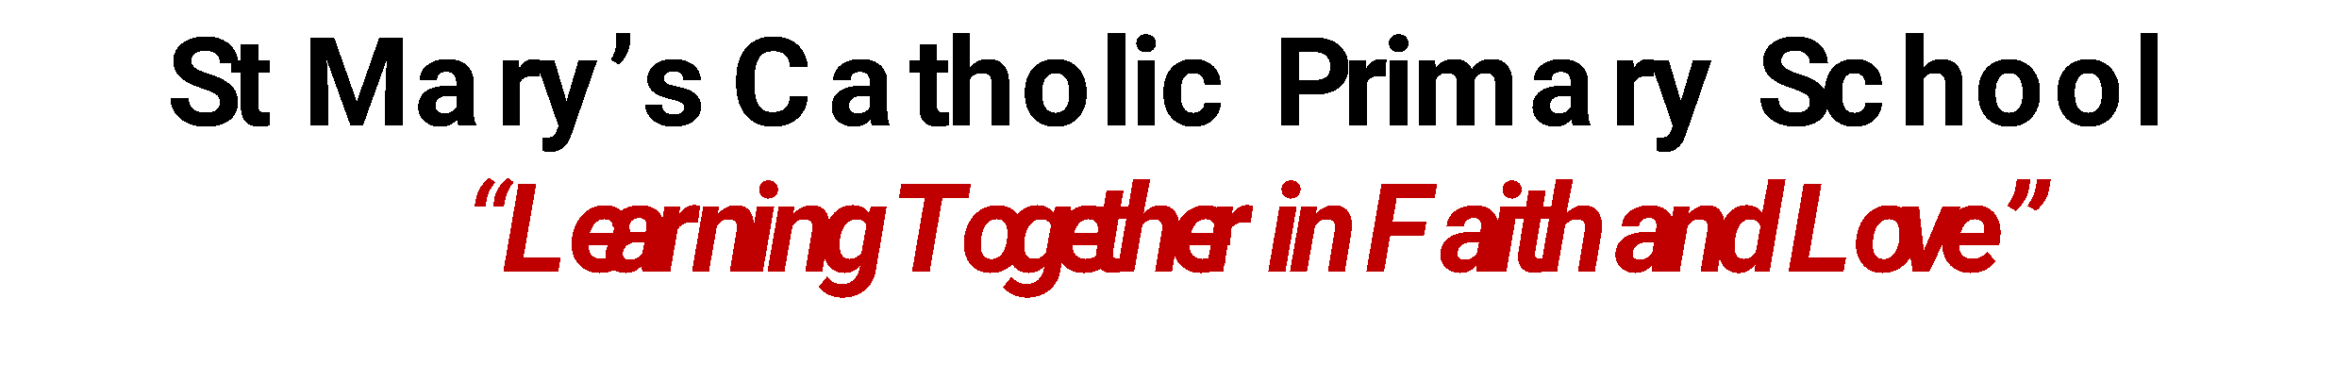


Whole School
Star of the Week
Friday 3rd October 2025

Slide 2

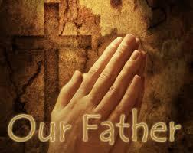
Our Father who art in Heaven
Hallowed be Thy Name
Thy Kingdom come
Thy will be done on Earth as it is in Heaven
Give us this day our daily bread
And forgive us our trespasses
As we forgive those who trespass against us
And lead us not into temptation
But deliver us from evil
Amen

Slide 3
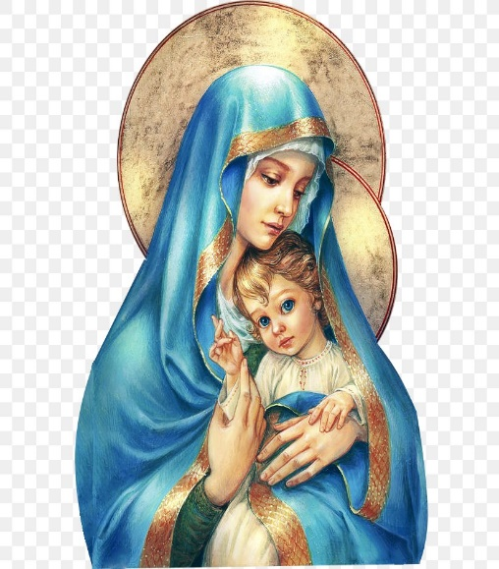
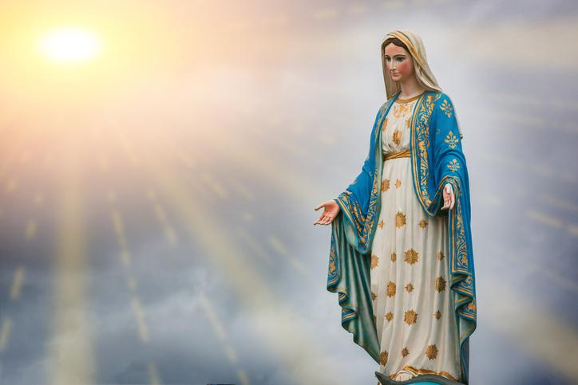
Hail Mary, Full of Grace
The Lord is with Thee
Blessed are Thou amongst women
And Blessed is the fruit of Thy womb, Jesus
Holy Mary , Mother of God
Pray for us sinners
Now and in the hour of our death
Amen

Slide 4
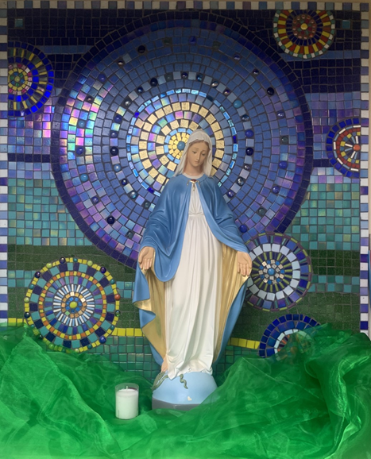
St Mary’s School Prayer
O Holy Mary,
Mother and Patron of our school,
Turn your eyes of mercy towards us,
that we may love God
With all our hearts!
May we imitate the tenderness
of your Son, Jesus,
showing love and respect
For each person
and ourselves as children of God.
Guided by the Holy Spirit,
May we create the school,
where Mercy and Compassion
Is the centre of our lives.
Amen

Slide 5
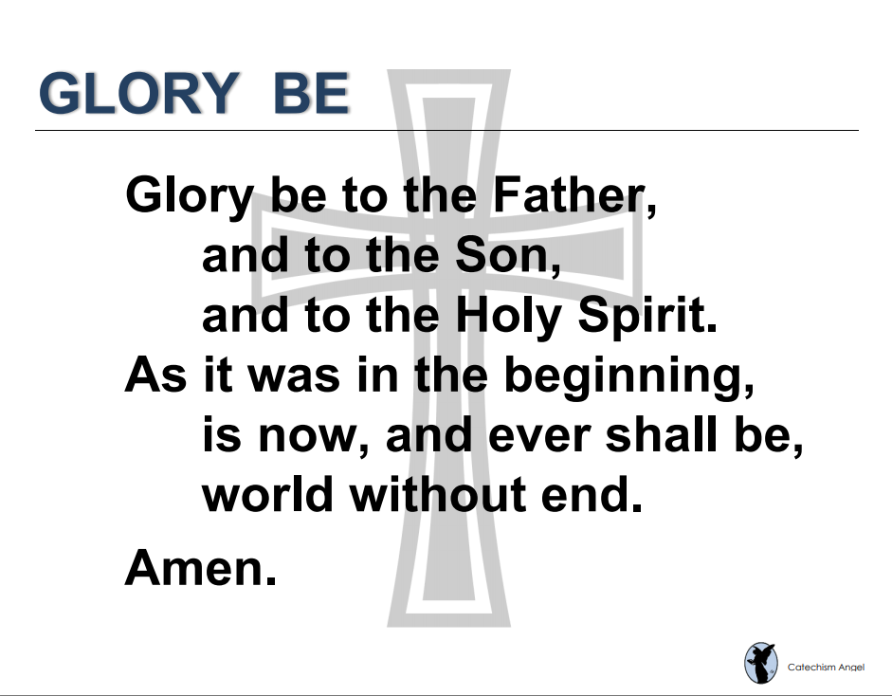

Slide 6
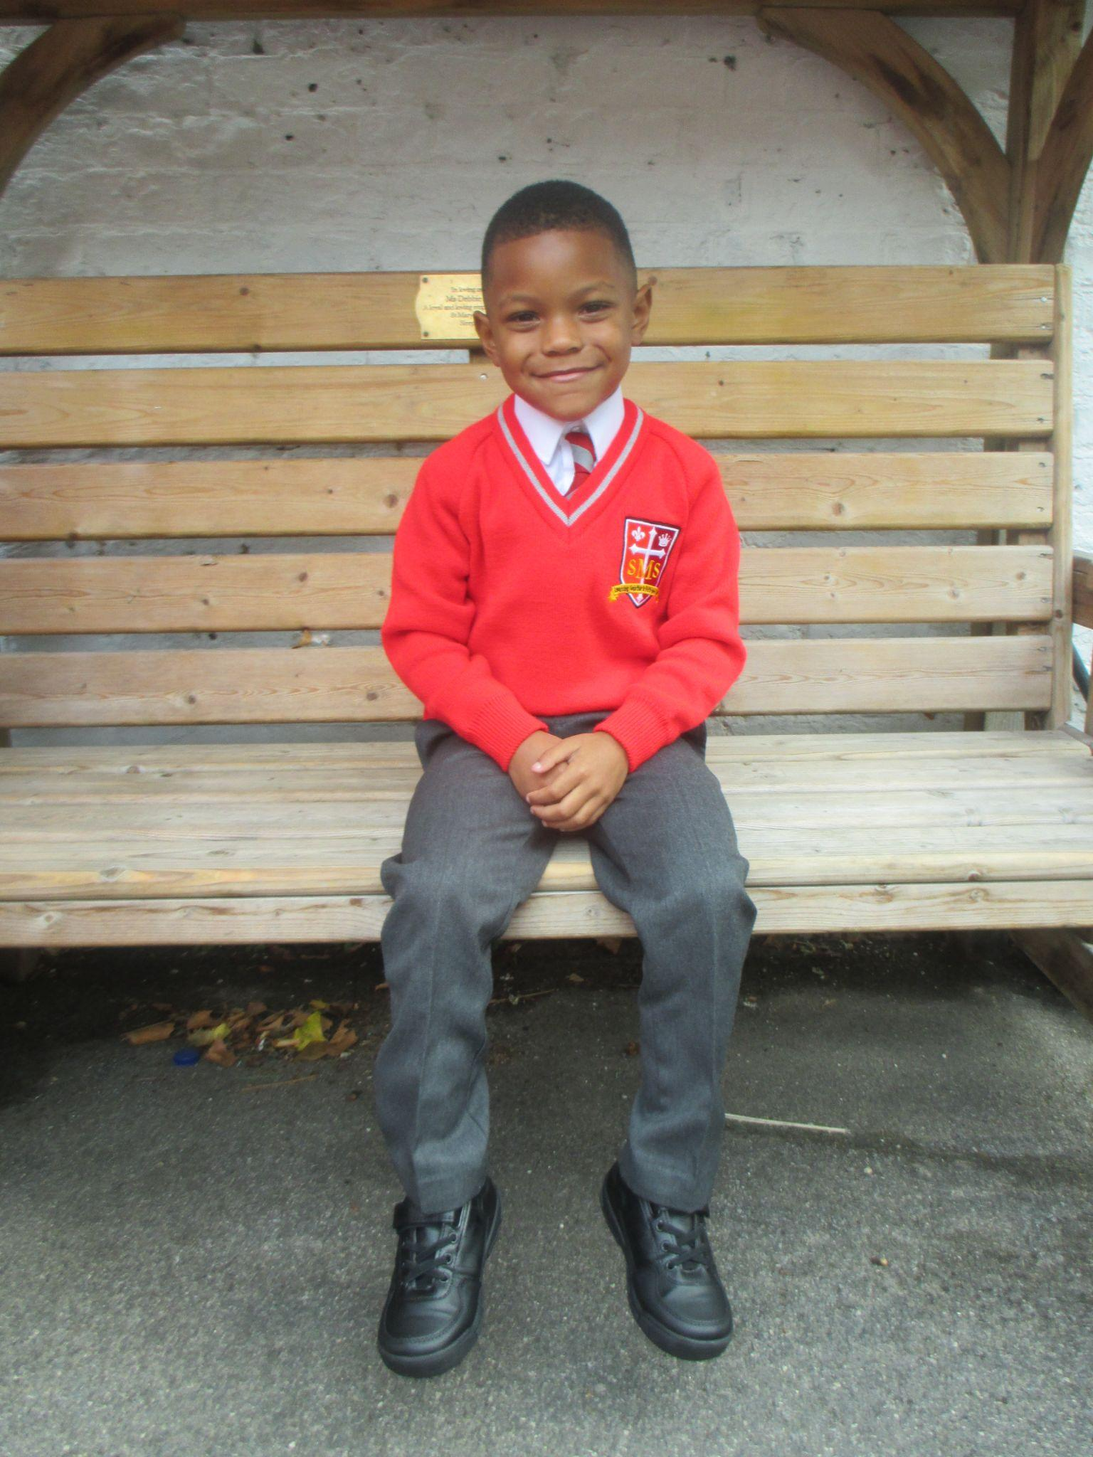
EYFS
Reception
For his amazing start to Reception learning so far and huge enthusiasm to Literacy lessons.
Miss Barker

Slide 7
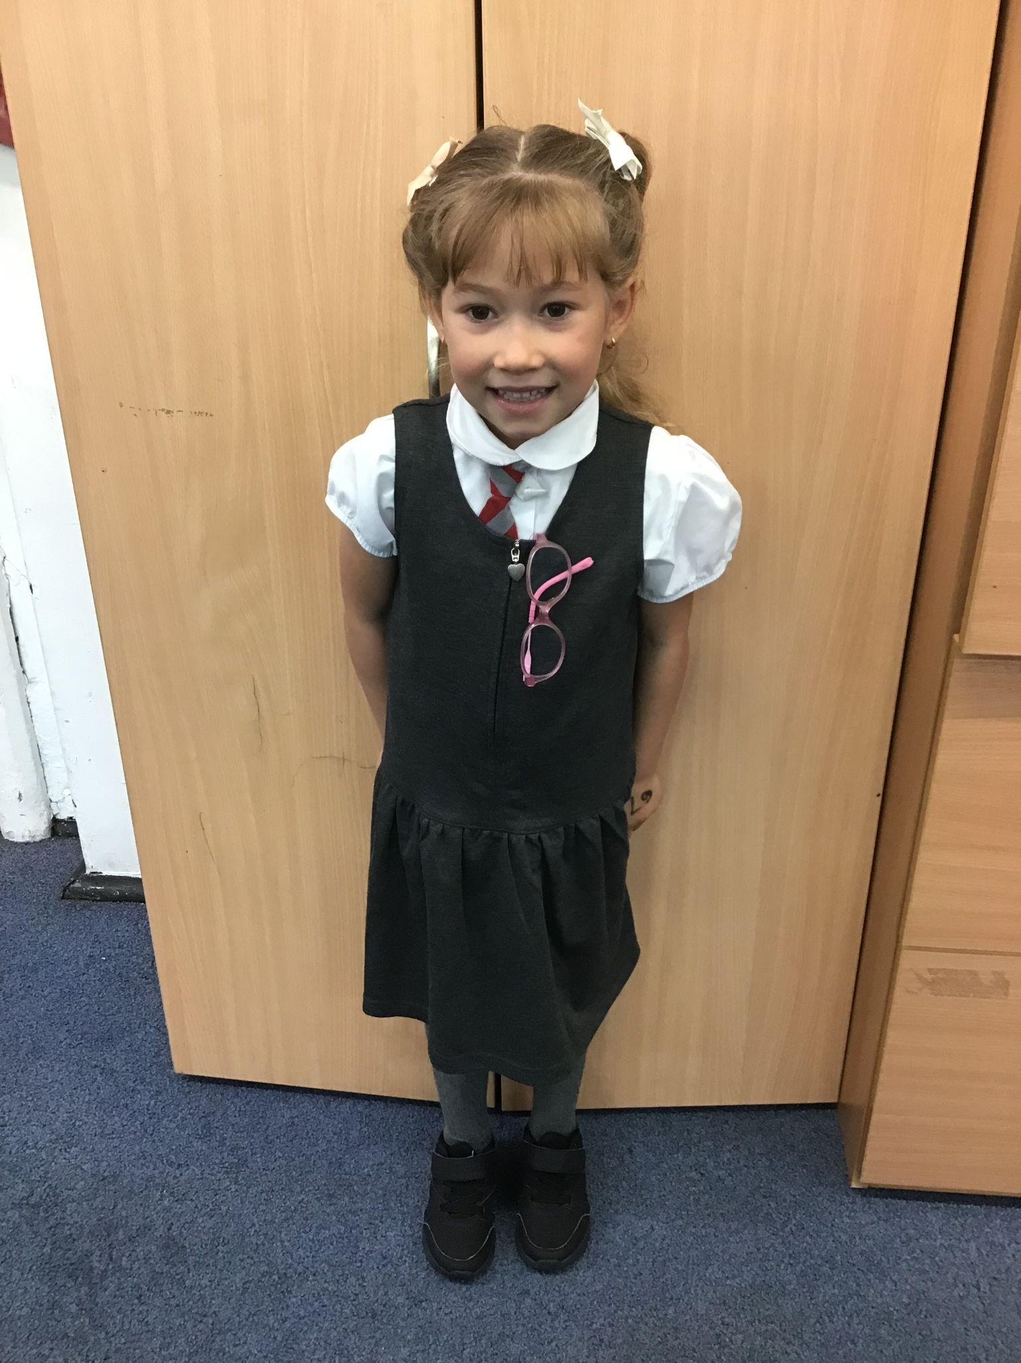
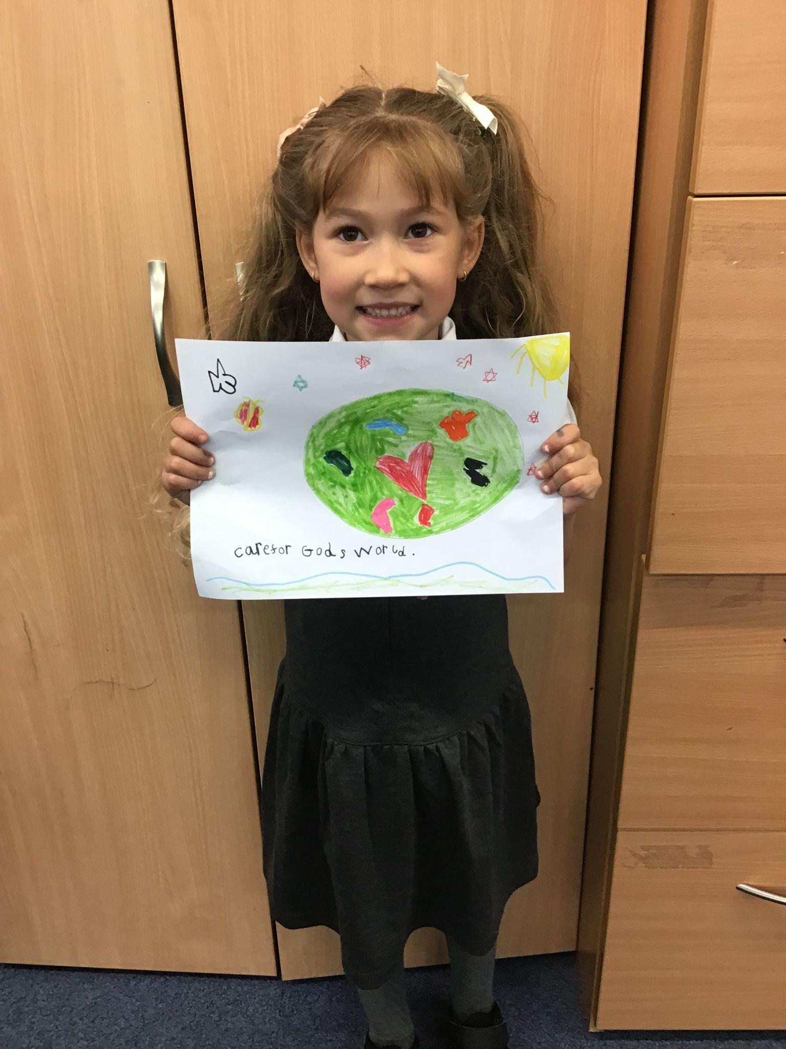
Year 1
For always trying her best to be a good role model and putting in effort into her writing.
Miss Begum

Slide 8
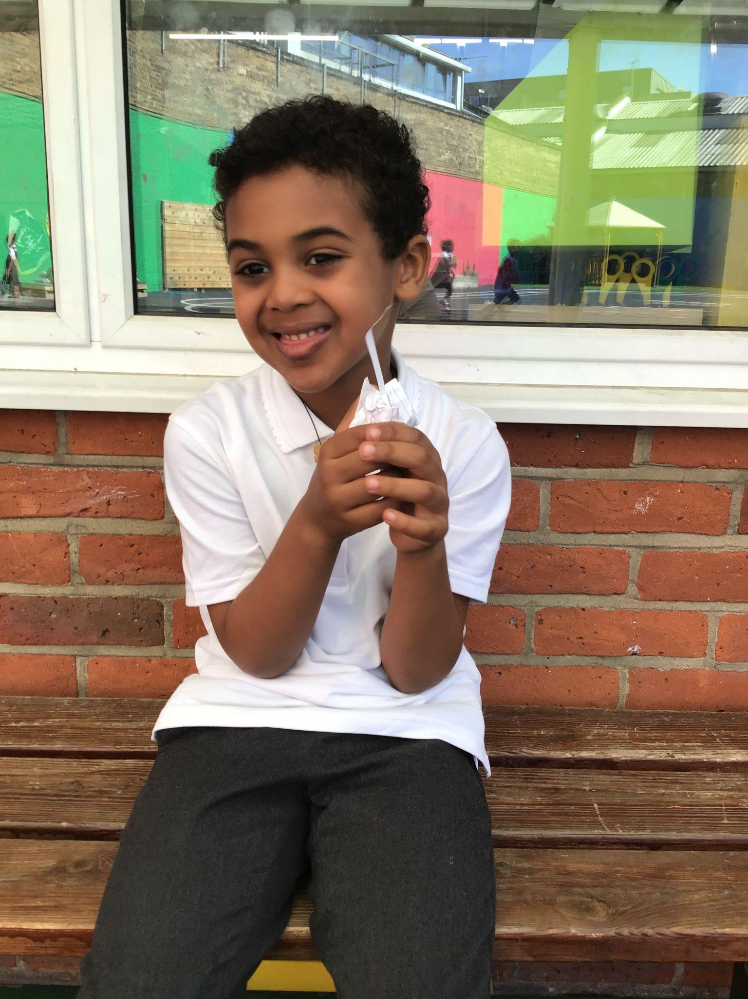
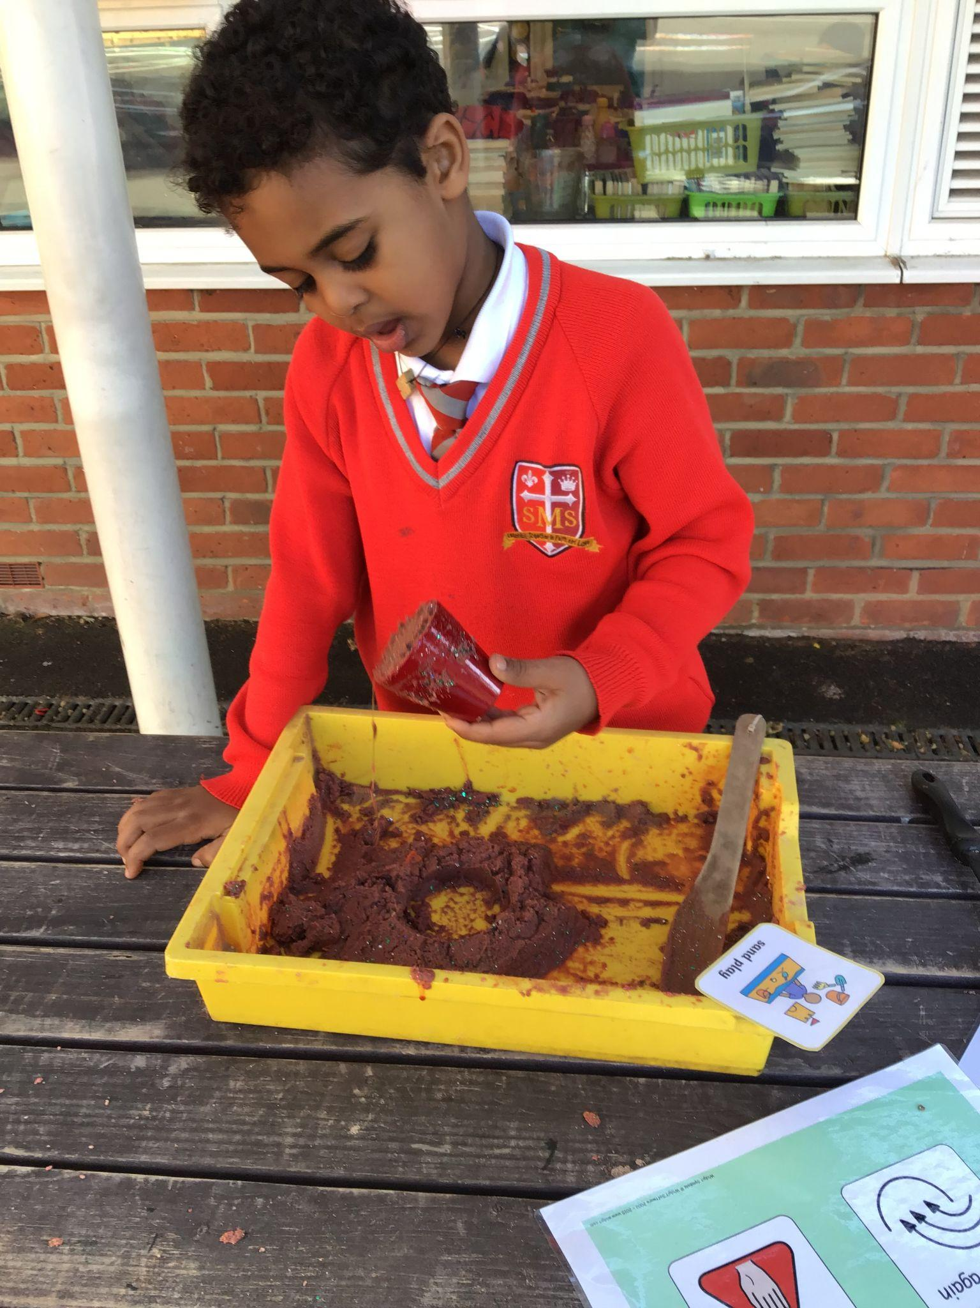
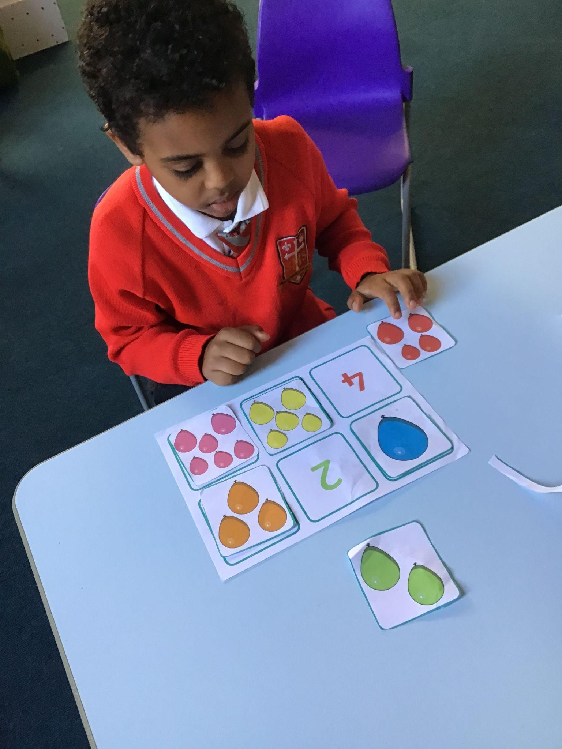
Year 2
For being a superstar in following his timetable and using his words!
Miss Sweet

Slide 9
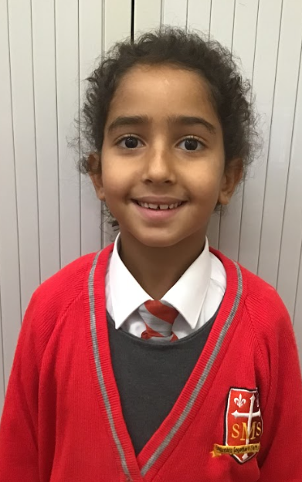
Year 3
For consistent, excellent effort in everything she does.
Mr. Larke

Slide 10
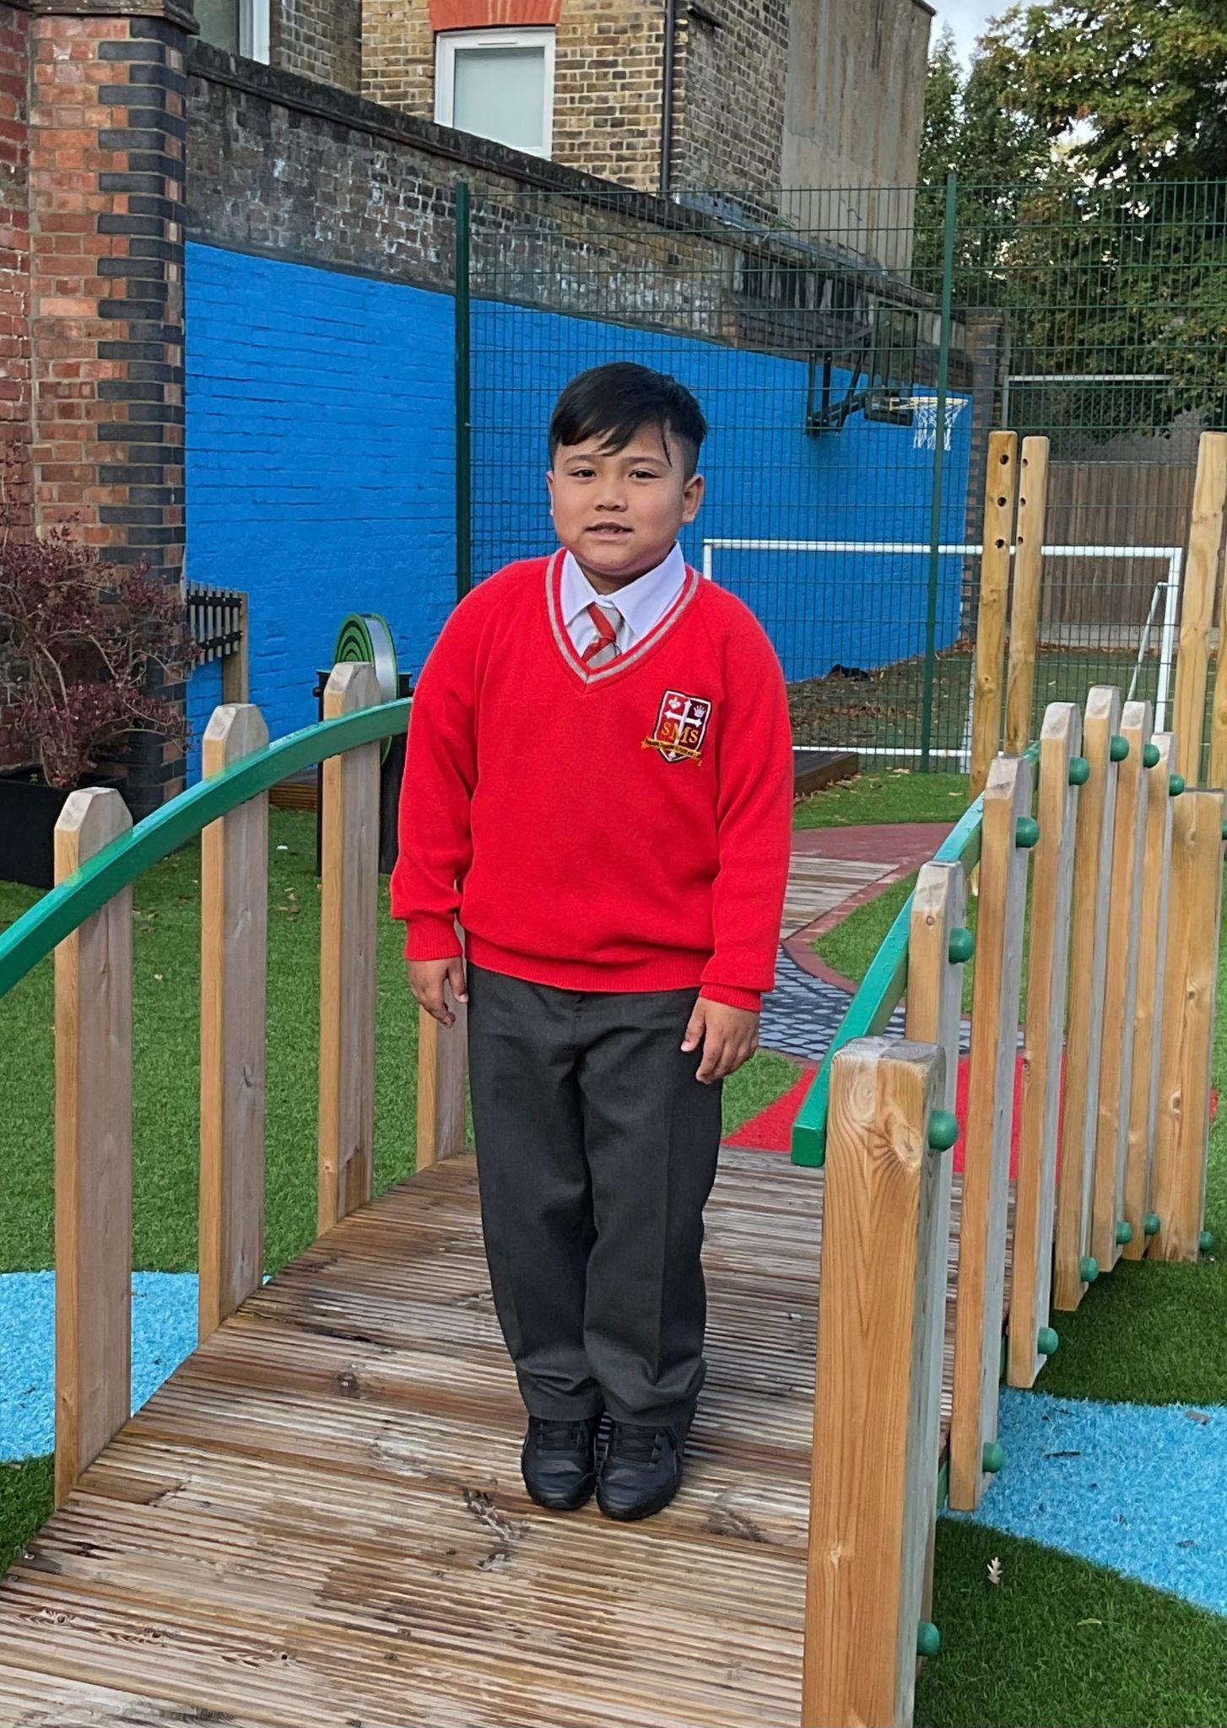
Year 4
For showing diligence, determination and not a little pizzazz in his learning!
Mr Whear

Slide 11
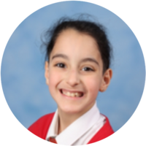
Year 5
For her hard work and determination in all her learning and seeking every opportunity to always make her learning even better! Well done Sofia.
Mr. Carey

Slide 12
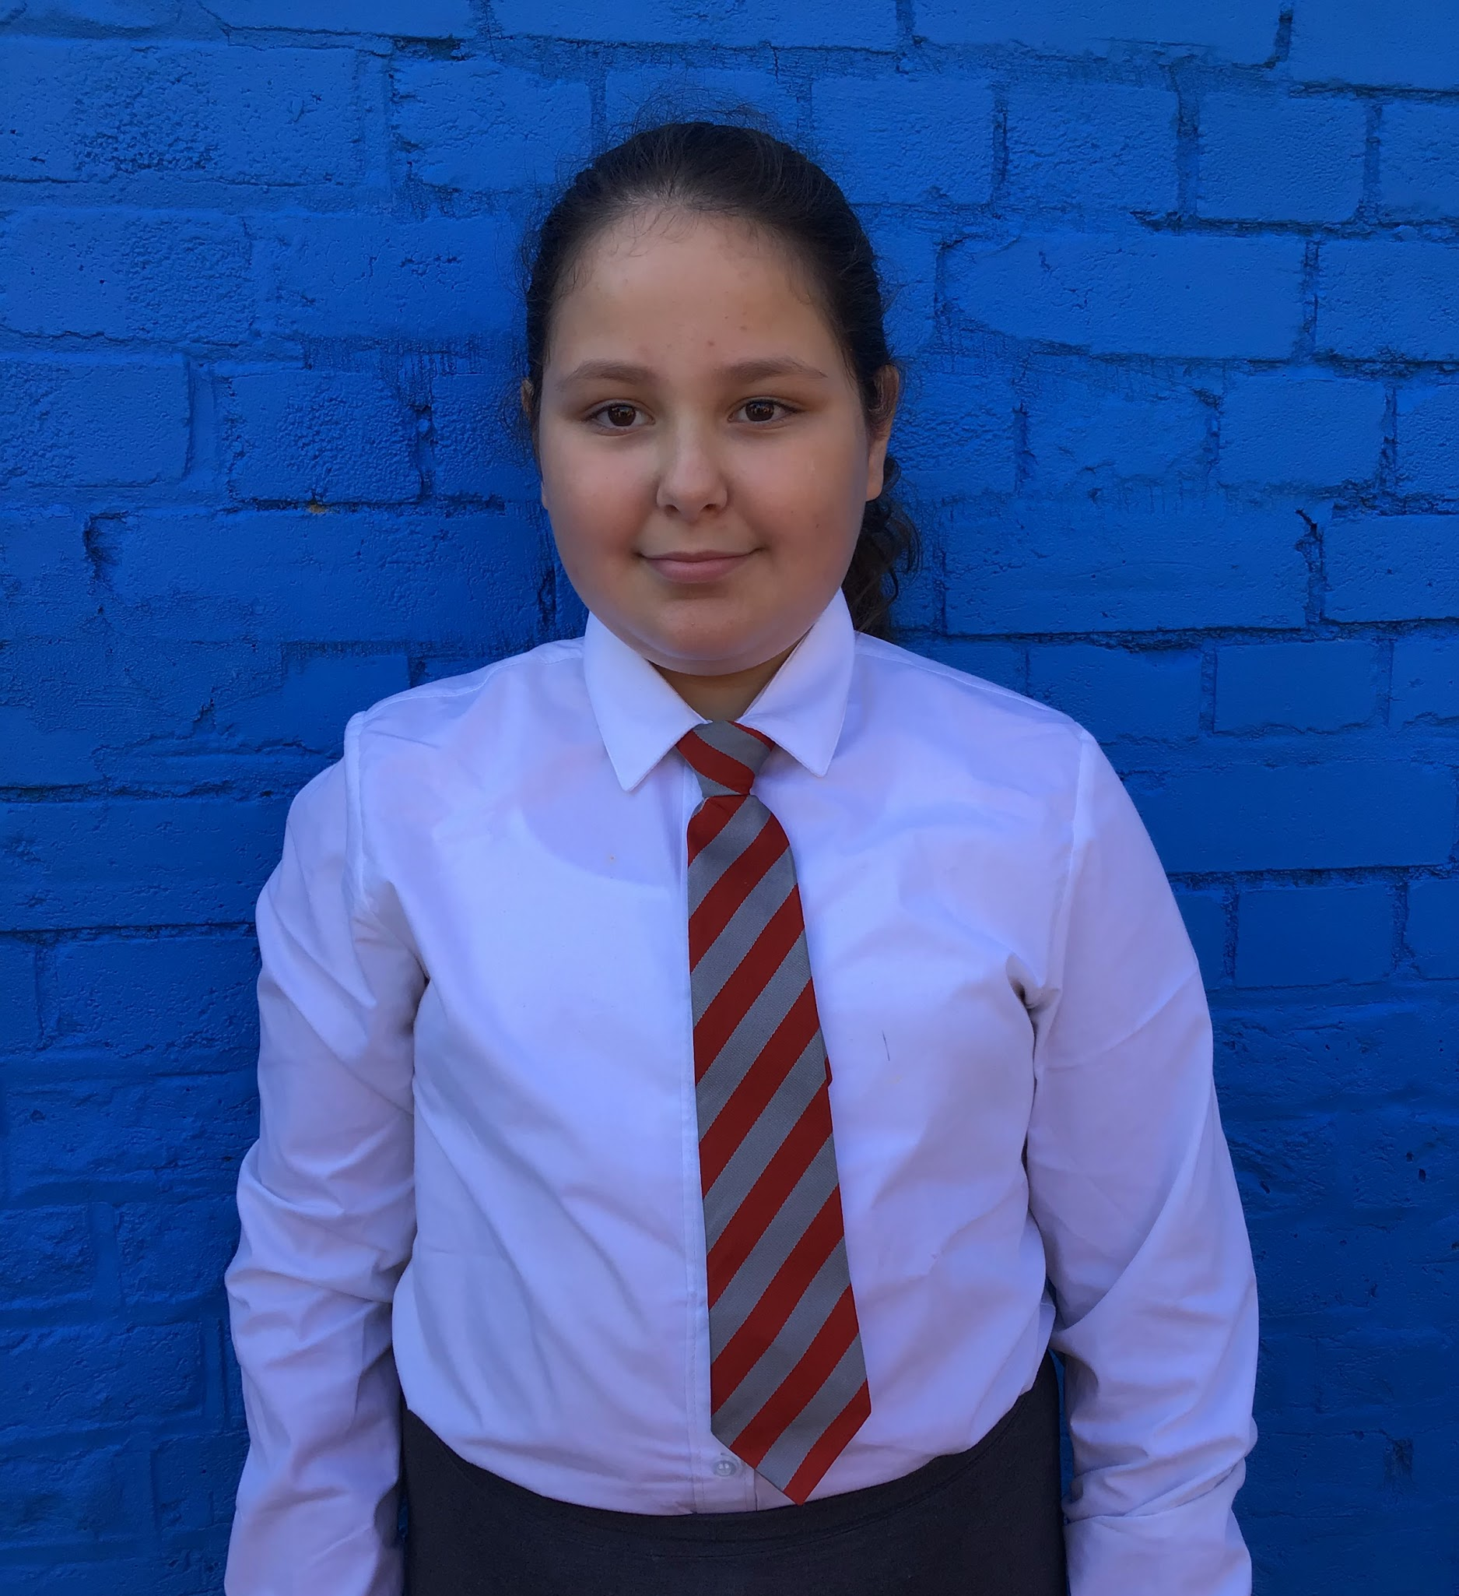
Year 6
For being a resilient and relentless learner. Layla has made exceptional progress and the pride she shows in this is beautiful.
Mr Cherfi & Mr Quinlan

Slide 13



Star Readers
Y1 - Jahmiel
Y2 - Jasmine
Y3 - Maria
Y4 - Ryan
Y5 - Cali
Y6 - Gideon

Slide 14

Kessiah - Y6
Savannah - Year 4
Melaysia - Y1

Slide 15
Whole School
Star of the Week
Friday 26th September 2025

