Slide 1
Whole School
Star of the Week
Friday 4th July 2025

Slide 2
Our Father who art in Heaven
Hallowed be Thy Name
Thy Kingdom come
Thy will be done on Earth as it is in Heaven
Give us this day our daily bread
And forgive us our trespasses
As we forgive those who trespass against us
And lead us not into temptation
But deliver us from evil
Amen

Slide 3
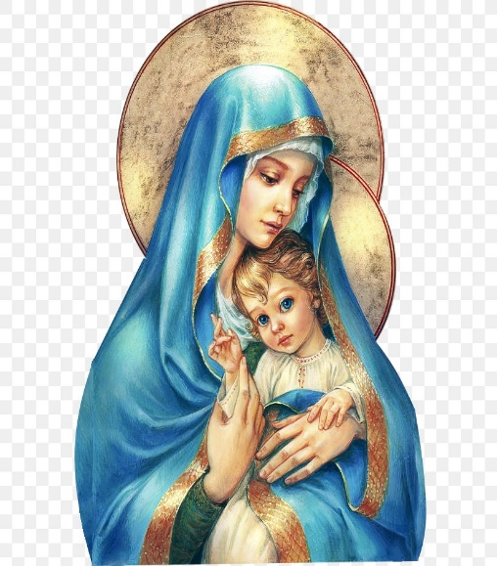
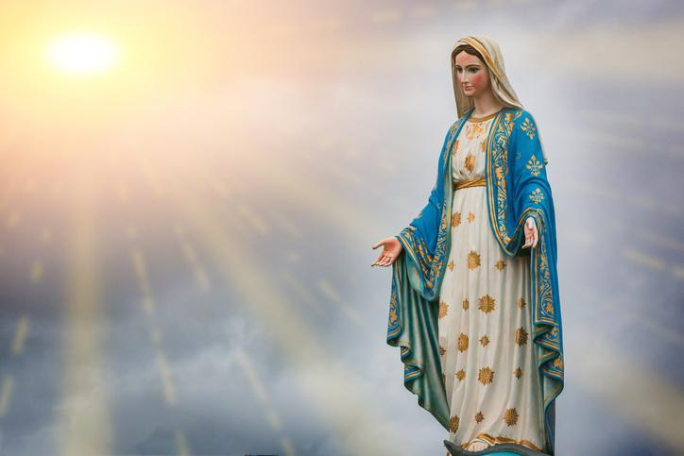
Hail Mary, Full of Grace
The Lord is with Thee
Blessed are Thou amongst women
And Blessed is the fruit of Thy womb, Jesus
Holy Mary , Mother of God
Pray for us sinners
Now and in the hour of our death
Amen

Slide 4
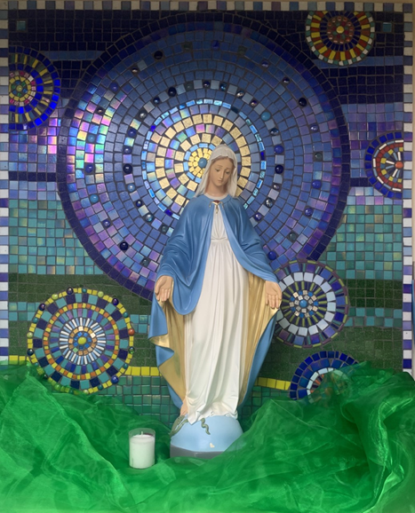
St Mary’s School Prayer
O Holy Mary,
Mother and Patron of our school,
Turn your eyes of mercy towards us,
that we may love God
With all our hearts!
May we imitate the tenderness
of your Son, Jesus,
showing love and respect
For each person
and ourselves as children of God.
Guided by the Holy Spirit,
May we create the school,
where Mercy and Compassion
Is the centre of our lives.
Amen

Slide 6
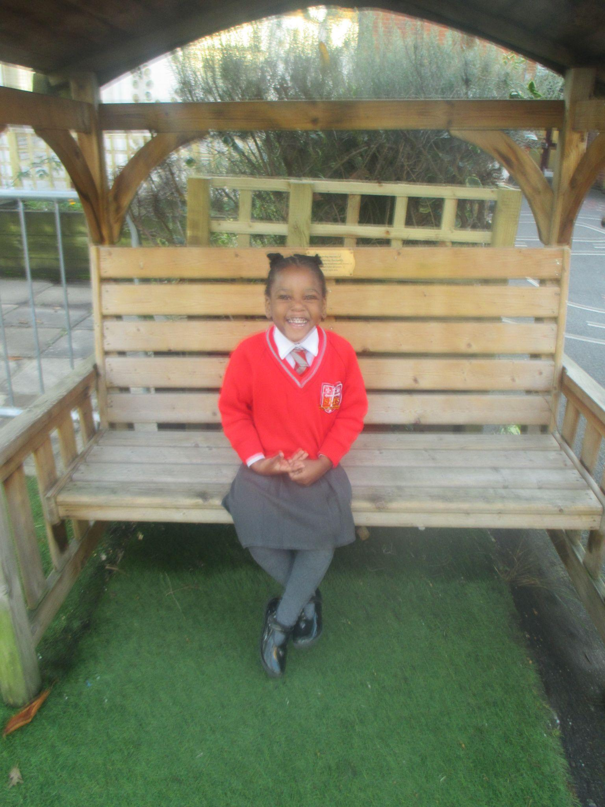
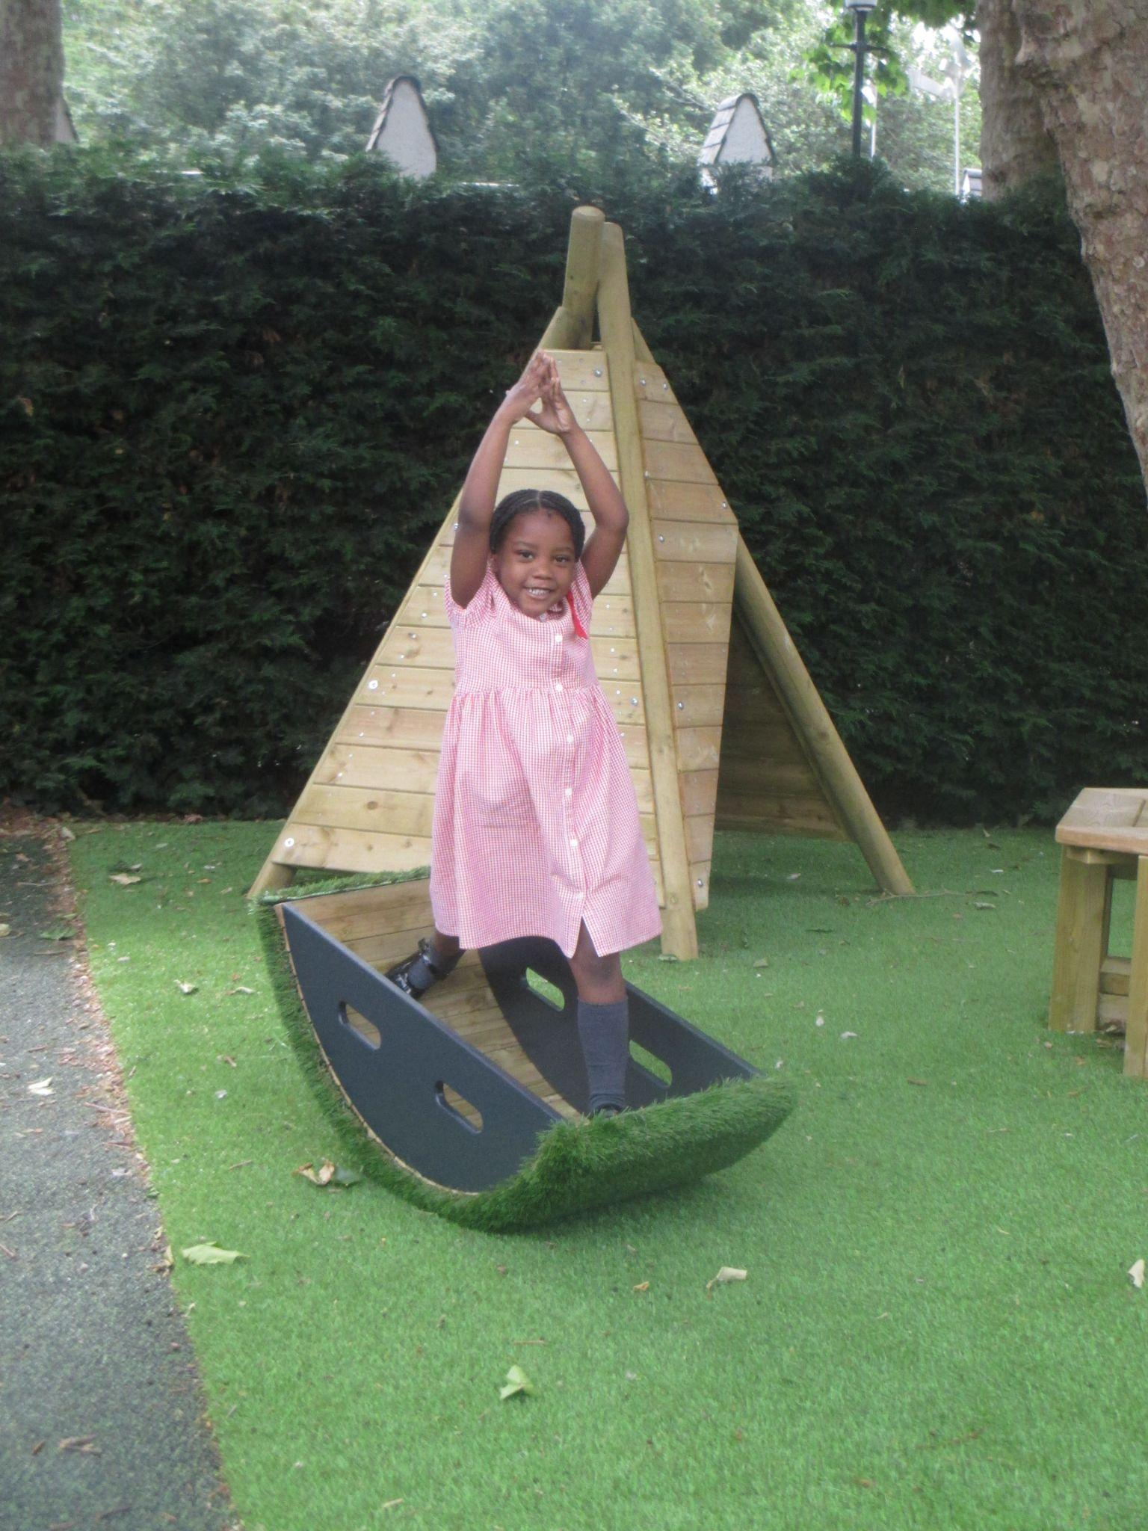
Reception
For her amazing progress this year academically and in her positive behaviour for learning.
Miss Barker

Slide 7
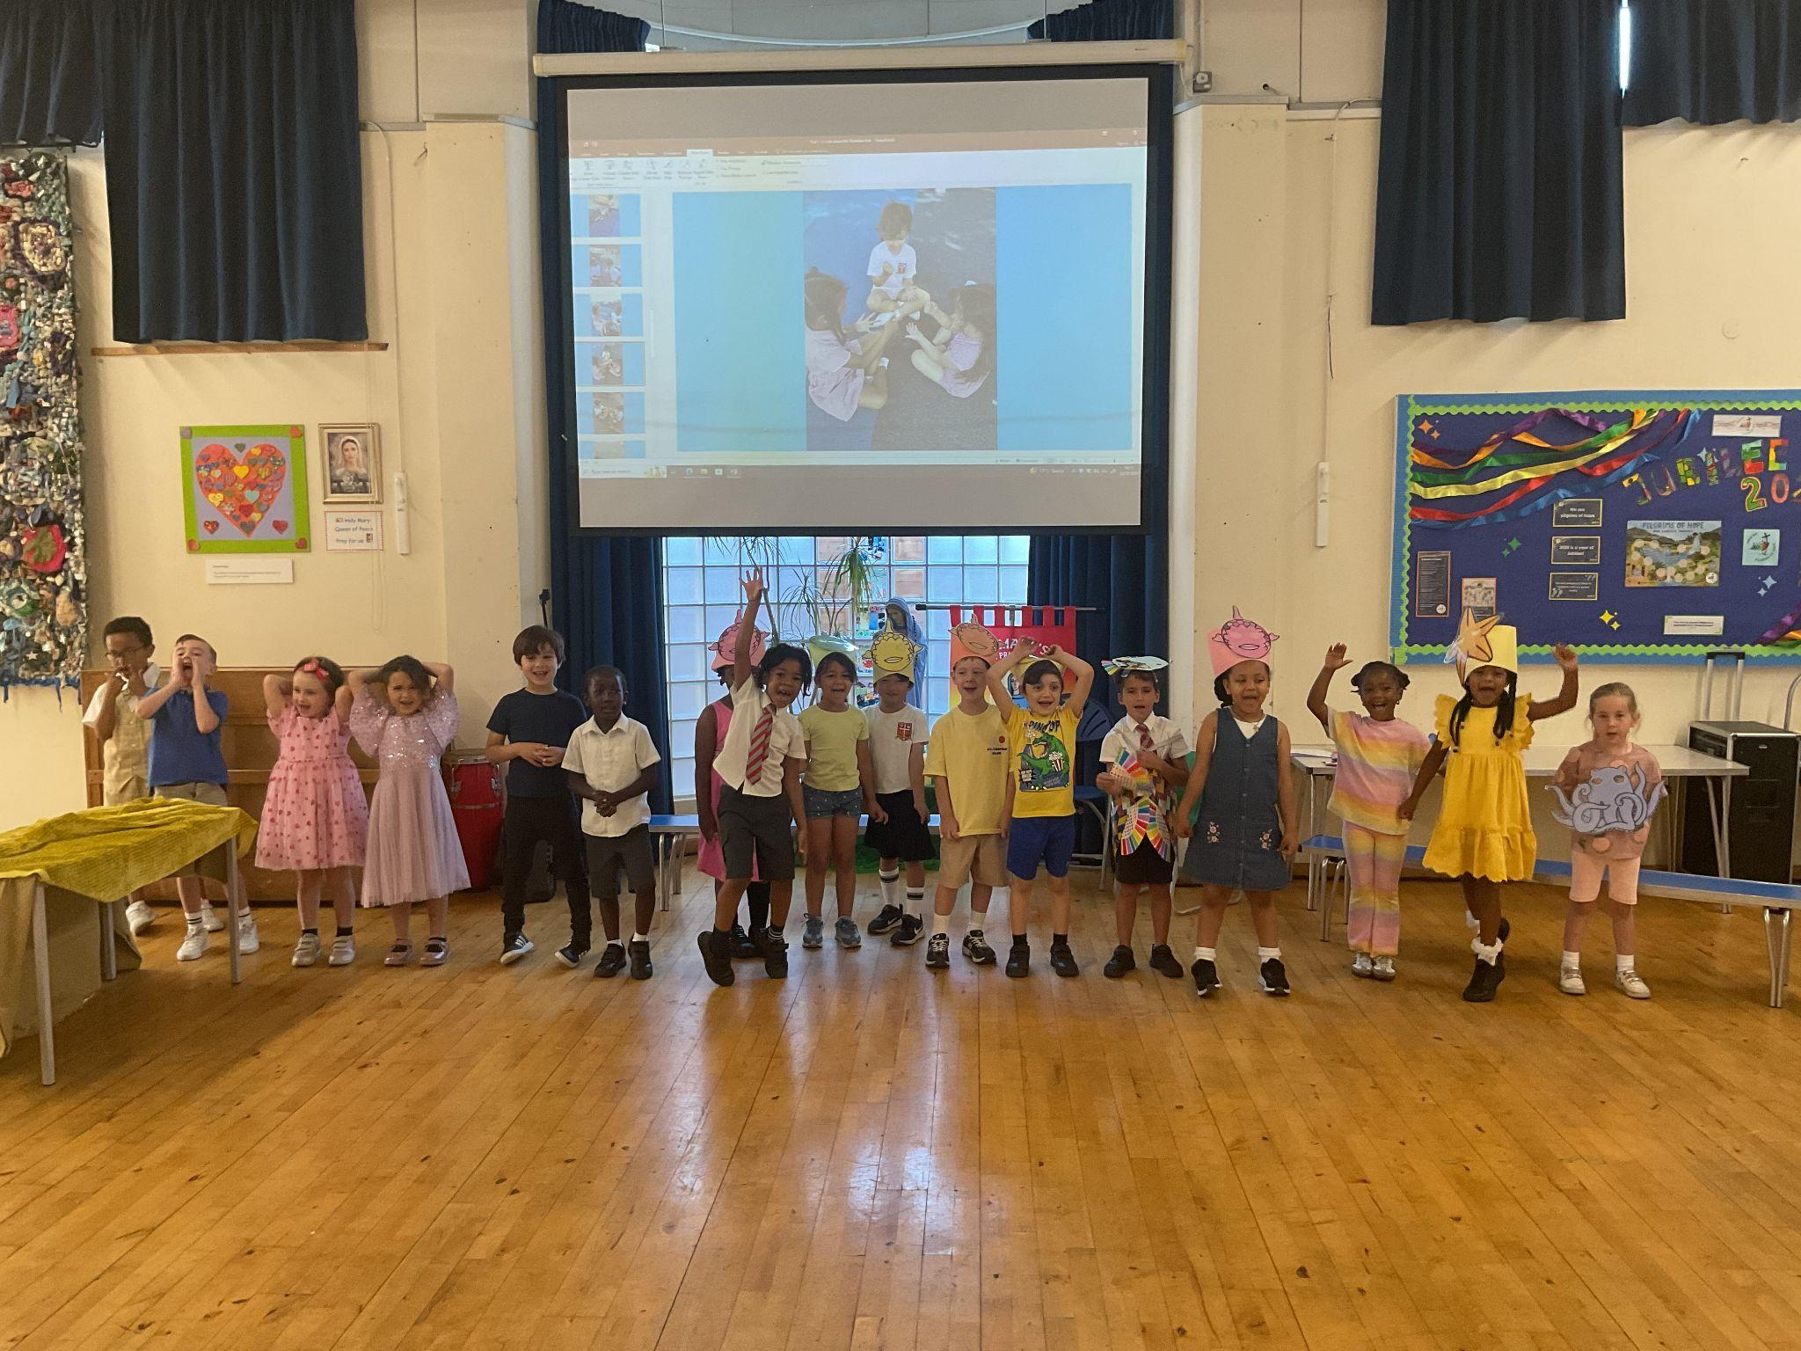
Year 1
Whole Class - For their amazing efforts in their class assembly with 2 days practise!
Miss Sweet

Slide 8
Year 2
For exemplary leadership in how to listen and try your hardest; and for showing kindness and cooperation in helping others with activities.
Mr Whear

Slide 9
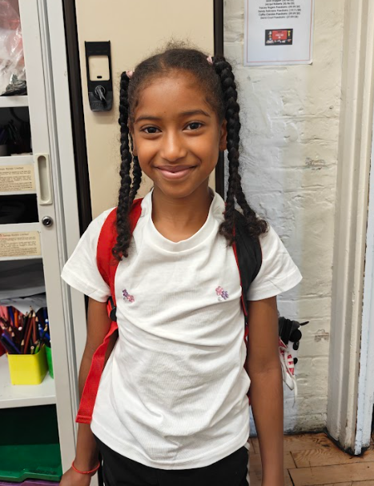
Year 3
For writing a very descriptive and imaginative setting description in English.
Miss Medioli

Slide 10
Year 4
For showing self-control and trying hard to channel her energy into producing good quality work this week.
Miss Forrest

Slide 11
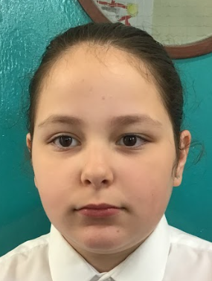
Year 5
For consistent positivity and effort!
Mr Larke

Slide 12
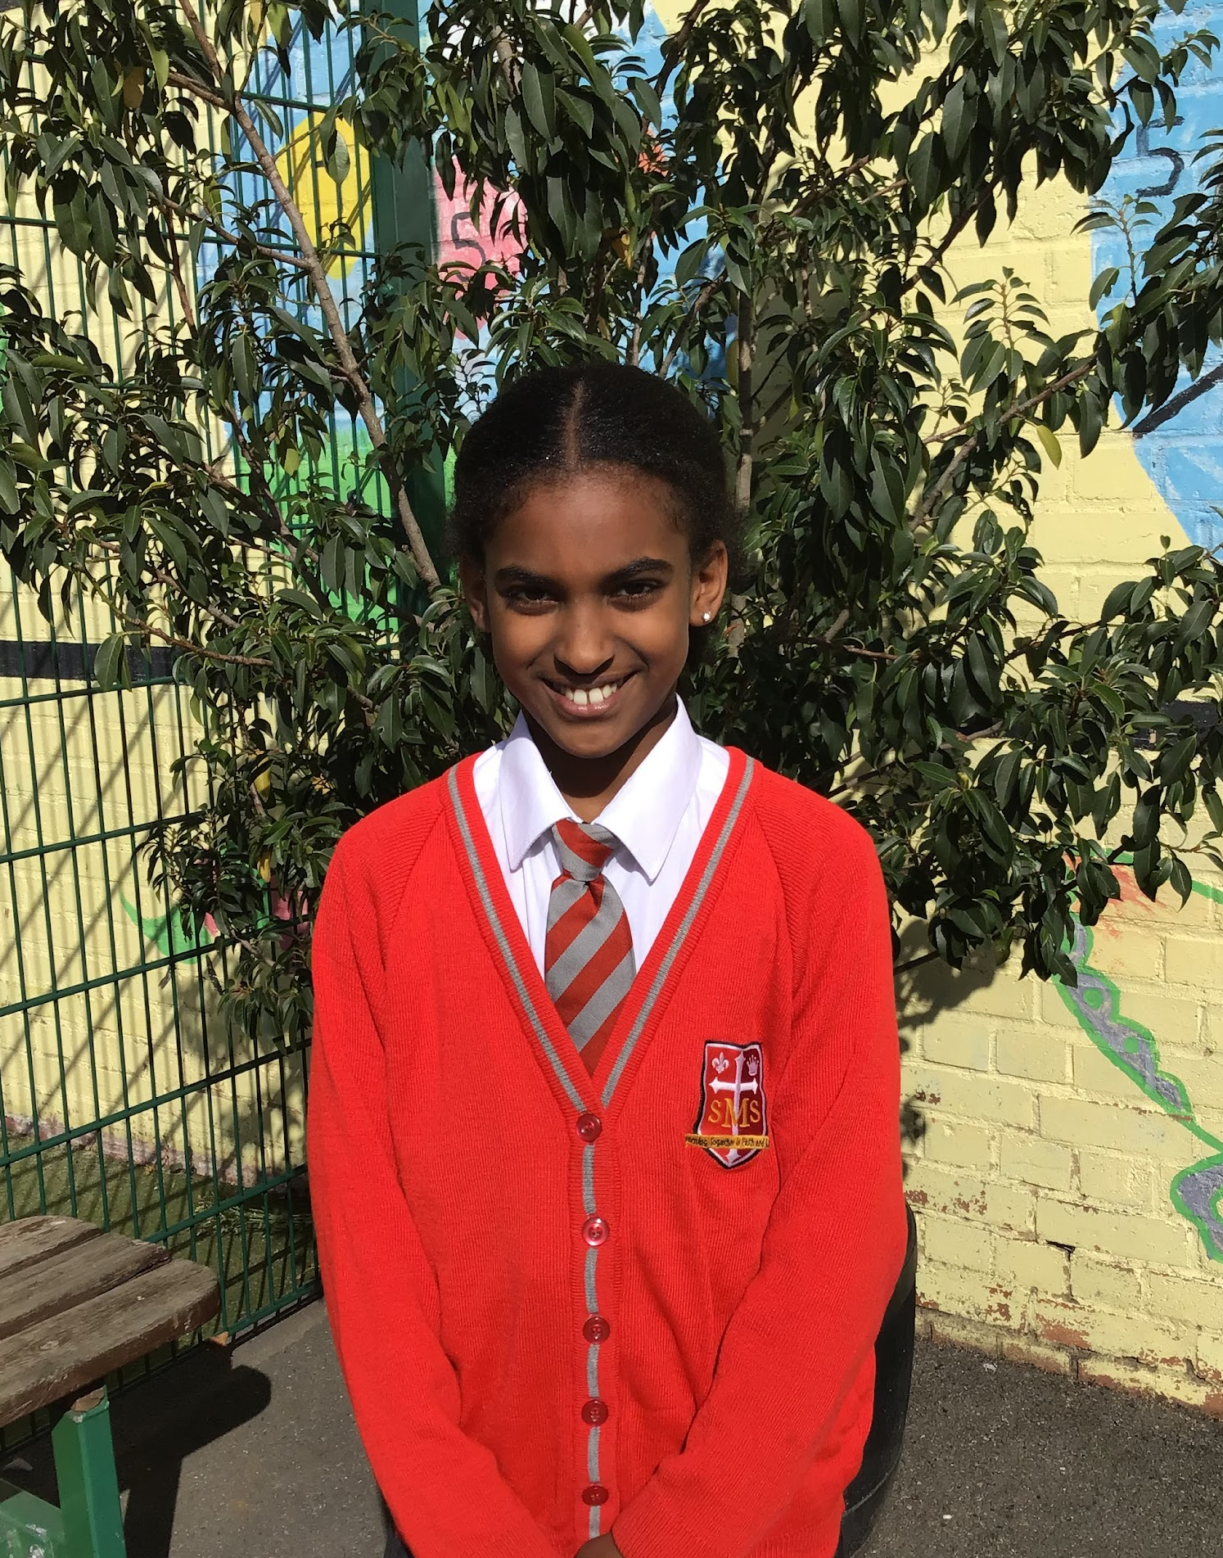
Year 6
For exceptional participation in class and always bringing a positive energy to the group. Her enthusiasm and joy are truly contagious.
Mr Cherfi & Mr Fowle

Slide 13
Star Readers
Y1 - Aniyah
Y2 - Victor
Y3 - Ryan and Rhenn
Y4 - Not this week
Y5 - Kessiah
Y6 - Kian

Slide 14
Y6 - Jayden
Y6 - Emily
Y2 - John
Rec - Khalil
Y6 - John
Rec - Jahmiel
Mr Whear

Slide 15
Whole School
Star of the Week
Friday 4th July 2025

