Slide 1



Whole School
Star of the Week
Friday 5th June 2026

Slide 2


Our Father who art in Heaven
Hallowed be Thy Name
Thy Kingdom come
Thy will be done on Earth as it is in Heaven
Give us this day our daily bread
And forgive us our trespasses
As we forgive those who trespass against us
And lead us not into temptation
But deliver us from evil
Amen

Slide 3
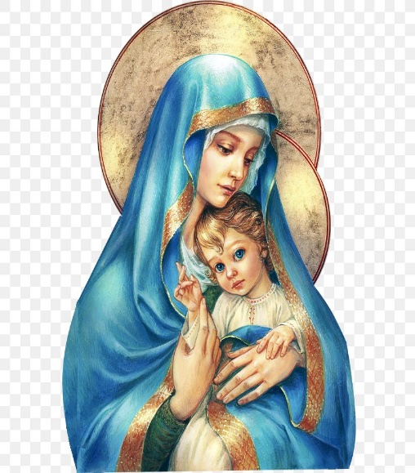
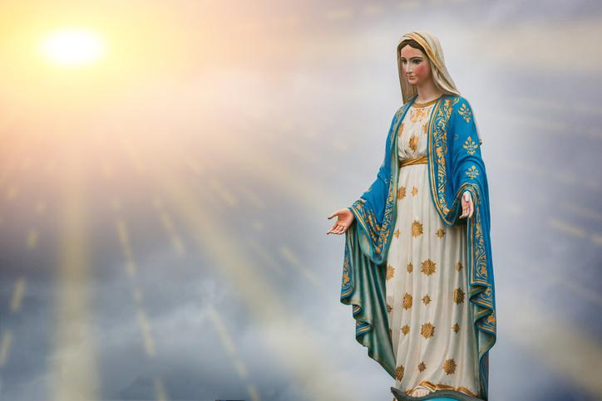
Hail Mary, Full of Grace
The Lord is with Thee
Blessed are Thou amongst women
And Blessed is the fruit of Thy womb, Jesus
Holy Mary , Mother of God
Pray for us sinners
Now and in the hour of our death
Amen

Slide 4
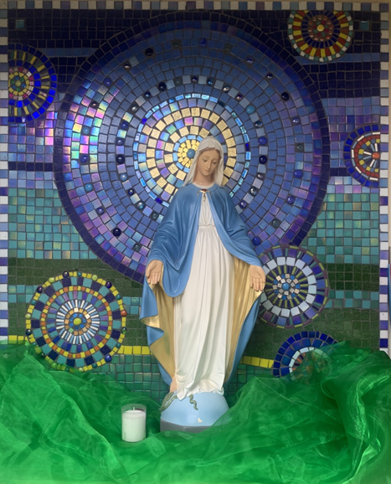
St Mary’s School Prayer
O Holy Mary,
Mother and Patron of our school,
Turn your eyes of mercy towards us,
that we may love God
With all our hearts!
May we imitate the tenderness
of your Son, Jesus,
showing love and respect
For each person
and ourselves as children of God.
Guided by the Holy Spirit,
May we create the school,
where Mercy and Compassion
Is the centre of our lives.
Amen

Slide 5
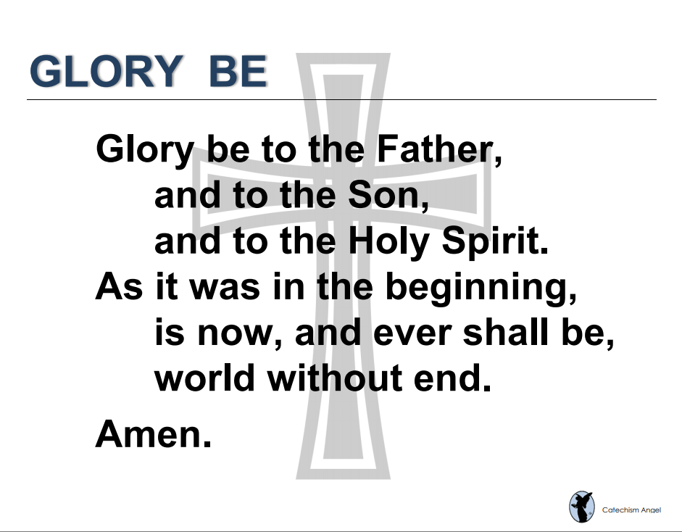

Slide 6
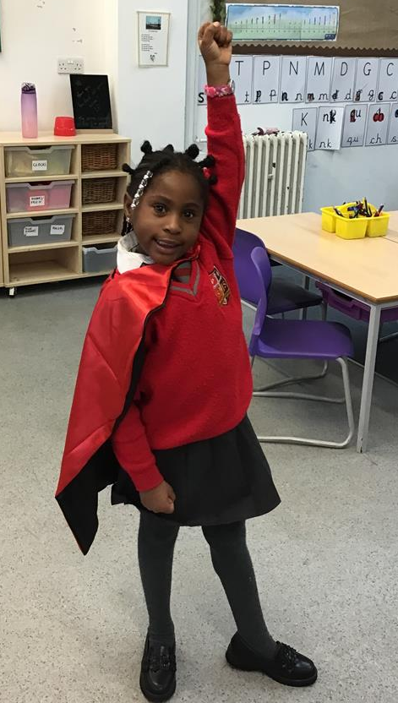
Year 1
Ginaiyah
For her wonderful ideas and hard work across the curriculum but especially in Phonics and Writing!
Miss Flashman

Slide 7
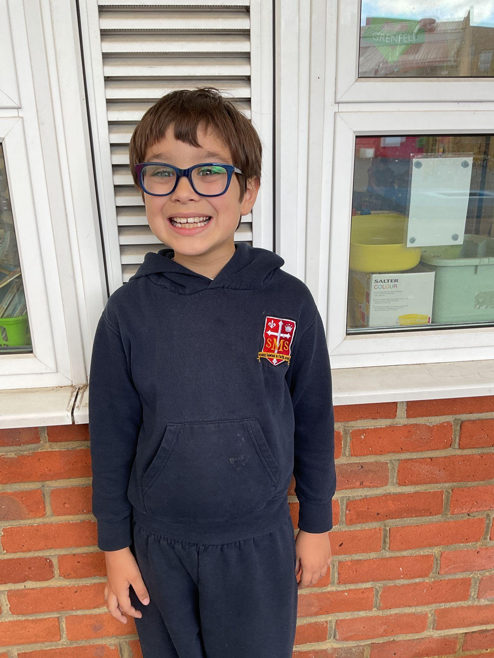
Year 2
Olly
For working hard in all of his lessons and managing big feelings!
Miss Sweet

Slide 8
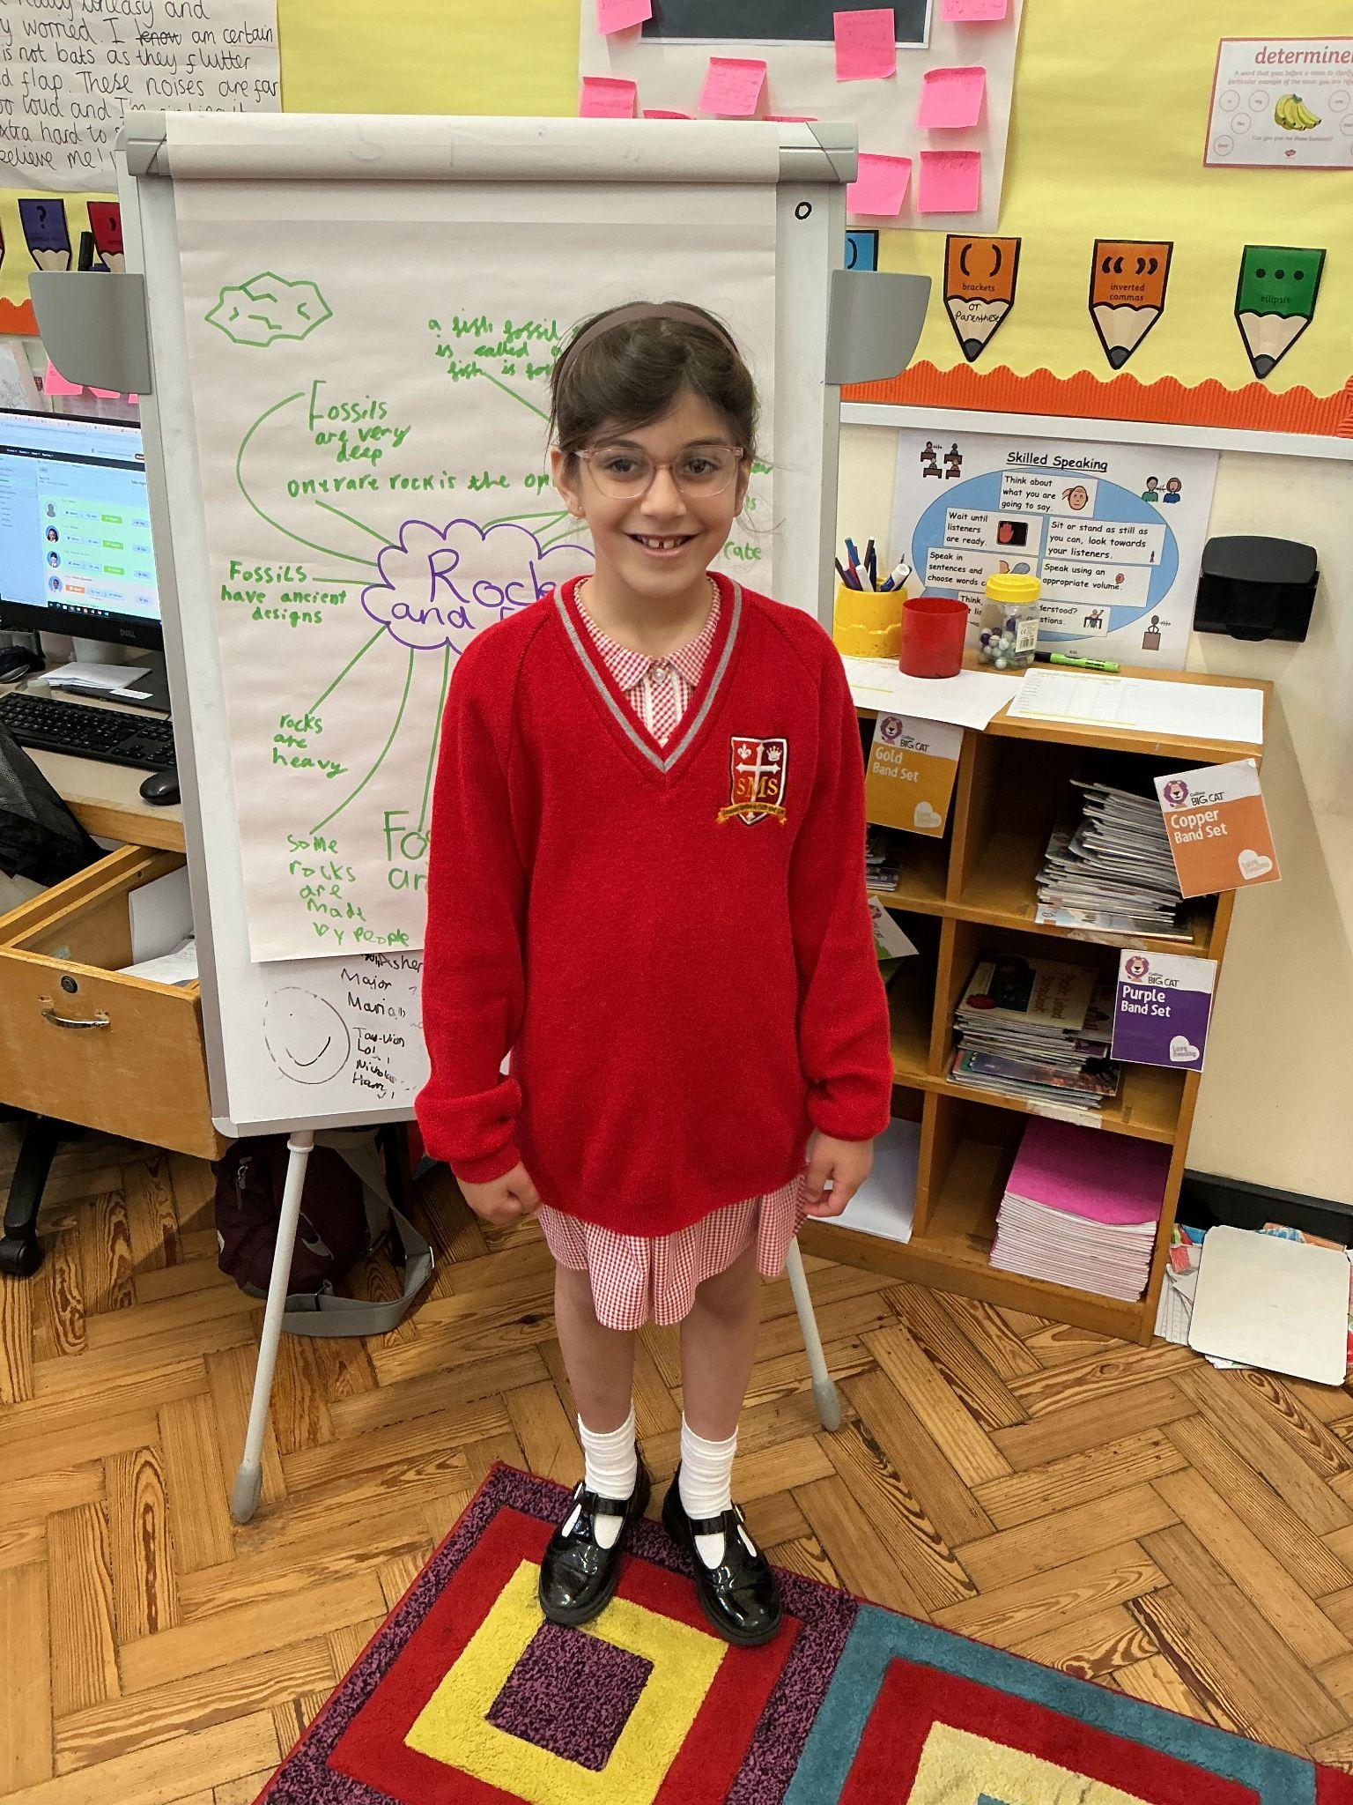
Year 3
Luna B
For an outstanding week. You’ve worked your socks off and what progress you’re making!
Miss Hickey

Slide 9
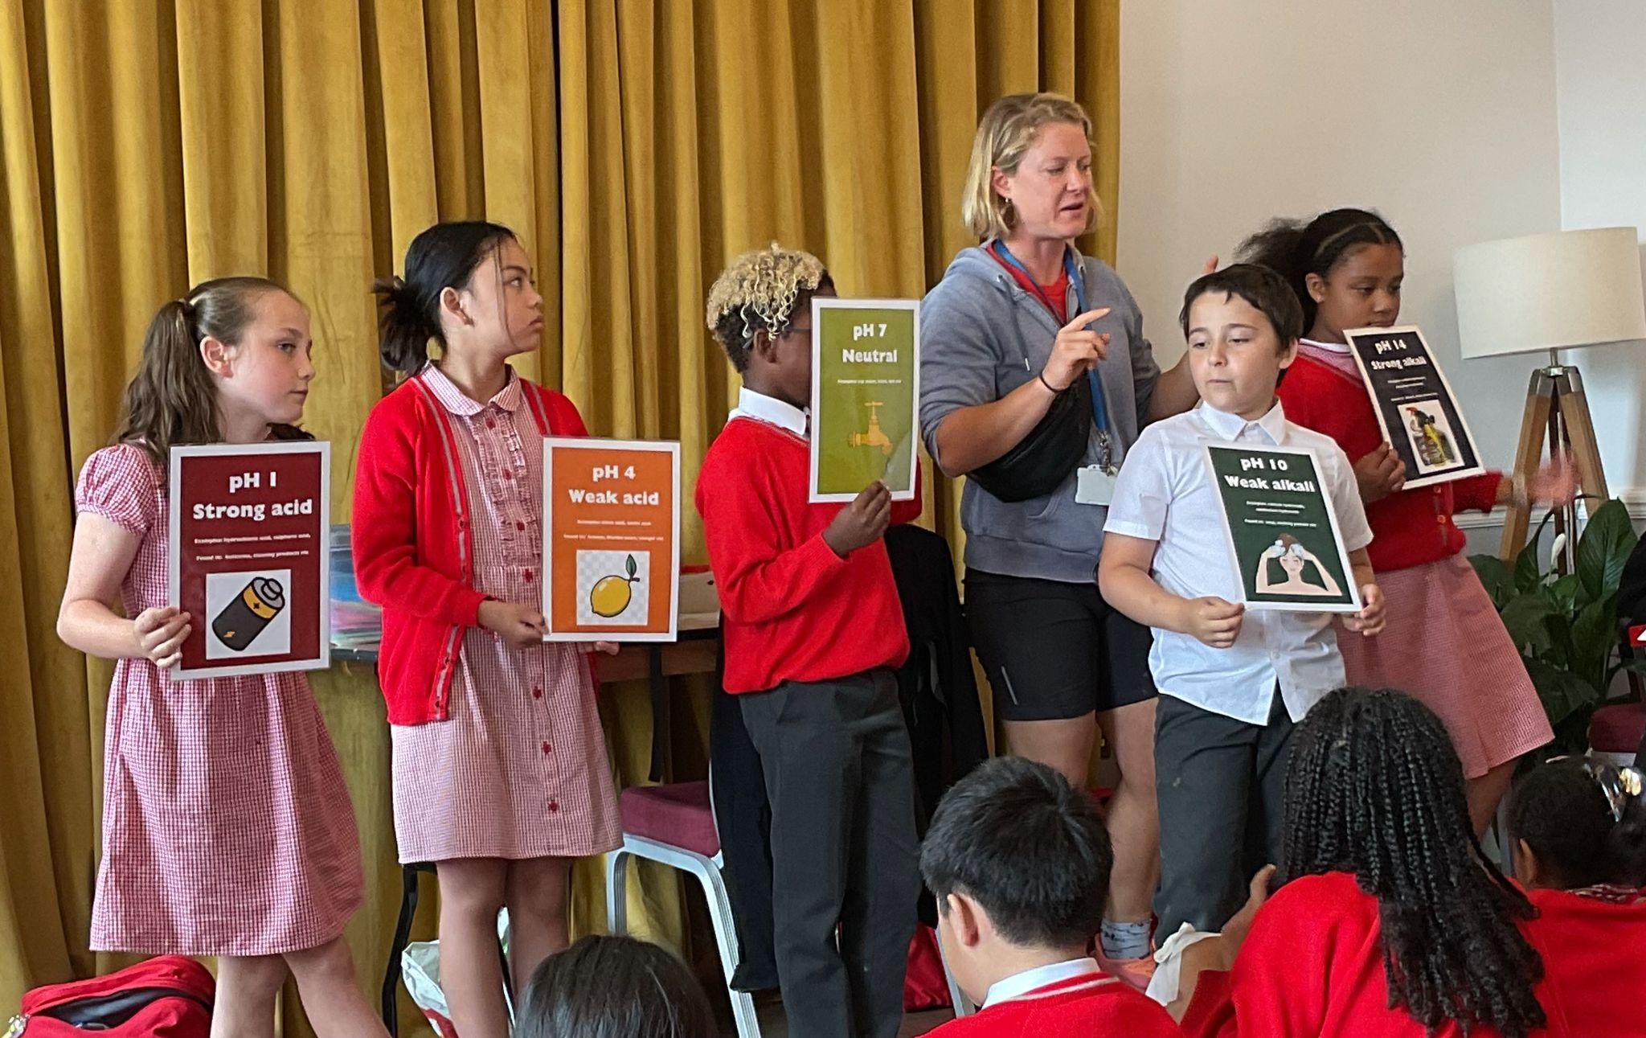

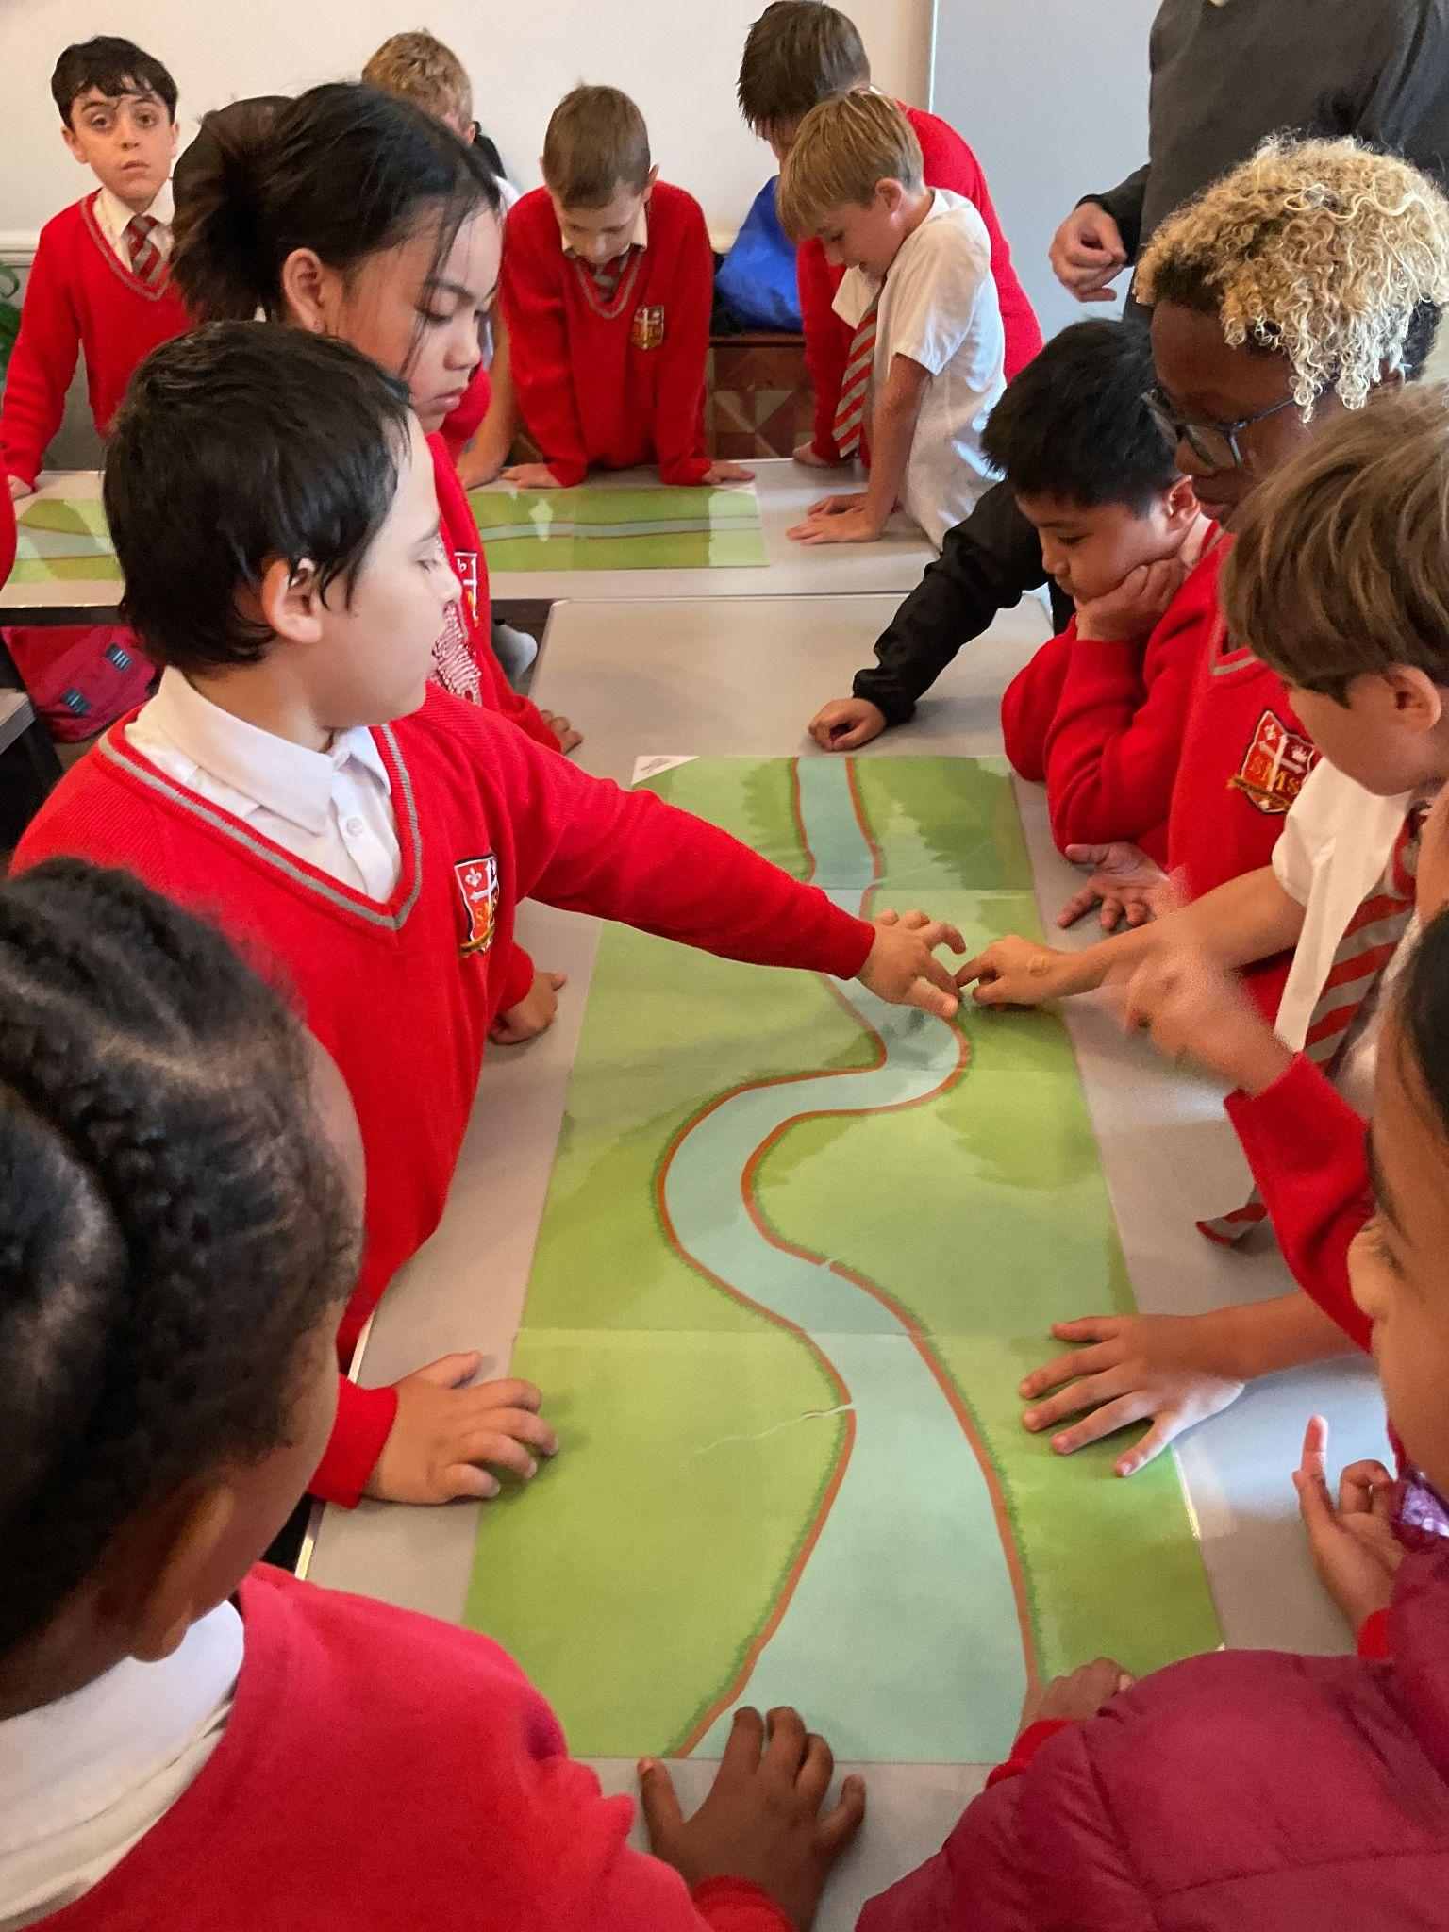
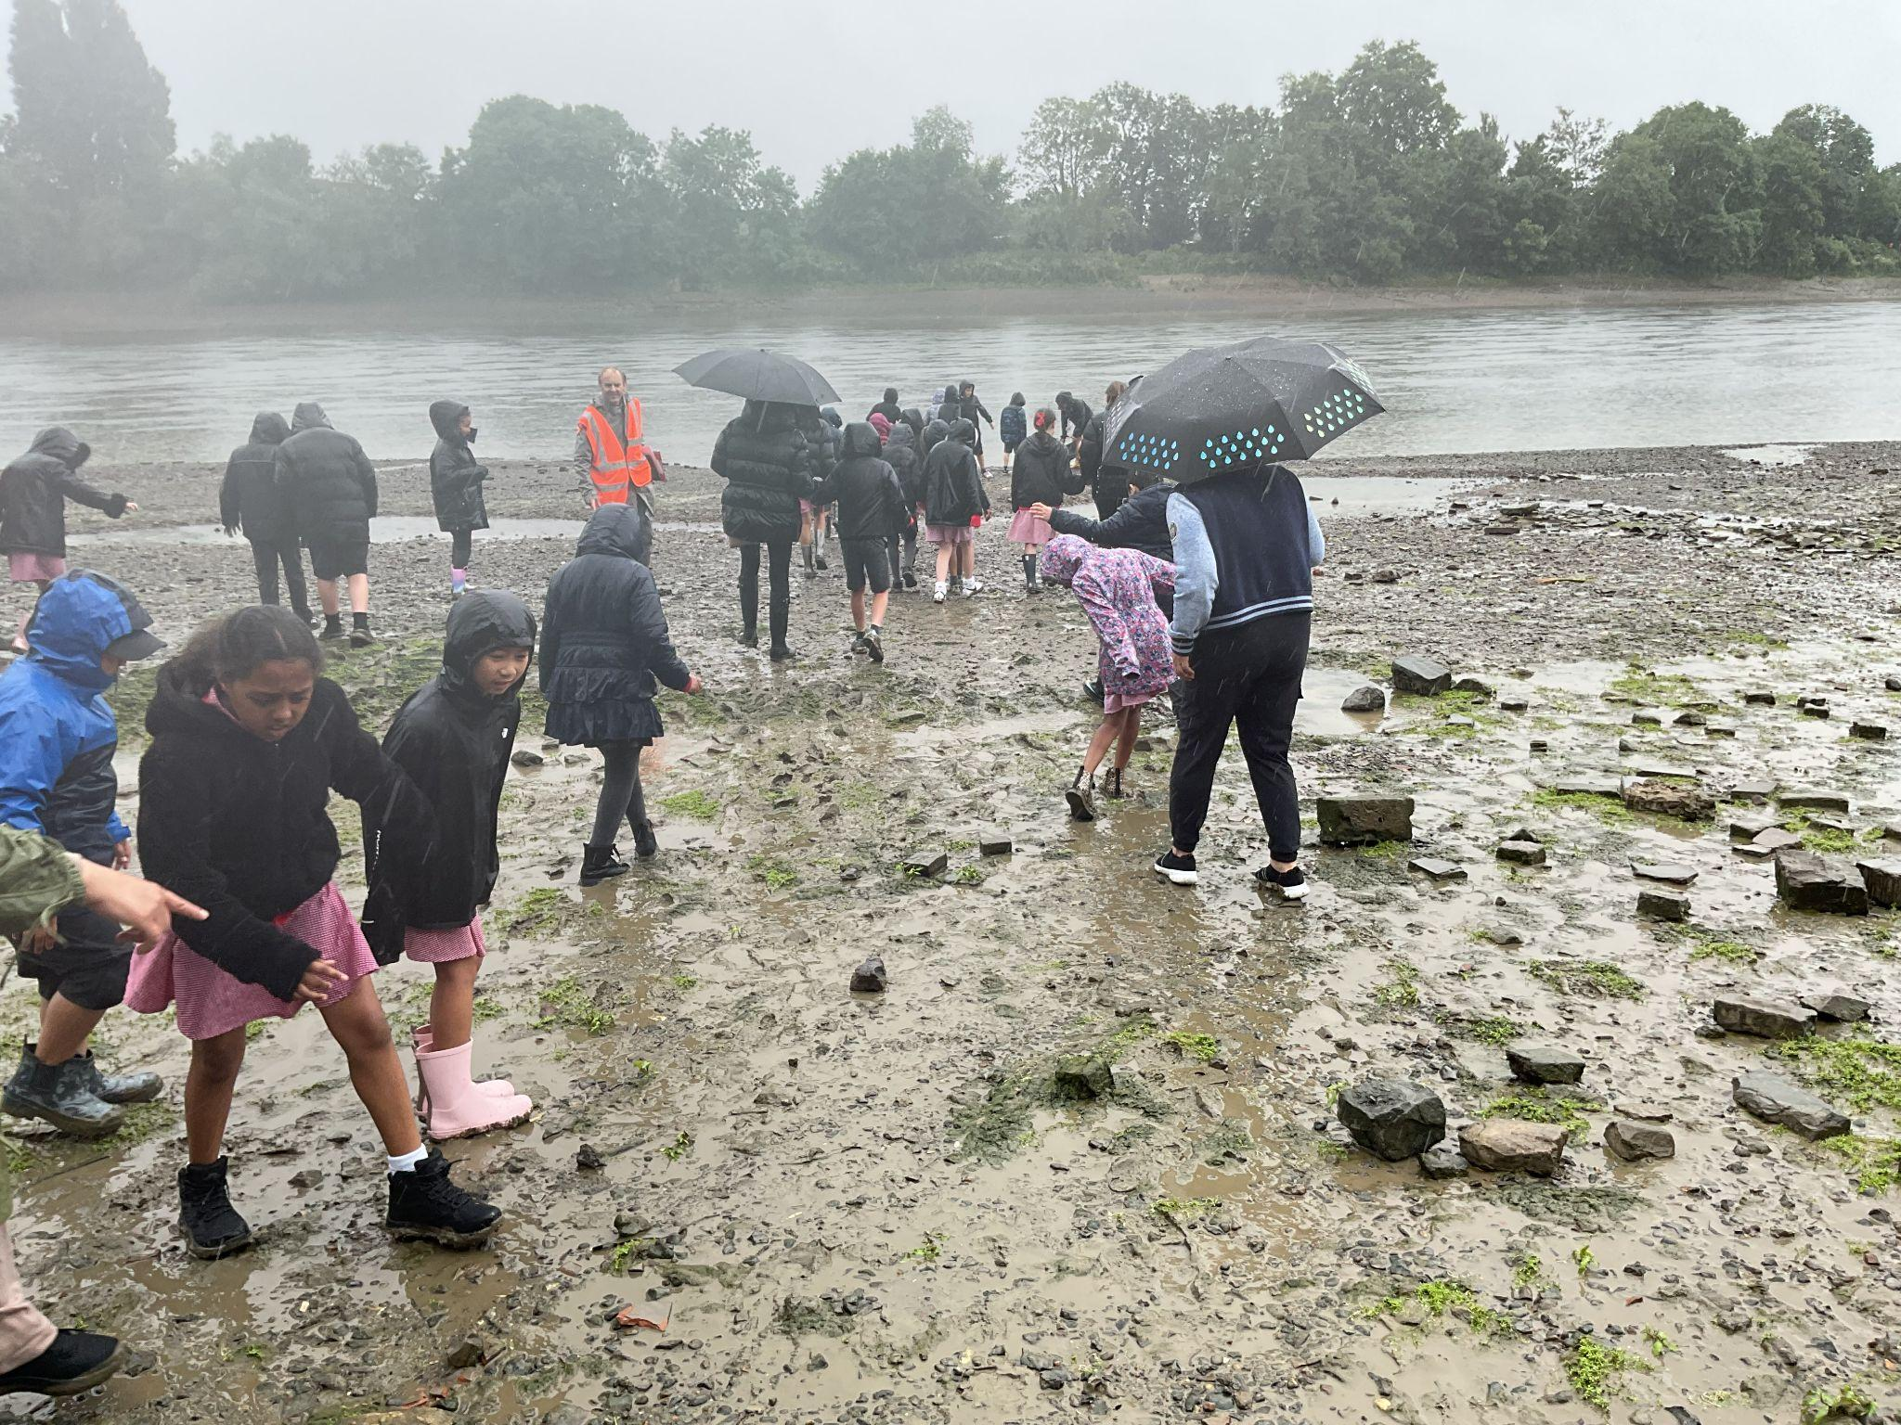
Year 4
The Whole Class, for magnificently representing our school
Mr Whear

Slide 10
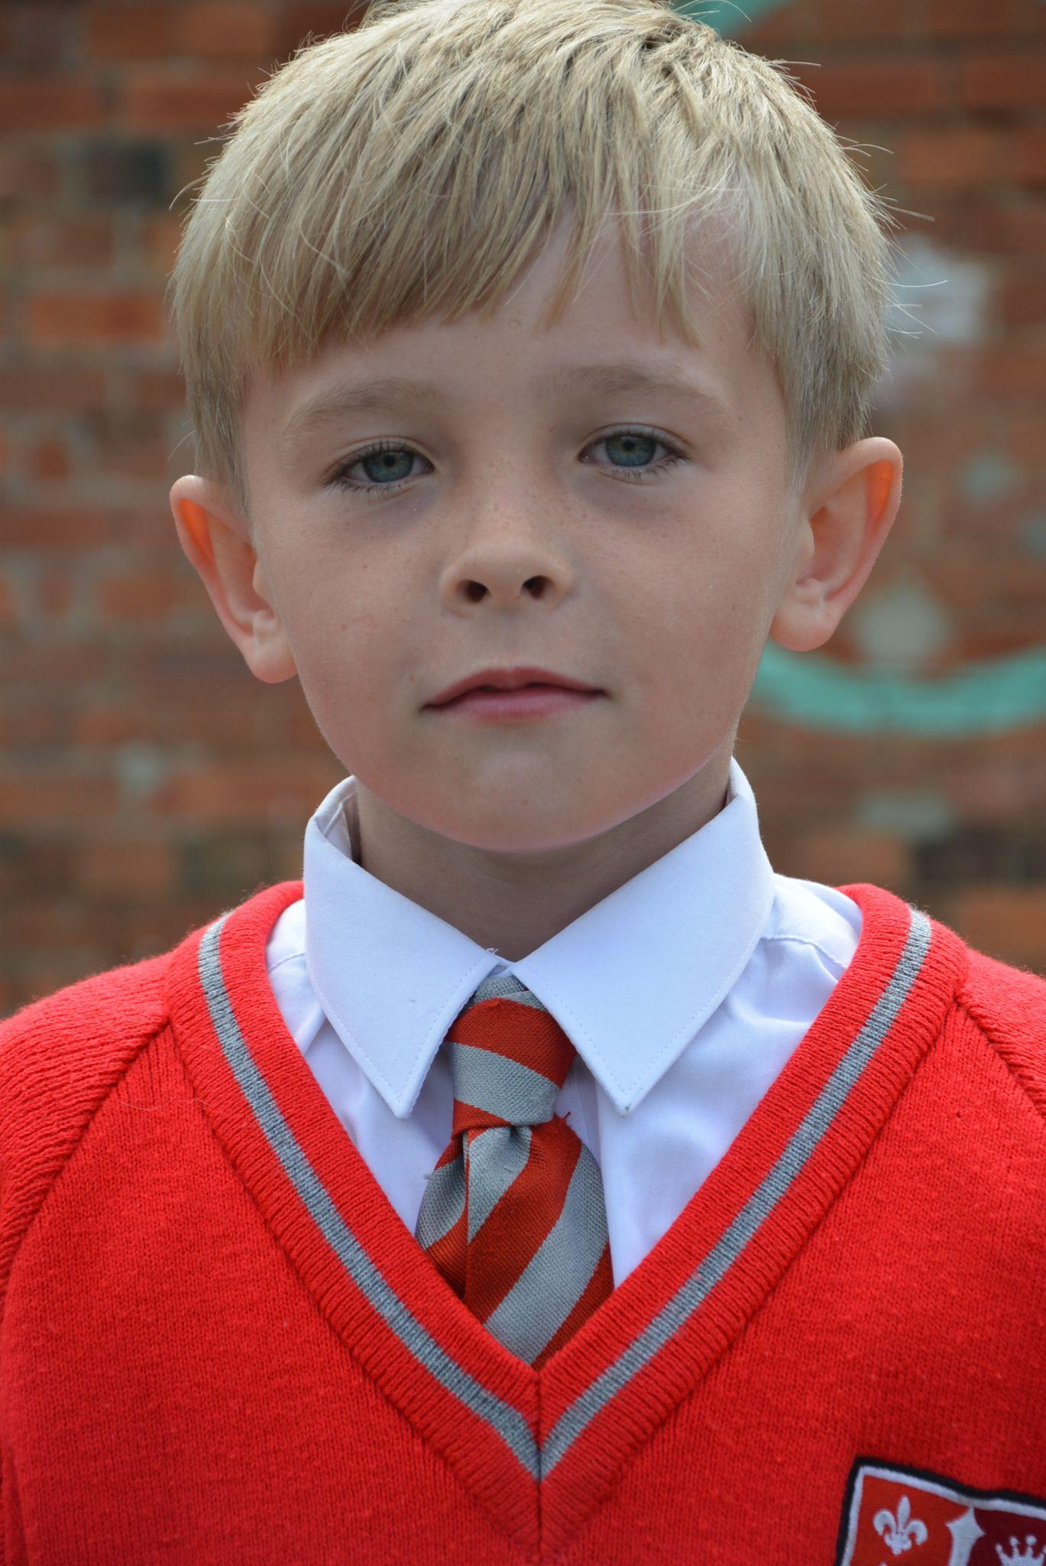
Year 5
Alby
Alby is making the right choices in sharpening his focus, proving he has the skills and potential to achieve great success across
the whole curriculum. Keep it up!
Ms Bakali

Slide 11
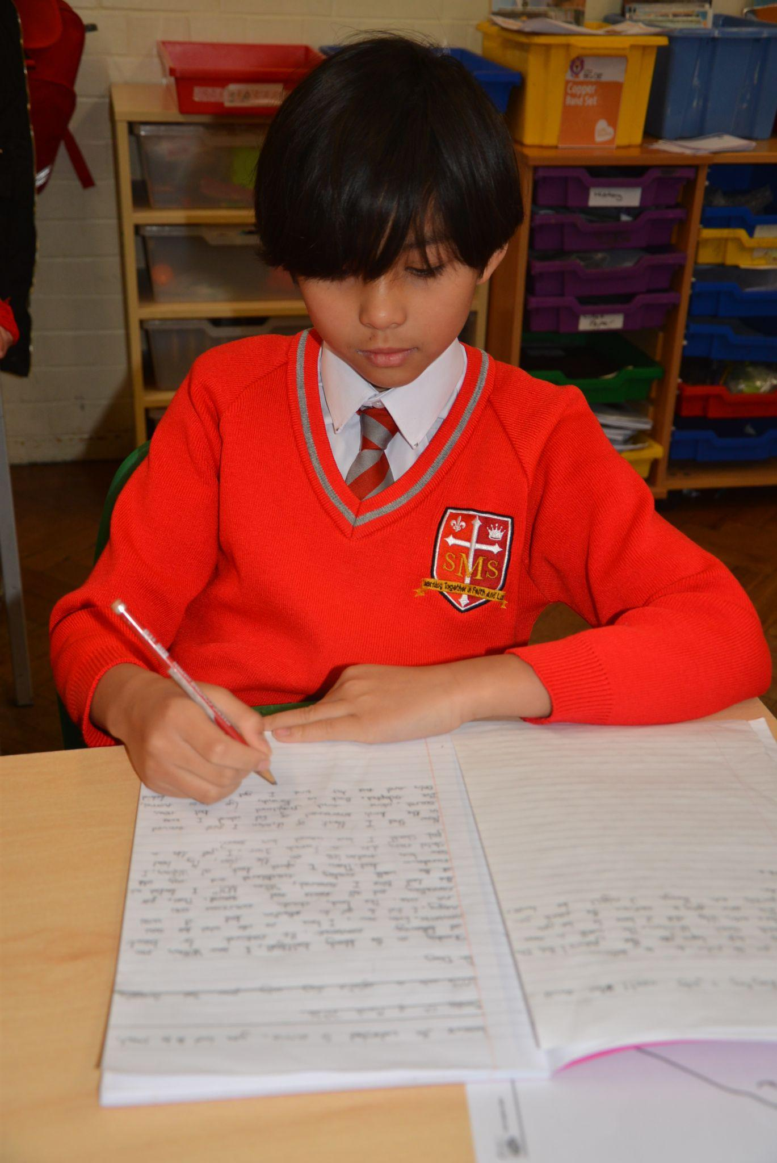
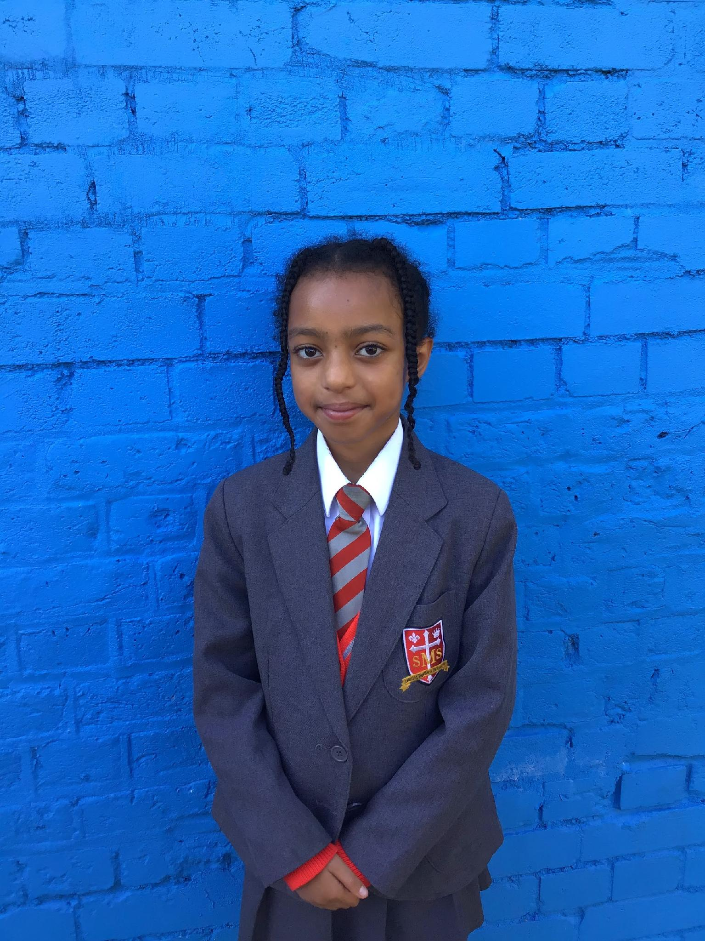
Year 6
Beza
Showing incredible improvement in the way she articulates answers in class.
Her enthusiasm to participate in class discussions is exceptional.
Mr Cherfi

Slide 12



Star Readers
Y1 - Tegan
Y2 - Naomi
Y3 - Harry
Y4 - Kareema
Y5 - Cali
Y6 - Zyann

Slide 13

Caleb Year 5
Olly Year 2
Zoe Year 3
Jacob L Reception
Harry Year 3
Rakeb Year 4
Eden Year 6
Tommy Year 6
Gideon Year 6

Slide 14
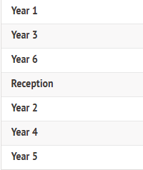
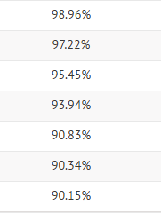
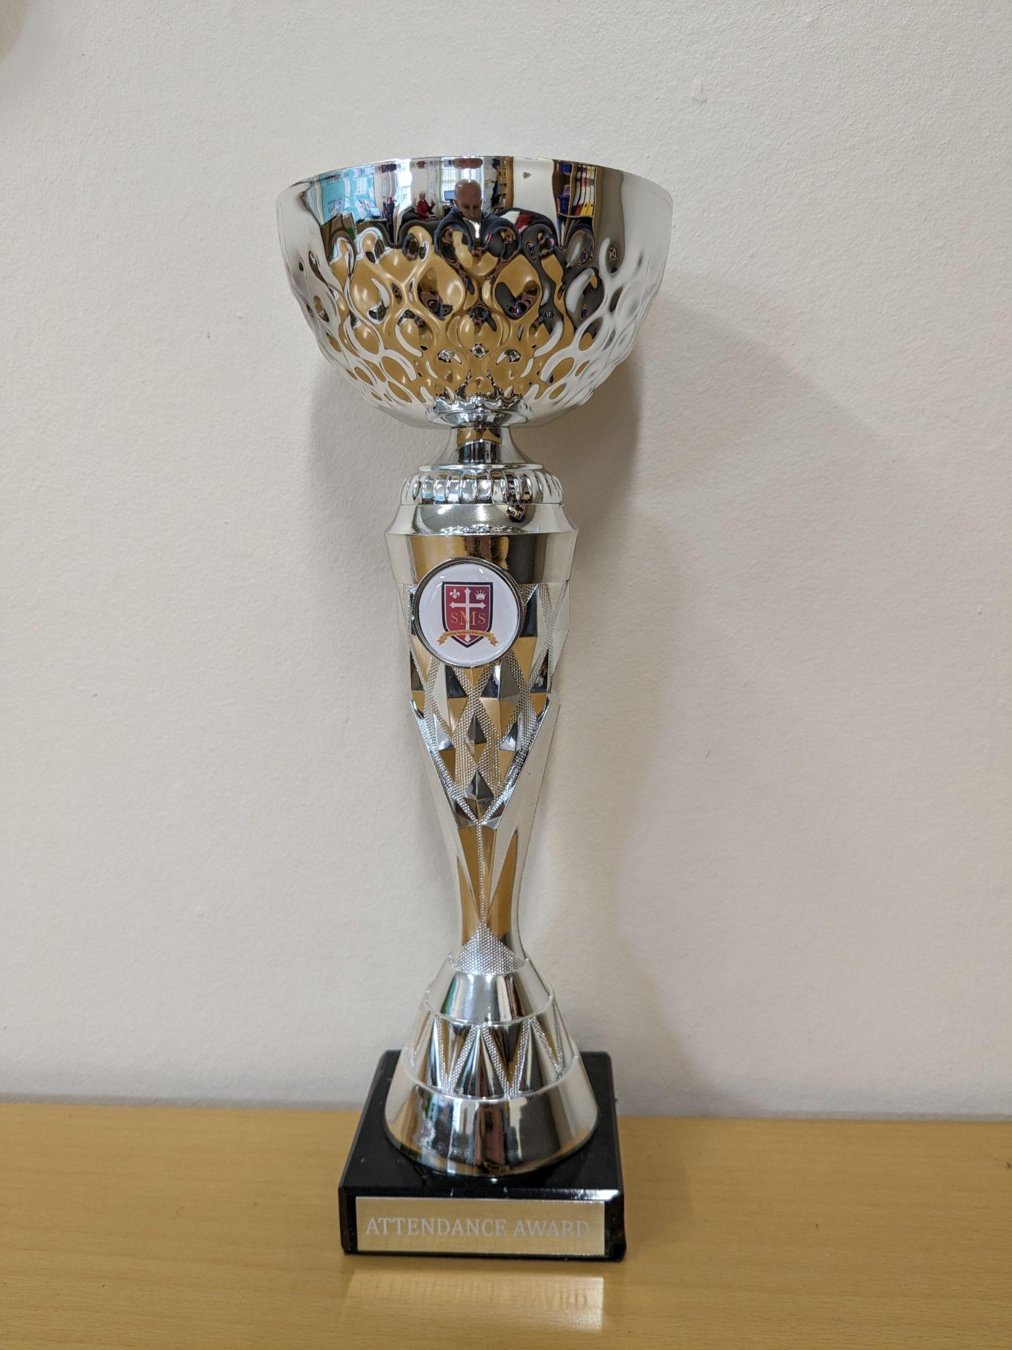
Attendance Weekly Leaders Summer Term:
Winners of the Pitch on Friday -

Slide 15
Whole School
Star of the Week
Friday 5th June 2026

